Slide 1
Value Adjustment Factor

Slide 2
Value Adjustment Factor
The value adjustment factor (VAF) is based on 14 general system characteristics (GSCs) that rate the general functionality of the application being counted. Each characteristic has associated descriptions that help determine the degrees of influence of the characteristics. The degrees of influence range on a scale of zero to five, from no influence to strong influence.
The 14 general system characteristics are summarized into the value adjustment factor. When applied, the value adjustment factor adjusts the unadjusted function point count +/-35 percent to produce the final function point count.

Slide 3
Value Added Factors
General System Characteristics
1. Data communications
2. Distributed data processing
3. Performance
4. Heavily used configuration
5. Transaction rate
6. Online data entry
7. End-user efficiency

Slide 4
Value Added Factors
General System Characteristics
8. Online update
9. Complex processing
10. Reusability
11. Installation ease
12. Operational ease
13. Multiple sites
14. Facilitate change

Slide 5
Degrees of Influence
0 - Not present, or no influence
1 - Incidental influence
2 - Moderate influence
3 - Average influence
4 - Significant influence
5 - Strong influence throughout

Slide 6
Guidelines to Determining Degrees of Influence

Slide 7
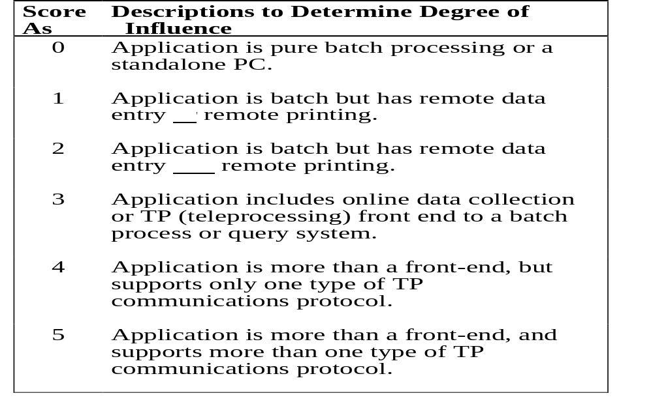
Data Communications

Slide 8
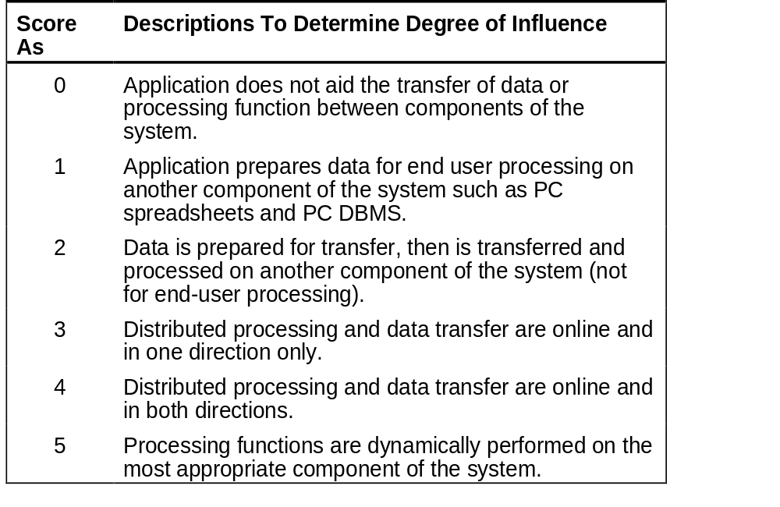
Distributed Data Processing

Slide 9
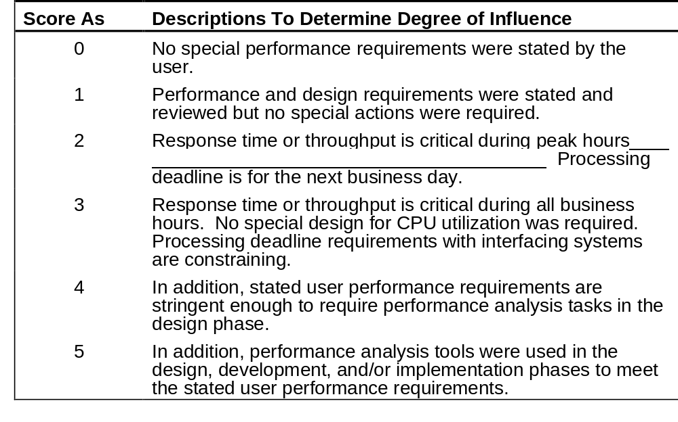
Performance

Slide 10
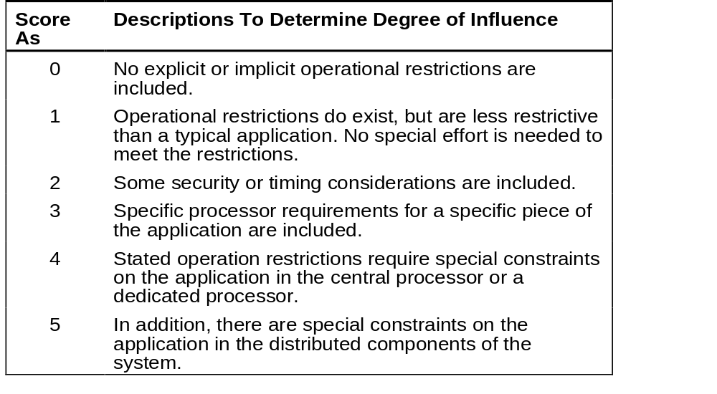
Heavily Used Configuration

Slide 11
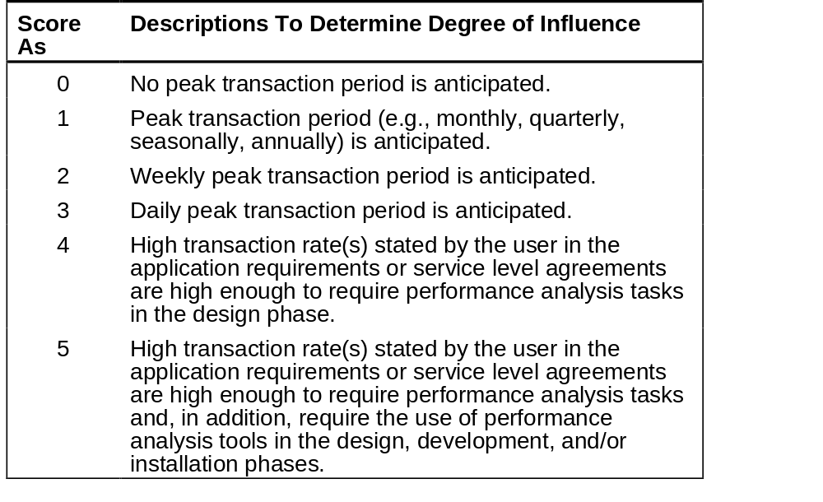
Transaction Rate

Slide 12
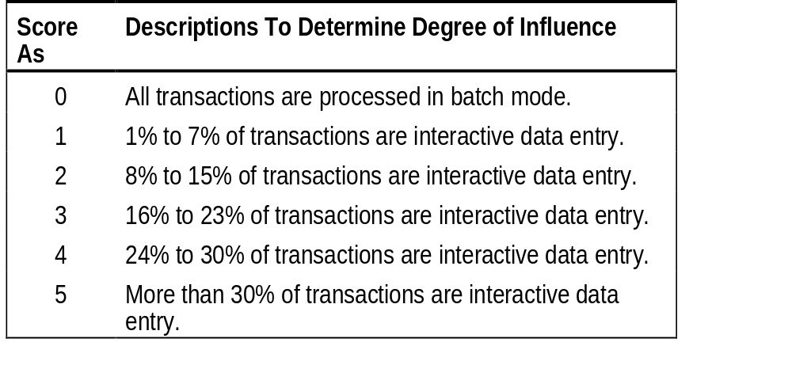
Online Data Entry

Slide 13
End User Efficiency
General Characteristics
•Navigational aids (for example, function keys, jumps, dynamically generated menus)
•Menus
•Online help and documents
•Automated cursor movement
•Scrolling
•Remote printing (via online transactions)
•Preassigned function keys
Batch jobs submitted from online transactions
•Cursor selection of screen data

Slide 14
End User Efficiency
General Characteristics
•Heavy use of reverse video, highlighting, colors underlining, and other indicators
•Hard copy user documentation of online transactions
•Mouse interface
•Pop-up windows.
•As few screens as possible to accomplish a business function
•Bilingual support (supports two languages; count as four items)
•Multilingual support (supports more than two languages; count as six items)

Slide 15
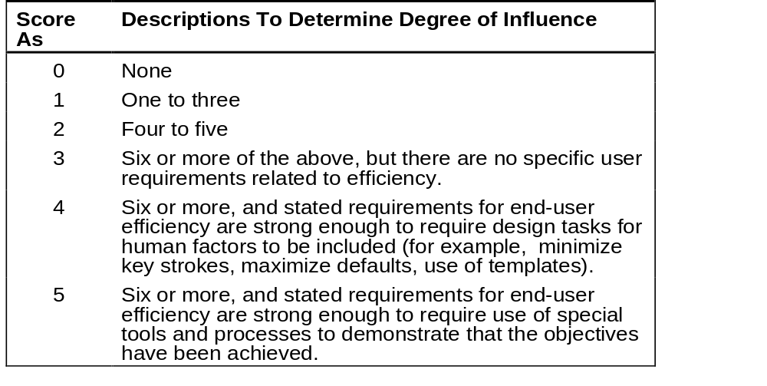
End User Factors

Slide 16
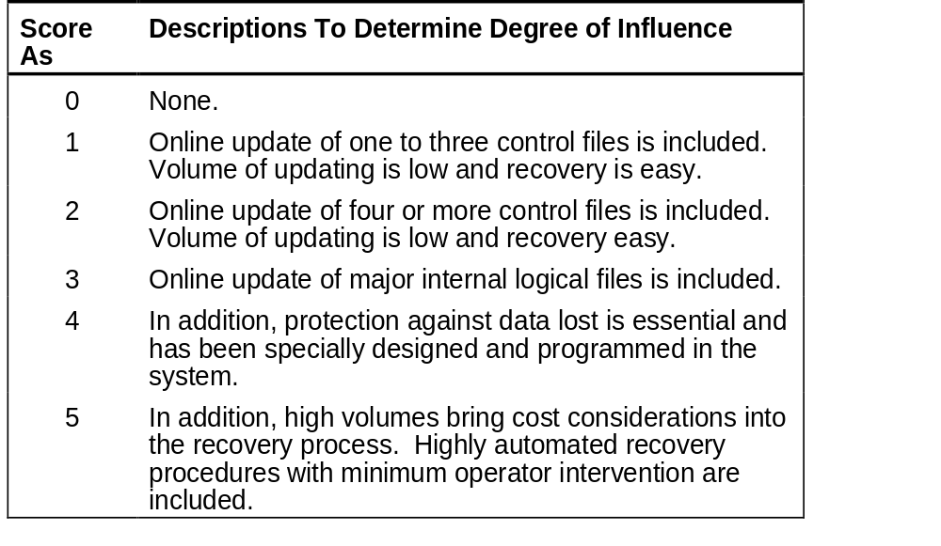
On-Line Update

Slide 17
Complex Processing Factors
Sensitive control (for example, special audit processing) and/or application specific security processing
• Extensive logical processing
• Extensive mathematical processing
• Much exception processing resulting in incomplete transactions that must be processed again, for example, incomplete ATM transactions caused by TP interruption, missing data values, or failed edits
• Complex processing to handle multiple input/output possibilities, for example, multimedia, or device independence

Slide 18
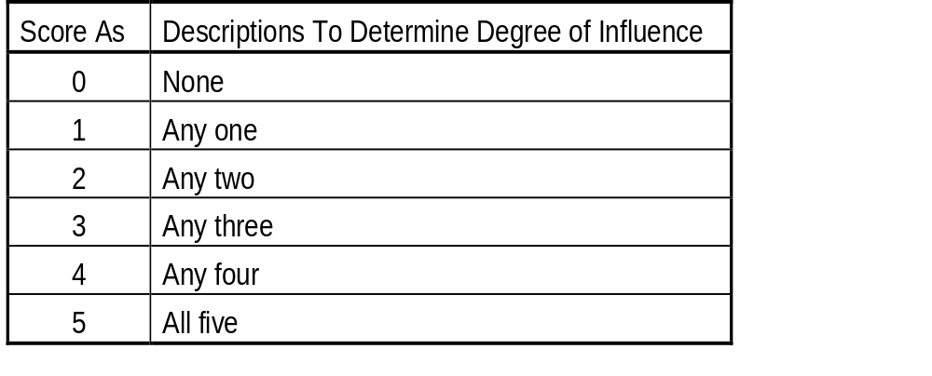
Complex Processing

Slide 19
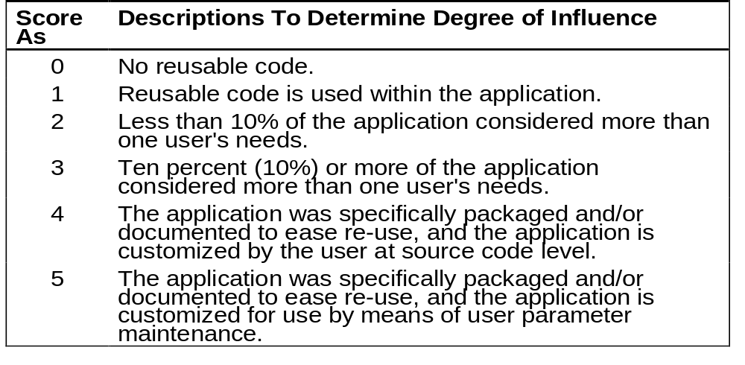
Reusability

Slide 20
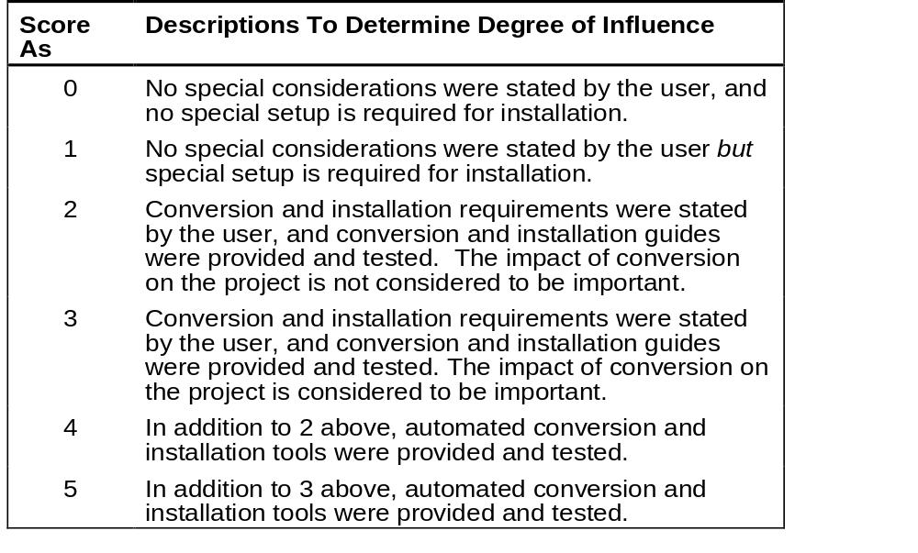
Installation Ease

Slide 21
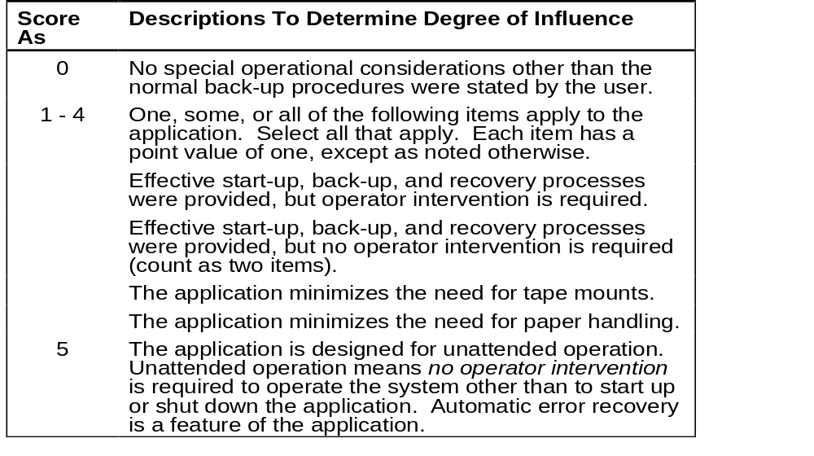
Operational Ease

Slide 22
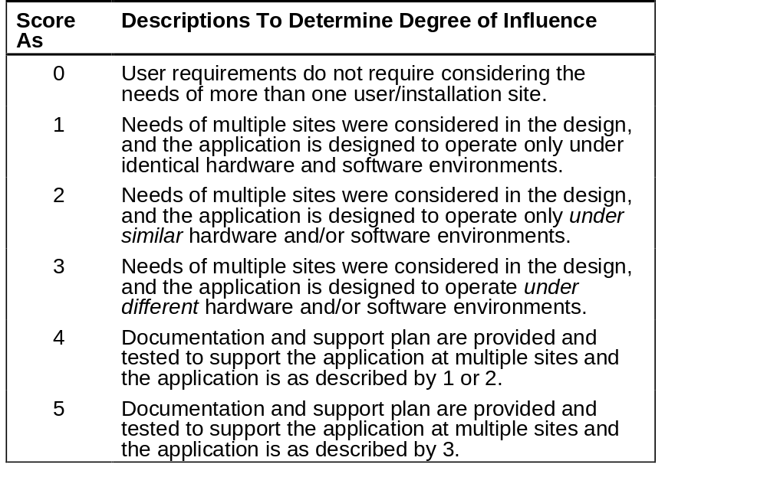
Multiple Sites

Slide 23
Facilitate Change
General Characteristics
Flexible query and report facility is provided to handle simple requests
Flexible query and report facility is provided to handle requests of average complexity
Flexible query and report facility is provided to handle complex requests
Business control data kept in tables that are maintained by the user with online interactive processes, but changes take effect only on the next business day.
Business control data kept in tables that are maintained by the user with online interactive processes, and the changes take effect immediately (count as two items).

Slide 24
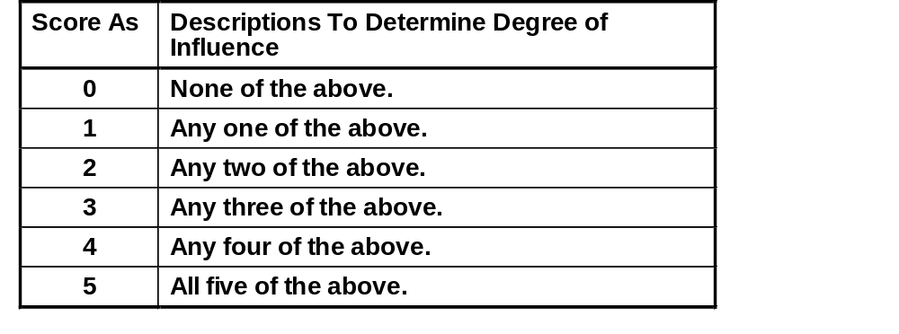
Facilitate Change

Slide 25
GUI Software Estimation
VAFs scoring High for GUI
  Transaction Rates
  End User Efficiency
  On Line Update
  Reusability
VAFs scoring Low for GUI
  PERFORMANCE
  Heavily used configuration
  Multiple Sites

Slide 26
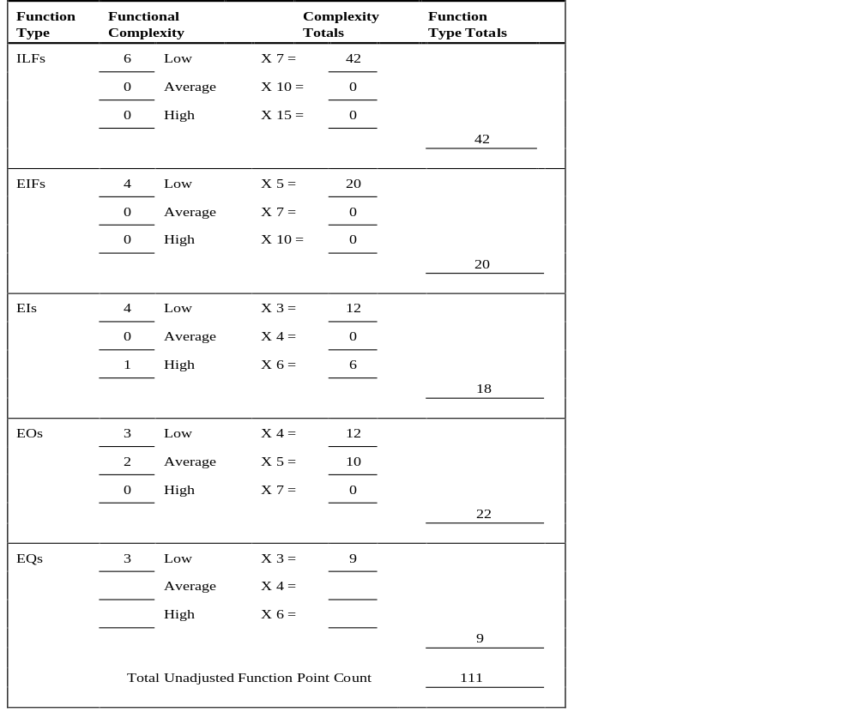
COMPUTE FUNCTION POINTS

Slide 27
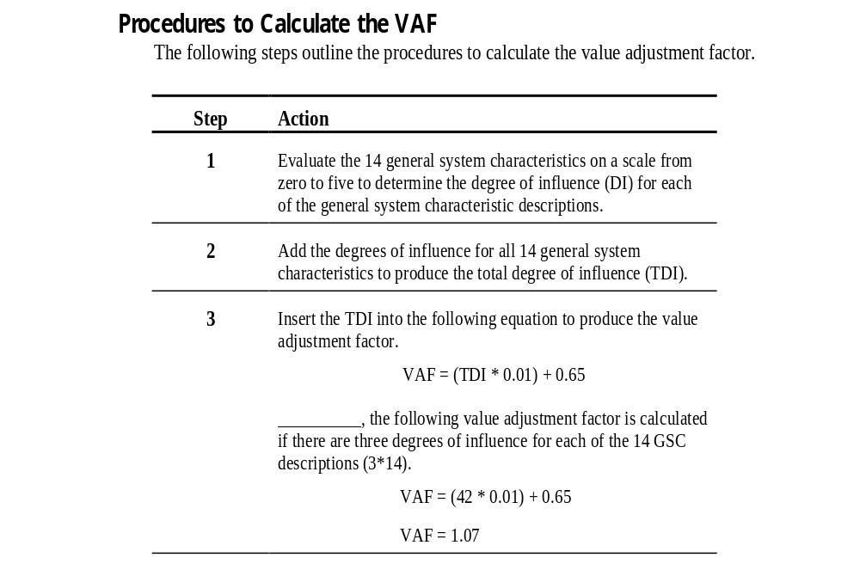

Slide 28
CALCULATE ADJUSTED FUNCTION POINTS
ADJ FP = UAFP * VAF

