Slide 1
EFFORTS and COSTING

Slide 2
EFFORTS and COSTING
Step 1 : Count Function Points
Step 2 : Convert Size to Estimated Effort Hours
Step 3 : Convert Effort Hours to Cost
Step 4 : Calculate Total Cost

Slide 3
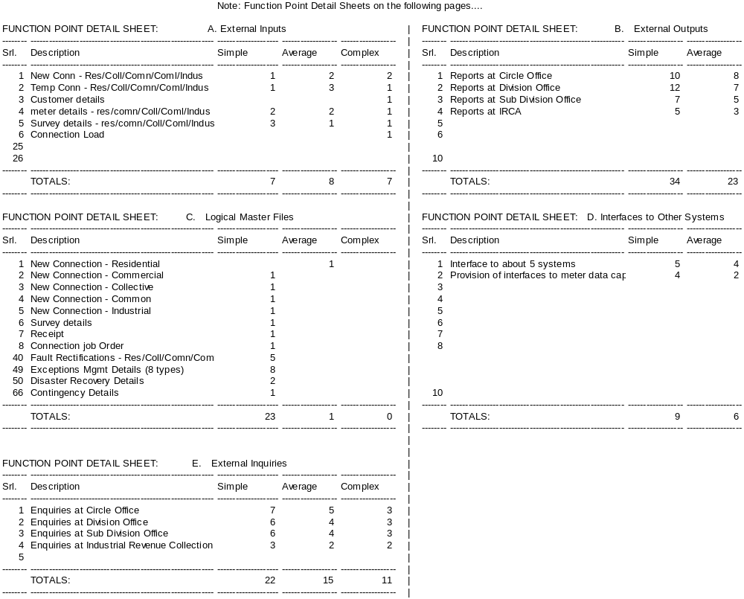

Slide 4
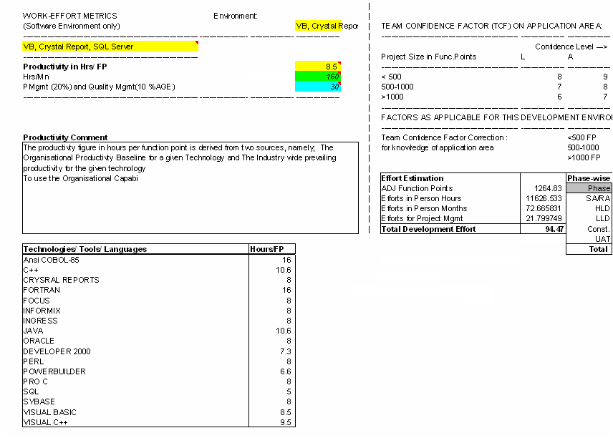

Slide 5
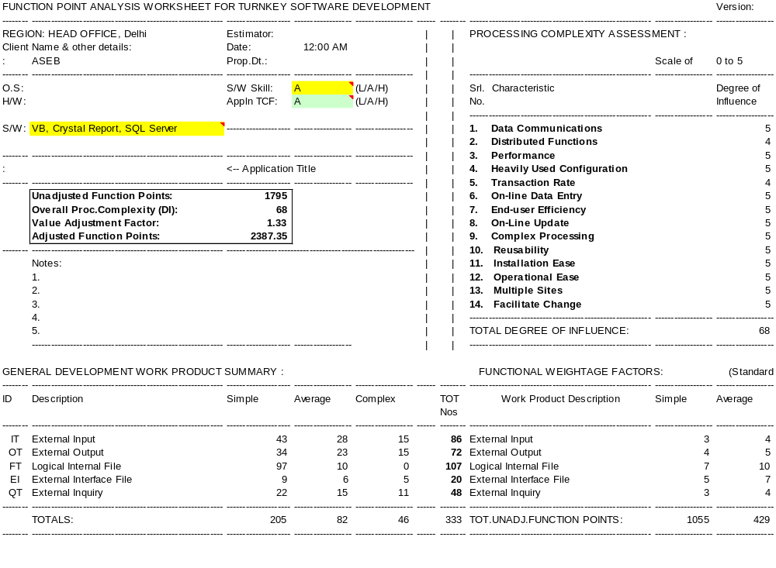

Slide 6
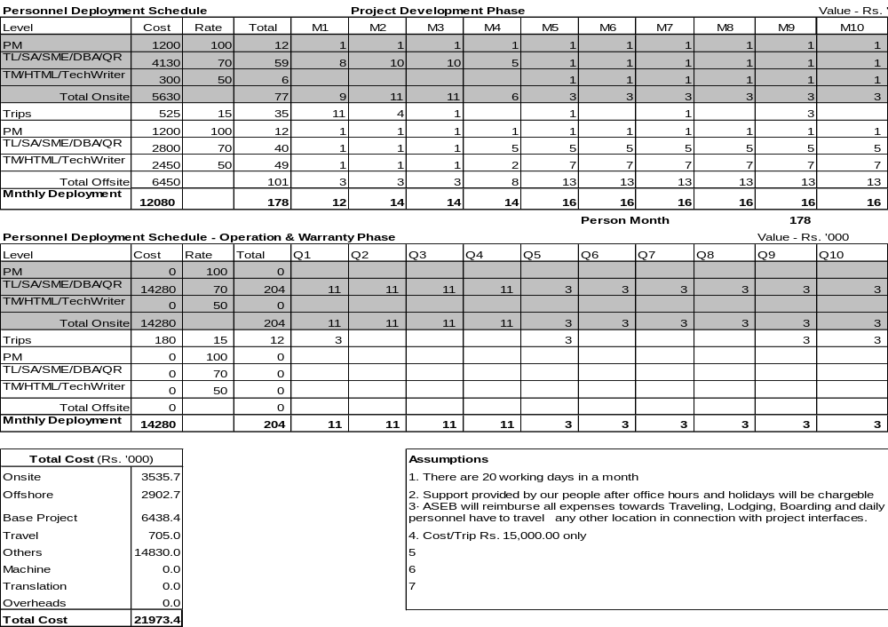

Slide 7
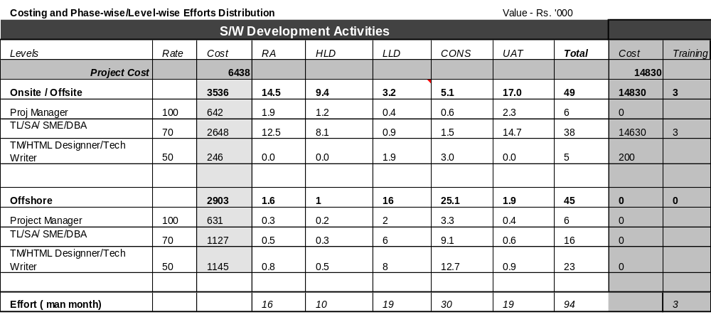

Slide 8
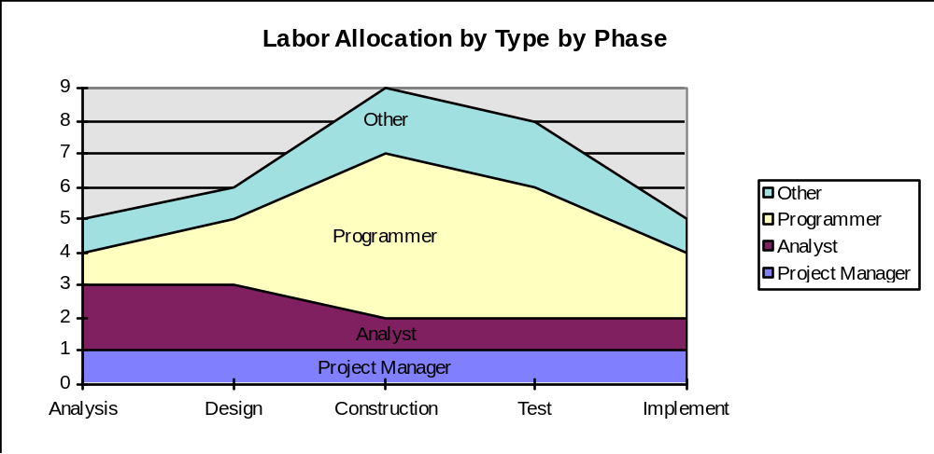

Slide 9
IMPACT OF ADDITIONAL INFLUENCES

Slide 10
Additional Influences
Other Product Factors
  Precedentedness
  Flexibility
  Required Reliability
  System Development Documentation
Personnel Factors
  Team Cohesion
  Personnel Continuity
  Analyst and Programmer Capabilities
  Application Experience
  Platform, Language and Tool Experience

Slide 11
Additional Influences
Project Factors
  Architecture/Risk Revolution
  Process Maturity
  Facilities
  Required Schedule

Slide 12
FUCTION POINTS TO ‘OO’ BASED APPLICATION

Slide 13
‘OO’ Based Appl Estimation
Develop Scenarios (Use cases) in a Subsystem
Identify Key Classes
Calculate Support Classes based on Interface Type
Interface Type Multiplier
  NO GUI 2.0
  Text Based user Interface 2.25
  GUI 2.5
  Complex GUI 3.0
Efforts = Total Classes (Key + Support) * 15-20 days
  (Source – Lorenz and Kidd)

Slide 14
‘OO’ Based Appl Estimation.. Rules
A message is the same as a function or procedure call in a traditional sense
A message sent to the client will generally manifest itself as an External Output or a External Inquiry.
A message prepared and sent from the client to the server is generally an External Input.
A method is a unit of functional logic contained within an object. According to IFPUG Standards, a transaction must have processing logic that is unique and represents the smallest unit of activity that is meaningful to the business user. Since a method is a unit of functional logic contained in an object, it is very similar to the definition of a transaction.
In OO applications only persistent data is considered an Internal Logical File not transient data. (Transient data is only valid inside a program or transaction and is lost when the program or transaction terminates).

Slide 15
Internet Based Appl Estimation.. Rules
"submit forms." This may be an html that is updated with information. It is one EI
A report that provides totals (calculated values) is an EO.
A report created from html such as listing of Name, Email, Responses etc. No calculated values hence an EQ. Additionally, each time an email is generated, that email is also an EQ.

Slide 16
KEY FIGURES

Slide 17
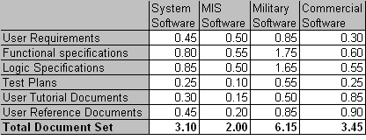
No. of pages per FP

Slide 18
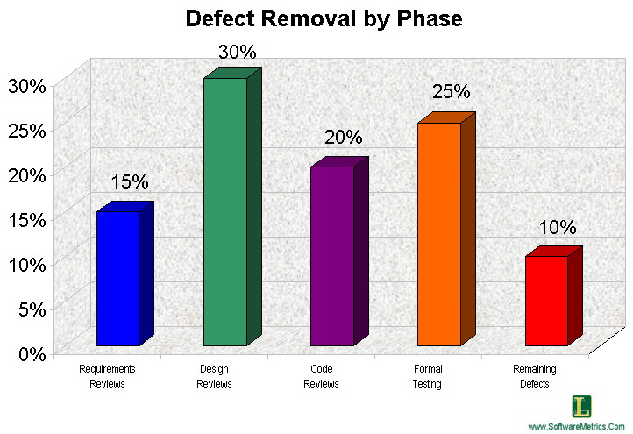
Test Cases And Defects
No. of acceptance test cases = FP * 1.2
No. of maximum potential defects =number of acceptance test cases which is 1.2 x Function Points.
Phase wise potential defects
Test cases are independent of
technology and implementation
techniques.

Slide 19
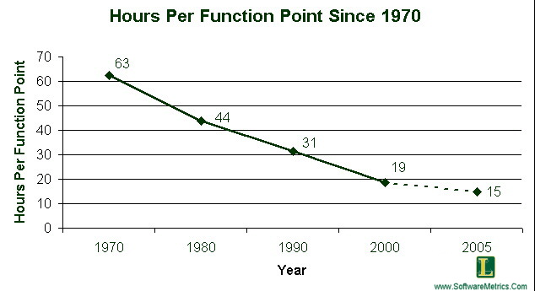
History of Software Productivity

Slide 20
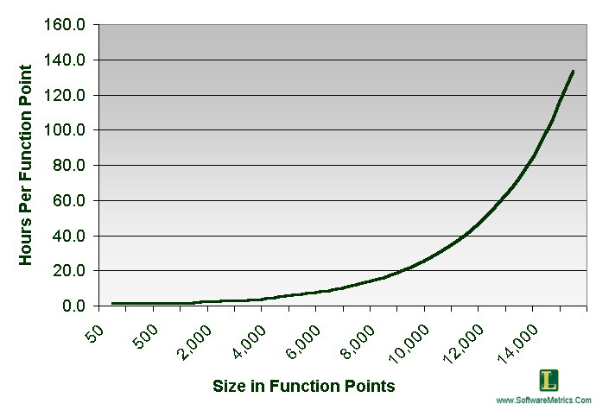
Impact of Size on Productivity
As size becomes larger complexity increases.
As size becomes larger a greater number of tasks need to be completed.
As size becomes larger there is a greater number of staff members and
they become more difficult to manage.

Slide 21
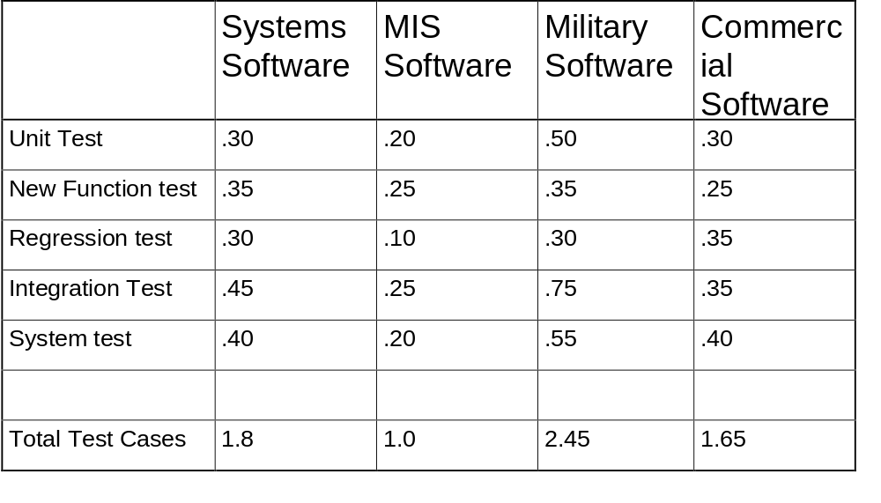
Number of Test Cases per Function Point

Slide 22
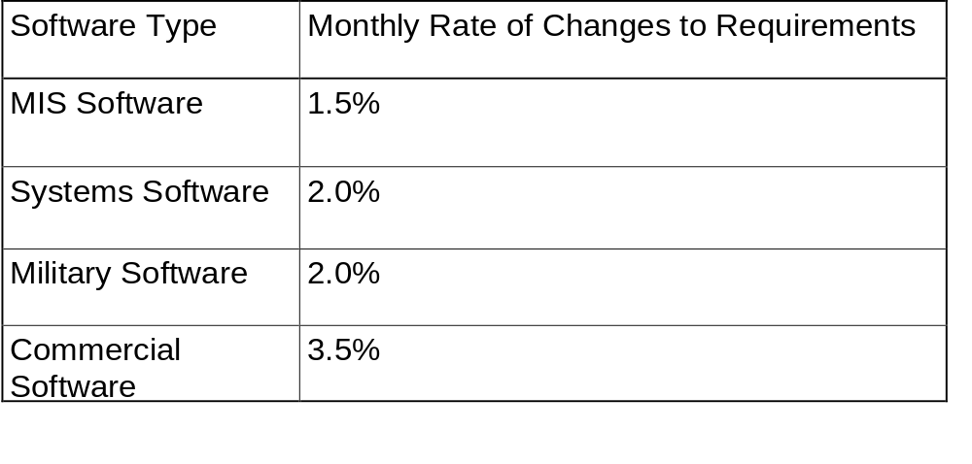
Rate of Requirement Creep after initial estimates

Slide 23
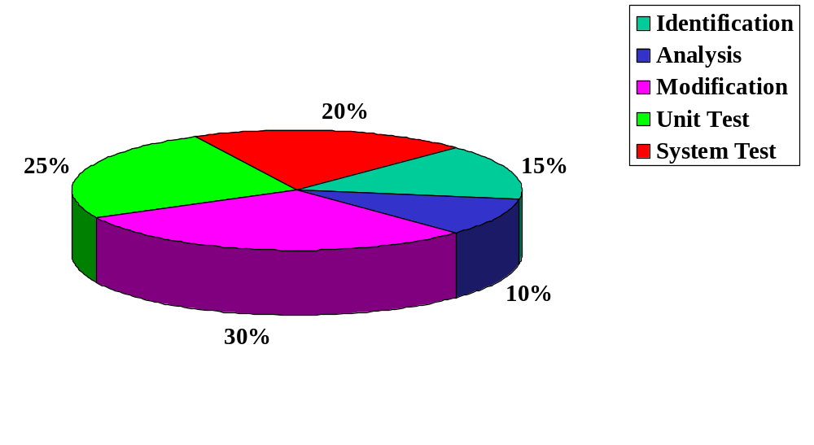
Estimated Costs by Function

Slide 24
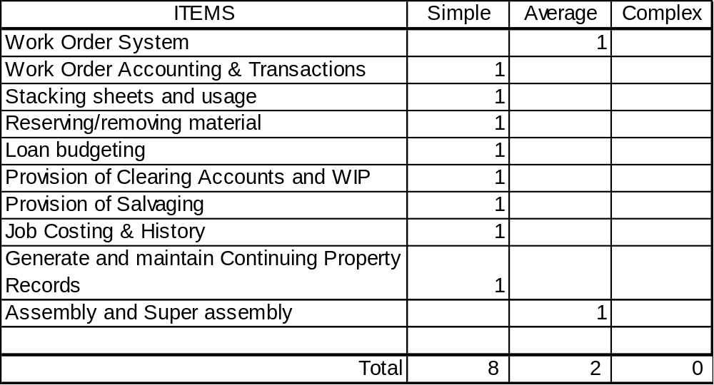
INTERNAL LOGICAL FILE (ILF)

Slide 25
ALL Tables for FPA
EI
DET | 1 to 4 | 4 to 15 | 16 or more
0 to 1 RET | L | L | A
2 to 5 RET | L | A | H
6 or More RET | A | H | H
EO
DET | 1 to 5 | 6 to 19 | 20 or more
0 to 1 RET | L | L | A
2 to 3 RET | L | A | H
4 or More RET | A | H | H
EQ
DET | 1 to 5 | 6 to 19 | 20 or more
0 to 1 RET | L | L | A
2 to 3 RET | L | A | H
4 or More RET | A | H | H
ILF
DET | 1 to 19 | 20 to 50 | 51 or more
0 to 1 RET | L | L | A
2 to 5 RET | L | A | H
6 or More RET | A | H | H
EIF
DET | 1 to 19 | 20 to 50 | 51 or more
0 to 1 RET | L | L | A
2 to 5 RET | L | A | H
6 or More RET | A | H | H

