Slide 1
FPA Basics

Slide 2
Elements of Good Estimating Practice
Use Best Practices
Use Structured Methods
Usable For All Software Product Elements
Should be Based on Statistics
People from related but different projects are involved in estimation
Validation against previous completed projects
Update the Estimates:
  Requirements changes or constraints change
  Actual values for products or processes are found to be significantly different from those which the plan is based

Slide 3
Software Estimation Risks
Inability to accurately size the software
  poor implementation
  emergency staffing
  cost overruns
Inability to accurately specify a development environment
  Inappropriate, underestimated or overestimated cost drivers
Improper assessment of staff skills
  misalignment of skills to tasks
  miscalculations of schedules
  improper staff requirements
Lack of well defined objectives, requirements or uncontrolled requirements growth

Slide 4
What are Function Points?
Function Points are a measure of the size of Computer Applications. The Size is measured from a Functional, or User, point of view.
It is independent of the Computer language, Development Methodology, Technology or Capability of the Project Team used to develop the Application.

Slide 5
History of Function Points
1970 - Invention By A.J.Albrecht at IBM
1979 - Release of Function Point Methodology
1984 - Revision of Function Points by Albrecht
1986 - Formation of IFPUG
1990 - Release of Version 3.0 by IFPUG (standard
Counting Practices Manual)
1994 - Release of Version 4.0 By IFPUG
1999 - Release of Version 4.1.1 By IFPUG
2009 - Release of Version 4.3 By IFPUB

Slide 6
FP Not Used For….
Sizing Maintenance Efforts (Fixing Problems)
Solving Performance Issues or Performance Tuning
Web Designing
Creating Graphics, Images, Page layouts etc.

Slide 7
Application of Function Points
Development cost estimating
Litigation involving software contracts
Litigation involving software taxation
Maintenance cost estimating
Outsource contracts
Process improvement analysis
Quality estimating
Quality measurements
Sizing all software deliverables (documents, source code, test materials)
Benchmark studies

Slide 8
FUNCTION POINTS….You Can Achieve..?
To measure the productivity of staff
To measure the productivity of each phase of
Software development Life Cycle
To estimate project effort
To compare productivity with earlier completed similar
projects
To drive business decisions regarding which
applications to retain, retire or redesign

Slide 9
IFPUG
Allan Albrecht at IBM First Created Function Points
Refined to formulate Counting Practice Manual
IFPUG Counting Practice Manual Rel. 4.1
  Defining Boundaries
  Identifying Internal Logical file (ILF)
  Identifying External Interfaces (EIF)
  Counting External Inputs (EI)
  Counting External Outputs (EO)
  Counting External Inquiries (EQ)
  Value Adjustment Factor (VAF)
  Degrees of Influence

Slide 10
Boundaries
Definition :
The function point counting boundary indicates the border between the project or application being measured and the external applications or user domain.

Slide 11
Purpose of Boundaries
Boundaries are used to establish :
The scope of the product being measured
Data ownership required for function point counting (whether data is owned by one application and/or another)
Processing relationships required for function point counting (where processing occurs and for what purpose).

Slide 12
Boundary Rules
The boundary is determined based on the user's point of view. The focus is on what the user can understand and describe.
The boundary between related applications is based on separate business functions as seen by the user, not on technological concerns.
For enhancement projects, the initial boundary must conform to the boundaries already established for the application or applications being modified.
There may be more than one application included in the scope of a single project. If so, multiple application boundaries would be identified.

Slide 13
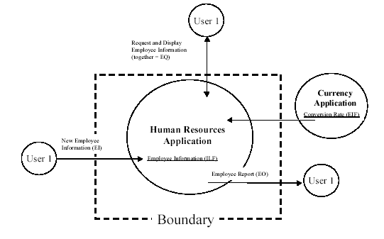
Boundary Example

Slide 14
Types of Function Point Counts
Development project function point count : measures the functions provided to the end users with the first installation of the software delivered when the project is complete.
Enhancement project function point count : measures the modifications to the existing application that add, change, or delete user functions delivered when the project is complete.
Application function point count : measures of the functions, the current application provides to the end-user (base-line FP). This number is initialized when the development project function point count is completed. It is updated every time completion of an enhancement project alters the application's functions

Slide 15
Definition of UFPC
The unadjusted function point count (UFPC) reflects the specific countable functionality provided to the user by the project or application.
The application's specific user functionality is evaluated in terms of what is delivered by the application, not how it is delivered. Only user-requested and defined components are counted

Slide 16
UFPC
Data Function Types represent the functionality provided to the user to meet internal and external data requirements. Data function types are either internal logical files or external interface files.
Transactional Function Types represent the functionality provided to the user to process data by an application. Transactional function types are defined as external inputs, external outputs, and external inquiries.

