Slide 1
Key terms used in FPA
DET: Data Element Type
RET: Record Element Type
FTR: File Type Reference
ILF & EIF uses DET & RET
EI, EO, EQ uses DET & FTR
UFPC
AFPC
VAF
Degree of Influence

Slide 2
Internal Logical Files
&
External Logical Files

Slide 3
Definition
An Internal Logical File (ILF) is a user identifiable group of logically related data or control information maintained within the boundary of the application

Slide 4
Control Information
Control Information is data that influences an elementary process of the application being counted. It specifies what, when, or how data is to be processed.
For example, someone in the payroll department establishes payment cycles to schedule when the employees for each location are to be paid. The payment cycle, or schedule, contains timing information that affects when the elementary process of paying employees occurs.

Slide 5
ILF Identification Rules
The group of data or control information is a logical, or user identifiable, group of data that fulfills specific user requirements.
The group of data is maintained within the application boundary.
The group of data is modified, or maintained, through an elementary process of the application.
The group of data identified has not been counted as an EIF for the application.

Slide 6
Hints for ILF/EIF Counting
Is the data a logical group that fulfills specific user requirements?
  An application can use an ILF or EIF in multiple processes, but the ILF or EIF is counted only once.
  Do not assume that one physical file equals one logical file when viewing data logically from the user perspective.
  Although some storage technologies such as tables in a relational DBMS or a sequential flat file relate closely to ILFs or EIFs, do not assume that this always equals a one-to-one physical-logical relationship.
  If a group of data was not counted as an ILF or EIF itself, count its data elements as DETs for the ILF or EIF which includes that group of data.
  Do not assume all physical files must be counted or included as part of an ILF or EIF.

Slide 7
Hints for ILF/EIF Counting
Where is data maintained? Inside or outside the application boundary?
- Look at the work flow.
- In the process functional decomposition, identify where the user and other application interfaces occur.
- Work through the process diagram to get hints.
Credit ILFs maintained by more than one application to each application at the time the application is counted.
An application can use an ILF or EIF multiple times, but you count the ILF or EIF only once.
  - Work through the process diagram to get hints.
  - Credit ILFs maintained by more than one application to each application at the time the application is counted.

Slide 8
Hints for ILF/EIF Counting Middleware
File structures that are used by an elementary process to analyze transaction data for the duration of the transaction is an ILF, even though the data itself is not retained.

Slide 9
Data Element Types
A data element type (DET) is a unique user recognizable, non-recursive field on the ILF or EIF.

Slide 10
DET Rules
❒ Count a DET for each unique user recognizable, non recursive field on the ILF or EIF.
❒ Count a DET for each piece of data in an ILF or EIF that exists because the user requires a relationship with another ILF to be maintained.
❒ Count the following physical implementation techniques as a single DET for the entire group of fields.
  Fields that appear more than once in an ILF or EIF because of technology or implementation techniques.
  Repeating fields that are identical in format and exist to allow for multiple occurrences of a data value.

Slide 11
Record Element Types
A record element type (RET) is a user recognizable subgroup of data elements within an ILF or EIF.
  Optional
  Mandatory
Optional subgroups are those that the user has the option of using one or none of the subgroups during an elementary process that adds or creates an instance of the data.
Mandatory subgroups are those of which the user must use at least one of the subgroups.

Slide 12
Record Element Types…Example
In a Human Resources Application, information for an employee is added by entering some general information. In addition to the general information, the employee is a salaried or hourly employee (The user has determined that an employee must be either salaried or hourly). Either type can have information about dependents. For this example, there are three subgroups or RETs as shown below:
• Salaried employee (mandatory); includes general information
• Hourly employee (mandatory); includes general information
• Dependent (optional)

Slide 13
RET Rules
❒ Count an RET for each optional or mandatory subgroup of the ILF or EIF.
Or
❒ If there are no subgroups, count the ILF or EIF as one RET.

Slide 14
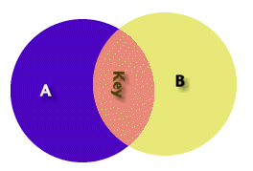
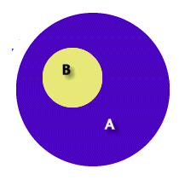
Example..RET
Some A are B – The first diagram represents two separate logical groups of data A and B (with key information between). This represents two internal logical files one RET each
All B are A – The second diagram represents one logical group of data A with two record types. B is a complete subset of A
Example – Imagine a music CD. Songs are a subset of a music CD. They do not exist independent of this. All Songs are part of the Music CD (all B are A). It has CD information and the song information. There are 5 data elements (singer, group, producer, label, date) for the CD RET and there are 3 data elements (song name, author, and length) for the Song RET. Hence in this example, there are 2 record element types and 8 data elements.

Slide 15
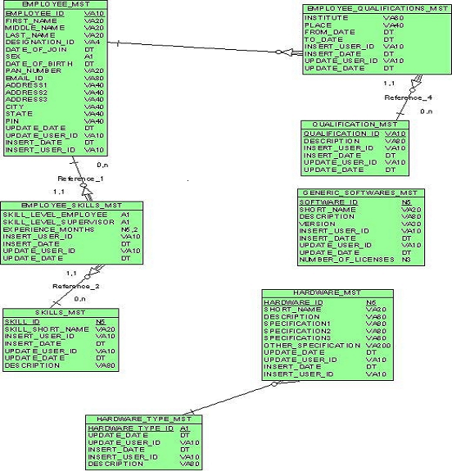
Example..ILF

Slide 16
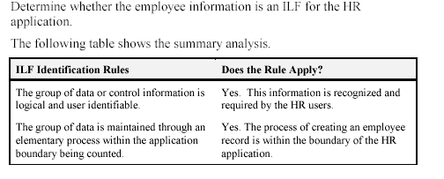
Example..ILF

Slide 17
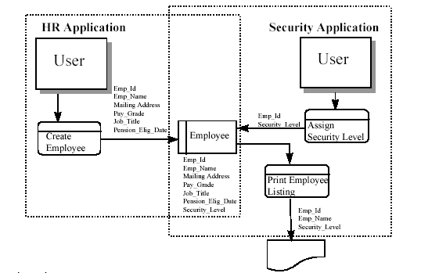
Example..ILF

Slide 18
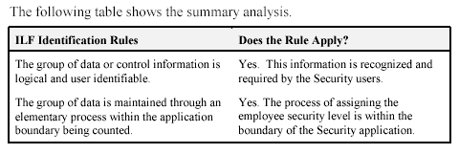
Example..ILF
Determine whether the employee information is an ILF for the Security application.

Slide 19
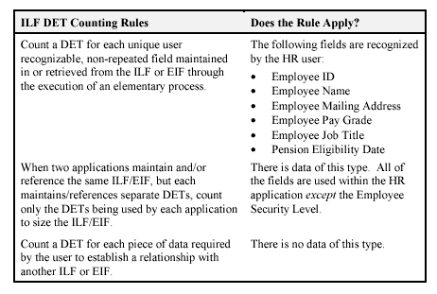
Example..ILF
Counting DETs

Slide 20
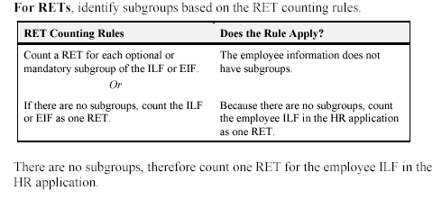
Example..ILF
Counting RETs

Slide 21
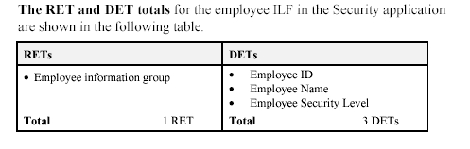
Example..ILF
Counting DETs and RETs for Security Application

Slide 22
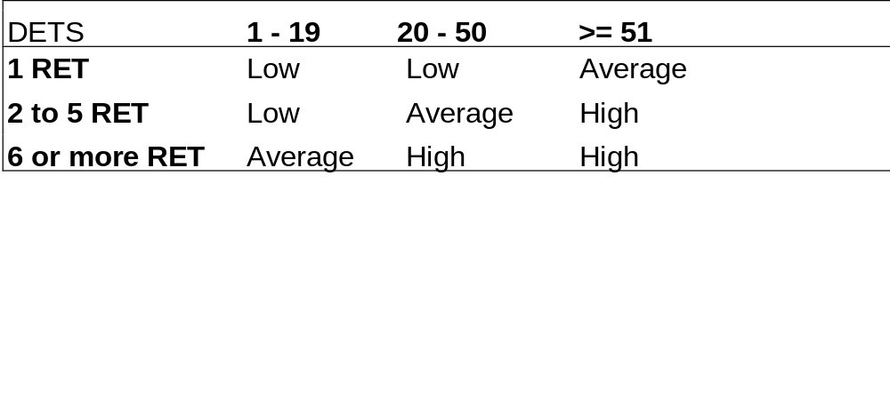
ILF Complexity Matrix

Slide 23
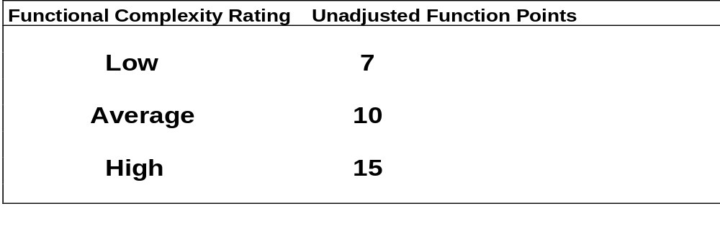
ILF Translation Tables

Slide 24
External Interface File

Slide 25
Definition
An external interface file (EIF) is a user identifiable group of logically related data or control information referenced by the application, but maintained within the boundary of another application. This means an EIF counted for an application must be an ILF in another application

Slide 26
EIF Identification Rules
❒ The group of data is referenced by, and external to, the application being counted.
❒ The group of data is not maintained by the application being counted.
❒ The group of data is counted as an ILF for at least one other application.
❒ The group of data identified has not been counted as an ILF for the application.

Slide 27
EIF Complexity Matrix

Slide 28
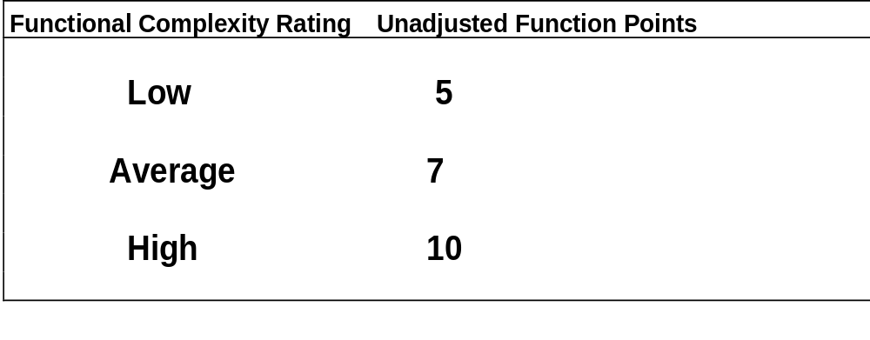
EIF Translation Tables

Slide 29
External Inputs

Slide 30
Definition
An external input (EI) processes data or control information that comes from outside the application's boundary. The external input itself is an elementary process. The processed data maintains one or more ILFs. The processed control information may or may not maintain an ILF.
OR
External Inputs (EI) is an elementary process in which data crosses the boundary from outside to inside. This data may come from a data input screen, electronically or another application. The data can be either control information or business information. If the data is business information it is used to maintain one or more internal logical files. If the data is control information it does not have to update an internal logical file.

Slide 31
Identification Rules
Input Data Counting Rules
❒ The data is received from outside the application boundary.
❒ The data in an ILF is maintained through an elementary process of the application.
❒ The process is the smallest unit of activity that is meaningful to the end user in the business.
The process is self-contained and leaves the business of the application being counted in a consistent state.
For example, the user requirements to add an employee include setting up salary and dependent information. If all the employee information is not added, an employee has not yet been created. Adding some of the information alone leaves the business of adding an employee in an inconsistent state. If both the employee salary and dependent information is added, this unit of activity is completed and the business is left in a consistent state.

Slide 32
Identification Rules
Input Data Counting Rules
❒ For the identified process, one of the following two rules must apply:
  - Processing logic is unique from other external inputs for the application.
  - The data elements identified are different from other external inputs for the application.

Slide 33
Identification Rules
Control Information Processing Rules
❒ The control information is received from outside the application boundary.
❒ The information is specified by the user to ensure compliance with business function requirements.
❒ For the identified process, one of the following two rules must apply:
  - Processing logic is unique from other external inputs for the application.
  - The data elements identified are different from other external inputs for the application.
The processed control information may or may not maintain an ILF

Slide 34
File Types Referenced
Definition
A file type referenced is
An internal logical file read or maintained by a function type
An external interface file read by a function type.

Slide 35
FTR Rules
❒ Count a file type referenced for each internal logical file (ILF) maintained.
❒ Count a file type referenced for each internal logical file (ILF) or external interface file (EIF) read during the processing of the external input.
❒ Count only one FTR for each ILF that is both maintained and read by the external input.

Slide 36
Data Element Types
A data element type (DET) is a unique user recognizable, non-recursive field maintained on the Internal Logical File by the External Input

Slide 37
DET Counting Rules
 Count a DET for each unique user recognizable, non-recursive field maintained on an ILF by an external input.
 Count a DET for each field that is not entered by the user, but through an external input, is maintained on an internal logical file.
❒ Count the following physical implementation techniques as a single DET for the entire group of fields:
  A logical field that is stored physically as multiple fields, but is required by the user as a single piece of information.
  For example, an account number or date physically stored in multiple fields, but required by the user as a single piece of information, is counted as one DET.

Slide 38
DET Counting Rules..GUI
Radio Buttons – One DET is counted for all the radio buttons contained in the frame.
❒ Check Boxes – Each check box, within a frame, that can be selected should be treated as a data element.
Command Buttons – According to IFPUG counting rules each command button would be counted as a data element for the action it invokes.
Display of Graphical Images or Icons – A display of a graphical image or schematic is treated as a single DET.
Sound Bytes - Sound byte is one DET.
Photographic Images – A photographic image is one DET.
Messages – Error message and Confirmation message are treated as a one DET each for the appropriate transaction.

Slide 39
DET Counting Rules..GUI
Command Buttons – Command Buttons are one DET each. Command buttons may specify an add, change, delete or inquire action. For example, a simple application to track Distributors could have fields for Distributor Name, Address, City, State, Zip, Phone Number, and Fax Number. This would represent seven data elements (7 DET’s) and the add command button would represent the 8th data element. In short, the add external input represents a one external input with eight data elements, the change external input represents another external input with eight data elements (7 fields plus the change command button), and the delete external input represents the last external input with eight data elements (7 fields plus the delete command button).
Graphic Images are one DET
Sound Bytes – This represents one data element. The number of notes played is simply recursive information. If the length of the sound byte increases, then the data element remains one. If it is played for two seconds or four seconds, then this is still one data element.

Slide 40
DET Counting Rules..GUI
In a GUI or OO environment it is common for information to move from one window to the next. The actual movement of data is not considered an external input because it has not crossed the application boundary (outside to inside) and does not maintain an ILF.

Slide 41
DET Counting Rules..GUI
Messages
  Error Messages / Confirmation Messages – It indicates that a process will be or has been completed. A message, “Zip code is required” would be an example of an error message. A message, “Are you sure you want to delete the customer?” is an example of a confirmation message. Neither of these type of messages are treated as a unique External Output, but they are treated as data elements for the appropriate transaction. Each is one DET
  Notification Messages – It is the basis of processing and a conclusion being drawn. For example, while withdrawing from an ATM machine more money than you have in your account. You may receive the message, “You have insufficient funds to cover this transaction.” This is the result of information being read from a file and a conclusion being drawn. A notification message is treated as an EO.
  Notification Messages may be the result of processing and the actual processing or derived data my not be seen. If a message is created to be sent to a pager (beeper) at a given time. This is much like an alarm. The pager message has one data element the text message.

Slide 42
DET Counting Rules..GUI
External Inputs
  In GUI external inputs are preceded by serial inquiries
  Each Add, Delete or Change function would be one External Input
Radio Buttons in a group are treated as one DET Within a group of radio buttons the user has the option of selecting only one radio button at a time, so only one data element type is counted for all the radio buttons contained in the entire frame.

Slide 43
DET Counting Rules..Examples
Example: An account number that is stored in multiple fields is counted as one DET.
Example: A before or after image for a group of 10 fields maintained for audit purposes would count as one DET for the before image (all 10 fields) and as one DET for the after image (all 10 fields) for a total of 2 DETs.
Example: The result(s) of a calculation from an elementary process, such as calculated sales tax value for a customer order is counted as one DET on the customer order ILF.
Example: Accessing the price of an item which is saved to a billing file or fields such as a time stamp if required by the user(s) are counted as DETs.

Slide 44
DET Counting Rules..Examples
Example: If an employee number appears twice in an ILF or EIF as (1) the key of the employee record and (2) a foreign key in the dependent record, count the DET only once.
Example: Within an ILF or EIF, count one DET for the 12 Monthly Budget Amount fields. Count one additional field to identify the applicable month.
When two applications maintain and/or reference the same ILF/EIF, but each maintains/references separate DETs, count only the DETs being used by each application to size the ILF/EIF. For example, Application A may specifically identify and use an address as: street address, city, state and zip code. Application B may see the address as one block of data without regard to individual components. Application A would count four DETs; Application B would count one DET.

Slide 45
DET Counting Rules..Examples
Example: Application X maintains and/or references an ILF that contains SSN, Name, Street Name, Mail Stop, City, State, and Zip. Application Z maintains and/or references the Name, City, and State. Application X would count seven DETs; Application Z would count three DETs.
Count a DET for each piece of data required by the user to establish a relationship with another ILF or EIF. For example, in an HR application, an employee's information is maintained on an ILF. The employee’s job name is included as part of the employee's information. This DET is counted because it is required to relate an employee to a job that exists in the organization. This type of data element is referred to as a foreign key.
Example: In an object oriented (OO) application, user requires an association between object classes, which have been identified as separate ILFs. Location name is a DET in the Location EIF. The location name is required when processing employee information; consequently, it is also counted as a DET within the Employee ILF.

Slide 46
When to Count Single DETs ?
Fields that appear more than once in an internal logical file because of technology or implementation techniques.
Fields that indicate an error occurred during processing or confirm that processing is complete.
Example: Error Message Fields.
Count a single DET for the capability to specify the action to be taken by the external input.
Example: count as one DET command lines or function/action (PF) keys that provide the capability to specify the action to be taken by the external input. Count this as one additional DET per external input.

Slide 47
DET Counting Rules..Real Time System
Real time and embedded systems – The time of diagnostics, hardware state during diagnostics, temperature, voltage etc. would all be examples of one DET each.
Operator Controls, Volume Controls, Sensor Readings, Radio Frequencies, Standards and Limit Settings (Alarms Settings etc.) would be counted as one DET each.

Slide 48
Hints for EI Counting
Is data received from outside the application boundary?
  - Look at the work flow.
  - Identify where the user and other application interfaces occur in the process functional decomposition.
Is the process the smallest unit of activity from the user perspective?
  - Look at the different forms used.
  - Review the ILFs to identify how the user groups the information.
  Identify where the user and other application interfaces occur in the process functional decomposition.
  - Look at what happened in the manual system.
  - Note that one physical input or transaction file or screen can, when viewed logically, correspond to a number of EIs.
  - Note that two or more physical input or transaction files or screens can correspond to one EI if the processing logic is identical.

Slide 49
Hints for EI Counting
Is the process self-contained and does it leave the business in a consistent state?
  - Review external outputs and external inquiries to understand how the user works with the information.
  - Work through the process diagram to get hints.
  - Look at what happened in the manual system.
  - Check for consistency with other decisions

Slide 50
Hints for EI Counting
Is the processing logic unique from other EIs?
  - Identify batch inputs based on the processing logic required.
Are the data elements different from those for other EIs?
  - If the data elements appear to be a subset of the data elements of another external input, be sure two elementary processes are required by the user—one for the main data elements and one for the subsets.

Slide 51
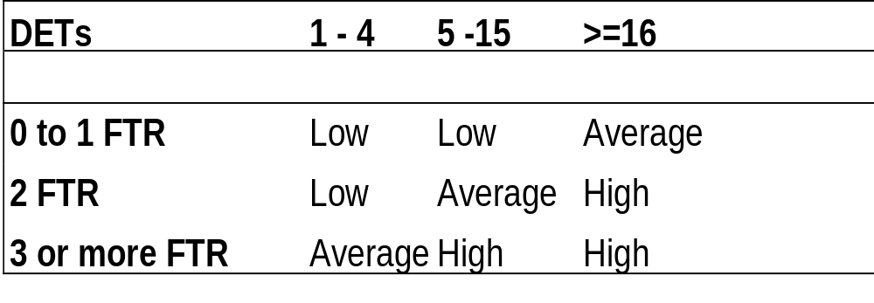
DET/FTR Complexity Matrix

Slide 52
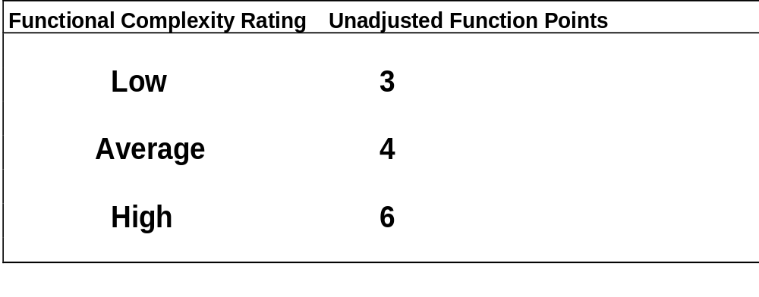
EI Translational Tables

Slide 53
External Outputs

Slide 54
Definition
An external output (EO) is an elementary process that generates data or control information sent outside the application's boundary.
OR
External Outputs (EO) is an elementary process in which derived data passes across the boundary from inside to outside. The data creates reports or output files sent to other applications. These reports and files are created from one or more internal logical files and external interface file .
Derived Data is data that is processed beyond direct retrieval and editing of information from internal logical files or external interface files. Derived data is the result of algorithms, and/or calculations. Derived data occurs when one or more data elements are combined with a formula to generate or derive an additional data element(s).

Slide 55
Identification Rules
❒ The process sends data or control information external to the application's boundary.
❒ The data or control information is sent through an elementary process of the application.
❒ The process is the smallest unit of activity that is meaningful to the end user in the business.
❒ The process is self-contained and leaves the business of the application being counted in a consistent state.
❒ For the identified process, one of the following must apply:
  - Processing logic is unique from other external outputs for the application.
  - The identified data elements are different from other external outputs for the application.

Slide 56
FTR for Outputs
Definition
❒ A file type referenced is a file read when the external output is processed
Rules
❒ Count a file type referenced for each internal logical file (ILF) or external interface file (EIF) read during the processing of the external output.

Slide 57
DETs for Outputs
Definition
❒ A data element type is a user recognizable, non-recursive field that appears on the external output
Rules
❒ Count a DET for each user recognizable, non-recursive field that appears on the external output.
❒ Do not count literal as DETs.
❒ Do not count paging variables or system-generated stamps.

Slide 58
Counting Outputs
When to Count Single DETs ?
A logical field that is stored physically as multiple fields, but is required by the user as a single piece of information.
Each type of label and each type of numerical equivalent in a graphical output.
Text information that may be a single word, sentence, or phrase.
For example, a message is included on a report to indicate why a transaction to add a job could not be completed successfully.

Slide 59
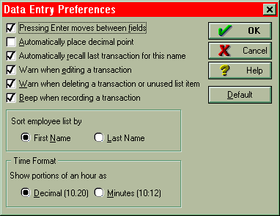
GUI Estimation
Check Boxes – This may represent one data element or multiple data elements. The screen listed as Data Entry Preferences has numerous check boxes. In this case, each check box is considered a data element type (DET). Each check box is independent from other check boxes and provides different business functionality. The sort employee name and Time format are two additional data element types (DET’s) also.
How many DET’s..?
This particular screen has X data elements (Y DET’s and action key).

Slide 60
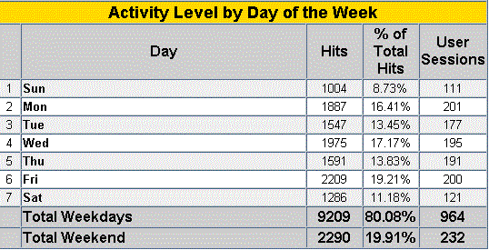
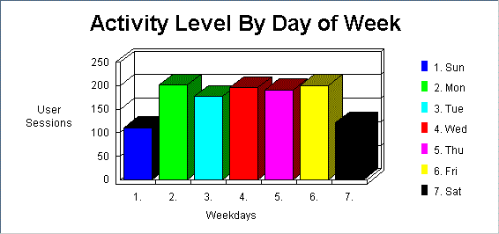
GUI Estimation…Example
THere are 10 data elements in the following table
1. Days
2. Hits
3. % of Total Hits
4. User Sessions
5. Total Hits (weekday)
6. Total % (weekday)
7. Total User Sessions (weekday)
8. Total Hits (weekend)
9. Total % (weekend)
10. Total User Sessions (weekend)
One output
One output

Slide 61
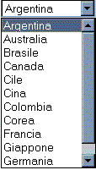
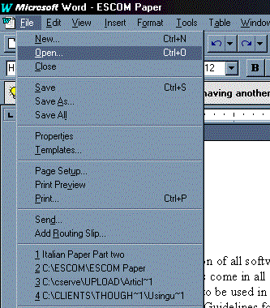
GUI Estimation…Example
Pick List – A dynamic pick list (drop down box) is an EQ if the country names are contained in an internal logical file or external interface file.
Menu – The menu displayed to the right is a dynamic menu. Word displays the last several files that have been opened. We can easily conclude that this information is being read from some type of internal file. Hence, the information is dynamic. The menu would be counted as an EQ. The real distinction is if a menu is dynamic or static. That is, are the contents of the screen or report dynamic (read from some file) or are they static.

Slide 62
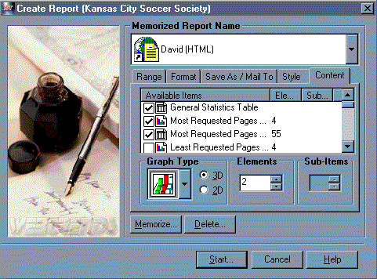
GUI Estimation…Example
It is common for GUI applications to have External Inputs preceded by serial inquiries. That is, a user may be able to select a customer name from a pick list (first EQ), the customer name is used as input for the second EQ which provides address, phone, zip and other contact information. From this point forward a user can add, change or delete the customer information (3 EI’s). In this case, this one screen would represent 2 EQ’s and 3 EI’s.
In the “Create Report” control screen, the user has the ability to select reports. This particular screen has several data elements types such as check box, graph type, dimensions, elements, sub-items and actions keys.
User can choice each report individually. In fact each report is as an object. The generated report is a combination of several reports (or objects). Each object has several attributes.

Slide 63
DET Counting Rules..GUI
External Outputs
  Textual, graphical or electronic information
  Each type of report to be treated as external outputs.
External Inquiries
  Serial Inquiries to be counted separately
  EQs do not contain derived data
  for e.g.. customer is selective from customer list which in turn is used to extract other customer details

Slide 64
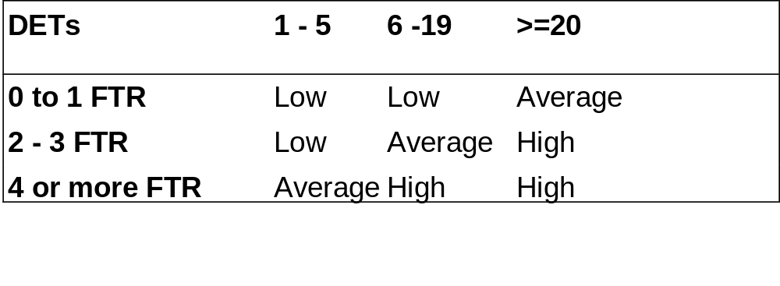
DET/FTR Complexity Matrix

Slide 65

EO Translational Tables

Slide 66
Hints for EO Counting
Is data sent outside the application boundary?
  - Look at the work flow.
  - Identify where the user and other application interfaces occur in the process functional decomposition.
Is the process self-contained and does it leave the business in a consistent state?
  - Review external inputs and external inquiries to get an overall view of how the user works with the information.
  - Work through the process diagram to get hints.
  - Look at what happened in the manual system.

Slide 67
Hints for EO Counting
Is the process the smallest unit of activity from the user perspective?
  - Look at the different forms used.
  - Review the ILFs to identify how the user groups the information.
  Identify where the user and other application interfaces occur in the process functional decomposition.
  Look at what happened in the manual system.
  Remember that one physical report, screen, or batch output file can, when viewed logically, correspond to a number of EOs.
  Remember that two or more physical reports, screens, or batch output files can correspond to one EO if the processing logic is identical.

Slide 68
Hints for EO Counting
Is the processing logic unique from other EOs?
  - Identify output based on the processing logic required.
  - Remember that resorting or rearranging a set of data does not make processing logic unique.
Are the data elements different from other EOs?
  - If the data elements appear to be a subset of the data element of another EO, be sure two elementary processes are required by the user—one for the main data element and one for the subsets.

Slide 69
External Query

Slide 70
Definition
An external inquiry (EQ) is an elementary process made up of an input-output combination that results in data retrieval. The output side contains no derived data. No internal logical file (ILF) is maintained during processing.
OR
External Inquiry (EQ) is an elementary process with both input and output components that result in data retrieval from one or more internal logical files and external interface files. This information is sent outside the application boundary. The input process does not update any Internal Logical Files and the output side does not contain derived data.

Slide 71
Identification Rules
❒ An input request enters the application boundary.
❒ Output results exit the application boundary.
❒ Data is retrieved.
❒ The retrieved data does not contain derived data.
❒ The input request and output results together make up a process that is the smallest unit of activity that is meaningful to the end user in the business.

Slide 72
Identification Rules
❒ The elementary process is self-contained and leaves the business of the application being counted consistent.
❒ The processing does not update an ILF.
❒ For the identified process, one of the following two rules must apply:
  The processing logic on the input or output side is unique from other external inquiries in the application.
  The data elements making up the input or output side are different from other external inquiries in the application.

Slide 73
FTR for Outputs
Definition
 A file type referenced is a file read when the external inquiry is processed
Rules
❒ For each input/output side of the external inquiry, count a file type referenced for each internal logical file and external interface file read during the processing of the external inquiry.

Slide 74
DETs for Outputs
Definition
❒ A data element type is a user recognizable, non-recursive field that appears in the external inquiry.
Rules
❒ Count a DET for each user recognizable, non-recursive field that appears on the input/output side of external inquiry.
❒ Count a DET for each field that specifies the data selection criteria.
❒ Do not count literal as DETs for output queries
❒ Do not count paging variables or system-generated stamps for output queries.

Slide 75
Counting Inquiries
When to Count Single DETs ?
Fields indicating that an error has occurred while processing the input DETs or confirming that processing is complete.
Fields that provide the capability to specify the external inquiry is to be executed
A logical field that is stored physically as multiple fields, but is required by the user as a single piece of information.
Fields that, because of technology or implementation techniques, appear more than once in an internal logical file.

Slide 76
Hints for EQ Counting
Is data directly retrieved from an ILF or EIF?
  - Look at the work flow.
  - Identify where the user and other application interfaces occur in the process functional decomposition.
Is the process self-contained and does it leave the business in a consistent state?
  - Review external inputs and external inquiries to get an overall view of how the user works with the information.
  - Work through the process diagram to get hints.

Slide 77
Hints for EQ Counting
Is the process the smallest unit of activity from the user perspective?
  - Look at the different forms used.
  - Review the ILFs to identify how the user groups the information.
  Identify where the user and other application interfaces occur in the process functional decomposition.
  Look at what happened in the manual system.
  Remember that one physical report, screen, or batch output file can, when viewed logically, correspond to a number of EQs.
  Remember that two or more physical reports, screens, or batch output files can correspond to one EQ if the processing logic is identical.

Slide 78
Hints for EQ Counting
Is processing logic unique from other EQs?
  - Look for derived data to distinguish inquiries from outputs.
  - Remember that resorting or rearranging a set of data does not make processing logic unique.
Are the data elements different from other EQs?
  If the data elements appear to be a subset of the data elements of another external inquiry, be sure two elementary processes are required by the user—one for the main data elements and one for the subset.

Slide 79
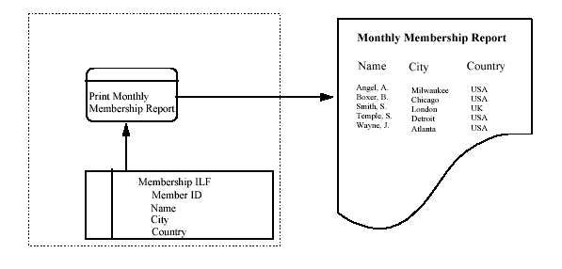
Example1 - EQ Counting

Slide 80
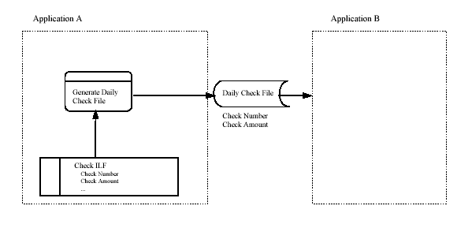
Example2 - EQ Counting

Slide 81
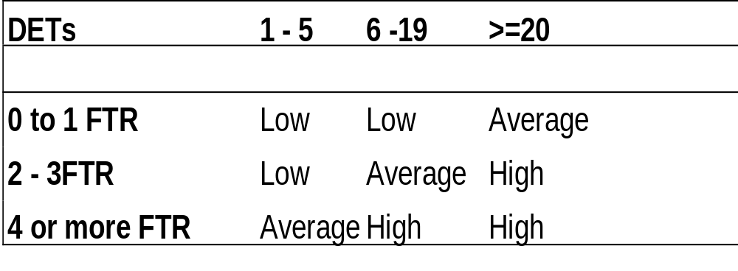
DET/FTR Complexity Matrix
(Input/Output Side)

Slide 82
EQ Translational Tables

