Slide 1
Corporate Background &
Overview
Presented by:
Tracy Reynolds,
Business Development Manager
&
Matt Scicchitano,
Account Manager
September 11, 2007

Slide 2
Overview
Global leader in testing and assessment
Recently acquired by ETS, Educational Testing Services, based in Princeton, NJ
Approximately 2,500 employees worldwide
Servicing over 600 clients in diverse marketplaces
More than 8 million tests delivered annually
  Over 3,000 testing centers worldwide
  Over 130 countries
  Over 30 languages

Slide 3

Global Operations
Minneapolis
Manchester
Lelystad





Beijing

Baltimore
London




Paris
Frankfurt
Seoul
New Delhi

Tokyo
Cairo



Singapore

Kuala Lumpur


Sydney

Johannesburg

Regional Contact Center
Regional Support Center
Corporate Headquarters - Baltimore
Regional Headquarters – London & Singapore
Testing Centers - over 3000 on six continents!


Slide 4
Partnership Advantages
Recognized industry-leading provider of testing and assessment
Leverage the expertise gained by developing and maintaining some of the world’s most recognized and credible testing programs
Experienced and collaborative partner to guide you through the process
Qualified and professional staff
Single source provider offering a fully integrated testing system to provide all the tools necessary for your global program

Slide 5
Paper and Pencil Conversion Experience
Successfully completed largest paper and pencil conversion to CBT to date (AICPA exam)
In paper format only available twice per year in large auditoriums and convention centers
Through a partnership with Prometric, candidates and client now benefit from:
  Modernized test items, stringent security
  Ease of review and enhancement of test content
  Clients proven commitment to the credential
  Flexible global testing offered 24/7/365
  Convenient scheduling and registration methods
  Consistent test center experience
  Certified and competent test center staff

Slide 6
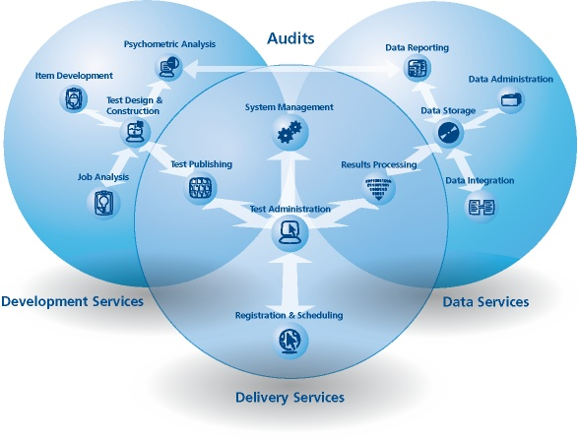
Comprehensive Testing System

Slide 7
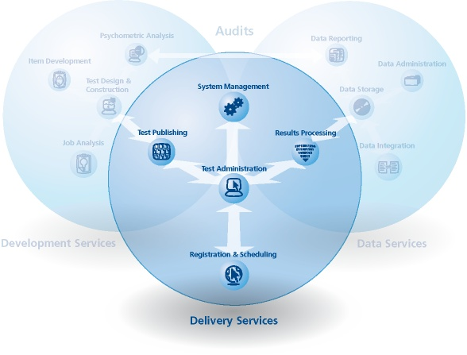
Test Delivery Services
Test Publishing
  Format, review, and package for distribution
System Management
  Project, account and program management
Registration & Scheduling
  Authorization, authentication & event scheduling
Test Administration
  Test delivery methodologies and models
Results Processing
  Test scoring and reporting

Slide 8
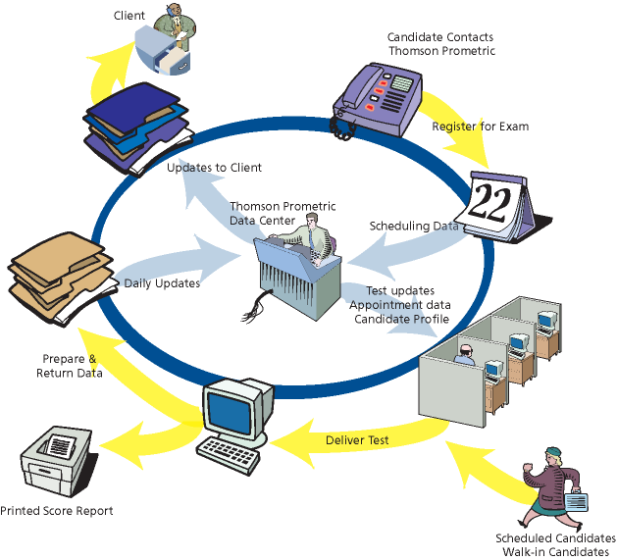
Test Delivery Lifecycle

Slide 9
Global Test Delivery Network
Existing test centers around the world
  Total testing locations exceed 3,000
  More than 27,000 testing seats
Strategic planning for targeting new test sites
Capacity planning model
  Client specific data is mapped to existing network
  Compared to current utilization & capacity to determine market needs
  Capacity is monitored weekly
Annual investments exceed $5 million in channel & infrastructure

Slide 10
Benefits of Partner-Operated Sites
Successfully worked with partner-operated sites for more than 10 years
Developed industry leading processes and quality standards relating to operation and management of partner sites
Partner-operated network provides us flexibility to service remote locations in a cost-effective manner
  Secure, consistent test center environment
  High quality testing centers
Prometric partners endure a rigorous approval process before becoming part of our network
Territory managers provide regional and local market area support to all sites

Slide 11
Test Center Advantages
Full time, professional proctors (Test Center Administrators)
  Comprehensive training
  Background checks
  Certification exam
  Annual re-certification process
  Continuous performance monitoring
Comprehensive corporate oversight and control of test centers
  Site management and security audits
  Candidate satisfaction survey and feedback

Slide 12
Program Maintenance
All testing programs must conduct regular program maintenance
Continuous assessment and analysis ensures ongoing success
Enables your test to stay current with the latest developments/trends in testing
Frequent review of testing content allows changes to be made
  Eliminates item over exposure
  Enables content update to keep up-to-date
  Provides confidence in validity and legal defensibility

Slide 13
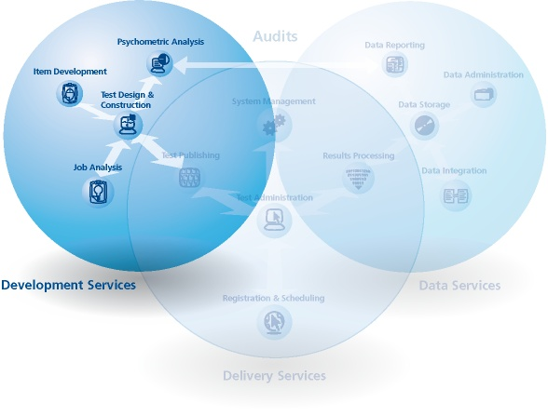
Test Development Services
Job Analysis
  Identifies what to measure
Item Development
  Creation and development of test items
Test Design & Construction
  Development of content and structure
Psychometric Analysis
  Evaluates validity, reliability and fairness

Slide 14
Test Development
Market-leading test development tools to automate and manage the item authoring process efficiently and in a secure environment
A collaborative approach to ensure quality control and validity
Multiple elements for accurate assessments:
  Job Analysis
    Identifies what to measure
  Item Development
    Creation of test items
  Test Design and Construction
    Development and content structure
  Psychometric Analysis
    Evaluate reliability, validity and fairness

Slide 15
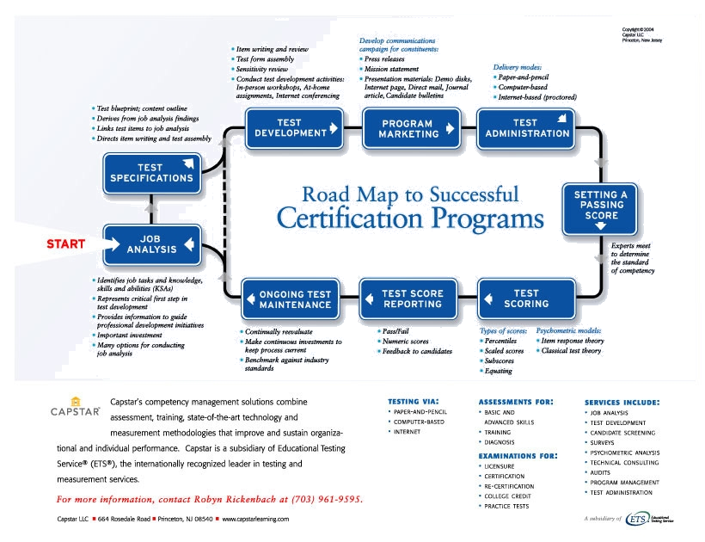
Certification Roadmap

Slide 16
Questions?
September 11, 2007

