Slide 1
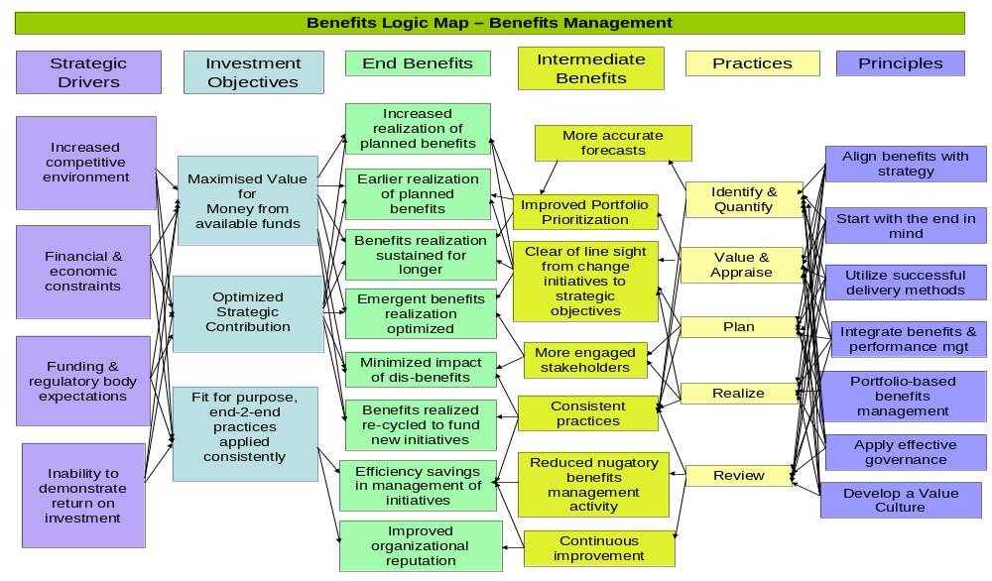
Benefits Logic Mapping

Slide 2
What is it?
A way of determining the rationale for an investment.
A one page ‘story’ of an investment.
A communication tool.
Re-visited and updated throughout a programme to reflect lessons learned.
Derived from the Victorian Government Investment Management Standard.
A ‘Problem’ or ‘Opportunity’, rather than a ‘Solution’-based, tool

Slide 3
How is it different from traditional benefits mapping?
It is undertaken before, and informs the preparation of, the Business Case.
An investment rather than a project or programme focus – what are we trying to achieve?
Derived from a workshop or short series of workshops.
Also encompasses a clear articulation of the metrics to be used to assess benefits realization.
It supports benefits-led rather than activity-centred change

Slide 4
How is it produced?
Workshop 1 – What is the Problem we are trying to solve/Opportunity to be exploited?
  What are the Strategic Drivers behind the intervention?
  What are the Investment Objectives the initiative is supposed to achieve*.
  What End or Outcome benefits would be realized from achieving these Investment Objectives?
* Stated in positive terms

Slide 5
How is it produced?
Workshop 2 – The Solution
  What solution is required to realize the end benefits identified by Workshop 1?
  What intermediate benefits will be realized?
  Followed by a ‘necessary & sufficient’ test –
    Are all elements of the proposed solution necessary to realize the defined benefits?
    In combination is the proposed solution sufficient to realize the defined benefits?

Slide 6
How is it produced?
Workshop 3 The Key Benefits Evidence Log/Record
  What metrics can be used to assess realization of the end and intermediate benefits identified on the Investment Logic Map?
  Metrics encompass: leading & lagging measures, proxy indicators, case studies, surveys and evidence events.

Slide 7
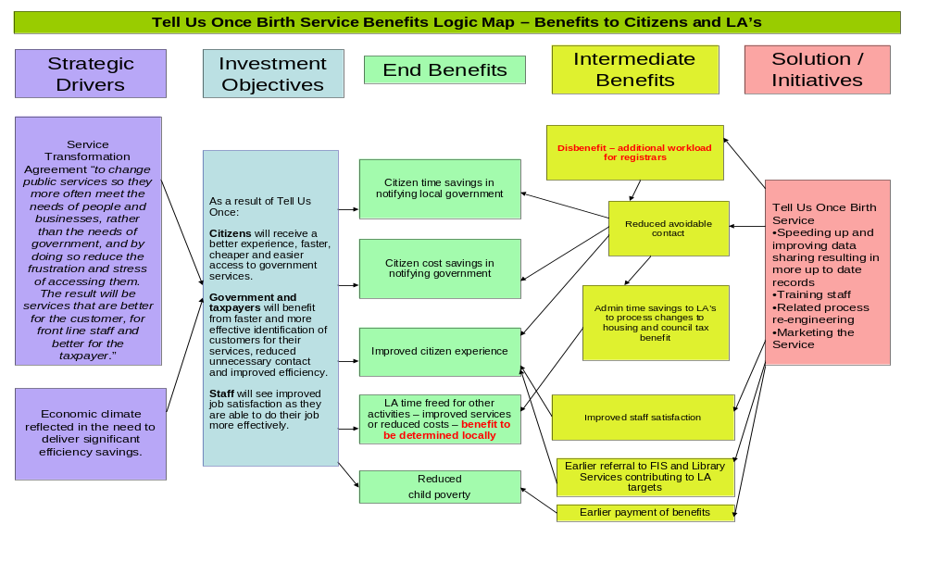
An example

