Slide 1
Project Management Office Roadmap

Slide 2
Proposal Objective
Systematically raising Project Management Maturity of organization from Level 0 to Level 5 within one year time frame

Slide 3

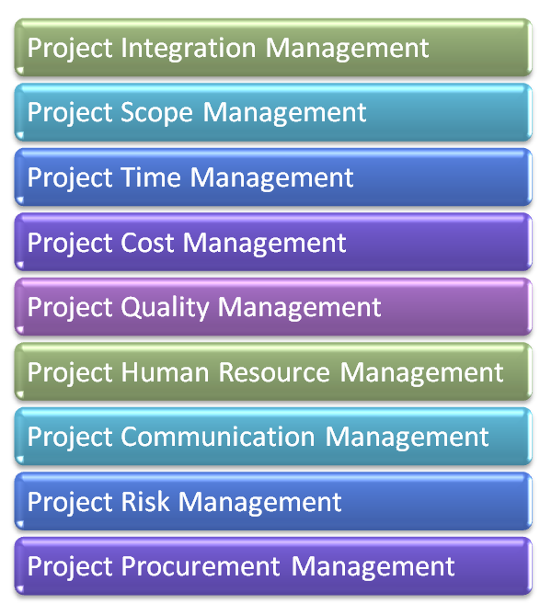
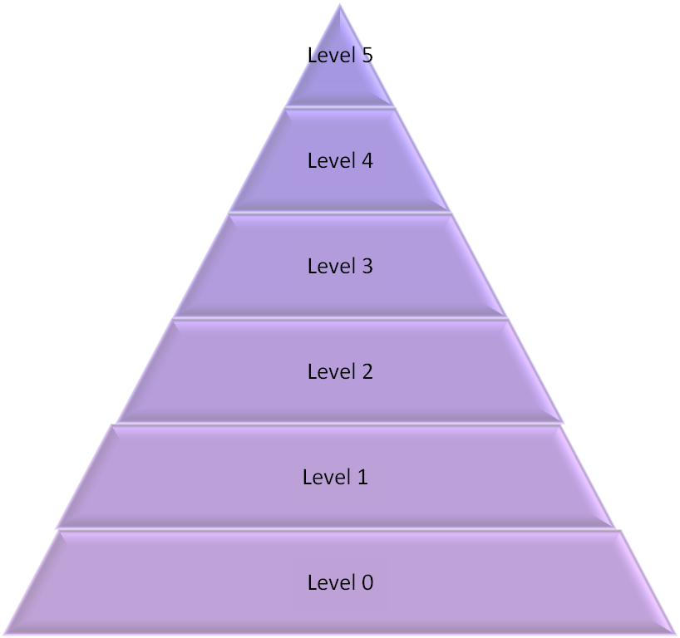

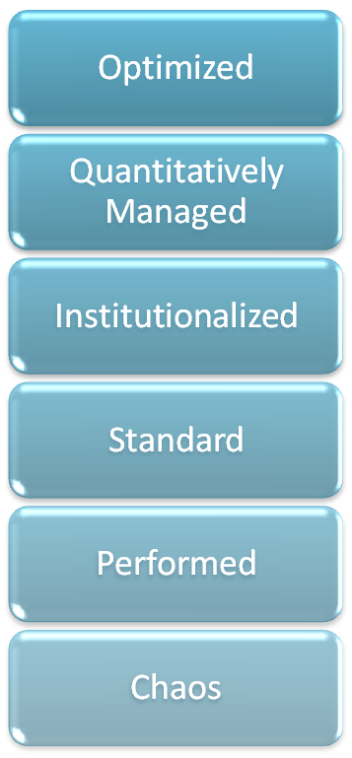
Project Management Maturity Levels
Maturity Levels
Optimize Stabilized Process
Collect org best practices from other projects Institutionalize standardized processes
Stabilize Institutionalized Process
Document the performed process, repeatable processes
Project are done using adhoc process, but all processes are identified
Notes:
Optimize Stabilized Process
Stabilize Institutionalized Process
Collect org best practices from other projects Institutionalize standardized processes
Document the performed process, repeatable processes
Project are done using adhoc process, but all processes are identified

Slide 4
Benefits
Organization will establish process assets and knowledge base over the period of time
Faster knowledge transfer
Least people dependency
Systematic approach for risk management
Higher customer satisfaction
Steep reduction in cost over runs
Steep reduction in schedule over run
Steep reduction in defects
Better negotiation for future projects
Repeat business

Slide 5
Benefits Because of ..
High visibility of the projects across the organization
Timely escalation
Capitalize on the lessons learned
Planning and executing projects using best practices and organizational experience
Built in predictability in the processes
Periodic review of the all projects with senior management

Slide 6
From where you get the reply for…
How many projects are running in the organization?
What is total fund budgeted for project for this year?
How much has been consumed till now and how much value has been realized till now?
Are we selecting right project?
What are the key business drivers for selecting any project?
I want to see the up to date status of projects department wise, region wise, objective wise, project manager wise. From where I will get the information?
Which are the projects where I need to pay special attention? Reputation? Financial Risk? New critical initiative? Brand Initiatives?
Which are the bleeding projects should be shut off?
Where putting more funds will bring the results faster?
What is customer satisfaction on any project?

Slide 7
What is the solution
Setup business driven PMO
Manage all projects under one roof (PMO)
No matter who is the owner of the project
Define project management framework
Project Team need to follow project management framework
Centralize the planning & governance processes
Automate the process flows as much as possible
Collect the data at source

Slide 8
Example of PMO Responsibilities
Develop project management standards
Institutionalize the processes & standards
Handholding to project staff
Project Audits and share best practices of other projects
Authorize and approve the project plans along with sponsor
Manage project knowledge base
Manage / optimize all project resources
Skill upgradation of the resource
Demand management
Project data security management
Timely escalation & damage control on projects
Take control of red-zone projects
Suggestion: To ensure high success go slow in loading PMO with responsibilities

Slide 9
Suggested PMO⁺ Team
PMO Head with 15-20 years experience in project management, PMO consulting domain. PMO Head should be reporting to CEO/MD.
*Champions form each departments which are involved in project or whose project are being managed under PMO
*Project managers (depends number/ size of project), who are solely responsible for project management activities, understanding of the business domain would be plus
⁺ All projects irrespective of department & technology are managed through PMO
* Should indirectly report to PMO Head

Slide 10
Suggested IT-PMO Team in Non-IT Organization
PMO Head with 15-20 years experience in project management, PMO consulting domain. PMO Head should be reporting to Portfolio Manager.
*Champion form each departments which are involved in project.
*Project managers (depends number/ size of project), who are solely responsible for project management activities, understanding of the business domain would be plus
* Should indirectly report to PMO Head

Slide 11
Suggested IT-PMO Team in IT Organization
PMO Head with 15-20 years experience in project management, PMO consulting domain. PMO Head should be reporting to Delivery Head.
*Team of Technical & Functional experts for feasibility assessment & estimation.
*Managers from support functions
*Project managers (depends number/ size of project), who are solely responsible for project management activities
* Should indirectly report to PMO Head

Slide 12
Project Steering Committee
CEO/MD/ Portfolio Manager
PMO Head
Project Managers
Champions for departments / Customer
Functional & Technical Experts (Optional)

Slide 13
Project Committee
PMO Head
Project Managers
Champions for departments/ Customer
Functional & Technical Experts

Slide 14
PMO Roadmap
Phase-1 (Define PMO)
Phase-2 (Automate PMO Processes)
Phase-3 (Handholding/ Manage PMO)

Slide 15
Phase-1 (Define PMO)
P1.1 *Assessment Phase
  Develop Project Charter for PMO setup
  Stakeholder Identification
  Design Survey
  Conduct assessment
  Prepare assessment report
  Share assessment report with stakeholders
P1.2 Define Phase
  Set PMO Success Criteria
  Establish a PMO Steering Committee & Project Committee
  Develop RACI⁺ Matrix & Project Org Chart to define the clear cut responsibility
  Develop Project Plan for PMO setup
  Interviews to understand requirement and pain areas
  Define the scope of PMO
  * All work in this phase should be performed by PMO consultant
  + RACI- Responsibility, Accountability, Consult, Inform
  7-10 : Should be performed by PMO Consultant along with Top Management
  10-12 Should be performed by PMO Head

Slide 16
Phase-1 (Define PMO)…
P1.3 *Project Risk Planning Phase
  Project Risk & Issue management workshop
  Identify initial risk & Develop Risk response plan
  Define risk dashboard
P1.4 Process Design Phase
  Identify **KPI/ metrics and calculation
  Map pain areas to PMI processes
  Define processes
  Design templates/forms/checklist as per the process requirement
P1.5 Process Validation & Verification Phase
  Review processes & related artifacts with relevant stakeholders
  Incorporate feedback
*This phase is possible while analyzing the previous completed projects and related artifacts and meeting project champions of these projects
**Key Performance Indicator (It will help in designing dashboards for quicker understanding of the status of project from EPM/ERP)
All work here should be performed by PMO Head and his team

Slide 17
Phase-2 (Automate PMO Processes)
P2.1 System Design Phase
  Identify automation requirement
  *Hardware/software procurement/installation/configuration
  *SharePoint/EPM customization
  Automate the work flows
  Design Formats of Customized Reports
  **Develop Customized Reports
  Design KPI & Dashboards
  **Develop KPI & Dashboards
P2.2 System Validation & Verification Phase
  System testing
  Incorporate feedback
* If you already have EPM/ERP system in place then these steps are not required
**Responsibility of ERP/EPM Technical Team, Other activities should be performed by PMO Head and his team
All work here should be performed by PMO Head and his team

Slide 18
Phase-2 (Automate PMO Processes)…
P2.3 User Acceptance Testing (UAT) Phase
  User Acceptance Testing
  Incorporate feedback
P2.4 PMO Training & Documentation
  PMI Trainings & Certification
  Design training modules for various roles
  PMO Role Based Training
P2.5 System Go Live
  Deploy to Production
  Hand-holding
All work here should be performed by PMO Head and his team

Slide 19
Phase-3 (Manage PMO)
P3.1 Running PMO & Audits
  Prepare project plan for all the projects managed by PMO
  Review/publish Plans, monitor actual status
  Maintain knowledge repository and publish required information for stakeholders
  Periodic reporting to stakeholders
  Conduct Audit for each project and related functions
  Prepare and compile audit report
  Share audit report with relevant stakeholders
P3-2 Reassessment
  Reassess the organization
  Prepare assessment report
  Share organizational maturity with senior management
All work here should be performed by PMO Head and his team

Slide 20
PMO Consultant Role
Until PMO:ML-3 PMO Consultant should play as Outsourced PMO Head role.
Once PMO is institutionalized, internal PMO head (if organization want) can be introduced.
Notes:
Lesser approval and process complications
Quick availability of PMO SME
Fast decision making
Cost effective

Slide 21
Time Lines
Maturity Level | ML1 | ML2 |  | ML3 |  |  | ML4 |  |  | ML5
Phases / Months=> | M1 | M2 | M3 | M4 | M5 | M6 | M7 | M8 | M9 | M10 | M11 | M12
P1 : Define PMO
P1.1 : Assessment Phase
P1.2 : Define Phase
P1.3 : Project Risk Planning Phase
P1.4 : Process Design Phase
P1.5 : Process Validation & Verification Phase
P2 : Automate PMO Process
P2.1 : System Design Phase
P2.2 : System Validation & Verification Phase
P2.3 : User Acceptance Testing (UAT) Phase
P2.4 : PMO Training & Documentation
P2.5 : System Go Live
P3 : Manage PMO
P3.1 : Running PMO/ Audits/ Improve
P3-2 : Reassessment

Slide 22
Consulting Efforts
One year engagement average 4 days per month at customer site. Total 48 days consulting days. To ensure the success if couple more days contact hours are required that can be discussed when time comes.
Although it is 48 days consulting engagement yet we will be in control of projects with the help of PMO team remotely.

Slide 23
Financial Cost Elements
One Year PMO Consulting Fees: Rs. 25 Lakhs + Service Tax
Cost of hardware/ software for EPM (if hardware/software is not in place)
Cost of EPM customization and implementation is separate
Airfare/ Boarding/ Lodging/ Local Transport expenses
Time commitment of senior management, steering committee members and project committee members.

Slide 24
PM-Learn Services
Trainings & Workshops
  Project Management Capsule Trainings
  PMP Trainings
  CAPM Training
  MSP 2007/ 2010 Trainings
  Earn Value Management Training
  Function Point Estimation
  Project Risk Management
  Project Schedule Management
  MS Office Productivity Tools
Assessment
  Project Management Maturity Assessment of Project Managers
Consulting
  PMO Consulting
  EPM 2007/2010 Implementation
  CMMI Consulting & Assessment

Slide 25

www.pm-Learn.com
Project Management Maturity Assessment Portal
Hari P Thapliyal,
PMP, MCITP, MBA, MCA, PGDFM
PMO Architect & Project Management Trainer
Reach Me:
hari.prasad@pm-learn.com, hari.prasad@fdsc.net
Skype: hari.thapliyal, YM: hari_thapliyal, Twitter: harithapliyal
Profile: http://in.linkedin.com/in/harithapliyal
Blog: http://pm-bestpractices.blogspot.com/
Website: www.pm-learn.com, https://sites.google.com/site/lifeisprojectplus

