Slide 1

QMS Awareness Training
November 2007
Presented to
AUROVISION Pvt Ltd
by
ePrama Technologies Pvt Ltd

Slide 2
General Information
Scope of this training is to spread awareness among all the relevant personnel at Aurovision, Worli Office on:
  ISO 9001:2000 Quality Management System Standards Aurovision and
  The QMS defined at Aurovision for implementation
This training material has been developed by ePrama for use within Aurovision; and shall not be used or shared by Aurovision, with any one outside Aurovision, with out the written consent from ePrama.
Duration of this training is 1 day (9:00 AM to 5:00 PM).
Cooperation from all participants is solicited to ensure that the training is completed as per the schedule and is effective.
All participants are requested to keep their cell phones switched off during the training sessions.
Please keep your questions/queries, if any, noted down and the same will be addressed during the last session.

Slide 3
QMS Awareness Training
Introduction to ISO 9000
The ISO 9001:2000 Approach
The Requirements of ISO 9001
Aurovision QMS Overview
The Audit Process
My Role
Summary
Questions/Queries

Slide 4
INTRODUCTION TO ISO 9000
What is “Quality”?
What is “Process”?
What is ISO 9001?
The “Process Approach”?

Slide 5
WHAT IS QUALITY?
Quality is… “VARIABILITY” … Shewart
+10%
0
-10%
Notes:
1. Quality is (select one or more correct statement):
Variability
Predictability
Conformance to requirement
Fitness for use
Customer’s opinion

Slide 6
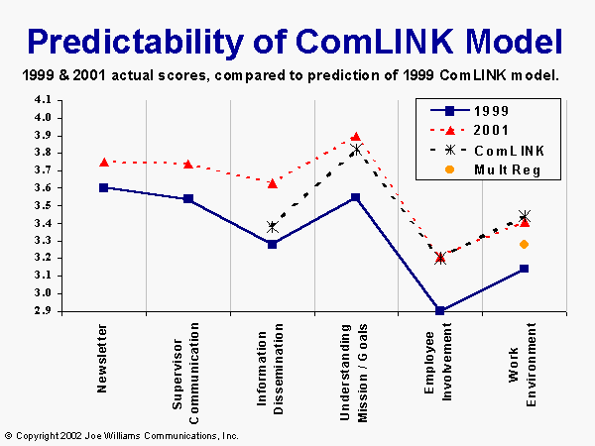
WHAT IS QUALITY?
Quality is… “PREDICTABILITY” … Deming
Notes:
1. Quality is (select one or more correct statement):
Variability
Predictability
Conformance to requirement
Fitness for use
Customer’s opinion

Slide 7
WHAT IS QUALITY?
Quality is…
“CONFORMANCE TO REQUIREMENT”
… Crosby
“FITNESS FOR USE’ … Juran
“CUSTOMER’S OPINION” … Feigenbaum
Notes:
1. Quality is (select one or more correct statement):
Variability
Predictability
Conformance to requirement
Fitness for use
Customer’s opinion

Slide 8
WHAT IS QUALITY?
Conformance to “Valid Requirements“.
Fundamentally Relational.
Customers' perception of the value of the suppliers‘ work output.
A perceived degree of excellence with a minimum, usually set forth by the customer.
Best value for money.

Slide 9
WHAT IS QUALITY?
The Totality of characteristics of an entity that bear on its ability to satisfy stated and implied needs
-ISO 8402
Notes:
Quality is:

Slide 10
WHAT IS QUALITY?
Why Quality?
  Remain and grow in business
  To be a Global player
  Satisfy the customer
  Take pride in our work
There are two definitive types of “quality“
  Product Quality
  Process Quality

Slide 11
WHAT IS PROCESS?
If you don’t know where you are,
a map won’t help !
Input
Black Box
Output
Unverified
Irrelevant
Garbage
Unplanned
Random tasks
Unexpected
Useless
Garbage
IMMATURE
If you don’t know where you are going,
any road will do !
Notes:
3. A Process is a Black-Box
True
False

Slide 12
WHAT IS PROCESS?
Process:
A sequence of steps performed for a given purpose. -IEEE
Software Process:
A set of activities, methods, practices, and transformations that people use to develop and maintain software and associated products -CMMI
Notes:
4. CMM defines a Software Process:
A set of ___________, ___________, ___________, and ______________ that people use to develop and maintain software and associated products

Slide 13
WHAT IS PROCESS?
E – T – V – X Model
(V) Validation and Verification
(E) Entry criteria
(T) TASKS
(X) eXit criteria
Notes:
5. In E -T-V -X for defining a process,
“T” is _____________
“X” is _____________

Slide 14
What is Process?
Project Planning Process
(Entry Criteria)
(Tasks)
(Exit Criteria)
Proposal
Initial Estimates
Contract
Communications
Commitments
Re-Estimation
Organize resources
Human, Infra, others
Preparing Software Project Plans
Approval of SPP
Project Kick-off
Estimation
SPP
Contract Review
Estimation review
Plan review
(Validation & Verification)
E – T – V – X

Slide 15
WHAT IS PROCESS?
The output of one process often becomes the input to another “downstream” process.
V
V
V
E
T
X
E
T
X
E
T
X
Work Items
Work Items
Work Items
Process 1
Planning
Process 2
Requirement
Process 2
Design

Slide 16

QUALITY AND PROCESS
Quality & Process are
two sides of the same coin.

Slide 17
What is ISO 9001:2000?
ISO 9001:2000 is an international standard containing requirements for establishing and maintaining a company’s quality management system.
A Quality Management System (QMS) is set up by a company to:
  establish a quality policy and quality objectives, and
  establish the means to achieve those objectives.

Slide 18
What is ISO 9001:2000?
The ISO 9001:2000 QMS standard can be applied to almost any company.
  Generic model
  Product Manufacturers to Service Providers
  Not specific to any product or service
  Does not focus on “What” you produce; but on “How” you produce.
ISO 9001:2000 requires systems for controlling the processes you use to develop and produce your products and/or deliver your services.
The world has adopted ISO 9001:2000 as an accepted standard for QMS.

Slide 19
The Process Approach
ISO 9001:2000 is based on Process Approach.
  Identifying and defining the processes (that are essential to the business)
  Implementing and institutionalizing the processes (training, practice, monitor, mentor) across the organization
  Managing the processes (and the interactions and handoffs between these processes), and
  (Learning from the experience and) Improving the processes continually.

Slide 20
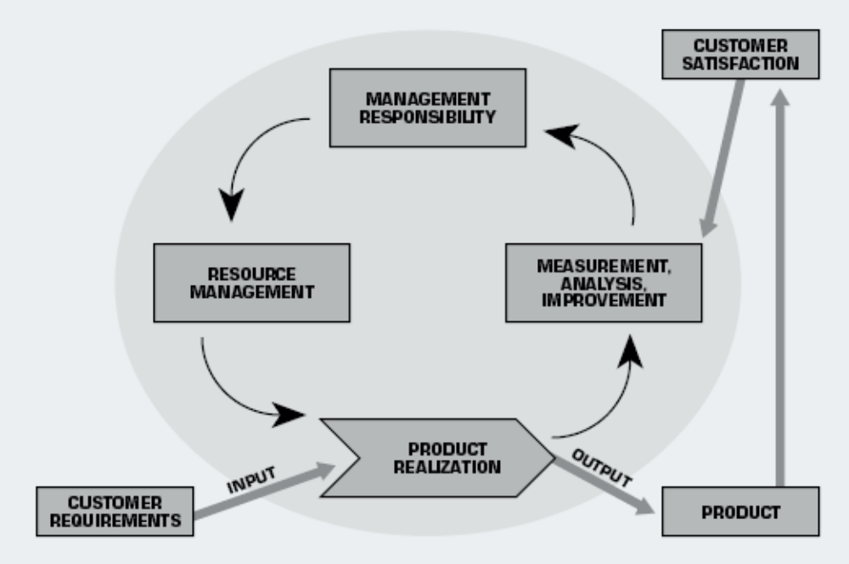
The Process Approach
The goal is to focus on the needs of the customer and
continually improve the processes

Slide 21
The ISO 9001:2000 Approach
A brief history of ISO 9000
Major Elements of QMS
Quality Management Principles
Meaning of Registration
Registration Process
Sample certificate
Why Aurovision wants to be ISO 9001:2000 Certified?

Slide 22
A brief history of ISO 9000
World War II
CSA Z299 (Canadian Std); NATO AQAP series and US MIL-SPEC
BS 5750
ISO/
TC 176
ISO 9000:1987
high-tech manufacturing industries were facing quality problems
to document the manufacturing procedures and to prove by record-keeping that the procedures are used
Focus was on conformance with procedures;
adopted BS 5750 as QMS
ISO 9001, 9002, 9003
ISO 9000:1994
Quality management & quality assurance approved in 1979
Emphasized quality assurance via preventative actions
creating shelf-loads of procedure manuals
ISO 9001, 9002, 9003
Combines 9001, 9002, and 9003 into, 9001
Demands involvement by upper executives
Continual process improvement and tracking customer satisfaction
ISO 9001:2000
Future?
ISO 9000:2008

Slide 23
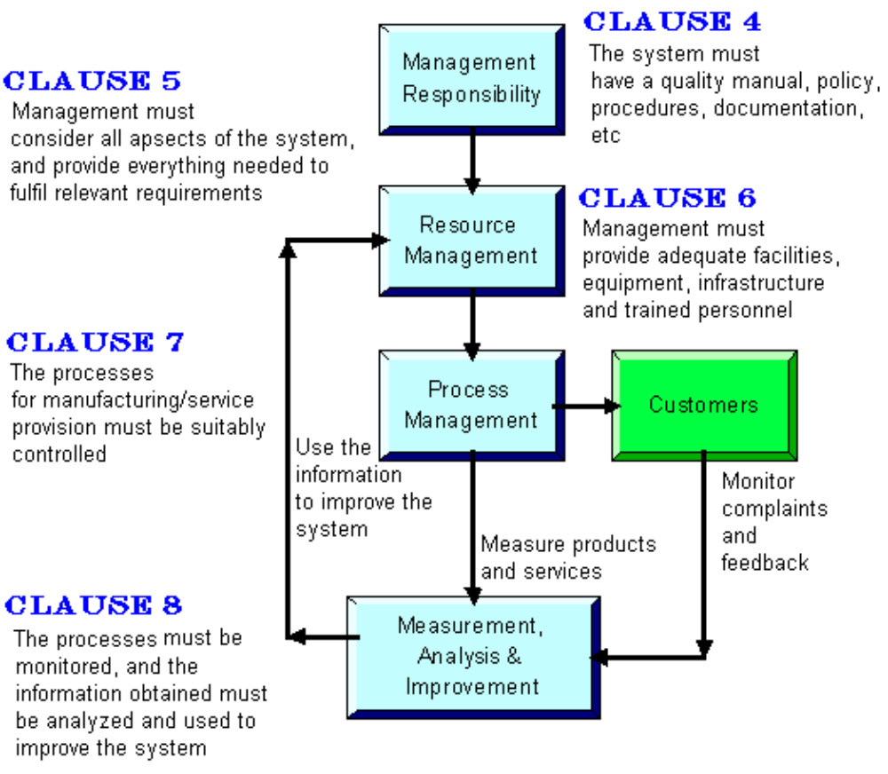
Major Elements of QMS

Slide 24
Major Elements of QMS
ISO 9001 Framework is divided into Four Major Elements based on Process Approach:
  Management Responsibility processes:
    includes planning and management review. (Clause 5).
  Resource management processes:
    includes human resources, infrastructure, and the work environment. (Clause 6).
  Product realization processes:
    includes sales order review, product design, purchasing, calibration, and the actual “production” of your product or service. (Clause 7).
  Measurement, analysis and improvement processes:
    includes internal auditing, inspection, testing, and corrective/preventive action. (Clause 8).

Slide 25
Major Elements of QMS
Management Responsibility:
  Management commitment
  Customer focus
  Quality policy
  Planning
  Responsibility, authority and communication
  Management review

Slide 26
Major Elements of QMS
Resource Management:
  Provision of resources
    Human resources
    Infrastructure
    Work environment

Slide 27
Major Elements of QMS
Product Realization:
  Planning of product realization
  Customer-related processes
  Design and development
  Purchasing
  Product and service provision
  Control of monitoring and measuring devices

Slide 28
Major Elements of QMS
Measurement, Analysis & Improvement:
  Monitoring and measurement
  Control of nonconforming product
  Analysis of data
  Improvement

Slide 29
Quality Management Principles
Eight Quality Management Principles:
  Customer-focused organization
  Leadership
  Involvement of people
  Process approach
  System approach to management
  Continual improvement
  Factual approach to decision-making
  Mutually beneficial supplier relationships

Slide 30
Quality Management Principles
Customer-focused organization
Principle:
  Organizations depend on their customers and therefore should understand current and future customer needs, meet customer requirements and strive to exceed customer expectations.
Action expected:
  Understand current and future customer needs and expectations. Measure customer satisfaction and act on it.

Slide 31
Quality Management Principles
Leadership
Principle:
  Leaders establish unity of purpose and direction of the organization. They should create and maintain the internal environment in which people can become fully involved in achieving the organization’s objectives.
Action expected:
  Establish vision, direction and shared values. Set challenging targets and goals and implement strategies to achieve them. Coach, facilitate and empower people.

Slide 32
Quality Management Principles
Involvement of people
Principle:
  People at all levels are the essence of an organization and their full involvement enables their abilities to be used for the organization’s benefit.
Action expected:
  Create personal ownership of an organization’s targets and goals, by using its peoples` knowledge and experience, and through training achieve involvement in operational decisions and process improvement.

Slide 33
Quality Management Principles
Process approach
Principle:
  A desired result is achieved more efficiently when related resources and activities are managed as a process.
Action expected:
  Explicitly identify internal/external customers and suppliers of processes. Focus on the use of resources in process activities, leading to effective use of people, equipment, methods and materials.

Slide 34
Quality Management Principles
System approach to management
Principle:
  Identifying, understanding and managing a system of interrelated processes for a given objective improve the organization’s effectiveness and efficiency*.
Action expected:
  Identify a set of processes in a system. Understand their interdependencies. Align the processes with the organization’s goals and targets. Measure results against key objectives.
* "Effective" means that the QMS works and achieves its objectives.
"Efficient" means that the QMS uses minimum resources

Slide 35
Quality Management Principles
Continual Improvement
Principle:
  Continual improvement should be a permanent objective of the organization.
Action expected:
  Set realistic and challenging improvement goals, provide resources and give people the tools, opportunities and encouragement to contribute to the continual improvement of the processes.

Slide 36
Quality Management Principles
Factual approach to decision-making
Principle:
  Effective decisions are based on the analysis of data and information.
Action expected:
  Decisions and actions are based on the analysis of data and information to maximize productivity and to minimize waste and rework.
  Effort is placed on minimizing cost, improving performance and market share through the use of suitable management tools and technology.

Slide 37
Quality Management Principles
Mutually Beneficial Supplier Relationship
Principle:
  An organization and its suppliers are interdependent, and a mutually beneficial relationship enhances the ability of both to create value.
Action expected:
  Establish strategic alliances or partnerships, ensuring early involvement and participation defining requirements for joint development and improvement of products, processes and systems. Develop mutual trust, respect and commitment to customer satisfaction and continual improvement.

Slide 38
Meaning of Registration
Once the QMS is in place and been implemented and is validated by internal audits, a Registrar selected by Aurovision (TUV/AQA/BVQI) will come and audit.
  If all the criteria are being followed, the company will be ISO 9001 Registered and Certification will be issued.
  Registered companies can put their Registration mark in marketing materials, website etc.
  Potential customers will know that you have a good Quality Management System in Place

Slide 39
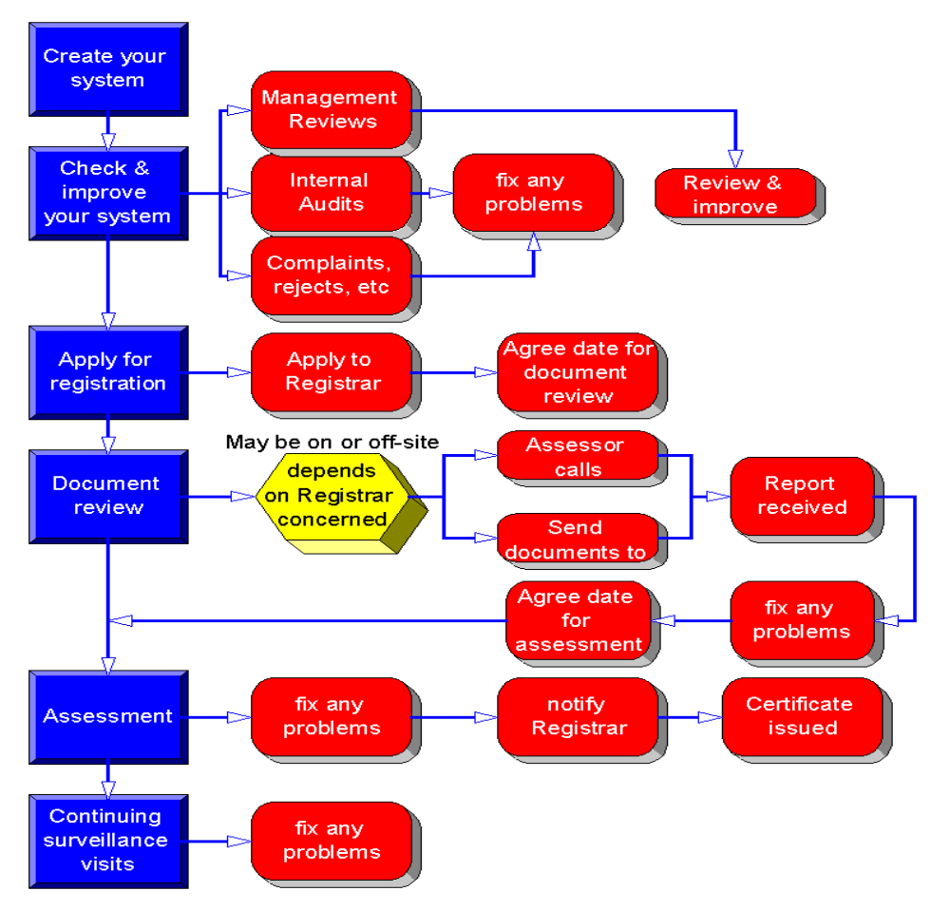
Registration Process

Slide 40
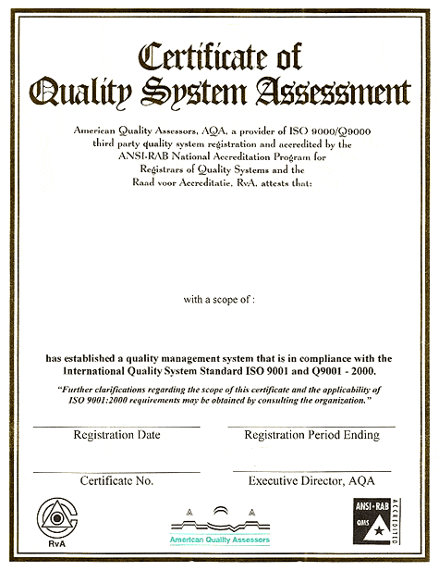
Sample Certificate
Name of the certificate
Name of the certifying org
(AQA, TUV etc)
Name and address of the company whose QMS is certified
Name of the Company
Certified
Scope of the
Certification
Scope of QMS certified
Ref to standard
For compliance
Date of Certification
Validity period
Certificate No
Signature

Slide 41
Why Certify Aurovision QMS?
Aurovision Management wants the QMS to be certified against a world class std, as a part of the Quality Journey
Customers expect and demand their vendors should have a proven processes & practice, certified by a third party,
Demonstrate our ability to provide quality products and/or services on time and within budget with least defects,
Competitive advantages in marketing; an improved “quality” image,
Improved performance due to internal process discipline (less defects / rework),
A stronger focus on customer satisfaction and continual improvement,
Better documentation of essentials and audit trail,
ISO 9001:2000 has become the de facto standard.

Slide 42
The Requirements of ISO 9001
A reference to clauses of ISO 9001:2000
ISO 9001:2000 QMS Requirements
QMS Documentation Hierarchy

Slide 43
A reference to ISO 9001:2000 Clauses
1 Scope
  1.1 General
  1.2 Application
2 Normative References
3 Terms and Definitions
4 Quality management system
  4.1 General requirements
  4.2 Documentation requirements
5 Management responsibility
  5.1 Management commitment
  5.2 Customer focus
  5.3 Quality policy
  5.4 Planning
  5.5 Responsibility, authority & communication
  5.6 Management review
6 Resource management
  6.1 Provision of resources
  6.2 Human resources
  6.3 Infrastructure
  6.4 Work environment

Slide 44
A reference to ISO 9001:2000 Clauses
7 Product realization
  7.1 Planning of product realization
  7.2 Customer-related processes
  7.3 Design and development
  7.4 Purchasing
  7.5 Production and service provision
  7.6 Control of monitoring and measuring devices
8 Measurement, analysis and improvement
  8.1 General
  8.2 Monitoring and measurement
  8.3 Control of nonconforming product
  8.4 Analysis of data
  8.5 Improvement

Slide 45
ISO 9001:2000 QMS Requirements
Scope
1.1 General
Ability to consistently provide product that meets customer requirements, and
Enhance customer satisfaction and
Continual improvement of the system.
1.2 Application
All requirements are generic;
Applicable to all organizations, regardless of type, size and product provided.
Normative reference: Apply the most recent edition.
Terms & References: Standard Vocabulary

Slide 46
ISO 9001:2000 QMS Requirements
4 Quality management system
4.1 General requirements
QMS which is kept up to date and continually improving.
  identify the processes involved,
  determine the sequence of operations,
  determine ways of monitoring effectiveness,
  ensure sufficient resources for the QMS activities
  monitor and improve your system

Slide 47
ISO 9001:2000 QMS Requirements
4.2 Documentation requirements
4.2.1 General
QP
Quality Manual
Documented Procedures
Other Procedures
(as in the QMS folders) that are required to ensure consistent implementation of QMS across all projects and functions,
Templates, Formats, Guidelines, Checklists, Standards, Plans, Records
(as in the QMS folders) that are provided by the MR for ease of operation and maintenance of QMS,

Slide 48
ISO 9001:2000 QMS Requirements
4.2.2 Quality Manual
High level document describing the org policies and practices and mapped to the clauses of ISO 9001:2000 std
Define the interaction between the various processes.
4.2.3 Control of Documents
Under Configuration Management
reviewed them for ongoing suitability (any changes required, still legible, relevant, accessible etc).
4.2.4 Control of Records
adequate records as evidence
Retention period
organized repository for easy access

Slide 49
ISO 9001:2000 QMS Requirements
5 Management Responsibility
5.1 Management Commitment
  Declare the quality policy
  Identify the Quality Objectives & Measures
  Conduct management reviews (convened by MR)
  Ensure that you make sufficient resources available
5.2 Customer Focus
  Define the commitment of Sr. Mgmt towards Customer satisfaction in determining, meeting and enhancing.

Slide 50
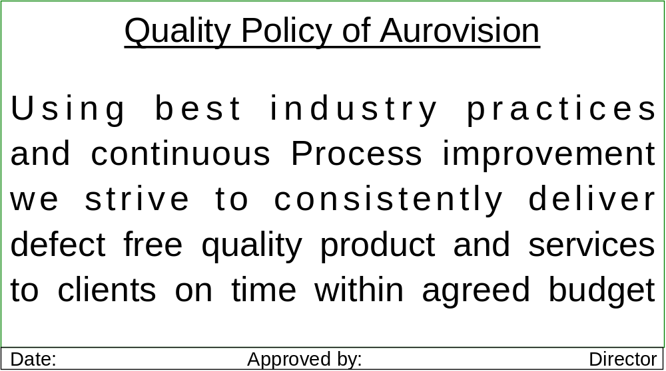
ISO 9001:2000 QMS Requirements
5.3 Quality Policy
Declaration of the Sr. Mgmt document.
Defines the approach to quality.
Review the quality policy during Mgmt Review Meetings

Slide 51
ISO 9001:2000 QMS Requirements
5.4 Planning
5.4.1 Quality Objectives
Define objectives for quality, using measurable terms
5.4.2 QMS Planning
Provide adequate resources
Ensure integrity of the system (Change Mgmt and Config Mgmt)
5.5 Responsibility, Authority & Communication
5.5.1 Responsibility & authority
Administer the QMS by proper control of documents, structure of the quality system, identifying authority & responsibility, etc
Identify the responsibilities of the key functions within the organization

Slide 52
ISO 9001:2000 QMS Requirements
5.5.2 Management Representative
MR is the "Quality Champion”,
Responsibilities of MR include:
  Ensure that the QMS processes are operating correctly,
  Report performance of the system to the top management
  Promote awareness of customer requirements.
5.5.3 Internal Communication
5.6 Management Review
5.6.1 General
Review the operation of the QMS, to ensure it is up to date and effective
Identify scope for improving the QMS, if any.
5.6.2 Review Input: Performance of QMS; Customer feedback
5.6.3 Review Output: Improvements, resource need, future directions

Slide 53
ISO 9001:2000 QMS Requirements
6. Resource Management
6.1 Provision of Resources
to implement QMS and improve
6.2 Human Resources
6.2.1 General
trained people for performing the job effectively and efficiently
6.2.2 Competence, Awareness & Training
Identify skills, Provide training, Evaluate the effectiveness;
Keep records of the training and experience, etc.
6.3 Infrastructure
Provide adequate facilities: tools & equipment, support services.
6.4 Work Environment
Manage the "human & physical" factors

Slide 54
ISO 9001:2000 QMS Requirements
7. Product Realization
7.1 Planning of Product Realization
Define the quality objectives and requirements for the products,
Plan all of the processes and sub-processes, testing
Identify the records that will be kept,
7.2 Customer-related Processes
7.2.1 Determination of Requirements Related to the Product
Define what your Customer requires from you, (such as legal requirements, warranties, and support, etc)
7.2.2 Review of Requirements Related to the Product
Ensure that customer requirements are defined properly
7.2.2 Customer Communication: feedback, project comm.

Slide 55
ISO 9001:2000 QMS Requirements
7.3 Design and Development
7.3.1 Design Planning
Plan to provide design tasks and responsibilities
7.3.2 Design Inputs
Include functional requirements, standards, legal requirements
similar previous designs and learn from them
7.3.3 Design Outputs
Identify the Design outputs (Architecture, HLD, LLD etc)
Update the Traceability of requirement to Design
7.3.4 Design Reviews
Review the progress of the design activities
Identify and record any problems and resolve

Slide 56
ISO 9001:2000 QMS Requirements
7.3.5 Design Verification
Verify designs; ensure the design meets the design input requirements
Plans should include the verification activities
7.3.6 Design Validation
Ensure that the product or service works correctly in practice
Validation may include reviews of Customer feedback after release of the product.
Plans should include the Design Validation activities
7.3.7 Design Changes
Follow the Change Management process
All changes should be reviewed and recorded.
Effect that the changes may have on any sections of the design work already completed or under way (Impact analysis)

Slide 57
ISO 9001:2000 QMS Requirements
7.4 Purchasing
7.4.1 Purchasing Control
Selection of the right suppliers (Vendor evaluation)
Clarity of requirement in Purchase requisition
7.4.2 Purchasing Information
PO to be clear on the requirements
Reviewed for adequacy before the PO is sent to the Vendor
7.4.3 Verification of Purchased Product
Verify that the Vendor has supplied the correct items.

Slide 58
ISO 9001:2000 QMS Requirements
7.5 Production & Service Provision
7.5.1 Control of Production & Service Provision
The processes, resources, infrastructure, facilities are managed
7.5.2 Validation of Processes for Production & Service Provision
Unit testing, System Testing, Acceptance testing, Regression testing
7.5.3 Identification and Traceability
Configuration management fulfils this requirement
  Naming conventions, Version control, Config mgmt tool
  Requirement traceability matrix
7.5.4 Customer Property: S/W, H/W, VPN, etc.,
7.5.5 Preservation of Product
7.6 Control of Monitoring & Measuring Devices: NA

Slide 59
ISO 9001:2000 QMS Requirements
7.5.4 Customer Property
Activities involve items belonging to the Customer
  Software, Hardware, VPN, Licenses, documents personnel, work place etc.,
  Record the Customer property upon receipt,
  Check that they are suitable for use.
    If any problems are discovered, or not usable, report this back to the Customer for replacement.
7.5.5 Preservation of Product
Configuration Mgmt tool for repository
Build-Release process
Regular Back-up, DRP/BCP;
Protection from virus, theft, fire,
7.6 Control of Monitoring & Measuring Devices:
Exclusion from QMS in Aurovision

Slide 60
ISO 9001:2000 QMS Requirements
8. Measurement, analysis & Improvement
8.1 General
Identify and plan your measurement/monitoring activities
Enable improvements to processes & product
Process for continually improving the QMS
8.2 Monitoring & Measurement
8.2.1 Customer Satisfaction
Customer perception of how you meet their requirements
Use this as inputs of the Management Reviews

Slide 61
ISO 9001:2000 QMS Requirements
8.2.2 Internal Audit
The standard requires that IQA are performed, so as to ensure that the QMS continues to meet ISO 9001:2000
8.2.3 Measuring & Monitoring of Processes
Metrics Program for measurable process parameters
Collection, analysis and interpretation of Process data
8.2.4 Measuring & Monitoring of Product
Defect management, defect tracking,
Collection, analysis and interpretation of Product data
8.3. Control of Nonconformity
Ensure nonconforming items are not used
8.4. Analysis of Data

Slide 62
ISO 9001:2000 QMS Requirements
8.5. Improvement
8.5.1 Continual Improvement
  The analysis of nonconformance, including audit reports
  Analysis and review of levels of Customer satisfaction
  Management Review
8.5.2 Corrective Action
  Defect data
  Nonconformance
  Issues
8.5.3 Preventive Action
  Defect Prevention
  Prevention of NCs

Slide 63
AUROVISION QMS
Aurovision QMS

Slide 64
Aurovision QMS
Aurovision QMS is organized in the following folder structure. This structure covers only the QMS documents and not the Records:
  SEPG Documents
    ISO_Document_ID
    QM_PRC_COM01-Quality-Manual-V1[1].0
  All Procedures
    Engineering (ENG)
    Process (PRC)
    Project (PRJ)
    Support (SUP)
  All Templates
    Engineering (ENG)
    Process (PRC)
    Project (PRJ)
    Support (SUP)

Slide 65
Aurovision QMS
  All Forms
    Engineering (ENG)
    Process (PRC)
    Project (PRJ)
    Support (SUP)
  All Standards & Guidelines
    Engineering (ENG)
    Process (PRC)
    Project (PRJ)
    Support (SUP)
  All Checklists
    Engineering (ENG)
    Process (PRC)
    Project (PRJ)
    Support (SUP)

Slide 66
The Audit Process
Internal Audit
Internal audits Flow
Nonconformity

Slide 67
Internal audits
Internal Audit Definition:
A systematic and independent examination to determine whether Qualities and related results comply with planned arrangements and whether these arrangements are implemented effectively and are suitable to achieve objectives
Internal audits are carried out by your own trained personnel.
Internal quality audits examine the elements of a quality management system in order to evaluate how well these elements comply with quality system requirements.

Slide 68
Audits
Third-party audits (audits by the registrar),
    Certification Audit – Once every 3 years
    Surveillance Audit – Once in 6/9/12 months
    audit has a pass/fail result
    Determine: become (or stay) registered to ISO 9001.
    tell what’s wrong with the system, but not “how” to fix.
Internal audits (self-audits by the company).
    to make the QMS work better for everyone,
    catch problems before your customer or registrar does.
    Identify problems with the quality management system, not with the people who are carrying it out

Slide 69
Audits
Audit Types
  Compliance Audit or Documentation Review
    To determine the extent to which the documented QMS meets the requirements of the ISO 9001:2000 Standard
    Carried out in advance of certification audit.
  Conformance or Implementation Audit
    To determine if the QMS is implemented effectively
    Identify any non-conformances and report the same
Audit Frequency
  Certification Audits: Every three years
  Surveillance Audits: Once in 6 months or 1 year.
  Internal Audits: Once every 3 months.

Slide 70
Nonconformity
Nonconformity
  The non-fulfillment of specified requirement
Minor Nonconformity
  Either a failure of meeting one requirement of a clause or other reference documents OR a single observed lapse in following one item of a company procedure
Major Nonconformity
  The absence or the total breakdown of a system to meet the requirements of a clause of ISO 9001 or other reference documents.
A number of minor NC’s against one clause can represent total breakdown of a system and thus can be considered a major NC

Slide 71
My Role
As User of QMS
As an Auditee

Slide 72
As user
As the user of Aurovision QMS
  Understand Quality Policy, Objectives and Measures defined
  Understand the QMS; participate in defining processes
  Always use org processes (procedures, templates, formats etc)
  Implement all applicable processes in your project/function
  Create and maintain relevant documents and records in the org repository.
  Participate in reviews of work products from peers.
  Identify scope for improving processes and communicate the same to the MR.

Slide 73
As Auditee
As Auditee during audits
  Participate objectively in the Internal / External Audits
  Provide objective evidences for process adherence
  Avoid arguing with the Auditor
  Take help of a team member, if needed.
  Agree on NCs found and
  Take timely corrective and Preventive action
  Get the closed NCs verified by an Internal Auditor
  Auditing is a “fact finding” and not “fault finding” activity; so no need to fear an audit.
  Remember, you are playing a constructive role in helping the organization fix any problems in the QMS.

Slide 74
Summary
PDCA Cycle
Critical Success Factors
Critical Barriers

Slide 75
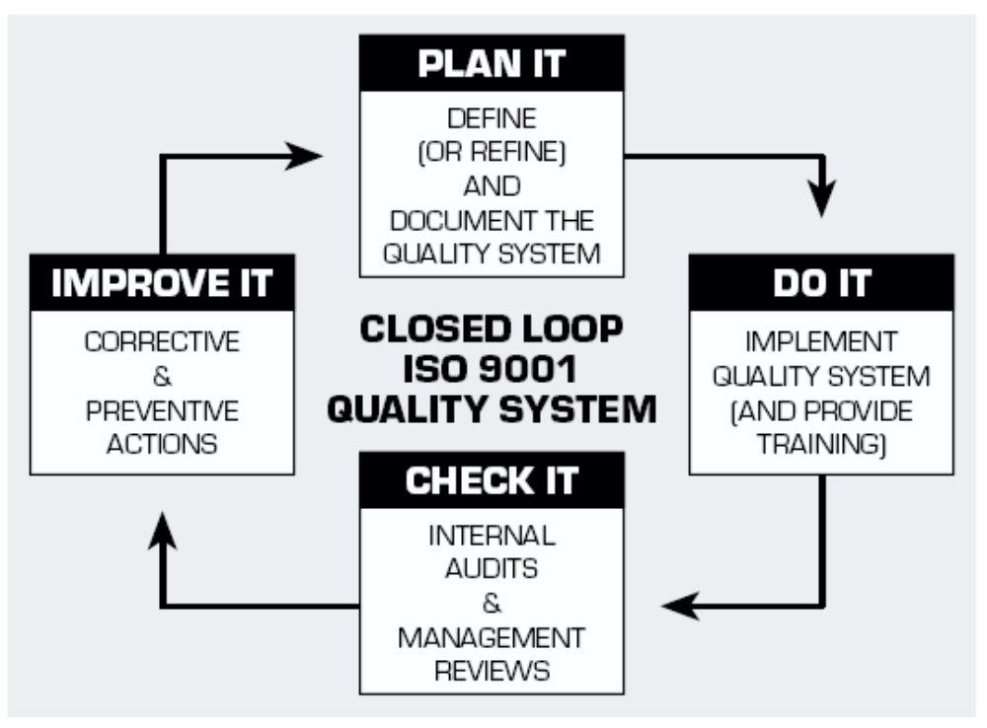
PDCA Cycle

Slide 76
Don't give up five minutes before the miracle!
- Frank Dabney

Slide 77
Any Questions?
Thank You!

Slide 78

Contact Information
M V Muralidharan
Director – Operations muralim@eprama.com
B-610, Kanara Business Centre
Ghatkopar – Andheri Link Road
Ghatkopar (East), Mumbai – 400 075
Phone: 982051895
URL: www.eprama.com ; Email: info@eprama.com

