Slide 1
Measure
Green Belt Training

Slide 2
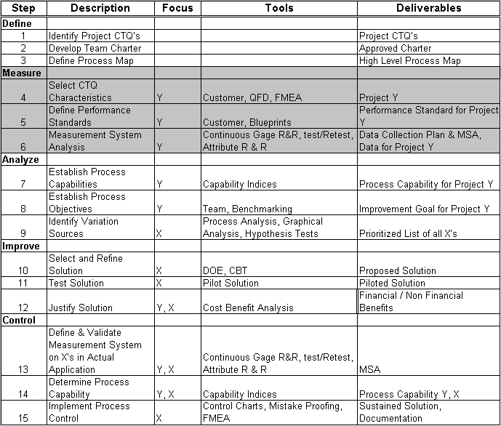
The 15-Step Process

Slide 3

Measure Phase Overview
What is the Measure phase?
This phase is concerned with selecting one or more product characteristics to measure, defining how the characteristics will be measured, planning data collection, and collecting data.

Slide 4
Measure Phase Overview
Why is the Measure phase important?
This phase is important because it ensures that accurate and reliable data is collected to measure current process performance related to the customer CTQ.

Slide 5
Measure Phase Overview
Steps involved in the Measure phase:
Measure 4: Select CTQ Characteristic
Measure 5: Define Performance Standards
Measure 6: Establish Data Collection Plan, Validate Measurement System & Collect Data

Slide 6
Measure 4–Select CTQ Characteristics
The goal for this step is to drill-down from what you learned in Define to identify the specific sub-process or system characteristic that will be the subject of your Green Belt project.
In the Measure phase, you need to further narrow the scope by focusing on one particular factor that impacts the CTQ.
Every project is different, and the level that you need to drill-down to depends on how broad in scope you want your project to be.
By the end of this step, you should have identified exactly what aspect of the product / service you will measure for your project.

Slide 7
Measure 4–Select CTQ Characteristics
Why is it important to Select a CTQ Characteristic?
It is important to manage the scope of your project.
By drilling-down to a sub-process or sub-system, if necessary, you keep the connection to the high-level customer CTQ while, at the same time, keeping the project scope manageable.

Slide 8
Measure 4–Select CTQ Characteristics
What are the project tasks for completing Measure 4?
Identify the measurable CTQ characteristic that will be improved (Project Y)

Slide 9


Selecting CTQ Characteristics
Two tools are commonly used to determine CTQs
CTQ Drill Down Tree
Quality Function Deployment (QFD)

Slide 10
CTQ Drill Down Tree
Why use it?
A CTQ Drill-Down Tree is a tool which can help you reduce the scope of your project.
It accomplishes this by taking a high-level CTQ or process (also called a Big Y) to a low-level CTQ or process (also called a Small y).
This process helps to ensure that your project remains focused on what is important to the customer.

Slide 11
CTQ Drill Down Tree
What does it do?
A tree diagram, in general, is a tool used to break any concept (e.g. product, process, service, goal, idea, objective, issue, or CTQ) into subcomponents, or lower levels of detail.
A CTQ Drill-Down Tree is used to break customer CTQ’s into lower level project CTQ’s.

Slide 12
CTQ Drill Down Tree
How do I do it?
To construct a tree diagram, follow these four steps:
1. Identify the high-level CTQ.
2. Break the high-level CTQ into lower level CTQ’s
3. Break each subcomponent into successive levels of detail.
4. Review the completed diagram for logical flow and completeness.

Slide 13
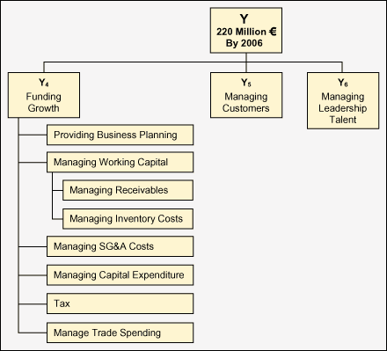
CTQ Drill Down Tree Example

Slide 14
QFD
Since 1966, Quality Function Deployment (QFD) has been used world wide in nearly every industry and sector to:
Prioritize spoken and unspoken customer ‘wows’, ‘wants’, and ‘needs’;
Translate these needs into actions and designs such as technical characteristics and specifications; and
Build and deliver a quality product or service by focusing various business functions toward achieving a common goal and customer satisfaction.
Measurable CTQ’s
Customer Needs
House of
Quality
#1

Slide 15
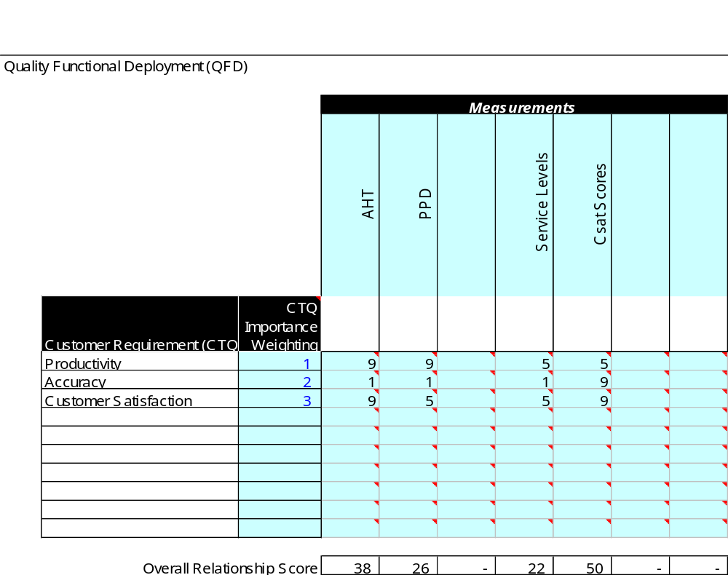
QFD
A blank column indicates a customer requirement with no metrics for measurement
A blank row indicates a metric with no corresponding customer requirement

Slide 16
Measure 5–Define Performance Standards
What does it mean to Define Performance Standards?
A performance standard defines the process to be measured, how it will be measured, and how much variance will be tolerated.
In step 4 of Measure, you determined the specific sub process that is now the subject of your Green Belt project. In step 5, you’ll create a standard for the performance of that process. This is the point when you determine the best way to turn what the customer wants into a numeric measurement.
This measurement will later be compared to the measurement of your current process in order to see how well you’re meeting the customer’s need.

Slide 17
Measure 5–Define Performance Standards
Why is it important to Define Performance Standards?
The performance standard translates the customer need into a clearly defined measure for which performance data can be collected.
Once you know what constitutes acceptable and unacceptable performance for your process, you can define a defect. What you define as a defect becomes the basis for determining performance capability and improvement goals for the project.

Slide 18
Measure 5–Define Performance Standards
What are the project tasks for completing Measure 5?
Develop operational definition for process to be measured
Identify target performance
Set specification limit(s)
Define unit, defect and defect opportunity1

Slide 19
Unit, Opportunity and Defect
A Unit is the number of parts, sub-assemblies, assemblies or systems inspected or tested.
An Opportunity is a characteristic you inspect or test
A Defect is anything that results in customer dissatisfaction / any non conformance
TOP or Total Opportunity
is the product of Number
of Units with the Number
of Opportunities
In the example below:
The Customer ordered for squares with 5 white circles etched on the surface
Therefore:
Each square is a UNIT
Each circle is an OPPORTUNITY
Each black circle is a DEFECT
Therefore we have:
4 Units
5 Opportunities per Unit
9 Defects
3 Defectives

Slide 20
Yield
If we think of transactions as either defects (leading to unsatisfied customers) or good (leading to satisfied customers), then we have described the potential outcomes of the process. Another way to describe the proportion of good transactions is yield.
411 Defects
Defect Rate = 34%
796 Good
Yield = 66%
Total Transactions = Good + Defects
100% = Yield + Defect Rate

Slide 21

Types of Yield
Different types of Yield can impact the quality level we measure. Here are the types we will review by looking at an example of statement printings.
  Classical Yield
  First Pass Yield
  Rolled Throughput Yield

Slide 22
Making a Statement
Customer Statements have the following requirements…
Entire
Address must be correct
Each Line Item must be correct
Each
Line Amount must be correct
Total
$ x,xx
Total
must be correct

Slide 23
Statement Printing Example
Four statements are printed and checked for errors. Those that contain errors are reprinted. Here are the results...
First
Printing
Wrong Address = 2
Wrong Line Item = 2
Wrong Amount = 1
Wrong Total = 1
Total
$ x,xx
Total
$ x,xx
Total
$ x,xx
Total
$ x,xx
Second
Printing
(Rework)
Wrong Address = 0
Wrong Line Item = 2
Wrong Amount = 1
Wrong Total = 0
Total
$ x,xx
Total
$ x,xx
Total
$ x,xx
Third
Printing
(Rework)
Wrong Address = 0
Wrong Line Item = 0
Wrong Amount = 0
Wrong Total = 0
Total
$ x,xx
Total
$ x,xx

Slide 24
Classical Yield
If we count all statements that passed inspection in all three operations, our fulfillment would be 100% (four out of four). This is the probability of statements having no defects after all rework has been completed.
First
Printing
Total
$ x,xx
Total
$ x,xx
Total
$ x,xx
Total
$ x,xx
Second
Printing
(Rework)
Total
$ x,xx
Total
$ x,xx
Total
$ x,xx
Third
Printing
(Rework)
Classical Yield= 100%
Total
$ x,xx
Total
$ x,xx
Classical Yield includes statements that were reworked.

Slide 25
First Pass Yield
If we define our defect as statements failing to pass inspection on the first try, then our fulfillment is only 25% (one out of four). This is the probability of having no defect without rework based on the number of first-time, defect-free statements. This is a better measure of process performance than Classical Yield
X
X
X
First
Printing
Total
$ x,xx
Total
$ x,xx
Total
$ x,xx
Total
$ x,xx
First Past Yield= 25%
First Pass Yield gives no credit for rework

Slide 26



Rolled Throughput Yield
A final look at yield concerns output that involves several steps. If we know the yield of each step, we can multiply the percentages together to compute the probability that a transaction will go through all steps correctly the first time
Take Card
Application
Enter
Request
List of Cards
to be Printed
Operation 1
Operation 2
Output
Performance
Level
95%
95%
X
95%
=
90.25%
99%
99%
X
99%
=
98.01%

Slide 27
Takeaways
There are three different types of yield
  Classical
  First Pass / Throughput
  Rolled Throughput
Rolled Throughput yield is the best yield measurement to determine how your process is performing
Adding inspectors does not guarantee better quality
Six Sigma cannot be reached by inspection

Slide 28
Specification Limits
Specification Limits are the customer's expectation for product or service deliverable/output
USL
An upper specification limit, also known as an upper spec limit, or USL, is a value below which performance of a product or process is acceptable.
Upper Specific Limit: representing the maximum acceptable value of a variable
LSL
A lower specification limit is a value above which performance of a product or process is acceptable. This is also known as a lower spec limit or LSL.
Lower Specific Limit: representing the minimum acceptable value of a variable

Slide 29
Measure 6–Plan Data Collection And Collect Data
What does it mean to Establish A Data Collection Plan, Validate the Measurement System, and Collect Data?
A project data collection plan is a written strategy for collecting the data you will use in your project. A validated measurement system is one that has been shown to provide reliable data that represents the process output.

Slide 30
Measure 6–Plan Data Collection And Collect Data
Why is it important to Establish A Data Collection Plan, Validate the Measurement System, and Collect Data?
A project data collection plan and a validated measurement system are important because they define a clear strategy for collecting reliable data efficiently.
The data collection plan helps ensure that resources are used effectively to collect only data that is critical to the success of the project.
A validated measurement system is important because it ensures that the collected data accurately represents the true nature of your process.
Data collection is costly; therefore, you need to make sure that both the data collection plan and the measurement system are sound.

Slide 31
Measure 6–Data Collection Plan And MSA
What are the project tasks for completing Measure 6?
Develop a plan to collect data
Validate the measurement system
Collect data per plan

Slide 32
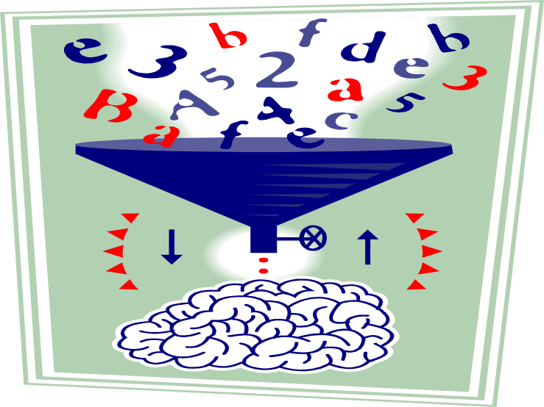
Measure 6
Before moving on to Data Collection Plan, it is important to understand the characteristics of data.
Data can be broadly classified into 2 types
Discrete Data
Continuous Data
Binary
Count

Slide 33
Types of Data
Discrete Data
  Binary (Yes/No, Defect/No Defect)
  Count Data (Number of PC breakdowns in a week)
Examples
  Number of incomplete applications
  Percent of responding with a “5” on survey
  Number of Green Belts trained so far
Continuous Data
  Can be broken down into increments
  Infinite number of possible values
  Refined e.g 2.746 tells you the exact dimension
Examples
  Cycle time (measured in days, hours, minutes, etc.)
  Weight (measured in tons, pounds, etc.)

Slide 34
Activity: Types of Data
What type of data is:
AHT
CSat
Number of people in this room taller than you
Number of Incoming calls per day
Service Levels
Accuracy percentage
Accuracy Sigma
Gender
Number of years of prior work experience
Cycle time for an application
Please make a note of the answers in your work books

Slide 35
Continuous Data Characterization
Location / Central Tendency
  It is a measure of the center point of any data set
Spread / Dispersion
  It is a measure of the spread of any data set around its center
Shape
  It is a measure of symmetry of any data set around its center
Frequency
Parameter of Interest

Slide 36
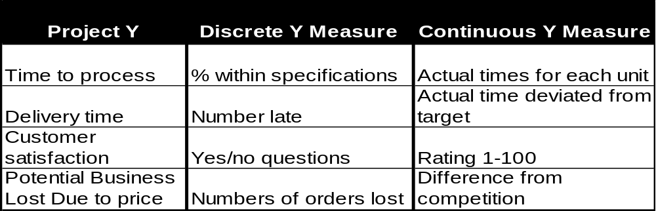
Importance of Data Type
Continuous data provides more information compared to a discrete data
Large sample sizes are required to measure higher Sigma multiples for discrete data
Discrete data does not allow to understand the process variation
The More Continuous We Can Make The Data, The More It Will Tell Us About Our Process

Slide 37
Measures - Location / Central Tendency
Mean is one of the most frequently used measure of central tendency, essentially is the mathematical average of the set of values.
Mean is influenced by extreme sets of values
Y₁ + Y₂ + Y₃ + ………. + Y_{n}
Y =
Where n = number of data points
n

Slide 38
Measures - Location / Central Tendency
Median is a measure of central tendency.
The median of a sample is the value for which one-half (50%) of the observations (when ranked) will lie above that value and one-half will lie below that value.
When the number of values in the sample is even, the median is computed as the average of the two middle values.
Odd number of data points
Even number of data points
Average
Mode is the most frequently occurring value in a data set.

Slide 39
Measuring the Spread
Range is the difference between the maximum & minimum data point
( Y₁ - Y )² + ( Y₂ – Y )² + ……. + ( Y_{n} – Y )²
Variance = σ² =
( n – 1 )

Slide 40
Measuring the Spread
Variance & standard deviation measure how individual data points are spread around mean
( Y₁ - Y )² + ( Y₂ – Y )² + ……. + ( Y_{n} – Y )²
Variance = σ² =
( n – 1 )
Standard Deviation (σ) = Variance

Slide 41

Activity: Centering and Spread
For the following dataset, please calculate the following:
Mean
Median
Range
Variance
Standard Deviation

Slide 42
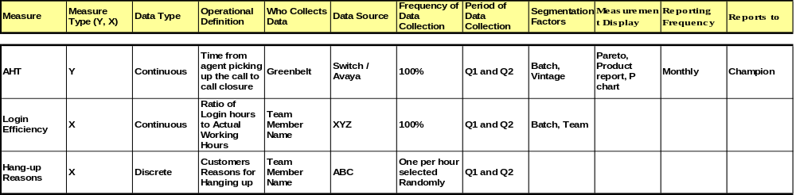

Data Collection Plan

Slide 43

Design Sampling Plan for Establishing Process Baseline
Baseline refers to a reference point from where the improvement would be measured
Sampling plan for base lining attempts to define the data collection approach only

Slide 44
Introduction to Sampling
Sampling is the process of:
Collecting only a portion of the data that is available or could be available, and drawing conclusions about the total population (statistical inference)
Population
Sample
x x x
x x
x x x x x xx x
x x x x x x
x xxxx x x
x x
x x x
x x
x x
x x x
N=5000
n=100
What is the average resolution time
From the sample, we figure that the average resolution time is 8 hours

Slide 45
Introduction to Sampling
Sampling is the process of collecting a portion or subset of the total data that may be available.
All of the data available is often referred to as a Population (N).
The purpose of sampling is to draw conclusions about the population using the sample (n). This is know as statistical inference.
In the example on the previous page, the population is all of the written inquiries received at a processing center last month (5,000). The manager of the process wants to know the average resolution time for the inquiries received last month. Measuring the resolution time for each inquiry is too expensive; therefore, a decision is made to take a sample. A random sample of 100 inquiries is made and the average resolution is estimated.

Slide 46
Introduction to Sampling
Table 1.60 | Population | Sample
Definition | Collection of items being considered | Portion of the population chosen for study
Characteristics | ‘Parameter’ | ‘Statistic’
 | Population Size = N | Sample Size = n
 | Population Mean = µ | Sample Mean = Y
 | Population Standard Deviation = σ | Sample Standard Deviation = s

Slide 47
When To Sample
When to sample
Collecting all the data is impractical or too costly
Data collection can be a destructive process
When measuring a high-volume process
When not to sample
A subset of data may not accurately depict the process, leading to a wrong conclusion (every unit is unique – e.g., structured deals)
One of the first questions to ask is ‘Do I need to sample?” The major reason sampling is done is for efficiency reasons-it is often too costly or time consuming to measure all of the data. Sampling provides a good alternative to collect data in an effective and efficient manner. If the circumstances surrounding the data collection plan do not justify sampling, then sampling should not be done. This is often the case in low volume processes.

Slide 48
Goal Of A Useful Sample
Representative sample
All parts of the target population are represented (i.e., selected for measurement) equally.
The customer’s view is captured
How to guarantee a representative sample
Understand special characteristics of the population before sampling
Design a sampling strategy

Slide 49
Goal of a Useful Sample
Regardless of the situation, a sample must be “representative” of the population. For practical purposes a sample is representative if it accurately represents the target population. Consideration that may hinder collection of a representative sample include:
The cost and ease of obtaining samples
Time constraints
Unknown characteristics of the population
Samples that are not representative of a target population are called biased samples. Often, the biases are not recognized until the collected data has been analyzed.

Slide 50
Sampling Methods
Four methods of sampling:
Random sampling
Stratified sampling
Clustered sampling
Systematic sampling

Slide 51
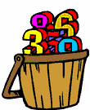
Random Sampling
All items in the population have an equal chance of being chosen in the sample
Example: A customer satisfaction survey team picking the customers to be contacted at random
How to do random sampling
  Generate random numbers from computer / printed tables
  Write each unit on a piece of paper & deposit the slips in a box

Slide 52
Stratified Sampling
When to use Stratified sampling?
When the population consists of mixture of more than one strata, each forming a homogeneous group, Stratified sampling can assure that sample represents the population adequately.
Like random samples, stratified random samples are used in population sampling situations, when reviewing historical or batch data.
This method may be the only way to accurately capture performance for different segments of the process.
M
M
M
M
F
F
M
M
M
M
F
F
M
M
M
M
M
M
M
M
M
M
F
F
M
M
F
F
A sample of size 6 - 4 males & 2 females

Slide 53
Clustered Sampling
When the population consists of clusters, each having large variation within the cluster, but clusters are essentially similar to each other.
We select a random sample of the clusters and assume that these clusters represent the population as a whole
This situation is quite opposite to the condition for stratified sampling
District 1
District 2
District 3
Sample
M
F
M
M
M
F
M
F
M
F
M
F
F
F
M
M
M
M
F
F
M
F
F
F
M
F
F
F
M
M

Slide 54
Systematic Sampling
Systematic sampling is the selection of samples from a population according to a set schedule or plan
Systematic sampling is typically used in process sampling situations when data is collected “real time” during process operation.
A frequency for sampling must be selected.
Every second item is being systematically picked

Slide 55
Sampling Bias
Regardless of the situation, a sample must be “representative” of the population. For practical purposes a sample is representative if it accurately represents the target population. Consideration that may hinder collection of a representative sample include:
The cost and ease of obtaining samples
Time constraints
Unknown characteristics of the population
Samples that are not representative of a target population are called biased samples. Often, the biases are not recognized until the collected data has been analyzed.

Slide 56
Avoid Sampling Bias
Bias occurs when systematic differences are introduced into the sample as a result of the sample selection & measurement process
A biased sample would not adequately represent the population & would lead to incorrect conclusions about the population
Types of sampling bias:
Convenience bias - when sample is drawn from the most easily accessible part of the population
Environment bias - when conditions have changed from the time sample was drawn to the time sample was used to draw conclusions
Measurement bias - when measurement system is not precise enough
Non-response bias - when respondents do not participate as a sample (survey conditions)

Slide 57
Common Segmentation Factors
Factor Example
What type Complaints, defects, problems
When Year, month, week, day
Where Country, region, city, work site
Who Business, department, individual, customer type, market segment
Note: Your team will need to segment the data in several different ways in order to uncover where the most significant differences occur.

Slide 58
How Do I Determine Sample Size?
Sample size (n) depends on three things
Level of confidence required for the result, “How confident I am that the result represents the true population”
  Level of confidence increases as sample size increases
Precision or accuracy (∆) required in the result, “The error bars or uncertainty in my result”
  Precision increases as sample size increases
Standard deviation of the population (σ), “How much variation is in the total data population”
  An estimate of standard deviation is needed to start. As standard deviation increases, a larger sample size is needed to obtain reliable results
In this equation, “1.96” represents a 95% confidence level
2
n =
1.96 * σ
∆

Slide 59
Sample Size For Continuous Data
Consider the following example:
We want to estimate average call length in handling customer inquiries, and we want our estimate to be accurate to within 1 minute. Based on a small random sample of 30 inquiries we know that the variation in call length, as measured by standard deviation, is 5 minutes. We want to have 95% confidence that the estimate will be in the range of specified accuracy – i.e.,  1 minute.
Therefore, from the statistical theory we can answer according to the formula:
Where n = sample size, u = standard deviation and ∆= degree of precision required. In our example, the required sample size is:
n = [(1.96*5)/1] ² = 96.04 or 96 samples
2
n =
1.96 * σ
∆

Slide 60
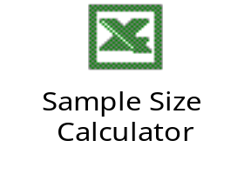
Sample Size For Discrete Data
Extending the same logic, we can find out the sample size required while dealing with discrete population
If the average population proportion non-defective is at ‘p’, population standard deviation can be calculated as
Where = Tolerance allowed on either side of the population proportion average in %
σ =
√( 1 – p)
2
1.96
n =
p ( 1 – p)

Slide 61
How To Estimate ↓ and P
Take a small pre-sample of data (n = 100) and calculate P
Use X from an existing control chart
Set P = .5 as a worst case (largest n)

Slide 62
Measurement System Analysis

Slide 63
Possible Sources Of Variation
Observed Process Variation
Actual Process
Variation
Measurement
Variation
Variation
due to
Operators
Variation
due to
Gage
Reproducibility
Bias
Stability
Linearity
Repeatability
To Address Actual Process Variability; The Variation Due To The Measurement System Must First Be Identified And Separated From That Of The Process

Slide 64
Measurement System Analysis–Objectives
Recognize that observed variation of a product/process includes the true variation of the product/process & the variation due to the measurement system
Identify & describe possible sources of variation in a measurement process
Describe the importance of a validated measurement system
Describe the terms precision, accuracy & resolution in relation to MSA
Use appropriate tools to validate measurement system, analyze, and interpret results
  – Gage R&R for continuous data
  – Attribute R&R for discrete data
One of the objectives of the Measure Phase is to validate your measurement system. A Gage R&R Study will help us do this!
The focus of this module is to review the methodology and tools to validate your measurement system.
MSA = Measurement System Analysis
Gage R&R = Gage Repeatability & Reproducibility

Slide 65
Why is MSA important?
Data is only as good as the process that MSA identifies how much variation is present in the measurement process. Understanding measurement variation is necessary for identifying “true” process variation and maximizing true Y improvements.
Without MSA, you run the risk of making decisions based on an inaccurate picture of your MSA helps direct efforts aimed at decreasing measurement variation.
Excessive measurement variation distorts our understanding of what the customer feels

Slide 66
Measurement System Variation vs. Process Variation
Call Taking Y= Time to Respond (Response Time)
– Process Variation: Time to answer a question varies for different operators, locations, etc.
– Measurement Error: Error in capturing the time measurement due to vague definition of when to stop.
Application Processing Y= Time to Decision
– Process Variation: Different types of applications vary in time to complete. Associates vary in their productivity.
– Measurement Error: Error in measurement time. Time stamp inconsistencies or application arrival times not recorded accurately.

Slide 67
Accuracy and Precision
Measurement System Error
Accuracy
Precision
Bias
Stability
Linearity
Repeatability
Reproducibility

Slide 68
A Good Measurement System
Good measurement systems have the following characteristics…
Accuracy:
The average of multiple measurements of an event are equal to the true value
Precision:
There is little variation in repeated measurements of the same event
Linearity:
The measurement system maintains its performance over a range of events
Stability:
The measurement system maintains its performance over time

Slide 69
Measurement System Errors
..
. .
.
..
. .
.
Precise NOT Accurate
Accurate NOT Precise
.
. .
. .
. . .
..
.
..
Accurate AND Precise
Neither Accurate, Nor Precise

Slide 70


Gage Repeatability
Gage repeatability is a measure of how consistently the same person (or system) measures the same event over time using the same measurement system.
To find this value, we record how the same operator or system repeatedly measures the same event with the same measurement system.
Since the event does not change, any change in the measurements must be due to variation in the measurement process.
Transaction

Slide 71

Gage Reproducibility
Gage reproducibility is a measure of how consistently several operators or measurement systems measure the same event over time. To find this value, we have several people or systems repeatedly measure the same event. We then look for differences in the results between the people or systems.
Transaction

Slide 72
Key Concepts
Repeatability is also called Equipment Variation
Reproducibility is also called Appraiser Variation
Gage ‘Repeatability’ & ‘Reproducibility studies are collectively referred as GRR studies
GRR studies should be performed over the range of expected observations
Actual equipment should be used for the GRR studies
Already written procedures should be followed
It should be business as usual

Slide 73
Data Collection
When you setup your Gage R&R, make sure you follow these guidelines:
You should have at least 30 different data points (Events or transactions) per Operator.
You need 3 different operators randomly selected.
When you run the second trial, randomize your data points (events) before having the operators judge them.
The data points you select should have at least 5 good and 5 bad

Slide 74

Gage R & R for Continuous Data
X Bar R Method
  Typically used in automobile industry
  Extreme values affect the method
  Short & Long Method
    Short Method does not measure operator and equipment variability separately
    Long method measures operator and equipment variability separately
ANOVA Method
  Measures operator & equipment variability separately as well as combined effect of operator & parts
  More effective when extreme value are present
  Most tedious to perform manual calculations

Slide 75
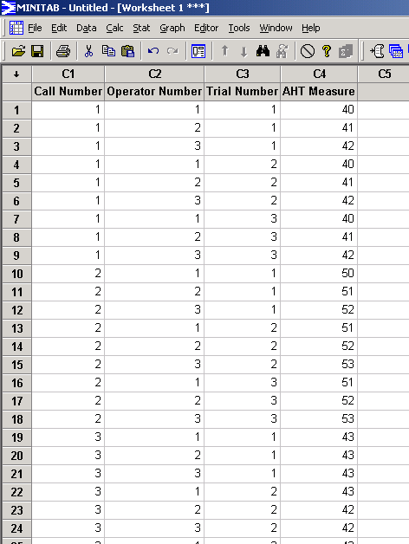
Gage R and R ANOVA Method: Example
In an AHT project in a call center, the team is conducting an MSA.
They pick up 3 calls and 3 operators.
They run 3 trials per call per operator
They arrange data in a Minitab worksheet as shown

Slide 76
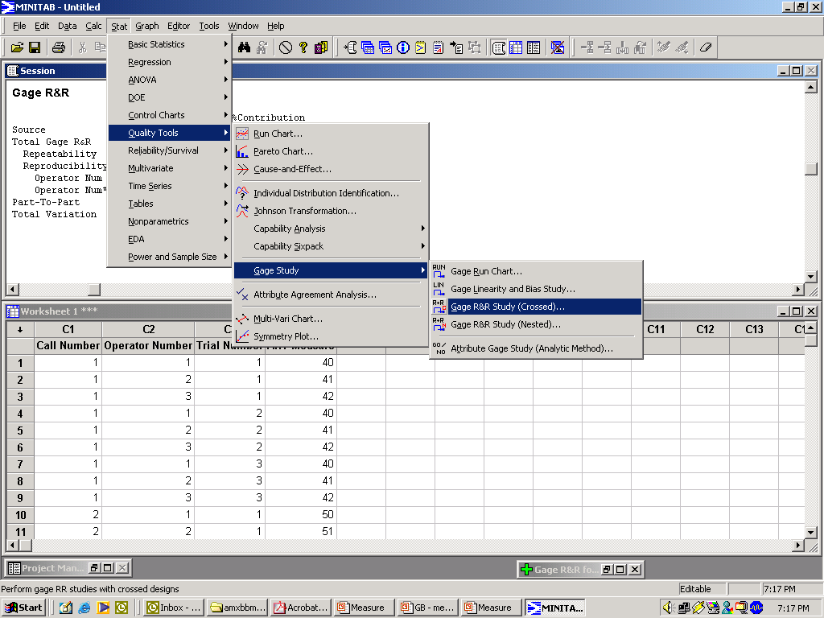
Gage R and R ANOVA Method: Example
Click on Stat>Quality Tools>Gage Study>Gage R&R (Crossed)

Slide 77
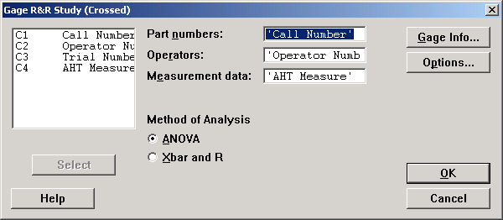
Gage R and R ANOVA Method: Example
Select cells as shown. Ensure that ANOVA is selected in the Method of Analysis and click on OK

Slide 78
Gage R and R ANOVA Method: Example
Two-Way ANOVA Table With Interaction
Source DF SS MS F P
Call Number 2 592.667 296.333 205.154 0.000
Operator Num 2 6.889 3.444 2.385 0.208
Call Number * Operator Num 4 5.778 1.444 7.800 0.001
Repeatability 18 3.333 0.185
Total 26 608.667
Gage R&R
%Contribution
Source VarComp (of VarComp)
Total Gage R&R 0.8272 2.46
Repeatability 0.1852 0.55
Reproducibility 0.6420 1.91
Operator Num 0.2222 0.66
Operator Num*Call Number 0.4198 1.25
Part-To-Part 32.7654 97.54
Total Variation 33.5926 100.00
Study Var %Study Var
Source StdDev (SD) (6 * SD) (%SV)
Total Gage R&R 0.90948 5.4569 15.69
Repeatability 0.43033 2.5820 7.42
Reproducibility 0.80123 4.8074 13.82
Operator Num 0.47140 2.8284 8.13
Operator Num*Call Number 0.64788 3.8873 11.18
Part-To-Part 5.72411 34.3447 98.76
Total Variation 5.79591 34.7755 100.00
Number of Distinct Categories = 8
The Total Gage R&R value under % contribution shows the measurement system error for this test, in this case 2.46% of the variation in the data comes from the measurement system. We like it to be less than 10%, so this measurement system is acceptable.
The remaining variation comes from Part-to-Part variation. In this study, 97.54% of the variation was due to variation in performance of the actual call cycle time – true process variation.

Slide 79
Rules of Thumb–Acceptable Ranges
Analyzing Gage R&R Results
  1. R&R less than 10%–Measurement System “acceptable”
  2. R&R 10% to 30%–May be acceptable–make decision based on classification of Characteristic, Application, Customer Input, etc.
  3. R&R over 30%–Not acceptable. Find problem, re-visit the Fishbone Diagram, remove Root Causes. Is there a better gage on the market, is it worth the additional cost?

Slide 80
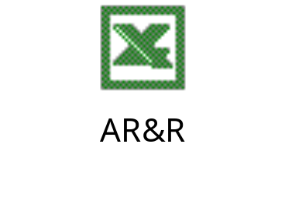
GRR for Discrete Data
Enter data in the Data Entry columns
On the ‘Reports’ tab, click on ‘Run ARR Report”

Slide 81

Tollgate - Measure
Detailed As-is Process Map
Specifications & Defects
Data Collection Plan
Sampling Plan & Sample Size
GRR for the measurement system

Slide 82

Quiz

