Slide 1


Sarcasm Detection System for Hinglish Language
A dissertation is presented towards the
fulfilment of the requirements for M.Sc. in Data Science
Submitted By: Hari Thapliyal
Student Number: PN927682
Submitted To: Liverpool John Moore University, UK

Slide 2
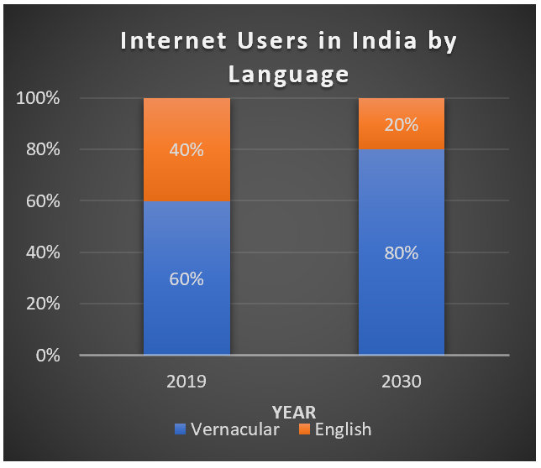
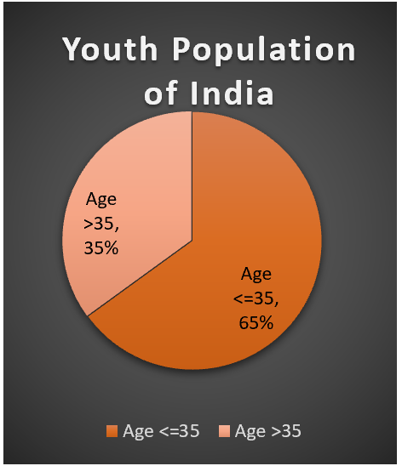
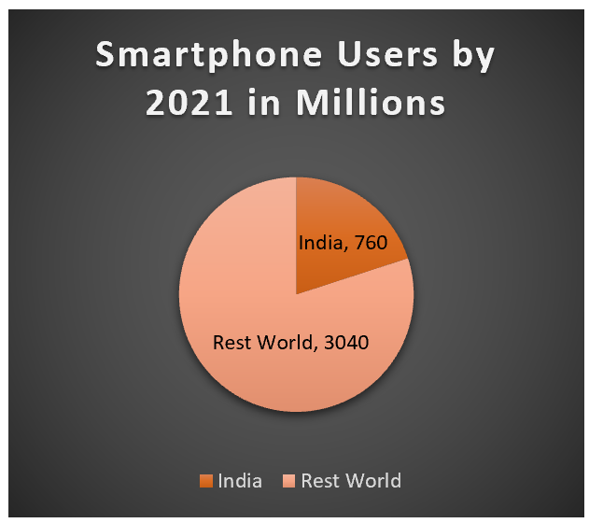
Introduction
Source:
https://en.wikipedia.org/wiki/Internet_in_India
Smartphone Data 2021
Notes:
1- Number of people communicating in their vernacular language are going to increase in percentage and absolute numbers.
2- Among top 10 countries, almost 25% of smartphone owners will be in India by 2021.
3- We know average life of Indian is 70 years. It means next 35 years 65% of the Indian population is going to live in the society and business conduct themselves in in the vernacular Language.

Slide 3
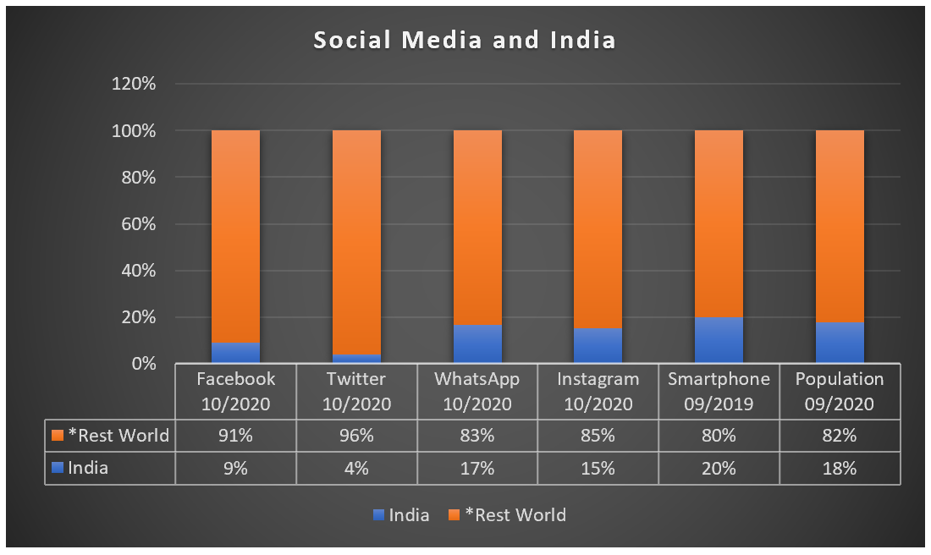
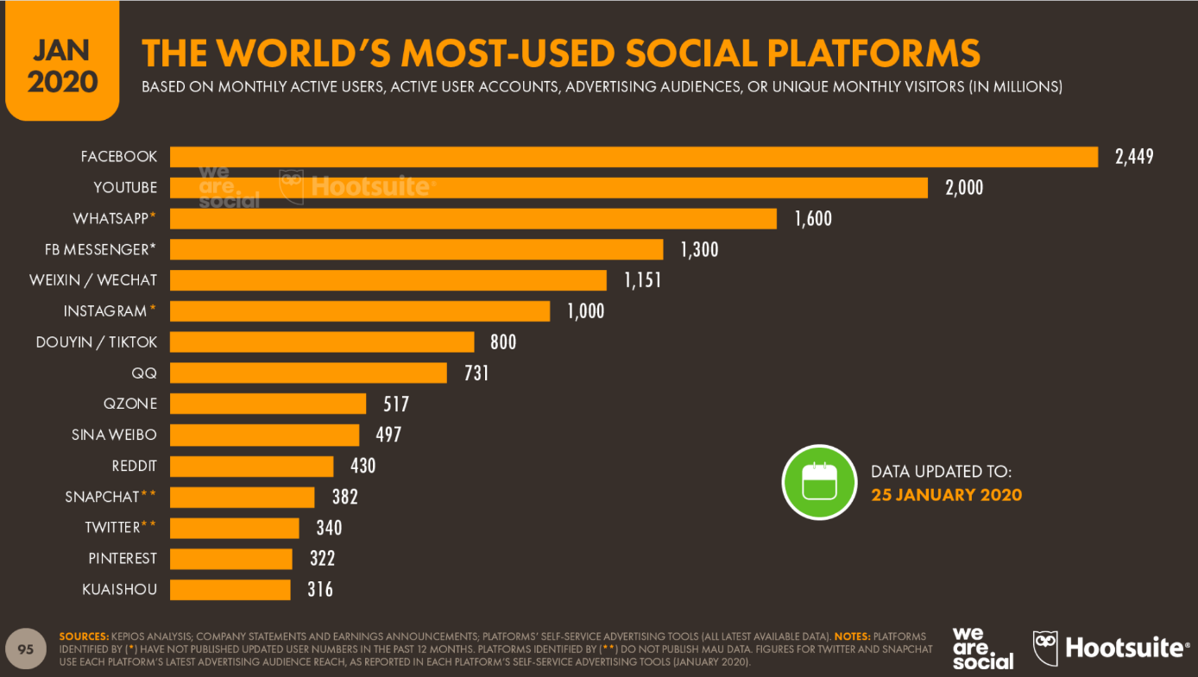
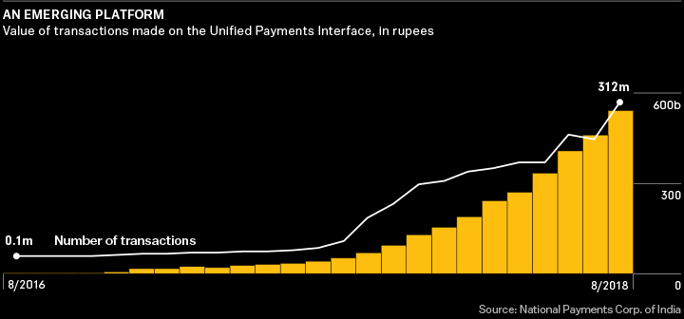
Introduction
https://fortunly.com/statistics/whatsapp-statistics/#gref
https://www.omnicoreagency.com/facebook-statistics/
https://www.omnicoreagency.com/twitter-statistics/
https://backlinko.com/instagram-users
https://en.wikipedia.org/wiki/List_of_countries_by_smartphone_penetration
*Rest Word- Except population other data is taken for top 10 countries. Smartphone data for top 20 countries
Notes:
As of today 18% of the world population lives in India. 20% smartphone users of the world are India. But usage of social media in India is less compared to number of smartphones we have. In coming time it is going to increase in absolute and percentage terms.
We can see top 15 social media platform and their users. In time to come more platforms will be available and more users will participate on those platforms.
Similarly we see digital transactions, online payment buying, giving feedback is exponentially increasing and it will increase future.

Slide 4
Problem Statement
Digital India program of GOI, recent COVID19 pandemic, youth population, surge in literacy and education, affordable cost of mobile-phone and internet connection are the catalyst to huge content surge in Indian languages.
Hindi people population is using this language in their all communication, specially to give feedback and social media communication.
Keeping the volume of transactions, trends of online transactions and interactions in mind, we want to develop a sarcasm detection system for Hinglish language which can work for all social media content, reviews, comments, and feedbacks.
People are buying online, consuming service online and giving feedback online.
Lots of work has been done for sentiment analysis for English language but less work has been for sarcasm detection. Although some work has been done for sarcasm detection in Hindi language but no significant work is available for sarcasm detection in Hinglish language.
Rise of a new language called Hinglish. This is written in two scripts (Devanagari and Roman) and adopts words from multiple language. Most of the words are taken from Hindi language and written in Devanagari script.
Hinglish
Generally, more educated people have more diplomatic language for the feedback.

Slide 5
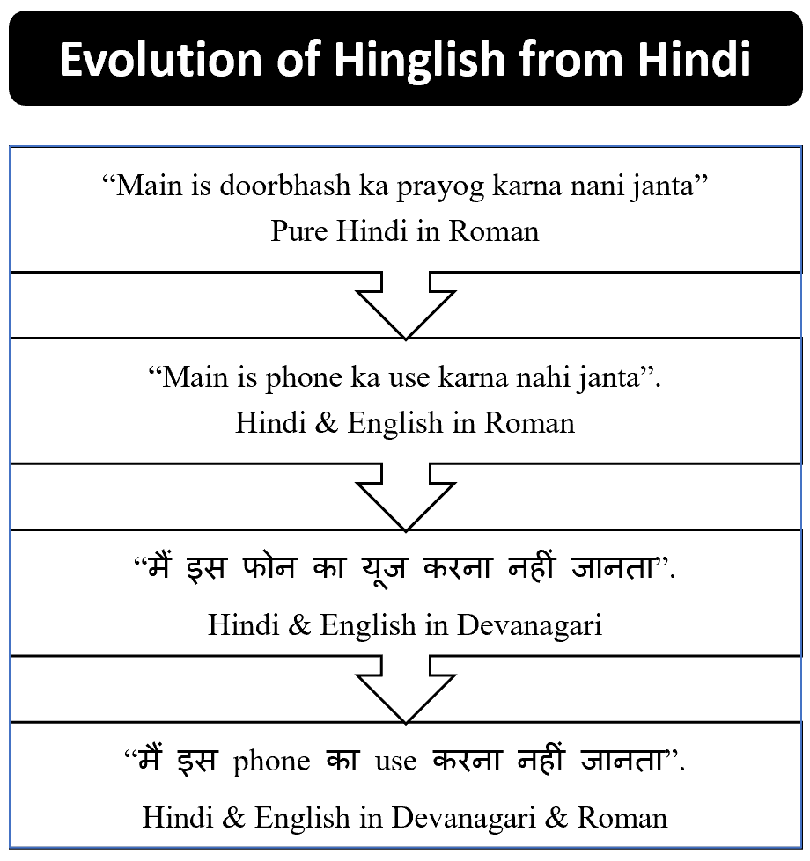
Evolution of Hinglish

Slide 6
Aim & Objective
To create Hinglish language dataset with minimum 2000 sentences, which can be used for training and testing a sarcasm detection system of Hinglish Language
To develop a sarcasm detection models
To check the effectiveness of Transfer learning for our work.
To understand which embedding model or library works best for Hinglish language.

Slide 7
Literature Review
We reviewed 32 research papers on Sentiment Analysis, Emotion Detection, and Sarcasm Detection.
Most of the work was done using English dataset. Some work has been done in Hindi but that is limited to twitter dataset.
We didn’t find any Sarcasm detection work using Hinglish language.
Depending upon dataset different metrics has been used to evaluate the performance of these systems. In most cases where dataset is balance Accuracy is used to measure the performance.
Accuracy of these systems varies from 55.59% to 99.79% depending upon data source, domain, text script (Roman, Devanagari, Tamil etc.) and language (English, Hindi, Marathi, Tamil, German, Spanish etc.) used for model building
https://github.com/Hari-thapliyal/SDSHL/blob/master/docs/final/Summary-of-Sarcasm-Papers.pdf

Slide 8
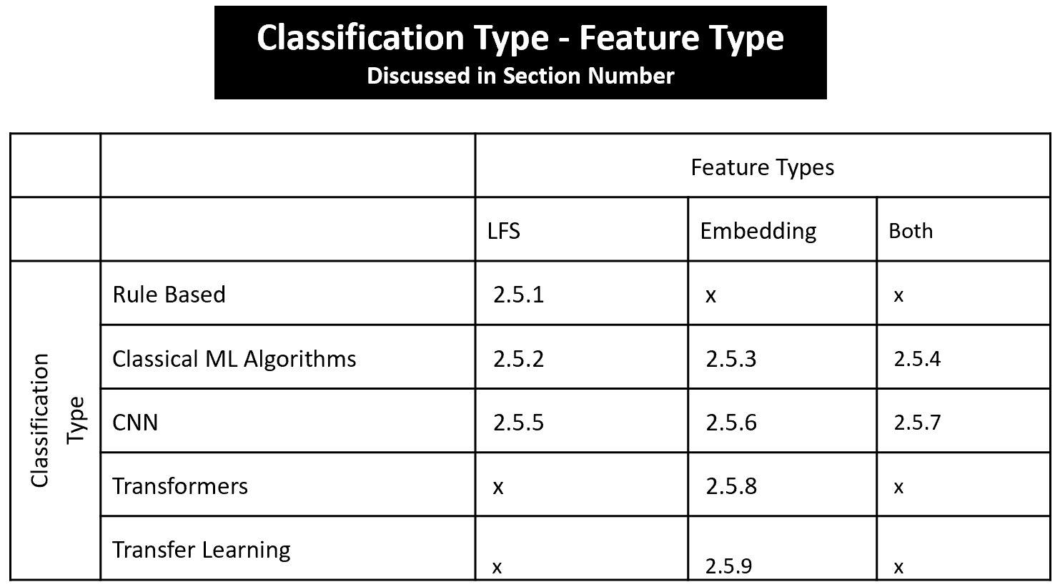
Literature Review

Slide 9
Type of Sarcasm Detection Systems
Architecture Based
Rule based, Classical ML, CNN Based, Transformer Based
Domain Based
Politics, IT, Finance, Medical, Law etc.
Mode of Communication Based
Text, Voice, Body Language, Image, Multi-modal
Time of Detection Based
Batch, Realtime
Language and Script Based
English, German, Spanish, Hindi, Tamil, Bangla etc

Slide 10
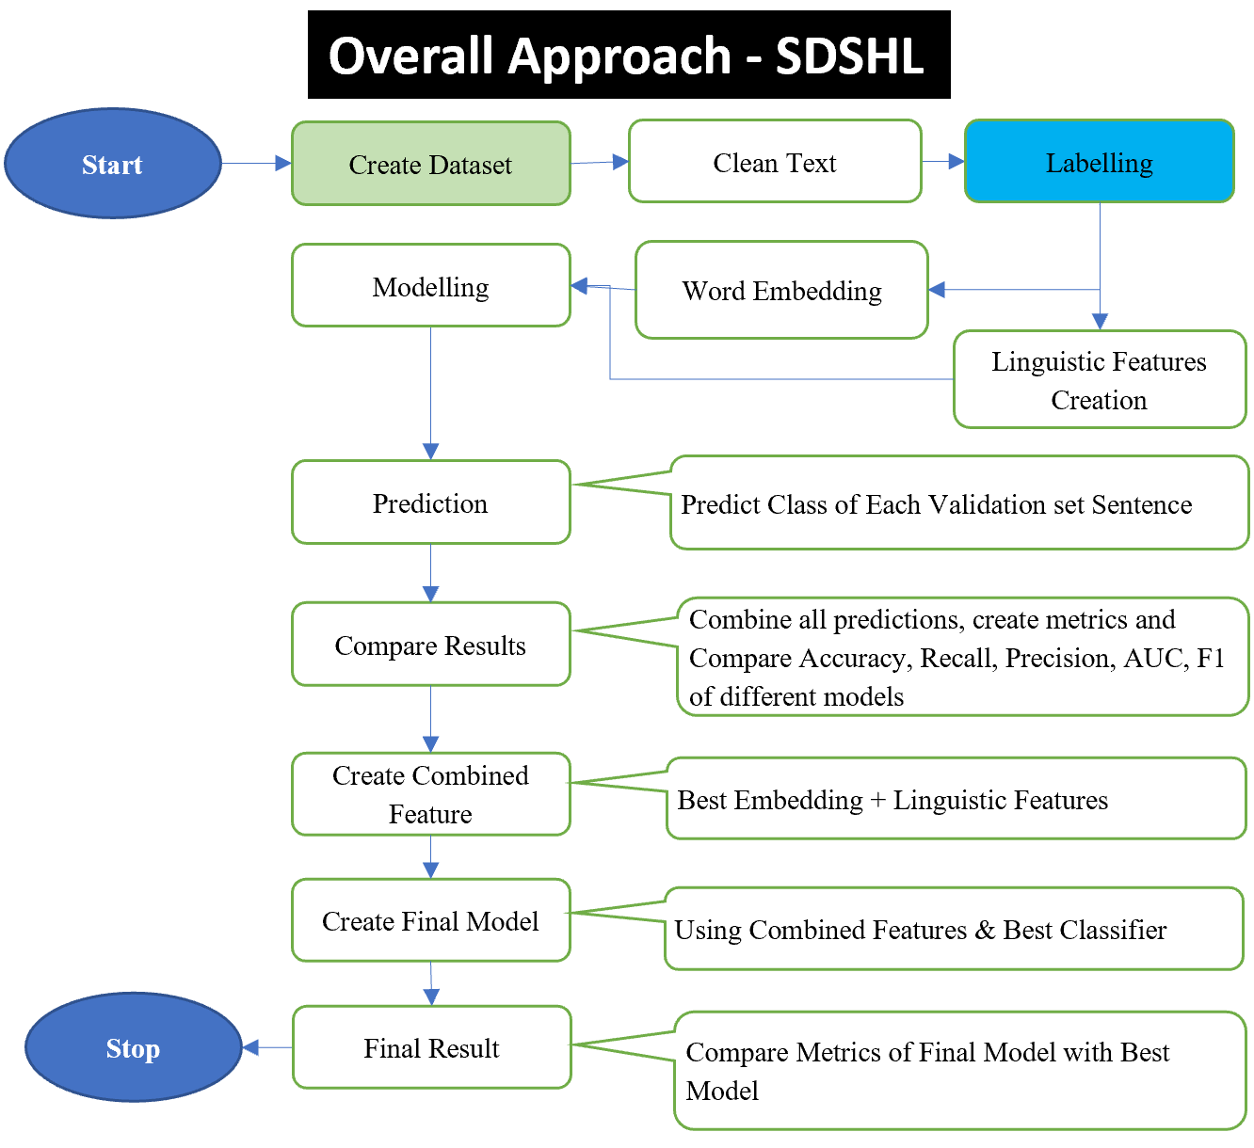
Methodology

Slide 11
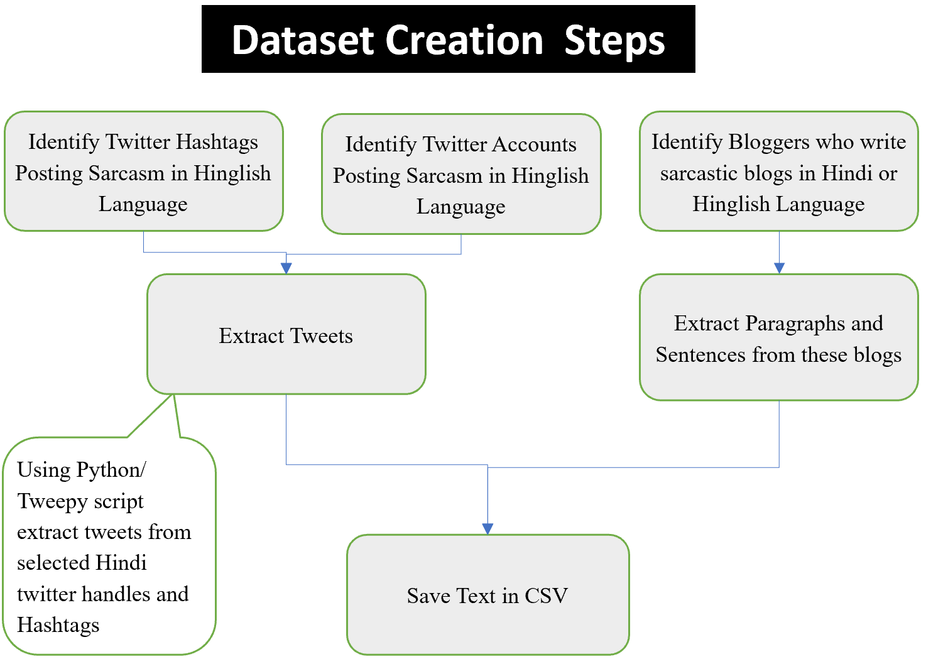
Dataset Creation Steps

Slide 12
Classifier, Embedding, TL Techniques
Classifiers | Word Embedding | Feature Engineering
Logistic Regression (LR) Light Gradient Boosting Method (LGBM) Naïve Bayesian (NB) AdaBoost (ADB) Support Vector Machine (SVC) Gradient Boost Classifier (GBC) Random Forest Classifier (RFC) XGBoost (XGB) Decision Tree (DT) Perceptron | No Transfer TFIDF Word2Vec BOW fastText Transfer Embedding IndicBERT Multilingual BERT fastText Wiki fastText Indicnlp/ IndicFT | Lexical Feature Combined = IndicFT + LexicalFeature Task Transfer mBERT (Pyrotch) mBERT (Transformer) IndicBERT IndicFT fastTextWiki

Slide 13
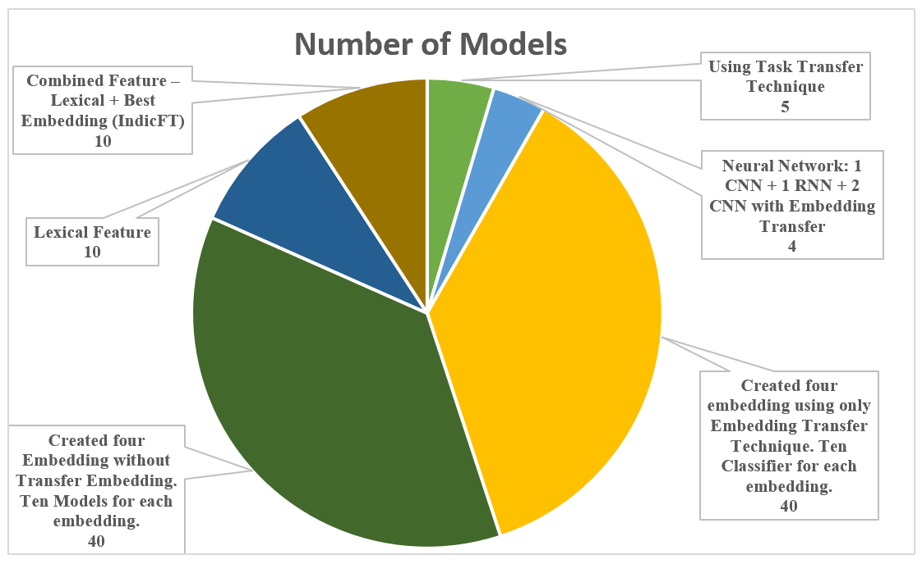
Models Types
Twelve classifiers are used, ten embedding used. Six approaches used to create 109 models are summarised in the graph.

Slide 14
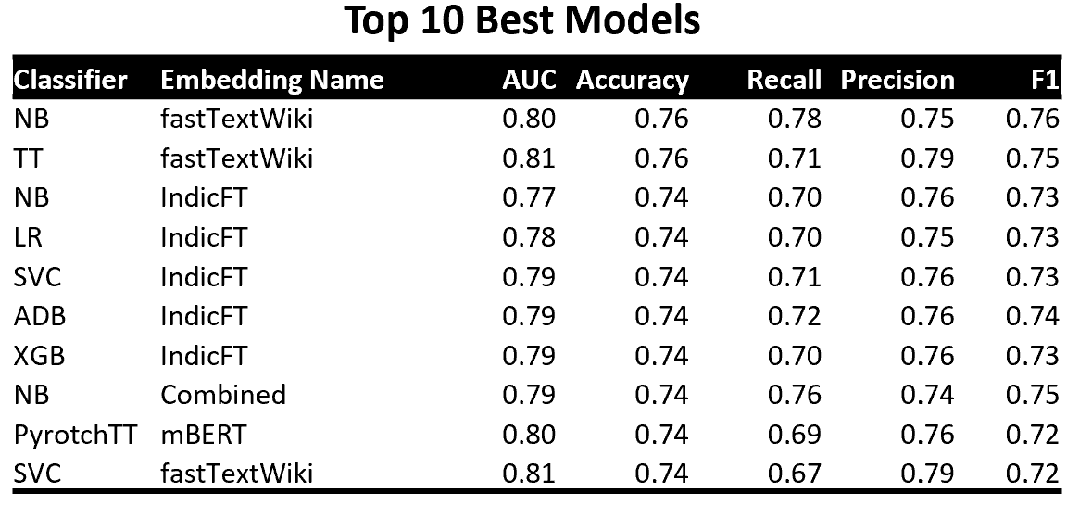
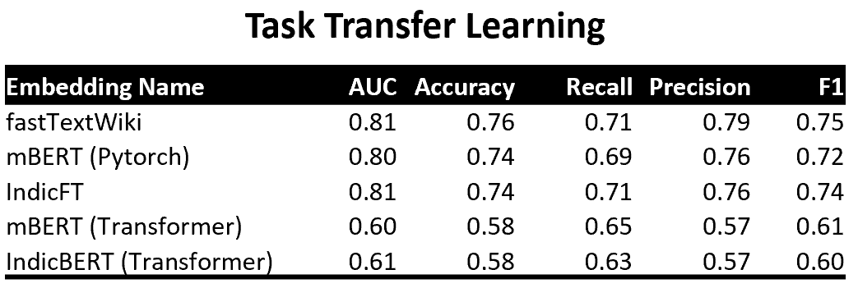
Results – Best Models

Slide 15
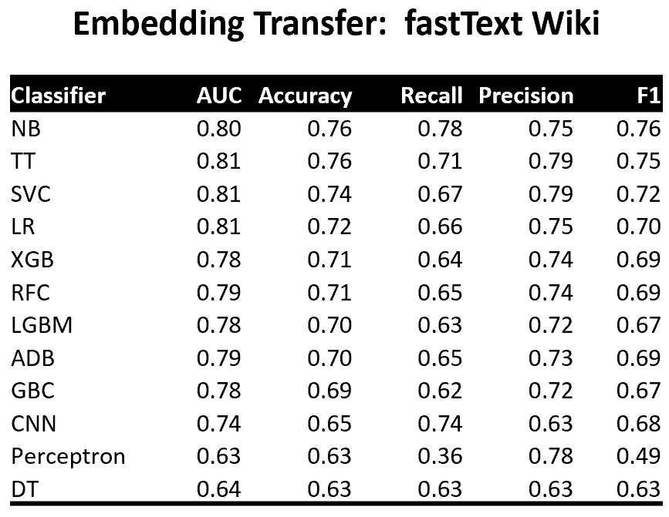
Best Classifier for Best Embedding

Slide 16
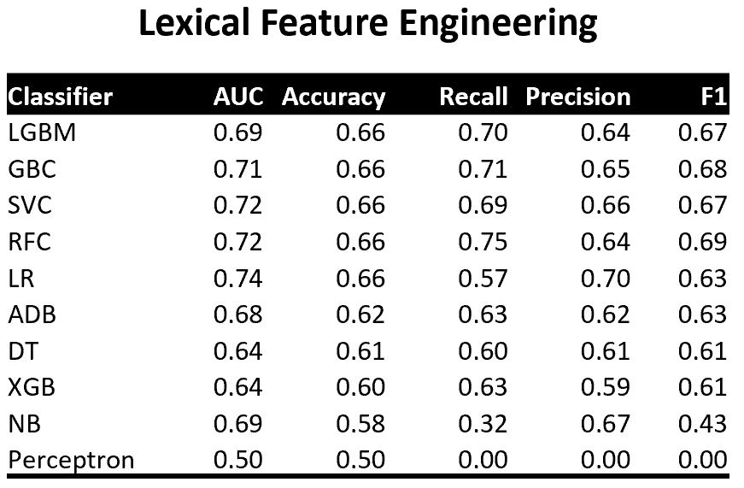
Lexical Features are Not Good

Slide 17
Conclusion
Two embedding transfer fastTextWiki and IndicFT both gives competitive results 76% and 74% accuracy respectably with NB classifier. Both of these are fastText based embedding.
Task transfer gives the best results, highest accuracy 76% when fastTextWiki pretrained model is used for classification
IndicBERT or mBERT Task transfer with transformer implementation are not giving good results.
All other models which were created using our own embedding could not perform good with any classifier used.
The best result of Lexical features is with LGBM classifier. Accuracy; 66%. Lexical features are not effective in sarcasm detection for Hinglish text.
NB & SVC are the best classifier provided good embedding are used.
Transliteration is quite complicated task and it need separate focus otherwise in future also we may not see enough improvement in Hinglish language-based models.

Slide 18
Limitation
We included only two scripts Devanagari and English. If text is in any other script, we will not get good results.
Trained only on general text and not related to any specific domain
Training dataset has more twitter data and less blog data but performance on blog data is better than twitter data. We are assuming that this may be because of high structure and consistency in blog text than twitter text.

Slide 19
Future Recommendation
Dataset
Our dataset has only 2000 sentences. To make a stable model we need more data for this sarcasm classification task. Hence, in future work we should focus on expending the dataset with Hinglish text.
Classifier & Task Transfer
NB & SVM are good classifier provided good embedding is chosen
Task transfer yields good results when fastTextWiki or IndicFT or mBERT (pytorch) models are used
Embedding
We used mBERT, fastTextWiki, IndicFT and IndicBERT models to finetune and transfer embedding. These embeddings are Hindi based but we need to develop Hinglish based embedding from scratch
Transliteration
Before we start fine tuning our model using Embedding transfer techniques, we should transliterate all text in Devanagari script. Hindi/Non-English word in Roman script words and English words in Roman should be transliterated into Devanagari
We should try other transformers like GPT

Slide 20

नमस्ते
नमः ते

