Slide 1

This presentation deals with ten important Mudras that can result in amazing health benefits.
Your health is, quite literally, in your hands….

Slide 2

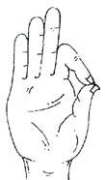
Method:
Touch the tip of the thumb to the tip of the index finger, with the other three fingers stretched out.
Specialty:
As it is a mudra of knowledge, it enhances the knowledge. The tip of thumb has centers of pituitary and endocrine glands. When we press these centers by index finger the two glands work actively.
Time duration:
There is no particular time duration for this mudra. You can practice by sitting, standing or lying on bed whenever and wherever you have time.
Benefits:
Increases memory power and sharpens the brain
Enhances concentration and prevents Insomnia
If we practice it regularly, it will cure all psychological disorders like Mental, Hysteria, Anger and Depression

Slide 3

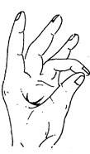
Method:
Tip of the ring finger touches the tip of the thumb, with the other three fingers stretched out.
Specialty:
It reduces all physical weaknesses.
Time Duration:
It has no particular time duration. You can practice it any time you want.
Benefits:
It helps to increase the weight for weak people
It improves the complexion of skin and makes the skin to glow
It makes the body active by keeping it healthy

Slide 4
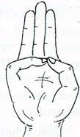

Varuna Mudra (Mudra of Water):
Method:
Tip of little finger touches the tip of thumb, with the other three fingers stretched out.
Specialty:
It balances the water content and prevents all diseases which come due to lack of water.
Time Duration:
It has no specific time duration and one can practice it according to their time.
Benefits:
It retains clarity in blood by balancing water content in the body
Prevents the pains of Gastroenteritis and Muscle Shrinkage

Slide 5

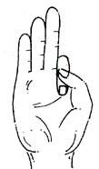
Vayu Mudra (Mudra of Air):
Method:
Keep the index finger on the base of the thumb and press with thumb keeping the other three fingers straight.
Specialty:
It prevents all the diseases that occur due to the imbalance of the air.
Time Duration:
The practice of this mudra for 45 minutes reduces the severity of the disease in 12 to 24 hours. For better results practice it for two months.
Benefits:
It cures Rheumatism, Arthritis, Gout, Parkinson's disease and paralysis without any medicine
It is useful for Cervical Spondilytis, paralysis to face and catching of nerve in neck
It corrects the disorder of gas in the stomach

Slide 6
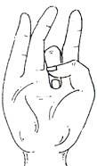

Shunya Mudra (Mudra of Emptiness):
Method:
Keep the middle finger at the mount of Venus and press it with thumb.
Specialty:
It reduces the dullness in our body.
Time Duration:
One can practice it for 40 to 60 minutes daily until to be cured from the disease.
Benefits:
It relieves an earache within 4 or 5 minutes
It is useful for the deaf and mentally challenged, but not for inborn ones.

Slide 7

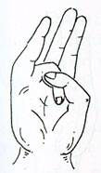
Surya Mudra (Mudra of Sun):
Method:
Bend the ring finger and press it with thumb.
Specialty:
It sharpens the center in thyroid gland.
Time Duration:
Practice it daily twice for 5 to 15 minutes.
Benefits:
It reduces cholesterol in body and helps in reducing weight
It reduces anxiety
It corrects indigestion problems

Slide 8

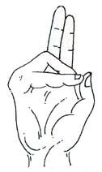
Prana Mudra (Mudra of Life):
Method:
Bend ring finger and little finger and touch the tip of thumb with their tips keeping the remaining two fingers stretched.
Specialty:
As it is the mudra of life, it improves the power of life. Weak people become strong. It reduces the clamps in blood vessels. If we practice it regularly, we will become active.
Time Duration:
No specific time duration. One can practice it any time.
Benefits:
It improves immunity
Improves the power of eyes and reduces eye related diseases
It removes the vitamin deficiency and fatigue

Slide 9

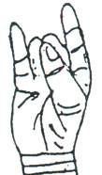
Apana Mudra (Mudra of Digestion):
Method:
The tips of middle finger and ring finger touch the tip of thumb while the other two fingers are stretched out.
Specialty:
It plays an important role in our health as it regulates the excretory system.
Time Duration:
Practice it daily for 45 minutes, but practice for longer time yields more benefits.
Benefits:
It regulates diabetes
It cures constipation and piles
It helps excreting the normal waste regularly

Slide 10

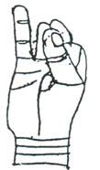
Apana Vayu Mudra (Mudra of Heart):
Method:
The tips of the middle finger and ring finger touch the tip of thumb, while the index finger touches the base of thumb and little finger stretched out..
Specialty:
It benefits the heart. It works like injection in the reduction of heart attack. It is as powerful as sorbitate tablet. It reduces the gas content in body.
Time Duration:
Practice it as many times as you can. Heart patients and BP patients can practice it for 15 minutes daily twice for better results.
Benefits:
It strengthens the heart and regularizes palpitation
It regulates excretory system
It redeems gastric trouble

Slide 11
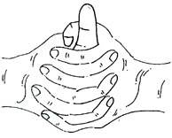
Linga Mudra (Mudra of Heat):
Method:
Interlock the fingers of both the hands and keep the thumb of the left hand vertically straight and encircle it with the thumb and the index finger of the right hand..
Specialty:
It generates heat in our body. Take milk, ghee, more water and fruit juices in addition to practice of this mudra for much benefits.
Time Duration:
Practice it any time you want. But don't practice it a lot as it produces heat in the body.. It can cause sweating even in winter if you practice it longer.
Benefits:
It stops production of phlegm and gives power to lungs
It cures severe cold and bronchial infection
It invigorates the body

Slide 12
You can do this anytime, anyplace – in the bus, train, car, office or at home.
To believe it, you must try it. There is nothing to lose and much to gain.
And lastly, please do not hoard this presentation. Forward it to all your friends, colleagues and relatives so that a maximum number of people can benefit.
Thank you.

