Slide 1
Relationship between Sarcasm & Satire
Satire
Satire is the use of humor, irony, exaggeration, or ridicule to expose and criticize people's stupidity or vices
Parody
Irony
Convey a meaning by using language that normally signifies the opposite, typically for humorous or emphatic effect.
Purpose is expressing in funny way
Sarcasm
Purpose is to mock or convey contempt

Slide 2
Evolution of Hinglish from Hindi
“मैं इस phone का use करना नहीं जानता”.
Hindi & English in Devanagari & Roman
“मैं इस फोन का यूज करना नहीं जानता”.
Hindi & English in Devanagari
“Main is phone ka use karna nahi janta”.
Hindi & English in Roman
“Main is doorbhash ka prayog karna nani janta”
Pure Hindi in Roman

Slide 3
Overall Approach - SDSHL
Start
Create Dataset
Clean Text
Labelling
Modelling
Word Embedding
Linguistic Features Creation
Prediction
Predict Class of Each Validation set Sentence
Compare Results
Combine all predictions, create metrics and Compare Accuracy, Recall, Precision, AUC, F1 of different models
Create Combined Feature
Best Embedding + Linguistic Features
Create Final Model
Using Combined Features & Best Classifier
Stop
Final Result
Compare Metrics of Final Model with Best Model

Slide 4
Classifiers | Word Embedding | Feature Engineering
Logistic Regression (LR) Light Gradient Boosting Method (LGBM) Naïve Bayesian (NB) AdaBoost (ADB) Support Vector Machine (SVC) Gradient Boost Classifier (GBC) Random Forest Classifier (RFC) XGBoost (XGB) Decision Tree (DT) Perceptron | No Transfer TFIDF Word2Vec BOW fastText Transfer Embedding IndicBERT Multilingual BERT fastText Wiki fastText Indicnlp/ IndicFT | Lexical Feature Combined = IndicFT + LexicalFeature Task Transfer mBERT (Pyrotch) mBERT (Transformer) IndicBERT IndicFT fastTextWiki

Slide 5
Text Cleaning Steps
Remove extra space, RT, http / www links, “@” account text information, line break
Remove non Hindi sentences
Remove over expression (extra emoticons),
Remove sentences which are less than 4 words.
Remove greeting related msg like #सुप्रभात, #राम राम जी, जय श्रीराम etc.
Remove duplicate sentences
Remove national or religious flag information like 🇮🇳🇮🇳
Replace Hindi । (Hindi sentence marker with “.”)

Slide 6
Dataset Creation Steps
Identify Twitter Hashtags Posting Sarcasm in Hinglish Language
Identify Twitter Accounts Posting Sarcasm in Hinglish Language
Identify Bloggers who write sarcastic blogs in Hindi or Hinglish Language
Extract Tweets
Extract Paragraphs and Sentences from these blogs
Using Python/ Tweepy script extract tweets from selected Hindi twitter handles and Hashtags
Save Text in CSV

Slide 7
Sentence Labelling Steps
Share CSV file with 3 Hindi Language expert
Expert Labelling for each Sentecne
Final Labelling based on Maximm Voting

Slide 8
Classification Type - Feature Type
Discussed in Section Number
 |  | Feature Types
 |  | LFS | Embedding | Both
Classification Type | Rule Based | 2.5.1 | x | x
 | Classical ML Algorithms | 2.5.2 | 2.5.3 | 2.5.4
 | CNN | 2.5.5 | 2.5.6 | 2.5.7
 | Transformers | x | 2.5.8 | x
 | Transfer Learning | x | 2.5.9 | x

Slide 9
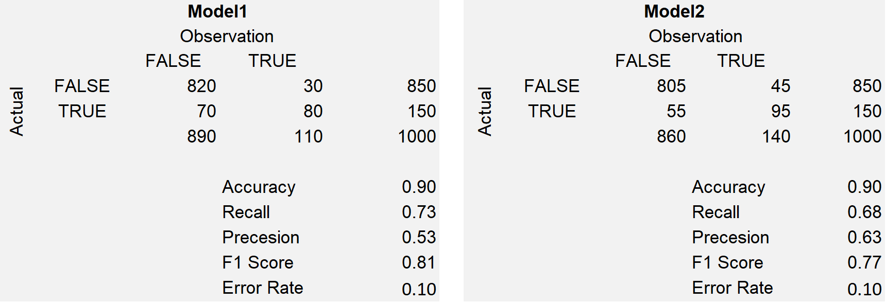
Metrics in ML Project

Slide 10
Modelling and Embedding Techniques
Modelling
1. Feature Engineering
3. Task Transfer
4. Embedding
2. NN
4.1 Transfer Embedding
4.2 Embedding
2.1 CNN
2.2 RNN
Use Classical Machine Learning Algorithm for Classification

Slide 11
Dataset Analysis

Slide 12
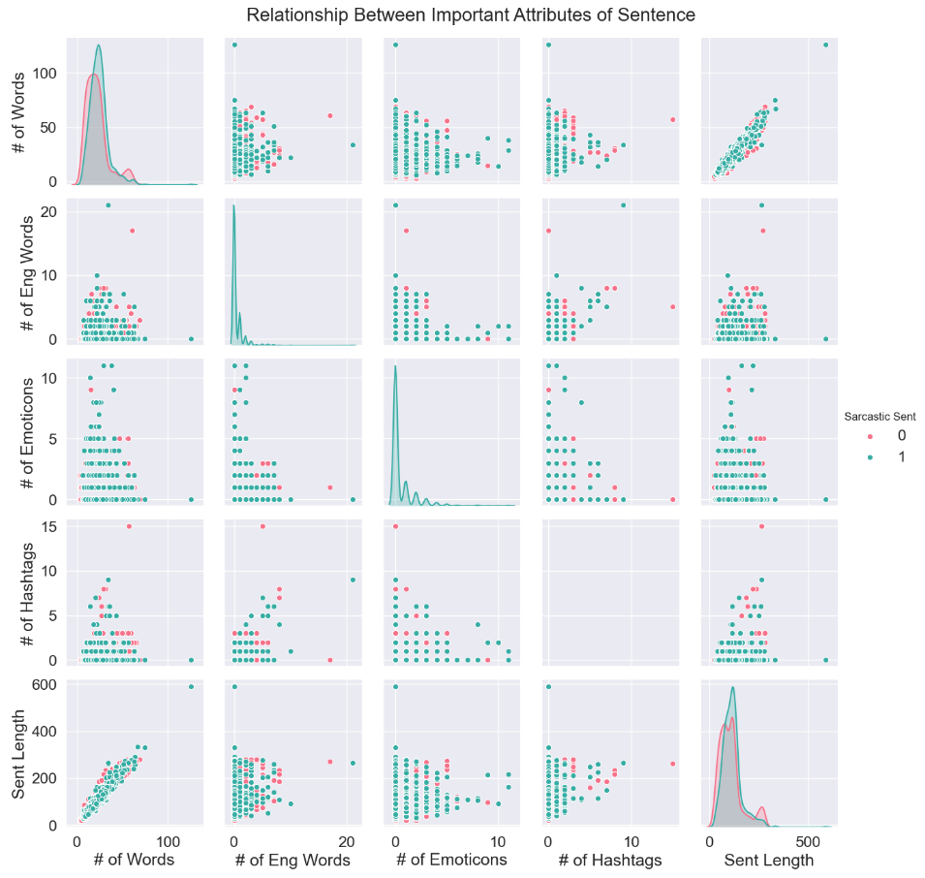

Slide 13
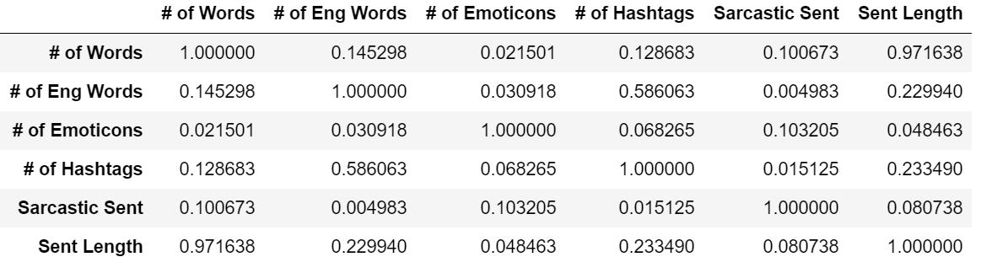

Slide 14
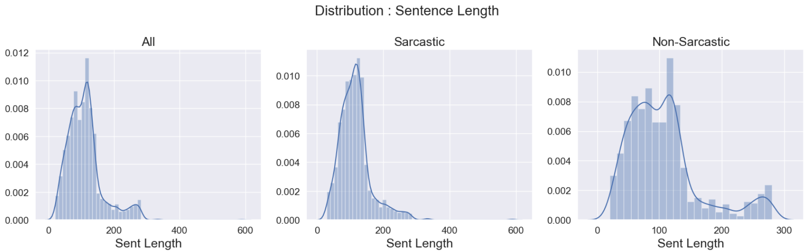

Slide 15
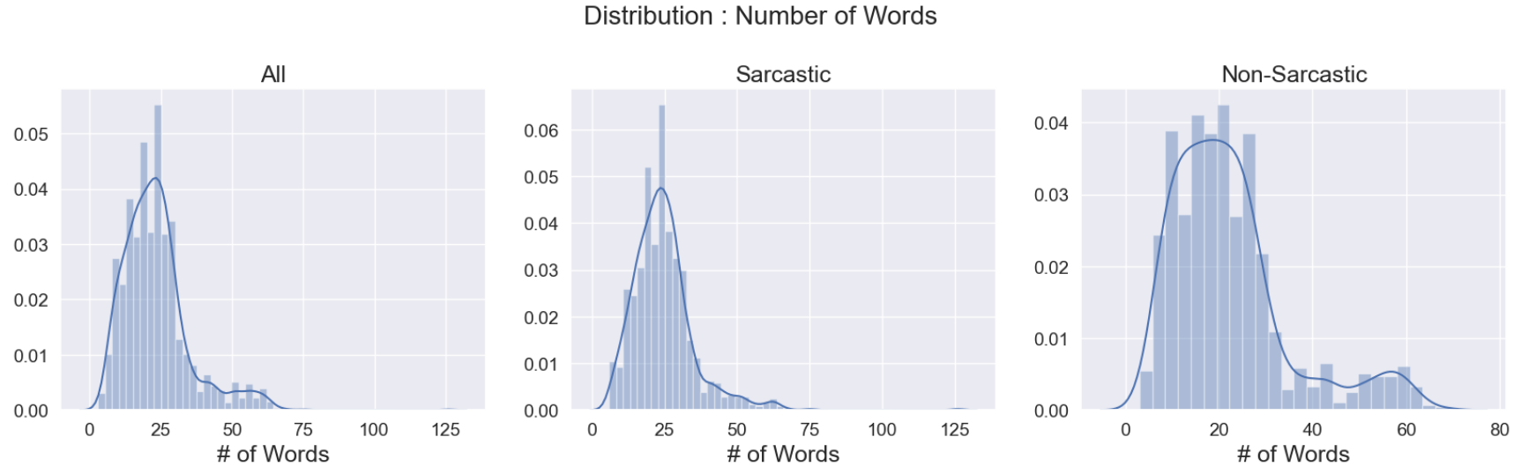

Slide 16
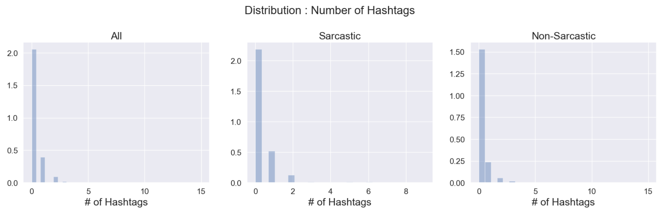

Slide 17
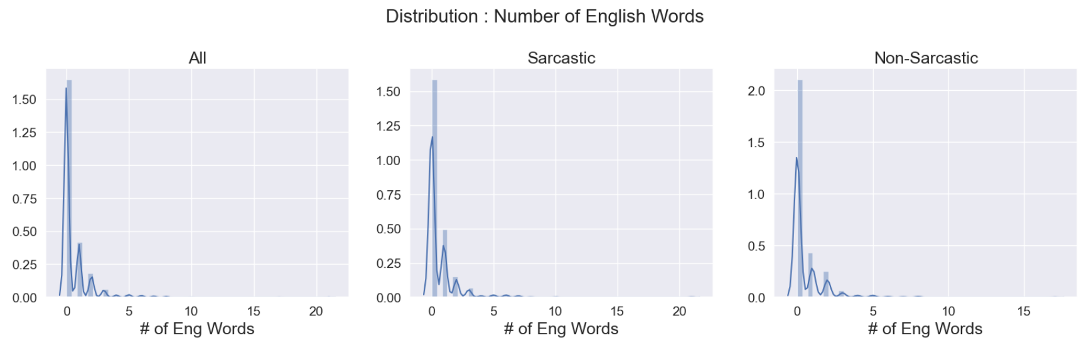

Slide 18
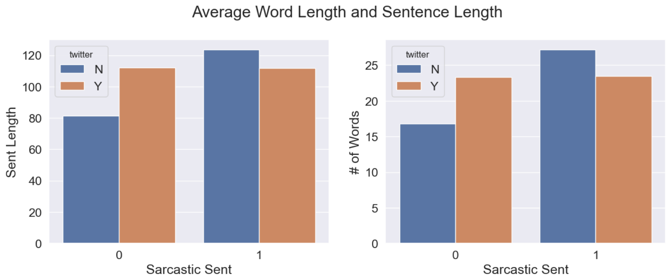

Slide 19
Performance based Metrics

Slide 20
1
Top 10 Best Models
Classifier | Embedding Name | AUC | Accuracy | Recall | Precision | F1
NB | fastTextWiki | 0.80 | 0.76 | 0.78 | 0.75 | 0.76
TT | fastTextWiki | 0.81 | 0.76 | 0.71 | 0.79 | 0.75
NB | IndicFT | 0.77 | 0.74 | 0.70 | 0.76 | 0.73
LR | IndicFT | 0.78 | 0.74 | 0.70 | 0.75 | 0.73
SVC | IndicFT | 0.79 | 0.74 | 0.71 | 0.76 | 0.73
ADB | IndicFT | 0.79 | 0.74 | 0.72 | 0.76 | 0.74
XGB | IndicFT | 0.79 | 0.74 | 0.70 | 0.76 | 0.73
NB | Combined | 0.79 | 0.74 | 0.76 | 0.74 | 0.75
PyrotchTT | mBERT | 0.80 | 0.74 | 0.69 | 0.76 | 0.72
SVC | fastTextWiki | 0.81 | 0.74 | 0.67 | 0.79 | 0.72

Slide 21
2
Bottom 10 Worse Models
Classifier | Embedding Name | AUC | Accuracy | Recall | Precision | F1
ADB | mBERT | 0.56 | 0.53 | 0.67 | 0.52 | 0.59
Perceptron | Word2Vec | 0.52 | 0.52 | 0.47 | 0.52 | 0.49
NB | mBERT | 0.55 | 0.52 | 0.30 | 0.53 | 0.38
DT | BOW | 0.56 | 0.52 | 0.51 | 0.53 | 0.52
NB | BOW | 0.58 | 0.52 | 0.39 | 0.52 | 0.45
Perceptron | mBERT | 0.50 | 0.50 | 0.24 | 0.51 | 0.33
Perceptron | Lexical | 0.50 | 0.50 | 0.00 | 0.00 | 0.00
Perceptron | Combined | 0.50 | 0.50 | 0.01 | 0.50 | 0.02
NB | Word2Vec | 0.64 | 0.50 | 0.95 | 0.50 | 0.66
NB | fastText | 0.66 | 0.50 | 0.95 | 0.50 | 0.66

Slide 22
3
Best Embedding – Average
All Metrics of All Embedding
Classifier | Avg AUC | Avg Acc | Avg Recall | Avg Prec. | Avg F1
RNN | 0.74 | 0.68 | 0.70 | 0.67 | 0.68
CNN | 0.73 | 0.66 | 0.68 | 0.66 | 0.67
RFC | 0.72 | 0.65 | 0.71 | 0.65 | 0.67
SVC | 0.70 | 0.65 | 0.68 | 0.65 | 0.66
GBC | 0.69 | 0.65 | 0.65 | 0.66 | 0.65
XGB | 0.70 | 0.64 | 0.63 | 0.65 | 0.64
LGBM | 0.70 | 0.65 | 0.63 | 0.65 | 0.64
LR | 0.69 | 0.64 | 0.64 | 0.64 | 0.64
ADB | 0.67 | 0.63 | 0.63 | 0.63 | 0.63
DT | 0.62 | 0.60 | 0.66 | 0.60 | 0.63
NB | 0.67 | 0.60 | 0.64 | 0.61 | 0.60
Perceptron | 0.56 | 0.56 | 0.36 | 0.55 | 0.41

Slide 23
4
Best Classifier – Average
All Metrics of All Classifier
Embedding | Avg AUC | Avg Acc | Avg Recall | Avg Prec. | Avg F1
IndicFT | 0.77 | 0.72 | 0.67 | 0.75 | 0.71
Keras_Tokenizer | 0.74 | 0.68 | 0.68 | 0.69 | 0.68
fastTextWiki | 0.76 | 0.69 | 0.64 | 0.73 | 0.67
Word2Vec | 0.64 | 0.59 | 0.74 | 0.58 | 0.64
fastText | 0.64 | 0.58 | 0.75 | 0.57 | 0.64
Combined | 0.74 | 0.68 | 0.59 | 0.70 | 0.62
IndicBERT | 0.64 | 0.61 | 0.59 | 0.62 | 0.59
TFIDF | 0.63 | 0.59 | 0.58 | 0.60 | 0.59
BOW | 0.63 | 0.59 | 0.55 | 0.60 | 0.57
Lexical | 0.67 | 0.62 | 0.56 | 0.58 | 0.56
mBERT | 0.60 | 0.57 | 0.58 | 0.57 | 0.56

Slide 24
5
Task Transfer Learning
Embedding Name | AUC | Accuracy | Recall | Precision | F1
fastTextWiki | 0.81 | 0.76 | 0.71 | 0.79 | 0.75
mBERT (Pytorch) | 0.80 | 0.74 | 0.69 | 0.76 | 0.72
IndicFT | 0.81 | 0.74 | 0.71 | 0.76 | 0.74
mBERT (Transformer) | 0.60 | 0.58 | 0.65 | 0.57 | 0.61
IndicBERT (Transformer) | 0.61 | 0.58 | 0.63 | 0.57 | 0.60

Slide 25
Transfer Embedding Based Metrics

Slide 26
6
Embedding Transfer: fastText Wiki
Classifier | AUC | Accuracy | Recall | Precision | F1
NB | 0.80 | 0.76 | 0.78 | 0.75 | 0.76
TT | 0.81 | 0.76 | 0.71 | 0.79 | 0.75
SVC | 0.81 | 0.74 | 0.67 | 0.79 | 0.72
LR | 0.81 | 0.72 | 0.66 | 0.75 | 0.70
XGB | 0.78 | 0.71 | 0.64 | 0.74 | 0.69
RFC | 0.79 | 0.71 | 0.65 | 0.74 | 0.69
LGBM | 0.78 | 0.70 | 0.63 | 0.72 | 0.67
ADB | 0.79 | 0.70 | 0.65 | 0.73 | 0.69
GBC | 0.78 | 0.69 | 0.62 | 0.72 | 0.67
CNN | 0.74 | 0.65 | 0.74 | 0.63 | 0.68
Perceptron | 0.63 | 0.63 | 0.36 | 0.78 | 0.49
DT | 0.64 | 0.63 | 0.63 | 0.63 | 0.63

Slide 27
7
Embedding Transfer: IndicFT
Classifier | AUC | Accuracy | Recall | Precision | F1
NB | 0.77 | 0.74 | 0.70 | 0.76 | 0.73
LR | 0.78 | 0.74 | 0.70 | 0.75 | 0.73
SVC | 0.79 | 0.74 | 0.71 | 0.76 | 0.73
ADB | 0.79 | 0.74 | 0.72 | 0.76 | 0.74
XGB | 0.79 | 0.74 | 0.70 | 0.76 | 0.73
TT | 0.81 | 0.74 | 0.71 | 0.76 | 0.74
DT | 0.71 | 0.72 | 0.61 | 0.77 | 0.68
Perceptron | 0.72 | 0.72 | 0.56 | 0.81 | 0.66
LGBM | 0.79 | 0.72 | 0.67 | 0.74 | 0.70
GBC | 0.79 | 0.72 | 0.67 | 0.75 | 0.71
RFC | 0.79 | 0.72 | 0.68 | 0.75 | 0.71
CNN | 0.71 | 0.66 | 0.65 | 0.66 | 0.66

Slide 28
9
Embedding Transfer: mBERT
Classifier | AUC | Accuracy | Recall | Precision | F1
DT | 0.63 | 0.62 | 0.65 | 0.61 | 0.63
SVC | 0.63 | 0.60 | 0.66 | 0.59 | 0.63
GBC | 0.64 | 0.60 | 0.65 | 0.60 | 0.62
RFC | 0.64 | 0.60 | 0.65 | 0.59 | 0.62
LR | 0.61 | 0.58 | 0.68 | 0.57 | 0.62
LGBM | 0.63 | 0.58 | 0.64 | 0.57 | 0.60
XGB | 0.61 | 0.57 | 0.62 | 0.56 | 0.59
ADB | 0.56 | 0.53 | 0.67 | 0.52 | 0.59
NB | 0.55 | 0.52 | 0.30 | 0.53 | 0.38
Perceptron | 0.50 | 0.50 | 0.24 | 0.51 | 0.33

Slide 29
10
Embedding Transfer: IndicBERT
Classifier | AUC | Accuracy | Recall | Precision | F1
RFC | 0.71 | 0.70 | 0.70 | 0.70 | 0.70
XGB | 0.71 | 0.66 | 0.65 | 0.67 | 0.66
LGBM | 0.69 | 0.64 | 0.58 | 0.67 | 0.62
GBC | 0.68 | 0.62 | 0.58 | 0.63 | 0.60
DT | 0.62 | 0.60 | 0.62 | 0.60 | 0.61
ADB | 0.64 | 0.60 | 0.59 | 0.60 | 0.59
NB | 0.61 | 0.59 | 0.67 | 0.58 | 0.62
LR | 0.59 | 0.57 | 0.61 | 0.57 | 0.59
Perceptron | 0.56 | 0.56 | 0.22 | 0.67 | 0.33
SVC | 0.60 | 0.56 | 0.65 | 0.55 | 0.59

Slide 30
12
Combined Embedding : fastTestWiki + Lexical Features
Classifier | AUC | Accuracy | Recall | Precision | F1
NB | 0.79 | 0.74 | 0.76 | 0.74 | 0.75
GBC | 0.78 | 0.72 | 0.66 | 0.74 | 0.70
XGB | 0.80 | 0.71 | 0.65 | 0.74 | 0.69
LGBM | 0.78 | 0.70 | 0.63 | 0.72 | 0.67
ADB | 0.78 | 0.70 | 0.64 | 0.74 | 0.68
LR | 0.80 | 0.70 | 0.61 | 0.74 | 0.67
RFC | 0.80 | 0.70 | 0.63 | 0.74 | 0.68
SVC | 0.75 | 0.68 | 0.70 | 0.67 | 0.68
DT | 0.63 | 0.63 | 0.63 | 0.63 | 0.63
Perceptron | 0.50 | 0.50 | 0.01 | 0.50 | 0.02

Slide 31
Non-Transfer Embedding Based Metrics

Slide 32
8
fastText Embedding
Classifier | AUC | Accuracy | Recall | Precision | F1
XGB | 0.66 | 0.64 | 0.61 | 0.64 | 0.63
GBC | 0.63 | 0.62 | 0.74 | 0.59 | 0.66
LGBM | 0.66 | 0.62 | 0.65 | 0.61 | 0.63
SVC | 0.67 | 0.61 | 0.75 | 0.59 | 0.66
LR | 0.65 | 0.58 | 0.83 | 0.55 | 0.66
Perceptron | 0.56 | 0.56 | 0.65 | 0.56 | 0.60
ADB | 0.61 | 0.56 | 0.52 | 0.56 | 0.54
RFC | 0.71 | 0.56 | 0.90 | 0.54 | 0.67
DT | 0.54 | 0.54 | 0.87 | 0.52 | 0.65
NB | 0.66 | 0.50 | 0.95 | 0.50 | 0.66

Slide 33
11
Lexical Feature Engineering
Classifier | AUC | Accuracy | Recall | Precision | F1
LGBM | 0.69 | 0.66 | 0.70 | 0.64 | 0.67
GBC | 0.71 | 0.66 | 0.71 | 0.65 | 0.68
SVC | 0.72 | 0.66 | 0.69 | 0.66 | 0.67
RFC | 0.72 | 0.66 | 0.75 | 0.64 | 0.69
LR | 0.74 | 0.66 | 0.57 | 0.70 | 0.63
ADB | 0.68 | 0.62 | 0.63 | 0.62 | 0.63
DT | 0.64 | 0.61 | 0.60 | 0.61 | 0.61
XGB | 0.64 | 0.60 | 0.63 | 0.59 | 0.61
NB | 0.69 | 0.58 | 0.32 | 0.67 | 0.43
Perceptron | 0.50 | 0.50 | 0.00 | 0.00 | 0.00

Slide 34
Word2Vec Embedding
Classifier | AUC | Accuracy | Recall | Precision | F1
LGBM | 0.68 | 0.64 | 0.72 | 0.62 | 0.66
ADB | 0.64 | 0.62 | 0.71 | 0.61 | 0.65
GBC | 0.64 | 0.62 | 0.70 | 0.61 | 0.65
SVC | 0.67 | 0.62 | 0.75 | 0.60 | 0.66
XGB | 0.69 | 0.62 | 0.63 | 0.62 | 0.63
LR | 0.64 | 0.61 | 0.76 | 0.58 | 0.66
DT | 0.60 | 0.58 | 0.79 | 0.56 | 0.65
RFC | 0.69 | 0.57 | 0.89 | 0.54 | 0.67
Perceptron | 0.52 | 0.52 | 0.47 | 0.52 | 0.49
NB | 0.64 | 0.50 | 0.95 | 0.50 | 0.66

Slide 35
BOW Embedding
Classifier | AUC | Accuracy | Recall | Precision | F1
RFC | 0.68 | 0.64 | 0.68 | 0.62 | 0.65
ADB | 0.61 | 0.62 | 0.61 | 0.62 | 0.62
LGBM | 0.65 | 0.62 | 0.56 | 0.63 | 0.59
GBC | 0.65 | 0.62 | 0.55 | 0.63 | 0.59
SVC | 0.69 | 0.62 | 0.61 | 0.63 | 0.62
XGB | 0.69 | 0.62 | 0.59 | 0.62 | 0.61
LR | 0.63 | 0.60 | 0.50 | 0.62 | 0.56
Perceptron | 0.55 | 0.55 | 0.51 | 0.55 | 0.53
DT | 0.56 | 0.52 | 0.51 | 0.53 | 0.52
NB | 0.58 | 0.52 | 0.39 | 0.52 | 0.45

Slide 36
TFIDF Embedding
Classifier | AUC | Accuracy | Recall | Precision | F1
GBC | 0.63 | 0.62 | 0.57 | 0.64 | 0.60
SVC | 0.68 | 0.62 | 0.58 | 0.64 | 0.61
Perceptron | 0.60 | 0.60 | 0.61 | 0.60 | 0.60
LR | 0.64 | 0.60 | 0.52 | 0.61 | 0.56
LGBM | 0.66 | 0.60 | 0.54 | 0.62 | 0.58
RFC | 0.66 | 0.60 | 0.56 | 0.61 | 0.58
DT | 0.61 | 0.58 | 0.73 | 0.57 | 0.64
NB | 0.60 | 0.56 | 0.53 | 0.56 | 0.54
ADB | 0.60 | 0.56 | 0.55 | 0.56 | 0.56
XGB | 0.65 | 0.56 | 0.59 | 0.56 | 0.58

Slide 37
Transfer Learning Based Metrics

Slide 38
14
Top 10 – Transfer Learning (Task & Embedding) Models
TL Type | Embedding Name | Classifier | AUC | Accuracy | Recall | Precision | F1
EMB | fastTextWiki | NB | 0.80 | 0.76 | 0.78 | 0.75 | 0.76
Task | fastTextWiki | TT | 0.81 | 0.76 | 0.71 | 0.79 | 0.75
EMB | IndicFT | NB | 0.77 | 0.74 | 0.70 | 0.76 | 0.73
EMB | IndicFT | LR | 0.78 | 0.74 | 0.70 | 0.75 | 0.73
EMB | IndicFT | SVC | 0.79 | 0.74 | 0.71 | 0.76 | 0.73
EMB | IndicFT | ADB | 0.79 | 0.74 | 0.72 | 0.76 | 0.74
EMB | IndicFT | XGB | 0.79 | 0.74 | 0.70 | 0.76 | 0.73
EMB | Combined | NB | 0.79 | 0.74 | 0.76 | 0.74 | 0.75
Task | mBERT (Pytorch) | PyrotchTT | 0.80 | 0.74 | 0.69 | 0.76 | 0.72
EMB | fastTextWiki | SVC | 0.81 | 0.74 | 0.67 | 0.79 | 0.72

Slide 39
13
Top 10 – No Transfer Learning Models
Embedding Name | Classifier | AUC | Accuracy | Recall | Precision | F1
Keras_Tokenizer | CNN | 0.74 | 0.68 | 0.65 | 0.70 | 0.67
Keras_Tokenizer | RNN | 0.74 | 0.68 | 0.70 | 0.67 | 0.68
Lexical | LGBM | 0.69 | 0.66 | 0.70 | 0.64 | 0.67
Lexical | GBC | 0.71 | 0.66 | 0.71 | 0.65 | 0.68
Lexical | SVC | 0.72 | 0.66 | 0.69 | 0.66 | 0.67
Lexical | RFC | 0.72 | 0.66 | 0.75 | 0.64 | 0.69
Lexical | LR | 0.74 | 0.66 | 0.57 | 0.70 | 0.63
fastText | XGB | 0.66 | 0.64 | 0.61 | 0.64 | 0.63
Word2Vec | LGBM | 0.68 | 0.64 | 0.72 | 0.62 | 0.66
BOW | RFC | 0.68 | 0.64 | 0.68 | 0.62 | 0.65

Slide 40
Classifier Based Metrics

Slide 41
15
Naïve Bayesian
Embedding Name | AUC | Accuracy | Recall | Precision | F1
fastTextWiki | 0.80 | 0.76 | 0.78 | 0.75 | 0.76
IndicFT | 0.77 | 0.74 | 0.70 | 0.76 | 0.73
Combined | 0.79 | 0.74 | 0.76 | 0.74 | 0.75
IndicBERT | 0.61 | 0.59 | 0.67 | 0.58 | 0.62
Lexical | 0.69 | 0.58 | 0.32 | 0.67 | 0.43
TFIDF | 0.60 | 0.56 | 0.53 | 0.56 | 0.54
mBERT | 0.55 | 0.52 | 0.30 | 0.53 | 0.38
BOW | 0.58 | 0.52 | 0.39 | 0.52 | 0.45
Word2Vec | 0.64 | 0.50 | 0.95 | 0.50 | 0.66
fastText | 0.66 | 0.50 | 0.95 | 0.50 | 0.66

Slide 42
16
Gradient Boost Classifier (GBC)
Embedding Name | AUC | Accuracy | Recall | Precision | F1
Combined | 0.78 | 0.72 | 0.66 | 0.74 | 0.70
IndicFT | 0.79 | 0.72 | 0.67 | 0.75 | 0.71
fastTextWiki | 0.78 | 0.69 | 0.62 | 0.72 | 0.67
Lexical | 0.71 | 0.66 | 0.71 | 0.65 | 0.68
TFIDF | 0.63 | 0.62 | 0.57 | 0.64 | 0.60
fastText | 0.63 | 0.62 | 0.74 | 0.59 | 0.66
Word2Vec | 0.64 | 0.62 | 0.70 | 0.61 | 0.65
BOW | 0.65 | 0.62 | 0.55 | 0.63 | 0.59
IndicBERT | 0.68 | 0.62 | 0.58 | 0.63 | 0.60
mBERT | 0.64 | 0.60 | 0.65 | 0.60 | 0.62

Slide 43
17
Light Gradient Boost Model (LGBM)
Embedding Name | AUC | Accuracy | Recall | Precision | F1
IndicFT | 0.79 | 0.72 | 0.67 | 0.74 | 0.70
fastTextWiki | 0.78 | 0.70 | 0.63 | 0.72 | 0.67
Combined | 0.78 | 0.70 | 0.63 | 0.72 | 0.67
Lexical | 0.69 | 0.66 | 0.70 | 0.64 | 0.67
Word2Vec | 0.68 | 0.64 | 0.72 | 0.62 | 0.66
IndicBERT | 0.69 | 0.64 | 0.58 | 0.67 | 0.62
BOW | 0.65 | 0.62 | 0.56 | 0.63 | 0.59
fastText | 0.66 | 0.62 | 0.65 | 0.61 | 0.63
TFIDF | 0.66 | 0.60 | 0.54 | 0.62 | 0.58
mBERT | 0.63 | 0.58 | 0.64 | 0.57 | 0.60

Slide 44
18
Logistic Regression
Embedding Name | AUC | Accuracy | Recall | Precision | F1
IndicFT | 0.78 | 0.74 | 0.70 | 0.75 | 0.73
fastTextWiki | 0.81 | 0.72 | 0.66 | 0.75 | 0.70
Combined | 0.80 | 0.70 | 0.61 | 0.74 | 0.67
Lexical | 0.74 | 0.66 | 0.57 | 0.70 | 0.63
Word2Vec | 0.64 | 0.61 | 0.76 | 0.58 | 0.66
BOW | 0.63 | 0.60 | 0.50 | 0.62 | 0.56
TFIDF | 0.64 | 0.60 | 0.52 | 0.61 | 0.56
mBERT | 0.61 | 0.58 | 0.68 | 0.57 | 0.62
fastText | 0.65 | 0.58 | 0.83 | 0.55 | 0.66
IndicBERT | 0.59 | 0.57 | 0.61 | 0.57 | 0.59

Slide 45
19
Random Forest Classifier (RFC)
Embedding Name | AUC | Accuracy | Recall | Precision | F1
IndicFT | 0.79 | 0.72 | 0.68 | 0.75 | 0.71
fastTextWiki | 0.79 | 0.71 | 0.65 | 0.74 | 0.69
IndicBERT | 0.71 | 0.70 | 0.70 | 0.70 | 0.70
Combined | 0.80 | 0.70 | 0.63 | 0.74 | 0.68
Lexical | 0.72 | 0.66 | 0.75 | 0.64 | 0.69
BOW | 0.68 | 0.64 | 0.68 | 0.62 | 0.65
mBERT | 0.64 | 0.60 | 0.65 | 0.59 | 0.62
TFIDF | 0.66 | 0.60 | 0.56 | 0.61 | 0.58
Word2Vec | 0.69 | 0.57 | 0.89 | 0.54 | 0.67
fastText | 0.71 | 0.56 | 0.90 | 0.54 | 0.67

Slide 46
20
Support Vector Machine (SVM)
Embedding Name | AUC | Accuracy | Recall | Precision | F1
IndicFT | 0.79 | 0.74 | 0.71 | 0.76 | 0.73
fastTextWiki | 0.81 | 0.74 | 0.67 | 0.79 | 0.72
Combined | 0.75 | 0.68 | 0.70 | 0.67 | 0.68
Lexical | 0.72 | 0.66 | 0.69 | 0.66 | 0.67
Word2Vec | 0.67 | 0.62 | 0.75 | 0.60 | 0.66
TFIDF | 0.68 | 0.62 | 0.58 | 0.64 | 0.61
BOW | 0.69 | 0.62 | 0.61 | 0.63 | 0.62
fastText | 0.67 | 0.61 | 0.75 | 0.59 | 0.66
mBERT | 0.63 | 0.60 | 0.66 | 0.59 | 0.63
IndicBERT | 0.60 | 0.56 | 0.65 | 0.55 | 0.59

Slide 47
21
Perceptron
Embedding Name | AUC | Accuracy | Recall | Precision | F1
IndicFT | 0.72 | 0.72 | 0.56 | 0.81 | 0.66
fastTextWiki | 0.63 | 0.63 | 0.36 | 0.78 | 0.49
TFIDF | 0.60 | 0.60 | 0.61 | 0.60 | 0.60
IndicBERT | 0.56 | 0.56 | 0.22 | 0.67 | 0.33
fastText | 0.56 | 0.56 | 0.65 | 0.56 | 0.60
BOW | 0.55 | 0.55 | 0.51 | 0.55 | 0.53
Word2Vec | 0.52 | 0.52 | 0.47 | 0.52 | 0.49
mBERT | 0.50 | 0.50 | 0.24 | 0.51 | 0.33
Lexical | 0.50 | 0.50 | 0.00 | 0.00 | 0.00
Combined | 0.50 | 0.50 | 0.01 | 0.50 | 0.02

Slide 48
22
AdaBoost
Embedding Name | AUC | Accuracy | Recall | Precision | F1
IndicFT | 0.79 | 0.74 | 0.72 | 0.76 | 0.74
Combined | 0.78 | 0.70 | 0.64 | 0.74 | 0.68
fastTextWiki | 0.79 | 0.70 | 0.65 | 0.73 | 0.69
BOW | 0.61 | 0.62 | 0.61 | 0.62 | 0.62
Word2Vec | 0.64 | 0.62 | 0.71 | 0.61 | 0.65
Lexical | 0.68 | 0.62 | 0.63 | 0.62 | 0.63
IndicBERT | 0.64 | 0.60 | 0.59 | 0.60 | 0.59
TFIDF | 0.60 | 0.56 | 0.55 | 0.56 | 0.56
fastText | 0.61 | 0.56 | 0.52 | 0.56 | 0.54
mBERT | 0.56 | 0.53 | 0.67 | 0.52 | 0.59

Slide 49
XG Boost
Embedding Name | AUC | Accuracy | Recall | Precision | F1
IndicFT | 0.79 | 0.74 | 0.70 | 0.76 | 0.73
fastTextWiki | 0.78 | 0.71 | 0.64 | 0.74 | 0.69
Combined | 0.80 | 0.71 | 0.65 | 0.74 | 0.69
IndicBERT | 0.71 | 0.66 | 0.65 | 0.67 | 0.66
fastText | 0.66 | 0.64 | 0.61 | 0.64 | 0.63
Word2Vec | 0.69 | 0.62 | 0.63 | 0.62 | 0.63
BOW | 0.69 | 0.62 | 0.59 | 0.62 | 0.61
Lexical | 0.64 | 0.60 | 0.63 | 0.59 | 0.61
mBERT | 0.61 | 0.57 | 0.62 | 0.56 | 0.59
TFIDF | 0.65 | 0.56 | 0.59 | 0.56 | 0.58

Slide 50
Decision Tree
Embedding Name | AUC | Accuracy | Recall | Precision | F1
IndicFT | 0.71 | 0.72 | 0.61 | 0.77 | 0.68
Combined | 0.63 | 0.63 | 0.63 | 0.63 | 0.63
fastTextWiki | 0.64 | 0.63 | 0.63 | 0.63 | 0.63
mBERT | 0.63 | 0.62 | 0.65 | 0.61 | 0.63
Lexical | 0.64 | 0.61 | 0.60 | 0.61 | 0.61
IndicBERT | 0.62 | 0.60 | 0.62 | 0.60 | 0.61
Word2Vec | 0.60 | 0.58 | 0.79 | 0.56 | 0.65
TFIDF | 0.61 | 0.58 | 0.73 | 0.57 | 0.64
fastText | 0.54 | 0.54 | 0.87 | 0.52 | 0.65
BOW | 0.56 | 0.52 | 0.51 | 0.53 | 0.52

Slide 51
23
CNN and RNN
Classifier | Embedding Name | AUC | Accuracy | Recall | Precision | F1
CNN | Keras_Tokenizer | 0.74 | 0.68 | 0.65 | 0.70 | 0.67
RNN | Keras_Tokenizer | 0.74 | 0.68 | 0.70 | 0.67 | 0.68
CNN | IndicFT | 0.71 | 0.66 | 0.65 | 0.66 | 0.66
CNN | fastTextWiki | 0.74 | 0.65 | 0.74 | 0.63 | 0.68

