Slide 1

Leveraging NLP for Mining Biomedical Data: Domain-specific Transformer Models for Drug-Protein Relation Extraction
Avisha Das, CPRIT Postdoctoral Research Fellow
School: School of Biomedical Informatics
Co-Authors: Zhao Li, Qiang Wei, Jianfu Li, Liang-Chin Huang, Yan Hu, Rongbin Li, W. Jim Zheng, Hua Xu

Slide 2
Agenda
Motivation
Task Overview
Models
Results
Conclusion

Slide 3
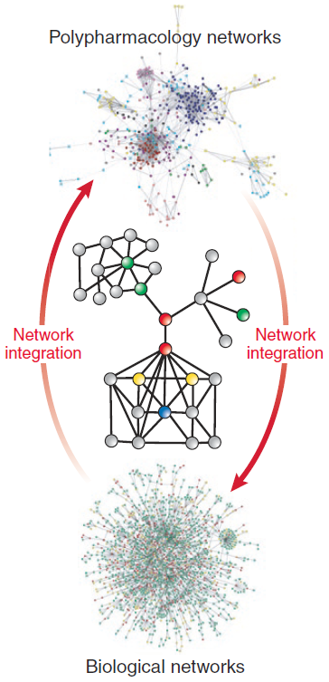
Motivation
Network pharmacology has been used to accelerate the process of drug discovery
Drug target databases
DrugBank, TTD, KEGG, CTD, DGIdb, DrugCentral, STITCH, TDR Targets,
Drug Target Commons…
Mode of action (MoA) is usually unknown
Automated methods to extract drug-protein relations
from biomedical literature
Drug
?
P
Group: Zhao Li, Qiang Wei, Jianfu Li, Liang-Chin Huang, Yan Hu, Rongbin Li, W. Jim Zheng, Hua Xu

Slide 4
Biocreative VII Challenge
Participated in the Track 1 – DrugProt Challenge
Goal:
Extract Drug-Protein relations from biomedical literature
Importance:
Quick identification of potential treatments
Repurposing existing drugs for illnesses

Slide 5
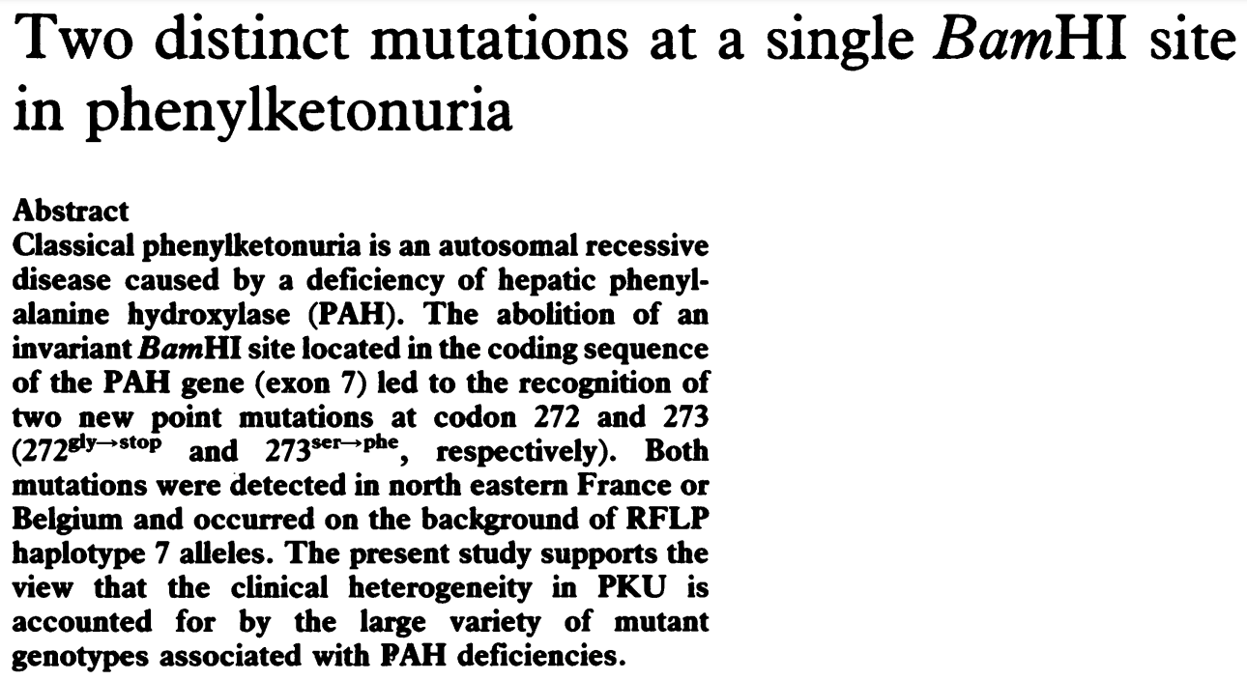
Example of Named Entities and Relations
D010661
D010661
D030342
OMIM:261600
5053
5053
rs62514953
rs62514952
Disease
D010661
Gene
Variant
OMIM:261600
https://pubmed.ncbi.nlm.nih.gov/1671881/

Slide 6
Brief Overview of DrugProt Task
Track 1: Text mining drug/chemical-protein interactions
Sub Tracks:
Main SubTrack DrugProt Corpus
Large Scale SubTrack

Slide 7
Brief Overview of DrugProt Task
Track 1: Text mining drug/chemical-protein interactions
Sub Tracks:
Main Track DrugProt Corpus
Large Scale SubTrack
 | Training | Development | Test
Documents | 3,500 | 750 | 10,750
Tokens | 1001168 | 199620 | 182908
Annotated Entities | 89529 | 18858 | 289664
Annotated Relations | 17288 | 3765 | -

Slide 8
Brief Overview of DrugProt Task
Track 1: Text mining drug/chemical-protein interactions
Sub Tracks:
Main Track DrugProt Corpus
Large Scale SubTrack
2,366,081 records (2.4 Million) are provided
Total of 53,993,602 entity annotations
No labels for the entity relations

Slide 9
Brief Overview of DrugProt Task
13 types of interactions
INDIRECT-REGULATOR, INDIRECT-UPREGULATOR, DIRECT-REGULATOR, ACTIVATOR, INHIBITOR, AGONIST, ANTAGONIST, AGONIST-ACTIVATOR, AGONIST- INHIBITOR, PRODUCT-OF, SUBSTRATE, SUBSTRATE_ PRODUCT-OF, PART-OF

Slide 10
Data Preprocessing
Preprocessing:
CLAMP Tool¹ for sentence boundary detection.
Training Set/Cross Validation:
Pooled the Training and Development (3,500 + 750 abstracts)
Randomly split them into ten folds
Each set 425 abstracts
Acts as its own development set during training
¹ “CLAMP – A Toolkit for efficiently building customized clinical natural language processing pipelines,” E. Soysal, et al., Journal of the American Medical Informatics Association

Slide 11
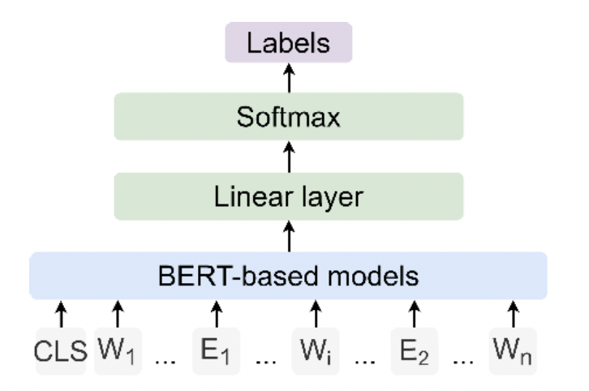
Biomedical BERT-based Models
Models 1 and 2: BioM-ALBERT_{xxlarge} model
Pre-trained on PubMed abstracts and PMC full article
Two fine-tuned versions based on overlapped chemical and gene entities:
BioM-ALBERT 1: Differentiated the overlapped chemical and gene entities
BioM-ALBERT 2: Ignored the overlapped chemical and gene entities
Model 3: BioBERT_{large} model
BERT weights and fine-tuned on PubMed abstracts and PMC full article
Model 4: PubMedBERT model
Trained from scratch on PubMed Abstracts
Model 5: BioM-BERT model
Trained on PubMed abstracts and PMC

Slide 12
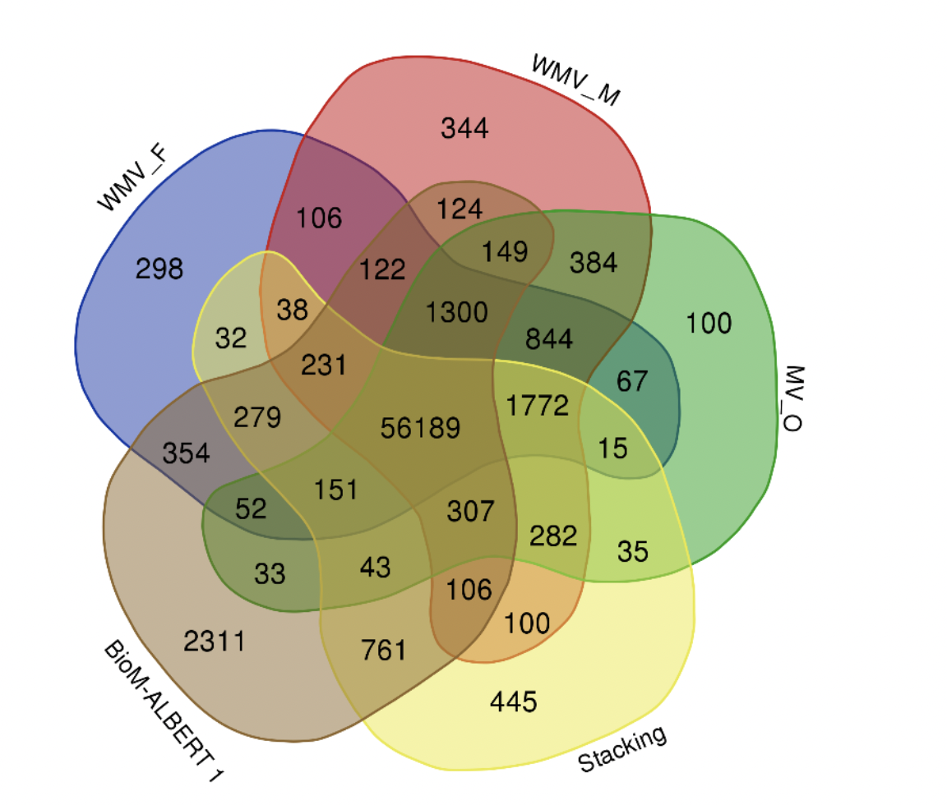
Ensemble Learning
Majority Voting
Weighted Majority Voting
Stacking
Overlaps among the five submissions for the test set.
WMV_F: fold-first weighted majority voting;
WMV_M: model-first weighted majority voting;
MV_O: overall majority voting

Slide 13
Ensemble Learning
Majority Voting
Weighted Majority
Voting
Stacking
Model-first:
Pooled the results from the ten folds for each model, kept relations >= 5 votes
Pooled the voting results from the five models, kept relations >= 3 votes
Fold-first:
Pooled the results from the five models for each fold, kept relations >= 3 votes
Pooled the voting results from the ten folds, kept relations >= 5 votes
Overall:
Pool the 50 prediction results from the five models for the ten folds
Then kept the relations >= 25 votes.

Slide 14

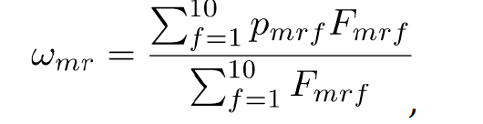
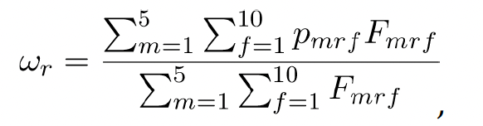
Ensemble Learning
Majority Voting
Weighted Majority
Voting
Assigned each vote a different weight
Based on performance of its relation type in different training sets
Stacking
Model-first:
Fold-first:
Overall:

Slide 15
Ensemble Learning
Majority Voting
Weighted Majority Voting
Stacking
Using the prediction results from the five BERT-based models as binary features
0 for negative and 1 for positive
Trained a J48 decision tree using WEKA
Pooled the results from each training set
Kept the relations having >= 5 votes.

Slide 16
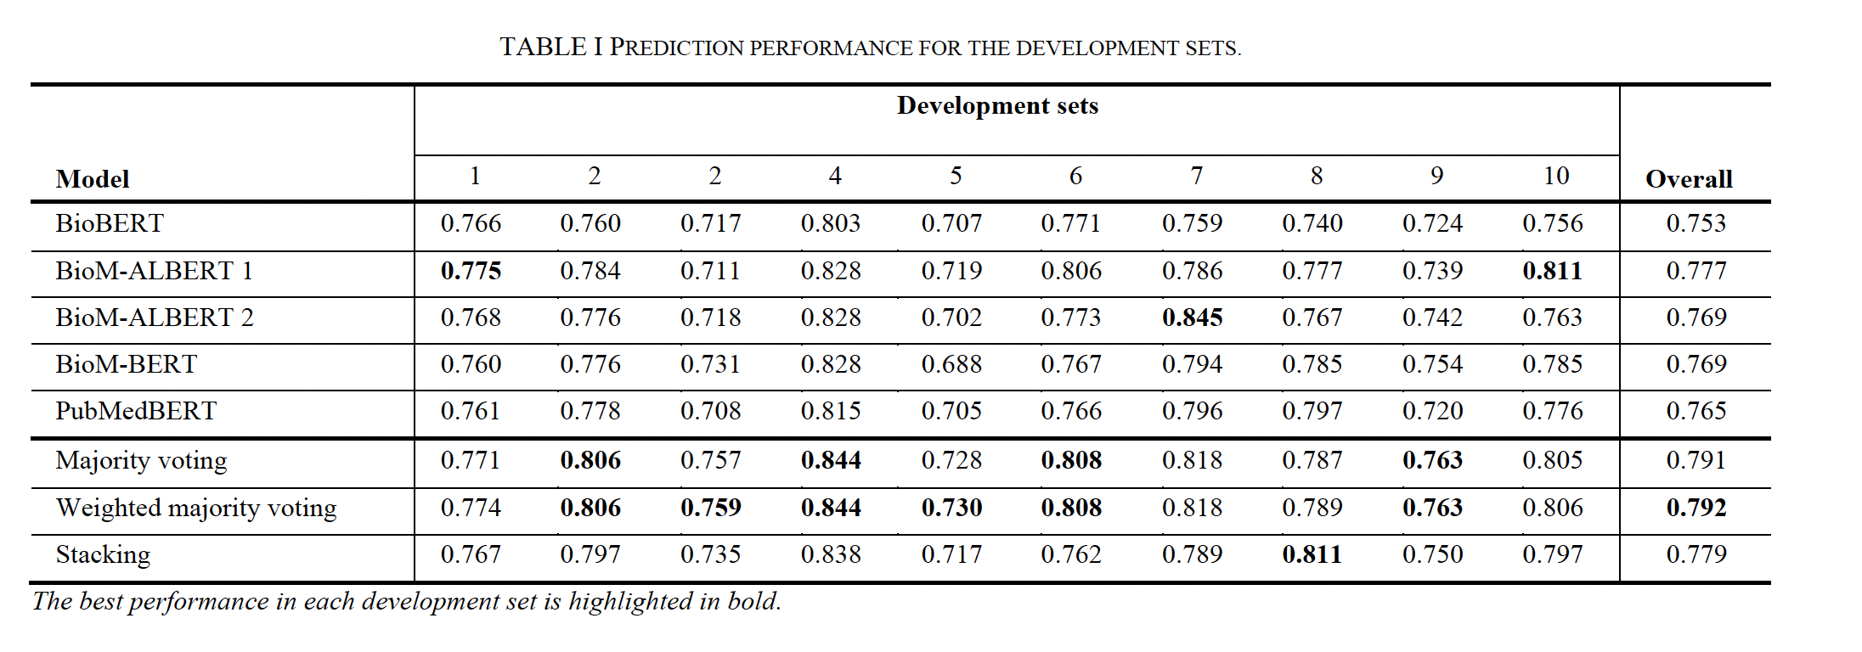
Results
Performance on Ten development sets

Slide 17
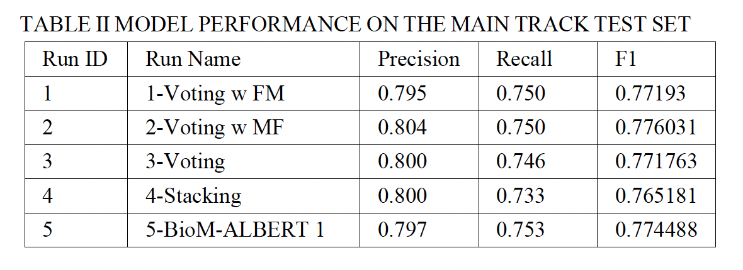
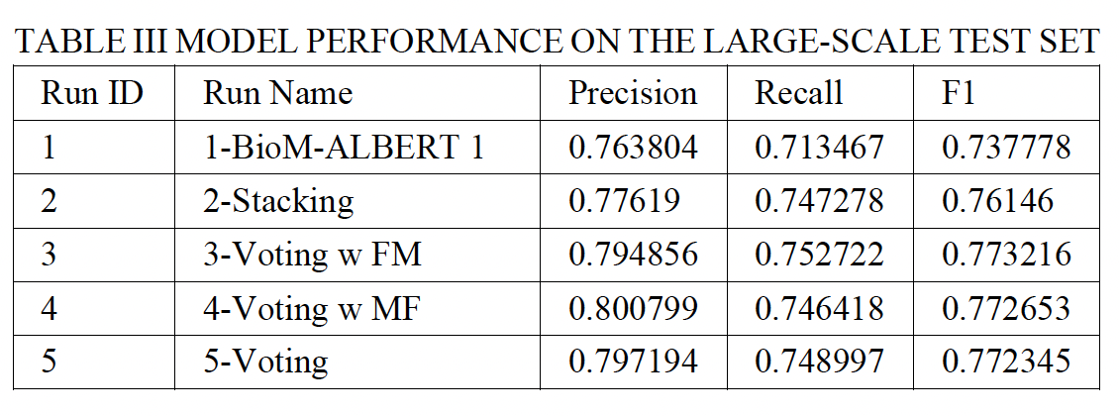
Results
Performance on the Test Sets

Slide 18
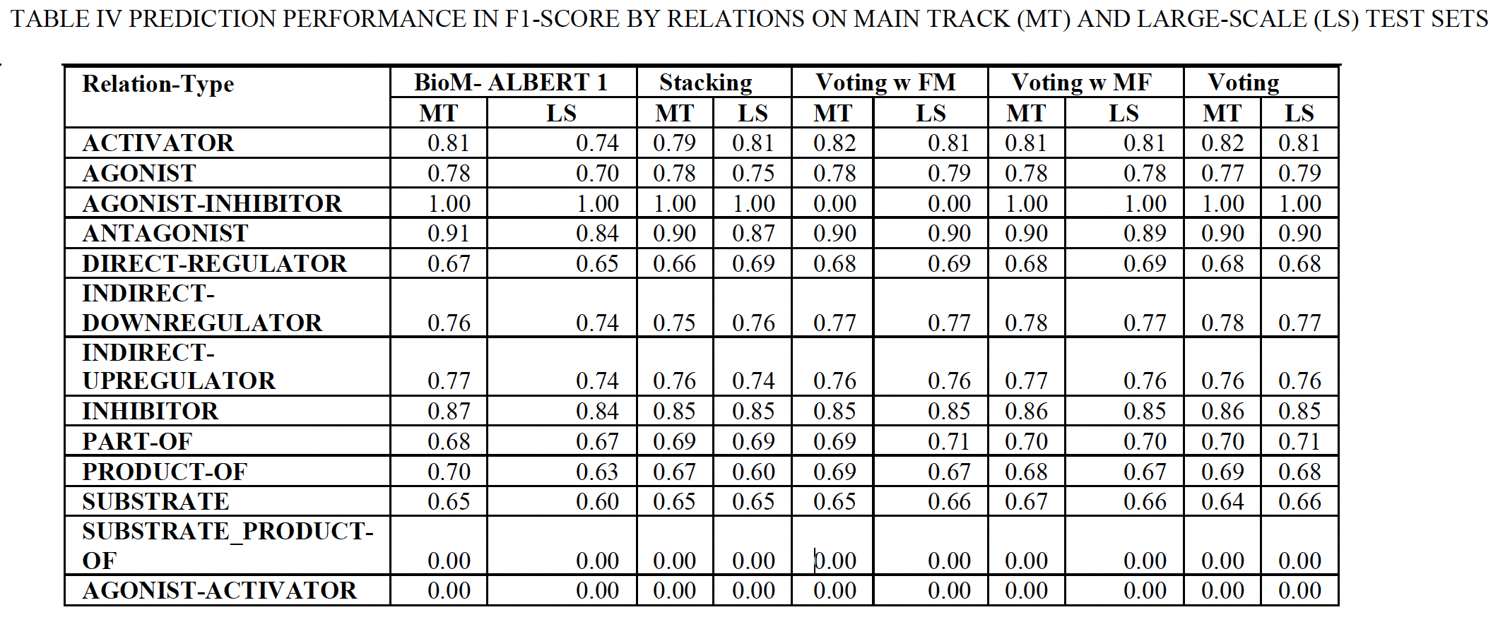
Results
Performance on Main and Large-scale Test Sets by Relation

Slide 19
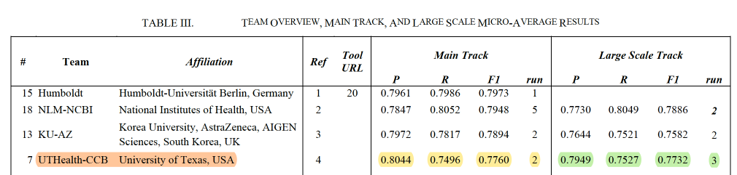
Results
4th
2nd
Source: Overview of DrugProt BioCreative VII track: quality evaluation and large scale text mining of drug - gene/ protein relations, Miranda et al.

Slide 20
Summary
Domain-specific transformer models achieve reasonable scores
Our best system performances
Main subtrack – Micro-averaged F1-score of 77.60%
Large scale subtrack - Micro-averaged F1-score of 77.32%
Ensemble Modeling enhances the effectiveness of deep learning-based approaches
Model-first Weighted Majority Voting performs the best for main subtrack
Fold-first Weighted Majority Voting performs the best for large scale subtrack

Slide 21
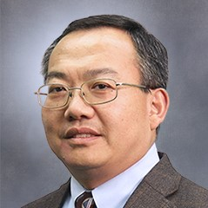
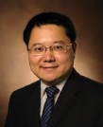
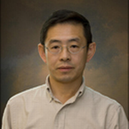
Acknowledgements
Current Mentors:
Co-Mentor:
Dr. W. Jim Zheng
Professor, SBMI
Dr. Hua Xu
Professor, SBMI
Dr. Zhiqiang An
Director, TTI
Also, huge thanks to:
Dr. Liang-Chin Huang, Senior Data Scientist, Melax Tech
Dr. Jianfu Li, Research Scientist, SBMI
Dr. Qiang Wei, Postdoctoral Scholar, SBMI
Zhao Li, Doctoral Candidate, SBMI
Note: Dr. Das is a CPRIT Postdoctoral Fellow in the Biomedical Informatics, Genomics and Translational Cancer Research Training Program (BIG-TCR) funded by Cancer Prevention & Research Institute of Texas (CPRIT RP210045). Dr. Das received the CPRIT Fellowship in the Biomedical Informatics, Genomics and Translational Cancer Research Training Program (BIG-TCR) funded by Cancer Prevention & Research Institute of Texas (CPRIT RP210045). We thank the support from the Cancer Prevention and Research Institute of Texas (CPRIT RP210045).

