Slide 1
Natural Language Understanding and Generation
Avisha Das, Ph.D.
Postdoctoral Fellow, UTHealth Houston
On behalf of Dr. Rakesh Verma
Advanced Natural Language Processing

Slide 2
Natural Language Understanding (NLU)
What is it?
Often refers to full comprehension/semantic processing of language
Here, natural language understanding is used to contrast with natural language generation (NLG)
UNDERSTANDING | GENERATION
Analyses (Parse trees, Logical forms, discourse segmentation, etc.)
Non-linguistic input (logical forms, database entries, etc.) or text
Text
Text

Slide 3
Natural Language Understanding (NLG)
What is it?
A process of constructing natural language outputs from non-linguistic inputs or text
Mapping some communication goal to some surface utterance that satisfies the goal
Some example tasks
Conversational Agents
Content Generation
Summarization
Machine Translation

Slide 4
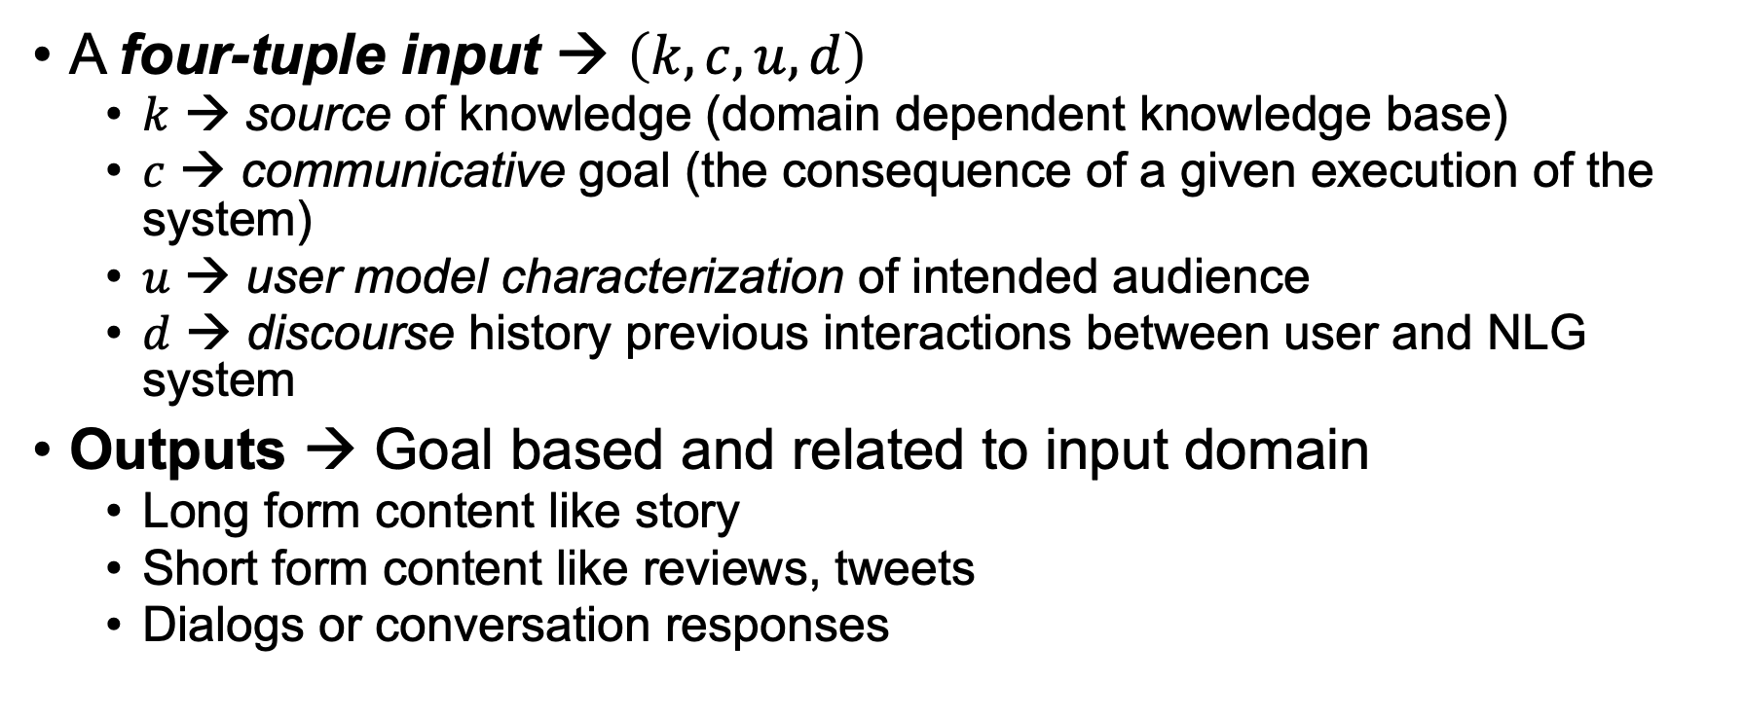
Inputs and Outputs to an NLG system
A four-tuple input → $\left(k, c, u, d\right)$
$k$ → source of knowledge (domain dependent knowledge base)
$c$ → communicative goal (the consequence of a given execution of the system)
$u$ → user model characterization of intended audience
$d$ → discourse history previous interactions between user and NLG system
Outputs → Goal based and related to input domain
Long form content like story
Short form content like reviews, tweets
Dialogs or conversation responses

Slide 5
NLG Systems Architecture
Control Data
Input Data
Output Data
Document Planning
Micro -planning
Realization
Content Determination
Lexical Choice
Referring Expressions
Document Structuring
Aggregation

Slide 6
Stages of NLG
The following different stages of Natural Language Generation can be identified:
Content Determination → Deciding what information to mention in the text
Document Structuring → Imposing an order and structure over the text
Lexical Choice → Determining the particular words to be used to express concepts and relations
Referring Expression Generation → What properties should be used in referring to an entity
Aggregation → Combining chunks of information into sentences.
Realization → Mapping underlying content of text to a grammatically correct sentence that expresses the desired meaning

Slide 7
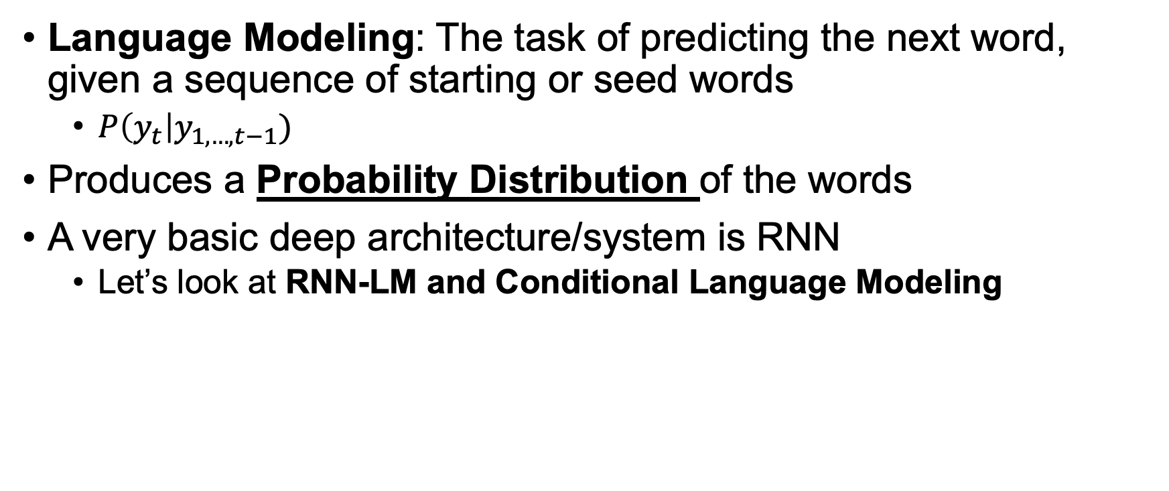
Building block of NLG
Language Modeling: The task of predicting the next word, given a sequence of starting or seed words
$P\left(y_{t}\right|y_{1,…,t−1})$
Produces a Probability Distribution of the words
A very basic deep architecture/system is RNN
Let’s look at RNN-LM and Conditional Language Modeling

Slide 8
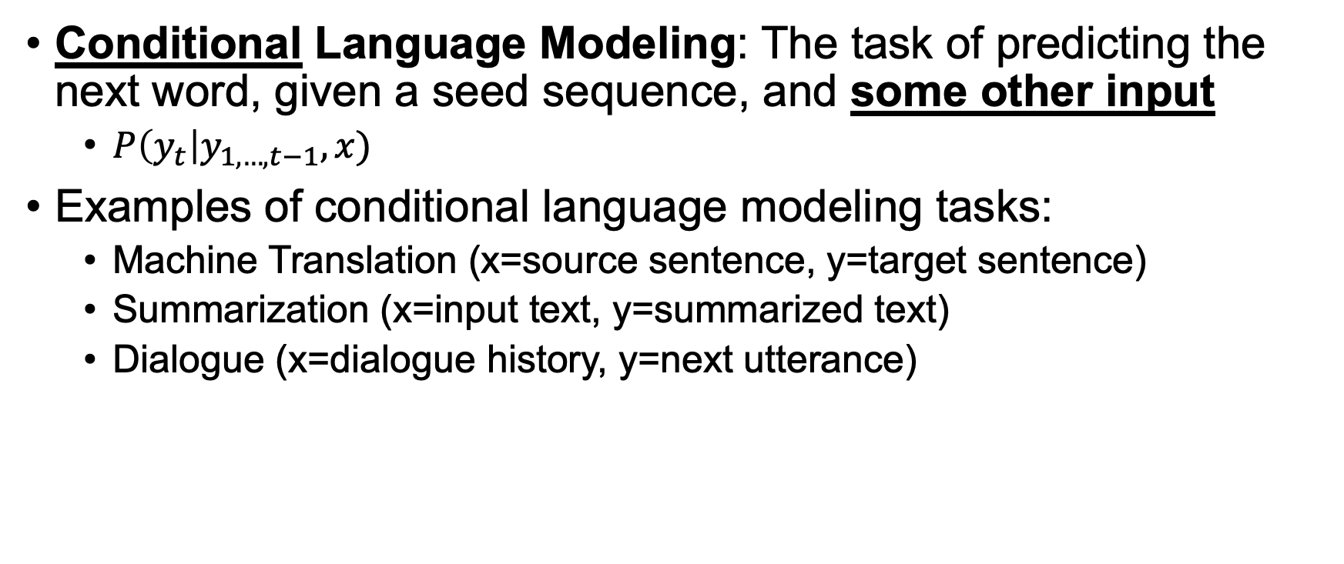
Building block of NLG
Conditional Language Modeling: The task of predicting the next word, given a seed sequence, and some other input
$P\left(y_{t}\right|y_{1,…,t−1}, x)$
Examples of conditional language modeling tasks:
Machine Translation (x=source sentence, y=target sentence)
Summarization (x=input text, y=summarized text)
Dialogue (x=dialogue history, y=next utterance)

Slide 9
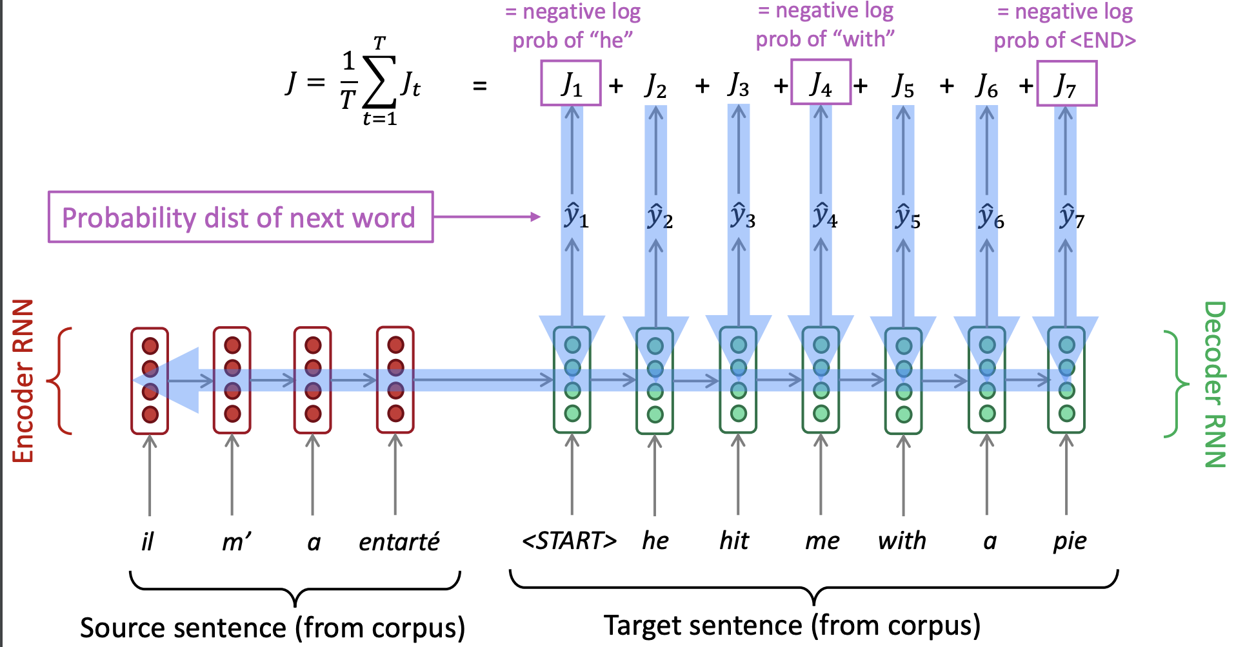
RNN-LM for Machine Translation

Slide 10
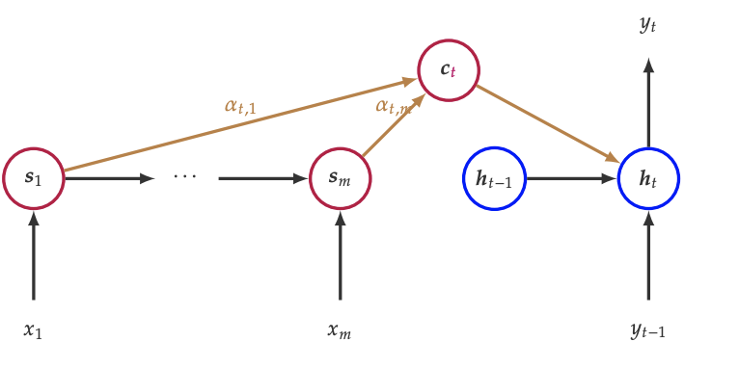

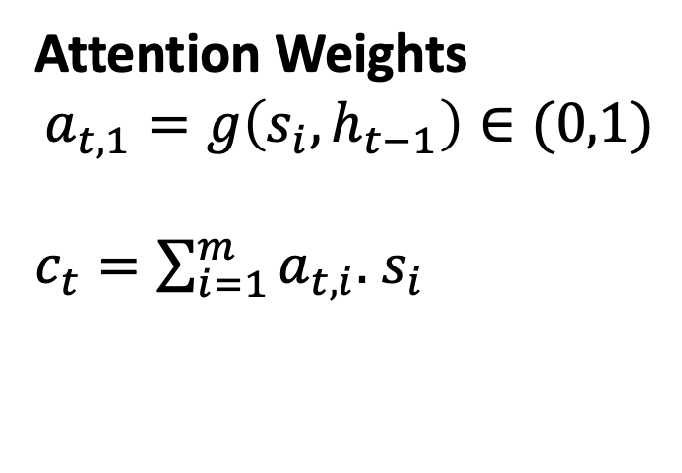
Attention Mechanism
Provides a way of actively encoding context information from preceding text$x=(x_{1}, · · · ,x_{m})$ via hidden states $(s_{1}, · · · ,s_{m})$
Attention Weights
$$a_{t,1}=g\left(s_{i},h_{t−1}\right)∈(0,1)$$
$c_{t}=\sum_{i=1}^{m}{a_{t,i}.}$ $s_{i}$

Slide 11
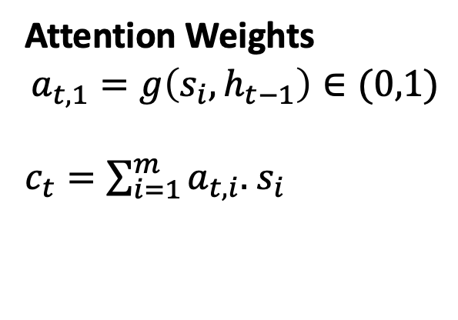
Attention Mechanism
Enables the decoder to be more selective on using contextual information
Widely used in many text generation tasks
response generation, story generation, and document summarization
Attention Weights
$$a_{t,1}=g\left(s_{i},h_{t−1}\right)∈(0,1)$$
$c_{t}=\sum_{i=1}^{m}{a_{t,i}.}$ $s_{i}$

Slide 12
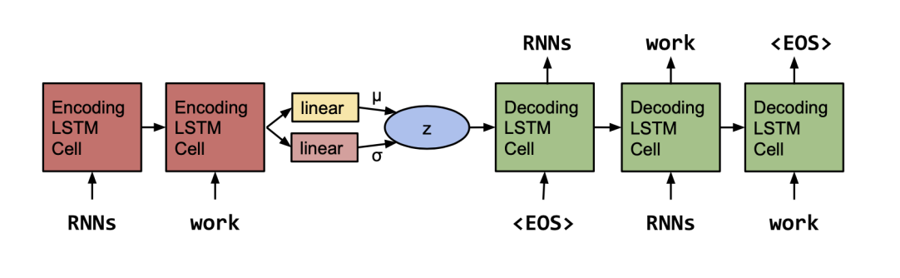
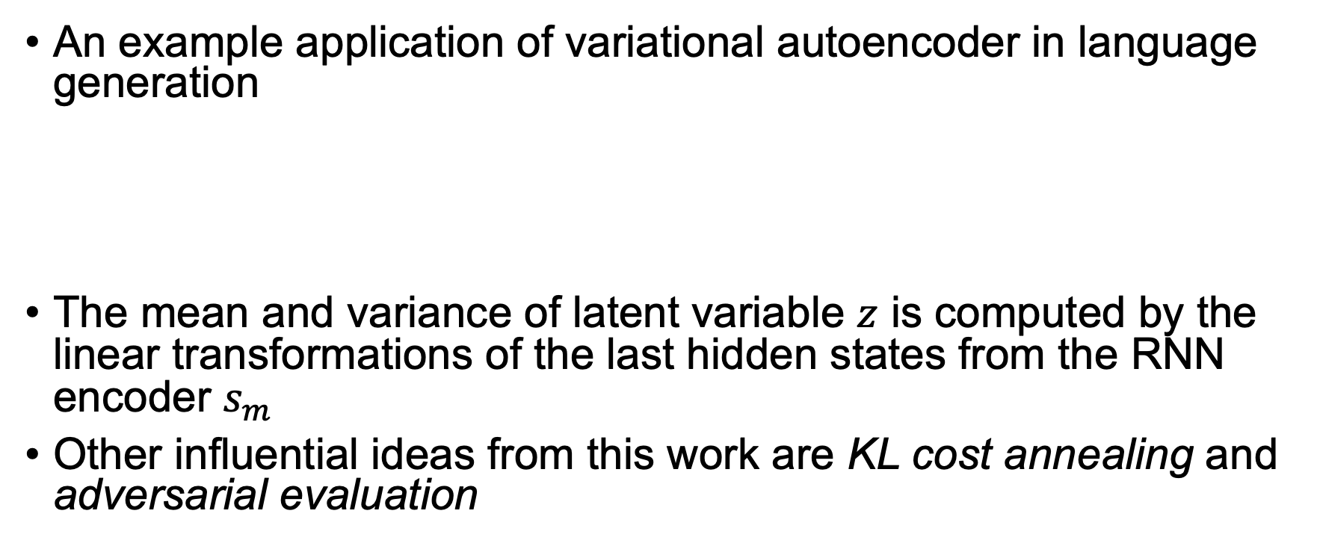
Variational Seq2Seq Models
An example application of variational autoencoder in language generation
The mean and variance of latent variable $z$ is computed by the linear transformations of the last hidden states from the RNN encoder $s_{m}$
Other influential ideas from this work are KL cost annealing and adversarial evaluation

Slide 13
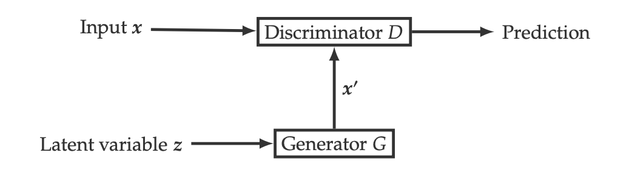
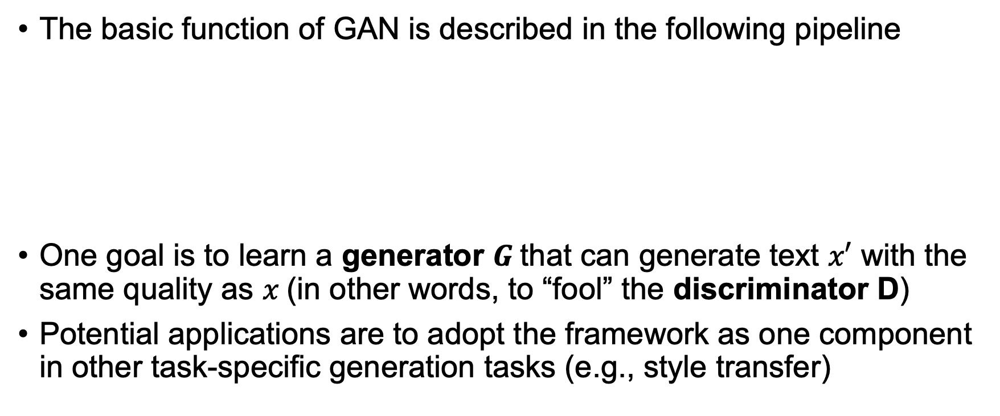
Generative Adversarial Networks
The basic function of GAN is described in the following pipeline
One goal is to learn a generator $G$that can generate text $x′$ with the same quality as $x$(in other words, to “fool” the discriminator D)
Potential applications are to adopt the framework as one component in other task-specific generation tasks (e.g., style transfer)

Slide 14
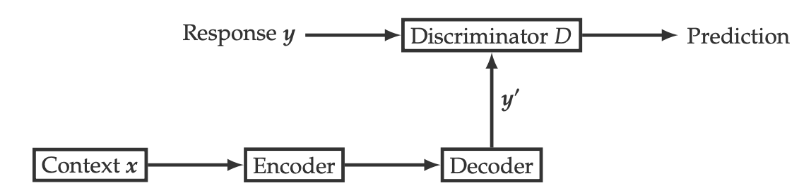
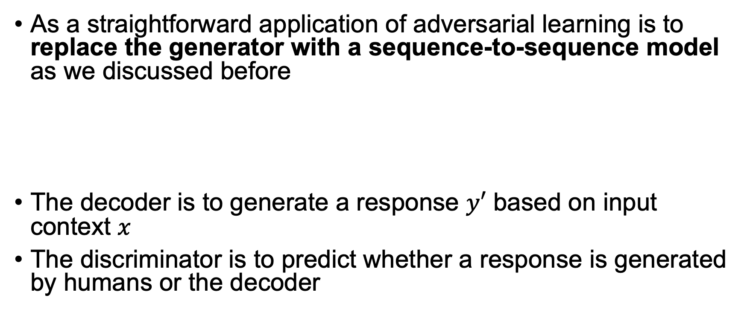
GANs for Generation
As a straightforward application of adversarial learning is to replace the generator with a sequence-to-sequence model as we discussed before
The decoder is to generate a response $y′$ based on input context $x$
The discriminator is to predict whether a response is generated by humans or the decoder

Slide 15
Transformers
“Attention mechanism, . . . , allowing modeling of dependencies without regard to their distance in the input or output sequences”
Recent applications of transformers use them as basic building blocks, like LSTM
Popular Transformer Architectures
Generative Pre-trained Transformers
XLNet

Slide 16
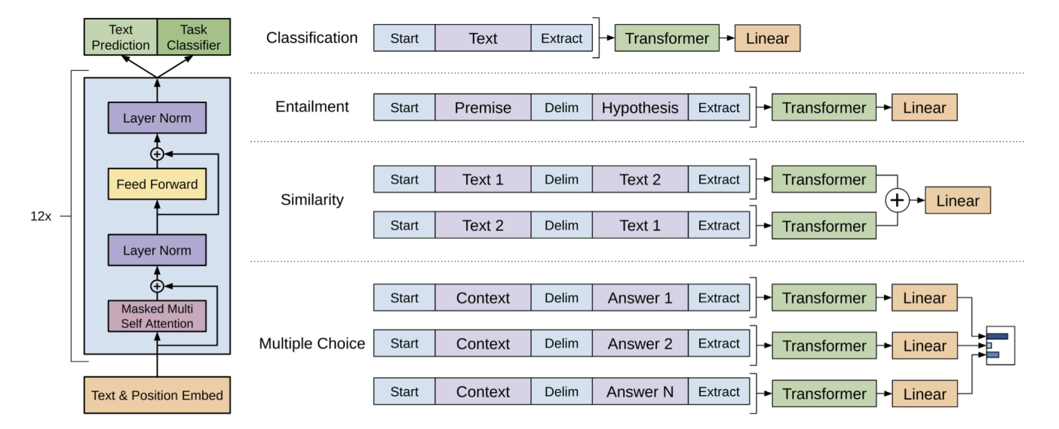

Generative Pre-trained Transformers (GPT)
GPT is trained simply by predicting the next words with
$h_{0}=W_{e}x_{t−k:t−1}+W_{p}$
$h_{l}=transformer_{block}\left(h_{l−1}\right)$for all $l∈\left[1, 12\right]$
$p\left(y_{t} \right|h_{n})=softmax\left(W_{o}h_{n}\right)$
Here, $W_{e} {and W}_{p}$ are word and position embeddings respectively

Slide 17
Decoding Algorithms
Once you’ve trained your language model, how do you use it to generate text?
A decoding algorithm is an algorithm you use to generate text from your language model
Popular Decoding Algorithms
Greedy Decoding
Beam Search
Top-k
Top-p

Slide 18
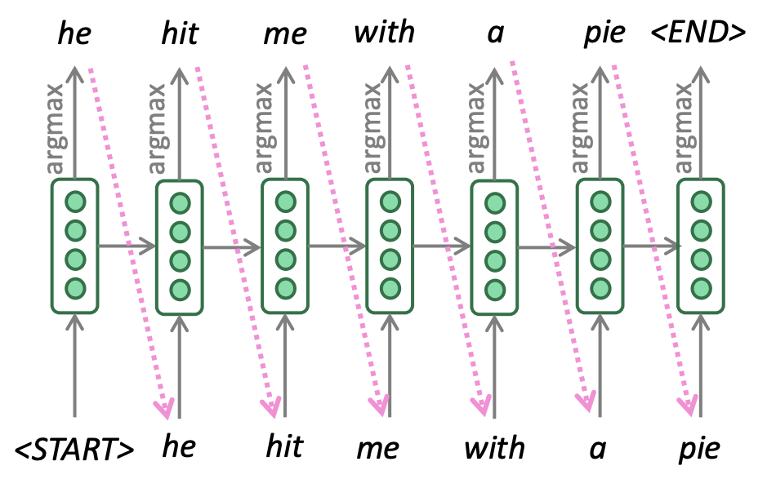
Greedy Decoding
At each step, take the most probable word (i.e., argmax)
Use it as the next word, and feed as input on the next step
Keep going until you produce (or reach some max length)
Due to lack of backtracking, output can be poor

Slide 19
Beam Search
A search algorithm which aims to find a high-probability sequence (not necessarily the optimal sequence, though) by tracking multiple possible sequences at once.
Core idea: On each step of decoder, keep track of the k most probable partial sequences (which we call hypotheses)
k is the beam size
After you reach some stopping criterion, choose the sequence with the highest probability (factoring in some adjustment for length)

Slide 20
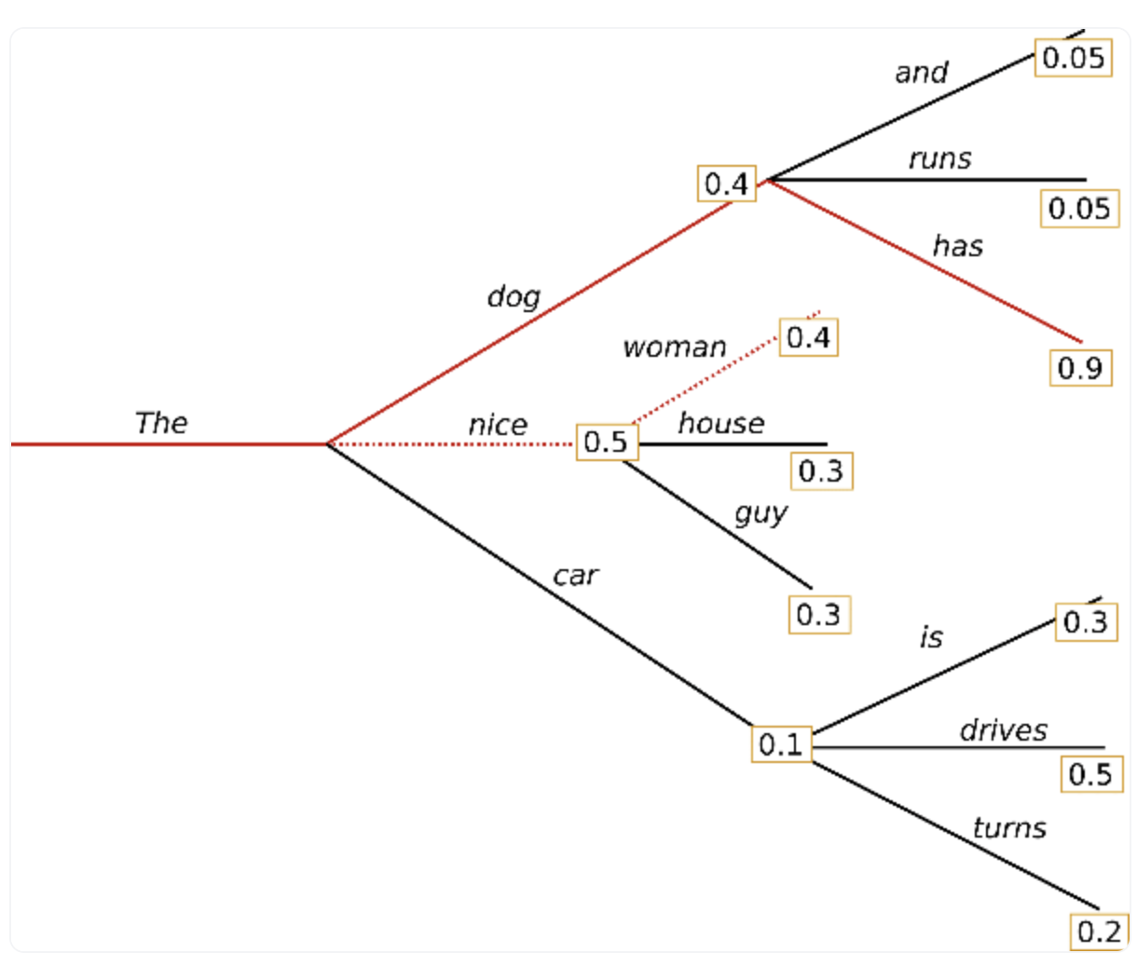
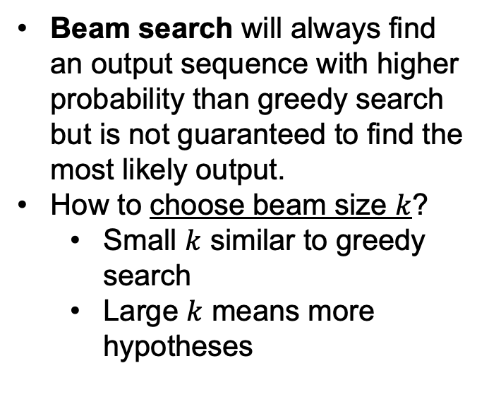
Beam Search
Beam search will always find an output sequence with higher probability than greedy search but is not guaranteed to find the most likely output.
How to choose beam size $k$?
Small $k$ similar to greedy search
Large $k$ means more hypotheses

Slide 21
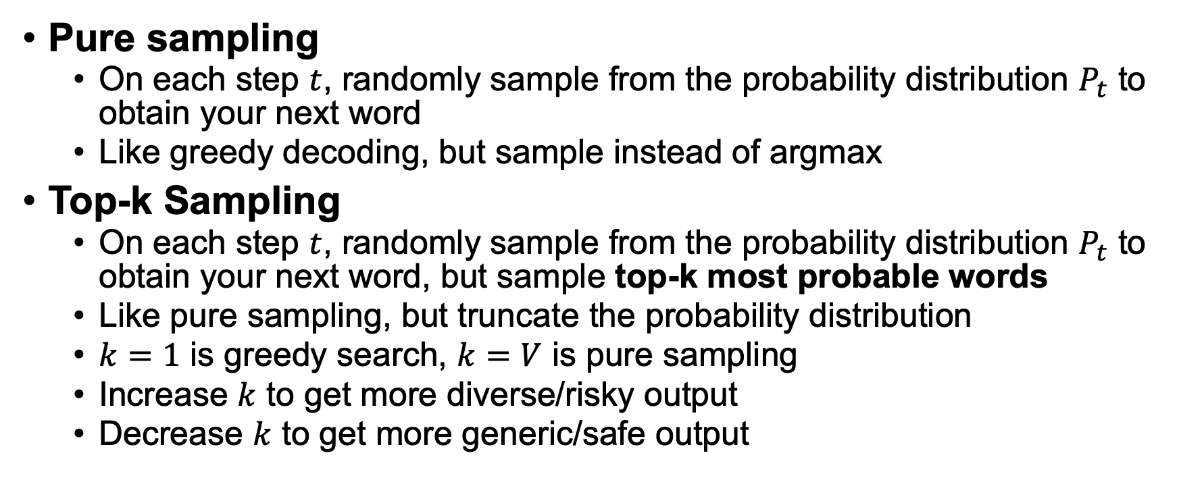
Sampling-based Decoding
Pure sampling
On each step $t$, randomly sample from the probability distribution $P_{t}$ to obtain your next word
Like greedy decoding, but sample instead of argmax
Top-k Sampling
On each step $t$, randomly sample from the probability distribution $P_{t}$ to obtain your next word, but sample top-k most probable words
Like pure sampling, but truncate the probability distribution
$k=1$ is greedy search, $k=V$ is pure sampling
Increase $k$ to get more diverse/risky output
Decrease $k$ to get more generic/safe output

Slide 22
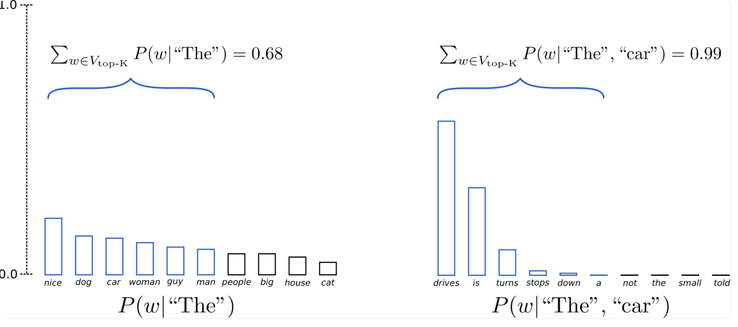
Top-k Sampling

Slide 23
Nucleus (Top-p) Sampling
Top-p sampling chooses from the smallest possible set of words whose cumulative probability exceeds the probability p.
Probability mass is then redistributed among this set of words
Size of the set of words (i.e., the number of words in the set) can dynamically increase and decrease according to the next word's probability distribution
Important: Read more from "THE CURIOUS CASE OF NEURAL TEXT DeGENERATION” by Holtzman et al.

Slide 24
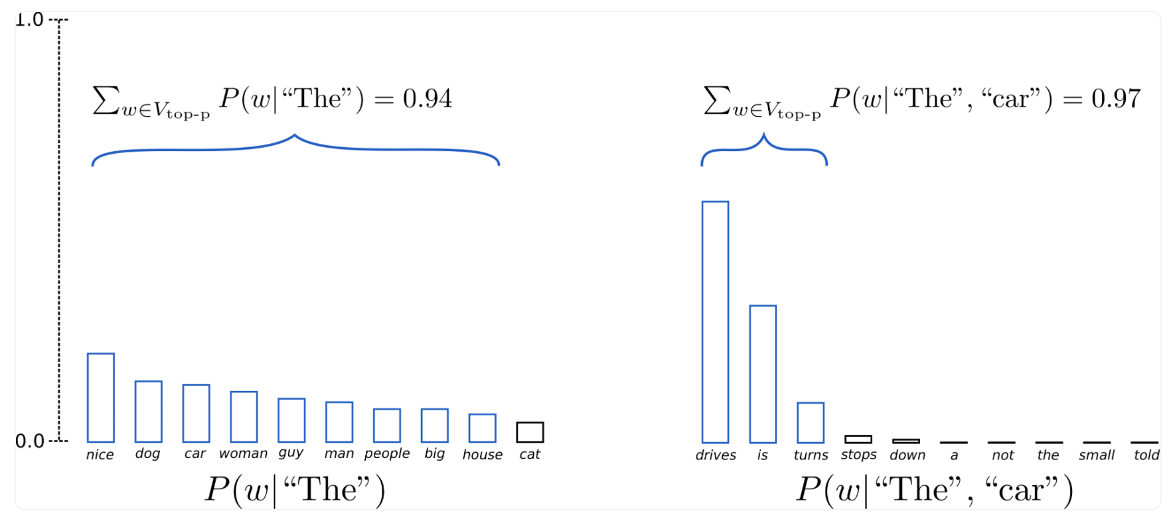
Nucleus (Top-p) Sampling

Slide 25

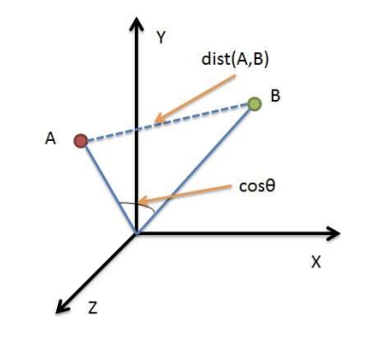
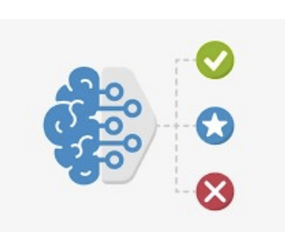
Types of Evaluation Methods
Human Evaluations
Un-trained Metrics
Trained Metrics

Slide 26
Human Evaluations
Most important form of evaluation for NLG systems
Automatic metrics fall short of replicating human decisions
Gold standard in developing new automatic metrics
Issues:
Expensive
Time consuming
Quality Control
Inconsistency in Evaluation and Reporting

Slide 27
Intrinsic Human Evaluations
Ask humans to evaluate the quality of generated text
Overall or along some specific dimension:
fluency
coherence
factuality and correctness
adequacy
commonsense
style / formality
grammaticality
typicality
redundancy

Slide 28
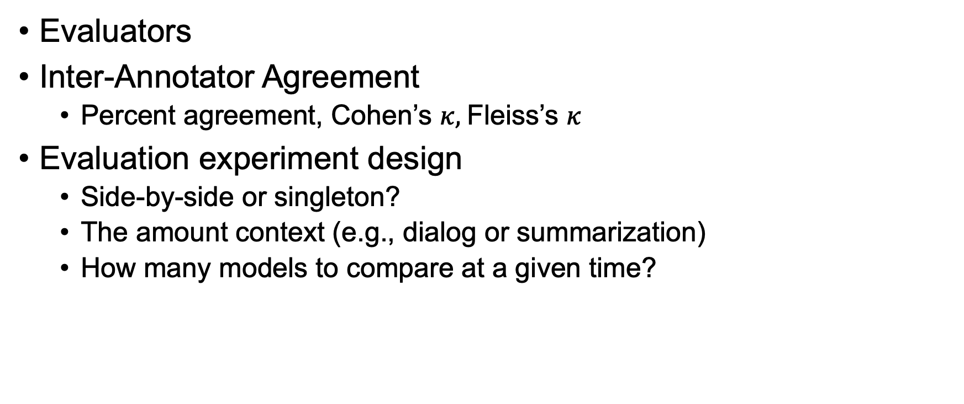
Human Evaluations: Other Aspects
Evaluators
Inter-Annotator Agreement
Percent agreement, Cohen’s $κ,$Fleiss’s $κ$
Evaluation experiment design
Side-by-side or singleton?
The amount context (e.g., dialog or summarization)
How many models to compare at a given time?

Slide 29
Un-trained Evaluation Metrics
Measure the effectiveness of the models that generate text
Compute a score that indicates the similarity between generated and gold-standard (human-written) text
Fast and efficient and widely used
Popular metrics
N-gram overlap metrics
Distance-based metrics
N-gram based diversity metrics
Content overlap metrics

Slide 30
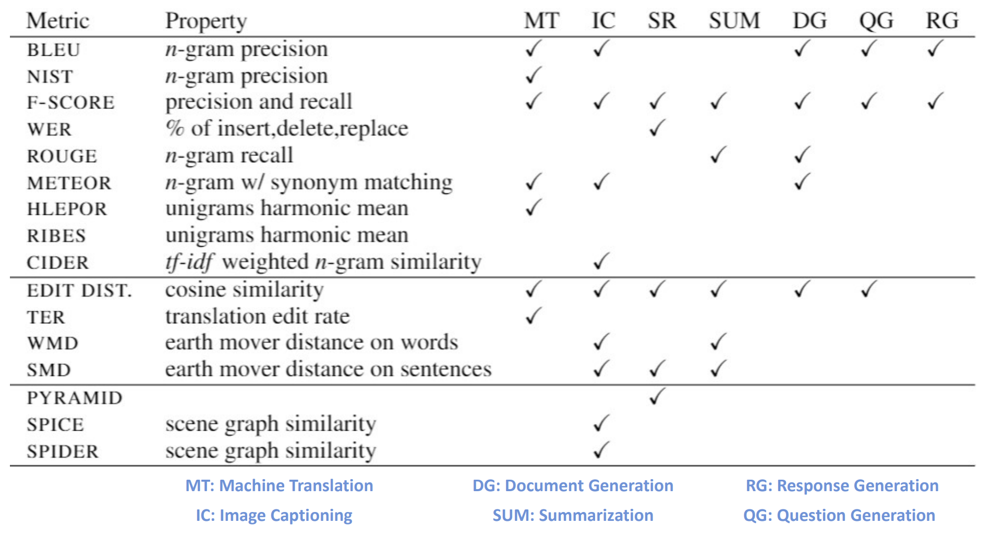
N-gram Overlap Metrics

Slide 31
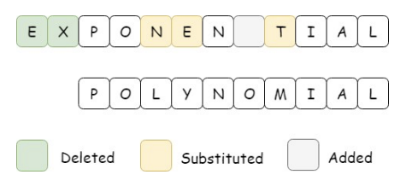
Distance-based Metrics
Distance function to measure similarity between two text units
Edit Distance
Measures how dissimilar two text units are based on the minimum number of operations required to transform one text into another.
Vector Similarity
Embedding based similarity for semantic distance between text
Word Mover’s Distance
Sentence Mover’s Similarity

Slide 32
Other metrics
N-gram Based Diversity Metrics
Type to Token Ratio (TTR) - The ratio of types to tokens in a corpus
Used to measure the lexical variety in a text
Content Overlap Metrics
Summation Pyramid – Semi-automatic metric for evaluating document summarization models
Spider – A combination of semantic graph similarity and n-gram similarity measure

Slide 33
Machine Learnt Metrics
Sentence similarity metrics
Learning from Human Feedback
BERT-based Evaluation
Factual Correctness metrics

Slide 34
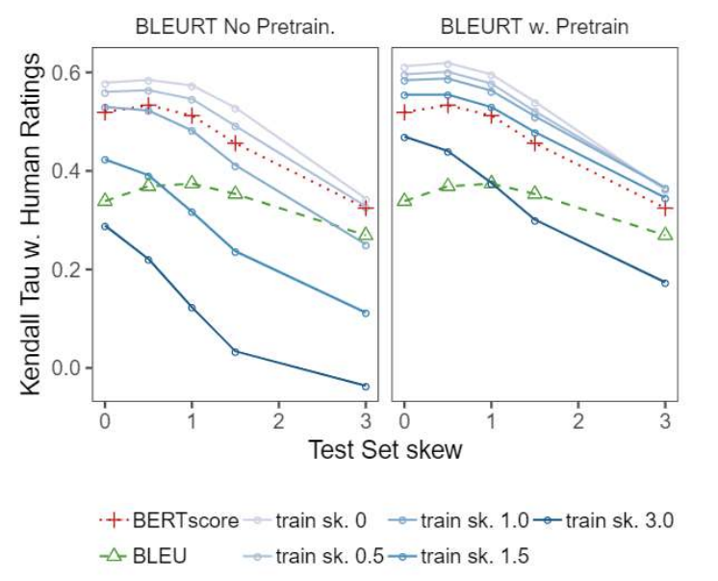
BERT-based Evaluation Metrics - BLEURT
A checkpoint from BERT is taken and fine-tuned on synthetically generated sentence pairs using automatic evaluation scores such as BLEU or ROUGE
Further fine-tuned on system-generated outputs and human-written references using human ratings and automatic metrics as labels
The fine-tuning of BLEURT on synthetic pairs is important
Improves the robustness to quality drifts of generation systems
Important: Read the paper “BLEURT: Learning Robust Metrics for Text Generation” by Sellam et al.

Slide 35
Exciting Current Trends in NLG
Incorporating discrete latent variables into NLG
May help with modeling structure in tasks that really need it, like storytelling, task-oriented dialogue, etc
Alternatives to strict left-to-right generation
Parallel generation, iterative refinement, top-down generation for longer pieces of text
Alternative to maximum likelihood training with teacher forcing
More holistic sentence-level (rather than word-level) objectives

Slide 36
Acknowledgements
Some resources on which the slides are based
https://web.stanford.edu/class/cs224n/slides/cs224n-2019-lecture15-nlg.pdf
The Amazing World of Neural Language Generation. https://nlg-world.github.io/
How to Generate text by HuggingFace. https://huggingface.co/blog/how-to-generate
Datasets on NLG: https://aclweb.org/aclwiki/Data_sets_for_NLG

