Slide 1
Privacy in Social Networks
Carlos Ordonez
David Matusevich

Slide 2
Outline
Overview
  What is a Social network?
  Prominent social networks
  What is Privacy?
Privacy Issues
  Social; Legal
  Differences with data security
  Commercial advantage
Controlling privacy
  What Data is Collected
  Managing Privacy Settings
Strategies for Safe Sharing:
  Protecting your online “brand”
  Safe Online Socializing
Notes:
Overview 60 minutes slides: 3 to 33
Privacy Issues 45 Minutes slides: 34 to 52
Controlling Privacy: 120 Minutes slides 53 to 102 (end)

Slide 3
I - Overview

Slide 4
What is a Social Network?
A Social Network Site is a Web-based service that allows individuals to “construct a public or semi-public profile within a bounded system; articulate a list of other users with whom they share a connection; and view and traverse their list of connections and those made by others within the system”, therefore increasing their social capital.
We will not consider other kinds of social networks that don’t rely on a social network provider.

Slide 5
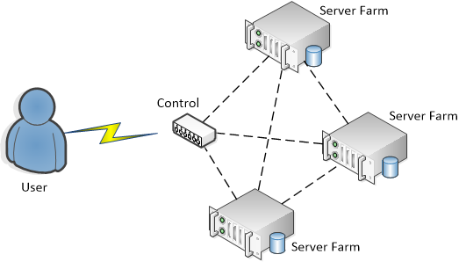
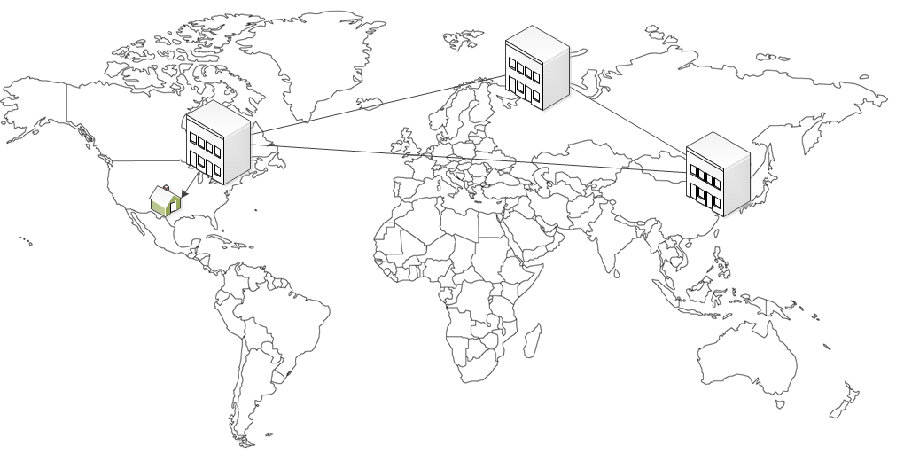
Social Network Data Storage
USA/Canada and Europe
  Local
  External
At multiple sites
Transferred and shared
Notes:
Add Graphics

Slide 6
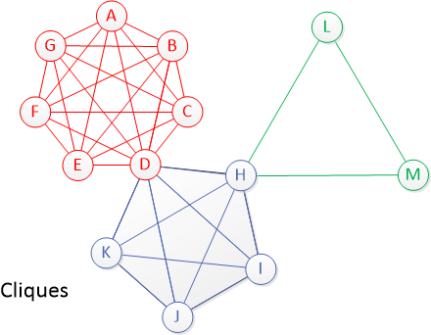
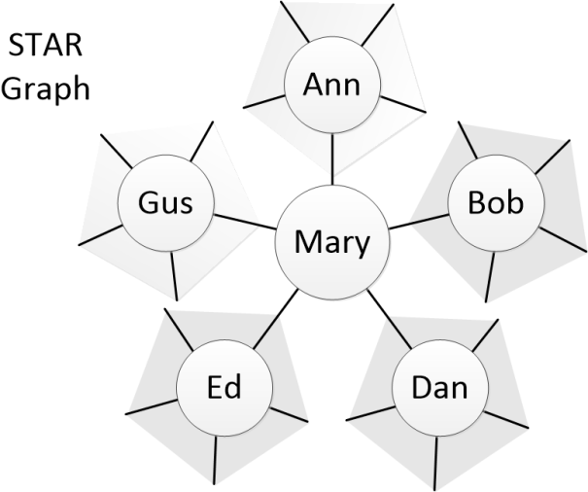
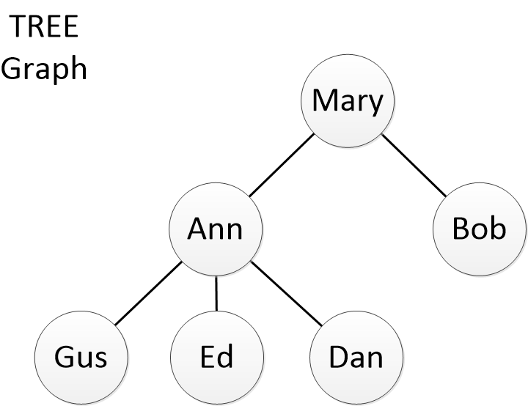
Dissemination of information
Shape of friends graph
Star
Tree
Interconnected circles
Cliques
Notes:
Add Diagrams!

Slide 7
Social Network
A Social network is a central place that combines
  Entertainment
  Social interactions
  Communication facilities
Social network operators (users) build profiles that can be seen by other users. The user manages the amount of information others can see.
Personal data is now considered the new “oil”, and companies are eager to cash in on this new resource.

Slide 8
Social Network Elements
A bounded set of users
Public or semipublic personal profiles
Definition of a set of people related to a person (friends, relatives)
Freedom to traverse lists of connections (their own and others)
Social Network Capital: The expected collective or economic benefits derived from the preferential treatment and cooperation between individuals and groups

Slide 9
Social Networks vs. Internet Communities
Internet Communities: Similar to social networks but there are no explicit interactions between users and no connections.
YouTube, Amazon, eBay are communities, but since there is no set of connections, they cannot be considered networks.
As time goes by, the lines between communities and networks are becoming more blurred.

Slide 10
The Social Aspect
Social networks are used to connect with people met offline or online
To a lesser extent investigate people (as a primitive background check)
Colleagues, classmates and friends in general, may share connections online, but not necessarily offline

Slide 11
Motivations for Joining a Social Network
People join social networks to:
Create and share content about themselves
To connect with others (either old acquaintances or new)
To meet people with similar interests
Financial Motivations
In order to achieve these goals, there must be a measure of voluntary disclosure among multiple users

Slide 12
Top Ten Social Networks by Users
Rank | Name | Active user accounts | Site Country of origin
1 | Facebook | 1 billion^{[1]} | United States
2 | Tencent QQ | 712 million^{[3]} | China
3 | Qzone | 400+ million^{[5]} | China
4 | Sina Weibo | 300+ million^{[7]} | China
5 | Google+ | 235 million^{[8]} | United States
6 | Twitter | 200+ million^{[10]} | United States
7 | VK | 190+ million^{[11]} | Russia
8 | LinkedIn | 160 million^{[12]} | United States
9 | Renren | 160+ million^{[13]} | China
10 | Skype | 145+ million^{[14]} | Estonia
Notes:
Country of origin does not imply where the users come from.

Slide 13
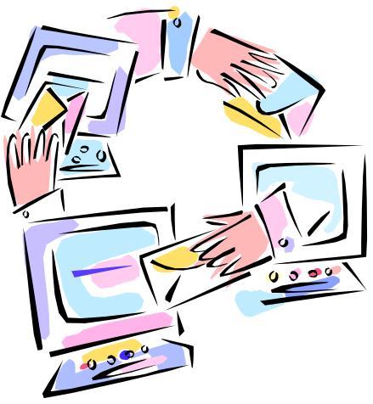
Social nets becoming more common
Social networks are an increasingly ubiquitous part of Americans' daily lives;
Recent data shows that 65% of Internet-using U.S. adults maintain a profile on an SNS
This figure is increased to 81% when considering teens

Slide 14
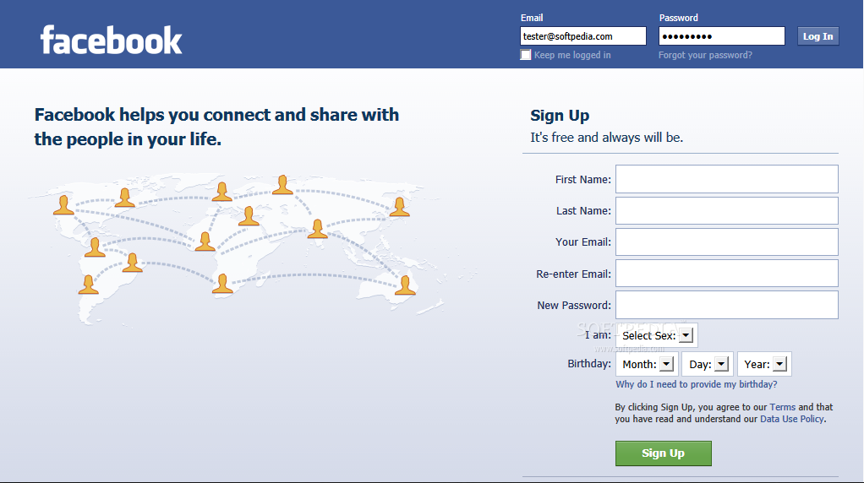
Facebook phenomenon
More than 1 Billion active users.
50% percent of users log in daily.
The average user has 130 friends,
Average user is a member of 12 groups, and spends more than 55 minutes per day on the site
Notes:
Data from 2010

Slide 15
Facebook in more detail
2.5 billion photos uploaded each month, with more than
3.5 billion pieces of content shared each week
There are currently more than 70 translations of the site available
70% of Facebook users coming from outside of the United States (Facebook, 2010).

Slide 16

Privacy Overview:
Privacy Definition
Privacy is the ability of an individual or group to seclude themselves or information about themselves and thereby reveal themselves selectively.
Westin 1967: “the claim of individuals, groups, or institutions to determine for themselves when, how and to what extent information about them is communicated to others’’
Altman 1975: selective control of access to the self

Slide 17
There is NO privacy any more!
In essence the European Community considers privacy a Human Right, not something that is granted by the government.
Article 8 of the European Convention on Human Rights provides a right to respect for one's "private and family life, his home and his correspondence", subject to certain restrictions that are "in accordance with law" and "necessary in a democratic society".
This view is not universally accepted. In 1999 Sun Microsystems CEO Scott McNealy called privacy a “red herring”. “You have zero privacy, get over it!”, he said.
Google CEO Eric Schmidt said that “If you have something that you don't want anyone to know, maybe you shouldn't be doing it in the first place”, when asked if users should be sharing their information with Google.

Slide 18
Principles governing the European Community (OECD) recommendations for protection of personal data
Notice—data subjects should be given notice when their data is being collected;
Purpose—data should only be used for the purpose stated and not for any other purposes;
Consent—data should not be disclosed without the data subject’s consent;
Security—collected data should be kept secure from any potential abuses;
Disclosure—data subjects should be informed as to who is collecting their data;
Access—data subjects should be allowed to access their data and make corrections to any inaccurate data; and
Accountability—data subjects should have a method available to them to hold data collectors accountable for following the above principles
Notes:
Organization for Economic Co-operation and Development

Slide 19
Online vs. offline privacy
We are weary of people that might approach us in our daily life, but we react different to strangers we meet online.
This behavior is seen on people from all ages, from children to adults.
There is a real disconnect between online and offline notions of privacy.

Slide 20
Hardware
Social networks can be accessed by a large number of different devices.
Laptop and desktop computers give access to better “views” of the network site, but limit the spontaneity of sharing.
Cellphones and tablets provide easy access to the social networks and enable quick sharing of photos and geo-location.

Slide 21

Privacy Invasion Experiment
Notes:
3:30 minutes long

Slide 22
Information privacy
Information privacy, or data privacy (or data protection), is the relationship between collection and dissemination of data, technology, the public expectation of privacy, and the legal and political issues surrounding them.

Slide 23
Privacy types
Social privacy: how people protect themselves from other users
Institutional privacy: how the company that runs the social network uses people’s data
Concern: the heightened visibility that is the result of having a large number of friends, including people in different ages → social surveillance and social control

Slide 24
Privacy issues of social networking sites
Social networks keep track of all interactions used on their sites and save them for later use.
Issues include:
  Cyber-stalking,
  location disclosure,
  social profiling,
  data leakage and information integration,
  3rd party personal information disclosure,
  government use of social network websites in investigations without the safeguard of a search warrant.

Slide 25
Impact
The privacy impact of social networks should not be underestimated.
Many users do not seem to realize that their free use of social networks has an indirect but steep effect through the exposure of their own personal data.
In addition, many users do not realize which impact they have on the privacy of their friends and families when they publish information about them.

Slide 26
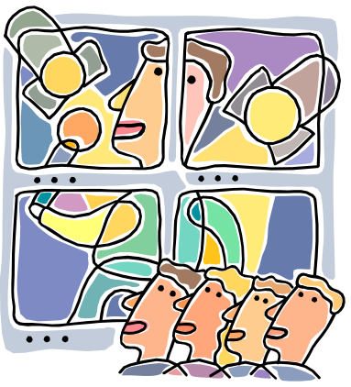
Unbounded audience
Marwick and Boyd (2011 )
“We may understand that the Twitter or Facebook audience is potentially limitless, but we often act as if it were bounded”

Slide 27
Privacy Awareness
Privacy issues often only become apparent when it is already too late.
It is practically impossible to predict (all) negative consequences of the use of personal data.
Even if one can foresee a few, they are very abstract, distant and uncertain.

Slide 28
Example: Consequences for
College Applications
Colleges currently use social media sites to recruit new students.
Of those admission officers that visited applicants SNS, 35% discovered something negative about the applicant.
(Kaplan’s College Admissions Survey)

Slide 29
Example: Consequences in the Job Hunting
93% of recruiters review a candidate’s online presence as part of the screening process.
42% have reconsidered candidates based on their online presence (both negatively and positively)
Even spelling and grammatical errors influence recruiters negatively (61%)
Posts/Tweets about volunteering and charity donations influence recruiters positively (65%)
(Jobvite Social Recruiting Survey, 2013)

Slide 30
Means to achieve privacy
Withdrawal from society activities
With physical or psychological means, in solitude or in a small group of people
Anonymity: the Dark Web; disable cookies; IP hiding.
Live “off-line”

Slide 31
Less privacy in the Future
Even if an individual might know intellectually that the usage might have negative consequences, this is not going to change behavior that much.
Our search-history, location-data, browsing-habits, reading-behavior and much more, is collected and/or used to a degree we can barely imagine.
Technology, nowadays, allows for unprecedented forms of data-matching, de-anonimization and data mining, all contributing to extensive ‘digital dossiers’.
Notes:
Timeline diagram: past==logs, now=controlling; future=company profit/ads/government/hackers

Slide 32
II - Privacy Issues

Slide 33
The Economics of Privacy
Companies can determine what adds you see online, what products to recommend you, even what articles to read, based on your previous behavior.
Companies adopt a “collect first, ask questions later” policy.
Some are selling consumer-specific data for purposes that fall right on the boundaries of the Fair Credit Reporting Act and other laws.

Slide 34
The Economics of Privacy
CampaignGrid (Republicans) and Precision Network (Democrats) have political information on 150 million American Internet users, or roughly 80 percent of the nation's registered voters.

Slide 35
Main causes of privacy issues
Data publically available
Blurred or no personal boundaries
User has limited control over information dissemination or transfer
For a long period of time; forever?
Hard to remove a derogatory post or comment
Net etiquette different from face to face etiquette
New cases not considered by existing law

Slide 36
Information Leakage and Linkage
Information leakage happens whenever a system that is designed to be closed to an eavesdropper reveals some information to unauthorized parties nonetheless.
Information linkage is joining together of two datasets to produce one single dataset. In short it is possible to use information leaked from social networks to sniff out information private to the user, such as email addresses, ID numbers, etc.
Linkage cannot happen without Leakage. Some measure of leakage is unavoidable.

Slide 37
Identity in social networks
True
Partially concealed
Anonymous
2nd life; alter ego

Slide 38
Apps and Information Leakage
Apps within social networks (games, messengers, utilities, music apps, etc.) are an important source of leakage.
People will share address books, phone numbers, credit card numbers, etc. with applications that have little or no security and may even be malicious.
This behaviour is the same in phone apps.

Slide 39
The Internet does not forget.
‘Right to be Forgotten’: The right of individuals to have their data no longer processed and deleted when they are no longer needed for legitimate purposes.
The ‘right to be forgotten’ clearly takes a proprietary approach to privacy protection. Its scope, therefore, strongly depends on a clear and consistent definition of ‘personal data’.

Slide 40
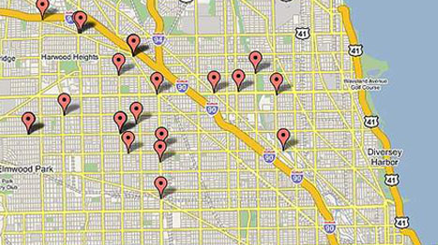
Compromised Privacy:
Finding user identity
Generic Searches (Google, Yahoo, etc.)
From user public profile
Matching data across sites
Exploit photos and video tags and geo-tags.

Slide 41
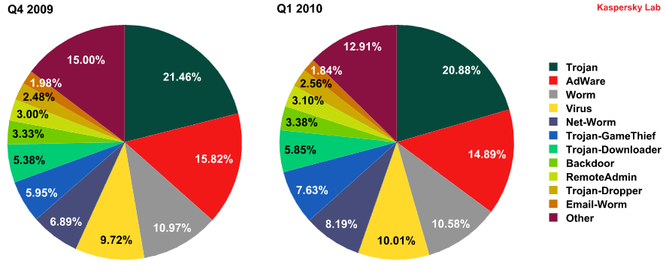
Security
Threats of unsecured access
Hackers
Identity thieves
Government global knowledge
SecureList.com
Kapersky.com

Slide 42
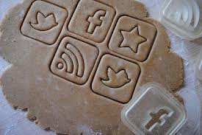
Cookies
Cookies are a way of storing persistent client data so that a site can maintain information
on a user across HTTP connections (text files).
Information stored ranges from
  Shopping Carts,
  Forms, Addresses and Personal information (usernames and passwords),
  Login information
Main culprit of information leakage.

Slide 43
Issues beyond security
Bad user behavior (bad language, cyberbullying, anonymous threats)
Inability to control social spheres
Blurred boundaries between acquaintances, friends, relatives
The user is responsible for managing what is disclosed, not an organization

Slide 44
Further privacy issues even when user willingly agrees to disclosure
Open discussion of personal information among contacts,
The posting and tagging of photographs that identify other users,
Disclosure of demographic data,
Posting personal information on profile pages that implicates other users

Slide 45


Who can disclose data?
Person himself/herself
A friend or relative
A 3rd party

Slide 46
Social aspects
Social Networks are a recent phenomenon and as such there are no existing, clear social conventions about their use. Example: ignore “friend” requests.
Other users consider the number of friends as a status symbol, effectively causing the boundaries between private life and professional life to become increasingly blurred.

Slide 47
Social Context Collapse
Social network collapse is the flattening out of multiple distinct audiences in one's social network.
People from different contexts become part of a singular group of message recipients. Users can quickly diffuse information across their entire network and facilitate interaction across diverse groups of individuals who would otherwise be unlikely to communicate.

Slide 48
Legal Cause
Privacy Policies and Users Rights
Written in vague legalese
People do not read them
Network externalities, lock-in and the lack of valid alternatives often force people into consenting.

Slide 49

Legal Issues
Regulation
Low: 3rd world countries
Medium: US
High: Europe

Slide 50
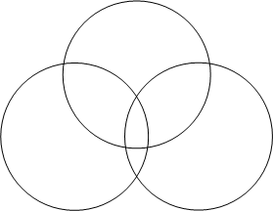
Legal issues boundary blurred
Personal
Business
Government
Personal
Legal
Commercial

Slide 51
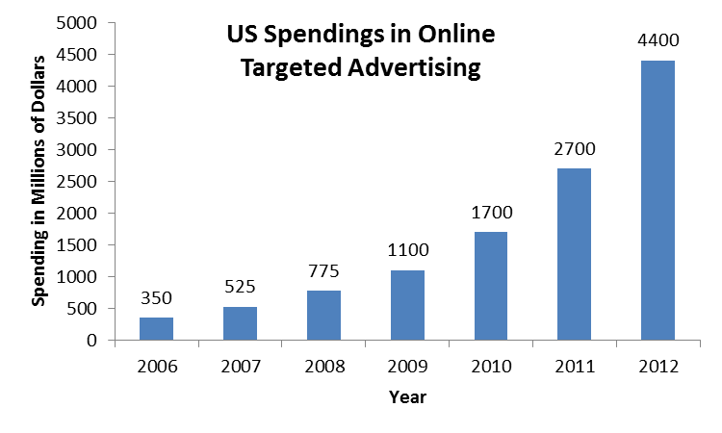
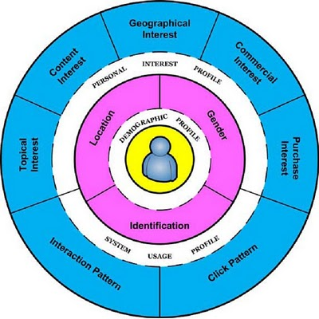
Commercial advantage
Targeted advertising
User profiling
Jansen, Bernard, et al. "To what degree can log data profile a web searcher?. "Proceedings of the American Society for Information Science and Technology46.1 (2009): 1-19.

Slide 52
Commercial advantage: Facebook
Selling targeted advertising
Virtual currency (Facebook credits)
Facebook apps and games collect information about your habits and about your friends, without your knowledge or consent.

Slide 53
The Situation in USA
There is currently no federal online privacy law, which makes it essentially impossible for government agencies like the Federal Trade Commission to go after Internet companies unless they violate their own published privacy policies.

Slide 54
The Situation in USA
There are some rules in place to deal with Privacy in regards to children under the age of 13.
The Children's Online Privacy Protection Act (or COPPA) was passed in 1998.
A new set of rules was published by the FTC (Dec 2012) clarifying what is or isn’t allowed.

Slide 55
New FTC Rules
Make clear that the "personal information" that can't be collected without parental consent includes geo-location information, photographs, and videos
Make clear that third parties (like advertising networks) must also comply with COPPA
Close a loophole that allowed kids' information to be collected via plug-ins without parental notice
Clarify that "persistent identifiers" are also protected information, like IP addresses and mobile device IDs
Require that websites aimed at kids have "reasonable procedures" for data retention and deletion

Slide 56

The Situation in USA (Cont)
Legislation has been proposed to include “Do Not Track” options on web browsers.
This legislation is not politically viable due to opposition from the business community.

Slide 57
III - Controlling Privacy

Slide 58
Automatically Collected Computer Data
IP address
Computer name
Linking data across different sites
Time, date
Location
Mechanism: Cookies

Slide 59
Information collected with cookies
Geographical Location
Detailed date/time
Computer name, id
IP address, MAC
Logged in user name
Other web pages visited
Form data

Slide 60
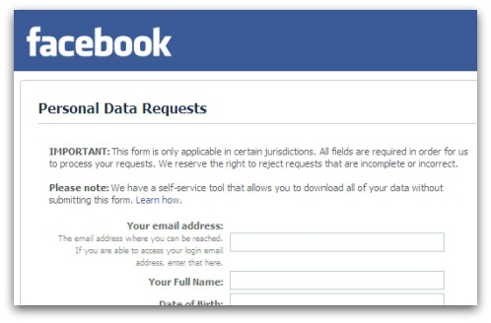
Computer Data Manually Entered
Personal information
Comments
Photos, Video

Slide 61

Social networks: users and data
Parties
  Social network operators
  Users
  Application providers
Roles to manage data
  Data controller
  Data processor
  Data provider

Slide 62
Palliative: Privacy Settings
Extensive sets of privacy controls different levels of sociability
Shield content sharing
Potential problem: users are not able to properly utilize the privacy settings provided by SNSs
    Controls are difficult to understand and most users just leave the recommended settings (preferred by the SSN)

Slide 63
Privacy control
Who in the network can access information in your personal Facebook profile?
Can you find the minimum age for using Facebook?
How can you change your Facebook settings to restrict visibility to your profile?
How can you change your Facebook settings so that you are alerted when you are tagged in a photo?

Slide 64
Controlling access to data
Limited
Site-dependent
Difficult to understand legal language
Impossible to know if other person discloses data
Transferrable

Slide 65
Dilemma
In either case below, the consequence is undesirable:
  if privacy is protected, then sociability and content sharing will be compromised,
  whereas if sociability and content sharing are promoted, then privacy will suffer.
Sociability
Privacy

Slide 66
Implications
Increased social utility and a growing social diversity of the user population, which help users to be readily available and visible to a lot of people: “all friends in one-place solution.”
SNS profiles mix friends, family, co-workers, and business contacts
No simple and adequate way to separate them and keep some parts of the information private

Slide 67
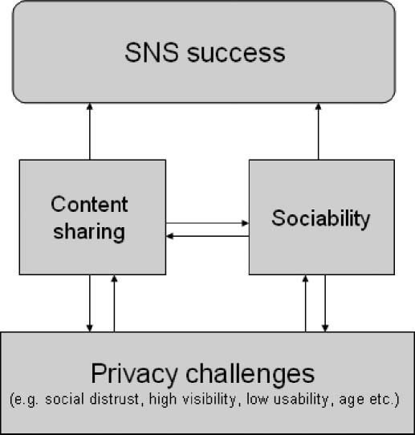

Slide 68
Comparison of the Younger Adult Sample and the Older Adult Sample in Regard to Social Practices
Young Adult
Older Adult
Uses SNS for short periods of time, but many times a day
Mainly contacts with friends that they see every day
Uses SNS for coordination with friends, flirting and photo sharing
Usually share large amounts of photos and videos from social gatherings
Infrequent status updates
Uses SNS for fewer longer sessions
Mainly contact with family and old friends that are not seen often
Uses them for getting in touch with old friends, nostalgia
Shares photos less often (rarely videos) mainly of vacations
Frequent status updates

Slide 69
Comparison of the Younger Adult Sample and the Older Adult Sample in Regard to Privacy
Young Adult
Older Adult
Confident in the usage and knowledge of privacy controls
Thinks other people are more likely to have problems with privacy
Concerned about privacy in the context of job hunting. Not concerned with the use of information by the SNS
Less confident. Usually ask for help from the younger adults in the household
Many privacy concerns, in particular regarding the younger generations
Concerned but less aware of privacy issue. May think that burglars might use SNS to case their homes, for instance

Slide 70

Lowest Common Denominator Strategy
Individuals for whom a message is not intended but would receive the message nonetheless.
Err on the side of caution: If any of these individuals would find the message problematic, it should not be posted.

Slide 71
Privacy Preservation Costs
Required from the user in order to make use of the site's privacy features:
  Time required to understand and operate the myriad of different user settings.
  Knowledge of the intricacies of the particular social network.
  The time and knowledge invested in one network is not transferrable to another.

Slide 72
Limitation principle
Confining data processing to a previously defined scope: might seem to restrict the amount of potential harm in theory.
But in an ever-increasing personalized web (where every piece of personal data can be considered as ‘useful’), the value of this principle has become questionable too.

Slide 73
Settings
Users may not be well-versed in privacy settings or unwilling to take the time to change settings.
Distributing content to one's entire network appears to carry a lower cost in terms of time, knowledge, and skills. However, such strategies may negatively impact relationships on the site, especially if the majority of posts are relevant to a minority of Friends.
While individuals choosing a lowest common denominator approach may avoid alienating friends with irrelevant content, they may also miss the benefits derived from interactions with all members of their networks.

Slide 74
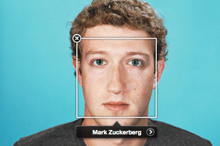
Additional automated sources of information
Recognition
  face
  voice
“sway” user into tagging

Slide 75

Concern: Status
Public Channels
Status updates provide the quickest method through which one can distribute messages to a wide audience
It may be more likely to be used even when the message is only relevant to a subset of Friends.

Slide 76
Control Data Transfer
Request ‘personal data’ to be deleted on one site
Deletion may imply just hiding data; not shredding it
Meanwhile the information might have been copied and/or ‘anonymized’ already.

Slide 77
Solutions to control data sharing and transfer
awareness-raising,
transparency,
clearer privacy notices,
data-minimization,
stricter control on the purpose limitation principle, ‘anonymisation’,
transparency,
encryption,

Slide 78
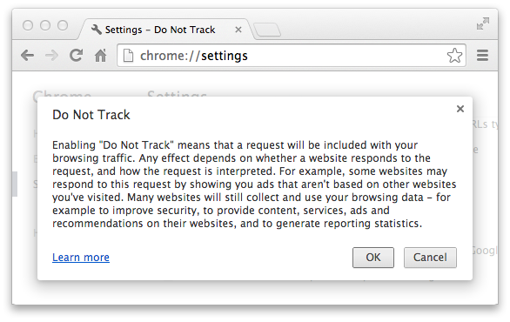
Anonymization
Major line of defense.
The right does not offer any solution.
Individuals may be profiled/targeted extensively and their data might (in)directly be used for comprehensive data-mining,
The individual cannot have a ‘right to be forgotten’ with regard to this information.
An Extreme Example: The Tor Network: The Deep Web.

Slide 79
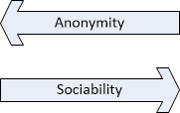
Anonymization Solutions: Catch 22
Anonymization measures prevent (potentially harmful) information to be shared
But, in an ever-increasing social Internet, many features depend on disclosing personal data.

Slide 80

Examples: Privacy Control Features
Facebook
Twitter
Snapchat
Foursquare

Slide 81

Facebook
Overwhelming
5 groups
Fine grained
Constantly changing
Pre-defined options: Friends, Public, Custom
Learning curve

Slide 82
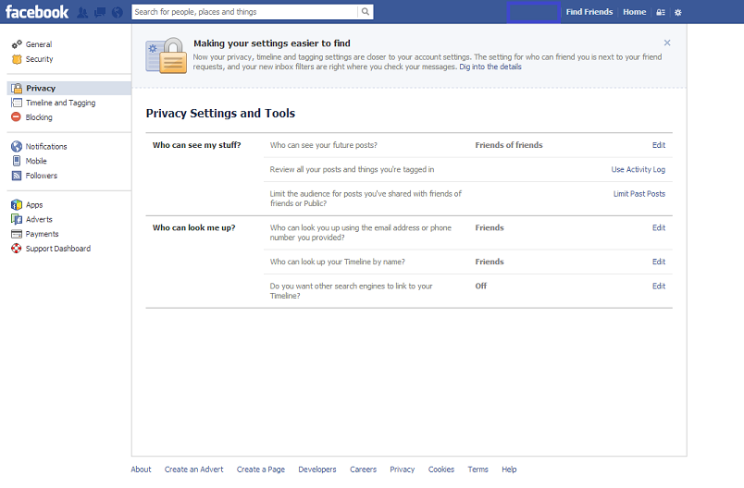

Slide 83
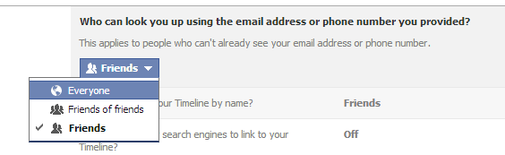
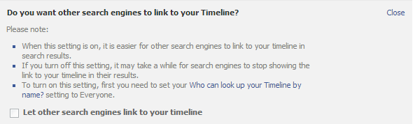

Slide 84

Twitter
The privacy settings are basic
Much simpler than FB.
Profiles can be public or private.
Your Bio, name and Twitter handle always visible
Email address is private
Guards against identity theft

Slide 85

Snapchat
Snapchat is a photo messaging application. Using the app, users can take photos, record videos, add text and drawings, and send them to a controlled list of recipients. These sent photographs and videos are known as "Snaps". Users set a time limit for how long recipients can view their Snaps (as of December 2013, the range is from 1 to 10 seconds), after which they will be hidden from the recipient's device and kept on Snapchat's servers forever

Slide 86
Snapchat
Snapchat has two privacy settings, one for who can send you Snaps and another for who can see your Stories. Both have two options "Everyone" and "My Friends."
By default, only users you add to your friends list can send you Snaps. If a Snapchatter you haven't added as a friend tries to send you a Snap, you'll receive a notification that they added you, but you will not receive the Snap they sent unless you add them to your friends list.
Usernames and personal phone numbers of millions of users have been stolen and posted online through a website entitled SnapchatDB.

Slide 87
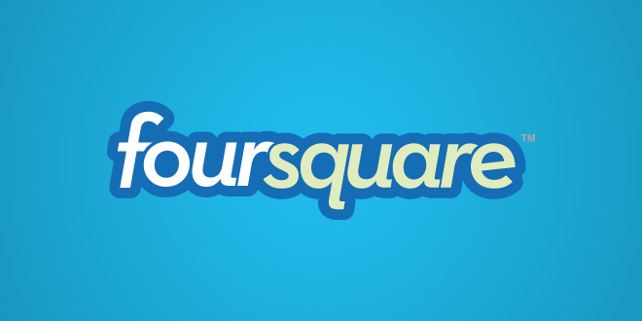
Foursquare
There are certain data that will always be public. This includes your name, your hometown (i.e. “location” in your profile), your bio, your profile picture and other public photos, your likes, your tips, your lists, and your friends. The only way to hide this info is to either not include it, or to change it so it doesn’t actually reveal any personal information about you. If you don’t, this information can easily be found through a simple Google search for your name, or other online outlets.

Slide 88
Your “Online Brand”
In business terms, a brand comprises all of the things that make up a company’s identity to customers, from its corporate logo to the names for its products. Because a strong brand is so important to a company’s reputation and success, executives take great pains to protect their brand
With high-powered search engines like Google and Bing, finding information about a potential job applicant, business partner, or date, is easier than ever. By applying the principles of business branding and online reputation management to yourself, you can make sure that your name looks good in search results.

Slide 89
IV - Strategies for Safe Sharing
Tips and advice

Slide 90

How to protect your “Online Brand”
Take charge of your “online reputation”
  Find out what is on the Internet about you
    Use search engines
    Search blogs and social networks
  Evaluate your online reputation
    Does the information about you reflect how you want others to perceive you?
  Protect your online reputation
    Think before you share
    Treat others as you would like to be treated
    Stay vigilant about what the Internet is saying about you

Slide 91
Restore your Online Reputation
If you find information about yourself that does not fit the reputation you want, act quickly. The longer it stays public, the greater the chance that it will be spread or archived.
In a respectful way, ask the person who posted it to remove it or correct an error. If it is a correction, ask him or her to include a notice (CORRECTION or UPDATED) right next to the original (incorrect) material.
If the person does not respond or refuses to help, ask the website administrator to remove the digital damage.
If you feel a public correction is necessary, present your case simply and politely without attacking the person.
(http://www.microsoft.com/security/online-privacy/reputation.aspx)

Slide 92
Safer Online Socializing
Set your boundaries:
  Think carefully about how public you want your profile or blog to be
  Evaluate the social site before you use it
Be selective about friends:
  Think twice about who you accept as a friend
  Periodically reassess who has access
  Review what your friends write about you

Slide 93
Safer Online Socializing
Think before you post
  Choose a user name that doesn’t attract unwanted attention or help someone find you
  Do not over share
  Treat others as you would like to be treated
  Think about the future of your information on the web
Defend your computer against online threats
  Be wary about clicking links
  Build up your computer’s defences and keep them up to date
  Be careful about installing add-on apps

Slide 94
Safer Online Socializing
Report Issues:
No one has the right to threaten or upset you. Report:
  Any negative incidents to the Web service, including content that exploits minors, obscene or hateful material, inappropriate behaviour, or theft of your account.
  Continued harassment or physical threats to local law enforcement.
  Identity theft to the U.S. Federal Trade Commission (FTC) at ftc.gov/idtheft or call toll free: (877) 438-4338.
  Scams or fraud to the FTC. Go to ftc.gov/bcp/consumer.shtm and click File a Complaint, or call toll free: (877) 382-4357.
(http://go.microsoft.com/?linkid=9708812)

Slide 95
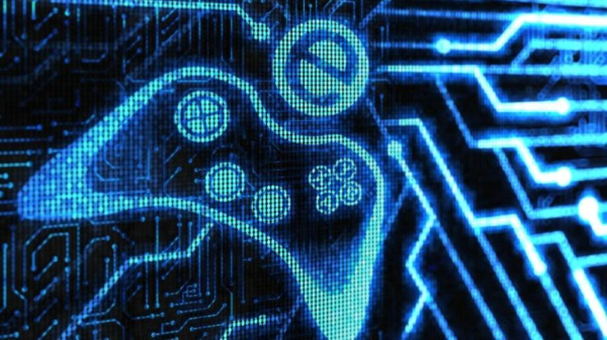
Social Networks and Gaming
Social gaming networks are a proof of that:
  Social networks fostered by the gaming companies: Xbox Live, Playstation Network, Nintendo Network, etc.
  Social networks maintained by users: Raptr, Playfire, Duxter, etc.

Slide 96
Safe Gaming
Educate yourself and your kids about the risks:
  Kids play alone, with others in the room, or online. They play against the game itself or another person, with a team of several players, or in games which may have hundreds of thousands playing at any one time.
  The bad may download with the good: some “free” games require extensive profiles, then illegally sell your data.
  Online bullying: Some gamers play simply to harass and taunt other players.
  Bad people may befriend kids, and through these social gaming sites obtain personal information that might lead to harm.

Slide 97
Conclusions
Privacy no longer viable
Companies hungry for data
We should become aware of privacy issues
Goal: safety+privacy, preserving “personal brand”

