Slide 1
One-class Training for Masquerade Detection
Ke Wang
Columbia University
Computer Science
IDS Lab

Slide 2
Masquerade Attack
One user impersonates another
Access control and authentication cannot detect it (legitimate credentials are presented)
Can be the most serious form of computer abuse
Common solution is detecting significant departures from normal user behavior

Slide 3
Schonlau Dataset
15,000 truncated UNIX commands for each user, 70 users
100 commands as one block
Each block is treated as a “document”
Randomly chose 50 users as victim
Each user’s first 5,000 commands are clean, the rest have randomly inserted dirty blocks from the other 20 users

Slide 4
Previous work
Use two-class classifier: self & non-self profiles for each user
First 5,000 as self examples, and the first 5,000 commands of all other 49 users as masquerade examples
Examples: Naïve Bayes [Maxion], 1-step Markov, Sequence Matching [Schonlau]

Slide 5
Why two class?
It’s reasonable to assume the negative examples (user/self) to be consistent in a certain way, but positive examples (masquerader data) are different since they can belong to any user.
Since a true masquerader training data is unavailable, other users stand in their shoes.

Slide 6
Benefits of one-class approach
Practical Advantages:
  Much less data collection
  Decentralized management
  Independent training
  Faster training and testing
No need to define a masquerader, but instead detect “impersonators”.

Slide 7
One-class algorithms
One-class Naïve Bayes (eg., Maxion)
One-class SVM

Slide 8
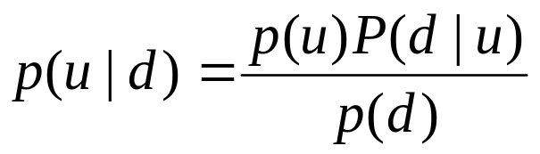
Naïve Bayes Classifier
Bayes Rule
Assume each word is independent (the Naïve part)
Compute the parameter during training, choose the class of higher probability during testing.

Slide 9
Multi-variate Bernoulli model
Each block is N-dimensional binary feature vector. N is the number of unique commands each assigned an index in the vector.
Each feature set to 1 if command occurs in the block, 0 otherwise.
Each 1 dimension is a Bernoulli, the whole vector is multivariate Bernoulli.

Slide 10
Multinomial model (Bag-of-words)
Each block is N-dimensional feature vector, as before.
Each feature is the number of times the command occurs in the block.
Each block is a vector of multinomial counts.

Slide 11
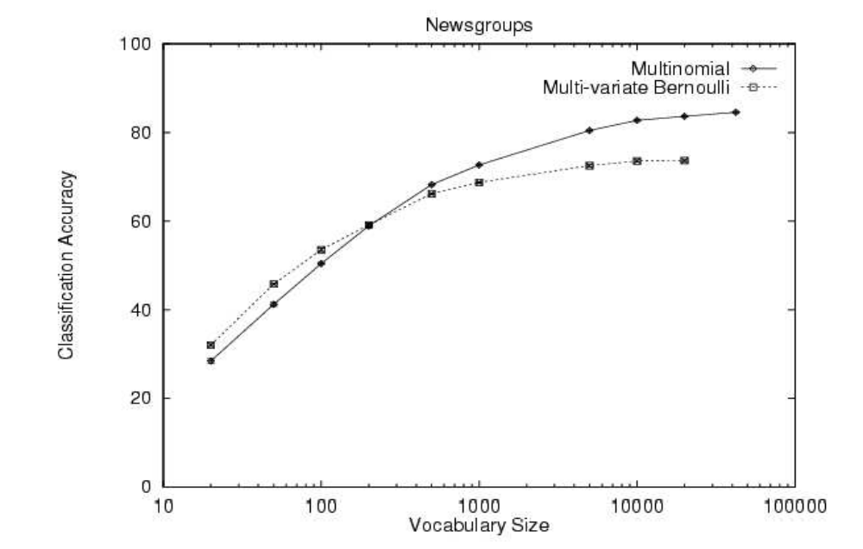
Model comparison
(McCallum & Nigam ’98)

Slide 12
One-class Naïve Bayes
Assume each command has equal probability for a masquerader.
Can only adjust the threshold of the probability to be user/self, i.e. ratio of the estimated probability to the uniform distribution.
Don’t need any information about masquerader at all.

Slide 13
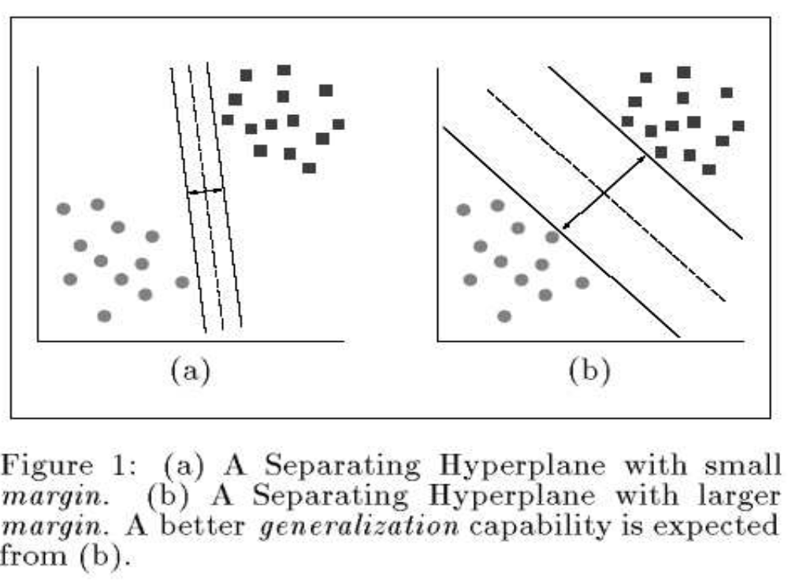
SVM (Support Vector Machine)

Slide 14
One-class SVM
Map data into feature space using kernel.
Find hyperplane S separating the positive data from the origin (negative) with maximum margin.
The probability that a positive test data lies outside of S is bounded by a prior v.
Relaxation parameters allow some outliers.

Slide 15
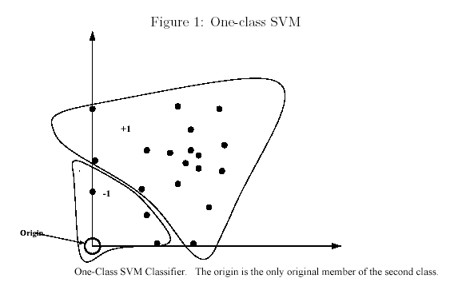
One-class SVM

Slide 16
Experimental setting (revisited)
50 users. Each user’s first 5,000 commands are clean, the rest 10,000 have randomly inserted dirty blocks from other 20 users.
First 5,000 as positive examples, and the first 5,000 commands of all other 49 users as negative examples.

Slide 17
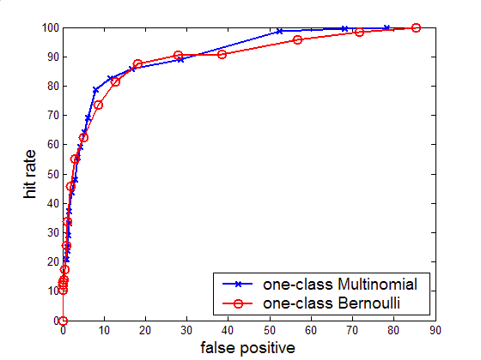
Bernoulli vs. Multinomial

Slide 18
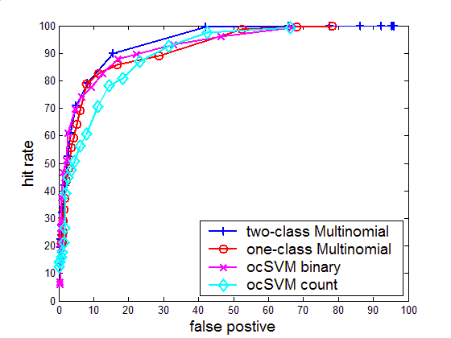
One-class vs. two-class result

Slide 19
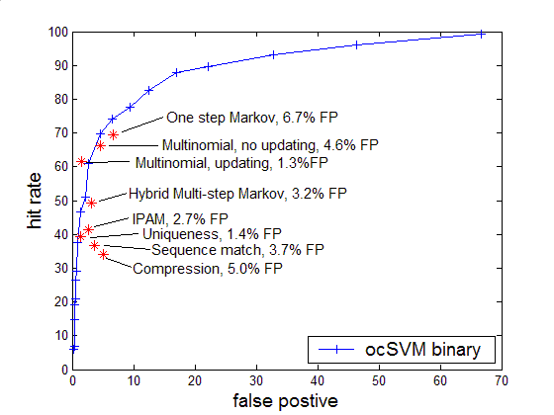
ocSVM binary vs. previous best-outcome results

Slide 20
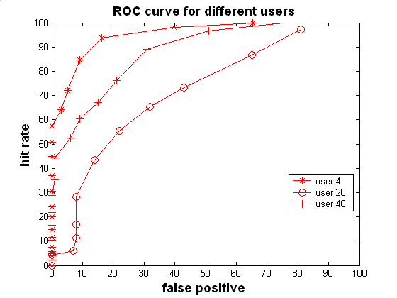
Compare different classifiers for multiple users
Same classifiers have different performance for different users. (ocSVM binary)

Slide 21
Problem with the dataset
Each user has a different number of masquerade blocks.
The origins of the masquerade blocks also differ.
So this experiment may not illustrate the real performance of the classifier.

Slide 22
Alternative data configuration 1v49
Only first 5,000 commands as user/self’s examples for training.
All other 49 users’ first 5,000 commands as masquerade data, against those clean data of self’s rest 10,000 commands.
Each user has almost the same masquerade block to detect.
Better method to compare the classifiers.

Slide 23
ROC Score
ROC score is the fraction of the area under the ROC curve, the larger the better.
A ROC score of 1 means perfect detection without any false positives.

Slide 24
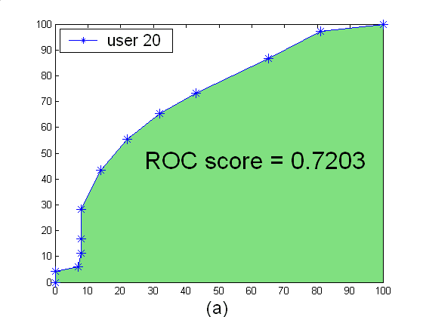
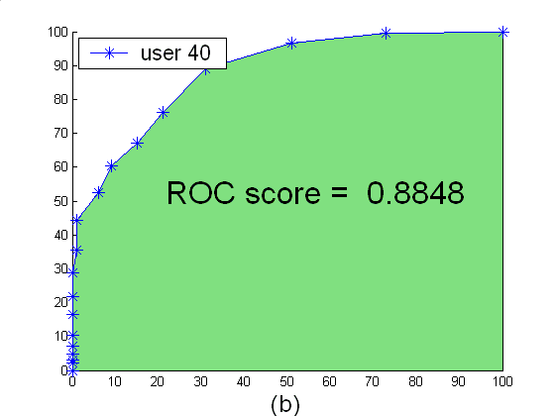
ROC Score

Slide 25
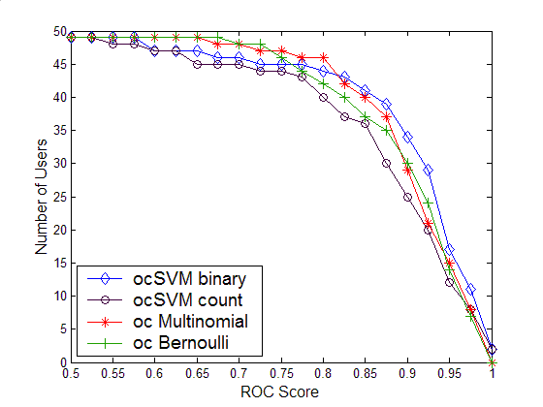
Comparison using ROC score

Slide 26
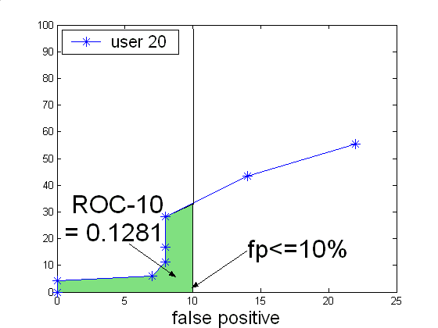
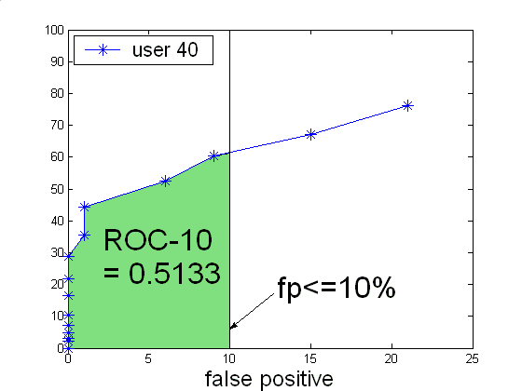
ROC-P Score: false positive<=p%

Slide 27
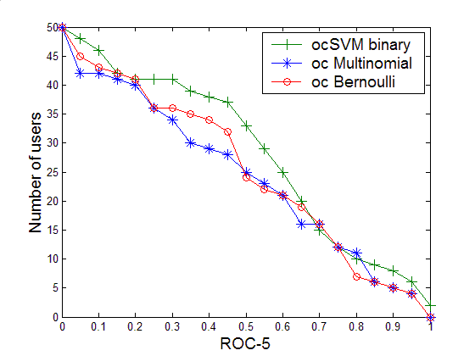
ROC-5: fp<=5%

Slide 28
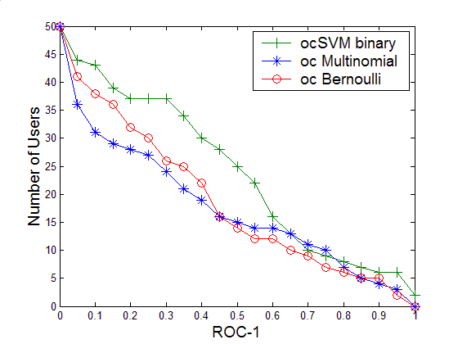
ROC-1: fp<=1%

Slide 29
Conclusion
One-class training can achieve similar performance as multiple class methods.
One-class training has practical benefits.
One-class SVM using binary feature is better, especially when the false positive rate is low.

Slide 30
Future work
Include command argument as features
Feature selection?
Real-time detection
Combining user commands with file access, system call

