Slide 1
machine learning for network intrusion detection

Slide 2
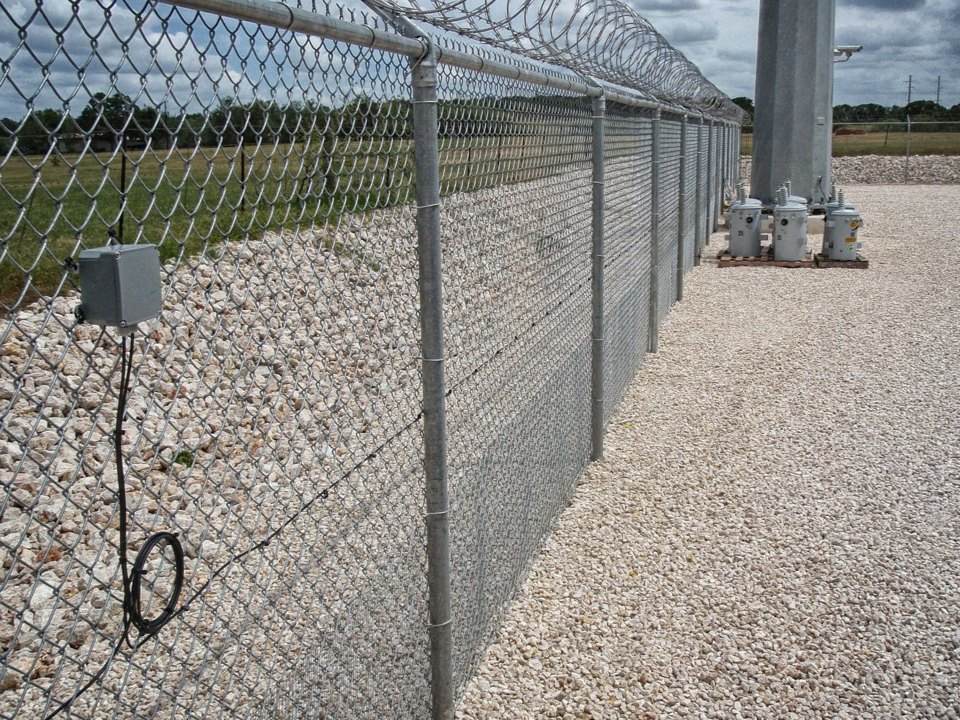
Intrusion detection Systems
device or application that monitors the network for malicious activities and produces reports to a management station.

Slide 3

Nids and hids
Network IDS (NIDS): The work by matching the traffic that passes on the subnets to a library of known attacks or by identifying deviations from a predefined notion of normal activity (anomaly detection)
Host IDS (HIDS) : Run on individual servers. If suspicious activity is detected, they take a snapshot of the system files and compare them to a previously taken snapshot to identify if there have been any changes.

Slide 4

Big question:
Why isn’t Machine Learning as successful for IDS as it is for other disciplines?

Slide 5
Challenges of Using machine learning for ids
Intrusion detection tries to find new kinds of attacks, but one can only train on normal traffic.
High cost of errors
Diversity of network traffic
Semantic Gap
Lack of training data.

Slide 6
Classification Problems
Inputs are divided into two or more classes, and the learner must produce a model that assigns unseen inputs to one or more of these classes. This is typically tackled in a supervised way.
Anomaly detection can be described as a classification problem: Activities are divided into “normal” and “not normal”.

Slide 7
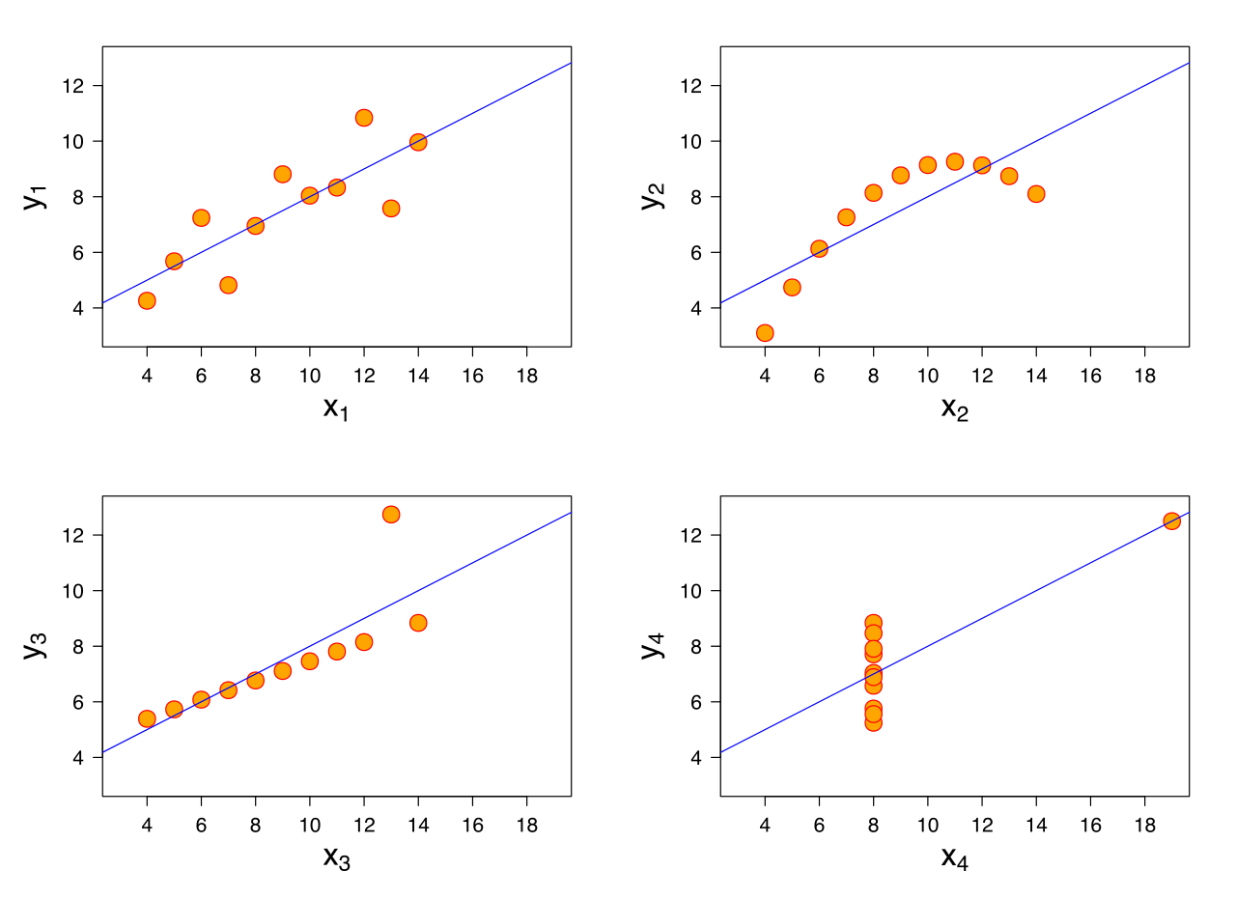
Outlier detection: Closed world assumption
The idea that specifying only positive examples and adopting the standing assumption that the rest are negative… is not of much practical use in real-life problems because they rarely involve “closed” worlds in which you can be certain that all cases have been covered.
Witten, Ian H., and Eibe Frank. Data Mining: Practical machine learning tools and techniques. Morgan Kaufmann, 2005.

Slide 8

High cost of errors
A very small rate of false positives can render a NIDS unusable: operators wasting too much time looking at incident reports of benign activity.
Even one false negative might compromise the entire IT infrastructure.

Slide 9
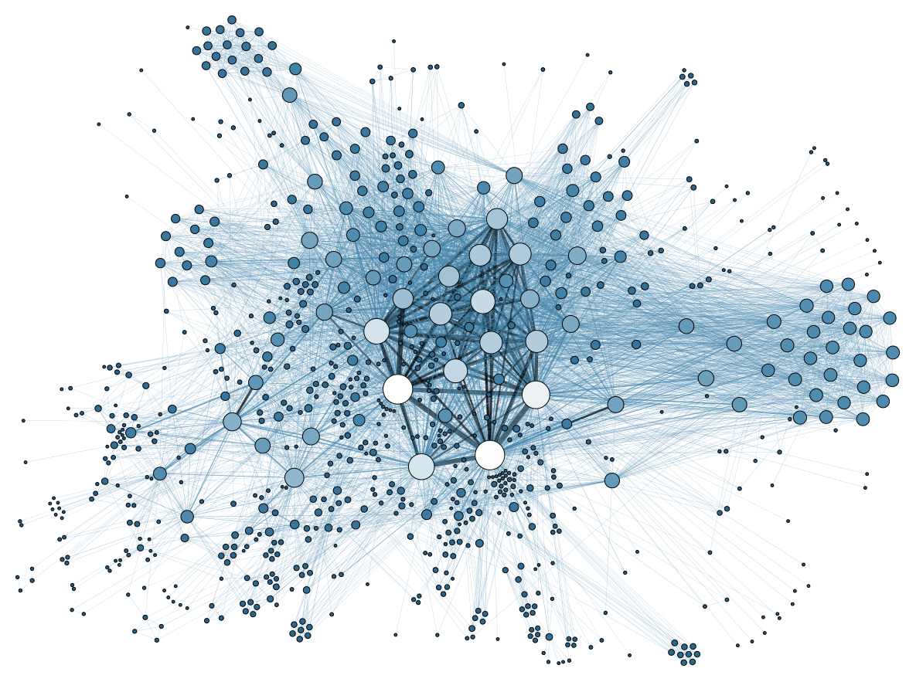
Diversity of network traffic
Network characteristics
Bandwidth
Duration of connections
Application mix
Can vary a lot, rendering them unpredictable over short intervals of time

Slide 10

Semantic gap
It is very challenging to translate the results from a classifier into a report that can be read by a human.
Systems are not designed to identify malicious behavior, but rather, behavior that has not been seen before.

Slide 11

Lack of training data
Only two publicly available datasets:
DARPA Network traces dataset
KDD Cup dataset.
Best way to train is real network data, but it is difficult to anonymize.
KDD

Slide 12
Recommendations for using machine learning in IDS
Understand what the system is doing
Understand the “Threat Model”
Target environment
Attack cost
Who are the attackers
Robustness requirements
Keep the scope narrow
Reduce the costs

Slide 13
spam filtering using support vector machines
*

Slide 14
Spam Classification
Spam emails can be recognized either by content or delivery manner.
Spam emails can be sent for commercial purposes (advertisement)
Fraudulent spam emails (phishing)
Spam emails might contain a piece of malicious code that might be harmful and cause a damage to the end user machines

Slide 15
ISP Spam filters
Some Internet service providers (ISPs) remove a lot of known spams before deposit them in user email accounts but a lot of spam emails bypass ISPs consuming the ISP’s CPU time

Slide 16
Spam Filtering and Machine Learning
Traditionally, many researchers have illustrated spam filtering problem as a case of text categorization.
However the nature and structure of email is richer than text (images, links, etc.)
Many researchers have focused on one portion of the email (headers, text, etc.) but a more complete approach is needed.

Slide 17
SVM Learning modes
Batch Filtering:
Training and testing sets are random samples drawn from a population.
Online Learning:
Spam filtering is a continuous task: Data is constantly collected and spam email characteristics evolve with time.

Slide 18
Transductive SVM
In traditional SVM the learner tries to build a model to approximate the whole problem space: The learner focuses on a universal model and a general purpose strategy for Spam detection.
TSVM estimates the value of the classification function: they use a large collection of unlabeled data with a few labeled examples for improving generalization performance
Margin-based classification,
Graph-based methods
Information regularization

Slide 19
Active Learning
Manual labeling is error-prone, time consuming and cost prohibitive.
Active learning strategies for SVM (Pool based approach)
Speculative sampling,
batch-simple,
error-reduction
angle-diversity

Slide 20
Conclusion
Spam filtering solutions generate acceptable, accurate results, but enhancement can be made by taking into account user feedback. Moreover, email content is richer than text, it has images, attachment, links, routing and meta information. Consequently, classifier might be improved if we consider such information

Slide 21
Poisoning Attacks
Attacks that inject specially crafted training data that increases the SVM's test error
Most learning algorithms assume that their training data comes from a natural or well-behaved distribution
This assumption does not generally hold in security-sensitive settings

Slide 22
Classification of Attacks
Attacks against learning algorithms can be classified, among other categories into:
causative (manipulation of training data) and
exploratory (exploitation of the classifier).
Poisoning refers to a causative attack in which specially crafted attack points are injected into the training data.

Slide 23
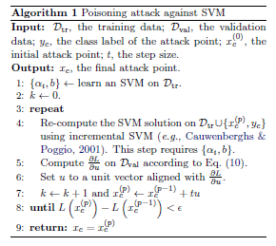

How does Poisoning work?
Given a training set $D=\left\{x_{i},y_{i}\right\}$, the goal is to find a point$\left(x_{c},y_{c}\right)$ whose addition to the training set maximally decreases the SVM classification accuracy.

