Slide 1
Basic Technical Concepts in Machine Learning
Introduction
Supervised learning
Problems in supervised learning
Bayesian decision theory
Notes:
What is machine learning?

Slide 2
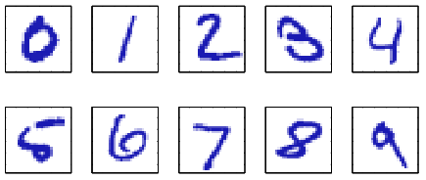
Ch1. Pattern Recognition & Machine Learning
Automatically discover regularities in data.
Based on regularities classify data into categories
Example:
Notes:
What is machine learning?

Slide 3
Pattern Recognition & Machine Learning
Supervised Learning:
Classification
Regression
Unsupervised Learning:
Clustering
Density Estimation
Dimensionality reduction
Notes:
What is machine learning?

Slide 4
Ch1. Pattern Recognition & Machine Learning
Introduction
Supervised learning
Problems in supervised learning
Bayesian decision theory
Notes:
What is machine learning?

Slide 5
Supervised Learning
Supervised Learning:
Training set x = {x1, x2, …, xN}
Class or target vector t = {t1, t2, …, tN}
Find a function y(x) that takes a vector x and outputs
a class t.
{(x,t)}
y(x)
Notes:
What is machine learning?

Slide 6
Supervised Learning
Medical example:
X = {patient1, patient2, …. patientN}
patient1 = (high pressure, normal temp., high glucose,…)
t1 = cancer
patient2 = (low pressure, normal temp., normal glucose,…)
t1 = not cancer
new patient = (low pressure, low temp., normal glucose,…)
t = ?
Notes:
What is machine learning?

Slide 7
Ch1. Pattern Recognition & Machine Learning
Introduction
Supervised learning
Problems in supervised learning
Bayesian decision theory
Notes:
What is machine learning?

Slide 8
Pattern Recognition & Machine Learning
Two problems in supervised learning:
Overfitting – Underfitting
Curse of Dimensionality
Notes:
What is machine learning?

Slide 9
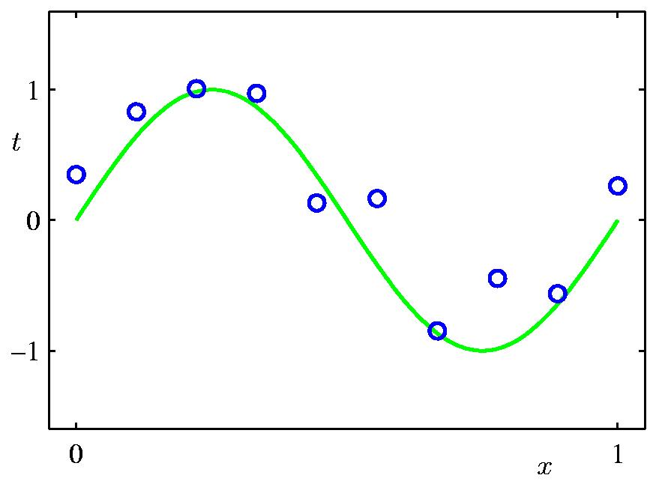
Pattern Recognition & Machine Learning
Example Polynomial Fitting (Regression):
Notes:
What is machine learning?

Slide 10
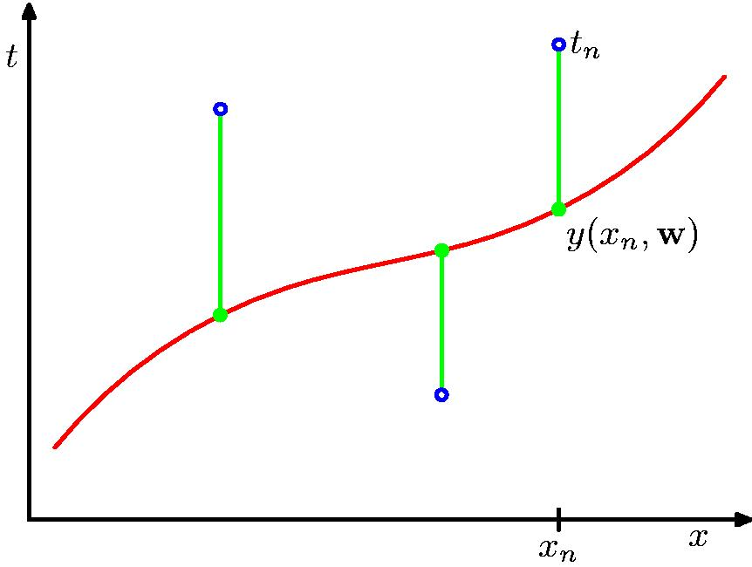
Pattern Recognition & Machine Learning
Minimize Error:
Notes:
What is machine learning?

Slide 11
Pattern Recognition & Machine Learning
If our function is linear:
y(x,w) = w0 + w1x + w2x² + … + wMX^{M}
Minimize error:
E(w) = ½ Σ_{n} {y(xn,w) – tn)²
What happens as we vary M?
Notes:
What is machine learning?

Slide 12
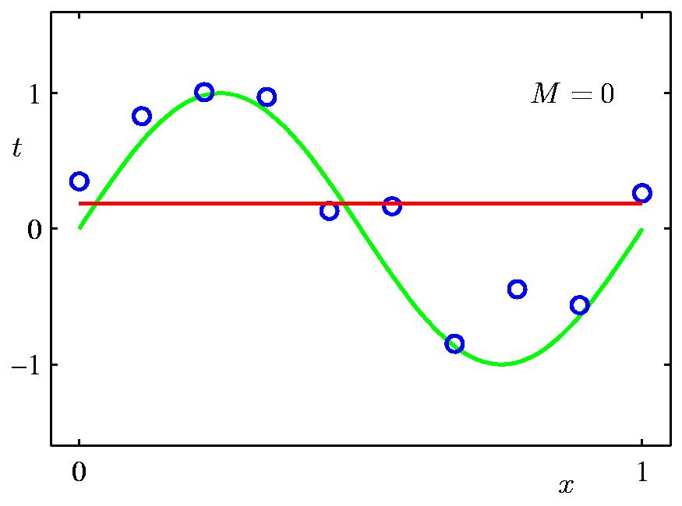
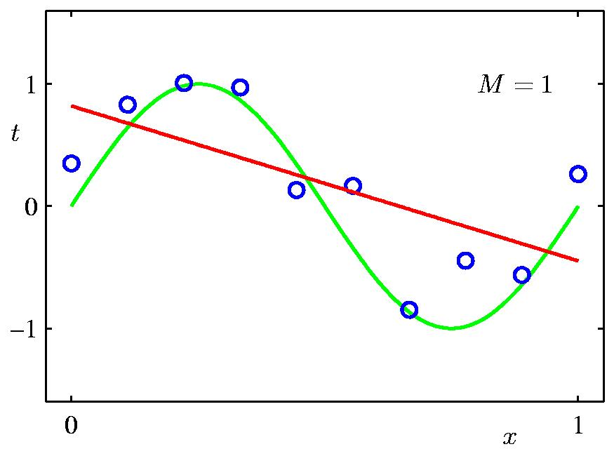
Underfitting
Underfitting
Notes:
What is machine learning?

Slide 13
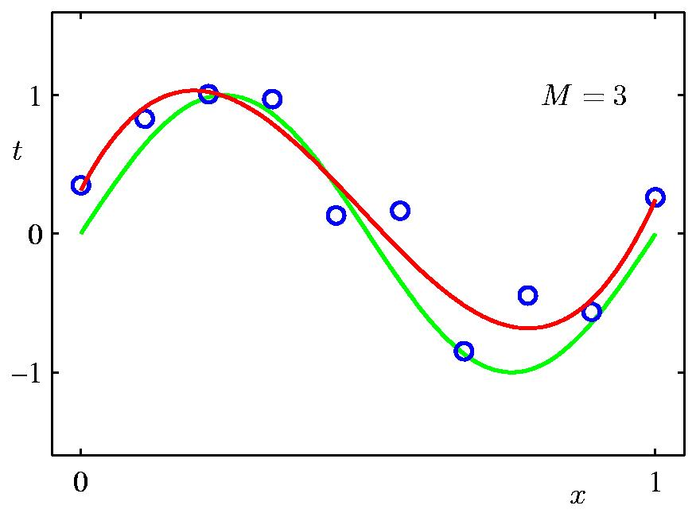
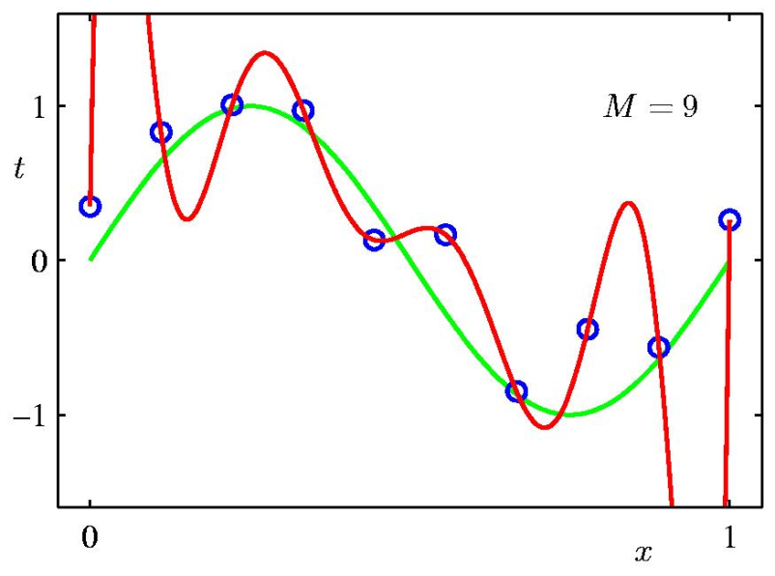
Overfitting
Overfitting
Notes:
What is machine learning?

Slide 14
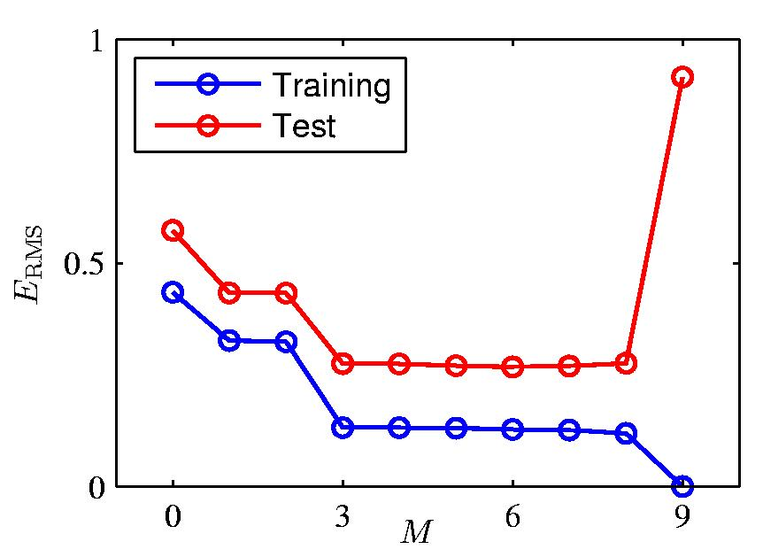
Pattern Recognition & Machine Learning
Root Mean Square Error (RSM)
Notes:
What is machine learning?

Slide 15
Regularization
One solution: Regularization
Penalize for models that are too complex:
Minimize error:
E(w) = ½ Σn {y(xn,w) – tn)2 + λ/2 ||w||²
Notes:
What is machine learning?

Slide 16
Pattern Recognition & Machine Learning
Two problems in supervised learning:
Overfitting – Underfitting
Curse of Dimensionality
Notes:
What is machine learning?

Slide 17
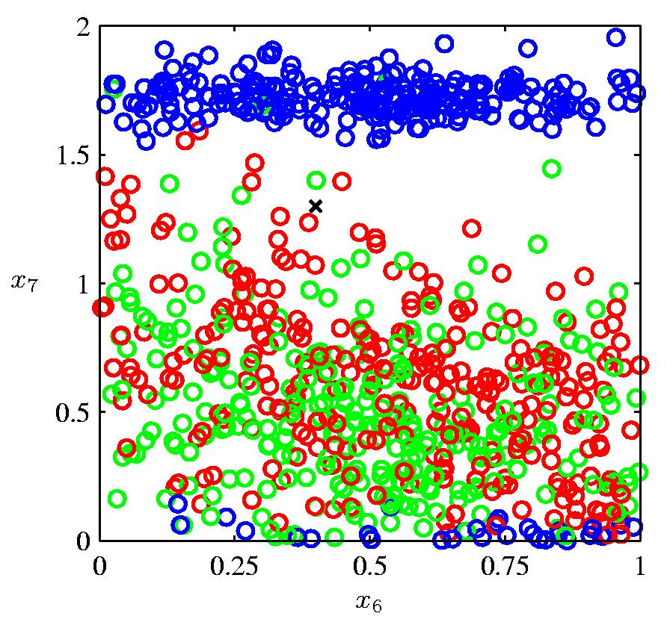
Curse of Dimensionality
Example: Classify vector x in one of 3 classes:
Notes:
What is machine learning?

Slide 18
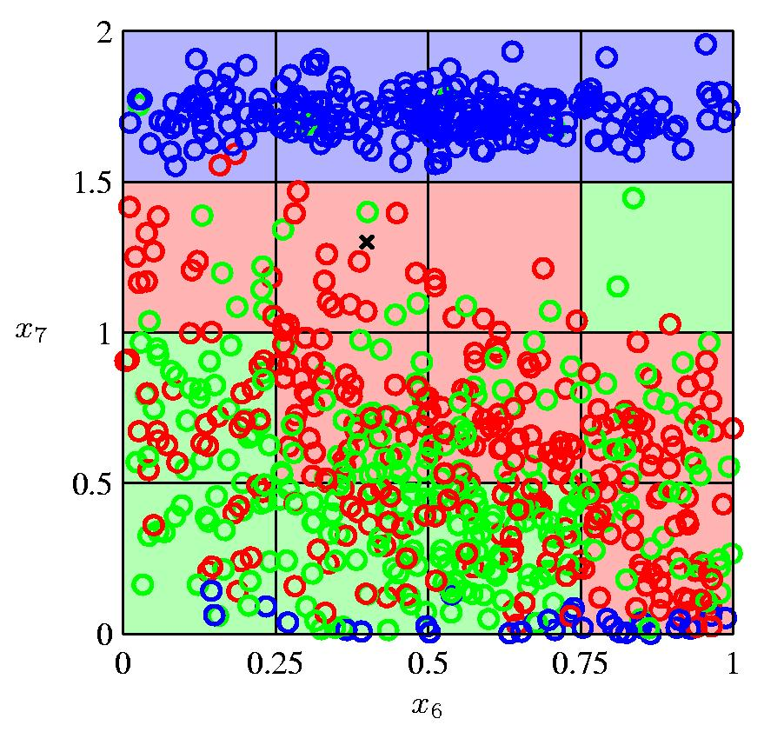
Curse of Dimensionaliy
Solution: Divide space into cells:
Notes:
What is machine learning?

Slide 19
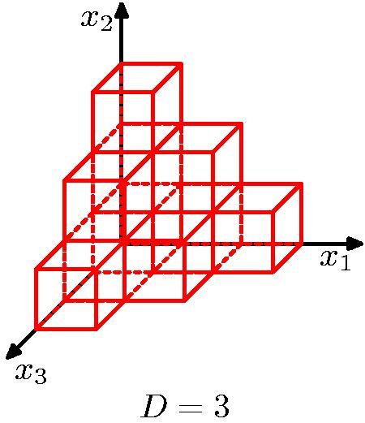
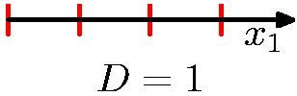
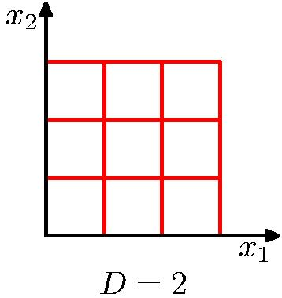
Curse of Dimensionality
But if the no. of dimensions is high we need to take
a huge amount of space to look at the ”neighborhood” of x.
Notes:
What is machine learning?

Slide 20
Introduction
Supervised learning
Problems in supervised learning
Bayesian decision theory
Notes:
What is machine learning?

Slide 21
Decision Theory
State of nature.
Let C denote the state of nature. C is a random variable.
(e.g., C = C1 for sea bass or C = C2 for salmon )
A priori probabilities.
Let P(C1) and P(C2) denote the a priori probability of C1
and C2 respectively.
We know P(C1) + P(C2) = 1.
Decision rule.
Decide C1 if P(C1) > P(C2); otherwise choose C2.

Slide 22
Basic Concepts
Class-conditional probability density function.
Let x be a continuous random variable.
p(x|C) is the probability density for x given the state of nature C.
For example, what is the probability of lightness given that the
class is salmon?
p(lightness | salmon) ?
Or what is the probability of lightness given sea bass?
P(lightness | sea bass) ?

Slide 23
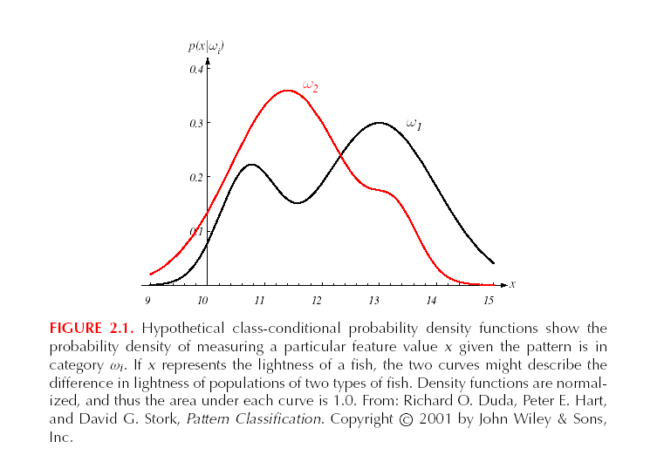
Figure 2.1

Slide 24
Bayes Formula
How do we combine a priori and class-conditional
Probabilities to know the probability of a state of nature?
Bayes Formula.
P(Cj | x) = p(x|Cj) P(Cj) / p(x)
prior probability
posterior
probability
evidence
likelihood
Bayes Decision:
Choose C1 if P(C1|x) > P(C2|x); otherwise choose C2.

Slide 25
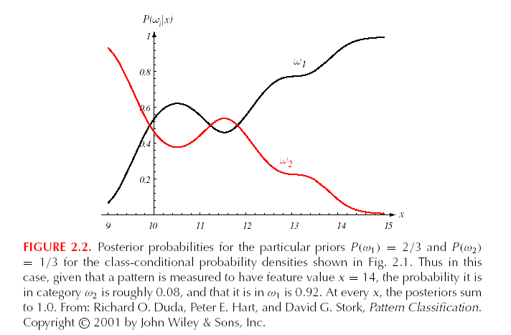
Figure 2.2

Slide 26
Minimizing Error
What is the probability of error?
P(error | x) = P(C1|x) if we decide C2
P(C2|x) if we decide C1
Does Bayes rule minimize the probability of error?
P(error) = ∫ P(error,x) dx = ∫ P(error|x) p(x) dx
and if for every x we minimize the error then P(error|x)
is as small as it can be.
Answer is “yes”.

Slide 27
Simplifying Bayes Rule
Bayes Formula.
P(Cj | x) = p(x|Cj) P(Cj) / p(x)
The evidence p(x) is the same for all states or classes so
we can dispense with it to make a decision.
Rule:
Choose C1 if p(x|C1)P(C1) > p(x|C2)P(C2);
otherwise decide C2
If p(x|C1) = p(x|C2) then decision depends on the priors
If P(C1) = P(C2) then decision depends on the likelihoods.

Slide 28
Loss Function
Let {C1,C2, …, Cc} be the possible states of nature.
Let {a1, a2, …, ak} be the possible actions.
Loss function
λ(ai|Cj) is the loss incurred for taking action ai when
the state of nature is Cj.
Expected loss
R(ai|x) = Σj λ(ai|Cj) P(Cj|x)
Decision: Select the action that minimizes the conditional risk
( ** best possible performance ** )

Slide 29
Zero-One Loss
We will normally be concerned with the
symmetrical or zero-one loss function:
λ (ai|Cj) = 0 if i = j
1 if i = j
In this case the conditional risk is:
R(ai|x) = Σj λ(ai|Cj) P(Cj|x)
= 1 – P(Ci|x)

