Slide 1
Perceptron as one Type of Linear Discriminants
Introduction
Design of Primitive Units
  Perceptrons
Security applications of perceptron
Notes:
What is machine learning?

Slide 2
Introduction
Artificial Neural Networks are crude attempts to model the
highly massive parallel and distributed processing we believe
takes place in the brain.
Consider:
1) the speed at which the brain recognizes images;
2) the many neurons populating a brain;
3) the speed at which a single neuron transmits signals.
Notes:
What is machine learning?

Slide 3
Introduction
Neural Network Representation
Left
Straight
Right
Output nodes
Internal nodes
Input nodes
Notes:
What is machine learning?

Slide 4
Introduction
Problems for Neural Networks
Examples may be described by a large number of attributes
(e.g., pixels in an image).
The output value can be discrete, continuous, or a vector of
either discrete or continuous values.
Data may contain errors.
The time for training may be extremely long.
Evaluating the network for a new example is relatively fast.
Interpretability of the final hypothesis is not relevant (the
NN is treated as a black box).
Notes:
What is machine learning?

Slide 5
Perceptron as one Type of Linear Discriminants
Introduction
Design of Primitive Units
  Perceptrons
Notes:
What is machine learning?

Slide 6
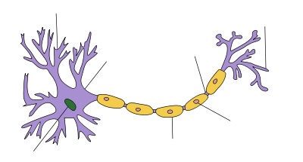
Perceptron as one Type of Linear Discriminants
Dendrites
Axon Terminal
Soma
Axon
Nucleus
(image copied from wikipedia, entry on “neuron”)
Notes:
What is machine learning?

Slide 7
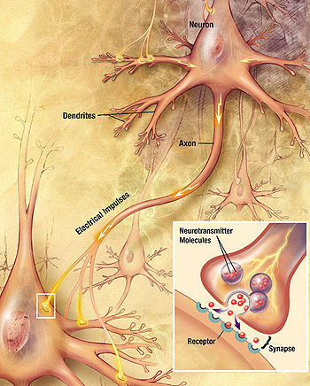
Perceptron as one Type of Linear Discriminants
(image copied from wikipedia, entry on “neuron”)
Notes:
What is machine learning?

Slide 8
Design of Primitive Units
Perceptrons
Definition.- It’s a step function based on a linear combination
of real-valued inputs. If the combination is above a threshold
it outputs a 1, otherwise it outputs a –1.
x₁
w₁
x₂
w₂
Σ
{1 or –1}
w₀
x_{n}
w_{n}
X₀=1
Notes:
What is machine learning?

Slide 9
Design of Primitive Units
Learning Perceptrons
1 if w₀ + w₁x₁ + w₂x₂ + … + w_{n}x_{n} > 0
-1 otherwise
O(x₁,x₂,…,x_{n}) =
To simplify our notation we can represent the function as follows:
O(X) = sgn(WX) where
sgn(y) =
1 if y > 0
-1 otherwise
Learning a perceptron means finding the right values for W.
The hypothesis space of a perceptron is the space of all
weight vectors.
Notes:
What is machine learning?

Slide 10
Design of Primitive Units
Representational Power
A perceptron draws a hyperplane as the decision boundary
over the (n-dimensional) input space.
Decision boundary (WX = 0)
+
+
+
-
-
-
Notes:
What is machine learning?

Slide 11
Design of Primitive Units
Representational Power
A perceptron can learn only examples that are called
“linearly separable”. These are examples that can be perfectly
separated by a hyperplane.
+
+
+
+
+
-
-
-
-
+
-
-
Linearly separable
Non-linearly separable
Notes:
What is machine learning?

Slide 12
Design of Primitive Units
Functions for Perceptrons
Perceptrons can learn many boolean functions:
AND, OR, NAND, NOR, but not XOR
AND:
x₁
W₁=0.5
Σ
W₂=0.5
x₂
W₀ = -0.8
X₀=1
Every boolean function can be represented with a
perceptron network that has two levels of depth or more.
Notes:
What is machine learning?

Slide 13
Design of Primitive Units
Design a two-input perceptron that implements the
Boolean function X₁ OR ~X₂ (X₁ OR not X₂).
Assume the independent weight is always +0.5
(assume W₀ = +0.5 and X₀ = 1). You simply have to
provide adequate values for W₁ and W₂.
x₁
W₁=?
Σ
W₂=?
x₂
W₀ = +0.5
x₀=1
Notes:
What is machine learning?

Slide 14
Design of Primitive Units
X₁ OR ~X₂ (X₁ OR not X₂).
x₁
W₁=?
Σ
W₂=?
x₂
W₀ = +0.5
x₀=1
Notes:
What is machine learning?

Slide 15
Design of Primitive Units
There are different solutions, but a
general solution is that:
W₂ < -0.5
W₁ > |W₂| - 0.5
where |x| is the absolute value of x.
x₁
(X₁ OR not X₂).
W₁=1
Σ
W₂= -1
x₂
W₀ = +0.5
x₀=1
Notes:
What is machine learning?

Slide 16
Design of Primitive Units
Perceptron Algorithms
How do we learn the weights of a single perceptron?
Perceptron rule
Delta rule
Algorithm for learning using the perceptron rule:
Assign random values to the weight vector
Apply the perceptron rule to every training example
Are all training examples correctly classified?
  Yes. Quit
  No. Go back to Step 2.
Notes:
What is machine learning?

Slide 17
Design of Primitive Units
A. Perceptron Rule
The perceptron training rule:
For a new training example X = (x₁, x₂, …, x_{n}),
update each weight according to this rule:
w_{i} = w_{i} + Δw_{i}
Where Δw_{i} = η (t-o) x_{i}
t: target output
o: output generated by the perceptron
η: constant called the learning rate (e.g., 0.1)
Notes:
What is machine learning?

Slide 18
Design of Primitive Units
A. Perceptron Rule
Comments about the perceptron training rule:
If the example is correctly classified the term (t-o) equals
zero, and no update on the weight is necessary.
If the perceptron outputs –1 and the real answer is 1,
the weight is increased.
If the perceptron outputs a 1 and the real answer is -1,
the weight is decreased.
Provided the examples are linearly separable and a small
value for η is used, the rule is proved to classify all training
examples correctly (i.e, is consistent with the training data).
Notes:
What is machine learning?

Slide 19
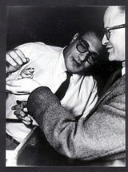
Historical Background
Early attempts to implement artificial neural networks:
McCulloch (Neuroscientist) and Pitts (Logician) (1943)
Based on simple neurons (MCP neurons)
Based on logical functions
Walter Pitts (right)
(extracted from Wikipedia)
Notes:
What is machine learning?

Slide 20
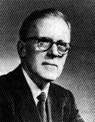
Historical Background
Donald Hebb (1949)
The Organization of Behavior.
“Neural pathways are strengthened
every time they are used.”
Picture of Donald Hebb
(extracted from Wikipedia)
Notes:
What is machine learning?

Slide 21
Design of Primitive Units
B. The Delta Rule
What happens if the examples are not linearly separable?
To address this situation we try to approximate the real
concept using the delta rule.
The key idea is to use a gradient descent search.
We will try to minimize the following error:
E = ½ Σ_{i} (t_{i} – o_{i}) ²
where the sum goes over all training examples.
Here o_{i} is the inner product WX and not sgn(WX)
as with the perceptron algorithm.
Notes:
What is machine learning?

Slide 22
Design of Primitive Units
B. The Delta Rule
The idea is to find a minimum in the space of weights and
the error function E:
E(W)
w₁
w₂
Notes:
What is machine learning?

Slide 23
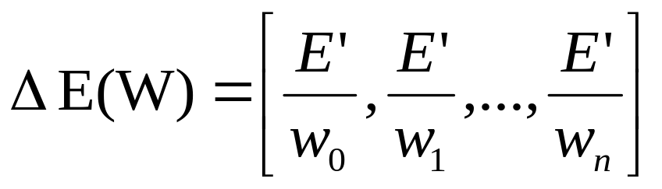
Design of Primitive Units
Derivation of the Rule
The gradient of E with respect to weight vector W,
denoted as E(W) :
E(W) is a vector with the partial derivatives of E with respect
to each weight w_{i}.
Key concept:
The gradient vector points in the direction with the
steepest increase in E.
Δ
Δ
Notes:
What is machine learning?

Slide 24
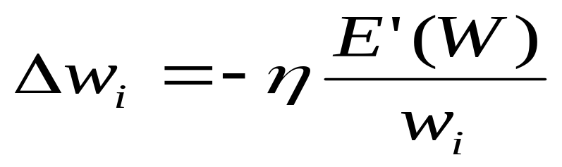
Design of Primitive Units
B. The Delta Rule
The delta rule:
For a new training example X = (x₁, x₂, …, x_{n}),
update each weight according to this rule:
w_{i} = w_{i} + Δw_{i}
Where
η: learning rate (e.g., 0.1)
Notes:
What is machine learning?

Slide 25
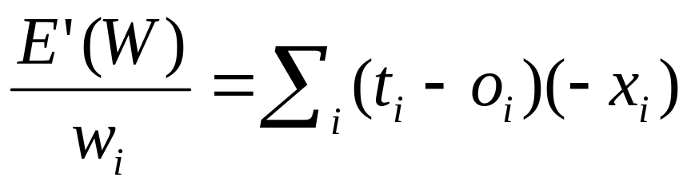
Design of Primitive Units
The gradient
How do we compute E(W)?
It is easy to see that
So that gives us the following equation:
∆ w_{i} = η Σ_{i} (t_{i} – o_{i}) x_{i}
Δ
Notes:
What is machine learning?

Slide 26
Design of Primitive Units
The algorithm using the Delta Rule
Algorithm for learning using the delta rule:
Assign random values to the weight vector
Continue until the stopping condition is met
  Initialize each ∆w_{i} to zero
  For each example:
    Update ∆w_{i}:
    ∆w_{i} = ∆w_{i} + n (t – o) x_{i}
  Update w_{i}:
    w_{i} = w_{i} + ∆w_{i}
Until error is small
Notes:
What is machine learning?

Slide 27

Historical Background
Frank Rosenblatt (1962)
He showed how to make incremental
changes on the strength of the synapses.
He invented the Perceptron.
Minsky and Papert (1969)
Criticized the idea of the perceptron.
Could not solve the XOR problem.
In addition, training time grows exponentially
with the size of the input.
Picture of Marvin Minsky (2008)
(extracted from Wikipedia)
Notes:
What is machine learning?

Slide 28
Design of Primitive Units
Difficulties with Gradient Descent
There are two main difficulties with the gradient descent
method:
Convergence to a minimum may take a long time.
2. There is no guarantee we will find the global minimum.
Notes:
What is machine learning?

Slide 29
Design of Primitive Units
Stochastic Approximation
Instead of updating every weight until all examples have been
observed, we update on every example:
∆ w_{i} = η (t-o) x_{i}
In this case we update the weights “incrementally”.
Remarks:
-) When there are multiple local minima stochastic gradient descent
may avoid the problem of getting stuck on a local minimum.
-) Standard gradient descent needs more computation but can be
used with a larger step size.
Notes:
What is machine learning?

Slide 30
Design of Primitive Units
Difference between Perceptron and Delta Rule
The perceptron is based on an output from a step function,
whereas the delta rule uses the linear combination of inputs
directly.
The perceptron is guaranteed to converge to a consistent
hypothesis assuming the data is linearly separable. The delta
rules converges in the limit but it does not need the condition
of linearly separable data.
Notes:
What is machine learning?

