Slide 1
Machine Learning for Computer Security
What you will learn ….
Current problems of computer security
Detection and prevention of unknown attacks
Large-scale analysis of security data, e.g. malware
Development of “intelligent” defenses
Machine learning as a tool for tacking
Key concepts of learning theory
Unsupervised and supervised learning algorithms
Features and feature spaces

Slide 2
Module Contents
Introduction to probabilistic learning
Learning theory
Feature design
Decision trees
Neural networks
Support Vector Machines
Clustering and classification of malware
Learning-based anomaly and intrusion detection methods
Special topics on security

Slide 3
What you will need …
Knowledge in core computer science
Computer security and operating systems
Network communication and protocols
Basic knowledge of:
Probability
Statistics
Linear algebra
Optimization
The “Hacker Spirit”
Eagerness to understand how things work
Some endurance, if things get tricky

Slide 4

Machine Learning
Machine learning = Branch of Artificial Intelligence
No science fiction please! We are talking algorithms

Slide 5
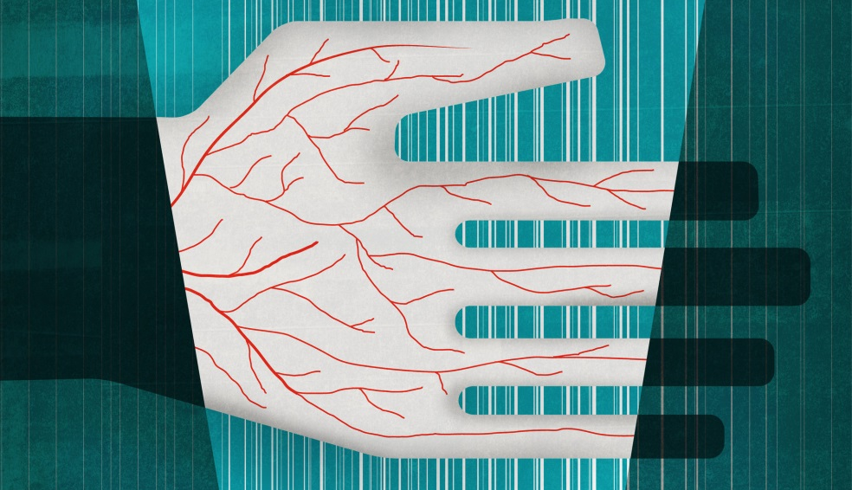
Machine Learning
Theory and practice of making computers learn
Automatic inference of dependencies from data
Generalization of dependencies; ↯ not simple memorization
Application of learned dependencies to unseen data
Example: Palm print recognition
Dependencies: biometric data identity

Slide 6
Hurdles for Learning
Computer security not the usual learning domain
Semantic gaps → what is actually learned?
Operational constraints → what do errors cost?
Need for transparency → why does the system work?
Unfortunate divergence of research objectives
Defense
Defense
Learning
Learning
Threats
Threats
Learning community
Security community

Slide 7
A Particular Example
Spam blocker
Sort incoming messages on an email account according to two classes:
Spam or
Valid messages
Steps:
Preprocessing (segmentation)
Feature extraction (measure features or properties)
Classification (make final decision)

Slide 8
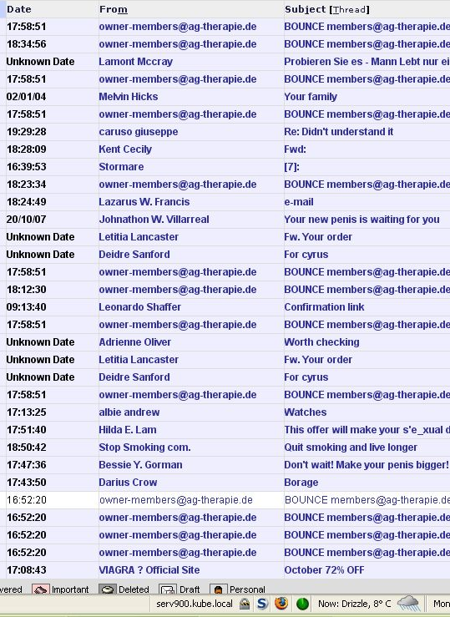
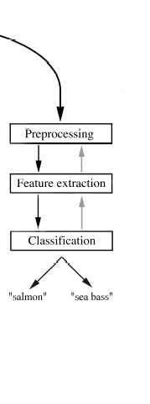
Figure 1.1
“valid message”
“spam”

Slide 9
Histograms
We decide to use “message subject” as the first feature.
Classification is then easy:
Decide Valid Message if length l < l*
Decide Spam if length l > l*
(l* : critical threshold)
Some features may give poor results.
Part of the design of pattern recognition systems
is to find the right features to discriminate between classes.
What if we try number of hyperlinks in the message?

Slide 10
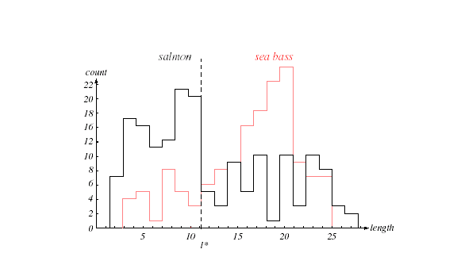

Figure 1.2
valid message
spam
count
22
20
18
16
12
10
8
6
4
2
0
length
5
10
15
20
25
$$h^{∗}$$

Slide 11
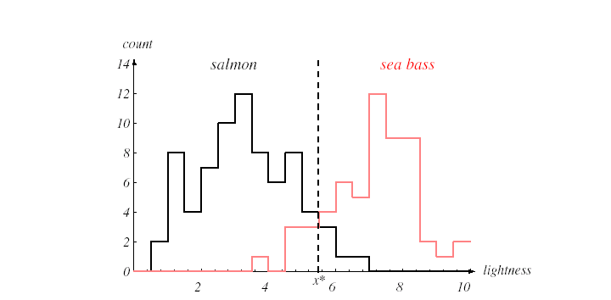

Figure 1.3
count
14
valid message
spam
12
10
8
6
4
2
0
number of
hyperlinks
2
4
$$h^{∗}$$
6
8
10

Slide 12
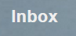
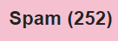
Decision Theory
Most times we assume “symmetry” in the cost.
(e.g., it is as bad to misclassify spam as valid messages).
That is not always the case:
Case 1.
Case 2.
Spam message in the inbox
X Work email in the spam folder

Slide 13
Decision Boundary
We will normally deal with several features at a time.
An object will be represented as a feature vector
X =
x1
x2
Our problem then is to separate the space of feature values
into a set of regions corresponding to the number of classes.
The separating boundary is called the decision boundary.

Slide 14
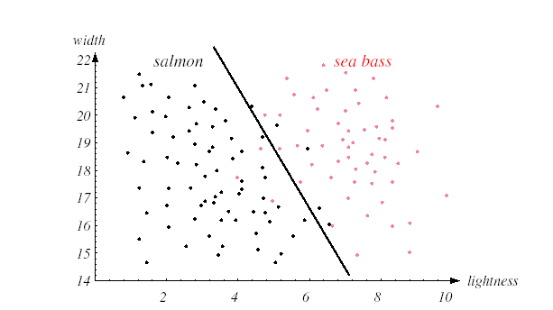
Figure 1.4
length
22
valid message
spam
21
20
19
18
17
16
15
14
number of
hyperlinks
2
4
6
8
10

Slide 15
Generalization
The main goal of pattern classification is as follows:
To generalize or suggest the class or action of objects
as yet unseen.
Some complex decision boundaries are not good at generalization.
Some simple boundaries are not good either.
One must look for a tradeoff between performance and complexity
This is at the core of statistical learning theory

Slide 16
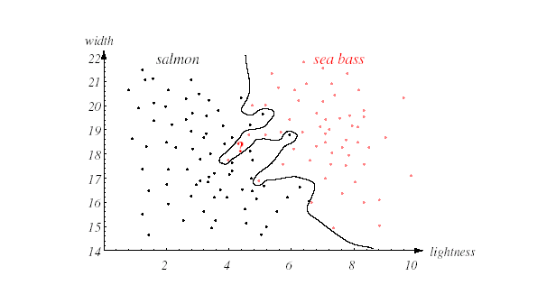
Figure 1.5
length
22
valid message
spam
21
20
19
18
17
16
15
number of
hyperlinks
14
2
4
6
8
10

Slide 17
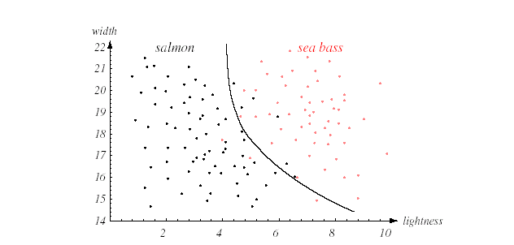
Figure 1.6
length
22
valid message
spam
21
20
19
18
17
16
15
14
number of
hyperlinks
2
4
6
8
10

Slide 18
Related Fields
Image processing
Input: image; output: image.
Associative memory
Input: pattern: output: pattern representative of groups of patterns
Regression
Predict values for new input (e.g., linear regression)
Interpolation
Predict the function for ranges of input
Density estimation
Estimate the probability density of input members

Slide 19
The Connection to Learning and Adaptation
Computer
Learning
Algorithm
Class of Tasks T
Performance P
Experience E
Supervised learning
Unsupervised learning
Reinforcement learning

Slide 20
References
Material taken from:
Chapters 1 and 2:
Pattern Classification by Duda, Hart and Stork,
2nd Edition Wiley-Interscience

