Slide 1
Data pre-processing for neural networks

Slide 2
Why
NNs learn faster and give better performance if the input variables are pre-processed before being used to train the network.
Bear in mind that exactly the same pre-processing should be done to the test set, if we are to avoid peculiar answers from the network.

Slide 3
But first
Can we split the problem to simplify things for the NN?
For example, if half your customers have identical details and identical result, why not partition this off to another system and leave the NN to deal with the other 50% of more difficult customers

Slide 4
And second
We must not train then network on one problem and then test it on another: for example training it on all of our low-income customers, then testing it on our high income customers
NNs (and statistical systems) can interpolate well but are poor at extrapolating

Slide 5
And third
Beware of Catastrophic Forgetting!
This is where we train the network to do task A, then train it to do Task B, and then find out it has forgotten how to do task A!
Solution is to mix data for tasks A and B together and train it to do both at same time

Slide 6
Scaling
One of the reasons for scaling the data is to equalise the importance of variables.
For example, if one input variable ranges between 1 and 10000, and another ranges between 0.1 and 0.001, the network should be able to learn to use tiny input weights for the first variable and huge weights for the second variable.

Slide 7
Scaling
However we are asking a lot of the network to cope with these different ranges.
We are initially starting training by telling network that one variable is thousands of times more important than the other
Network will probably find correct weights, but why not make its task easier? - by giving it data scaled in such a way that all the weights can remain in small, similar, predictable ranges.

Slide 8
Scaling
To scale the data for a particular input X, find the maximum X (maxX) for that input, the minimum X (minX) and find the scaled value of any input X
scaledX = (X - minX)/(maxX - minX)
So for example, if maxX = 80, minX = 20 and we want to scale the value of X which is 50:
scaledX = (50-20)/(80-20)
= 0.5

Slide 9
Transformations
A common way of dealing with data that is not normally distributed is to perform some form of mathematical transformation on the data that shifts it towards a normal distribution.

Slide 10
Trends
Statistical and numerical measures of trends in historical data can also be quite useful.
For example a financial analyst might be interested in the pattern of cash flow for a company over the previous five years, or a marketing specialist might be interested in the trend in sales of certain product over the past six months.

Slide 11
Trends
In situations such as these, it is often useful to extract the most salient information from the trend data and present the neural network with only a summary measure.
Typically analysts are interested in three aspects of a variable’s trend:
What is the current status of the variable? This is just the most recently available value for the variable.

Slide 12
Trends
How volatile is the variable over time?
This can be measured using the standard deviation of the data series.
This can then be normalised by dividing it by the absolute value of the mean of the points in the series (assuming the mean is not 0). Normalisation is necessary to make comparisons across series with differing scales.

Slide 13
Trends
In what direction is the variable moving? & To what degree is the variable moving?
The simplest way of doing this is to calculate the percentage change in the variable from the previous period:

Slide 14
Trends
However this only captures the most recent change in the variable and may be misleading if the underlying data series is highly volatile.
Also, the percent change is only valid if both values are positive.
More robust numerical values calculate the first derivative of the line through a series of data points using numerical differentiation techniques

Slide 15
Seasonality
Another aspect of trend analysis that could affect the results is the seasonal or time-lagged aspect of some types of data.
Some phenomena have a natural cyclicality associated with them.
If a variable exists which has this form, it may not be appropriate to compare values if they are taken from different phases of a cycle.

Slide 16
Seasonality
For example, when examining the change in quarterly sales volume in a department store, we should consider that the volume in the last quarter of the year (i.e. around Christmas) will probably be much higher than in the first quarter.
To address this problem many analysts compare quarterly data on a lagged basis. Lagging data simply means comparing the current period’s data with the previous corresponding periods in the cycle.

Slide 17
Seasonality
For higher frequency time series such as those found in market prediction or signal-processing problems, it may be more appropriate to use more sophisticated curve fitting techniques such as fast-Fourier transforms or wavelets, both of which estimate curves by building equations of mathematical and/or trigonometric functions.

Slide 18
Categories
One of the most frequent mistakes made in constructing NN models is incorrect coding of categories
Case study - in a bioinformatics application the shape of a sequence of amino acids making up a protein can take three forms:
alpha helix (A)
beta-sheet (B)
random coil (C)

Slide 19
Categories
Given that we like to keep the number of inputs to a NN down, to reduce training time and avoid overfitting (discussed later) a sensible coding scheme seems to be to have a single unit, with input values:
A = 0
B = 0.5
C = 1

Slide 20
Categories
This is absolutely the worst way to do this, as we are telling the network:
‘Beta sheet is larger than alpha helix’, and:
‘Random coil is twice the size of beta sheet’

Slide 21
Categories
This is nonsense, as it is similar to saying:
‘Red is bigger than green’, and:
‘Yellow is twice as big as red’

Slide 22
Categories
With this input representation, we would be deliberately confusing the network. A far better representation is to use 3 binary input units, as in:
A = 1 0 0
B = 0 1 0
C = 0 0 1

Slide 23
Thermometer coding
Ordinal variables (where there is some ranking, but differences between variables cannot be ranked)
For example, ‘desirability of location’ (of property) which could be ranked as ‘very low’, ‘low’, ‘medium’, ‘high’ or ‘very high’. We could use 1 variable with: very low = 0, low = 0.25, medium = 0.5, high = 0.75 and very high = 1

Slide 24
Thermometer coding
However, this would be confusing to the network. For example, we are telling it that ‘a high location is exactly 3 times more than a low location’, which does not make sense

Slide 25
Thermometer coding
It is better to code this variable as (n-1) = 4 binary inputs:
very low = 0 0 0 0
low = 1 0 0 0
medium = 1 1 0 0
high = 1 1 1 0
very high = 1 1 1 1

Slide 26
Thermometer coding
For each given input value, turn on the corresponding neuron and all the neurons less than it
In fact, there is no theoretical need for turning on neurons below the one designating the variable’s value. The same information could be conveyed by turning on just one neuron

Slide 27
Thermometer coding
However, training is usually faster with this method
Each neuron makes a contribution to a decision, and larger values retain the contributions of smaller values

Slide 28
Circular discontinuity
Sometimes the variables we present to neural networks are fundamentally circular.
Examples are a rotating piece of machinery, or the dates in the calendar year.
These variables introduce a special problem due to the fact that they have a discontinuity, i.e. we have a serious problem as the object passes from 360 degrees to 0 degrees or from 31st December to 1st January (i.e. day 365 to day 1).

Slide 29
Circular discontinuity
If we use a single input neuron to represent this value, we find that two extremely close values such as 359 degrees and 1 degree or 31st December and 1st January are represented by two extremely different activations, nearly full on and nearly full off.
We are deliberately lying to the network by telling it these degrees/dates are far apart!

Slide 30
How to handle?
Could have 365 binary inputs, all being 0 except the one for that particular day, which would be set to 1
Would then run into terrible problems with training time and overfitting

Slide 31
How to handle?
The best way to handle circular variables is to encode them using two neurons.
We find new variables which change smoothly as the circular variable changes, and whose values when taken together are in a one-to one relationship with the circular variable.

Slide 32
Circular discontinuity
The most common transformation is to make sure our original variable is normalised to lie in the range 0 to 359 and then create two new variables as inputs to the network. If our original variable is X then the two new variables are:
Var 1 = sin(X)
Var 2 = cos(X)

Slide 33
Network Architecture
Three layer MLP in theory should be able to model any function (according to Kolmogorov)
However, theory assumes a hidden layer of up to infinite size
In practice three layer nets usually OK, but for some problems you will get better results with an additional hidden layer

Slide 34
Network outputs and error calculation
If output(s) should be categories (NN is a classifier), output(s) should be a logistic function trained by the error between output and target or a soft-max function with a cross-entropy error term should be calculated between outputs and targets
If output(s) should be real numbers (NN is performing regression), output(s) should be linear and a mean-square error term should be calculated between outputs and targets

Slide 35
Training algorithm
Back-propagation now long in the tooth (but easy to code if you are writing your own network)
Modern algorithms (such as Scaled Conjugate Gradients) approximately 30 times faster
Some algorithms more suitable to classification problems, some to regression

Slide 36
Partitioning training data
Typically have three sets of training data
Training data (used when training the network, errors from this dataset used by weight change algorithm)
Validation data (used to periodically test network as it trains, to prevent overfitting)
Test data (used when training has finished to test generalisation ability of network to data it has never seen before)

Slide 37
Splitting the data
Make sure each of the three sets of data is representative of the whole dataset
Randomly allocate data to each set
Ensure each set contains the full range of the data the network is to encounter

Slide 38
Numbers in each class
Must ensure that the numbers of each class we are trying to model are equivalent in the data
For example, imagine a dataset containing 99 dogs and 1 cat
Network can achieve 99% correct by just saying ‘dog’ all the time!

Slide 39
Solution?
Ideal solution is to go out and find data on another 98 cats, so giving 99 of each class in the dataset
May not always be possible, so we have to make copies of the less frequent class in the dataset until the numbers are equal

Slide 40
Overfitting
A primary problem to consider when building network is how to prevent overfitting
Overfitting is when the network performs well on the training set, but poorly on the test set
Network is becoming too well fitted to the training data

Slide 41
Overfitting
Consider two networks (A and B) that have been trained to categorize two types of widget, X and Y
Then a test example (Z) is presented, that the network has not seen before

Slide 42
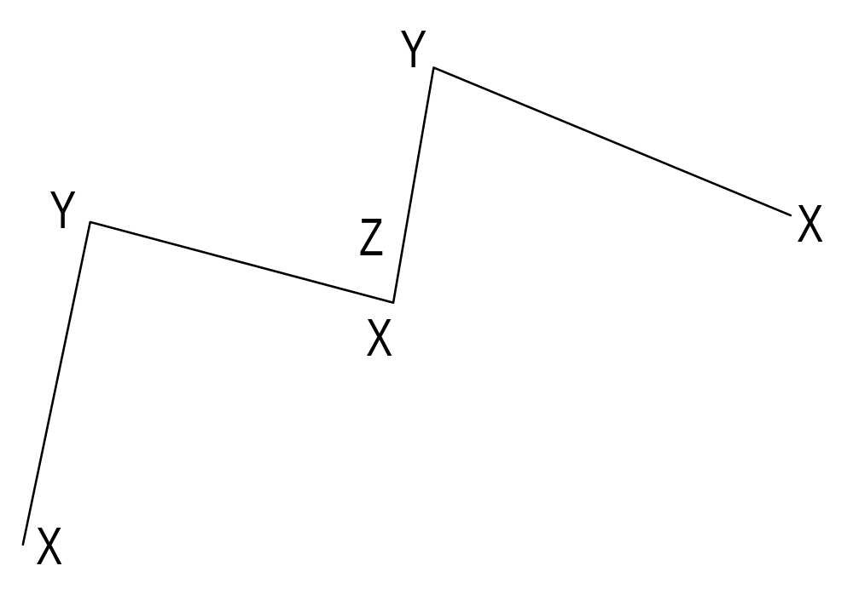
First NN ‘A’ with overfitted decision surface

Slide 43
Overfitting
The network with the overfitted decision surface wrongly classified Z as a Y, when really it is an X
A network with a smoother decision surface would not make this mistake

Slide 44
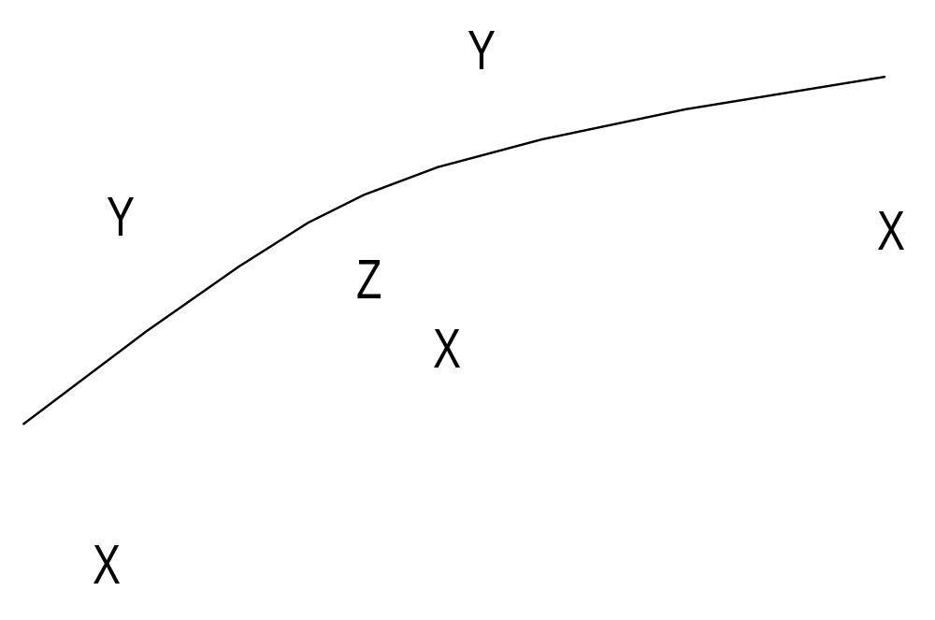
Second NN ‘B’ with smooth decision surface

Slide 45
Overfitting
The network with the ‘smooth’ decision surface correctly classified Z as an X
How do we prevent overfitting?

Slide 46
Causes of overfitting
Too many parameters (weights) in network
Too large parameters in network (i.e., weights have become large)
(related to above) Large number of weights being used to model very few training patterns
Regularisation is the prevention of overfitting

Slide 47
Too many weights?
Reduce size of input layer (hopefully without throwing away useful information), such as not representing day of year by 365 inputs but by 2 (discussed earlier)
Reduce size of hidden layer (but be careful, too large may cause overfitting, to small and may not solve problem)
‘Prune’ unnecessary weights from network (several algorithms that do this)

Slide 48
Weights too large?
Prevent overtraining, where network is trained too long on training set
Make weights slowly decay during the training process

Slide 49
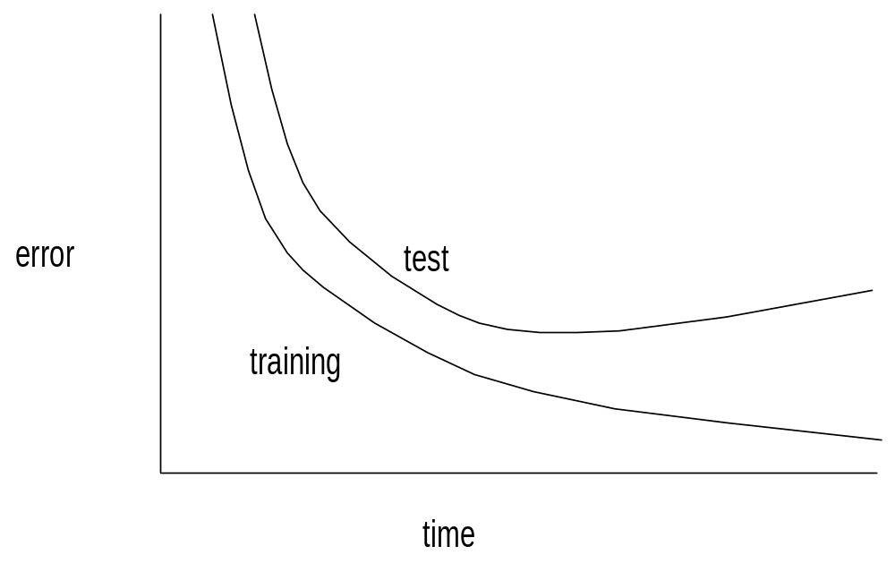

Overtraining (mistake in slide, ‘test’ should say ‘validation’)

Slide 50
Preventing overtraining
Periodically stop training
Apply validation dataset and inspect results
If validation error less than previous cycle, then save weights
If not, discard weights
In this way, we always have a copy of the best set of weights

Slide 51
Weight decay
Weights slowly decay in magnitude as training progresses
Weights that need to be large will be maintained by their importance in reducing network errors
Other weights will decay toward small values
Need some method of choosing weight decay parameters (such as Bayesian Regularisation - see later)

Slide 52
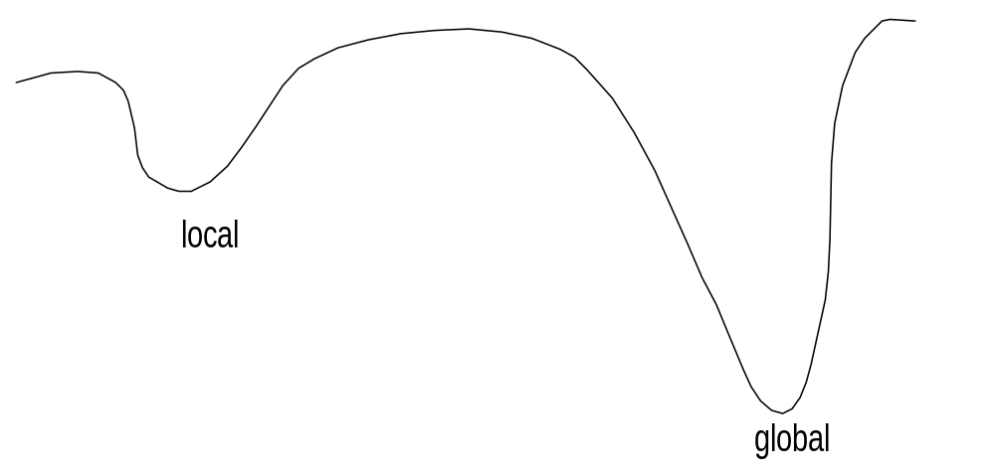
Local minima

Slide 53
Local minima
Training error drops, but then flattens out before an acceptable performance level is reached
Several ways of avoiding, but first consider if you have too few hidden units. Too few will make it impossible for network to find solution, can appear to be a local minimum as network gets ‘stuck’

Slide 54
Local minima
Restart training with a different set of starting weights and/or different range of initial weights
Inject noise into the training process, then slowly decrease it
Try different training algorithm, some less prone to falling into local minima

Slide 55
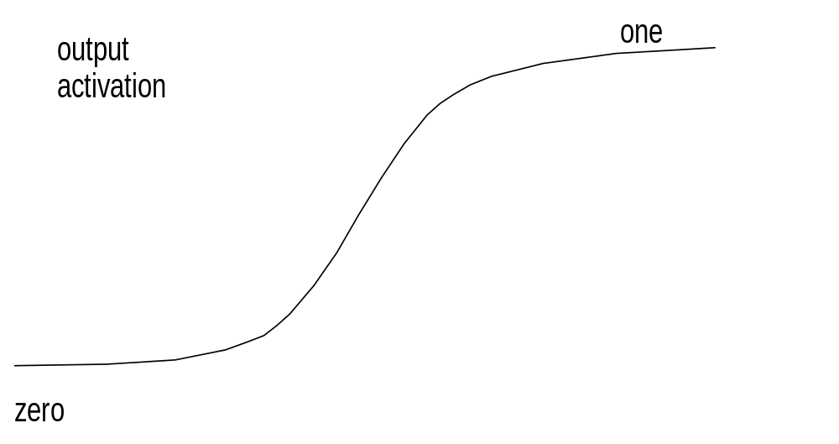
Problems with asymptote of output function

Slide 56
Asymptote problems
In trying to reach asymptote network weights become to large
Solution is to re-code output targets so that the sigmoidal output function does not saturate
So 1.0 becomes 0.9, and 0 becomes 0.1
Only relevant for classifiers, for regression we just use linear output function that does not saturate

Slide 57
Summary
Today we have:
Looked at data transformation, one of the key principles involved in neural network application development.
Described a number of pre-processing techniques used to make the learning process easier for the network.
Described the critical parameters that control the construction and training of a good network

