Slide 1
Classification

Slide 2
Supervised vs. Unsupervised Learning
Supervised learning (classification)
Supervision: The training data (observations, measurements, etc.) are accompanied by labels indicating the class of the observations
New data is classified based on the training set
Unsupervised learning (clustering)
The class labels of training data is unknown
Given a set of measurements, observations, etc. with the aim of establishing the existence of classes or clusters in the data

Slide 3
Prediction Problems: Classification vs. Numeric Prediction
Classification
predicts categorical class labels (discrete or nominal)
classifies data (constructs a model) based on the training set and the values (class labels) in a classifying attribute and uses it in classifying new data
Numeric Prediction
models continuous-valued functions, i.e., predicts unknown or missing values
Typical applications
Credit/loan approval:
Medical diagnosis: if a tumor is cancerous or benign
Fraud detection: if a transaction is fraudulent
Web page categorization: which category it is

Slide 4
Classification—A Two-Step Process
Model construction: describing a set of predetermined classes
Each tuple/sample is assumed to belong to a predefined class, as determined by the class label attribute
The set of tuples used for model construction is training set
The model is represented as classification rules, decision trees, or mathematical formulae
Model usage: for classifying future or unknown objects
Estimate accuracy of the model
The known label of test sample is compared with the classified result from the model
Accuracy rate is the percentage of test set samples that are correctly classified by the model
Test set is independent of training set (otherwise overfitting)
If the accuracy is acceptable, use the model to classify new data
Note: If the test set is used to select models, it is called validation (test) set

Slide 5
Process (1): Model Construction
Classification
Algorithms
Training
Data
Classifier
(Model)
IF rank = ‘professor’
OR years > 6
THEN tenured = ‘yes’

Slide 6
Process (2): Using the Model in Prediction
Classifier
Testing
Data
Unseen Data
(Jeff, Professor, 4)
Tenured?

Slide 7
Decision Tree Induction: An Example
Training data set: Buys_computer
The data set follows an example of Quinlan’s ID3 (Playing Tennis)
Resulting tree:
age?
<=30
overcast
>40
31..40
student?
yes
credit rating?
no
yes
excellent
fair
no
yes
no
yes

Slide 8
Algorithm for Decision Tree Induction
Basic algorithm (a greedy algorithm)
Tree is constructed in a top-down recursive divide-and-conquer manner
At start, all the training examples are at the root
Attributes are categorical (if continuous-valued, they are discretized in advance)
Examples are partitioned recursively based on selected attributes
Test attributes are selected on the basis of a heuristic or statistical measure (e.g., information gain)
Conditions for stopping partitioning
All samples for a given node belong to the same class
There are no remaining attributes for further partitioning – majority voting is employed for classifying the leaf
There are no samples left

Slide 9
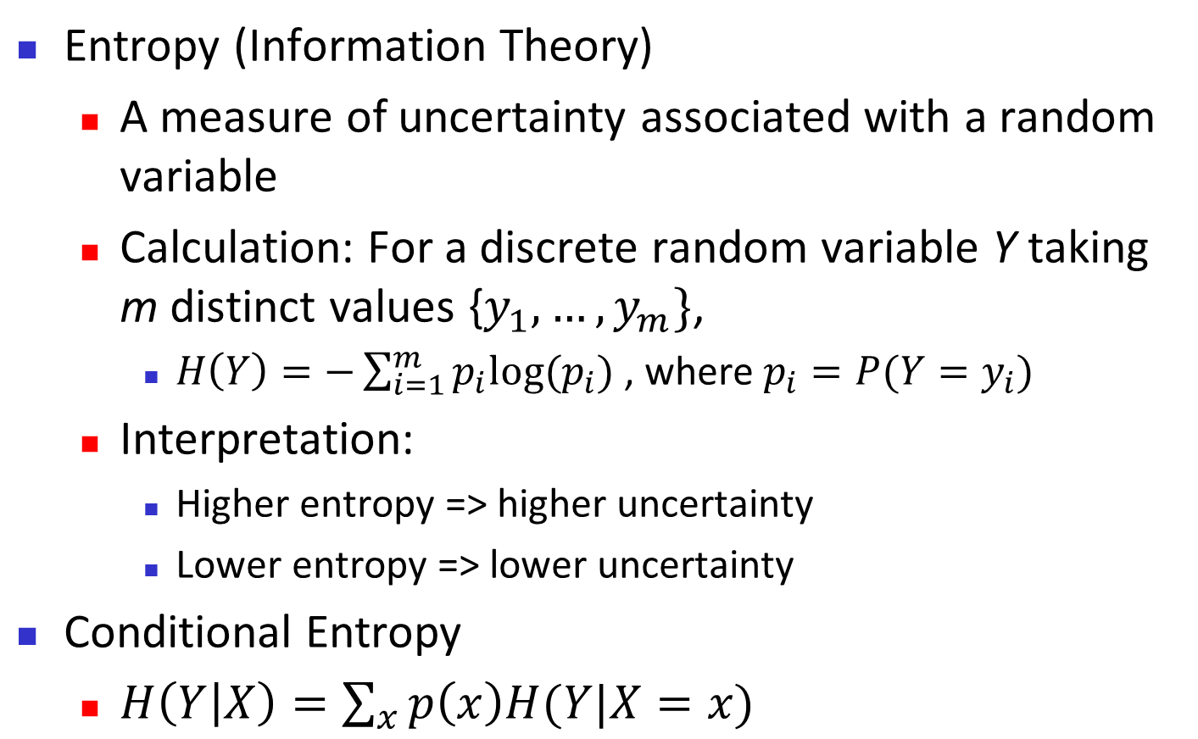
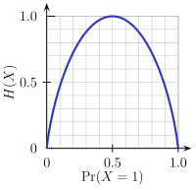
Brief Review of Entropy
m = 2

Slide 10
Attribute Selection Measure: Information Gain (ID3/C4.5)
Select the attribute with the highest information gain
Let p_{i} be the probability that an arbitrary tuple in D belongs to class C_{i}, estimated by |C_{i, D}|/|D|
Expected information (entropy) needed to classify a tuple in D:
Information needed (after using A to split D into v partitions) to classify D:
Information gained by branching on attribute A
Notes:
I : the expected information needed to classify a given sample
E (entropy) : expected information based on the partitioning into subsets by A

Slide 11
Attribute Selection: Information Gain
Class P: buys_computer = “yes”
Class N: buys_computer = “no”
means “age <=30” has 5 out of 14 samples, with 2 yes’es and 3 no’s. Hence
Similarly,

Slide 12
Computing Information-Gain for Continuous-Valued Attributes
Let attribute A be a continuous-valued attribute
Must determine the best split point for A
Sort the value A in increasing order
Typically, the midpoint between each pair of adjacent values is considered as a possible split point
(a_{i}+a_{i+1})/2 is the midpoint between the values of a_{i} and a_{i+1}
The point with the minimum expected information requirement for A is selected as the split-point for A
Split:
D1 is the set of tuples in D satisfying A ≤ split-point, and D2 is the set of tuples in D satisfying A > split-point

Slide 13
Gain Ratio for Attribute Selection (C4.5)
Information gain measure is biased towards attributes with a large number of values
C4.5 (a successor of ID3) uses gain ratio to overcome the problem (normalization to information gain)
GainRatio(A) = Gain(A)/SplitInfo(A)
Ex.
gain_ratio(income) = 0.029/1.557 = 0.019
The attribute with the maximum gain ratio is selected as the splitting attribute

Slide 14
Gini Index (CART, IBM IntelligentMiner)
If a data set D contains examples from n classes, gini index, gini(D) is defined as
where p_{j} is the relative frequency of class j in D
If a data set D is split on A into two subsets D₁ and D₂, the gini index gini(D) is defined as
Reduction in Impurity:
The attribute provides the smallest gini_{split}(D) (or the largest reduction in impurity) is chosen to split the node (need to enumerate all the possible splitting points for each attribute)

Slide 15
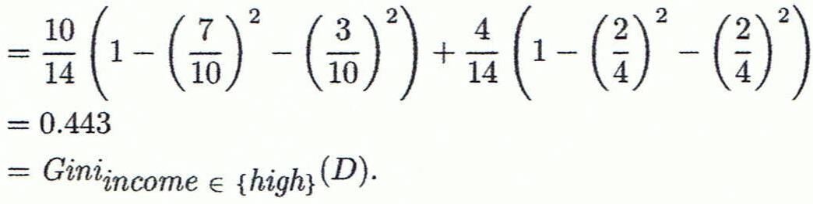
Computation of Gini Index
Ex. D has 9 tuples in buys_computer = “yes” and 5 in “no”
Suppose the attribute income partitions D into 10 in D₁: {low, medium} and 4 in D₂
Gini_{{low,high}} is 0.458; Gini_{{medium,high}} is 0.450. Thus, split on the {low,medium} (and {high}) since it has the lowest Gini index
All attributes are assumed continuous-valued
May need other tools, e.g., clustering, to get the possible split values
Can be modified for categorical attributes

Slide 16
Comparing Attribute Selection Measures
The three measures, in general, return good results but
Information gain:
biased towards multivalued attributes
Gain ratio:
tends to prefer unbalanced splits in which one partition is much smaller than the others
Gini index:
biased to multivalued attributes
has difficulty when # of classes is large
tends to favor tests that result in equal-sized partitions and purity in both partitions

Slide 17
Overfitting and Tree Pruning
Overfitting: An induced tree may overfit the training data
Too many branches, some may reflect anomalies due to noise or outliers
Poor accuracy for unseen samples
Two approaches to avoid overfitting
Prepruning: Halt tree construction early ̵ do not split a node if this would result in the goodness measure falling below a threshold
Difficult to choose an appropriate threshold
Postpruning: Remove branches from a “fully grown” tree—get a sequence of progressively pruned trees
Use a set of data different from the training data to decide which is the “best pruned tree”

Slide 18
Enhancements to Basic Decision Tree Induction
Allow for continuous-valued attributes
Dynamically define new discrete-valued attributes that partition the continuous attribute value into a discrete set of intervals
Handle missing attribute values
Assign the most common value of the attribute
Assign probability to each of the possible values
Attribute construction
Create new attributes based on existing ones that are sparsely represented
This reduces fragmentation, repetition, and replication

Slide 19
Classification in Large Databases
Classification—a classical problem extensively studied by statisticians and machine learning researchers
Scalability: Classifying data sets with millions of examples and hundreds of attributes with reasonable speed
Why is decision tree induction popular?
relatively faster learning speed (than other classification methods)
convertible to simple and easy to understand classification rules
can use SQL queries for accessing databases
comparable classification accuracy with other methods
RainForest (VLDB’98 — Gehrke, Ramakrishnan & Ganti)
Builds an AVC-list (attribute, value, class label)

Slide 20
Bayesian Classification: Why?
A statistical classifier: performs probabilistic prediction, i.e., predicts class membership probabilities
Foundation: Based on Bayes’ Theorem.
Performance: A simple Bayesian classifier, naïve Bayesian classifier, has comparable performance with decision tree and selected neural network classifiers
Incremental: Each training example can incrementally increase/decrease the probability that a hypothesis is correct — prior knowledge can be combined with observed data
Standard: Even when Bayesian methods are computationally intractable, they can provide a standard of optimal decision making against which other methods can be measured

Slide 21
Bayes’ Theorem: Basics
Total probability Theorem:
Bayes’ Theorem:
Let X be a data sample (“evidence”): class label is unknown
Let H be a hypothesis that X belongs to class C
Classification is to determine P(H|X), (i.e., posteriori probability): the probability that the hypothesis holds given the observed data sample X
P(H) (prior probability): the initial probability
E.g., X will buy computer, regardless of age, income, …
P(X): probability that sample data is observed
P(X|H) (likelihood): the probability of observing the sample X, given that the hypothesis holds
E.g., Given that X will buy computer, the prob. that X is 31..40, medium income

Slide 22
Prediction Based on Bayes’ Theorem
Given training data X, posteriori probability of a hypothesis H, P(H|X), follows the Bayes’ theorem
Informally, this can be viewed as
posteriori = likelihood x prior/evidence
Predicts X belongs to C_{i} iff the probability P(C_{i}|X) is the highest among all the P(C_{k}|X) for all the k classes
Practical difficulty: It requires initial knowledge of many probabilities, involving significant computational cost

Slide 23
Classification Is to Derive the Maximum Posteriori
Let D be a training set of tuples and their associated class labels, and each tuple is represented by an n-D attribute vector X = (x₁, x₂, …, x_{n})
Suppose there are m classes C₁, C₂, …, C_{m}.
Classification is to derive the maximum posteriori, i.e., the maximal P(C_{i}|X)
This can be derived from Bayes’ theorem
Since P(X) is constant for all classes, only
needs to be maximized

Slide 24
Naïve Bayes Classifier
A simplified assumption: attributes are conditionally independent (i.e., no dependence relation between attributes):
This greatly reduces the computation cost: Only counts the class distribution
If A_{k} is categorical, P(x_{k}|C_{i}) is the # of tuples in C_{i} having value x_{k} for A_{k} divided by |C_{i, D}| (# of tuples of C_{i} in D)
If A_{k} is continous-valued, P(x_{k}|C_{i}) is usually computed based on Gaussian distribution with a mean μ and standard deviation σ
and P(x_{k}|C_{i}) is

Slide 25
Naïve Bayes Classifier: Training Dataset
Class:
C1:buys_computer = ‘yes’
C2:buys_computer = ‘no’
Data to be classified:
X = (age <=30,
Income = medium,
Student = yes
Credit_rating = Fair)

Slide 26
Naïve Bayes Classifier: An Example
P(C_{i}): P(buys_computer = “yes”) = 9/14 = 0.643
P(buys_computer = “no”) = 5/14= 0.357
Compute P(X|C_{i}) for each class
P(age = “<=30” | buys_computer = “yes”) = 2/9 = 0.222
P(age = “<= 30” | buys_computer = “no”) = 3/5 = 0.6
P(income = “medium” | buys_computer = “yes”) = 4/9 = 0.444
P(income = “medium” | buys_computer = “no”) = 2/5 = 0.4
P(student = “yes” | buys_computer = “yes) = 6/9 = 0.667
P(student = “yes” | buys_computer = “no”) = 1/5 = 0.2
P(credit_rating = “fair” | buys_computer = “yes”) = 6/9 = 0.667
P(credit_rating = “fair” | buys_computer = “no”) = 2/5 = 0.4
X = (age <= 30 , income = medium, student = yes, credit_rating = fair)
P(X|C_{i}) : P(X|buys_computer = “yes”) = 0.222 x 0.444 x 0.667 x 0.667 = 0.044
P(X|buys_computer = “no”) = 0.6 x 0.4 x 0.2 x 0.4 = 0.019
P(X|C_{i})*P(C_{i}) : P(X|buys_computer = “yes”) * P(buys_computer = “yes”) = 0.028
P(X|buys_computer = “no”) * P(buys_computer = “no”) = 0.007
Therefore, X belongs to class (“buys_computer = yes”)

Slide 27
Avoiding the Zero-Probability Problem
Naïve Bayesian prediction requires each conditional prob. be non-zero. Otherwise, the predicted prob. will be zero
Ex. Suppose a dataset with 1000 tuples, income=low (0), income= medium (990), and income = high (10)
Use Laplacian correction (or Laplacian estimator)
Adding 1 to each case
Prob(income = low) = 1/1003
Prob(income = medium) = 991/1003
Prob(income = high) = 11/1003
The “corrected” prob. estimates are close to their “uncorrected” counterparts

Slide 28
Naïve Bayes Classifier: Comments
Advantages
Easy to implement
Good results obtained in most of the cases
Disadvantages
Assumption: class conditional independence, therefore loss of accuracy
Practically, dependencies exist among variables
E.g., hospitals: patients: Profile: age, family history, etc.
Symptoms: fever, cough etc., Disease: lung cancer, diabetes, etc.
Dependencies among these cannot be modeled by Naïve Bayes Classifier
How to deal with these dependencies? Bayesian Belief Networks (Chapter 9)

Slide 29
Using IF-THEN Rules for Classification
Represent the knowledge in the form of IF-THEN rules
R: IF age = youth AND student = yes THEN buys_computer = yes
Rule antecedent/precondition vs. rule consequent
Assessment of a rule: coverage and accuracy
n_{covers} = # of tuples covered by R
n_{correct} = # of tuples correctly classified by R
coverage(R) = n_{covers} /|D| /* D: training data set */
accuracy(R) = n_{correct} / n_{covers}
If more than one rule are triggered, need conflict resolution
Size ordering: assign the highest priority to the triggering rules that has the “toughest” requirement (i.e., with the most attribute tests)
Class-based ordering: decreasing order of prevalence or misclassification cost per class
Rule-based ordering (decision list): rules are organized into one long priority list, according to some measure of rule quality or by experts

Slide 30
Rule Extraction from a Decision Tree
Rules are easier to understand than large trees
One rule is created for each path from the root to a leaf
Each attribute-value pair along a path forms a conjunction: the leaf holds the class prediction
Rules are mutually exclusive and exhaustive
age?
<=30
31..40
>40
student?
yes
credit rating?
no
yes
excellent
fair
no
yes
no
yes
Example: Rule extraction from our buys_computer decision-tree
IF age = young AND student = no THEN buys_computer = no
IF age = young AND student = yes THEN buys_computer = yes
IF age = mid-age THEN buys_computer = yes
IF age = old AND credit_rating = excellent THEN buys_computer = no
IF age = old AND credit_rating = fair THEN buys_computer = yes

Slide 31
Rule Induction: Sequential Covering Method
Sequential covering algorithm: Extracts rules directly from training data
Typical sequential covering algorithms: FOIL, AQ, CN2, RIPPER
Rules are learned sequentially, each for a given class C_{i} will cover many tuples of C_{i} but none (or few) of the tuples of other classes
Steps:
Rules are learned one at a time
Each time a rule is learned, the tuples covered by the rules are removed
Repeat the process on the remaining tuples until termination condition, e.g., when no more training examples or when the quality of a rule returned is below a user-specified threshold
Comp. w. decision-tree induction: learning a set of rules simultaneously

Slide 32
Sequential Covering Algorithm
while (enough target tuples left)
generate a rule
remove positive target tuples satisfying this rule
Examples covered
by Rule 2
Examples covered
by Rule 1
Examples covered
by Rule 3
Positive examples

Slide 33
Rule Generation
To generate a rule
while(true)
find the best predicate p
if foil-gain(p) > threshold then add p to current rule
else break
A3=1
A3=1&&A1=2
A3=1&&A1=2
&&A8=5
Positive examples
Negative examples

Slide 34
How to Learn-One-Rule?
Start with the most general rule possible: condition = empty
Adding new attributes by adopting a greedy depth-first strategy
Picks the one that most improves the rule quality
Rule-Quality measures: consider both coverage and accuracy
Foil-gain (in FOIL & RIPPER): assesses info_gain by extending condition
favors rules that have high accuracy and cover many positive tuples
Rule pruning based on an independent set of test tuples
Pos/neg are # of positive/negative tuples covered by R.
If FOIL_Prune is higher for the pruned version of R, prune R

Slide 35
Reference
www.cs.uiuc.edu/homes/hanj/cs412/bk3_slides/08ClassBasic.ppt‎ UIUC CS412 by Prof. Jiawei Han

