Slide 1
Clustering

Slide 2
Clustering
Clustering is a technique for finding similarity groups in data, called clusters. I.e.,
it groups data instances that are similar to (near) each other in one cluster and data instances that are very different (far away) from each other into different clusters.
Clustering is often called an unsupervised learning task as no class values denoting an a priori grouping of the data instances are given, which is the case in supervised learning.
Due to historical reasons, clustering is often considered synonymous with unsupervised learning.
In fact, association rule mining is also unsupervised
This chapter focuses on clustering.

Slide 3
Clustering
Clustering is a technique for finding similarity groups in data, called clusters. I.e.,
it groups data instances that are similar to (near) each other in one cluster and data instances that are very different (far away) from each other into different clusters.
Clustering is often called an unsupervised learning task as no class values denoting an a priori grouping of the data instances are given, which is the case in supervised learning.
Due to historical reasons, clustering is often considered synonymous with unsupervised learning.
In fact, association rule mining is also unsupervised
This chapter focuses on clustering.

Slide 4
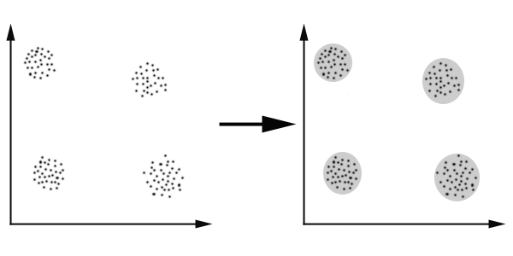
An illustration
The data set has three natural groups of data points, i.e., 3 natural clusters.

Slide 5
What is clustering for?
Let us see some real-life examples
Example 1: groups people of similar sizes together to make “small”, “medium” and “large” T-Shirts.
Tailor-made for each person: too expensive
One-size-fits-all: does not fit all.
Example 2: In marketing, segment customers according to their similarities
To do targeted marketing.

Slide 6
What is clustering for? (cont…)
Example 3: Given a collection of text documents, we want to organize them according to their content similarities,
To produce a topic hierarchy
In fact, clustering is one of the most utilized data mining techniques.
It has a long history, and used in almost every field, e.g., medicine, psychology, botany, sociology, biology, archeology, marketing, insurance, libraries, etc.
In recent years, due to the rapid increase of online documents, text clustering becomes important.

Slide 7
Aspects of clustering
A clustering algorithm
Partitional clustering
Hierarchical clustering
…
A distance (similarity, or dissimilarity) function
Clustering quality
Inter-clusters distance ⇒ maximized
Intra-clusters distance ⇒ minimized
The quality of a clustering result depends on the algorithm, the distance function, and the application.

Slide 8
Partitioning Algorithms: Basic Concept
Partitioning method: Partitioning a database D of n objects into a set of k clusters, such that the sum of squared distances is minimized (where c_{i} is the centroid or medoid of cluster C_{i})
Given k, find a partition of k clusters that optimizes the chosen partitioning criterion
Global optimal: exhaustively enumerate all partitions
Heuristic methods: k-means and k-medoids algorithms
k-means (MacQueen’67, Lloyd’57/’82): Each cluster is represented by the center of the cluster
k-medoids or PAM (Partition around medoids) (Kaufman & Rousseeuw’87): Each cluster is represented by one of the objects in the cluster

Slide 9
The K-Means Clustering Method
Given k, the k-means algorithm is implemented in four steps:
Partition objects into k nonempty subsets
Compute seed points as the centroids of the clusters of the current partitioning (the centroid is the center, i.e., mean point, of the cluster)
Assign each object to the cluster with the nearest seed point
Go back to Step 2, stop when the assignment does not change

Slide 10
An Example of K-Means Clustering
K=2
Arbitrarily partition objects into k groups
Update the cluster centroids
The initial data set
Loop if needed
Reassign objects
Partition objects into k nonempty subsets
Repeat
Compute centroid (i.e., mean point) for each partition
Assign each object to the cluster of its nearest centroid
Until no change
Update the cluster centroids

Slide 11
Comments on the K-Means Method
Strength: Efficient: O(tkn), where n is # objects, k is # clusters, and t is # iterations. Normally, k, t << n.
Comparing: PAM: O(k(n-k)² ), CLARA: O(ks² + k(n-k))
Comment: Often terminates at a local optimal
Weakness
Applicable only to objects in a continuous n-dimensional space
Using the k-modes method for categorical data
In comparison, k-medoids can be applied to a wide range of data
Need to specify k, the number of clusters, in advance (there are ways to automatically determine the best k (see Hastie et al., 2009)
Sensitive to noisy data and outliers
Not suitable to discover clusters with non-convex shapes

Slide 12
Variations of the K-Means Method
Most of the variants of the k-means which differ in
Selection of the initial k means
Dissimilarity calculations
Strategies to calculate cluster means
Handling categorical data: k-modes
Replacing means of clusters with modes
Using new dissimilarity measures to deal with categorical objects
Using a frequency-based method to update modes of clusters
A mixture of categorical and numerical data: k-prototype method

Slide 13
What Is the Problem of the K-Means Method?
The k-means algorithm is sensitive to outliers !
Since an object with an extremely large value may substantially distort the distribution of the data
K-Medoids: Instead of taking the mean value of the object in a cluster as a reference point, medoids can be used, which is the most centrally located object in a cluster
10
10
9
9
8
8
7
7
6
6
5
5
4
4
3
3
2
2
1
1
0
0
1
2
3
4
5
6
7
8
9
10
0
0
1
2
3
4
5
6
7
8
9
10

Slide 14
PAM: A Typical K-Medoids Algorithm
Total Cost = 20
10
9
8
Arbitrary choose k object as initial medoids
Assign each remaining object to nearest medoids
7
6
5
4
3
2
1
0
0
1
2
3
4
5
6
7
8
9
10
K=2
Randomly select a nonmedoid object,O_{ramdom}
Total Cost = 26
Do loop
Until no change
10
10
9
Compute total cost of swapping
9
Swapping O and O_{ramdom}
If quality is improved.
8
8
7
7
6
6
5
5
4
4
3
3
2
2
1
1
0
0
1
2
3
4
5
6
7
8
9
10
0
0
1
2
3
4
5
6
7
8
9
10
14
Notes:
14

Slide 15
The K-Medoid Clustering Method
K-Medoids Clustering: Find representative objects (medoids) in clusters
PAM (Partitioning Around Medoids, Kaufmann & Rousseeuw 1987)
Starts from an initial set of medoids and iteratively replaces one of the medoids by one of the non-medoids if it improves the total distance of the resulting clustering
PAM works effectively for small data sets, but does not scale well for large data sets (due to the computational complexity)
Efficiency improvement on PAM
CLARA (Kaufmann & Rousseeuw, 1990): PAM on samples
CLARANS (Ng & Han, 1994): Randomized re-sampling

Slide 16
Hierarchical Clustering
Use distance matrix as clustering criteria. This method does not require the number of clusters k as an input, but needs a termination condition
Step 0
Step 1
Step 2
Step 3
Step 4
agglomerative
(AGNES)
a
a b
b
a b c d e
c
c d e
d
d e
e
divisive
(DIANA)
Step 4
Step 3
Step 2
Step 1
Step 0

Slide 17
AGNES (Agglomerative Nesting)
Introduced in Kaufmann and Rousseeuw (1990)
Implemented in statistical packages, e.g., Splus
Use the single-link method and the dissimilarity matrix
Merge nodes that have the least dissimilarity
Go on in a non-descending fashion
Eventually all nodes belong to the same cluster

Slide 18
Distance between Clusters
X
X
Single link: smallest distance between an element in one cluster and an element in the other, i.e., dist(K_{i}, K_{j}) = min(t_{ip}, t_{jq})
Complete link: largest distance between an element in one cluster and an element in the other, i.e., dist(K_{i}, K_{j}) = max(t_{ip}, t_{jq})
Average: avg distance between an element in one cluster and an element in the other, i.e., dist(K_{i}, K_{j}) = avg(t_{ip}, t_{jq})
Centroid: distance between the centroids of two clusters, i.e., dist(K_{i}, K_{j}) = dist(C_{i}, C_{j})
Medoid: distance between the medoids of two clusters, i.e., dist(K_{i}, K_{j}) = dist(M_{i}, M_{j})
Medoid: a chosen, centrally located object in the cluster
18
Notes:
18

Slide 19
Centroid, Radius and Diameter of a Cluster (for numerical data sets)
X
Centroid: the “middle” of a cluster
Radius: square root of average distance from any point of the cluster to its centroid
Diameter: square root of average mean squared distance between all pairs of points in the cluster
19
Notes:
19

Slide 20
Extensions to Hierarchical Clustering
Major weakness of agglomerative clustering methods
Can never undo what was done previously
Do not scale well: time complexity of at least O(n²), where n is the number of total objects
Integration of hierarchical & distance-based clustering
BIRCH (1996): uses CF-tree and incrementally adjusts the quality of sub-clusters
CHAMELEON (1999): hierarchical clustering using dynamic modeling

Slide 21
BIRCH (Balanced Iterative Reducing and Clustering Using Hierarchies)
Zhang, Ramakrishnan & Livny, SIGMOD’96
Incrementally construct a CF (Clustering Feature) tree, a hierarchical data structure for multiphase clustering
Phase 1: scan DB to build an initial in-memory CF tree (a multi-level compression of the data that tries to preserve the inherent clustering structure of the data)
Phase 2: use an arbitrary clustering algorithm to cluster the leaf nodes of the CF-tree
Scales linearly: finds a good clustering with a single scan and improves the quality with a few additional scans
Weakness: handles only numeric data, and sensitive to the order of the data record

Slide 22
Clustering Feature Vector in BIRCH
Clustering Feature (CF): CF = (N, LS, SS)
N: Number of data points
LS: linear sum of N points:
SS: square sum of N points
CF = (5, (16,30),(54,190))
(3,4)
(2,6)
(4,5)
(4,7)
(3,8)

Slide 23
The CF Tree Structure
Root
B = 7
L = 6
CF₁
CF₂
CF₃
CF₆
child₁
child₂
child₃
child₆
Non-leaf node
CF₁
CF₂
CF₃
CF₅
child₁
child₂
child₃
child₅
Leaf node
Leaf node
prev
CF₁
CF₂
CF₆
next
prev
CF₁
CF₂
CF₄
next

Slide 24
The Birch Algorithm
Cluster Diameter
For each point in the input
Find closest leaf entry
Add point to leaf entry and update CF
If entry diameter > max_diameter, then split leaf, and possibly parents
Algorithm is O(n)
Concerns
Sensitive to insertion order of data points
Since we fix the size of leaf nodes, so clusters may not be so natural
Clusters tend to be spherical given the radius and diameter measures

Slide 25
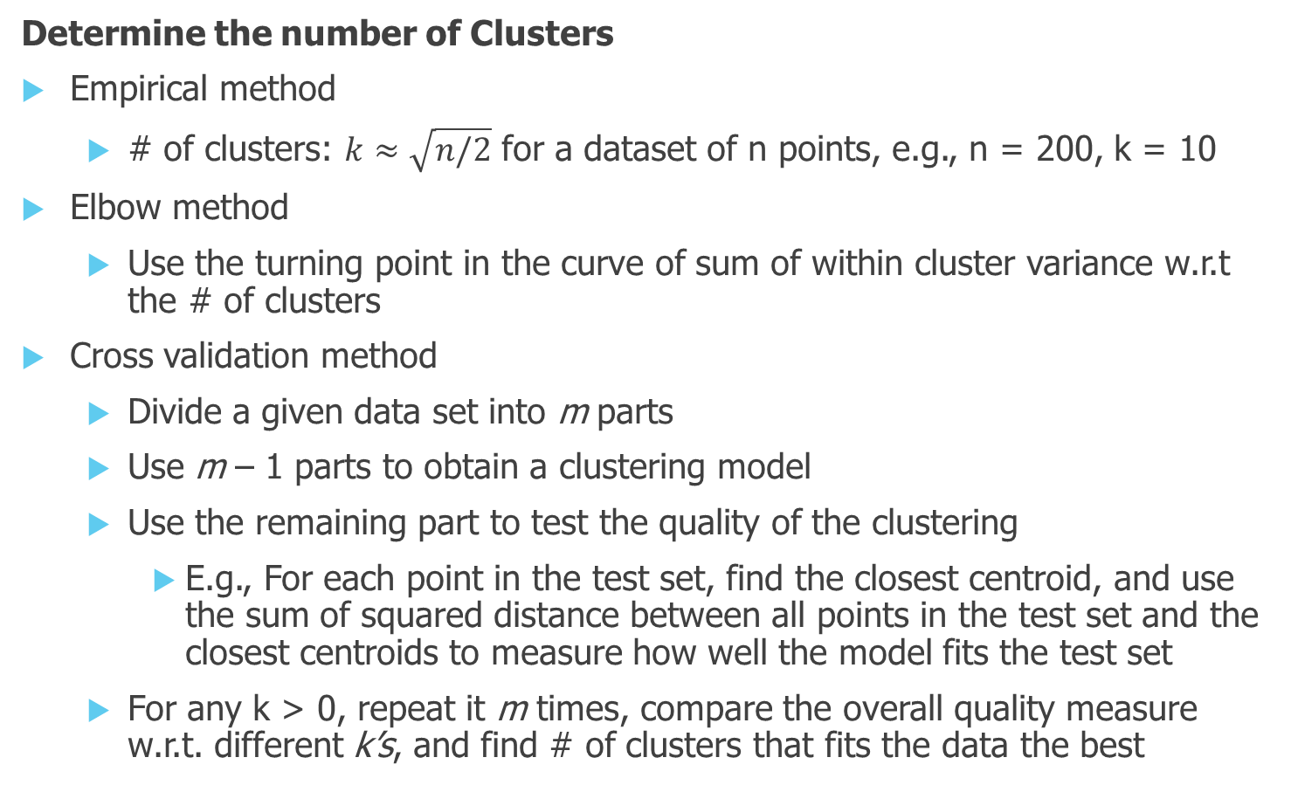
Cluster Evaluation
Determine the number of Clusters
Empirical method
# of clusters: $k≈\sqrt{n/2}$ for a dataset of n points, e.g., n = 200, k = 10
Elbow method
Use the turning point in the curve of sum of within cluster variance w.r.t the # of clusters
Cross validation method
Divide a given data set into m parts
Use m – 1 parts to obtain a clustering model
Use the remaining part to test the quality of the clustering
E.g., For each point in the test set, find the closest centroid, and use the sum of squared distance between all points in the test set and the closest centroids to measure how well the model fits the test set
For any k > 0, repeat it m times, compare the overall quality measure w.r.t. different k’s, and find # of clusters that fits the data the best
25

Slide 26
Measuring Clustering Quality
3 kinds of measures: External, internal and relative
External: supervised, employ criteria not inherent to the dataset
Compare a clustering against prior or expert-specified knowledge (i.e., the ground truth) using certain clustering quality measure
Internal: unsupervised, criteria derived from data itself
Evaluate the goodness of a clustering by considering how well the clusters are separated, and how compact the clusters are, e.g., Silhouette coefficient
Relative: directly compare different clusterings, usually those obtained via different parameter settings for the same algorithm
26

Slide 27
Measuring Clustering Quality: External Methods
Clustering quality measure: Q(C, T), for a clustering C given the ground truth T
Q is good if it satisfies the following 4 essential criteria
Cluster homogeneity: the purer, the better
Cluster completeness: should assign objects belong to the same category in the ground truth to the same cluster
Rag bag: putting a heterogeneous object into a pure cluster should be penalized more than putting it into a rag bag (i.e., “miscellaneous” or “other” category)
Small cluster preservation: splitting a small category into pieces is more harmful than splitting a large category into pieces
27

Slide 28
Some Commonly Used External Measures
Matching-based measures
Purity, maximum matching, F-measure
Entropy-Based Measures
Conditional entropy, normalized mutual information (NMI), variation of information
Pair-wise measures
Four possibilities: True positive (TP), FN, FP, TN
Jaccard coefficient, Rand statistic, Fowlkes-Mallow measure
Correlation measures
Discretized Huber static, normalized discretized Huber static
Ground truth partitioning T₁
T₂
Cluster C₁
Cluster C₂
28

Slide 29
Reference
http://www.cs.uic.edu/~liub/teach/cs583-fall-05/CS583-unsupervised-learning.ppt
https://wiki.engr.illinois.edu/display/cs412/

