Slide 1
SMART HOME NETWORKS USING PACKET TRACER
BISHWA JYOTI DAS
School of Computer Science & Engineering
Dr.P.Sriramalakshmi
School of Electrical Engineering
Dr.C.Vaithilingam
School of Electrical Engineering

Slide 2
OUTLINE
OBJECTIVE
INTRODUCTION
METHODOLOGY
IMPLEMENTATION
REFERENCES

Slide 3
OBJECTIVE
In the present world technology has evolved a lot. IOT technologies have gained much of the limelight nowadays.
This paper mainly focuses on how to run IOT based technologies with the use of software.
For this Cisco Packet Tracer software is used where simulations are done to find how to control the IOT devices by connecting it to a home portal gateway.
IOT devices in real life environment by connecting a Solar Panel and Battery as well are simulated using Cisco Packet Tracer.

Slide 4
INTRODUCTION
Smart Home Networks basically focus on modernising our home by connecting the devices in it respectively. Here are some of the literature reviews based on the previous work done on smart home networks.
Sohail Iqbal Malik and others in 2019 did basic research on how to run IOT devices in Packet Tracer. They basically studied how to run IOT devices by connecting them to the home gateway respectively( Ghaliya Alfarsi , Abir Alsidiri, Jasiya Jabbar,Ragad M Tawafak, Sohail Iqbal Malik & Maryam Alsinani, 2019).
Isa Al-Shemsi at in 2018 used the updated packet tracer software in implementing Smart Home Networks and also providing programming environment for controlling objects. It implemented Home Gateway and microcontroller (MCU) for wireless communication. Devices were registered using home gateway and MCU was used to link the sensors to the device. The researcher used Java Script along with Python for implementation purposes. (Al-Shemsi, 2018).

Slide 5
METHODOLOGY
Smart Home Networks have been the topic of discussion since the beginning of the century. As we know most of these works are visualised with the help of Cisco Packet Tracer as it supports not only the basic networking features like sending packets but also supports programming languages like JavaScript(JS) ,Python, Visual Basic.
We can connect as many network devices to our Smart Home Gateway and see whether they are functioning properly or not. We can perform this by using the smartphone and then going to web browser and typing the IP address of the Home Gateway. This will open an interface which will allow us to check the working of these networking devices.

Slide 6
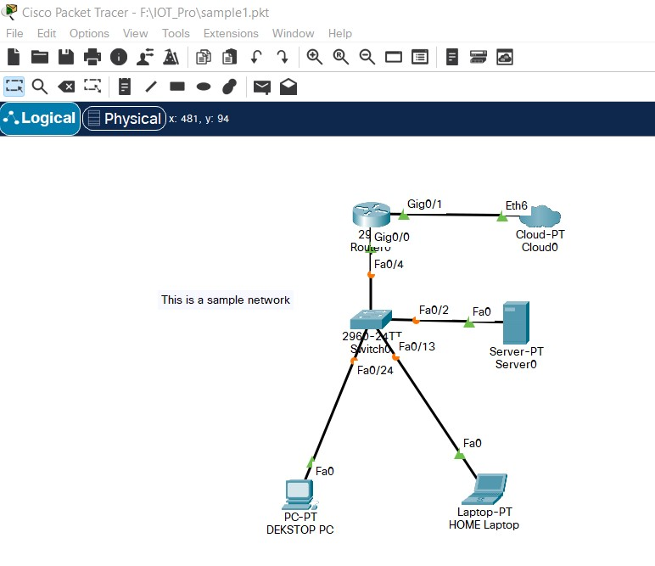
CREATE A BASIC NETWORK

Slide 7
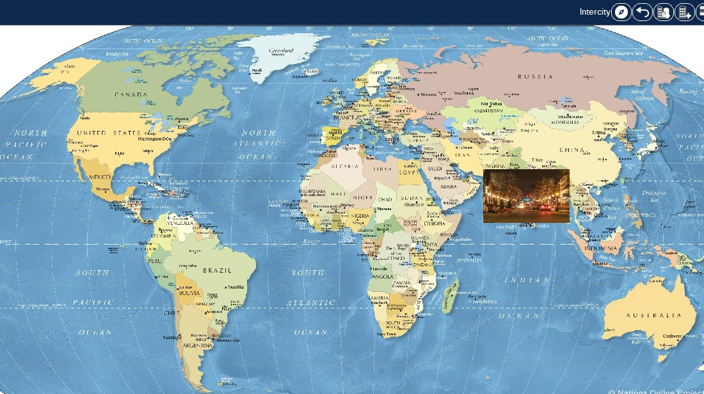
PHYSICAL VIEW OF THE NETWORK

Slide 8
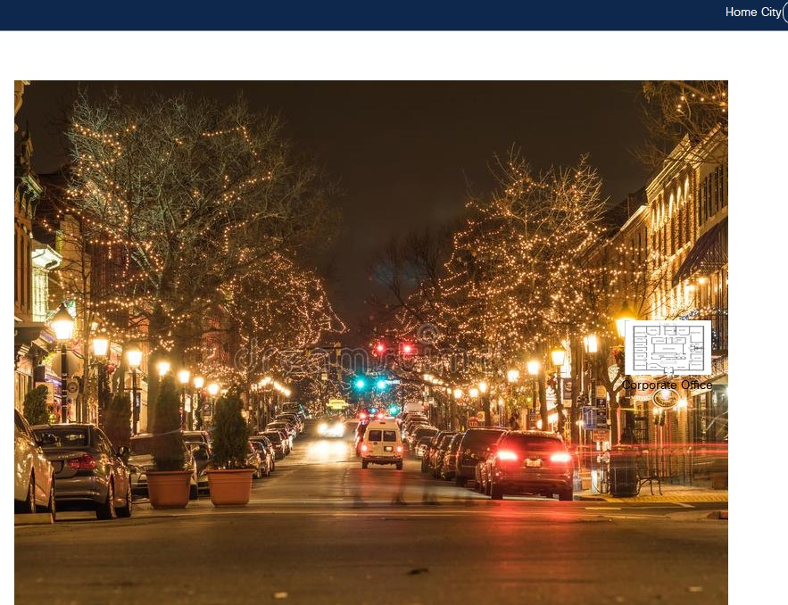
PHYSICAL VIEW OF CITY

Slide 9
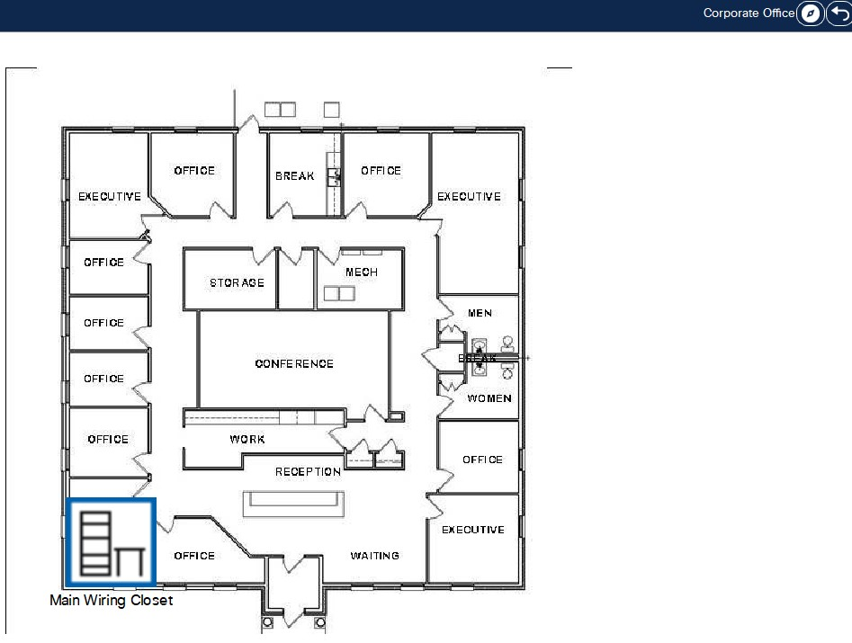
PHYSICAL VIEW OF CORPORATE OFFICE

Slide 10
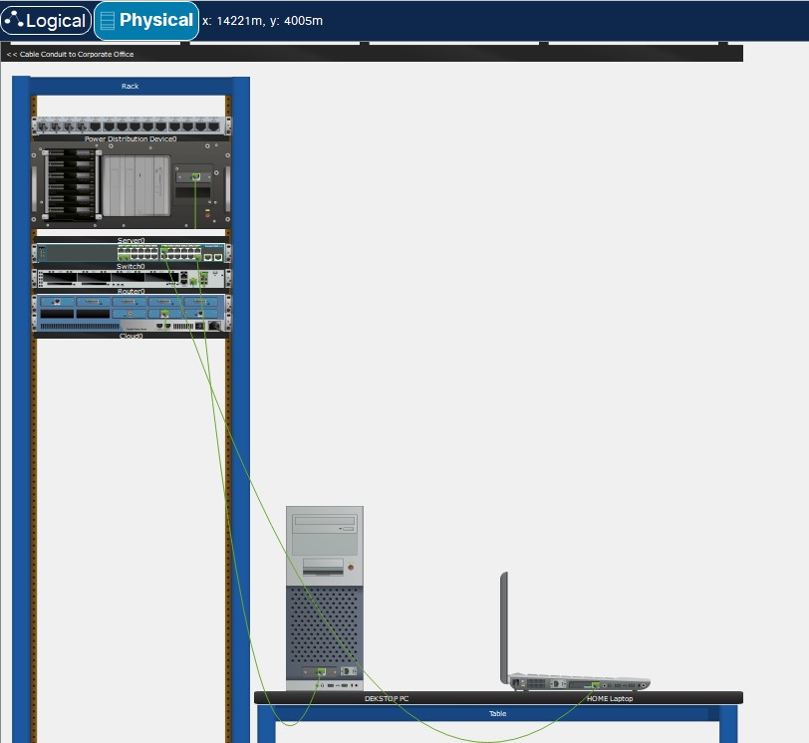
MAIN WIRING CLOSET

Slide 11
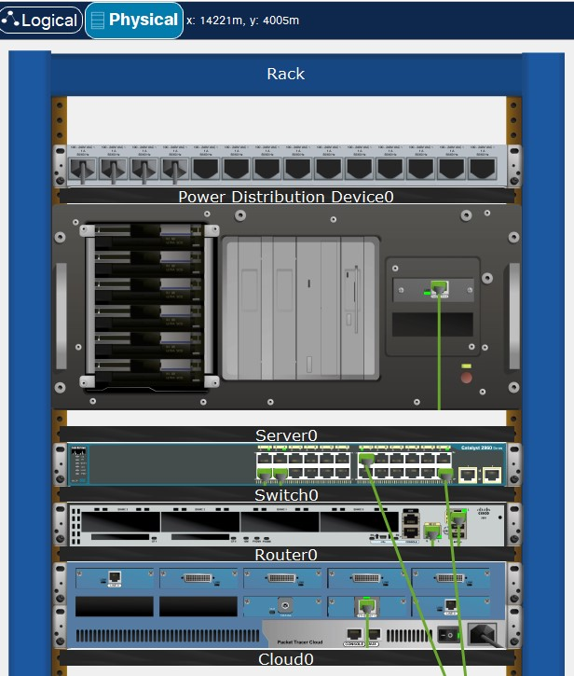
VIEW OF RACK CONTAINING SERVERS,SWITCHES,ROUTERS AND CLOUD

Slide 12
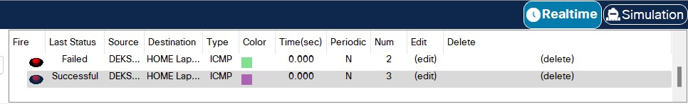
WHEN PROPERLY CONNECTED PACKETS CAN BE SENT TO CHECK NETWORK CONNECTIVITY

Slide 13
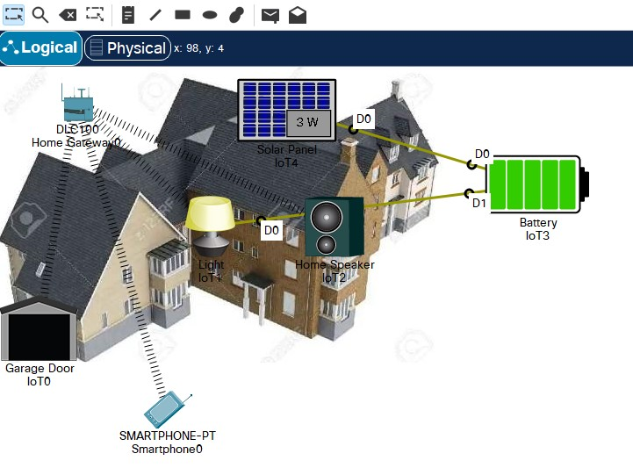
SMART HOME NETWORK SYSTEM

Slide 14
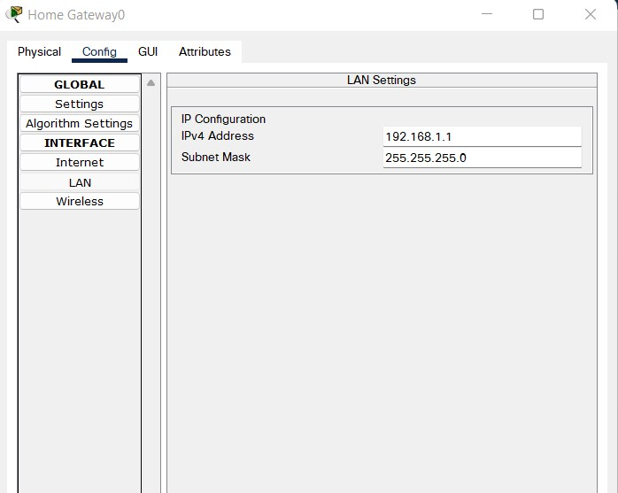
CONFIGURATION OF IP ADDRESS

Slide 15
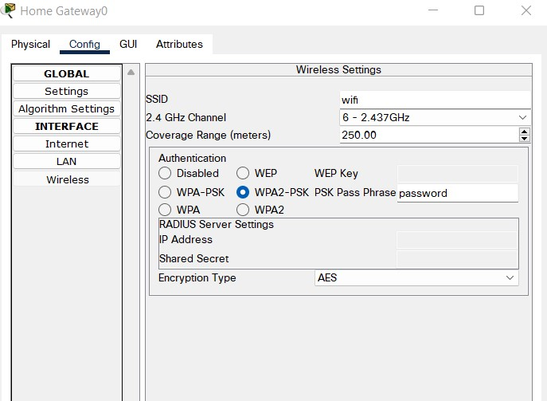
WIRELESS SETTINGS CONFIGURATION

Slide 16
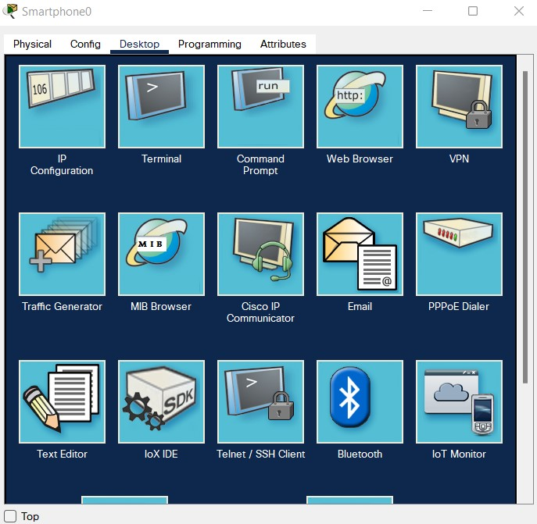
TO CONNECT TO DEVICES VIA WEB BROWSER OF THE SMARTPHONE

Slide 17
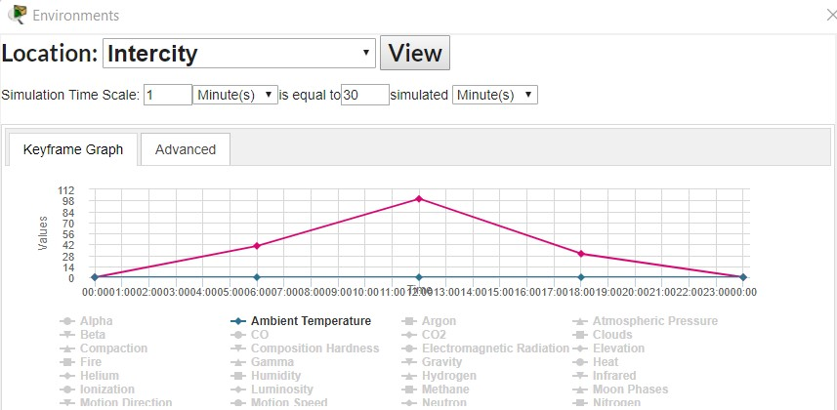
GRAPH OF SUNLIGHT INTENSITY VS TIME

Slide 18
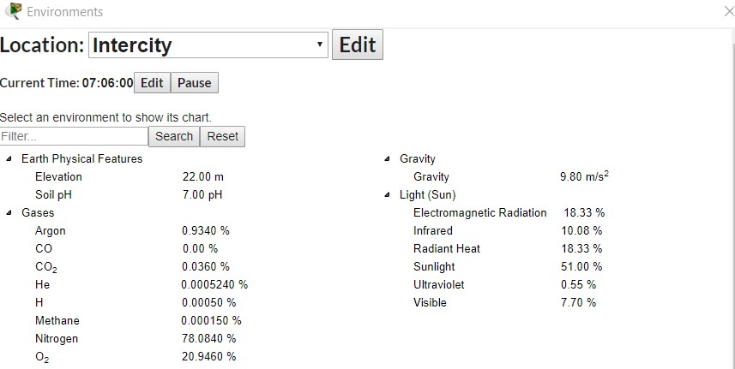
SUNLIGHT INTENSITY AND OTHER FACTORS AT A PARTICULAR TIME OF DAY

Slide 19
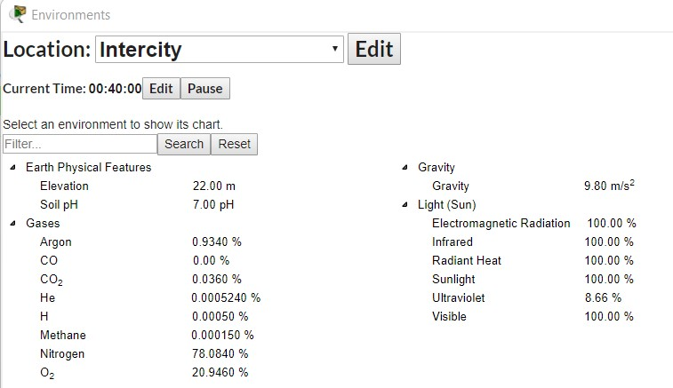
SUNLIGHT AND OTHER FACTORS AT ANOTHER TIME INTERVAL

Slide 20
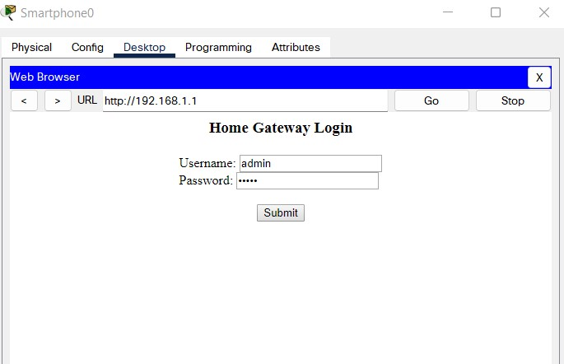
CONNECT TO HOME GATEWAY

Slide 21
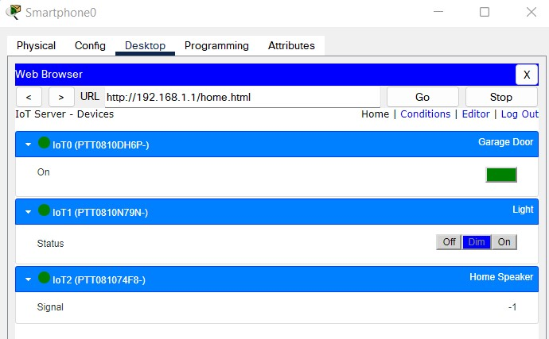
VARIOUS IOT DEVICES CAN BE CONTROLLED FROM GATEWAY

Slide 22
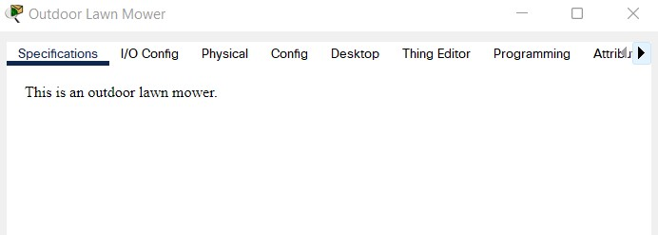
CONFIGURATION OF OUTDOOR LAWN MOWER

Slide 23
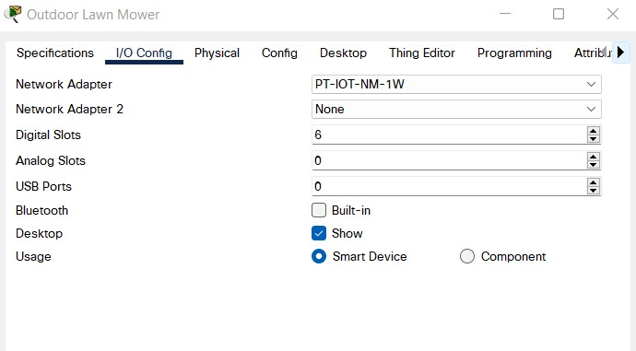
I/O CONFIGURATION SETTINGS

Slide 24
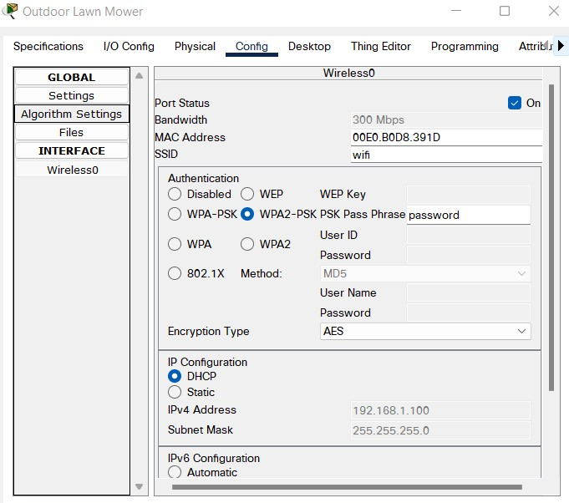
CONFIGURATION SETTINGS

Slide 25
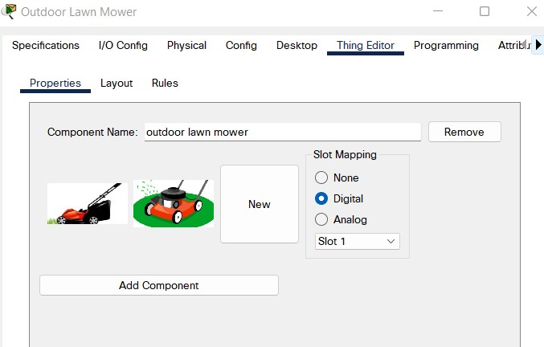
ADD RESPECTIVE COMPONENTS ACCORDING TO OUR NEED

Slide 26
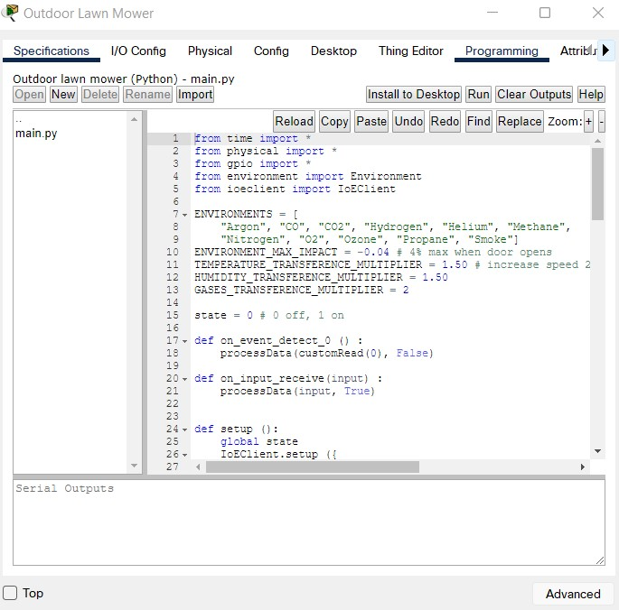
PROGRAMMING PART OF LAWN MOWER

Slide 27
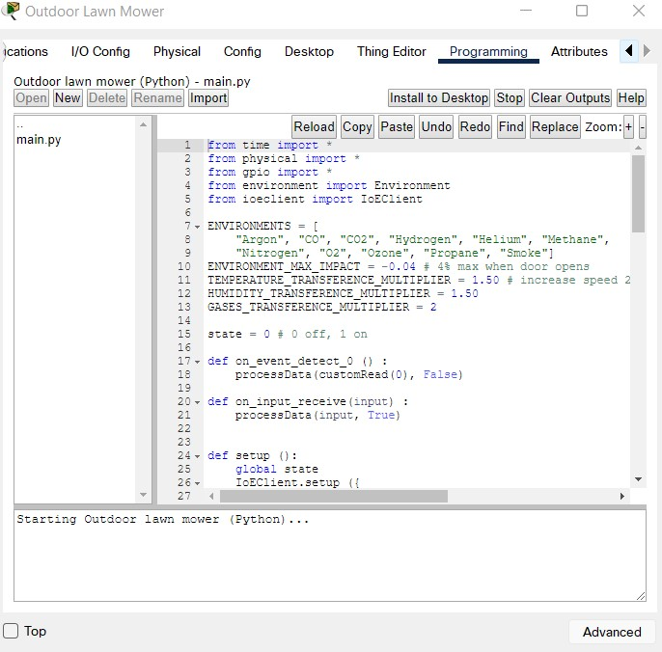
TO START LAWN MOWER CLICK ON RUN

Slide 28
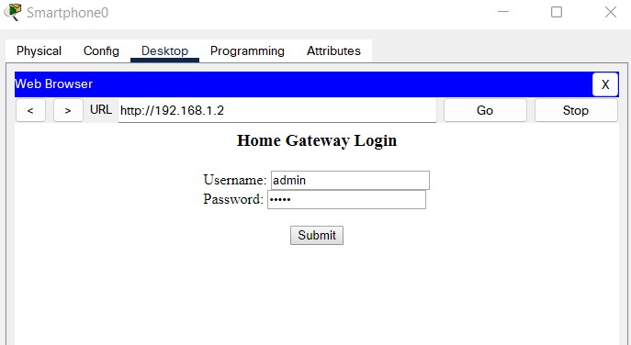
CONNECT TO HOME GATEWAY

Slide 29
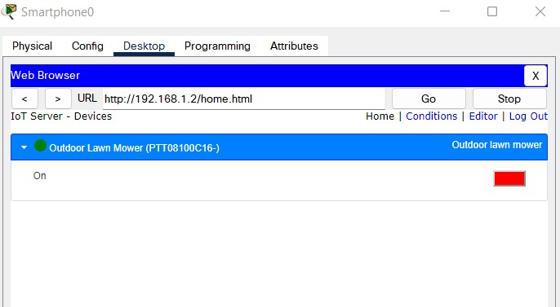
LAWN MOWER IS CURRENTLY OFF

Slide 30
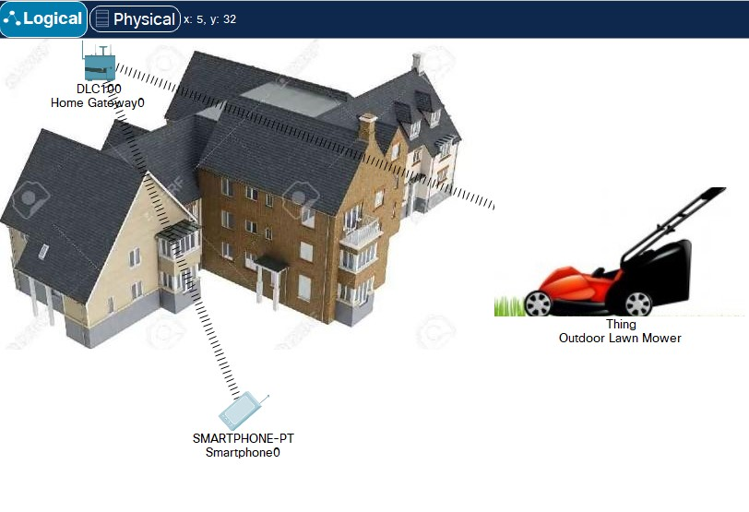
VIEW OF HOME GATEWAY WHEN MOWER IS OFF

Slide 31
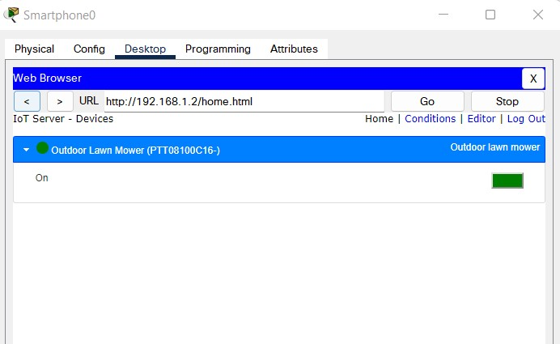
LAWN MOWER IS SWITCHED ON

Slide 32
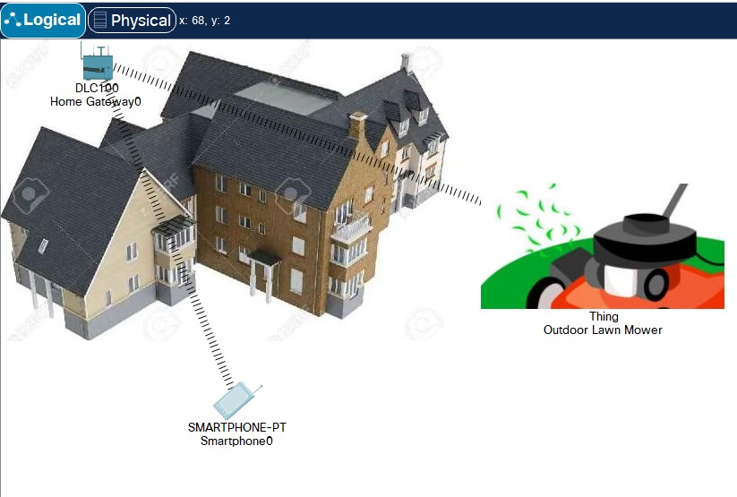
VIEW OF HOME GATEWAY WHEN MOWER IS ON

Slide 33
REFERENCES
1) packettracernetwork. (2018, January):Link: http://www.packettracernetwork.com/features/packettracer-7- new-features.html
2) A, E., & K. A, H. (nd.). To design and implement a WiFi Based Home Automation System using Packet Tracer.
3) Abdi, A. (2018). Designing Smart Campus Using Internet of Things(IOT). International Journal of Computer Science Trends and Technology (IJCST).
4) al, M.c.(n.d.). Designing Smart Campus Using IOT or Internet of Things. 6(3).
5) ALFarsi, G., Jabbar, J., & ALSinani, M. (2018). Implement a Mobile Application News Tool for Distributing and Spreading Messages as well as Events. International Journal of Interactive Mobile Technologies (iJIM), 12(7).
6) ALFARSI, G., M, K. A., & ALSINANI, M. (2017). A RULE-BASED SYSTEM FOR ADVISING UNDERGRADUATE STUDENTS. Journal of Theoretical and Applied Information Technology, 95(11)

Slide 34


