Slide 1
Resource Optimization in Virtualization
BY BISHWA JYOTI DAS (19BCE1755)
Storage
Backup
Connectivity
Networking
Shared Responsibility

Slide 2
NEED FOR OPTIMISING RESOURCES IN THE CLOUD
Cloud has made it possible to access our data from anywhere around the world.
Cloud is based on the fact that you pay for the resources that you use.
Scheduling of tasks as well as resource allocation plays a key role in the cloud.
Services are delivered to the users on the basis of what they choose to do. For example we can go for Infrastructure as a Service(IAAS), Platform as a Service(PAAS) or Software as a Service. Each have their own merits as well as demerits.
In IAAS we don’t have to worry about hardware resources and their servicing at all as it is maintained by the cloud service provider. In Platform as a Service even the Operating Systems are managed by the provider. In SAAS our applications as well as network are managed by the cloud provider.
Thus this results in different prices for different scenarios. As the responsibilities decrease from us and increase in the cloud provider’s end it will obviously lead to increase in pricing overall. But it will also be very helpful as most of the processes are automated rather than manual thus leading to savings as well.

Slide 3
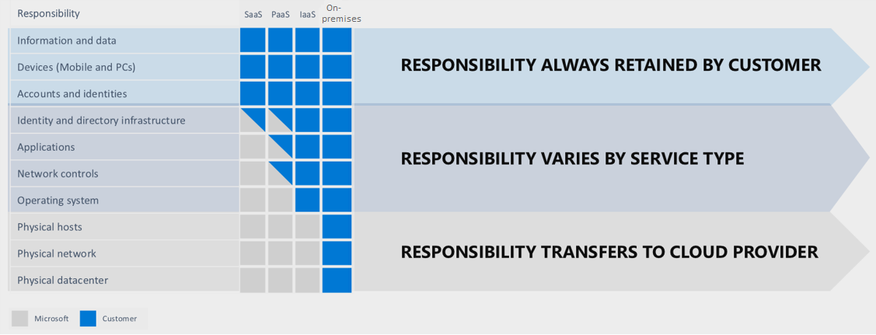
DIFFERENT SCENARIO’S FOR CLOUD RESPONSIBILITIES IN AZURE

Slide 4
BENEFITS OF CLOUD OPTIMISATION
Using cloud has many advantages like the ability to easily be able to scale up or down according to our need.
The challenge lies in the pattern to understand our spends and what we need to do to save as much as possible. We may not use many of the resources properly and thus it leads to a wastage for us.
There are certain situations where our cloud costs are increasing. There may be a possibility that the customer base is increasing regularly as well. But without a proper visibility we won’t be able to know why our costs have been increasing and the specific techniques we can use for it.
A Cloud Optimisation stratergy thus comes into picture where the goal is to reduce the wastage of resources as well as increase the performance by removing the unnecessary features.
Cloud optimisations help companies in the longer run as well. Cloud optimization is important for companies that want to have more cloud benefits such as reducing their cloud costs, boosting the productivity of employees, and moving their operations from on-premises architecture to a cloud based environment.

Slide 5
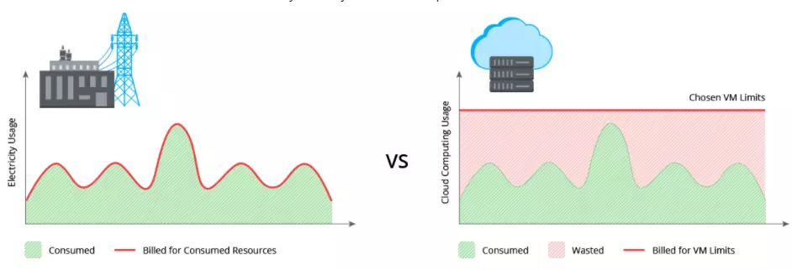
PRACTICING CLOUD OPTIMISATION BOOSTS VISIBILITY
Most of the users of cloud think that they are are using the Pay-as-you-go model efficiently. The thing that we have to know is that even the most of the famous cloud service providers like Google Cloud, Microsoft Azure and others don’t enable these capabilities in our accounts automatically. The pay-as-you-go model sometimes works rather inefficiently where certain resources are overallocated leading to an increase in the overall costs.

Slide 6
CLOUD OPTIMISATION ADVANTAGES
The Cloud optimisation process focusses on finding out underutilized features, or resources which are overprovisioned or mismanaged tools and services to find out the areas where improvement can be made.
TO REDUCE UNNCESSARY COST
Cloud optimisation also helps to reduce any unnecessary extra costs. This is helpful for people those people who are new to cloud as well as those who have been using the cloud for some time.

Slide 7
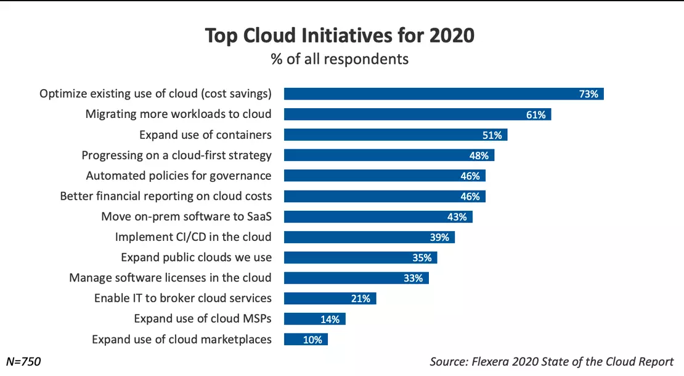
CLOUD OPTIMISATION REDUCES CLOUD COST

Slide 8
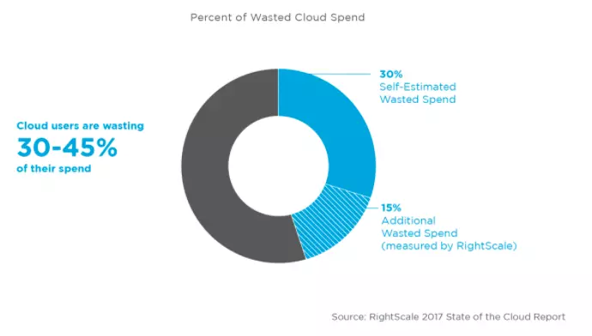
WASTAGE OF CLOUD RESOURCES

Slide 9
BOOSTING CLOUD UTILISATION
Cloud offers several features and new features are added after some particular time. Some famous cloud companies offers hundreds of new features after a year.
Some of these features may be helpful depending on the need of the company but most of it may be unnecessary usage of cloud resources.
Companies and individuals working alone need to target this bare minimum in order to optimize their cloud costs to the maximum.
It also helps engineers and employees to increase their productivity by focusing on their job. Using cloud optimization stratergies thus frees up time and ensures that the team performance does not decrease.

Slide 10
COMMANDS FOR CREATING A LINUX VM THROUGH CLI
az group create --location centralus --resource-group bishwa3 :To create a resource group in a specific location.
az vm create --resource-group bishwa3 --name MeanStack --image Canonical:0001-com-ubuntu-server-focal:20_04-lts:latest --admin-username bishwa19 --generate-ssh-keys :run the az vm create command to create an Ubuntu VM
az vm open-port --port 80 --resource-group bishwa3 --name MeanStack :Open port 80 on the VM to allow incoming HTTP traffic to the web application
ipaddress=$(az vm show --name MeanStack --resource-group bishwa3 \--show-details \--query [publicIps] \--output tsv) : It is useful to store the address in a Bash variable called ipaddress.
ssh bishwa19@$ipaddress :Connect to VM
sudo apt update && sudo apt upgrade -y :All current packages are up-to date

Slide 11
SOME MORE USEFUL COMMANDS
sudo apt-get install -y mongodb :To install MongoDB Package.
sudo systemctl status mongodb :To check MongoDB is up and running.
mongod --version :To verify the installation process.
curl -sL https://deb.nodesource.com/setup_17.x | sudo -E bash - :To register the Node.js repository so the package manager can locate the packages.
sudo apt install nodejs :To install NodeJS.
ipaddress=$(az vm show --name MeanStack --resource-group bishwa3 --show-details --query [publicIps] --output tsv)
echo $ipaddress : 40.86.94.39
cd Books
sudo nodejs server.js :Connect to Server

Slide 12


