Slide 1
Resource Optimization in Virtualization
BY BISHWA JYOTI DAS (19BCE1755)
Storage
Backup
Connectivity
Networking
Shared Responsibility

Slide 2
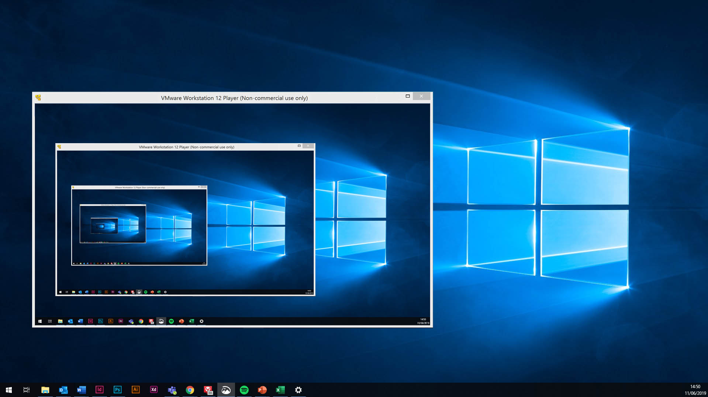
SCOPE
The scope of the project is to visualize the resource optimizations in virtual environment. We will also check how virtual resources are handled in the cloud.
The resource allocation problem is a major issue in cloud based services whose focus is to reduce the wastage of resources as much as possible. There are many methods through which cloud achieves this and virtualization is an integral part of it.
Though the deployment and allocation of virtual machines in data centers can be a bit of an issue when cloud infrastructure is made of lightweight computing devices.

Slide 3

OBJECTIVE
To check how the various resources are handled and optimized in virtual as well as the cloud environment. There are various resources in Cloud as well as Virtual environments. Virtual environments are largely used in Cloud to increase it’s functionality and efficiency.
The allocation of resources plays a very significant role in determining the power consumption, performance as well as the good use of the allocated resources such that there is a minimum wastage. Thus resource optimization is a key technique of achieving such results efficiently.

Slide 4

METHODOLOGY
We will basically review several research papers to check all the available optimisation techniques for cloud based services as well as virtualisation environments.
We will also see the respective ways through which the famous cloud service providers such as Google and AWS optimise their resources.
If possible we will also see how to use machine learning for cloud optimisation.

Slide 5

IMPLEMENTATION
We will basically check the available resource optimization techniques available today. The way Google Cloud and AWS manage their resource optimizations will also be shown.
As for our personal cloud space one way is that Google sends us Recommendations that our instance of our virtual machine is currently being used inappropriately so we can downsize it so that it saves us our cost.
There are many such ways through which we can reduce our costs and optimize our resources for proper usage. We can make use of preemptible instances along with our regular instances for finishing larger and complex workloads faster and in a cost effective way.
We can make use of Densify which has a free trial available for two weeks of use and has many supported technologies like AWS, Google Cloud , Microsoft Azure, Kubernetes and more.

Slide 6


