Slide 1
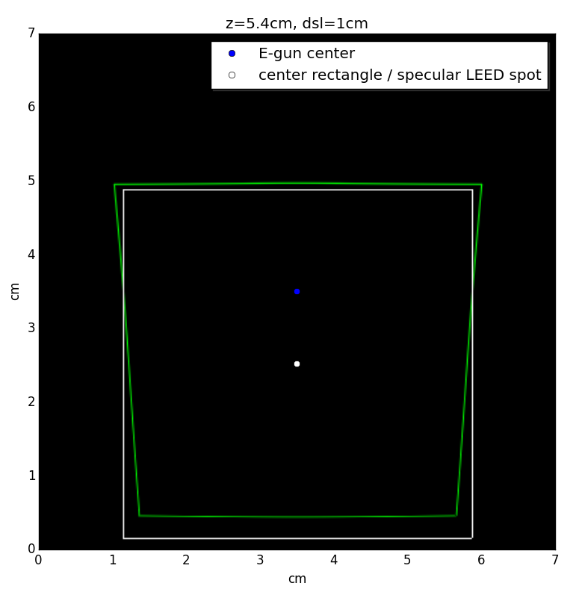
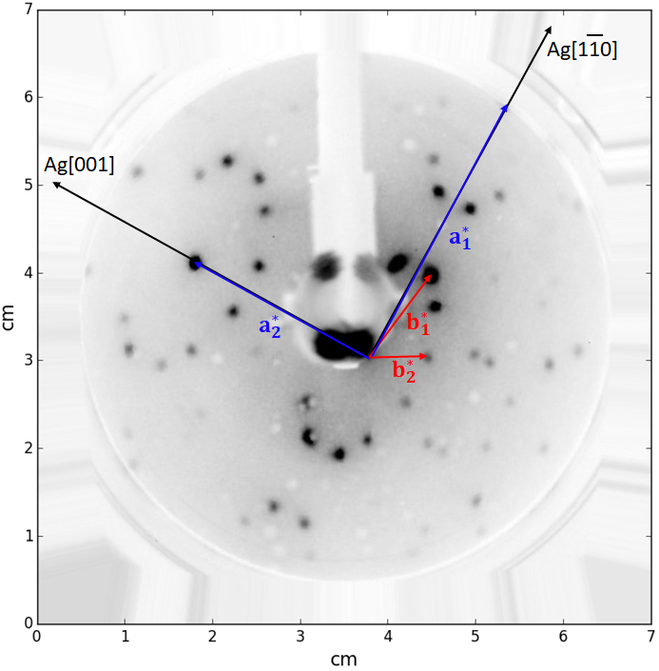
Central- and spherical projection applied to an image:
a low energy electron diffraction pattern (right)
Code: data-analysis/LEED-correction/LEEDcorrection.py

Slide 2
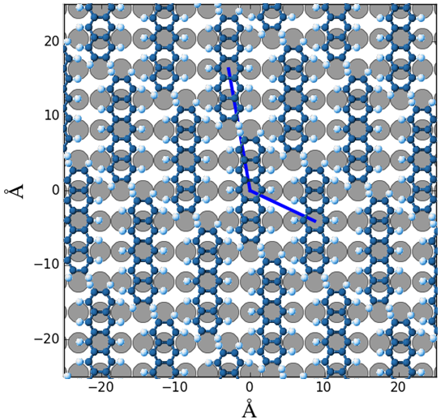
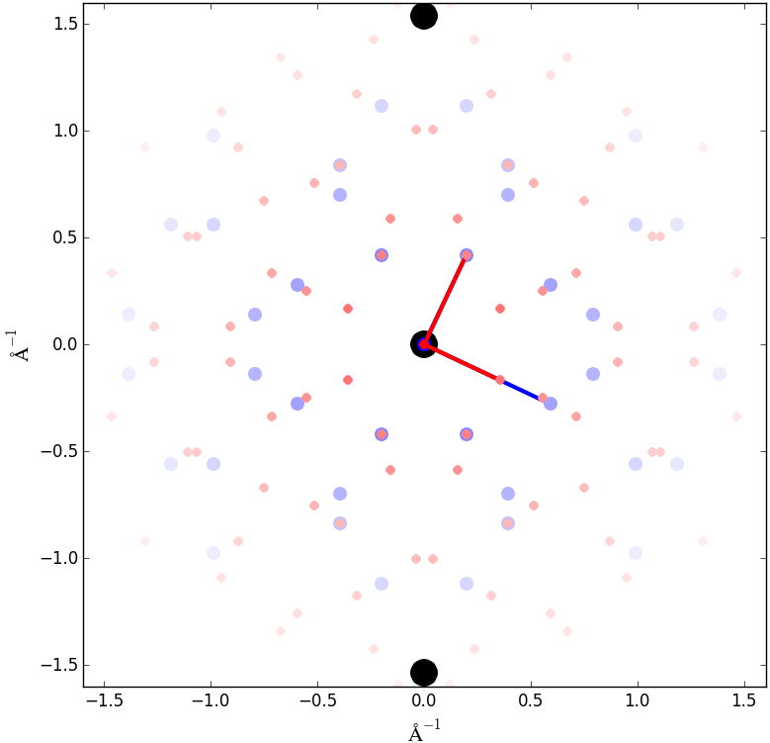
Adsorption geometry visaulization in reciprocal- and real space:
Adsorption geometry of one layer Pentacene molecules on top of a Ag(110) surface.
Code: adsorbate-structure/adsorption_structure.py

Slide 3
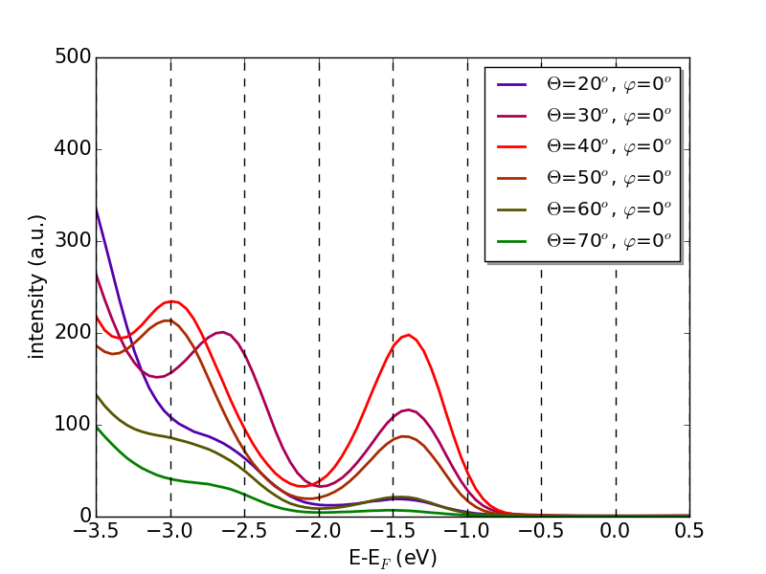
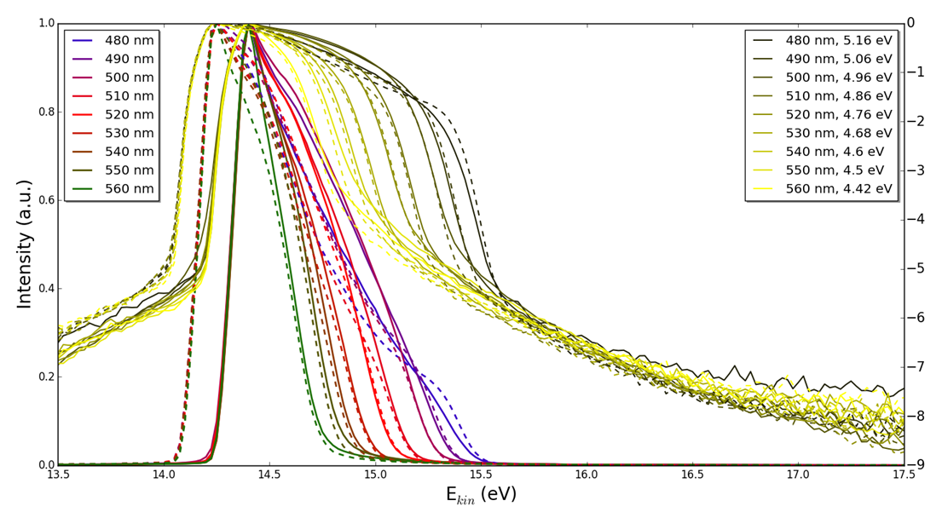
Visualization of 1D spectra:
Left some spectra with normal- and logarithmic scale,
Right some spectra normal scale with binding energy axis
code: UPS, XPS, 2PPE Spectra/2PPE, UPS, XPS.py

Slide 4
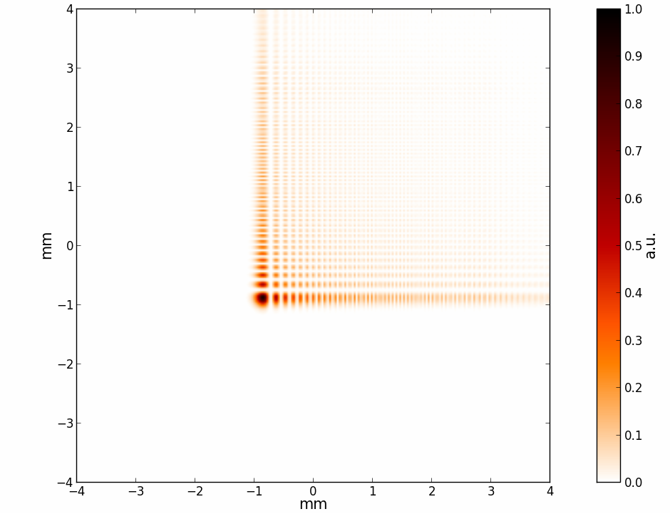
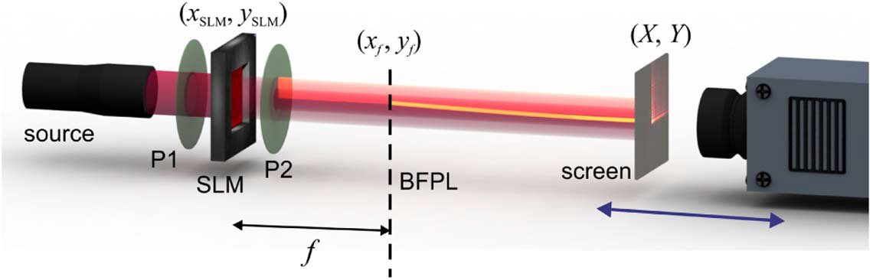
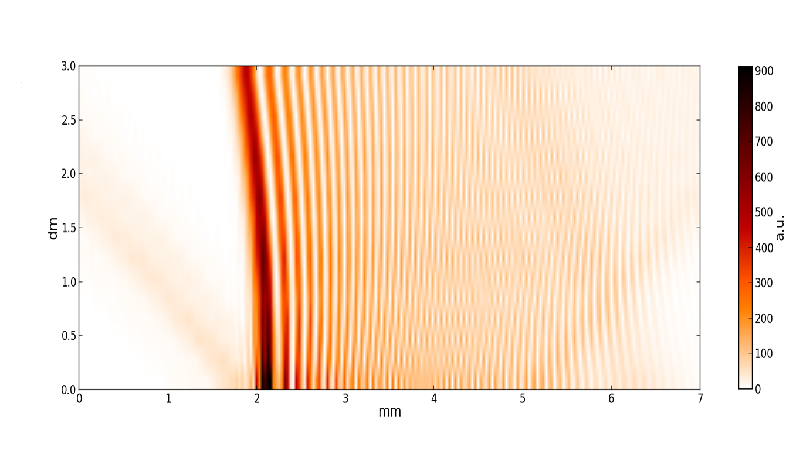
Propagation of any monochromatic wavefront:
Left: Airy beam profile (plane view)
Right: optical setup (top) and beam propagation visualization (d vs z)
{main spot in the beam profile (left image) undergoes a quadratic deflection during propagation (without external force)}
code: wavefront propagation with ASM/angular_spectrum_method.py

Slide 5
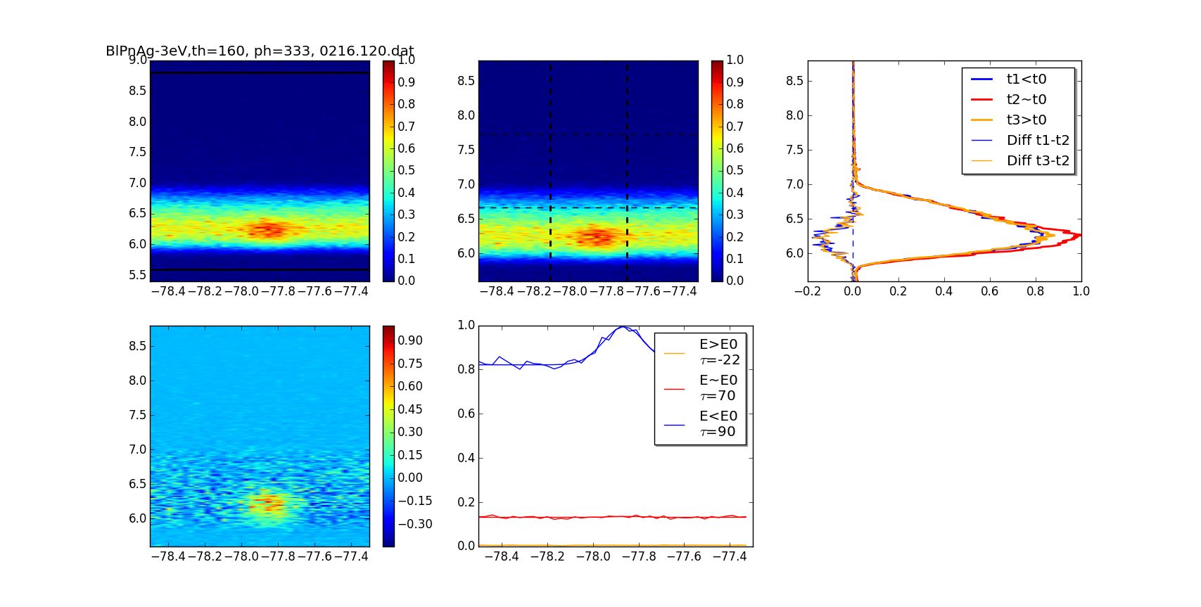
Analsys of time resolved spectra, there is a spectra for each timestep:
Difference plot (bottom left) and Gaussian fit to traces in three different energy regions
Code: TR-UZHLab/TR_UZHlab.py

Slide 6
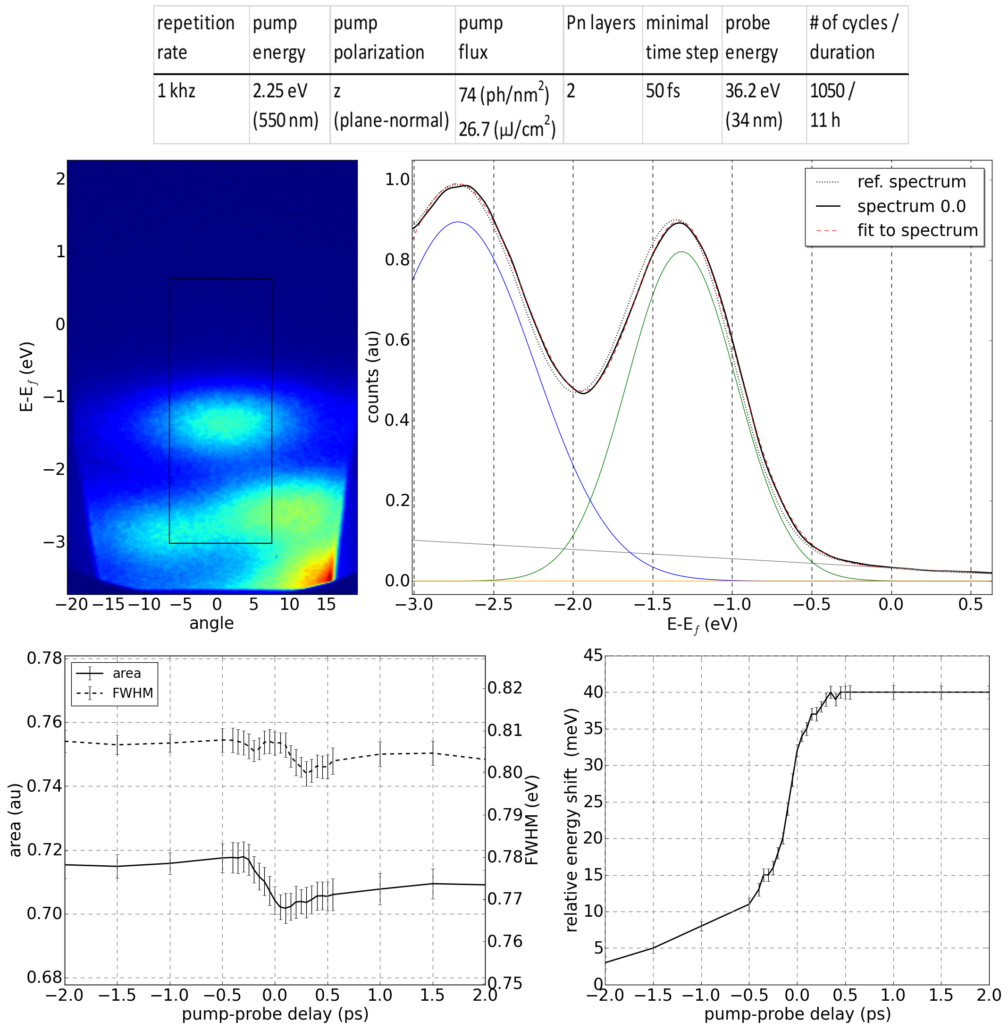
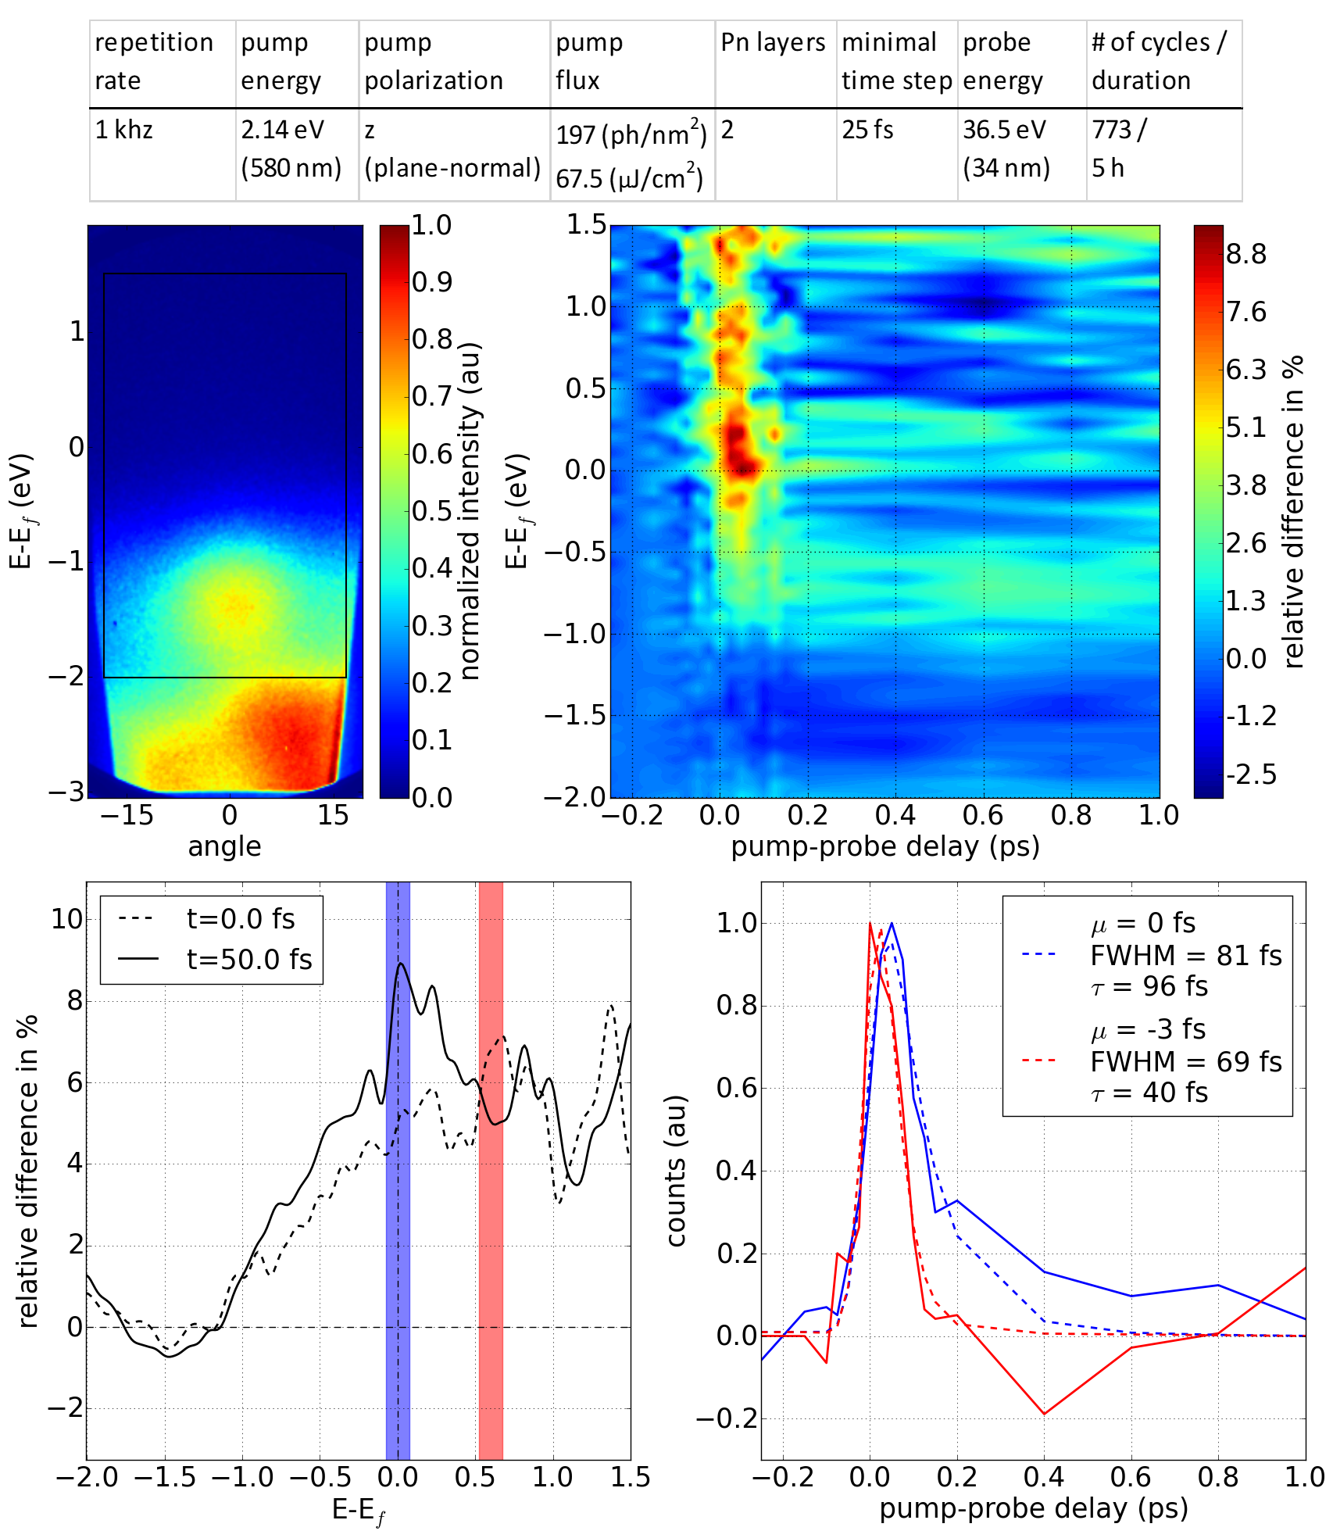
Analysis of time-resolved spectra in the occupied and unoccupied states:
Left: Gaussian fit with linear background to each spectra to get time
depending parameters of occupied states.
Right: Selected traces over small energy regions of the relative difference
with a exponential modified Gaussian fit function to estimate the decay parameters.
Code: TR-ARTEMIS-Oxford/TR_ARTEMIS_procedures.py

