Slide 1
Flexible and Efficient QoS Provisioning in AXI4-Based Network-on-Chip Architecture - A brief comprehension
An In-Depth Analysis of the Paper and its Key Findings
Dustin Heither - Neuartige Rechnerarchitekturen - SoSe 2025

Slide 2
Agenda
01
Objective
02
Paper Concepts
03
Paper Analysis
04
Results
05
Critical Reflexion

Slide 3
Objective
Goal
Understanding the concepts of Wang & Lu (2022): „Flexible and Efficient QoS Provisioning in AXI4-Based Network-on-Chip Architecture“
Critical reflection on their architecture and results
Questions
What makes their architecture special?
What alternative approaches exist in the literature? (only discussed in the paper)
Is their architecture still state of the art?

Slide 4
Paper Concepts

Slide 5
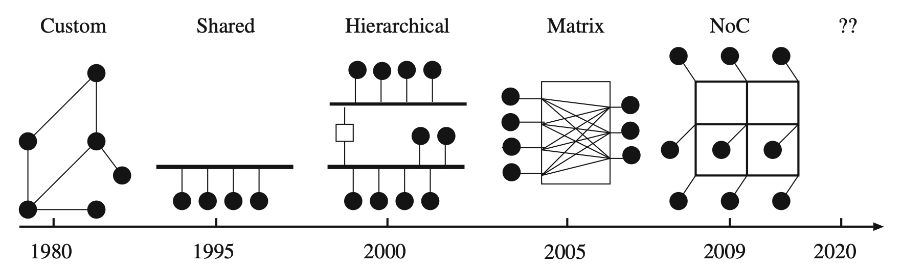
Paper Concepts
Network-on-Chip (NoC) - 1
Definition
Communication backbone in modern SoCs (connects CPUs, memory, accelerators)
Motivation
Shared buses became bottleneck with increasing number of cores
Hierarchical buses & bus matrices improved things, but lacked scalability and flexibility
NoC idea
Replace buses with a packet-based on-chip network, inspired by computer networks
Provides scalability, parallelism, IP reuse and energy efficiency
Fig. 1 - Evolution of Interconnects [1]
Notes:
SoC = System on Chip, Processing Cores, Memory, I/O interfaces
NoC = Network on Chip, connects the different parts of the SoC
Shared Buses —> Bottleneck, because all SoC are connected to the same line
Hierarchical Buses —> spliting into segments, but still issues regarding scalability
Bus Matrix —> Parrallel connections between Master and Slave —> Wiring complexity grows quadratically

Slide 6
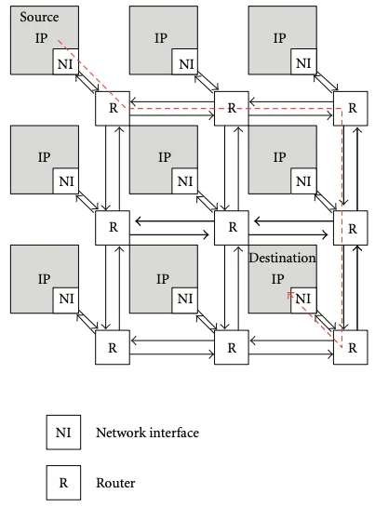
Paper Concepts
Network-on-Chip (NoC) - 2
Key Components
Routers: Switch and forward packages
Links: Connecting routers
Network Interfaces (NIs): Translate between component (Protocols) and NoC packets (~Network)
Advantages
scalable bandwidth, modular design, better performance
Challanges
more design effort, area/ power overhead, complex routing
Fig. 2 - NoC Components [2]
Notes:
Routers:
Connected to the components
Decides the path
Links:
Physical connections
NI:
Components like CPU communication in protocols (like AXI4)
NoC speaks in packets
NI ensures the translation
QoS handling
Ordering/ Flow Control

Slide 7
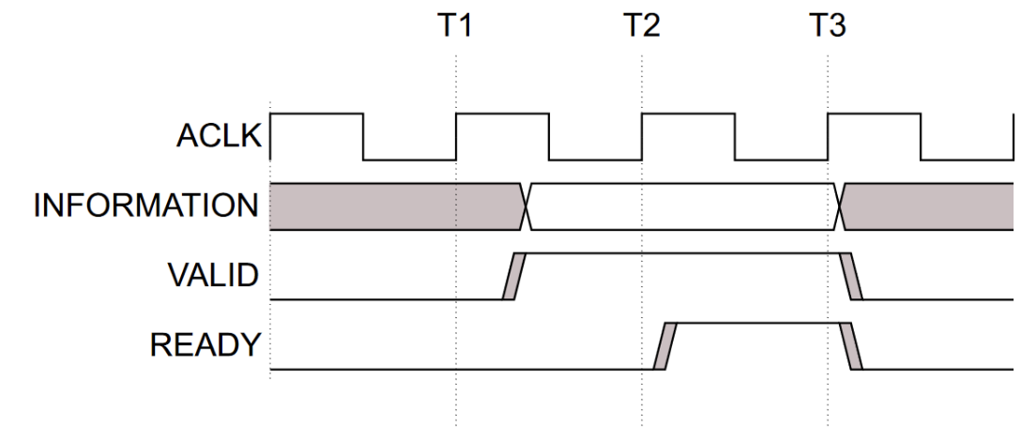
Paper Concepts
AMBA & AXI Protocol
AMBA Evolution:
1996 - 1999: AMBA 1/2: Basic buses
2003: AMBA 3: AXI3 – out-of-order transactions
2010: AMBA 4: AXI4 family (AXI4, AXI4-Lite, AXI4-Stream)
2013+: AMBA 5: Cache-coherent extensions
Advantages
High bandwidth & scalability
Flexible timing (decoupled address/ data)
Fits diverse SoC needs
AXI4 Key Features:
5 independent channels (AW, W, B, AR, R)
Separate READ & WRITE: parallelism & high troughput
Burst transfers (fixed, incr, wrap)
Out-of-Order transactions
Handshake protocol (VALID/ READY)
Fig. 3 - AXI Handshake (VALID before READY) [3]
Notes:
AMBA = Advanced Microcontroller Bus Architecture
Introduced by ARM
AXI = Advanced eXtensinle Interface —> Communication Protocol
5 channels between master and slave
AW = Adress Write —> tells where to write the data
W = Write —> carries the Data
B = Write Response —> slave reports success/error
AR = Read Address —> tells where to read from
R = Read Data —> returns the data + response
Each Channel works independently with its own handshake (VALID/ READY) —> parrallel
Decouples READ and WRITE path —> parallel, because they don‘t block each other
Burst Modes = Block transfer —> 1 adresss + 8 words of data in a row —> less overhead, more performance
Master can issue several requests at once, Slaves can return out of order

Slide 8
Paper Concepts
Quality of Service (QoS)
Definition
Technique to manage & prioritize network traffic
Key Parameters
Bandwidth/ Throughput: capacity vs. actual rate
Latency: transmission delay
Jitter: variation in packet arrival
Packet loss: dropped data
How QoS works
classify & mark packets (by priority)
queuing & scheduling (priority queues)
bandwidth management
QoS Models
Best Effort – no guarantees
IntServ – strict guarantees (resource reservation)
DiffServ – scalable, widely used (class-based)
Notes:
CPU cares about latency
GPU cares about bandwidth
Video/ voice sensitive to jitter and packet loss
Best Effort: All packets treated the same
IntServ (Integrated Services): Resource Reservation
DiffServ (Differentiated Services): Packets are classified (based on classes like important, less important) and marked

Slide 9
Paper Analysis

Slide 10
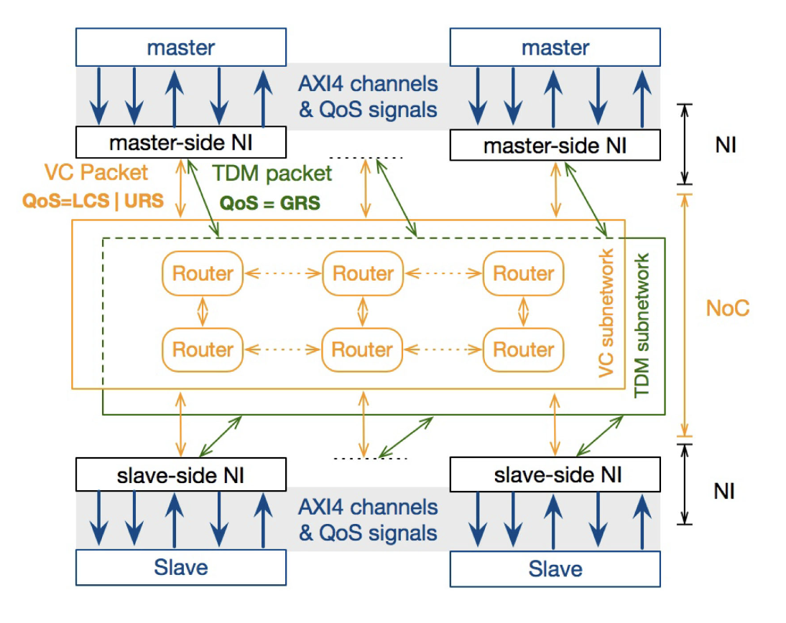
Paper Analysis
Overall Architecture
Goal
Provide flexible QoS for AXI4-based SoCs
Three QoS Classes
LCS – low latency, bursty traffic (CPU)
GRS – guranteed bandwidth, streaming traffic (GPU)
URS – best effort, fair resource sharing (I/O)
Main Components
AXI Masters/ Slaves
Network Interfaces (NIs) – protocol conversion, QoS
Dual Subnetworks: VC-based for LCS or URS and TDM-based for GRS
Select Core Functions
Identify essential functions for AI framework (e.g., add, ReLU, matrix multiplication)
Use MNIST Dataset
Select MNIST for a manageable, well-understood image classification task
Choose Training Framework
Implement model training using TensorFlow v1, selected for its documentation and wide usage
Export Model Weights
Use a human-readable text format for exporting weights, avoiding complex formats like ONNX
Fig. 4 - System Architecture [4]
Notes:
Key Idea: Decouple NoC from AXI4 details while providing scalable, efficient, and adaptive QoS provisioning for diverse SoC workloads
How it works:
Network Interfaces (NIs)
Convert AXI4 channels → 4 unified packet types
Attach QoS labels (LCS / GRS / URS)
Ensure QoS inheritance for responses
Dual Subnetwork Design
VC (Virtual Channel) Subnetwork: for LCS + URS
Low latency (LCS) + fair best-effort (URS)
TDM (Time Devision Multiplexing) Subnetwork: for GRS
Guaranteed bandwidth + predictable latency
Traffic Converter
Dynamically shifts packets between VC ↔ TDM
Reduces congestion, balances utilization, preserves QoS
LCS: Latency Critical Service
GRS: Guaranteed Rate Service
URS: Unspecified Rate Service

Slide 11
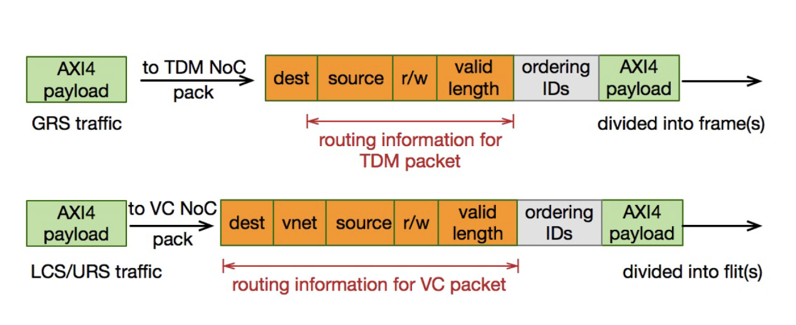
Paper Analysis
Message Conversion & Network Interface
Why Message Conversion?
Direct mapping (5 AXI channels → 5 packet formats) = inefficient
Adopted approach: 4 unified packet types
Read request / Read response
Write request / Write response
Packets carry QoS label (LCS/GRS/URS)
NI Roles
direct packets to correct AXI channel / subnetwork
Conversion: AXI4 ↔ NoC packets
QoS inheritance: responses keep QoS class of request
Fig. 5 - Message Format Conversion [4]
Notes:
vnet = Indicator which virtual channel is used
NI simplifies the AXI Protocol + QoS label

Slide 12
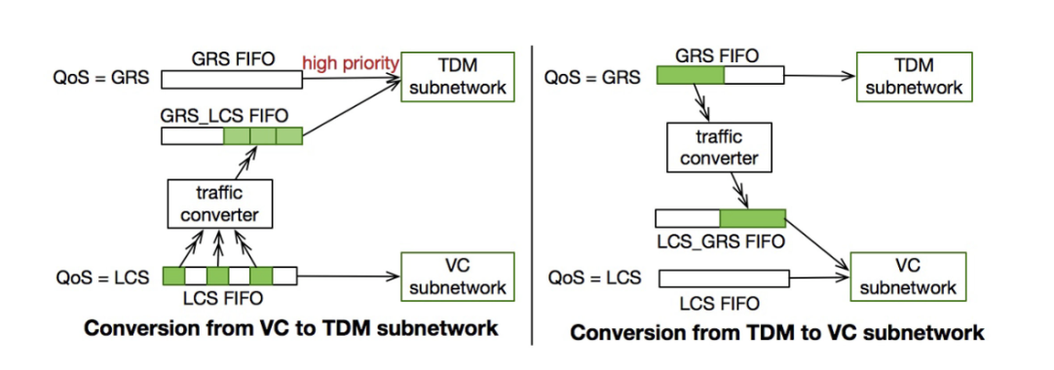
Paper Analysis
Dual Subnetworks & Traffic Converter
VC Subnetwork (GRS, LCS)
Supports different flow control schemes
Goal: prioritize latency-sensitive LCS while maintaining fairness for URS
TDM Subnetwork (GRS)
Static routing via precomputed time slots
Guarantees bandwidth and predictable time slots
Traffic Converter Subnetwork (GRS)
VC → TDM: offload LCS if VC congested
VC → TDM: offload GRS if TDM congested
Improves utilization, latency, throughput
Fig. 6 - Traffic Conversion Unit [4]
Notes:
Load is not balanced, there are two subnetworks VC / TDM

Slide 13
Results

Slide 14
Results
Key Findings & Conclusion
Key Findings
High Throughput
VC: 12.3 Gb/s, TDM: 7.4 Gb/s → ~19.7 Gb/s total
Latency
LCS stays low with Individual_Shared flow control
URS higher delay, but fairness maintained
Resource Utilization
VC ports: 4.4% → 16.5% utilization before saturation
TDM slots: ~17% utilization
Traffic Converter
VC→TDM: cuts LCS latency
TDM→VC: reduces GRS queuing delay
Up to ~94% performance improvement
Simulator Setup
Custom Simulator (C++, BookSim2- & Gem5-based)
168 nodes, dual-subnetwork NoC (VC + TDM)
Realistic traffic via two-level MMP generator
Conclusion
Dual-subnetwork
Adaptive conversion achieves scalable throughput, low LCS latency, and balanced QoS across traffic types

Slide 15
Critical Review
Contributions
AXI4-compatible NoC with flexible QoS provisioning
Dual-subnetwork design
NI: AXI4 → packet conversion + QoS inheritance
Adaptive load balancin: VC ↔ TDM Conversion
Strengths
Integrates three QoS services in one unified framework
Decouples AXI4 protocol details from NoC fabric
Demonstrates tangible performance improvements
Limitations
Hardware complexity: Dual subnetworks + traffic converter
Synthetic traffic only: Limited validation with real workloads
Adaptability: Rule-based switching; no runtime intelligence

Slide 16
Bibliography
[1] B. A. Abderazek, Multicore Systems On-Chip: Practical Software/Hardware Design, 2nd ed. 2013, vol. 7.
[2] J. Hertz, Why SoCs Need NoCs: Network on Chip and the Future of Computing, in ALL ABOUT CIRCUITS, 25.07.2025, (https://www.allaboutcircuits.com/news/why-socs-need-nocs-network-on-chip-and-future- computing/) – accessed 28.09.2025.
[3] P. Holzinger, On-Chip Bussysteme und Perpherie (Schwerpunkt CPU Entwicklung) in CPU-Entwicklung mit VHDL, SoSe 2025, Slide 12.
[4] B. Wang and Z. Lu, “Flexible and Efficient QoS Provisioning in AXI4-Based Network-on-Chip Archtecture,” IEEE Transactions on Computer-Aided Design of Integrated Circuits and Systems, vol. 41, no. 5, pp. 1523–1536, May 2022.

