Slide 1
Working with Terraform

Slide 2
Objectives
Infrastructure as Code
Introducing Terraform
Terraform Project Structure
Terraform State

Slide 3
Infrastructure as Code
When deploying to a cloud platform or a Docker based environment, you are not creating any physical infrastructure but rather creating virtual environments
Virtual environments can be created using Web consoles and CLI commands
But this is not scripted, and is a manual process that is error prone and slow
Infrastructure as code is where we create a script that specifies the infrastructure that we want
Every time we run the script, we get the same infrastructure result
Repeatable
Consistent
Since it is a script, it can also go in source control
Version controlled infrastructure!!

Slide 4
Infrastructure as Code Technology
There are numerous infrastructure as code technology options
AWS have CloudFormation and the Serverless Application Model (SAM) and the Cloud Developer Kit (CDK)
Azure have Azure Resource Templates
Google Cloud have Deployment Manager
In addition for serverless applications there is the Serverless Framework
Given that there are so many options, in an enterprise environment where multiple cloud providers and deployment variations are in use, it would be good if your teams could work with one consistent technology – enter Hashicorp Terraform

Slide 5
Introducing Terraform
Terraform is a technology that allows you to create infrastructure as code, and it works with multiple different platforms
Docker
AWS
Azure
GCP
Terraform is available from Hashicorp and you can download it from here
https://www.terraform.io/downloads.html

Slide 6
Installing Terraform
The Terraform installation is straightforward
For example, on Windows
Download the zip from the installation site
Extract the zip (it contains one file terraform.exe)
Place terraform.exe somewhere in your PATH
To use with AWS, you will also need to configure the AWS CLI with your access key / secret key since this is used by Terraform to access AWS

Slide 7
The AWS CLI
The CLI is based on the Python AWS library called Boto and can be installed on
Mac
Windows
Linux
Installation is straightforward

Slide 8
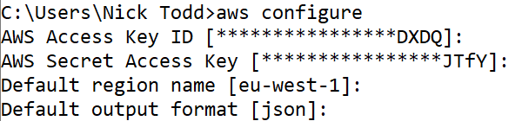
Setting up the CLI
To initialise the CLI, you can run
aws configure
This prompts for
An access key
A secret key
A default region
A default output format

Slide 9
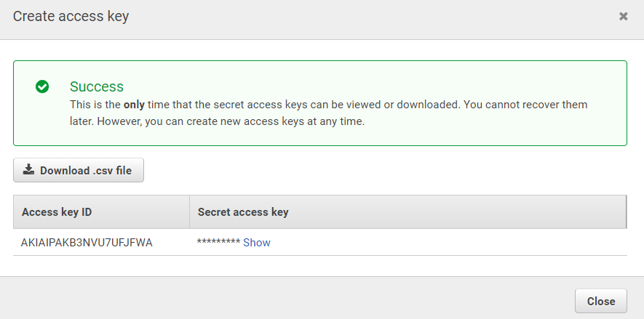
Access / Secret Keys
Access and Secret keys can be generated for users in the Web console

Slide 10
Using the CLI
The CLI is used using the following command format
aws <service-name> <command-name> [parameters]
For example
aws s3 ls
aws ec2 describe-instances

Slide 11
Defining a Terraform Deployment
Terraform infrastructure is defined using HCL which is a configuration language from Hashicorp
It looks quite a lot like JSON
You can also use JSON
Terraform configuration files use the extension .tf
The main terraform configuration file for your infrastructure is called main.tf
terraform {
required_providers {
aws = {
source = "hashicorp/aws"
version = "~> 3.27"
}
}
}

Slide 12
Terraform Single EC2 Example
terraform {
required_providers {
aws = {
source = "hashicorp/aws"
version = "~> 3.27"
}
}
}
provider "aws" {
profile = "default"
region = "us-west-2"
}
resource "aws_instance" "example" {
ami = "ami-08d70e59c07c61a3a"
instance_type = "t2.micro" tags = {
Name = "ExampleInstance"
}
}
Here is a main.tf file that will configure a single EC2 instance on AWS

Slide 13
Configuring a Provider
Remember, Terraform supports multiple deployment environments such as AWS and Azure
Set the required_providers
In this case, we are using the Hashicorp AWS provider
You should specify a specific version in case a version increment affects your templates
Configure the provider
Since this is AWS, we must set the region and the AWS CLI profile to use
terraform {
required_providers {
aws = {
source = "hashicorp/aws"
version = "~> 3.27"
}
}
}
provider "aws" {
profile = "default"
region = "us-west-2"
}

Slide 14
Creating Resources
The most important entities in any Terraform template file are the resource objects that you define
Resources are defined as follows
An EC2 therefore can be defined as follows
resource “resource_type" “your_choice_of_resource_name" {
property = “value“
}
resource "aws_instance" "example" {
ami = "ami-08d70e59c07c61a3a"
instance_type = "t2.micro"
tags = {
Name = "ExampleInstance"
}
}

Slide 15
Creating the Infrastructure
In order to run our Terraform template, we can run a series of terraform commands
terraform init
terraform validate
terraform plan
terraform apply

Slide 16
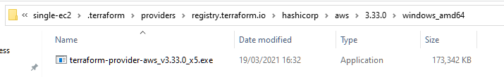
Running terraform init
The purpose of terraform init is to initialise the terraform working directory
A .terraform folder is created that contains the provider that you specified in the main.tf file
Below is a screenshot of Windows Explorer folders after the terraform init has been executed

Slide 17
Running terraform validate

