Slide 1
2.5D Visual Sound
Dristanta Das• 24.06.2021

Slide 2
Objective:
Mono_to_Binaural Model
Mono Audio
Binaural Audio

Slide 3
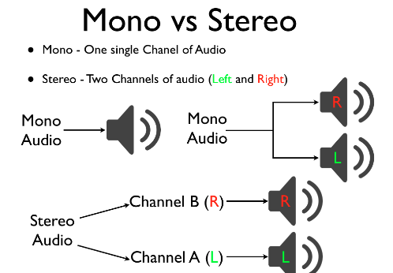
What is Mono And Stereo audio!

Slide 4
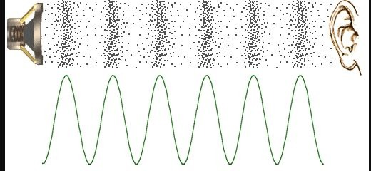
Mono
Binaural

Slide 5

How this helps us to get the spatial knowledge of the audio!

Slide 6
Overview
1871 Video clips and Respective Audios
FAIR-Play Dataset
Train (70%)
1309 Audios
Test (10%)
188 Audios
Validation (20%)
374 Audios

Slide 7
Key Idea
The key idea is that the visual frames reveals important spatial cues.

Slide 8
Suggestion:
Video of that Audio
Respective Frames
Mono_to_Binaural Model
Mono Audio
Binaural Audio

Slide 9
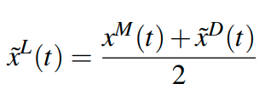

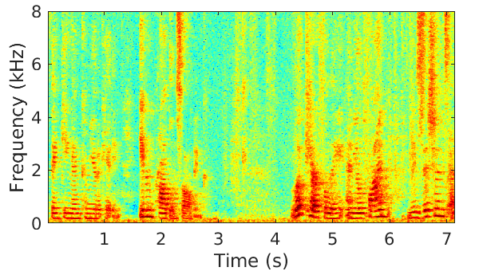
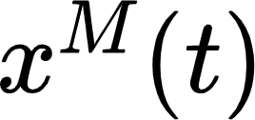


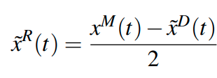
The Model Diagram
Visual Feature
Frame
Pretrained
ResNet18
1x1 Conv
Reshape
C
o
n
c
a
t
e
n
a
t
e
Video
Complex Mask
Predicted Left
Channel
Left Audio Channel
Spectrogram
ISTFT
Mixed Audio
STFT
Predicted Right
Channel
Right Audio Channel

Slide 10
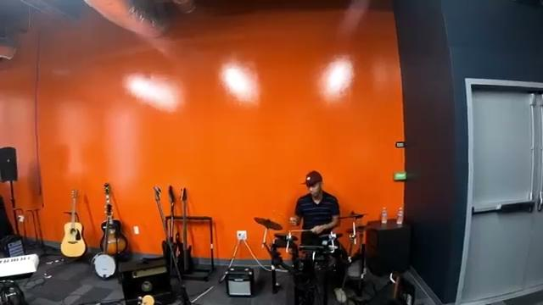
Some Of Test Results:-
Result 1
Input Audio with Video

Slide 11
Some Of Test Results:-
Result 1
Predicted

Slide 12
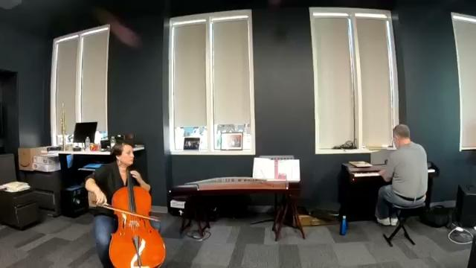
Some Of Test Results:-
Result 2
Input audio with Video

Slide 13
Some Of Test Results:-
Result 2
Predicted

Slide 14
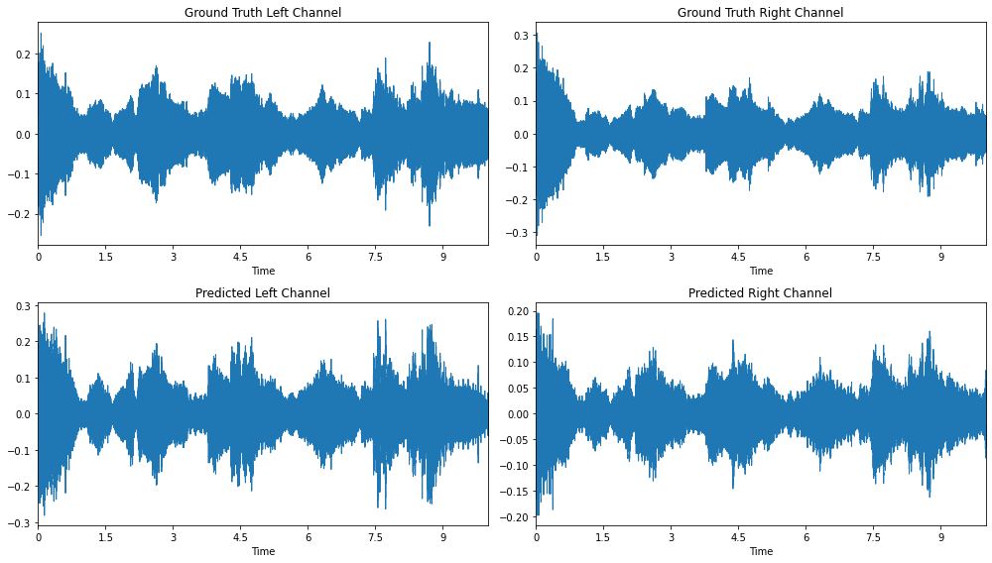
How the previous audio “looks” like!

Slide 15
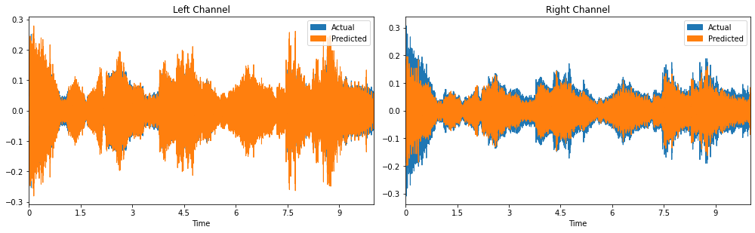
How the previous audio “looks” like!

Slide 16
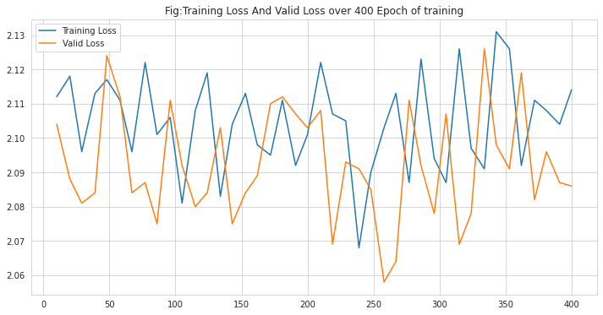
Training and Validation loss

Slide 17
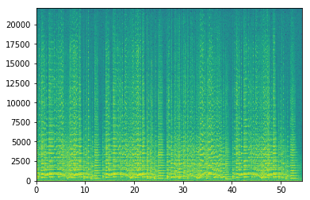
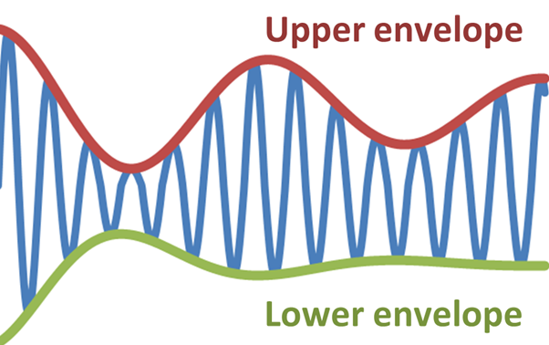


Used Metrics for Accuracy Generation
STFT Distance
Envelope Distance
Let E[x(t)] denote the envelope of signal x(t). The envelope distance is defined as:

Slide 18
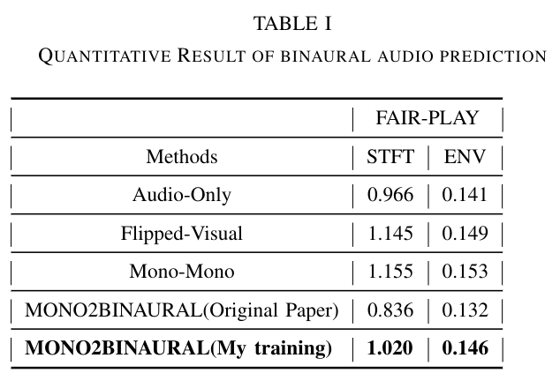
Accuracy

Slide 19
Thanking
All

