Slide 1

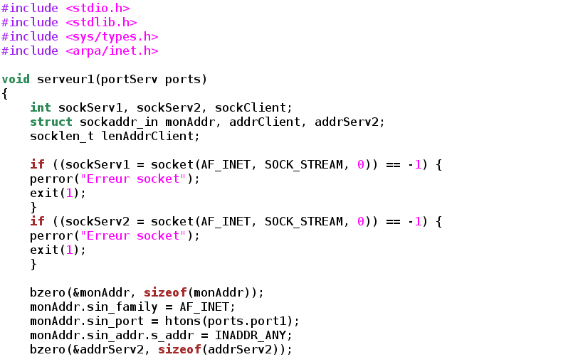


Introduction to C programming
Vistas in Advanced Computing Program
Martín Huarte-Espinosa
mhuartee@central.uh.edu
cacdsatuh
@UHCACDS
www.cacds.uh.edu

Slide 2
Mon 26 June 2017, week 2, day 1
Morning Videos:
Stanford, Programming paradigms,
https://youtu.be/Ps8jOj7diA0?list=PLD28639E2FFC4B86A
https://youtu.be/jTSvthW34GU?t=1m27
Afternoon videos:
Sorting
Quick, https://youtu.be/ywWBy6J5gz8

Slide 3
Write a C program to Sort the N Names in an Alphabetical Order
The program should accepts names & then sorts them using string operation (e.g. strcpy). Example input and output:
Enter the value of n 7 Enter 7 names heap stack queue object class program project Input Names Sorted names heap class stack heap queue object object program class project program queue project stack
Notes:
http://www.sanfoundry.com/c-program-sort-names-alphabetical-order/

Slide 4
Solve the Magic Squares Puzzle without using Recursion. You will receive “magicSquare.c” via email. Copy paste it to your C programming console (codechef, visual studio, etc.). Read it and make sure you understand what it does -except for the missing code.
Then, substitute ALL ??, ??? by the correct code so that it works properly.
Can you think of a different way of doing the same task? Maybe faster? If so, then share your thoughts!
Notes:
http://www.sanfoundry.com/c-program-magic-squares-without-recursion/

Slide 5
Write a function that determines if one string starts with all the characters of another. For example, "applecart" starts with "apple", but "applecart" does not start with "apples". Every string starts with the null string. Here is a start, along with a testing program:
#include <stdio.h> #include <stdlib.h> int startsWith( char const *bigString, char const *start ) { } int main(int argc, char *argv[]) { char *trials[][2] = { {"abcdef", "a"}, {"abcdef", "x"}, {"abcdef", "ab"}, {"abcdef", "abx"}, {"abcdef", "abcdef"}, {"abcdef", "f"}, {"abcdef", "abcdefx"}, {"abcdef", "abcdefxyz"}, {"abcdef", "fooey"}, {"abcdef", "rats"}, {"aaaaaa", "a"}, {"abcdefg", "g"},
{"applecart", "apple"},
{"green", "apple"}, {"apple", ""}, {"", "rats"}, {"",""} };
int j; for ( j=0; j<sizeof(trials)/sizeof(trials[0]); j++ ) { int result = startsWith( trials[j][0], trials[j][1] ) ; if ( result ) printf("%s\t starts with\t%s\n", trials[j][0], trials[j][1] ); else printf("%s\t does not start with\t%s\n", trials[j][0], trials[j][1] ); } return 0; }
Notes:
https://chortle.ccsu.edu/CPuzzles/PartS/AnswersS11/answerS13.html

Slide 6
Tue 27 June 2017, week 2, day 2
Morning Videos:
Bubble, https://youtu.be/lyZQPjUT5B4
Programing in the large, https://youtu.be/YmXnM2KTJP0?t=3m57s
Afternoon videos:
File IO
-https://youtu.be/8nIilb2kiSU
-https://youtu.be/Hxhbp1WSDJA
-https://youtu.be/yPYrxbkY2rk

Slide 7
stuct
Structure is a collection of variables of different types under a single name.
For example: You want to store some information about a person: his/her name, citizenship number and salary. You can easily create different variables name, citNo, salary to store these information separately.
However, in the future, you would want to store information about multiple persons. Now, you'd need to create different variables for each information per person: name1, citNo1, salary1, name2, citNo2, salary2
You can easily visualize how big and messy the code would look. Also, since no relation between the variables (information) would exist, it's going to be a daunting task.
A better approach will be to have a collection of all related information under a single name Person, and use it for every person. Now, the code looks much cleaner, readable and efficient as well.
This collection of all related information under a single name Person is a structure.

Slide 8
Syntax of structure
struct structure_name { data_type member1; data_type member2; . . data_type member; };
NOTE THE SEMICOLON IN THE VERY LAST LINE

Slide 9
We can create the structure for a person as mentioned above as:
struct person { char name[50]; int citNo; float salary; };
Structure variable declaration
When a structure is defined, it creates a user-defined type but, no storage or memory is allocated. For the above structure of a person, variable can be declared as:
struct person { char name[50]; int citNo; float salary; }; int main() { struct person person1, person2, person3[20]; return 0; }

Slide 10
Accessing members of a structure
There are two types of operators used for accessing members of a structure.
Member operator(.)
Structure pointer operator(->) (is discussed in structure and pointers tutorial)
Any member of a structure can be accessed as:
structure_variable_name.member_name
Suppose, we want to access salary for variable person2. Then, it can be accessed as:
person2.salary

Slide 11
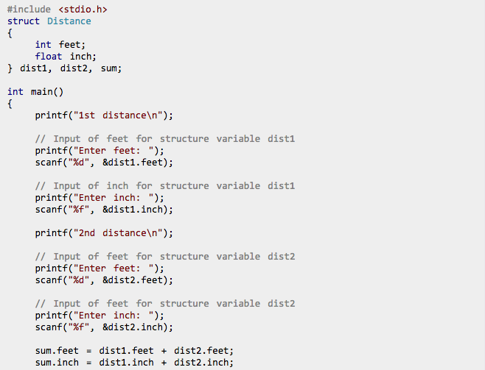
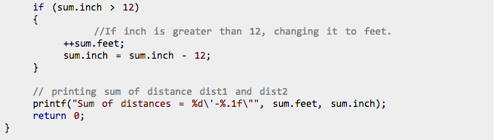
EXAMPLE

Slide 12
Write a program that stores the information (name, roll and marks) of 10 students using structures.
This structure has three members: name (string), roll (integer) and marks (float).
Then, we created a structure array of size 10 to store information of 10 students. Don’t forget about loops.
Hints:
... struct student { ??? name[50]; ??? roll; ... } s[???]; int main() { int i; printf("Enter information of students:\n");
...

Slide 13
Go to the link below and solve all 10 struct problems.
DO NOT CHEAT!
Only look at the answer once you either have solved it or have been working on it for a long time. (If you are found to cheat, you will then have to bring 10 mars bars for everyone…. in the building)
Keep up the hard work.
https://chortle.ccsu.edu/CPuzzles/PartG/CpuzzlesGsection01.html
End of Tue 6/27/17

Slide 14
Wed 28 June 2017, week 2, day 3
VIDEOS
MORNING
C Programming Tutorial - 47 - The Heap
C Programming Tutorial - 48 - Creating an Expandable Program using the Heap
C Programming Tutorial - 49 - Structures
AFTERNOON
C Programming Tutorial - 55 - Global vs Local Variables
C Programming Tutorial - 56 - Passing Arguments to Functions
C Programming Tutorial - 58 - Pass by Reference vs Pass by Value

Slide 15
Go to the link below and solve all 10 2d array problems.
DO NOT CHEAT!
Only look at the answer once you either have solved it or have been working on it for a long time. (If you are found to cheat, you will then have to bring 20 mars bars plus coffee for everyone.)
Keep up the hard work.
https://chortle.ccsu.edu/CPuzzles/PartD/CpuzzlesDsection11.html

Slide 16
Go to the link below and solve all NEW random number problems.
DO NOT CHEAT!
Only look at the answer once you either have solved it or have been working on it for a long time. (If you are found to cheat, you will then have to bring 30 mars bars plus tickets to the movies for everyone and their friends.)
Keep up the hard work.
https://chortle.ccsu.edu/CPuzzles/PartB/CpuzzlesBsection01.html
End of Wed 6/29/17

Slide 17
Thus 29 June 2017, week 2, day 4
VIDEOS
MORNING
Algo design, https://www.youtube.com/watch?v=a_otxyu0mSQ
AFTERNOON
More on data structures,
https://youtu.be/5hKEhXEui6w?list=PL7121C1A1226FA772

Slide 18
Go to the link below and solve all 10 pointers problems.
DO NOT CHEAT!
Only look at the answer once you either have solved it or have been working on it for a long time. (If you are found to cheat, you will then have to bring 2 fresh croissants and hot chocolate for everyone.)
Keep up the hard work.
https://chortle.ccsu.edu/CPuzzles/PartF/CpuzzlesFsection21.html

Slide 19
Fri 30 June 2017, week 2, day 5
VIDEOS
MORNING
Linked-lists, https://youtu.be/o5wJkJJpKtM
https://www.youtube.com/watch?v=udapt4FGY20&t=1s
Then we will revise previous problems.
Then go to the next slide and work on the final problems.
Then… wait for it…. I have 2 final projects for you. See below.
Good luck!

Slide 20
Go to the link below and solve all 15 file handling problems.
DO NOT CHEAT!
Only look at the answer once you either have solved it or have been working on it for a long time. (If you are found to cheat, you will then have to bring mochi japanese ice cream everyone.)
Keep up the hard work.
http://www.w3resource.com/c-programming-exercises/file-handling/index.php

Slide 21
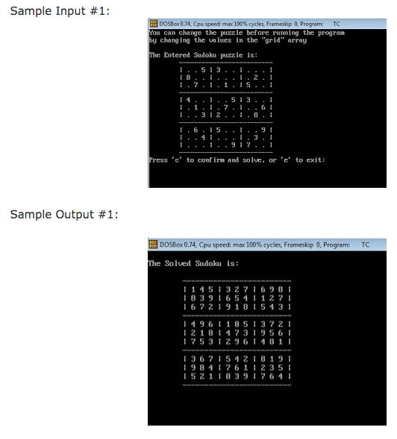
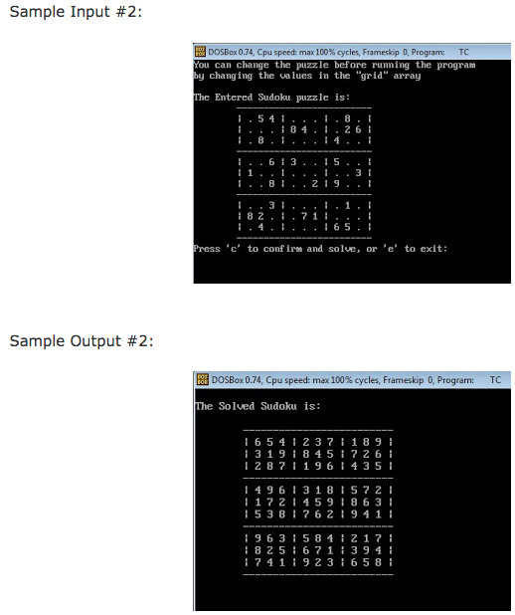
Final projects
- Make teams of 2 people (only 1 team may have three if someone would be left alone)
- Choose one of the following and code it:
Sudoku. Make a program to solve sudoku.
Notes:
http://shadowhackit.blogspot.com/2015/10/C6.html

Slide 22
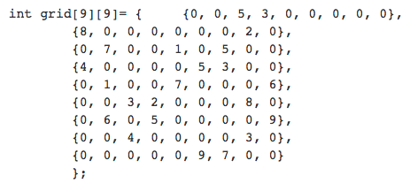
Hint:
Notes:
http://shadowhackit.blogspot.com/2015/10/C6.html

Slide 23
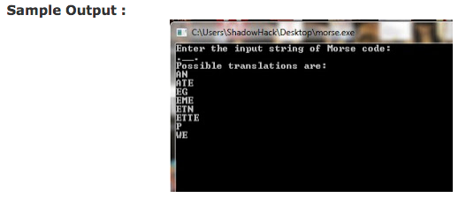
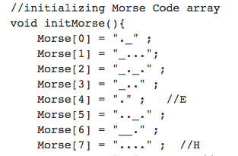
B) Morse. A program to print all the possible translations of string of 'morse code'.
← HINT
Notes:
http://shadowhackit.blogspot.in/2015/12/program-to-print-all-possible.html

