Slide 1
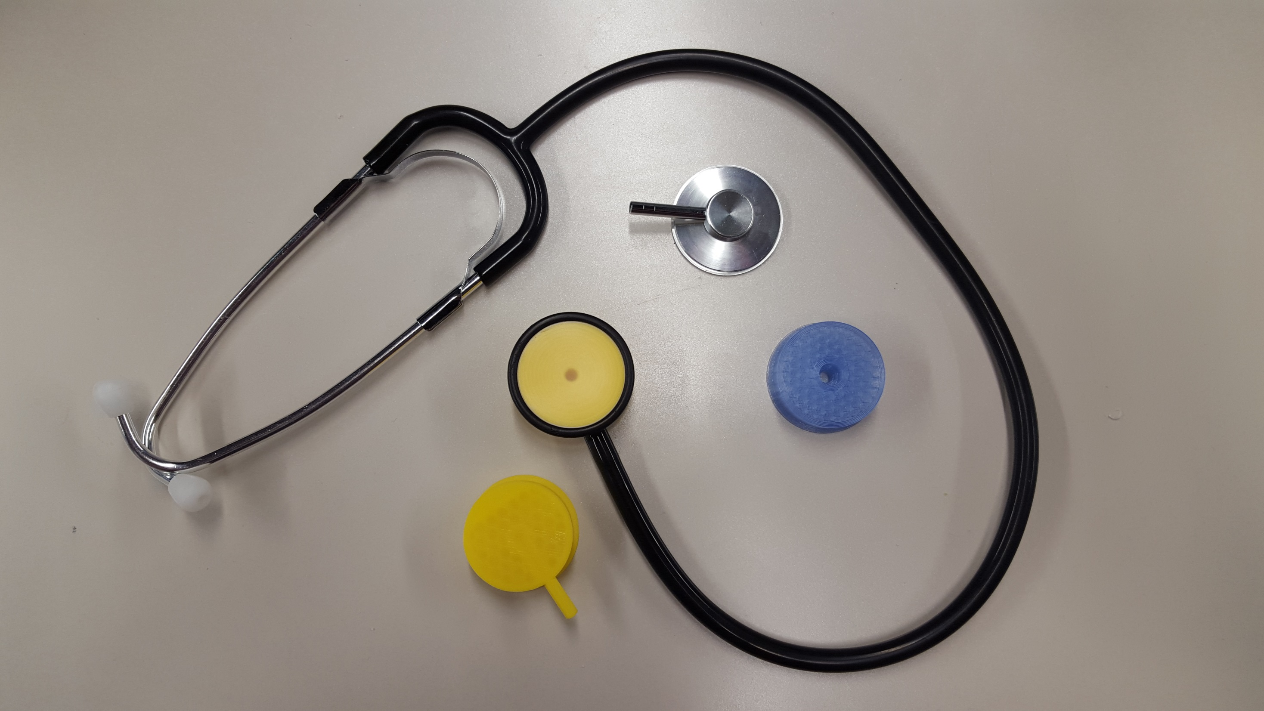
3D Printed Stethoscopes
Thick-walled, hollowed infill
Regular metal stethoscope

Slide 2
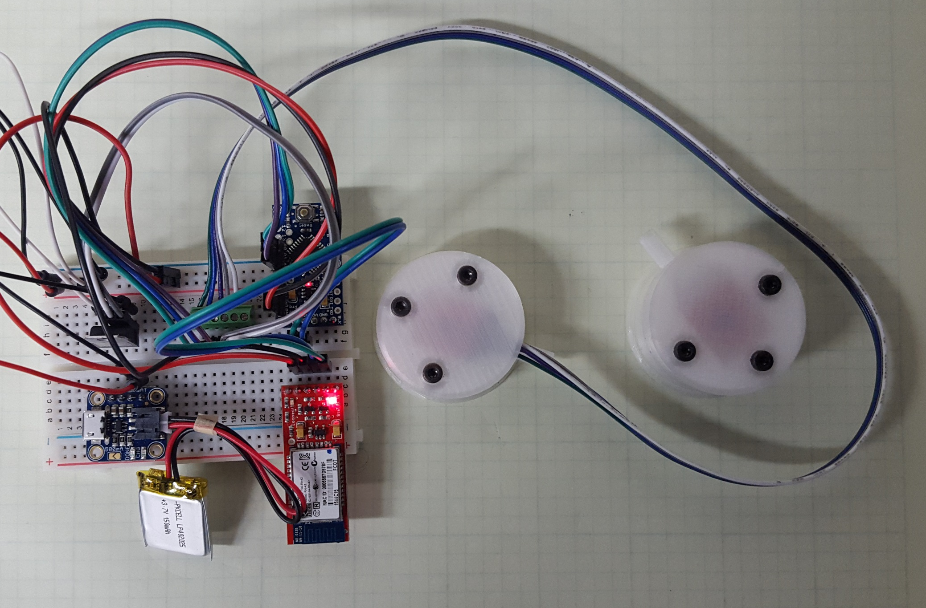
Arduino
Accelerometer
Bluetooth
Charger
Battery
Microphone

Slide 3
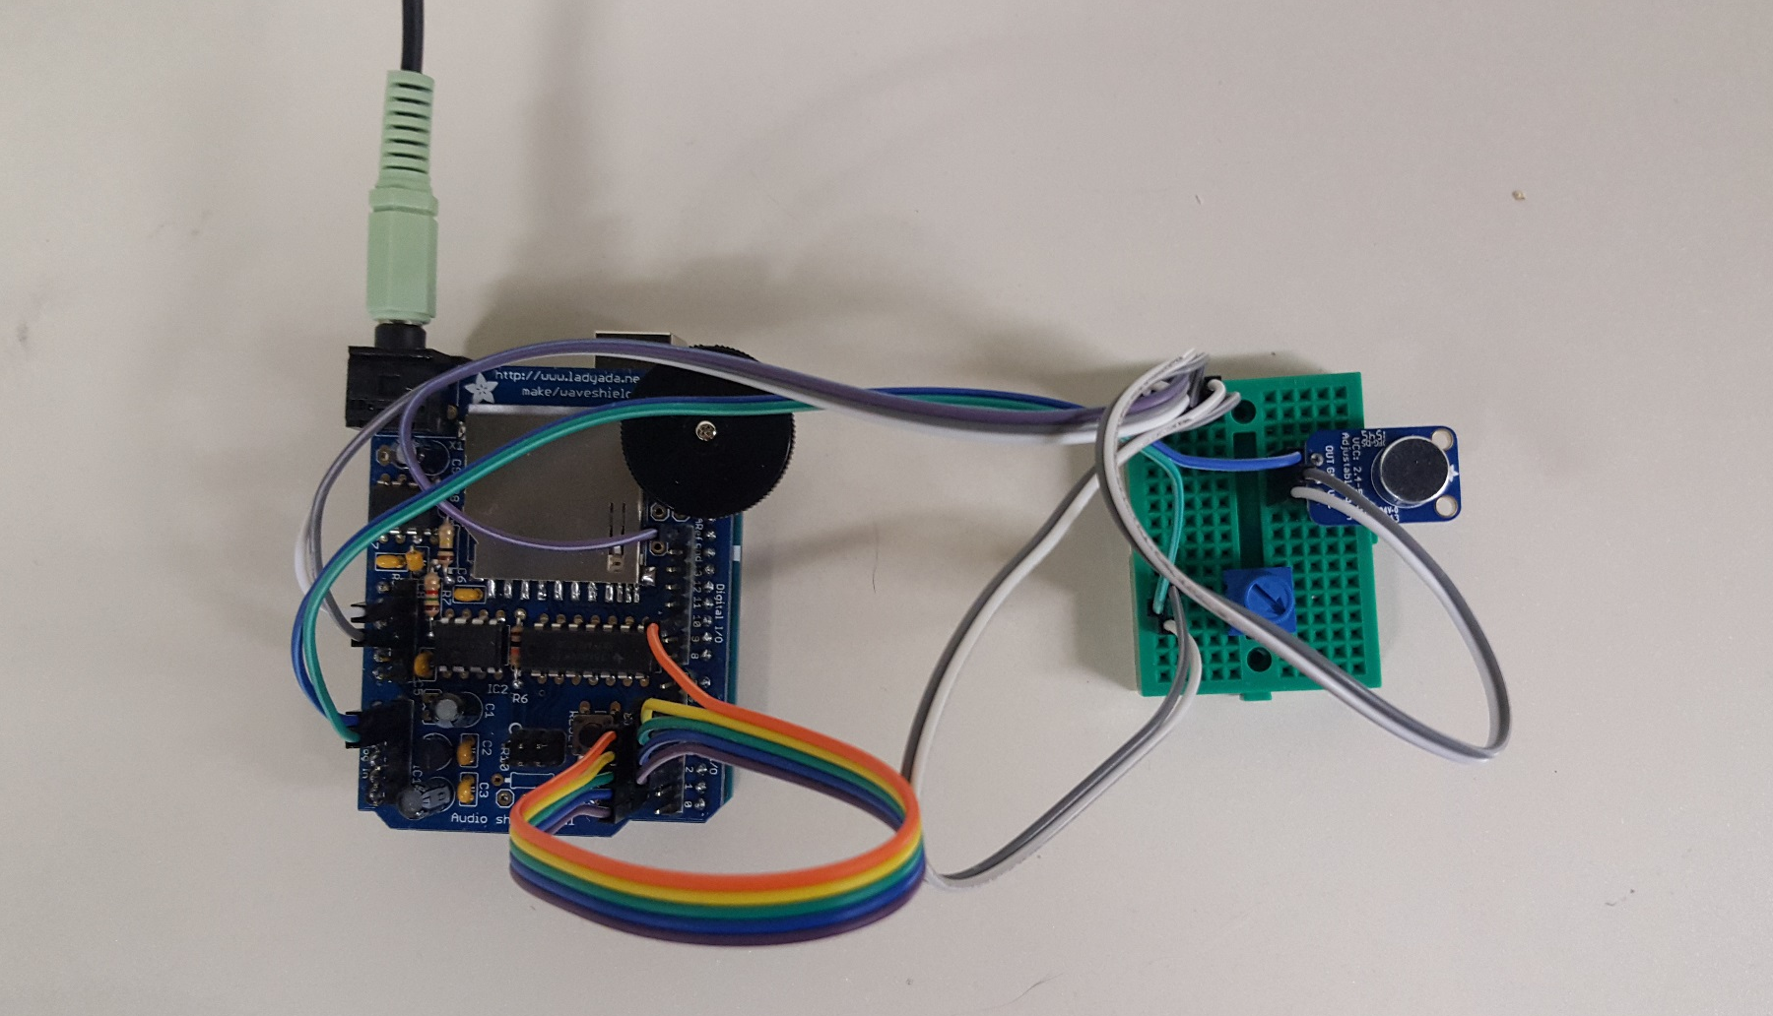
Audio Sink
Microphone
Volume Control
WAV Shield
Pitch Shifter
Arduino

