Slide 1
Cost Benefit Analysis of Human Papillomavirus Vaccine
Savanah Russ & Dasha Pokutnaya

Slide 2
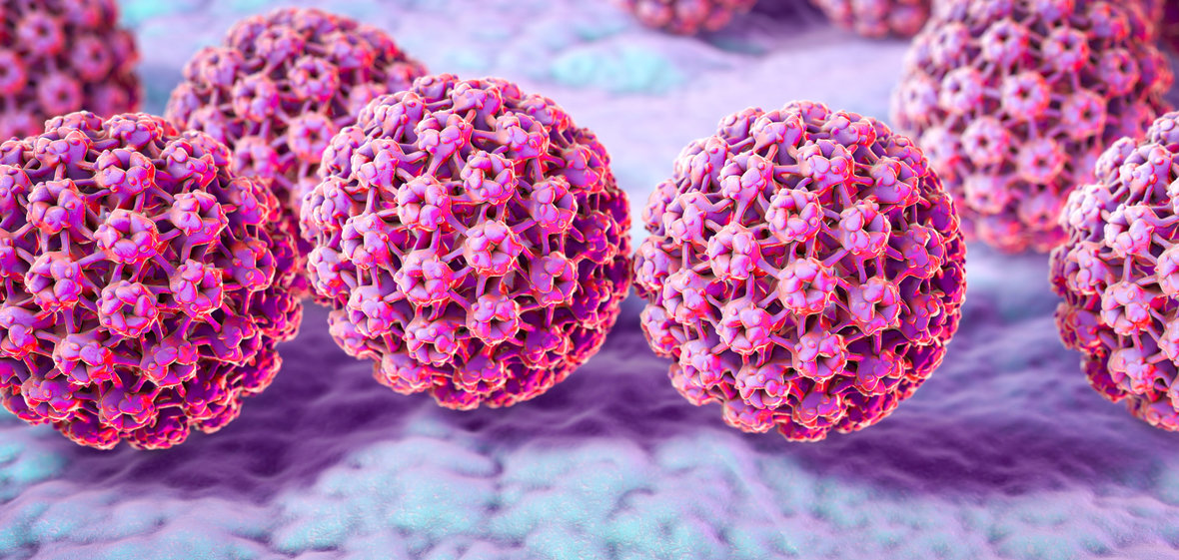
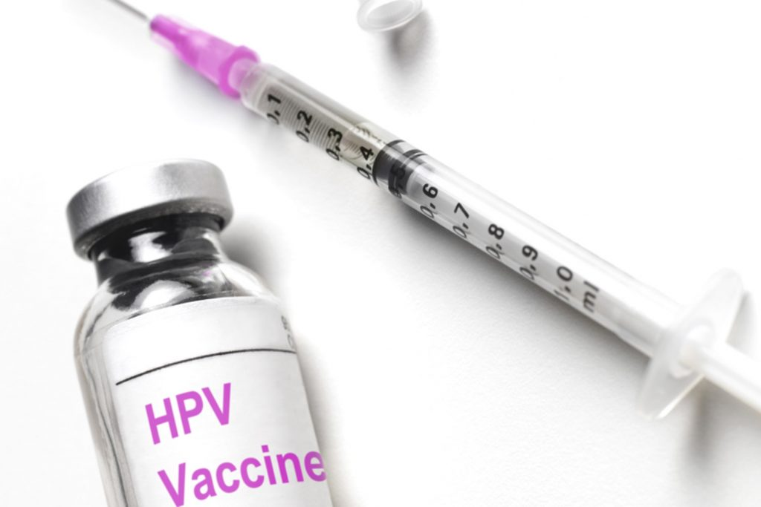
Human Papillomavirus
Sexually transmitted virus
150 genotypes of HPV
90% of infections are asymptomatic
HPV 16 and 18 account for 70% of cervical cancer
HPV 6 and 11 common cause of genital warts
Notes:
Human papillomavirus infection is a sexually transmitted infection caused by HPV. There are over 150 genotypes of HPV. Of those that cause infection, about 90% of the infections cause no symptoms and resolve spontaneously. However some HPV genotypes induce persistent infections that if not cleared, results in warts or precancerous lesions characterized by cervical intraepithelial neoplasia or the presence of abnormal cells. The amount of proportion of abnormal cells correlates to the CIN level. Specifically HPV16 and HPV18 account for 70% of all cervical cancer cases while HPV6 and HP11 are common causes of genital warts.
Men are also at risk of developing anal and ophoryngeal cancer if infected with HPV-6 and HPV-11. However for the simplification of our model, we will only be focusing on the female population for the rest of the presentation.

Slide 3
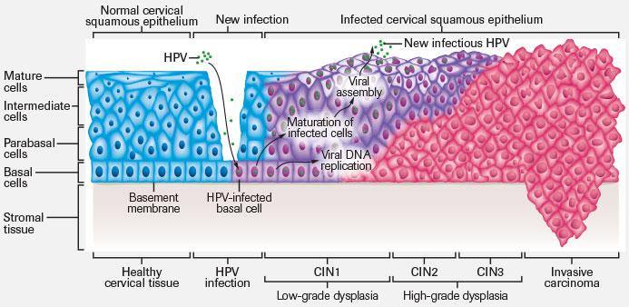
Natural History of Human Papillomavirus and Pre-Cancer
80% lifetime risk
12,000 cases per year;
4,000 deaths per year
1 million women per year
500,00 women per year
Notes:
The lifetime risk of acquiring an HPV infection is 80%. Of those that acquire an infection and have HPV
, about 90% clear the infection without any symptoms while 5% move onto cervical intraepithelial neoplasia which is charecisized by a portion o f

Slide 4
HPV Vaccine
HPV Vaccine: released 2006
~90-98% effective at prevention of cancer from HPV types 16/18;
No therapeutic effect
Recommended for both males & females between ages of 12-26 years of age

Slide 5
Study Question & Methods
Question: Is the Human Papillomavirus vaccine cost effective? Is the payback from implementing the vaccine proportional to the payout?
Methods:
Evaluate cost effectiveness and cost benefit of the Human Papillomavirus in a female only population on the outcome of precancerous lesions in the cervix (cervical intraepithelial lesions or CIN)
Discrete-time Markov Model
Used input parameters from the literature to inform the model

Slide 6
Input Probabilities for Transition
CIN II+
(Pre-Cancer Class)
0.05
HPV Acquisition
(Infected Class)
0.8
Healthy Patient
(Susceptible Class)
0.2
0.9
HPV
Vaccination 1
(Vaccination Class)
Notes:
We assume that everyone starts at a susceptible.

Slide 7
Input Cost Parameters
CIN II+
(Pre-Cancer Class)
0.05
$250/yr
HPV Acquisition
(Infected Class)
$2500/yr
0.8
$50 / 3
Healthy Patient
(Susceptible Class)
0.2
0.9
HPV
Vaccination 1
(Vaccination Class)
($95/dose) *2
Notes:
You get a pap smear every 3 years.
250 hpv test and a papsmear that year
2500 biopsy and subsequent 3 pap smears for the year

Slide 8
Probability Transition Matrix: No Vaccination
 | Susceptible | HPV Infection | CIN II
Susceptible | 0.2 | 0.8 | 0.0
HPV Infection | 0.9 | 0.05 | 0.05
CIN II | 0.5 | 0.0 | 0.5

Slide 9
Probability Transition Matrix: 60% Vaccination Coverage
 | Susceptible | Vaccinated | Post Vaccinated | HPV Infection | CIN II
Susceptible | 0.2 | 0.6 | 0.0 | 0.2 | 0.0
Vaccinated | 0.0 | 0.0 | 1.0 | 0.0 | 0.0
Post Vaccinated | 0.0 | 0.0 | 1.0 | 0.0 | 0.0
HPV Infection | 0.9 | 0.0 | 0.0 | 0.05 | 0.05
CIN II | 0.5 | 0.0 | 0.0 | 0.0 | 0.5

Slide 10
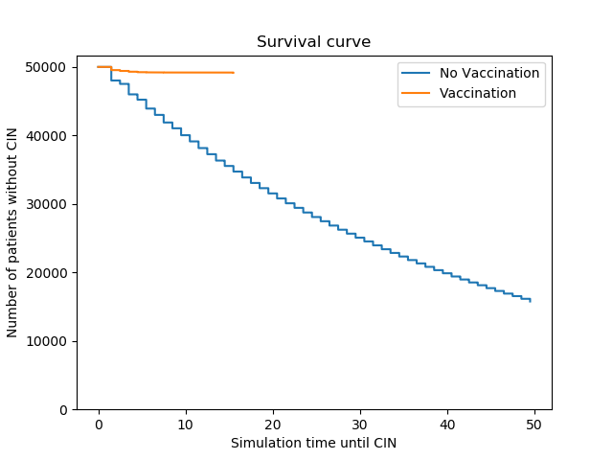
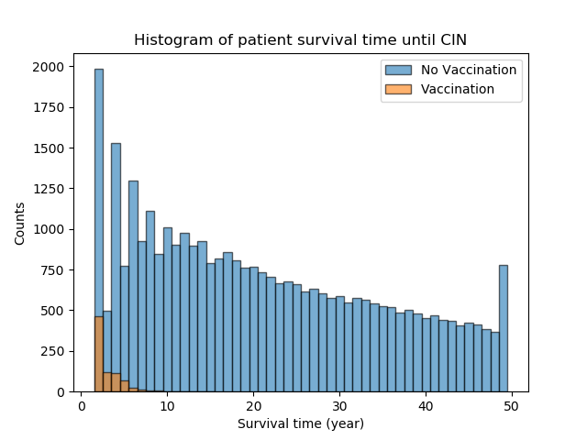
Results: 60% Vaccination Coverage

Slide 11
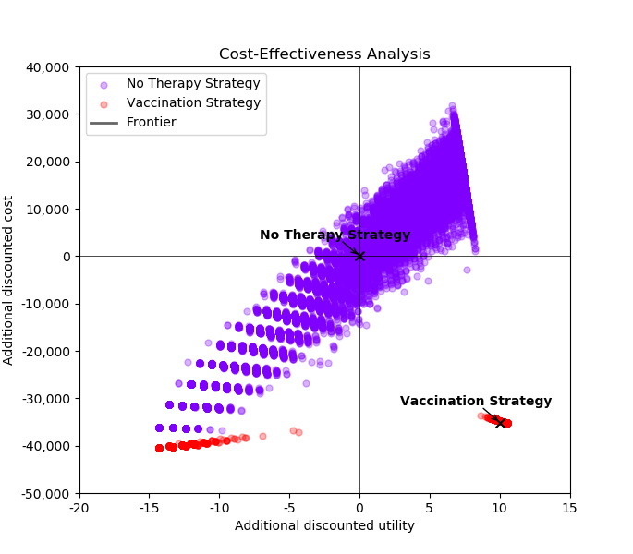
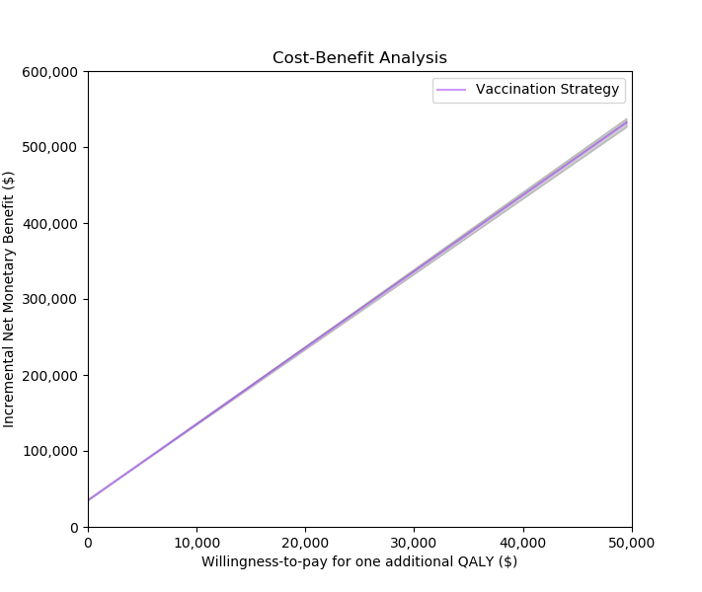
Results: 60% Vaccination Coverage

Slide 12
Probability Transition Matrix: 80% Vaccination Coverage
 | Susceptible | Vaccinated | Post Vaccinated | HPV Infection | CIN II
Susceptible | 0.1 | 0.8 | 0.0 | 0.1 | 0.0
Vaccinated | 0.0 | 0.0 | 1.0 | 0.0 | 0.0
Post Vaccinated | 0.0 | 0.0 | 1.0 | 0.0 | 0.0
HPV Infection | 0.9 | 0.0 | 0.0 | 0.05 | 0.05
CIN II | 0.5 | 0.0 | 0.0 | 0.0 | 0.5

Slide 13
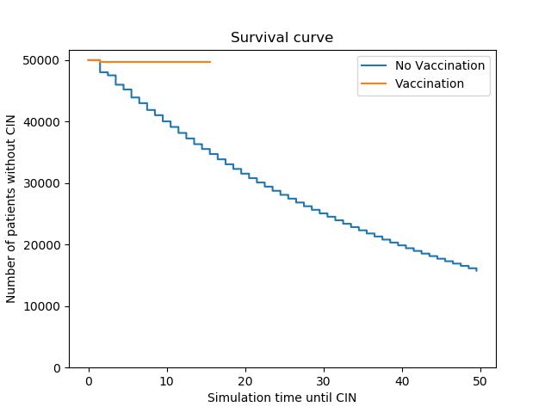

Results: 80% Vaccination Coverage

Slide 14
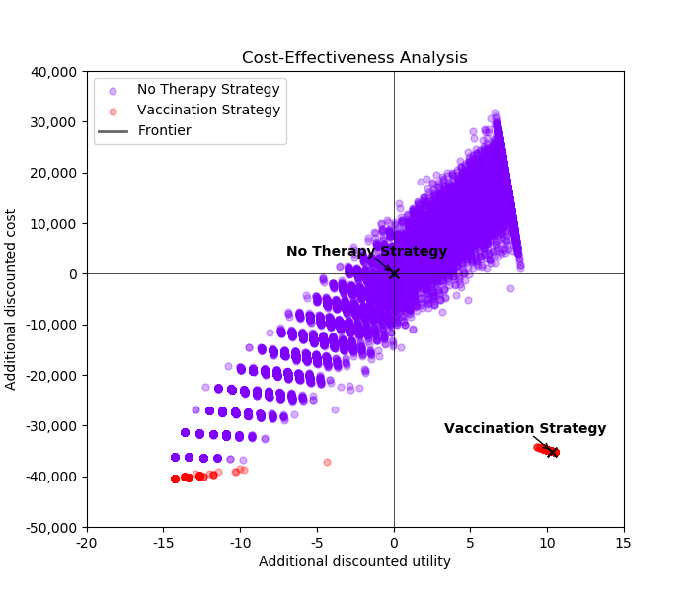
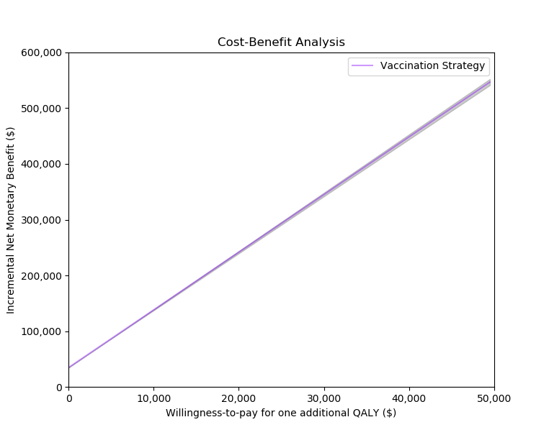
Results: 80% Vaccination Coverage

Slide 15
Conclusions
Survival Curves & Histograms:
Implementing the HPV vaccine intervention greatly reduces the number of women who develop CIN II lesions, as compared to the model without a prevention intervention
Cost Effectiveness:
60% & 80% Vaccination Coverage: HPV vaccine allows us to pay less for better health if introduced into a fully susceptible population
Vaccination above 60% does not greatly alter the cost effectiveness of introducing the vaccine
Cost Benefit:
60% & 80% Vaccination Coverage: As willingness to pay for one additional QALY increases, we reach a positive discounted net social benefit
Payback on implementation of the vaccine is proportional to the payout

Slide 16
Limitations
Homogenous population
Only US-born females
85% of cervical cancer cases in developing countries
All individuals received both doses
No variation in treatment costs among individuals
Fully susceptible population; does not recapitulate realistic HPV & CIN II prevalence
Cause of the model running out of individuals to develop HPV and move to the outcome class (CIN II) for the survival curve
Assumes 100% vaccine efficacy
Actual vaccine is 90-98% efficacious

Slide 17
Citations
1 Human Papillomavirus (HPV). (2018, January 25). Retrieved April 29, 2018, from https://www.cdc.gov/hpv/clinician-factsheet.html
2 Wright, J., MD. (n.d.). Cervical intraepithelial neoplasia: Terminology, incidence, pathogenesis, and prevention. Retrieved April 28, 2018, from https://www.uptodate.com/contents/cervical-intraepithelial-neoplasia-terminology-incidence-pathogenesis-and-prevention?topicRef=859&source=see_link
3 Matsumoto, K., Oki, A., Furuta, R., Maeda, H., Yasugi, T., Takatsuka, N., . . . Yoshikawa, H. (2010). Predicting the progression of cervical precursor lesions by human papillomavirus genotyping: A prospective cohort study. International Journal of Cancer, 128(12), 2898-2910. doi:10.1002/ijc.25630
4 Chelimo, C., Wouldes, T. A., Cameron, L. D., & Elwood, J. M. (2013). Risk factors for and prevention of human papillomaviruses (HPV), genital warts and cervical cancer. Journal of Infection, 66(3), 207-217. doi:10.1016/j.jinf.2012.10.024
5 Ock, M., Park, J.-Y., Son, W.-S., Lee, H.-J., Kim, S.-H., & Jo, M.-W. (2016). Estimation of utility weights for human papilloma virus-related health states according to disease severity. Health and Quality of Life Outcomes, 14, 163. http://doi.org/10.1186/s12955-016-0566-8
6 Healthcare Bluebook. (n.d.). Retrieved April 30, 2018, from https://healthcarebluebook.com/page_ProcedureDetails.aspx?cftid=369&g=Cervical Cone Biopsy

