Slide 1

Solving 1D heat equation
Daria Demeshko

Slide 2
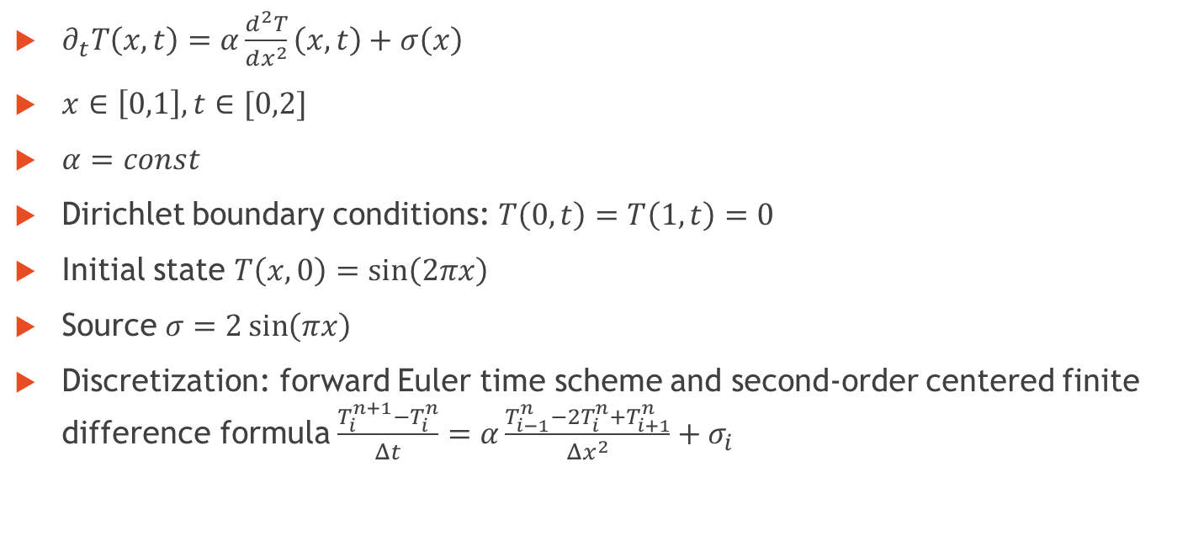
Problem statement and discretization
$∂_{t}T\left(x,t\right)=α\frac{d^{2}T}{dx^{2}}\left(x, t\right)+σ\left(x\right)$
$x∈\left[0,1\right], t∈[0,2]$
$α=const$
Dirichlet boundary conditions: $T\left(0,t\right)=T\left(1,t\right)=0$
Initial state $T\left(x,0\right)=\sin\left(2πx\right)$
Source $σ=2\sin\left(πx\right)$
Discretization: forward Euler time scheme and second-order centered finite difference formula $\frac{T_{i}^{n+1}−T_{i}^{n}}{Δt}=α\frac{T_{i−1}^{n}−2T_{i}^{n}+T_{i+1}^{n}}{Δx^{2}}+σ_{i}$

Slide 3
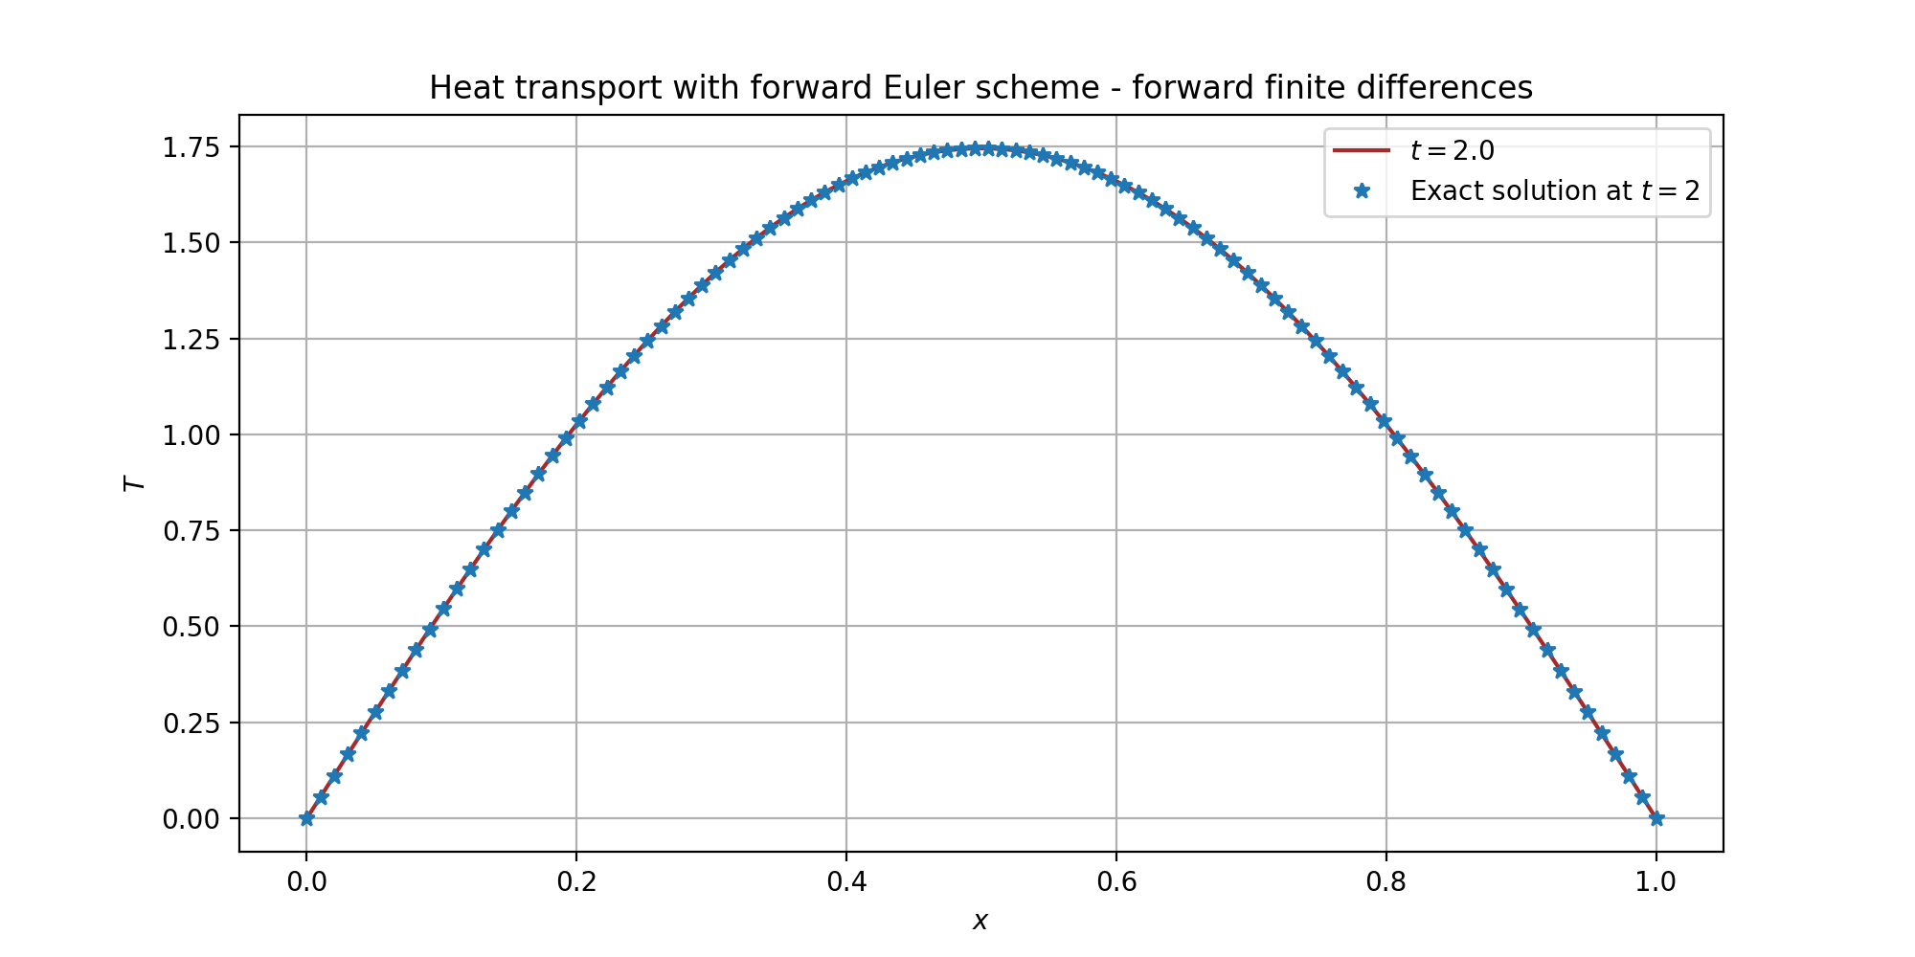
Results

Slide 4
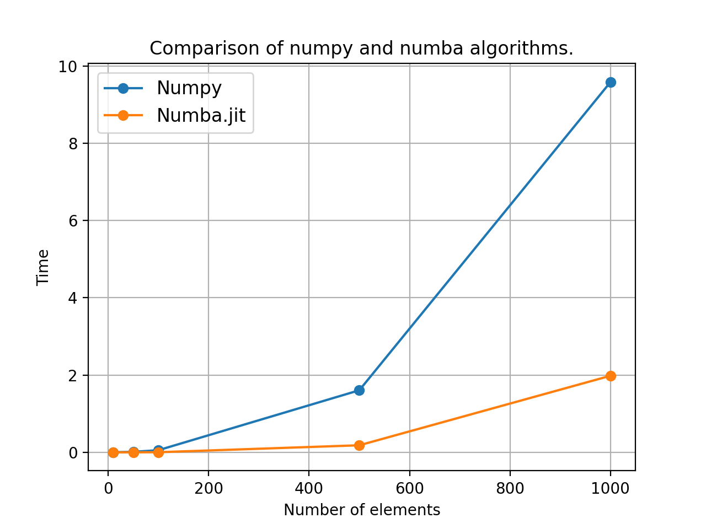
Numpy vs Numba

Slide 5
Thanks!

