Slide 1


Slide 2
Software Development and Software Supply Chain
Developer 1
Developer 2
Source Code
Code Build
Package
Consumers
Developer 3
Developer 4
Dependencies
.
.
.
.
Dependencies
Dependencies
Dependencies
.
.
.
.
Diagram inspiration: RSAConference talk

Slide 3
Open Source trust
Source code is available to everyone
Group immunity
Open Source Software
Repository scores/stars are treated like reviews
Everyone is watching and scrytinizing even Big tech

Slide 4
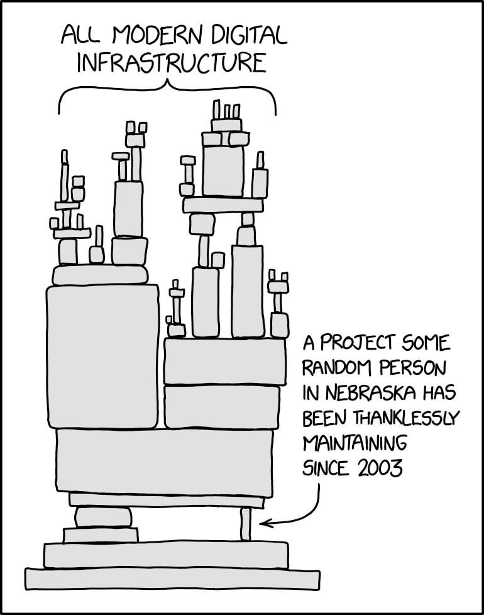
Maintainer’s burden
No pay
Burnout
Source: Redit

Slide 5
(In)Famous Supply Chain attacks
SolarWinds Orion, an infrastructure monitoring and management platform
Early 2020, malicious code embedded into an update that grants attackers backdoor access to sensitive data
Led to early 2021 attack on email security vendor Mimecast
Asus computers
2018 , malicious code embedded into Asus update that had the potential to take control of users’ computers
Actors pushed the malicious software through the Live Update utility.
It was difficult to detect as the attackers used a legitimate software certificate along with the "ASUSTek Computer Inc." name.
CodeCov, a code coverage tool
Generating machine-readable reports and uploading them to a server as developers run tests.
2021, Attackers leveraged a curl|bash script that uploads reports
Altered bash script used to infiltrate clients’ CI pipelines for environment variables

Slide 6
XZ backdoor attack saga (CVE-2024-3094)
XZ, a popular library for lossless data compression
Social Engineering
Dev burnout
2021
2022
Account JiaTan (Jiat75) created
First commit to XZ repo
2023
JiaT75 merges their first commit submitted by fake account
Social engineering in progress
2024
PR request ot mask change introduced
Malacious files added to gitignore
Encrypted stages introduced
AndresFreundTec, discovers the backdoor during SSHD bench marking session
”Is XZ for Java still maintained? I asked a question here a week ago and have not heard back.”
”You ignore the many patches bit rotting away on this mailing list. Right now you choke your repo. Why wait until 5.4.0 to change maintainer? Why delay what your repo needs?”
”Jia Tan has helped me … and he might have a bigger role in the future … It’s clear that my resources are too limited … so something has to change in the long term.”
”Yes, by some definition at least, like if someone reports a bug it will get fixed. Development of new features definitely isn’t very active. :-(”
”It’s also good to keep in mind that this is an unpaid hobby project”
”Finding a co-maintainer or passing the projects completely to someone else has been in my mind a long time but it’s not a trivial thing to do.
Timeline source:
https://boehs.org/node/everything-i-know-about-the-xz-backdoor
https://robmensching.com/blog/posts/2024/03/30/a-microcosm-of-the-interactions-in-open-source-projects/
Maintainer’s blog: https://tukaani.org/xz-backdoor/

Slide 7
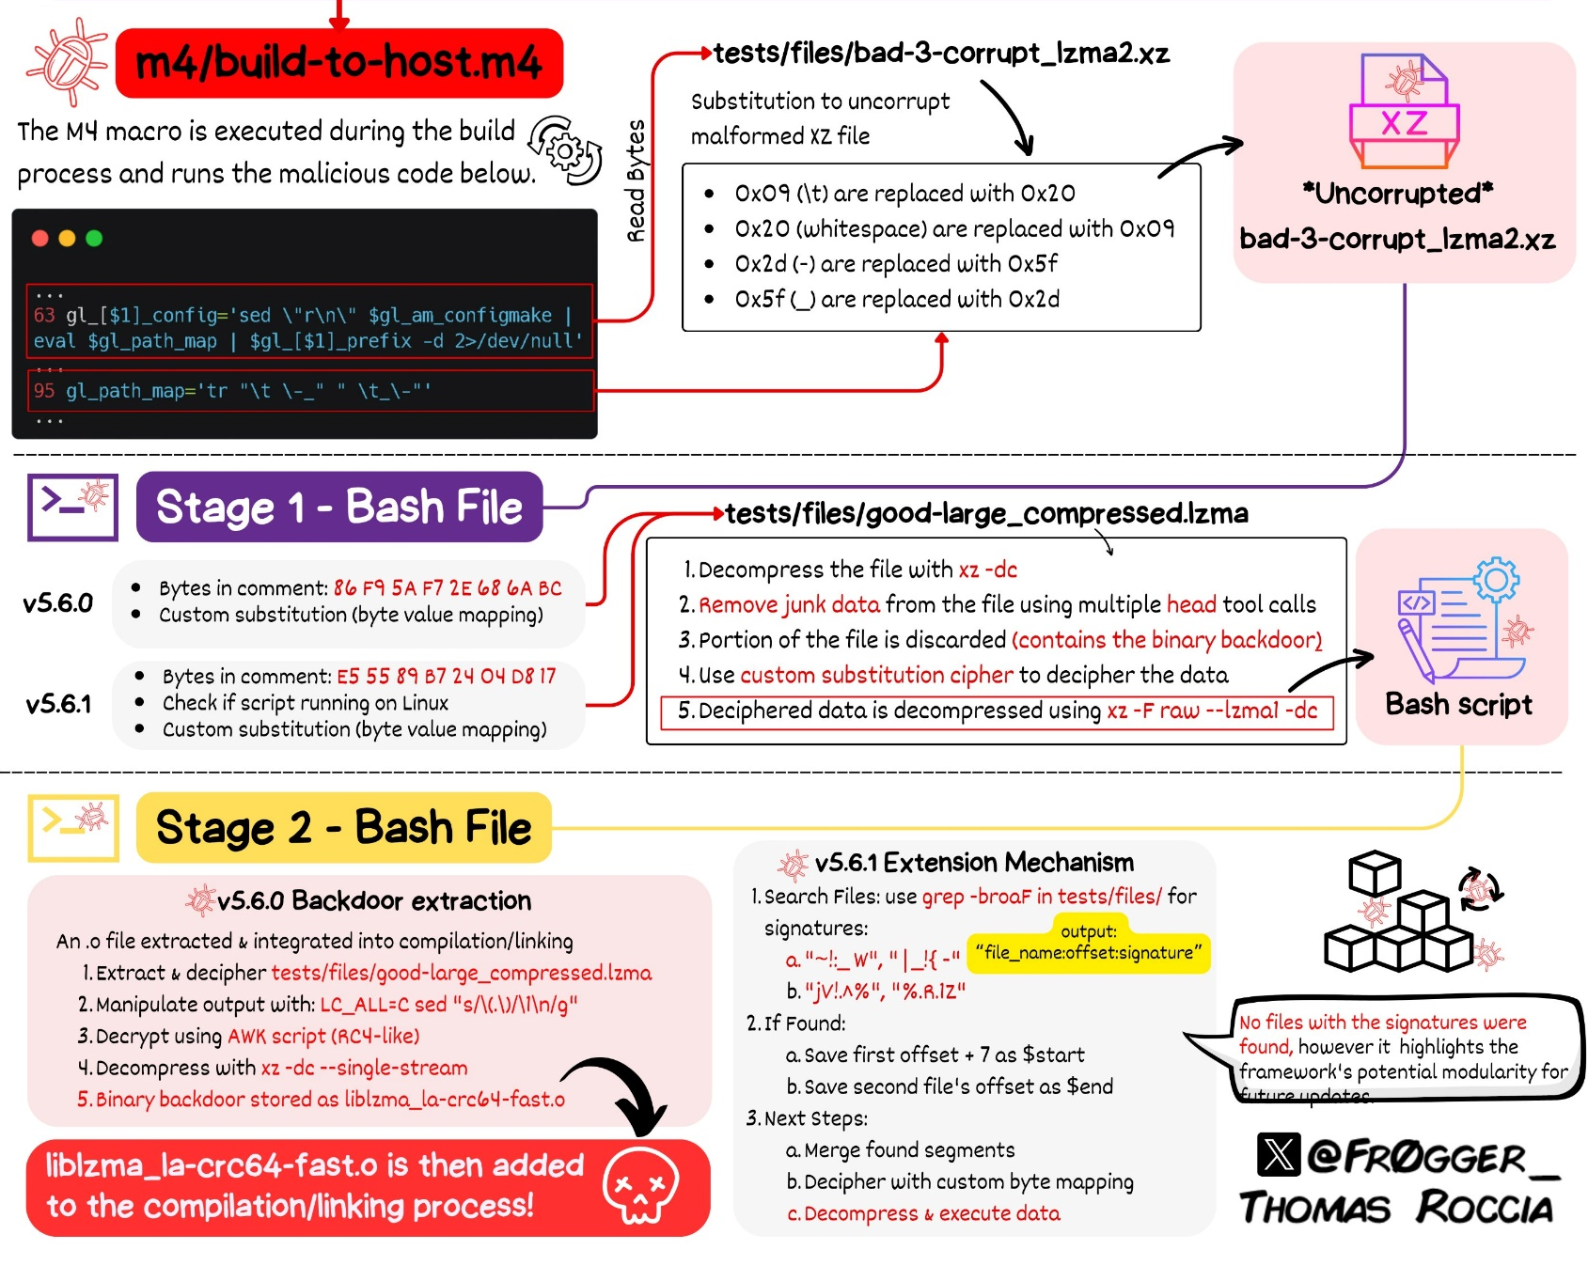
Technical Details
Source: Twitter Thomas Roccia

Slide 8
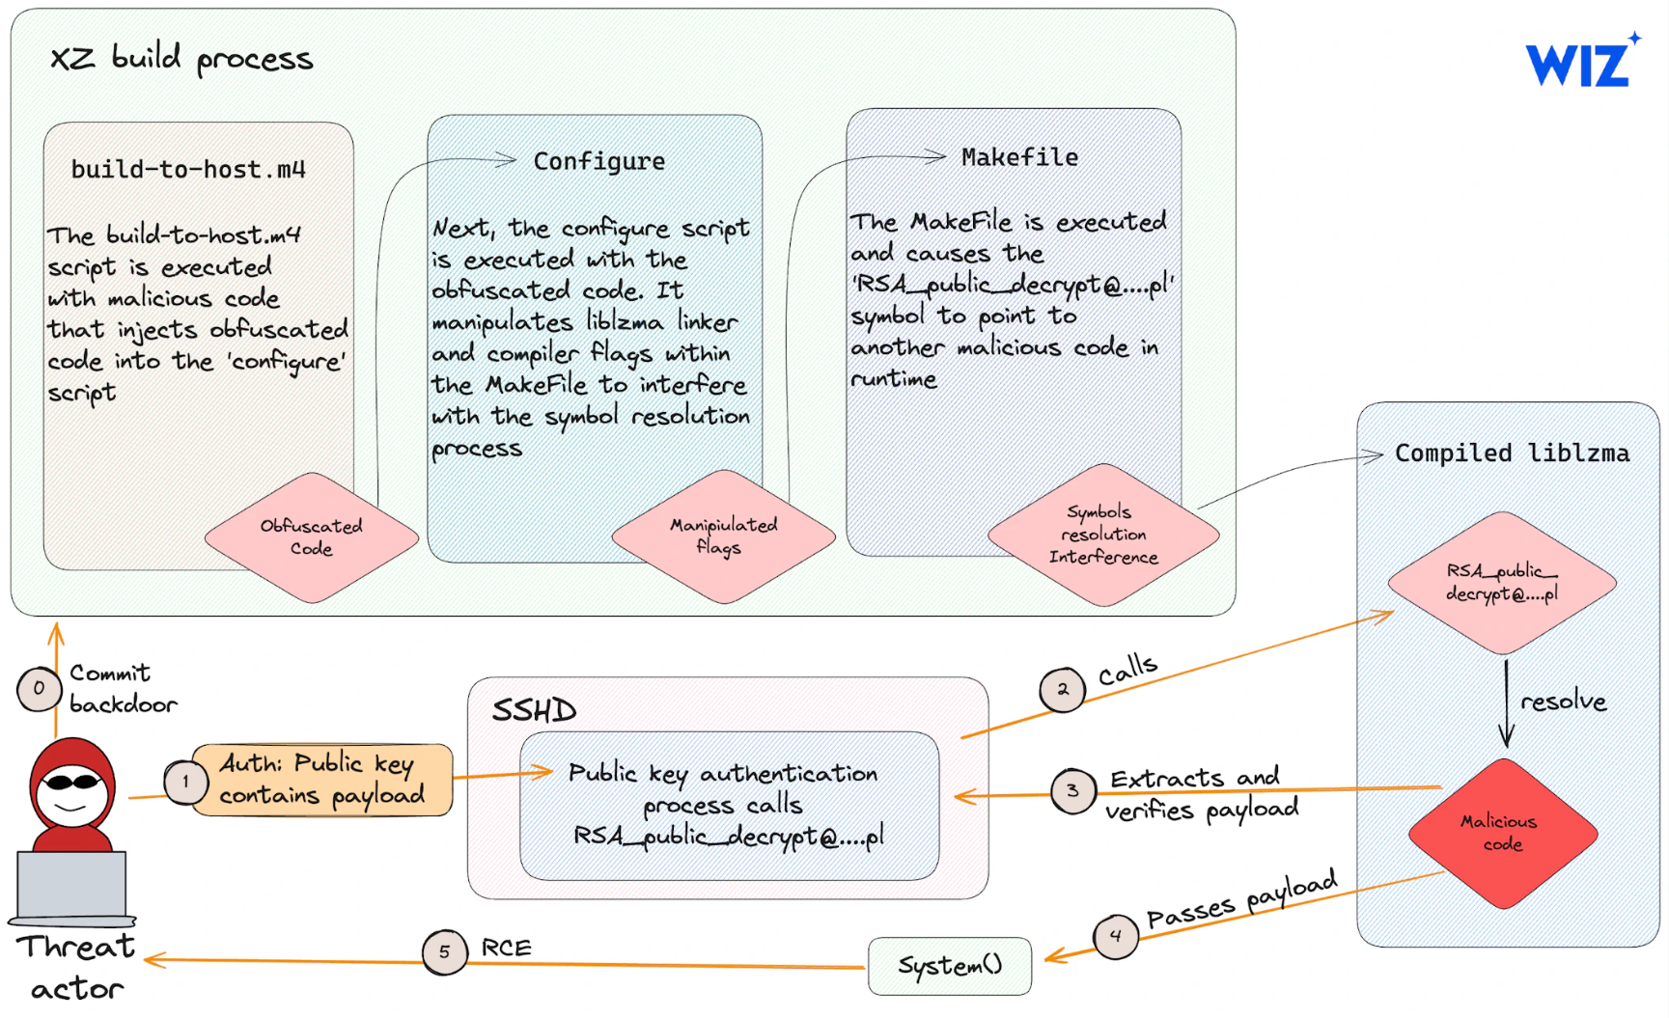
Technical Details
Source: Twitter Thomas Roccia

Slide 9
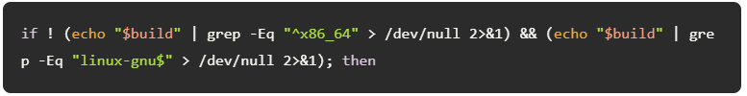
Why was it difficult to find?
Attacker intended to complicate the analysis process for researchers.
The obfuscated code running within the configure script during the build process installs the backdoor only under certain conditions. Among several checks, the following two are noteworthy:
The targeted OS must be x86-64 Linux. If this condition is not met, the backdoor will not be installed.
The XZ build process must be part of a Debian or RPM package build. This makes it more difficult to reproduce, as the backdoor won't be installed when attempting to manually build the XZ package.
Source: https://www.wiz.io/blog/cve-2024-3094-critical-rce-vulnerability-found-in-xz-utils

Slide 10
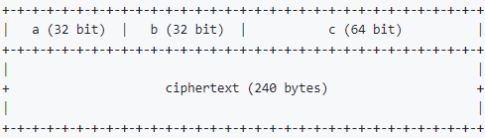
Smart Payload for trigger
The backdoor can be triggered by connecting with an SSH certificate with a payload in the CA signing key N value. This payload must be encrypted and signed with the attacker's ED448 key.
A request type is derived from the three values above (a * b + c). If this value is greater than 3, the backdoor skips processing.
Type 1: unknown, expects zero bytes
Type 2: executes null-terminated payload with system()
Type 3: unknown, expects 48 bytes (signed)
Source: https://github.com/amlweems/xzbot/tree/main

Slide 11


Slide 12
