Slide 1
STAYZE – Rent Prediction TEAM – DATA BLITZ
Dashang Makwana
Nevina Dalal
Simran Mulani
Vishakha Singh

Slide 2
Problem Statement

Slide 3
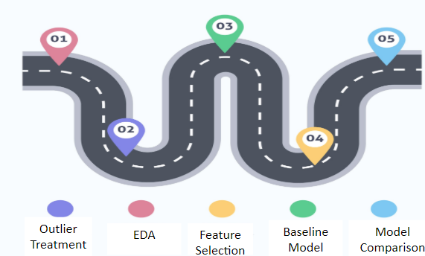
Our Approach

Slide 4
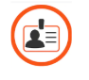
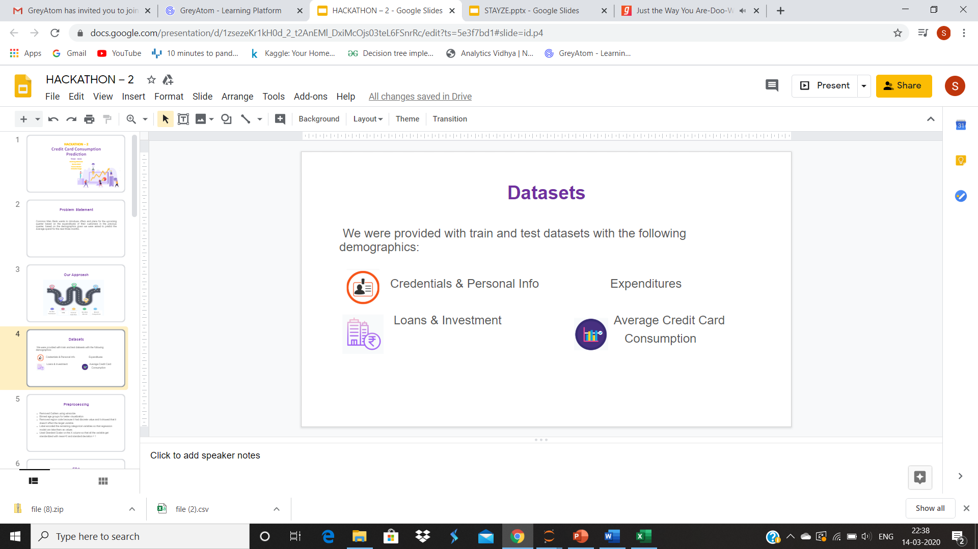
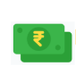

Datasets
We were provided with the following Train and Test datasets with the following information and details:
ID, Name Details of the host
Price Reviews, availability etc.

Slide 5
Pre-processing
Removed unwanted variables (host ID, host, name)
Applied log transform on Price
Label encoded the Category column (neighbourhood, neighbourhood group, room type)

Slide 6
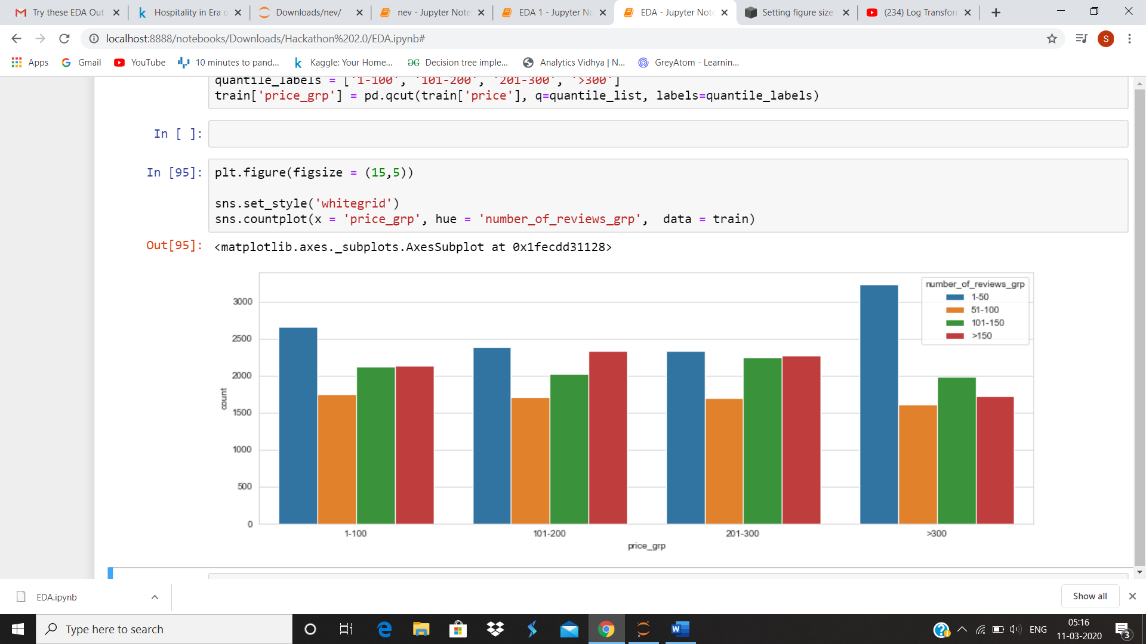
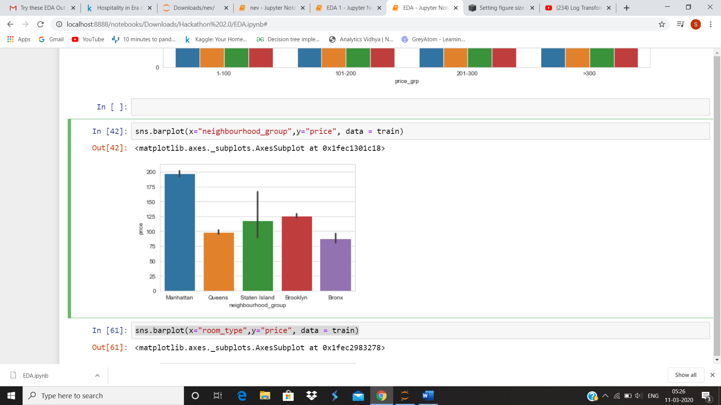
EDA

Slide 7
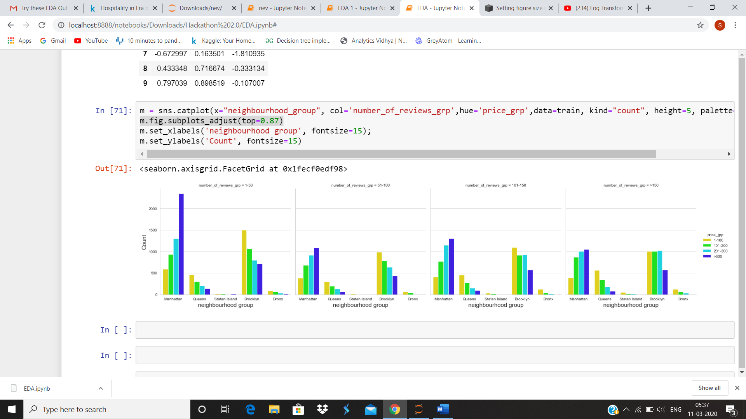

Slide 8
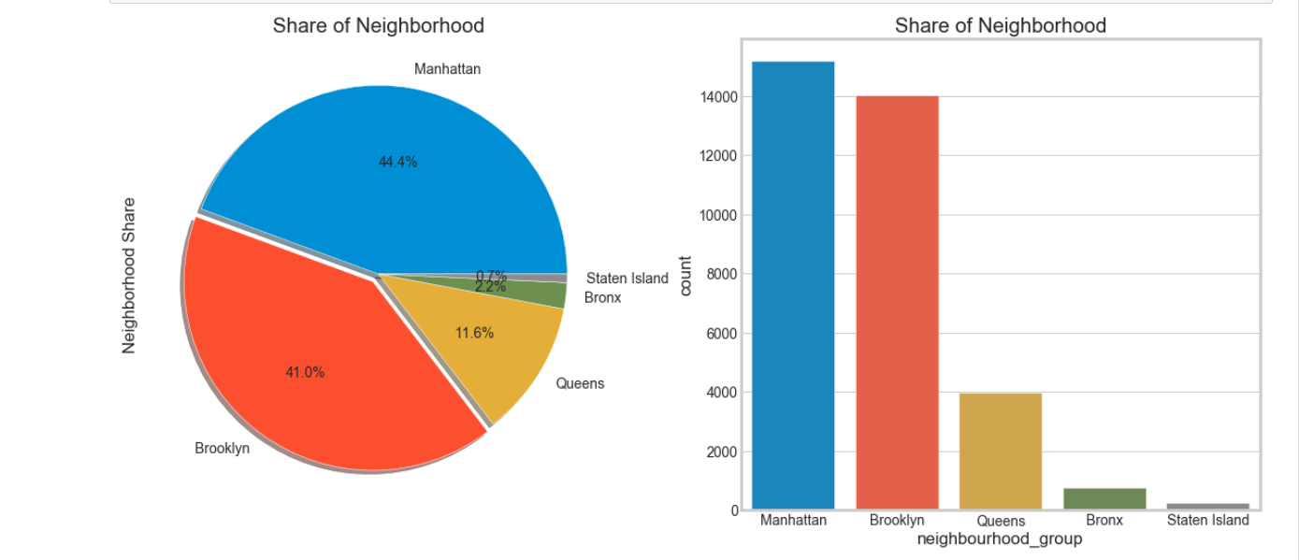

Slide 9
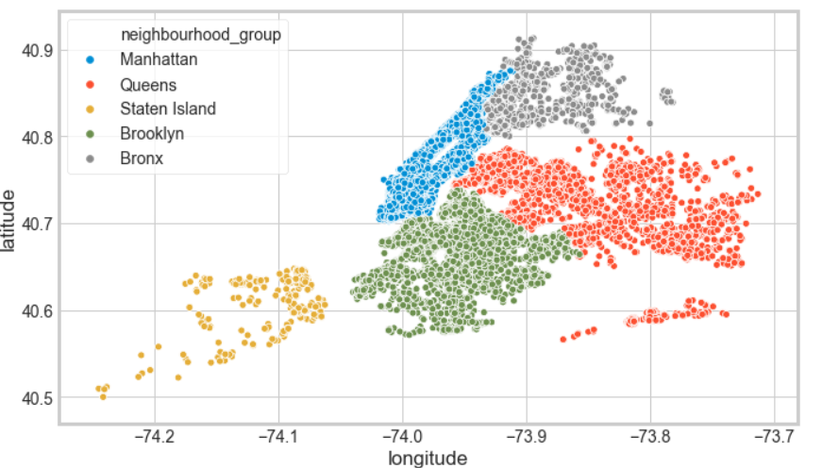
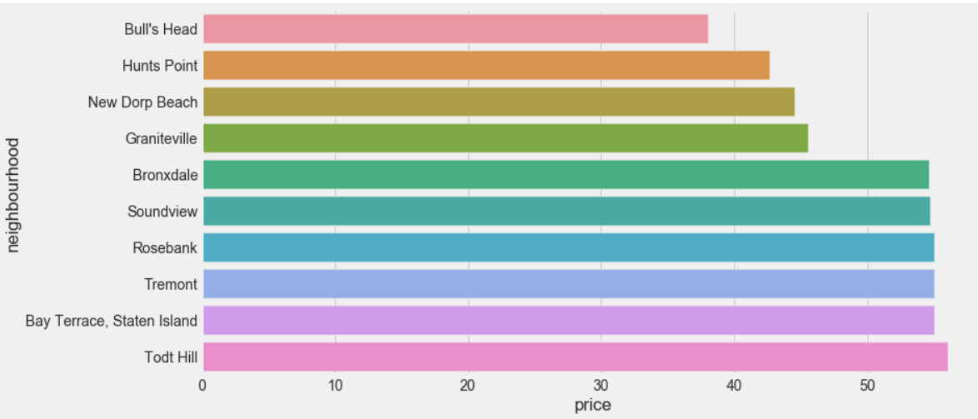

Slide 10
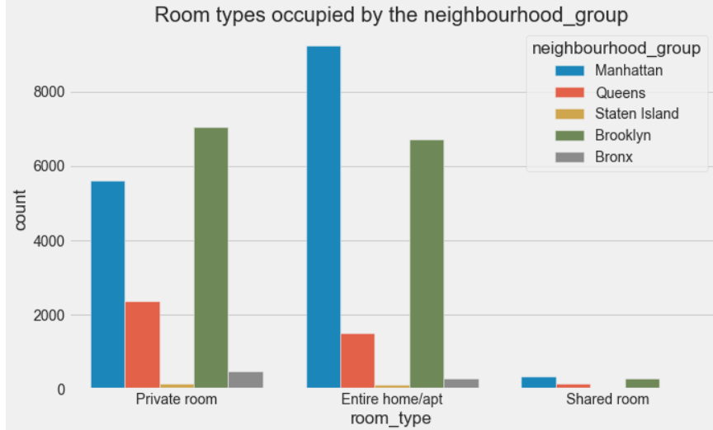
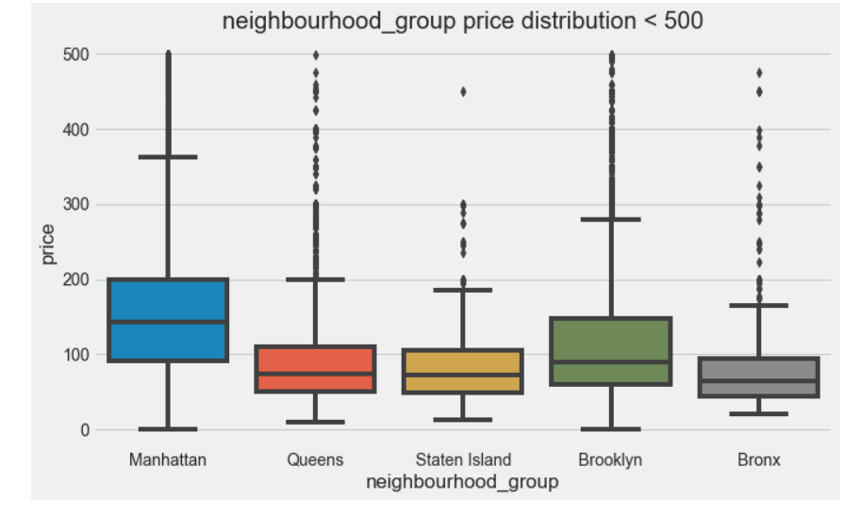

Slide 11
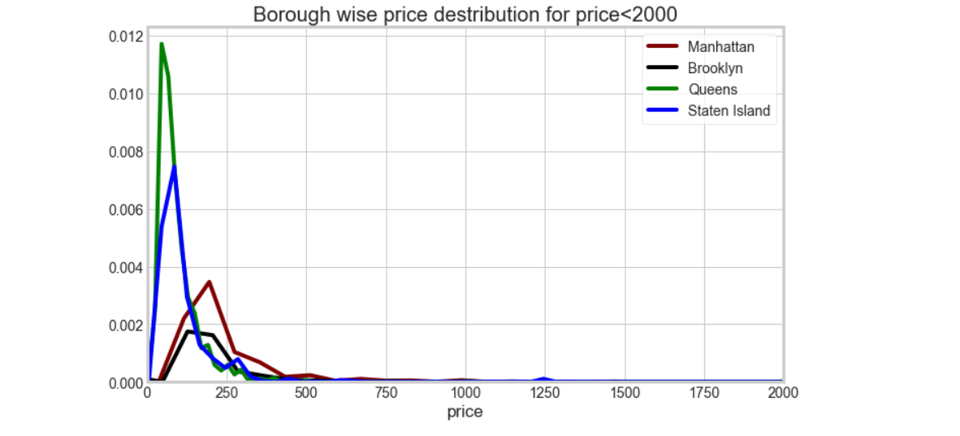

Slide 12
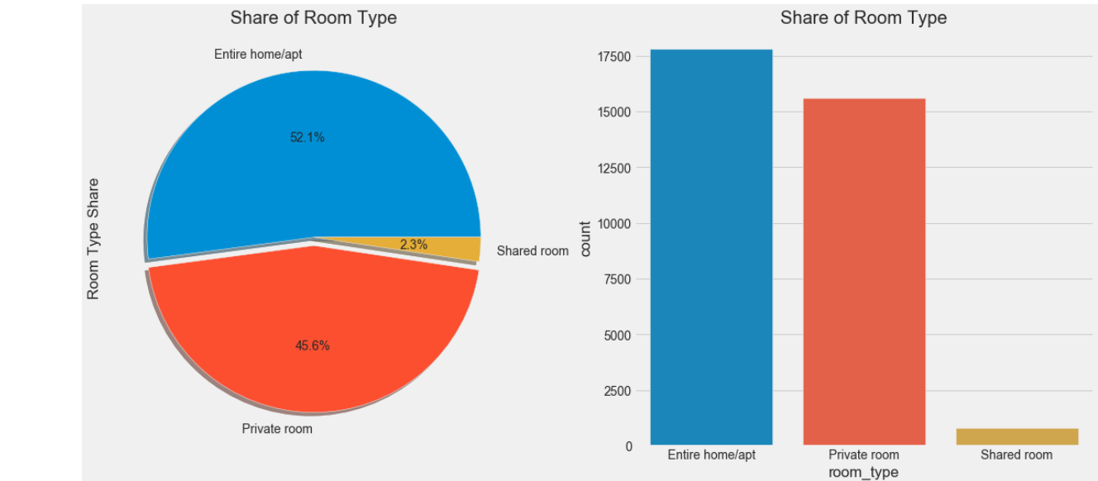

Slide 13
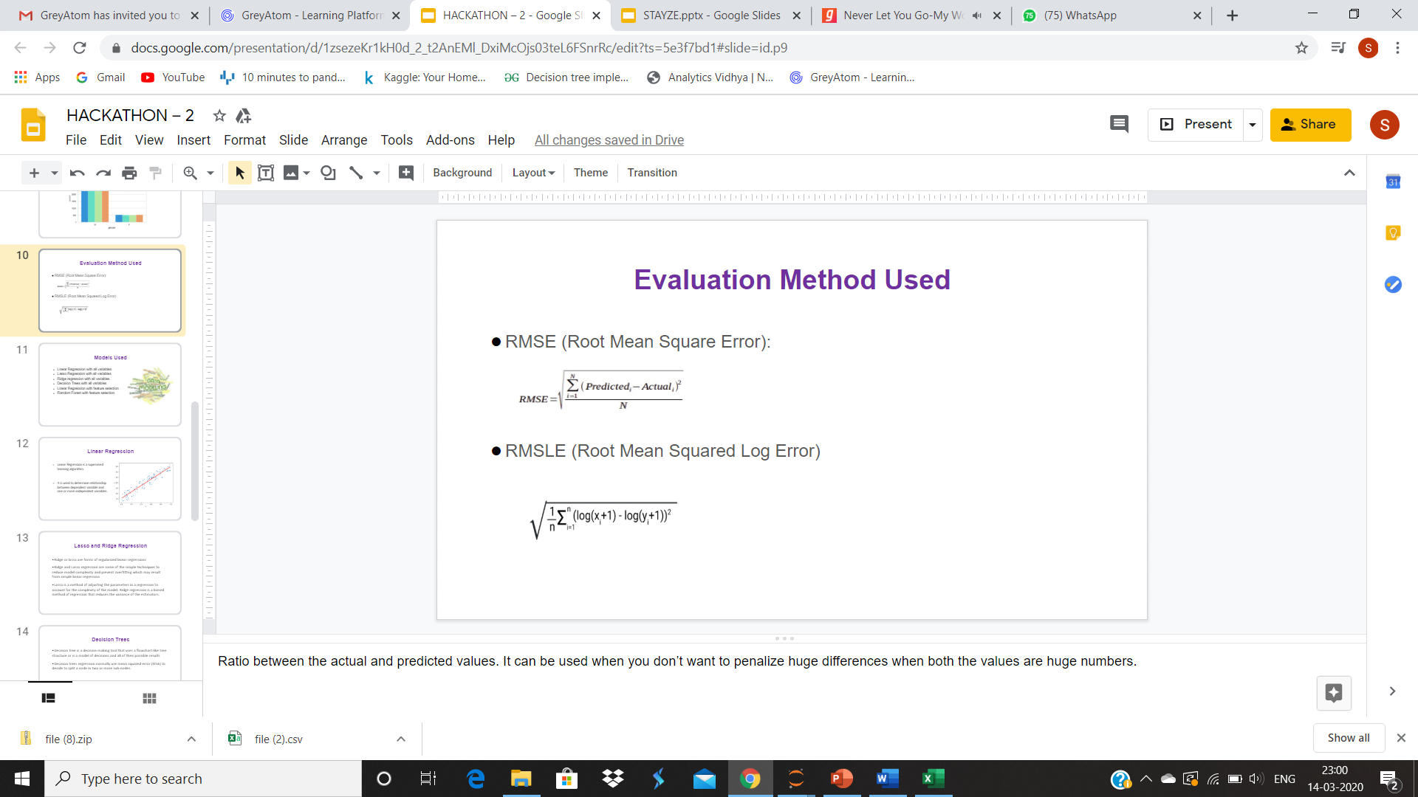
Evaluation Methods Used
RMSE (Root Mean Square Error):
RMSLE (Root Mean Squared Log Error):

Slide 14
Models Used
Models | Train RMSE | Test RMSE | Platform Result
Linear Regression | 234.97 |  | 222.36
Gradient Boosting Regressor | 232.19 |  | 220.63
Random Forest Regressor | 231.86 |  | 233.39
Random Forest with Search CV | 223.14 |  | 211.1
Random Forest with Feature selection | 232.51 |  | 233.86
Lasso | 109.370 | 109.372 | 234.82
Ridge | 135.648 | 136.165 | 222.27
Bagging | 138.513 | 139.240 | 220.69
Adaboost | 209.96 | 209.95 | 233.24
XG Boost | 235.53 |  | 222.79
Random Forest with Feature Selection and Randomized Search CV | 223.56 |  | 213.07

Slide 15
Business Insights

Slide 16
Additional Data for better Insights..
If the following data was also provided we could’ve been able to explore the data in more depth:
Property specifications
(area, room amenities, parking space, society amenities, smoking area, no. of beds, ppl capacity)
Review category
(good/bad)
Host data
( personal details , profession)

Slide 17
More Business problems that could be solved..
Customer(home owner) attrition
Leverage reviews
Dynamic pricing
On-board new home owners to company

Slide 18
THANK YOU!!

