Slide 1
Current Topics in Digital Philology project presentation
Corpus-based approach to Ancient and Byzantine world:
what do humanists need?
Dariya Rafiyenko Barbara Pavlek

Slide 2
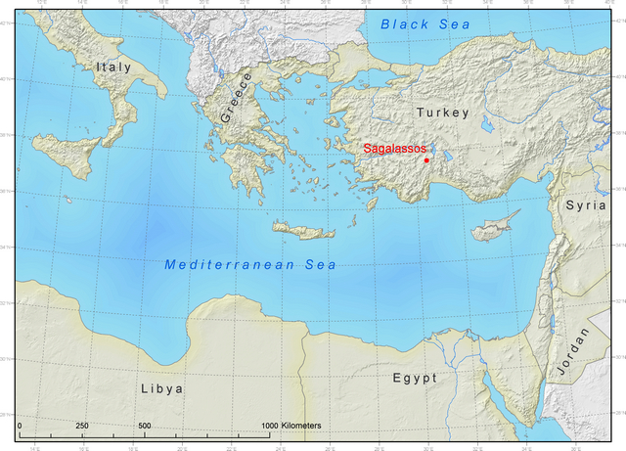
Introduction
‚Ancient Greek‘ is a language with a huge written tradition.
Time: 8 B.C. – 15/16 A.D.
Space: Eastern Mediterranian (Greece, Near East, Egypt, Cyprus, Creta et al.)
HOW did the language change in time and space?
=> How were the same words used?
=> How were the same ideas/concepts expressed?

Slide 3
Introduction
HOW did the language change in time and space?
=> How were the same words used? => track a word usage in the corpus
=> How were the same ideas/concepts expressed? => track a bunch of words in the corpus

Slide 4
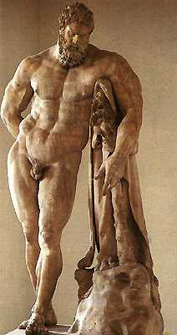
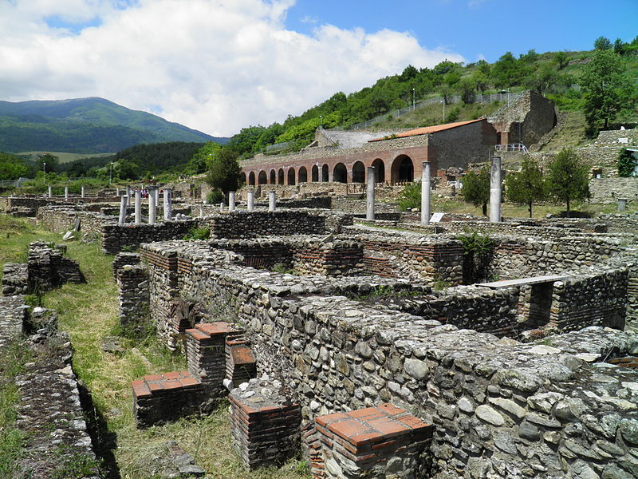
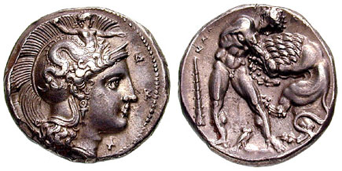
Introduction

Slide 5


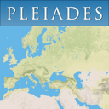



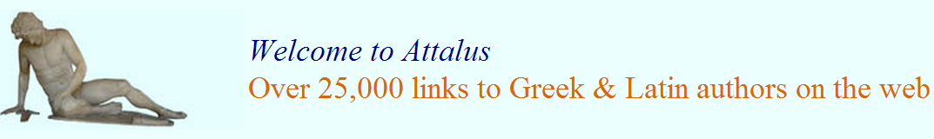
Corpus(es)

Slide 6
http://www.perseus.tufts.edu/hopper/collection?collection=Perseus:collection:Greco-Roman
Greek texts = 13,507,448 words
http://www.perseus.tufts.edu/hopper/artifactBrowser
1305 coins, 1909 vases, 2003 sculptures, 179 sites, 140 gems, 424 buildings
http://referenceworks.brillonline.com/entries/der-neue-pauly/herakleia-e508170?s.num=0&s.f.s2_parent=s.f.book.der-neue-pauly&s.q=herakleia
11 results for „Herakleia“ 1 result for „Heracles“
http://www.attalus.org/names/h/heracleia.htm
6 results for „Heracleia“, 90 examples quoted 1 result for „Heracles“, 96 examples quoted
http://pleiades.stoa.org/search?SearchableText=herakleia&submit=Search
60 items from the search for „Herakleia“, sorted by relevance, 29 items relevance 80%<
http://papyri.info/ddbdp/bgu;1;61
„Ηράκλεια“ = 340 results
http://epigraphy.packhum.org/inscriptions/main

Slide 7
access
Perseus -> open access
Pleiades -> open access
Papyri.info -> open access
Brill Online Reference -> access provided by University Library Leipzig, register or sign in for more options
Attalus.org -> open access
PHI Greek Inscriptions -> open access if terms accepted (personal use only)

Slide 8
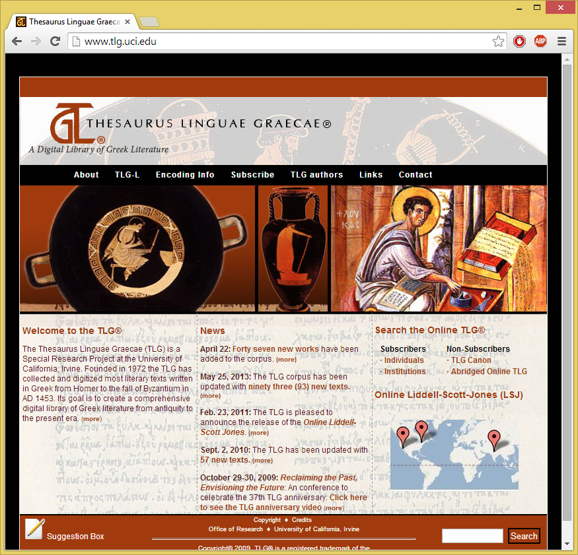
Thesaurus Linguae Graecae (TLG)
- 105 Mln. tokens (November 2013)
- 8 B.C. – 17. A.D.
Appr. 20 Mln. tokens up to 4 A.D. (‚Classical‘)
Appr. 85 Mln. tokens 4 A.D. – 17 B.C. (‚Byzantine‘)
Ca. 2300 authors and more the 10 000 works
They provide metadata:
- Time
- Genre (for author and for work separately)
- Some additinal information about the author
They provide a good lemmatizer to search
BUT they are not open-licenced

Slide 9
My corpus: ‘Gout’
I want to know:
- What words were used to denote the disease; and how they were used? (distribution in corpus)
- What was understood under the disease? (context?)
After an extensive search in the dictionnaries I used the regexp:
ποδα[λγ][γρ]|αρθρ[ιη]τ|χειρα[λγ][γρ]
to extract: 1572 cases of usage (token, reference to work, <20 lines of context)
157 unique tokens => 21 lemmata => 5 stems
ARTHR; PODALG; PODAGR; CHEIRALG; CHEIRAGR
I enriched the extracted data with the metadata (time, genre)

Slide 10
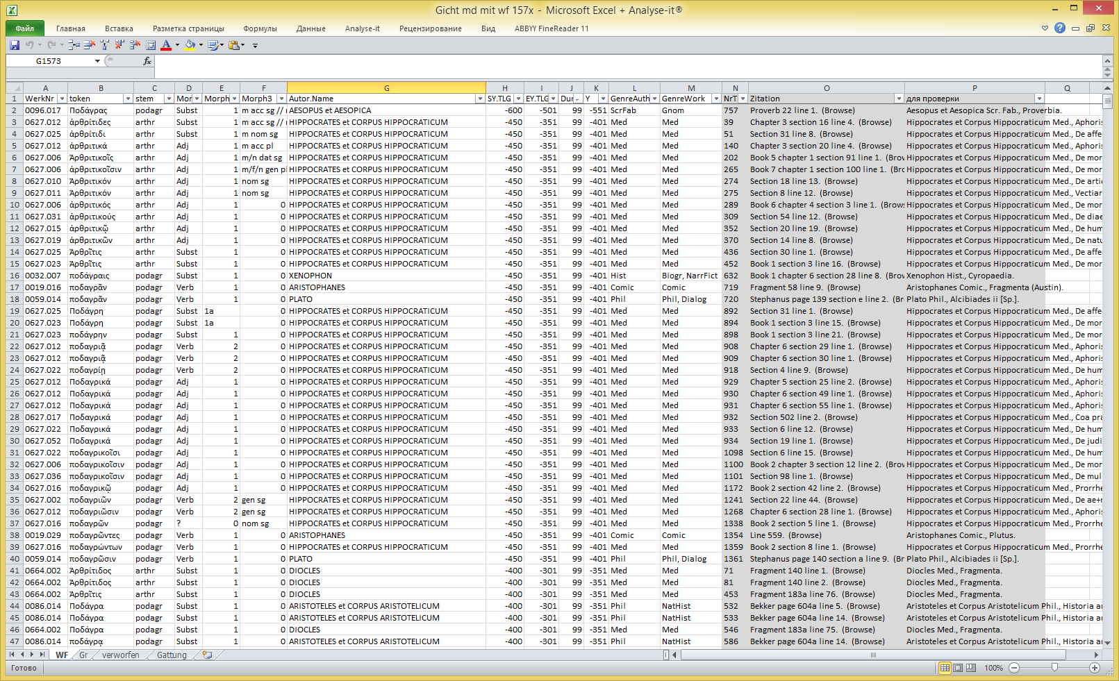

Slide 11
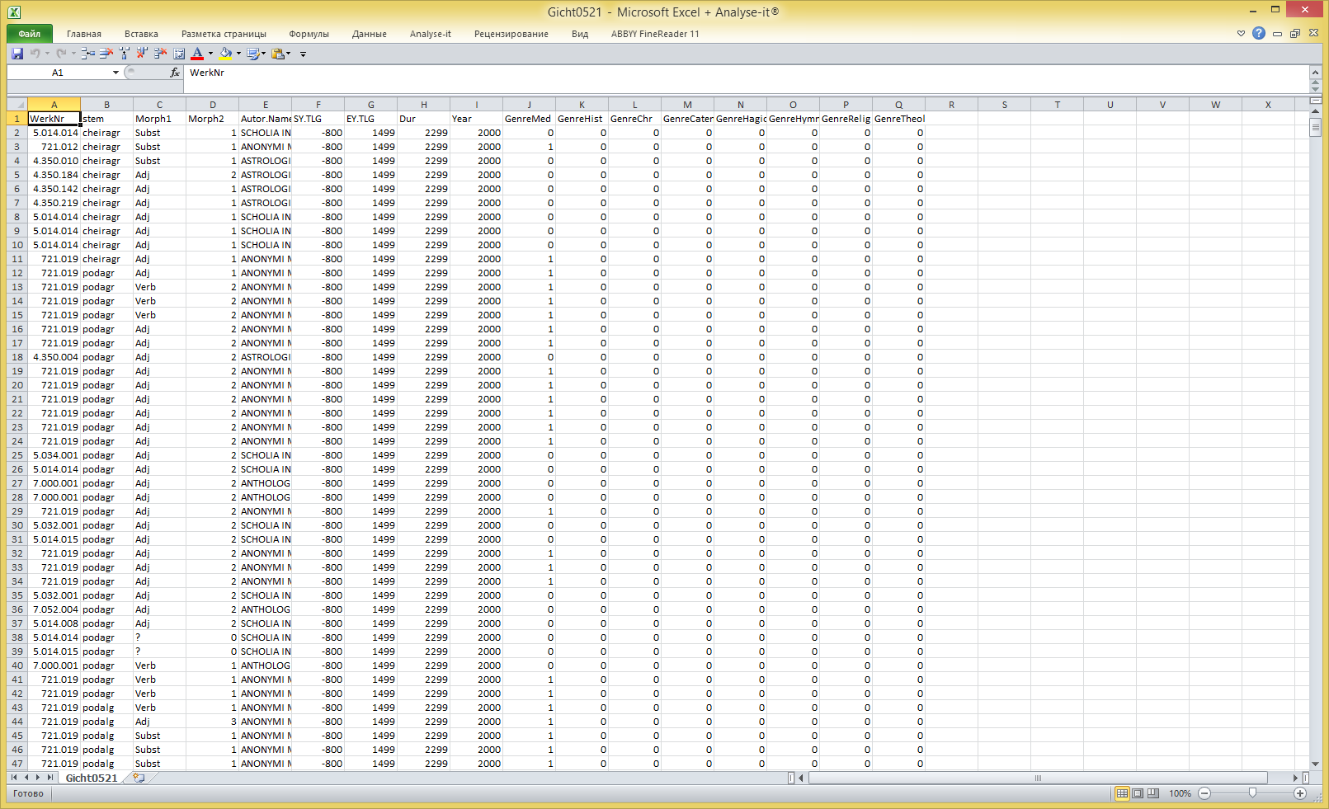

Slide 12
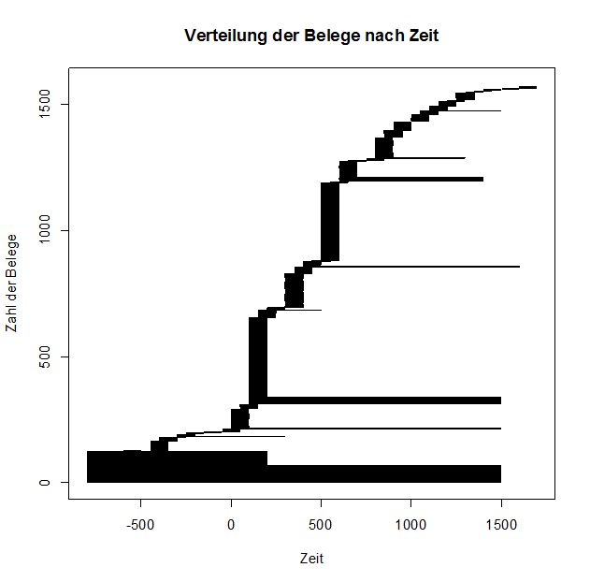
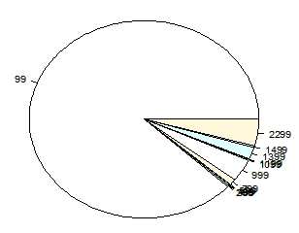
Visualisation of Distribution in time
- the longer the line of the x-axis, the poorer is the dating
- the higher the ‚column‘ in the y-axis, the more examples fall into a 99-years span (100-200 A.D; 500-600 A.D.)

Slide 13
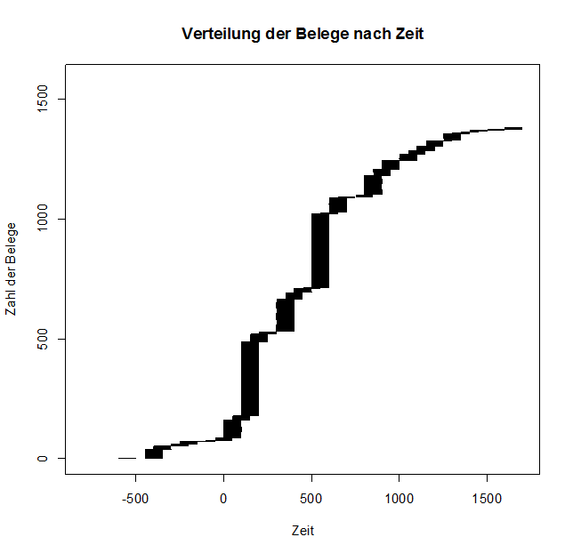
Perfectly dated examples: 100-200 A.D.; 300-400 A.D.; 500-600 A.D.

Slide 14
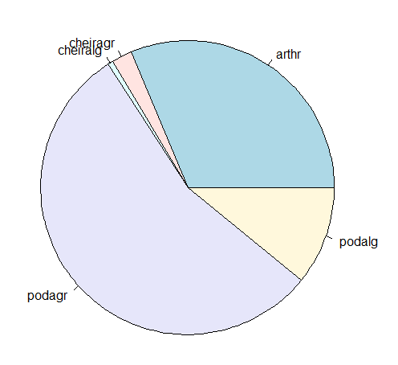
Stems
Summary tables:
arthr cheiragr cheiralg podagr podalg
492 35 9 866 170
HOW PRECISELY IS EACH STEM DATED:
Duration: 99 299 399 499 599 799 999 1099 1199 1399 1499 2299
arthr 447 4 1 3 1 15 21 0 0 0 0 0 (9%)
cheiragr 25 0 0 0 0 0 0 0 0 0 0 10 (29%)
cheiralg 9 0 0 0 0 0 0 0 0 0 0 0
podagr 761 0 0 0 0 0 36 2 2 30 4 31 (14%)
podalg 141 0 0 0 0 0 1 0 0 0 0 28 (17%)

Slide 15
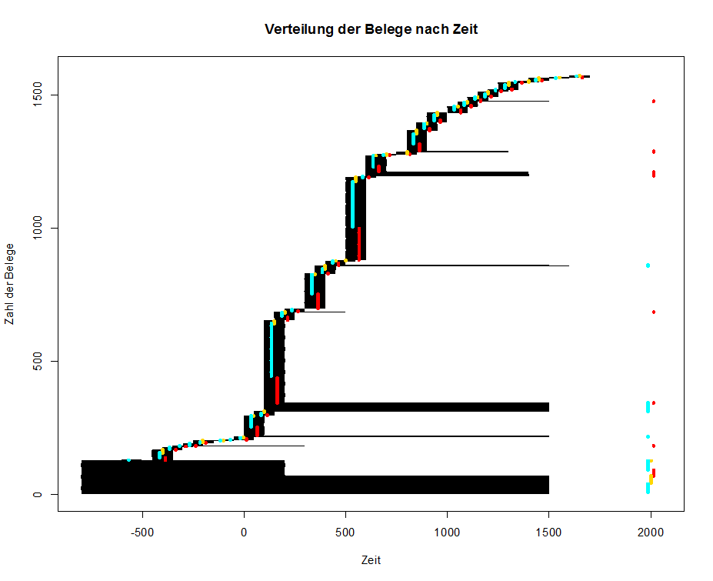
Red: Arthr
Blue: Podagr
Yellow: Podalg
- The stems co-exist
- Arthr and Podagr keep the ratio

Slide 16
Genres: Pearson product-moment correlation coefficient
Pearson product-moment correlation coefficient (sometimes referred to as the PPMCC or PCC orPearson's r) is a measure of the linear correlation (dependence) between two variables X and Y, giving a value between +1 and −1 inclusive, where 1 is total positive correlation, 0 is no correlation, and −1 is total negative correlation.
Medical treatises (med in the TLG)
r arthr podagr cheiralg cheiragr podalg
med 0,313 -0,029 -0,105 -0,113 -0,341
Historical works (hist, chronol in the TLG)
r podalg cheiralg cheiragr arthr podagr
hist 0,213 0,099 0,008 -0,061 -0,095
Theological works (scr.eccl, theol, caten, relig and some other in the TLG)
r podalg cheiralg cheiragr arthr podagr
theol 0,121 0,065 0,017 -0,047 -0,047

Slide 17
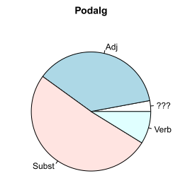
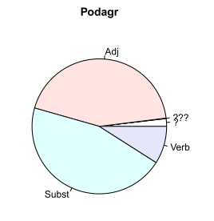
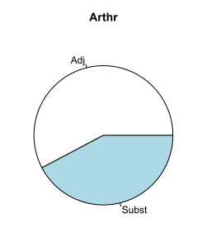
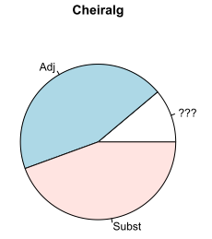
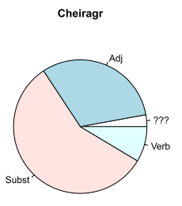
Morphology

Slide 18
Conclusions: existing dictionaries
Lemma | WB | Bedeutungen | angeführte Textstellen
ἀρθρῖτις f | Pape | sc. νόσος, Gliederkrankheit, Gicht | Hdn. 3, 14, 4 Medic.
ἀρθρῖτις f | LSJ | of or in the joints, νόσος; ἡ ἀ. gout | Hp.Aff.30 Hp.Aph.3.16 (pl.) Aret.SD2.12 etc.
ἀρθριτικός, ή, όν | Durling | diseased in the joints, gouty
ποδάγρα f | LSJ | II. foot disease of dogs, oxen, horses | Arist.HA604a5,14,23
ποδάγρα f | Pape | 2) gichtische Lähmung der Füße, Podagra | Plut. Sull. 26 Luc.
ποδάγρα f | Durling | gout, of human beings
ποδαγρία f | Trapp | Fußgicht | NChonPar 749 EustH I 332,19 ScholAr 324,31,34
ποδαγρίτης m | BZ 2 1893 524-5 | an Fußgicht Erkrankter, | Leviticus rabba c. 5,6
ποδαγράω | LSJ | have gout in the feet | Ar.Pl.559 Pl.Alc.2.139e

Slide 19
Conclusions: dictionaries of the future
Stems (5) | Words (1572) | Description
Podagr | 55% | Seems to be a neutral word for ‚gout‘ (of the feet), used throughout the whole period from 5 B.C-15 A.D. . Peaks in 2, 4, 6 A.D., probably connected with the rise of medical knowledge, attested at the same time
Arthr | 31% | Medical term (Pearson's r 0,313). Peaks in 2, 4, 6 A.D. Has no verb!
Podalg | 11% | Non-medical term (Pearsons's r history 0,213, theology 0,121), used with respect to emperors, evenly distributed
Cheiragr | 2,3% | Late rare word, the first dated example 9 A.D.
Cheiralg | 0,5% | Extremely rare word that appears only in couple with podalg (in the context ‚gouty in the feet and in the hands‘)
‚Podagra‘
‚Arthritis‘ [med]
‚Podalgia‘ [hist, theol, …]
‚Cheiragria‘
‚Cheiralgia‘
Concept ‚gout‘

Slide 20
Further research
Use Python
- to check the coocurrences and to establish the context for token/stem/etc.
- to automatize the routines
- ???

