Slide 1

ECONOMIC JOURNAL SUBCRIPTION
Group No. 11 – Wolverine
Akshat Shreemali
Darshan Dalvi
Vaibhav Bavishi
Prashant Kasalkar
Prof Douglas Jones
Course : DADM
Term: Fall 17

Slide 2
INTRODUCTION
The dataset contains subscriptions to economics journals at US libraries, for the year 2000.
OBJECTIVE
Impact of dataset variables like Price, age, citations on prediction of subscription of journals have being made.
A data frame containing
180 observations on 10
variables.
Variable | Description
title | Journal title
publisher | factor with publisher name.
society | factor. Is the journal published by a scholarly society?
price | Library subscription price.
pages | Number of pages.
charpp | Characters per page.
citations | Total number of citations.
foundingyear | Year journal was founded.
subs | Number of library subscriptions.
field | factor with field description.

Slide 3
List of Software and Packages
R & RStudio for Windows
R Packages: AER
GGplot2
Ggally
Faraway
gridExtra
Car
Daag

Slide 4
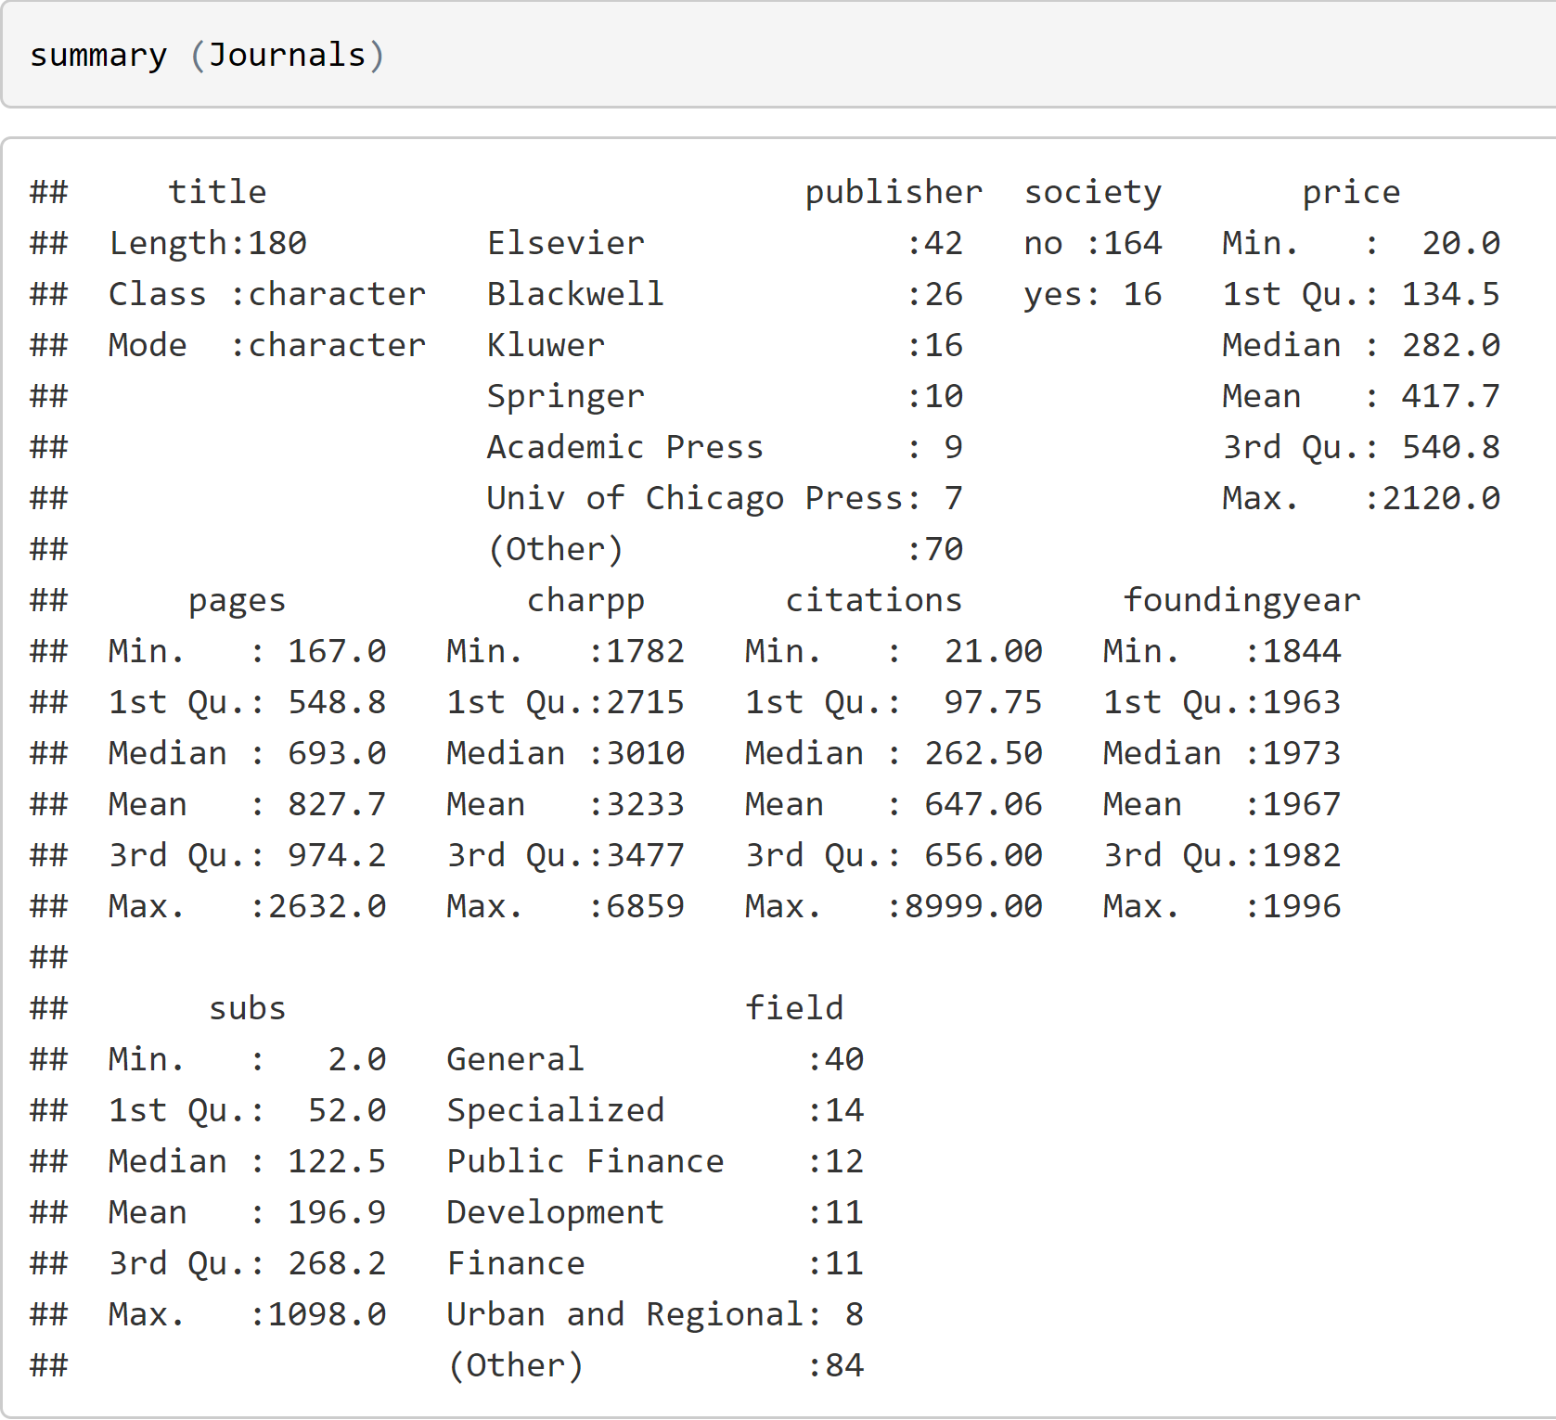
SUMMARY OF DATASET
No Data Cleaning Required as there are no Missing Values and Data Issues

Slide 5
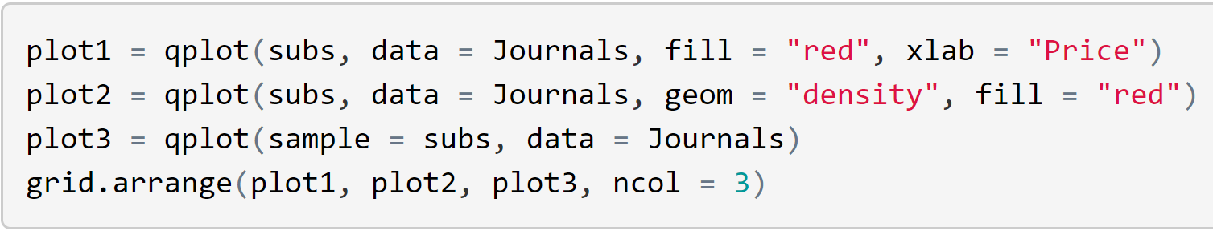
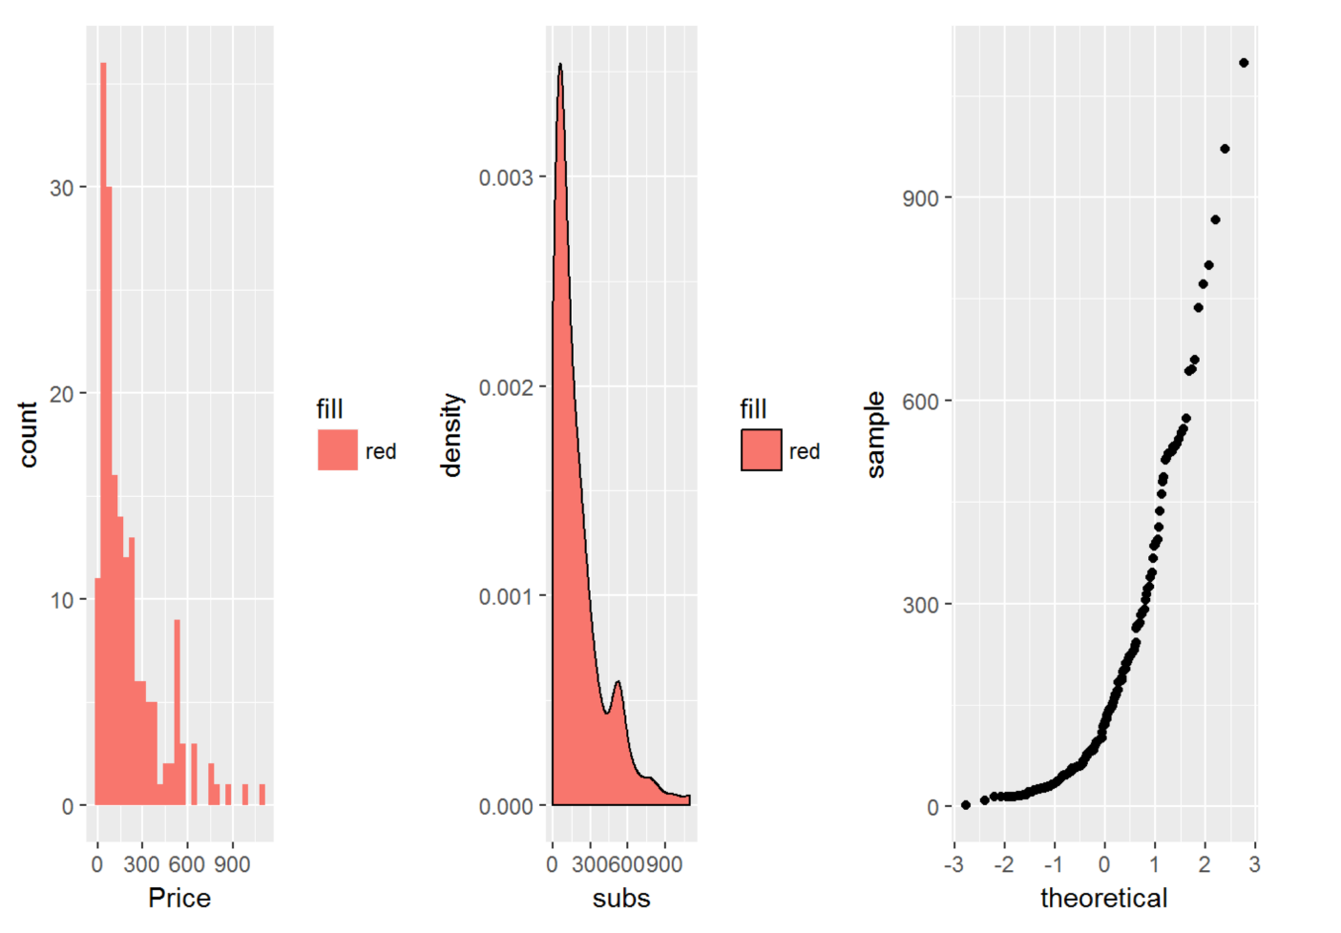
Distribution 'Subs' Variable
ANALYSIS
As we can see, subs variable is rightly skewed with median 122 and mean of 196.9

Slide 6
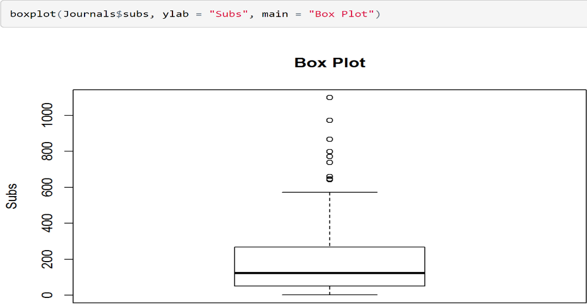
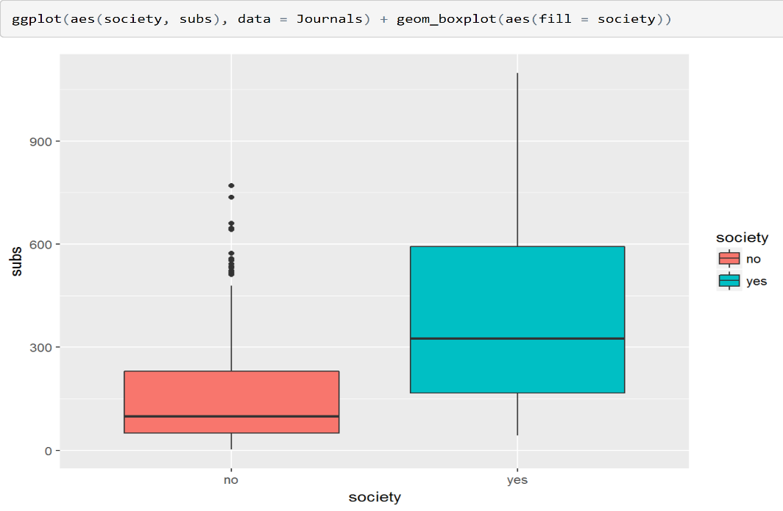
Box Plot
Since it is rightly skewed, we see outliers present in the data.
The evaluation score lies between 20 to 1200 with outliers stretching the values till 2000.
ANALYSIS
We can clearly see that if the
Journals is published by the scholarly
society then the number of subs
increases.

Slide 7
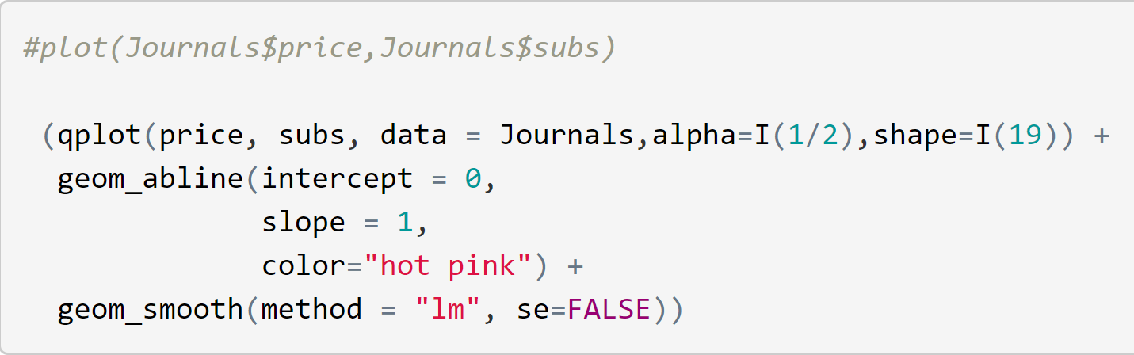
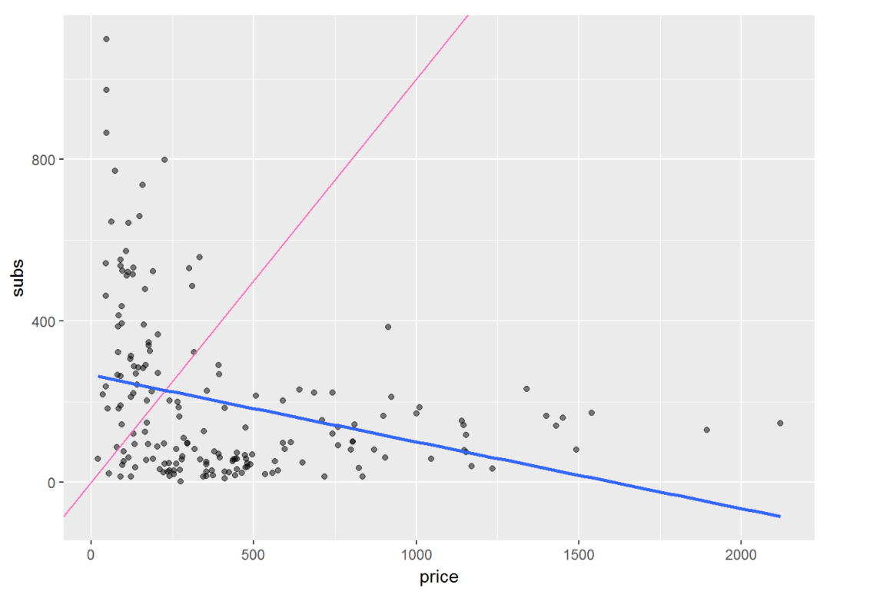
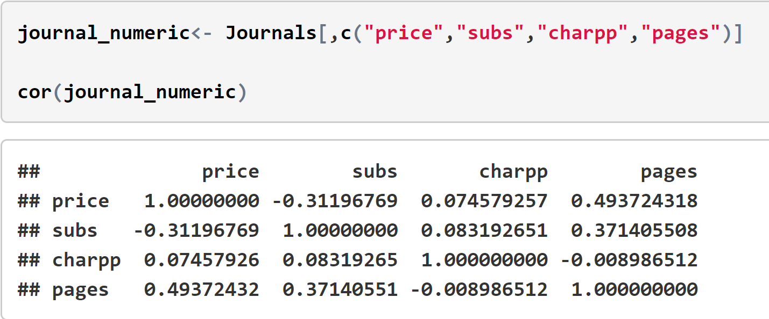
Scatterplot & Correlation
We can see it clearly that the
relationship between price and
subs is non linear.
ANALYSIS
Subs has a positive correlation with
pages.
Subs has negative correltion with price.
The relation between charpp and subs
is very low (0.084).

Slide 8
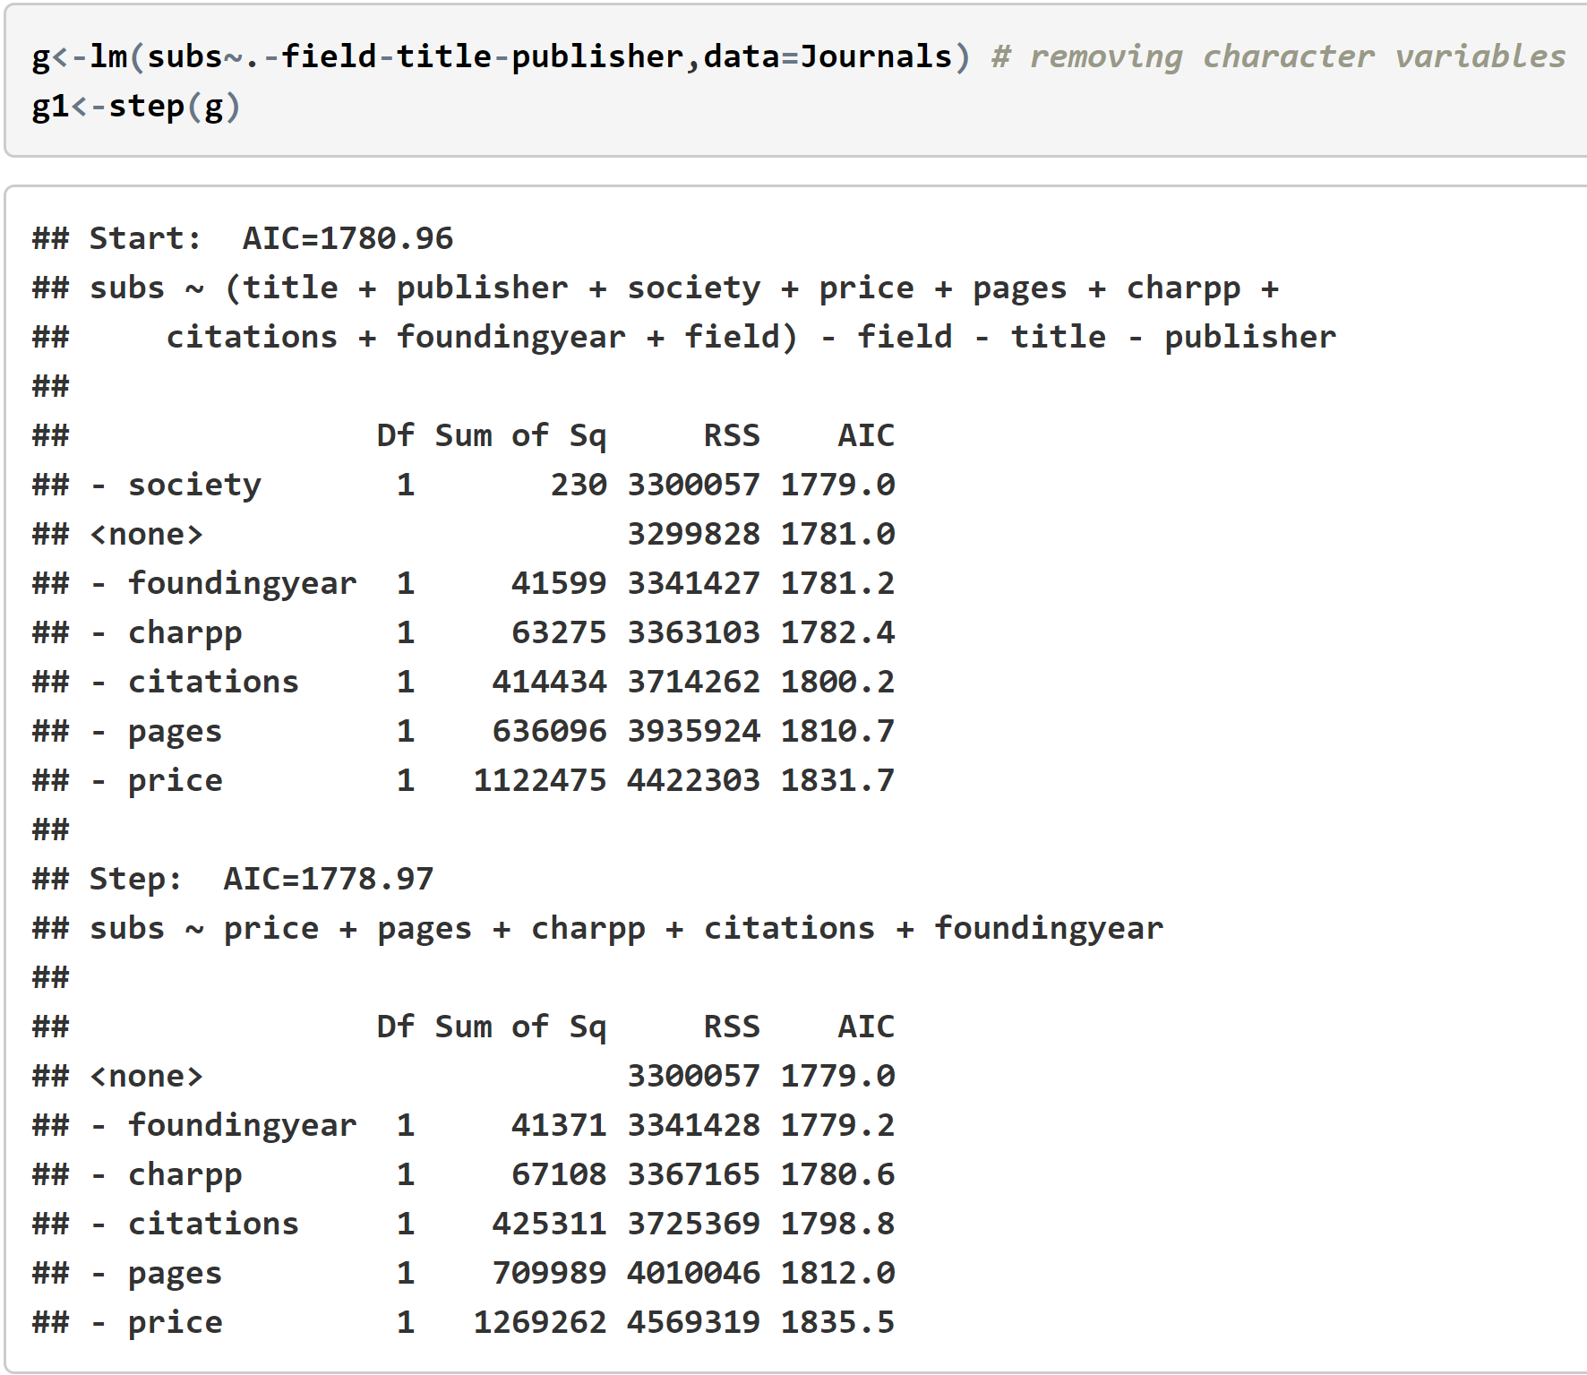
Performing Step wise Regression
Using step wise we can identify those predictors which are not required.
ANALYSIS
After performing step wise Regression we found that only five variables out of 10 are considered to be predictors and the rest are removed.
We will use these 5 predictors to create our model.

Slide 9
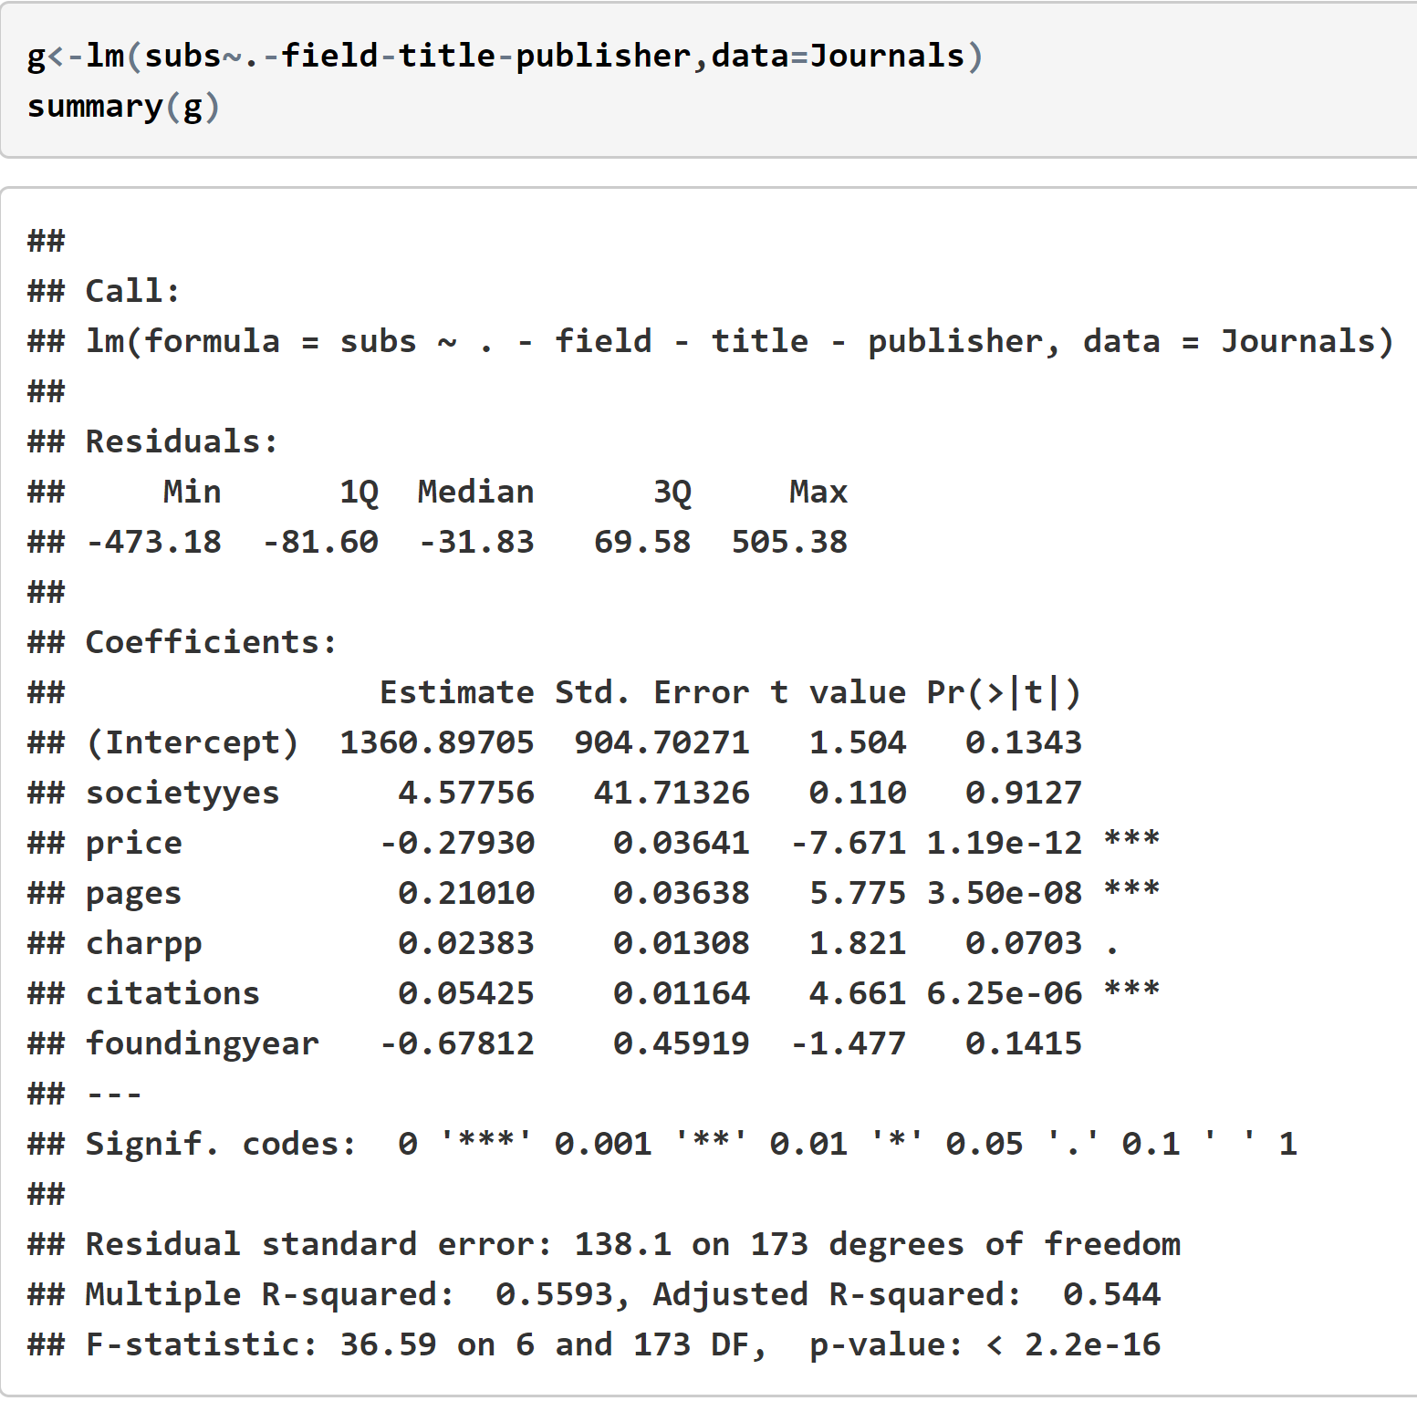
NULL HYPOTHESIS
ANALYSIS
p-value and f-value do a good job on
deciding the goodness of a linear model.
If the p-value is less than or equal to
the alpha (i.e p < .05), the result is
statistically significant. If the p-value is
greater than alpha (p > .05), the result is
statistically insignificant.
The f-Ratio 36.59 is large and
p-value 2.2e-16 is less than (0.05).
The result is significant.
As we can see Since the F-Statistic is 36.59 , we can reject the NULL Hypothesis and can accept the Alternate Hypothesis
Therefore we can proceed with our model and can normalize and improve it.

Slide 10
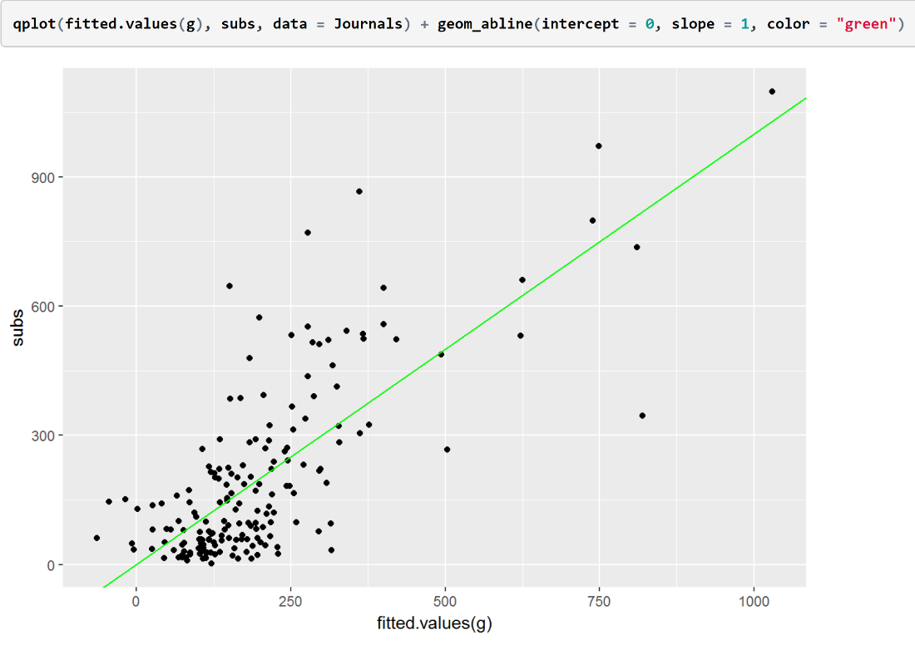
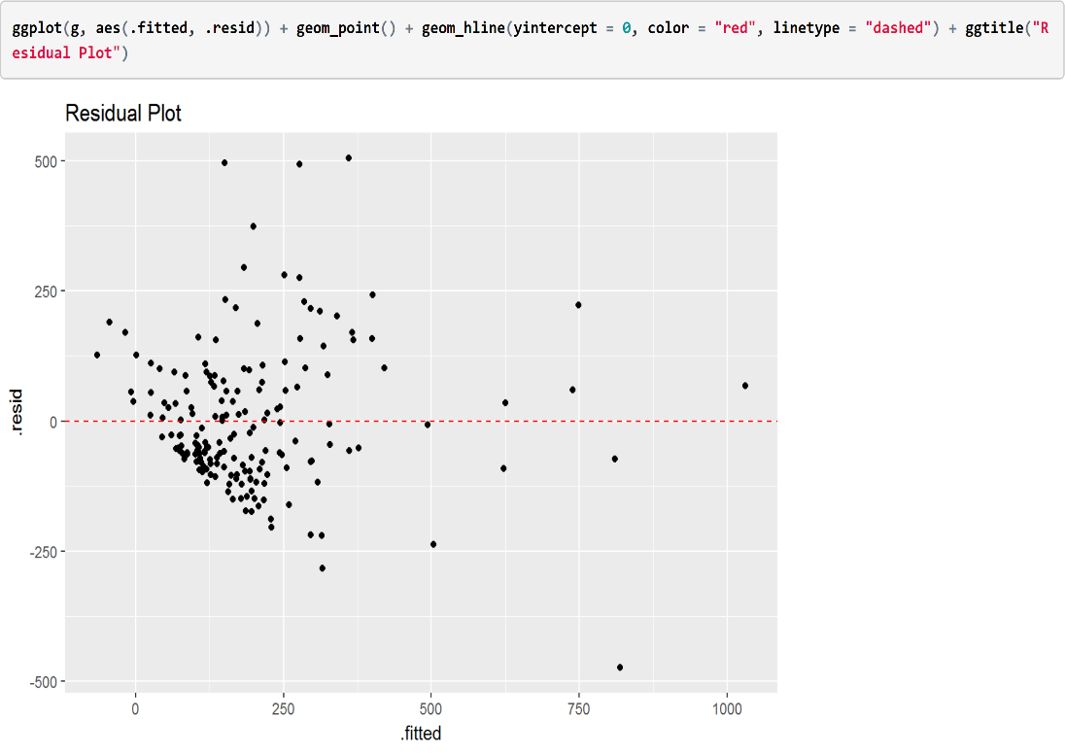
Normality of Residuals
Fit Plot and Residual Plot Fit plot for the variable ‘subs’.
ANALYSIS
We don’t observe any pattern and the distribution is widely spread with some outliers.
The points in a residual plot are
randomly dispersed around the
horizontal axis, a linear regression
model is appropriate for the data.

Slide 11
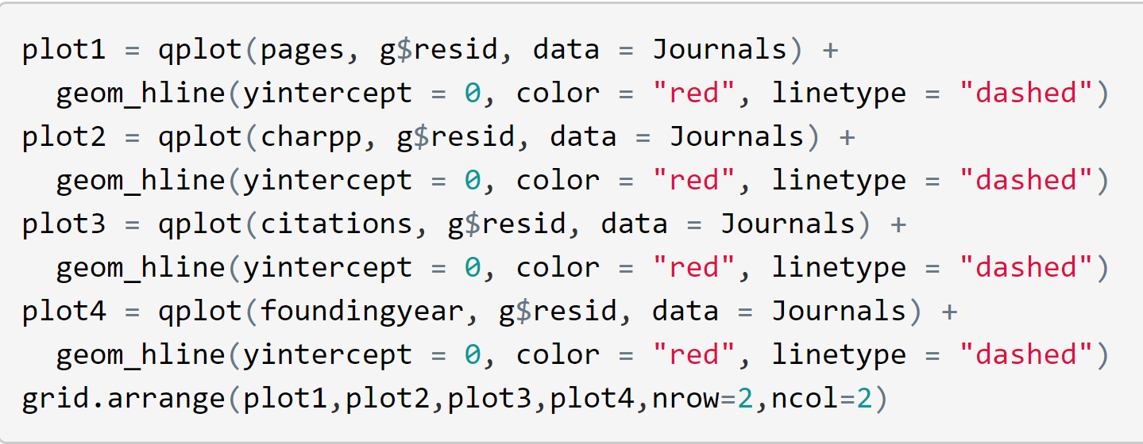
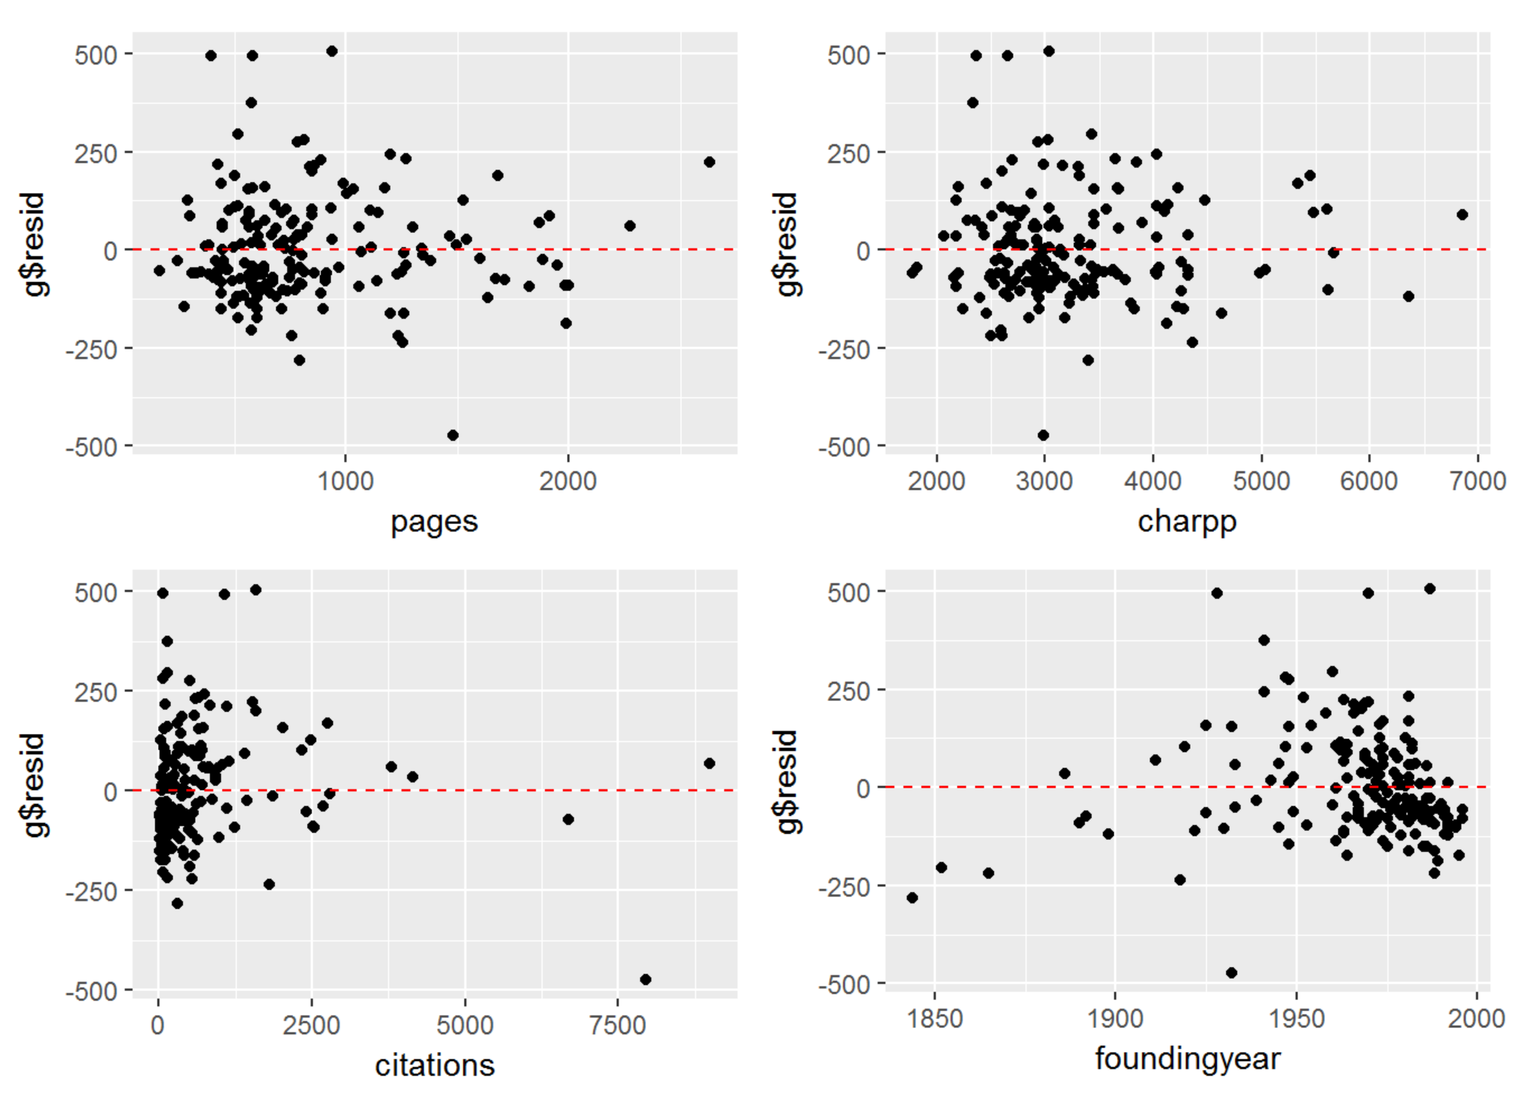
Exploring Model Structure
ANALYSIS
We don’t see pronounced
patters indicating that we do
need to include square of the predictors or other transforms
of the predictors.

Slide 12
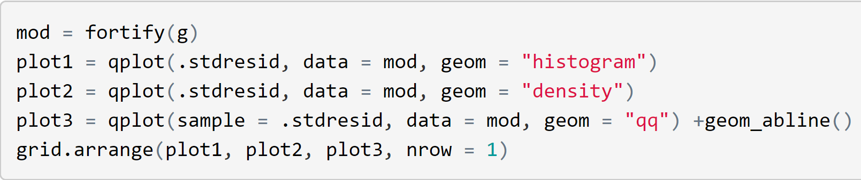
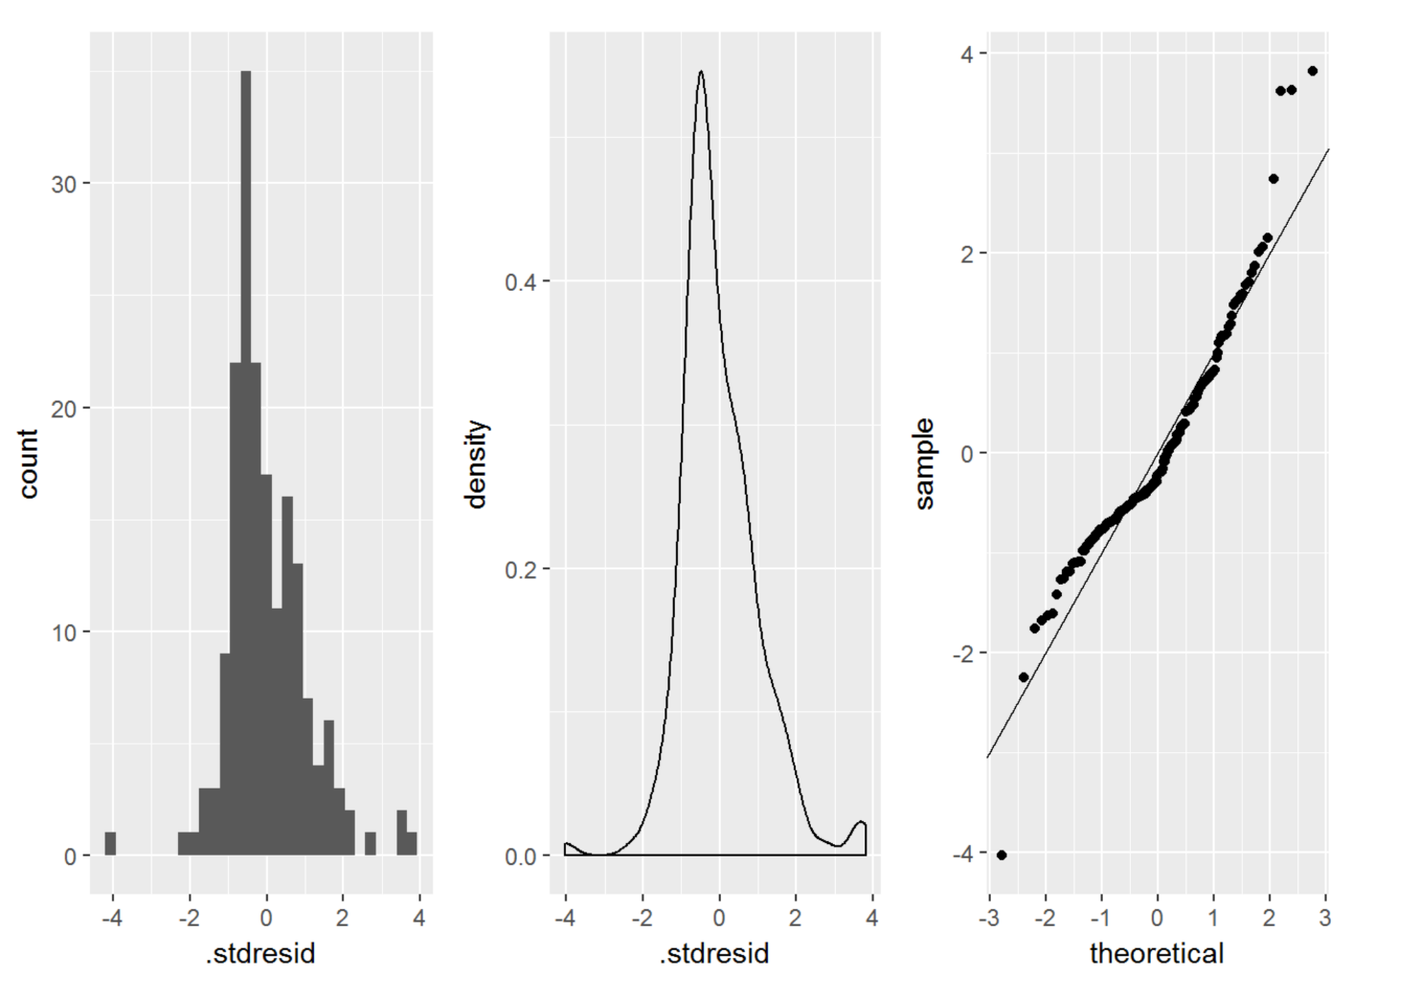
Normality of Residuals
ANALYSIS
The residual do not look as though they come from a normal distribution.
The QQ-Plot looks slightly linear with outliers Density plot is not appearing like a normal distribution.

Slide 13
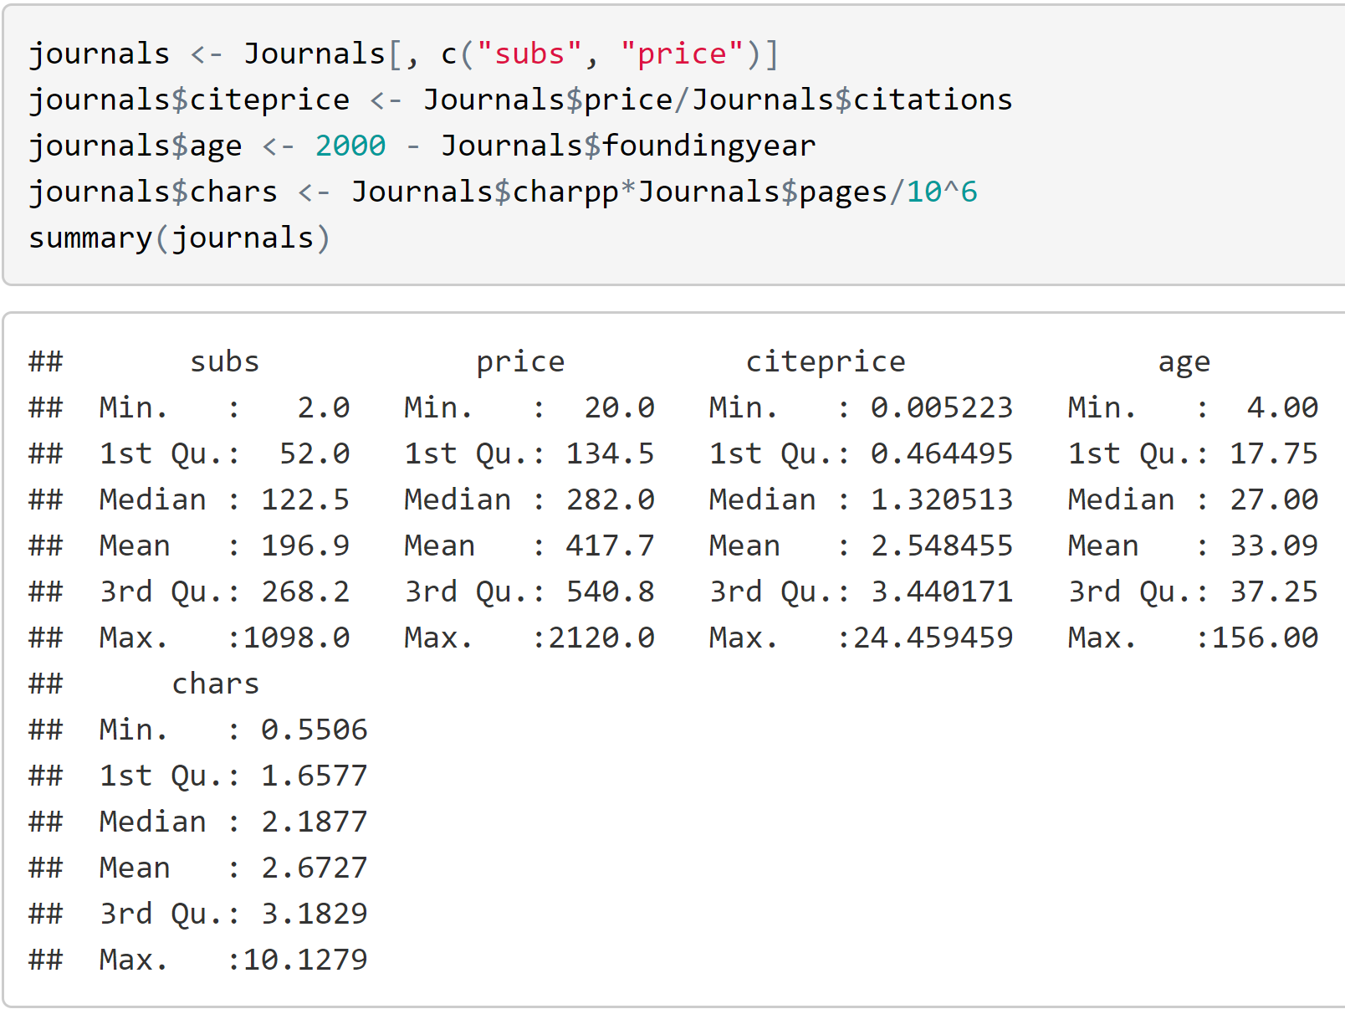
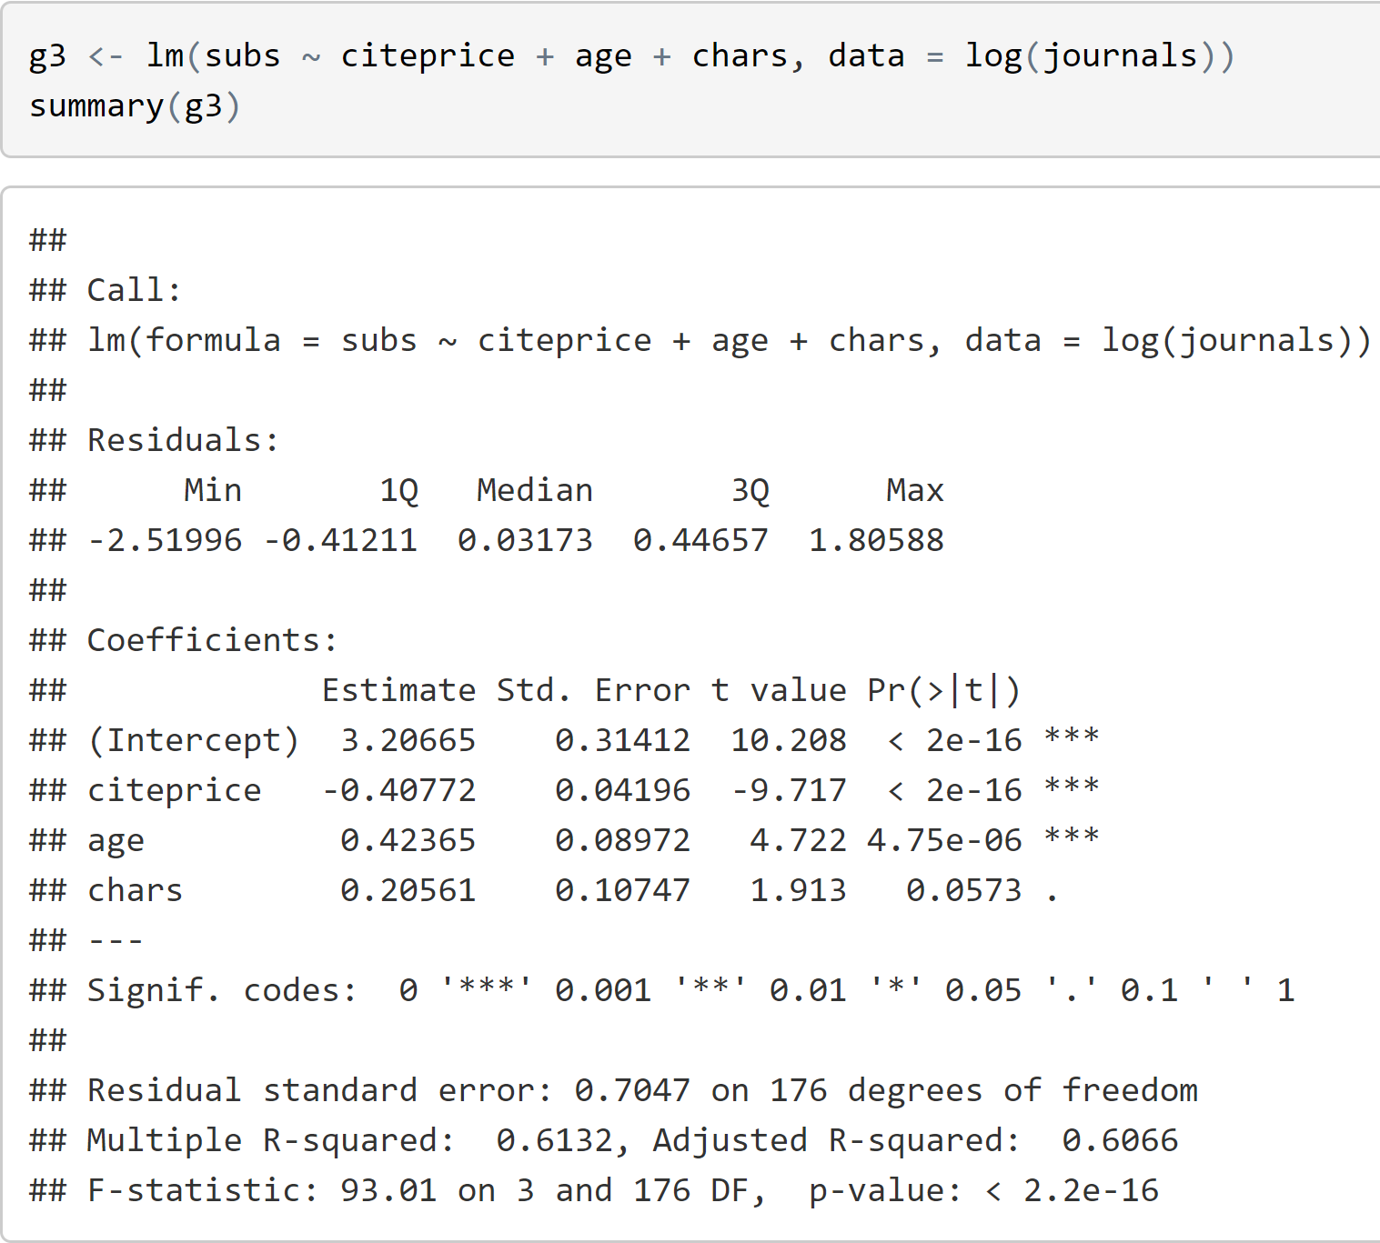
Creating another model to Improve Efficiency
Creating a new dataset containing only numerical predictors.
After creating the dataset we will take log of data to create our linear model.

Slide 14
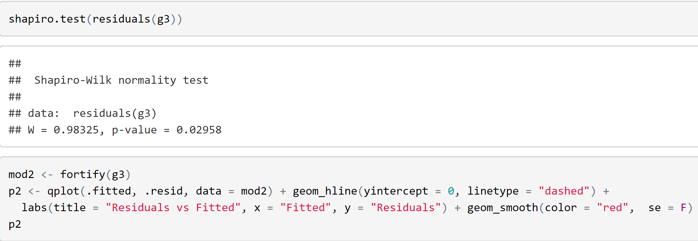
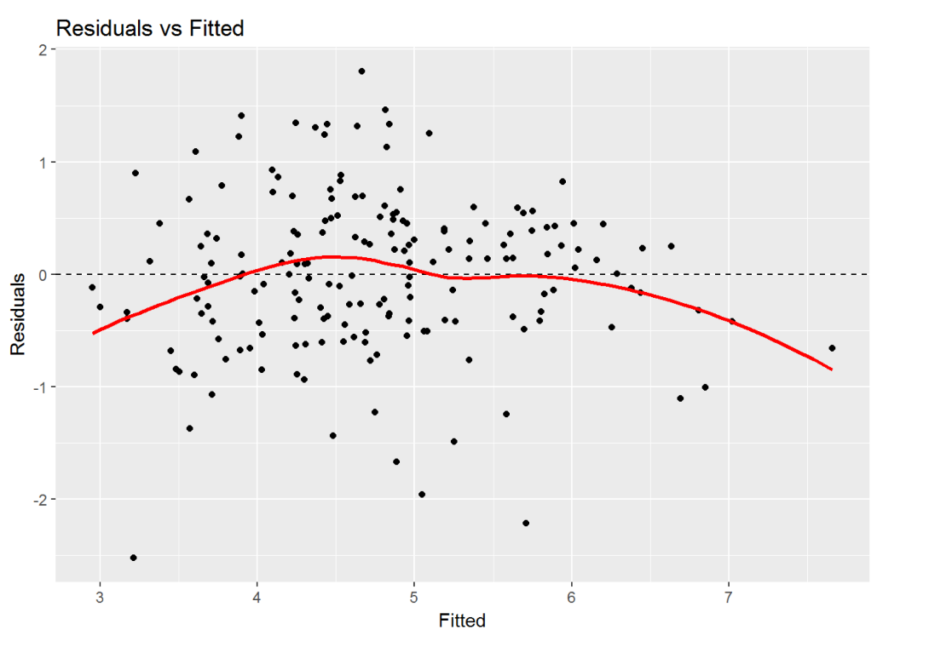
Shapiro Test for Normality

Slide 15
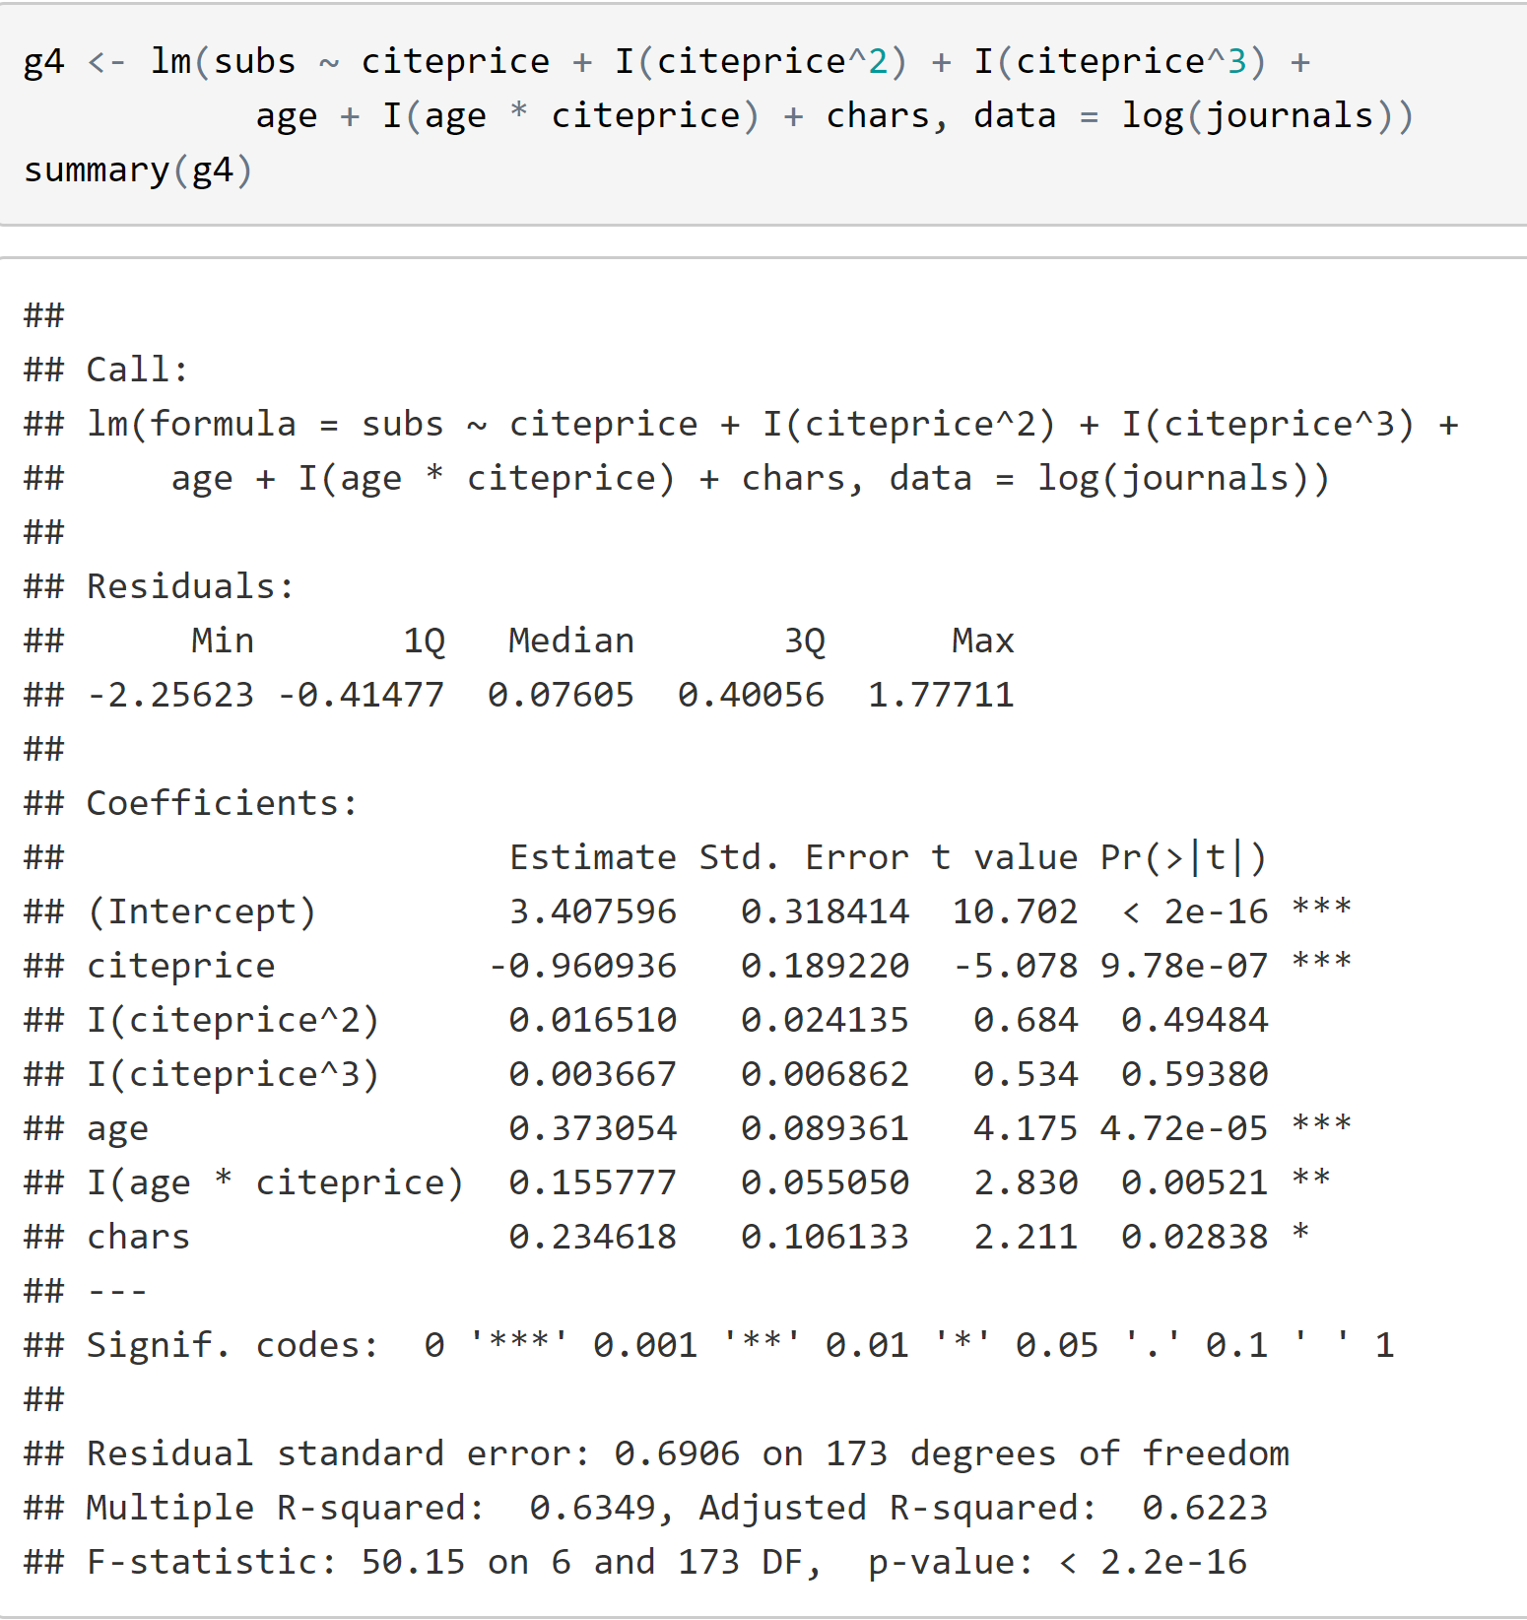
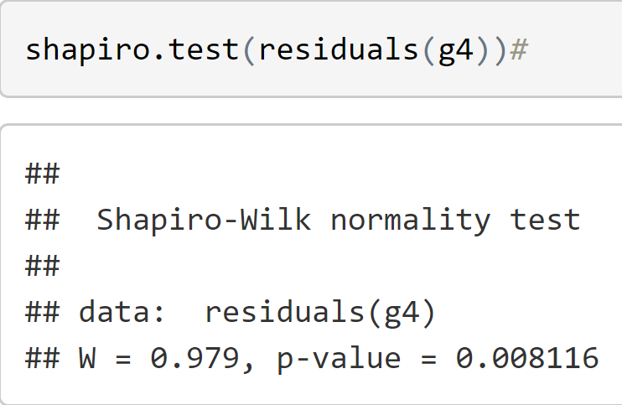
Creating Quadratic Model
Performing Shapiro-Wilk
Normality Test

Slide 16
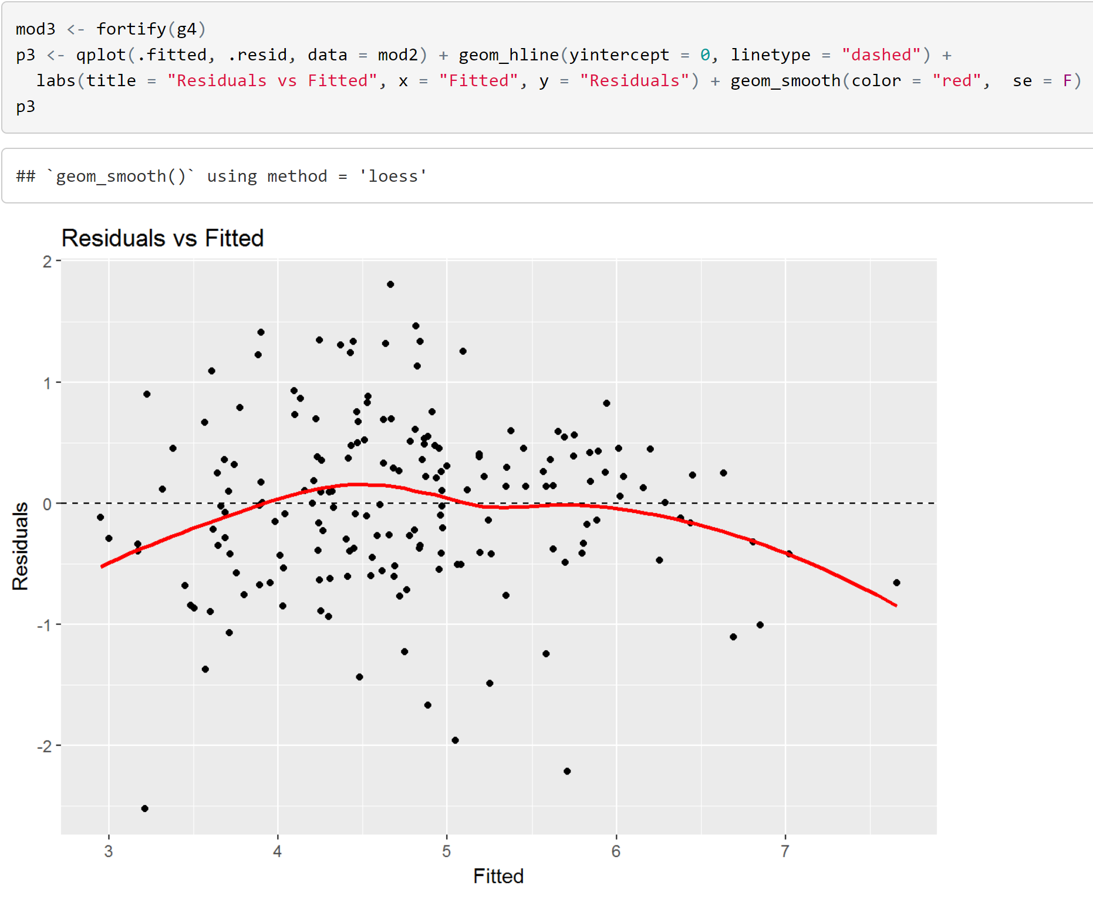
Normality of Residual of New Model

Slide 17

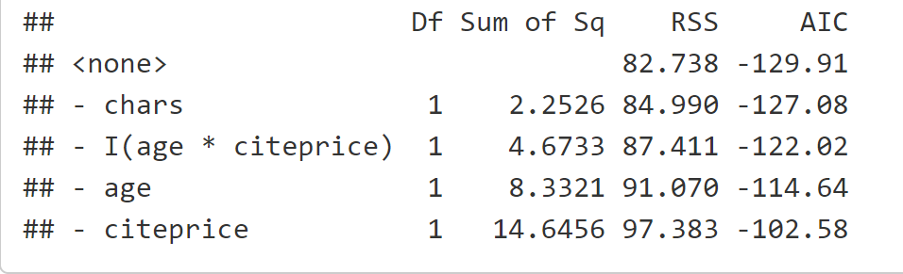
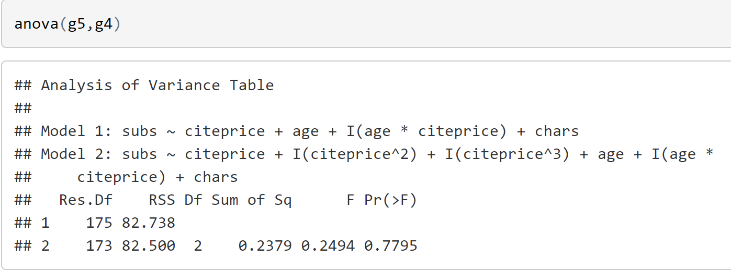
Comparing both Models
We take the first model Since the F-ratio is small

Slide 18
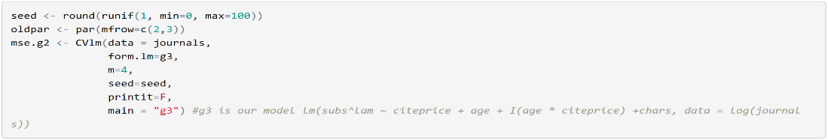
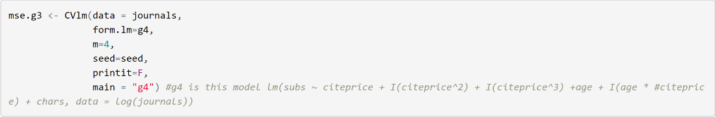
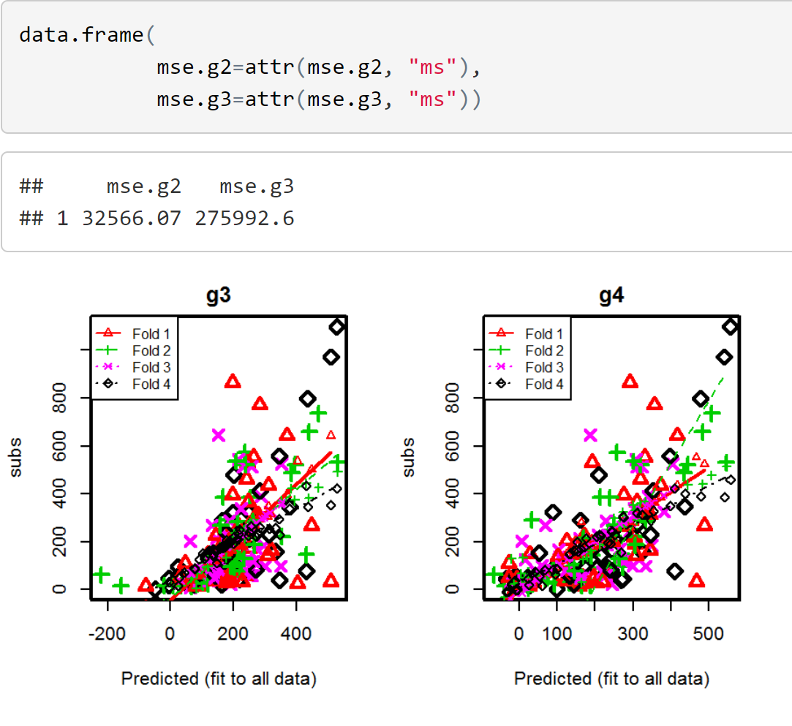
Cross Validation on both Models
ANALYSIS
We can clearly see that mse for our second model is lower than the first one. Hence we select our first model

Slide 19
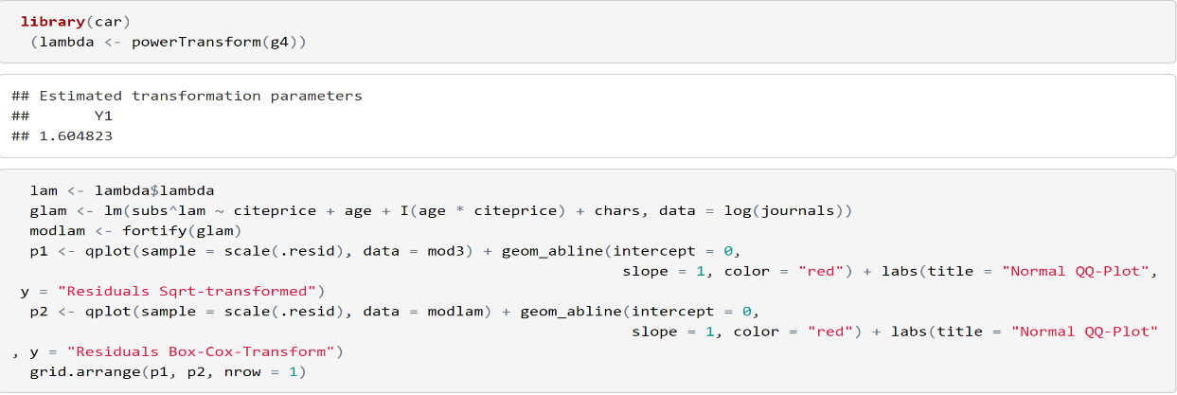
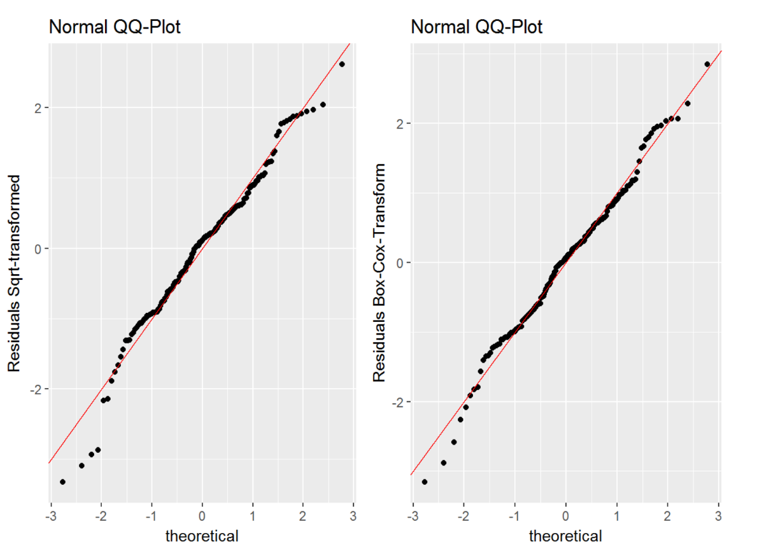
BOX COX Transform

Slide 20
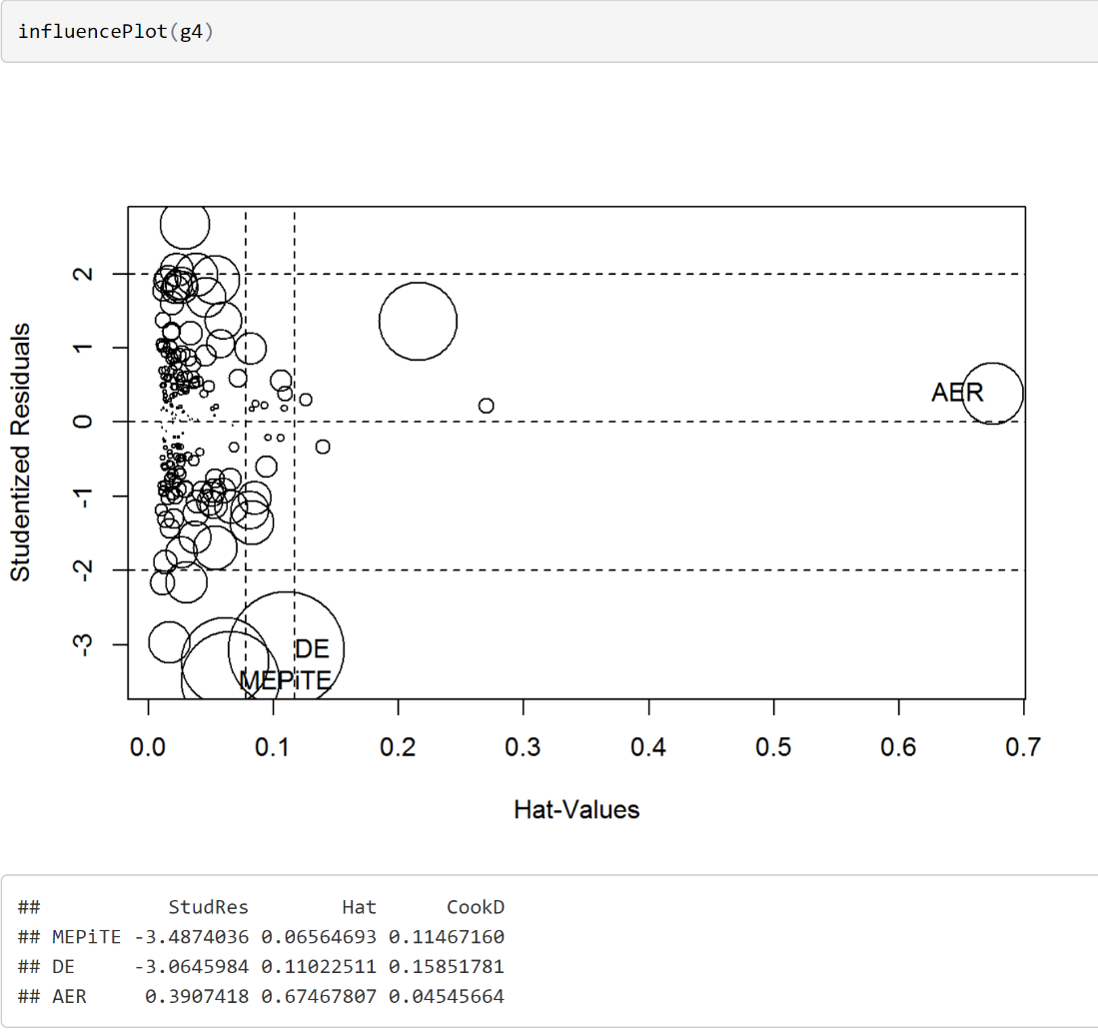
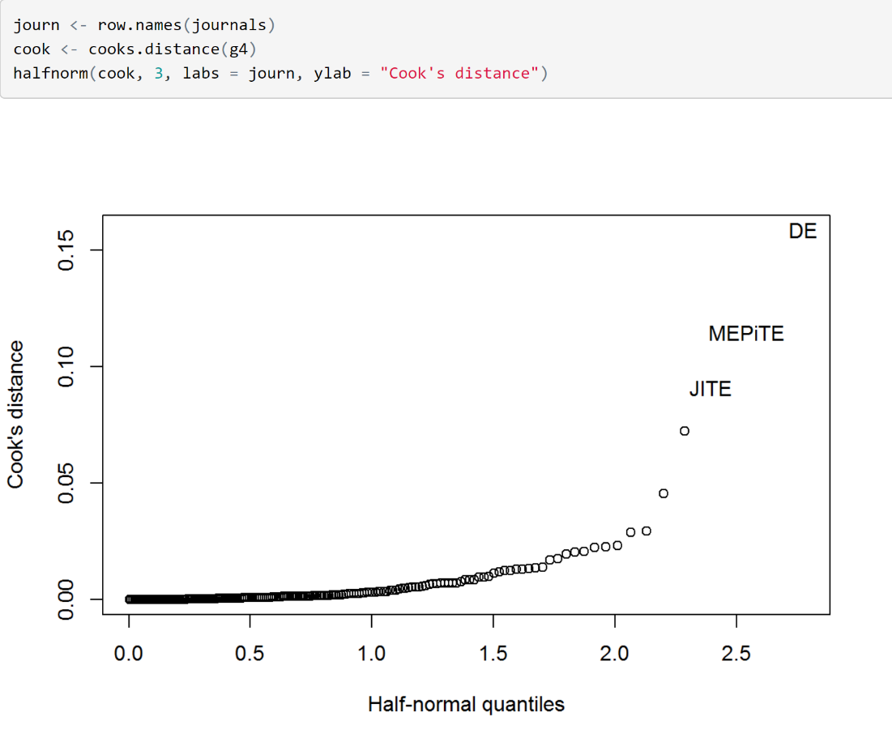
BOX COX Transform Cont.

Slide 21
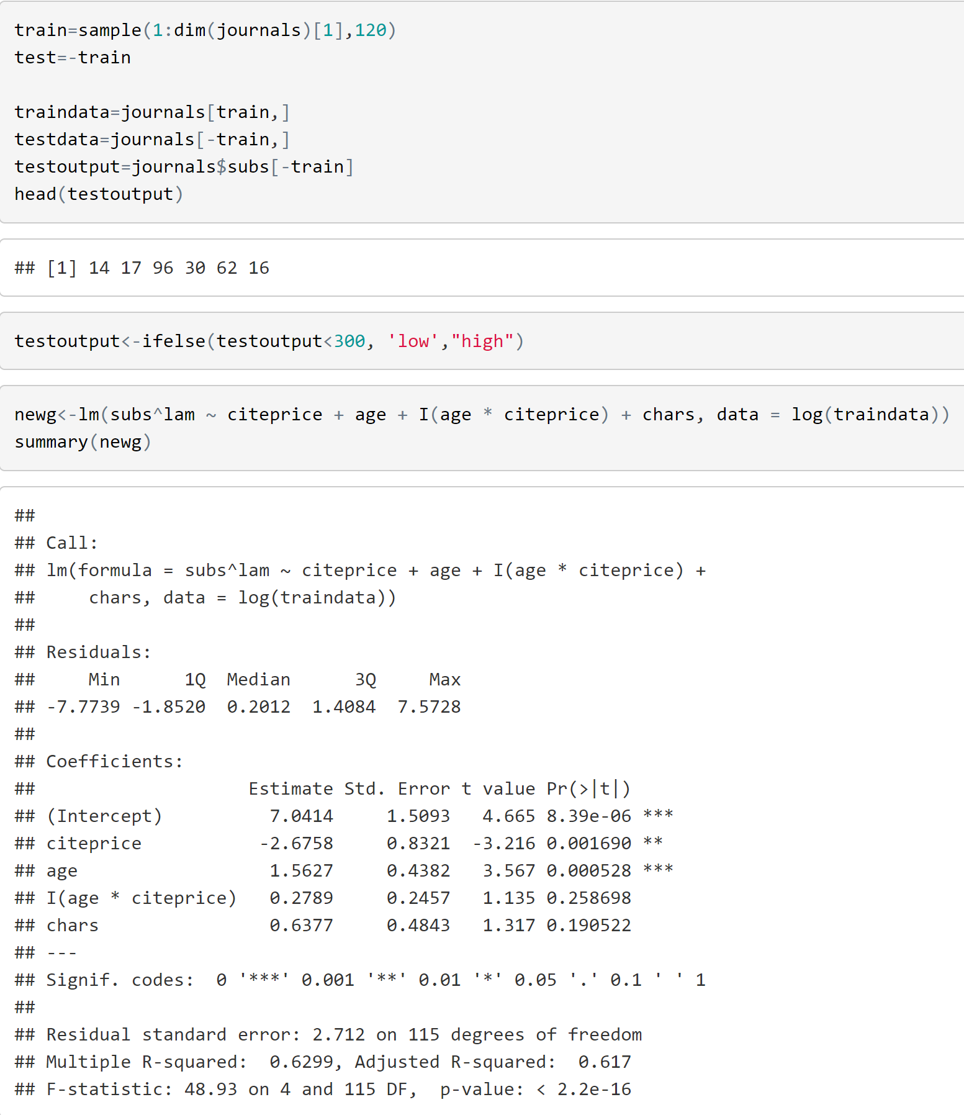
Creating of Test and Training data

Slide 22
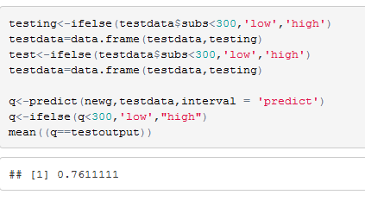
Improvement of our Model
Initially we started our model with R2 of 0.544 by improving our
models and getting rid other variables and using quadratic function of the variables The new R2 is 0.60.
Final Analysis
After creating a correct model based on the traninig data, our model has predicted almost 76.1% of the data from the test data

Slide 23
THANK YOU Q & A

