Slide 1

appcom Subtitle

Slide 2

interactive GmbH
marketing GmbH
440 erfolgreiche Projekte 18 Mitarbeiter 4,5 Jahren aktiv

Slide 3
Content
Introduction
Basics
Methods
Classes and modules
Exceptions
Ruby gems
Ruby on Rails

Slide 4
Introduction
Created by Yukihiro Matsumoto in 1995
Dynamic programming language
Some features
Garbage collecting
(almost) everything is an object
Interpreted (not compiled)
Reflection/Retrospection
REPL (IRB)

Slide 5
Introduction
$ irb
> puts „hello world“
hello world
=> nil

Slide 6
Basics - Comments
> puts „hello world“ # this is the hello world program
hello world
=> nil
> =begin
> This is a multi line comment
> =end

Slide 7
Basics - Numbers
> 42 # decimal
> 0x2a # hex
> 0052 # oct
> 0b101010 # binary
> 42.class
> 3.upto(10) { |i| puts i }
Numbers are objects
We can use methods on numbers

Slide 8
Basics - String
> “hello world“
> ‘hello world‘
> “hello #{name}, nice to meet you“
> str = “hello “ + “world“ << “!“
Backslash only in “-type string interpreted
Use ‘-type strings whenever you can
Many convenient methods
e.g. split, count, delete, [ ], …

Slide 9
Basics - Range
> (1..10) # => 1, 2, 3, 4, 5, 6, 7, 8, 9, 10
> (1...10) # => 1, 2, 3, 4, 5, 6, 7, 8, 9
> (‘a‘..‘z‘) # alphabet of downcased characters
> (1..10) === 2.5 # true
> (1..10) === 42 # false
Array like object to define ranges
Example of beautiful ruby syntax

Slide 10
Basics - Symbol
> :symbol
> “symbol“.object_id # some variant value
> :symbol.object_id # some constant value
Symbols are unique to ruby
Share the same address in memory
Good for „instance-less“ comparison or keys

Slide 11
Ruby gems
Ruby gem is basically a library
Has defined directory structure
Can be build, installed and managed by gem
$ gem install timecop
$ gem list timecop
$ irb
> require ‘timecop‘
=> nil

Slide 12
Ruby on rails - Introduction
Web framework for ruby
First release in 2004 by David Heinemeier Hansson
Based on 5A modules
Active Support Active Record Action Pack Action Mailer Active Resource

Slide 13
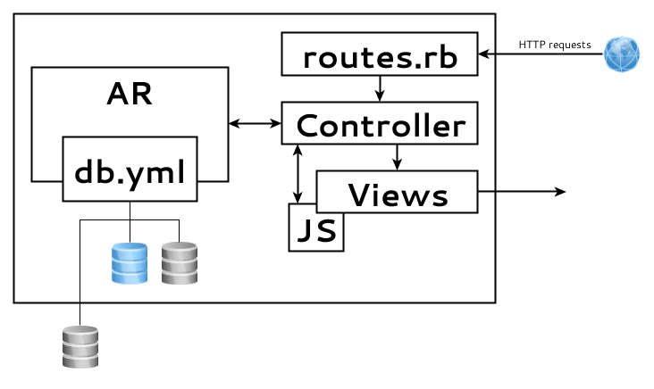
Ruby on rails - Architecture

