Slide 1

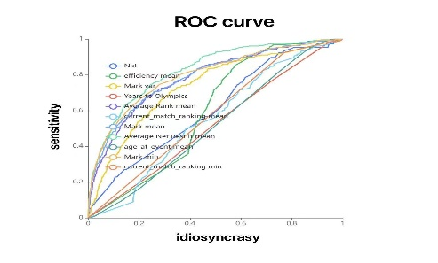
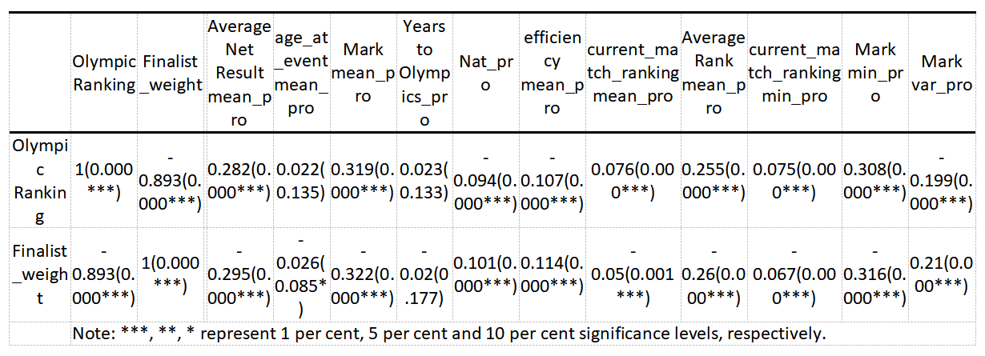

Predicting 2024 Paris Olympics Men’s 100m
Hypothesis:
Whether an athlete reaches the final is determined by the form (performance) of the previous four years of competition, ignoring the effects of possible missed plays and opponent specificity in the actual Olympic competition.
Influencing Factors:
Age at event
Average Net Result mean
Mean mark
Best mark(min)
Variance of the mark
Mean match ranking
Best match ranking(min)
Average Rank mean
Mean efficiency
Nation Score
Years to Olympics
Characteristic engineering
Handling of outliers and missing values
Data formatting
normalization of data
Pearson correlation analysis
This ROC curve chart shows the performance of multiple features in a binary classification model. The horizontal axis represents idiosyncrasy, and the vertical axis represents sensitivity. Each curve represents the idiosyncrasy and sensitivity of a feature at various thresholds. The closer the curve is to the top left corner, the better the classification performance of that feature. For example, Nat, efficiency mean, Mark var, and Years to Olympics can effectively distinguish between positive and negative samples, while Mark mean and current match ranking mean may still be useful in some cases but might need to be combined with other features or optimized through feature engineering.
This table presents the correlation coefficients between various features related to Olympic Ranking and Finalist Weight. The coefficients are shown along with their significance levels, indicated by asterisks where *** denotes significance at the 1% level, ** at the 5% level, and * at the 10% level. For example, Olympic Ranking and Finalist Weight have a strong positive correlation (0.893) with high statistical significance (***). Other notable correlations include Average Net Result mean (0.282) and Mark mean (0.319) with Olympic Ranking, both significant at the 1% level. This data suggests significant relationships between these features and the dependent variables.
Group3:
Youyao Gao
Yu Liang
Haosong Sun
Xinyi Zeng
NUS SOC Summer Workshop 2024

