Slide 1

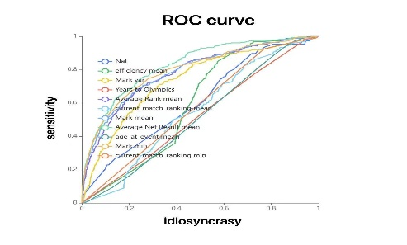

Predicting 2024 Paris Olympics Men’s 100m
This ROC curve chart shows the performance of multiple features in a binary classification model. The horizontal axis represents idiosyncrasy, and the vertical axis represents sensitivity. Each curve represents the idiosyncrasy and sensitivity of a feature at various thresholds. The closer the curve is to the top left corner, the better the classification performance of that feature. For example, Nat, efficiency mean, Mark var, and Years to Olympics can effectively distinguish between positive and negative samples, while Mark mean and current match ranking mean may still be useful in some cases but might need to be combined with other features or optimized through feature engineering.
Group3:
Youyao Gao
Yu Liang
Haosong Sun
Xinyi Zeng
NUS SOC Summer Workshop 2024

