Slide 1
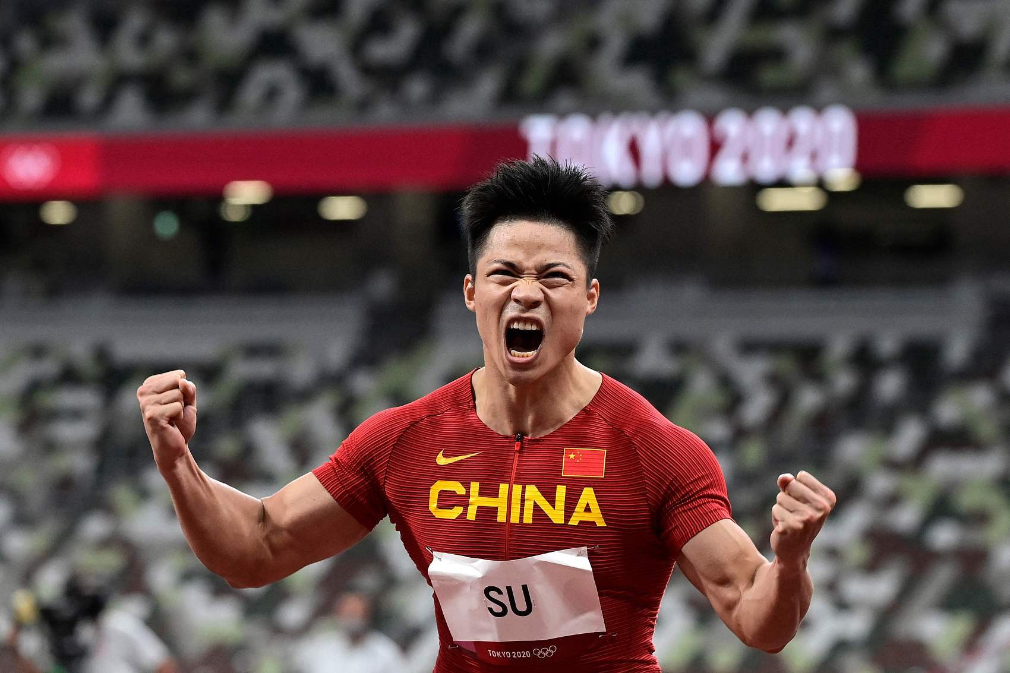
Attention Grabber

Slide 2
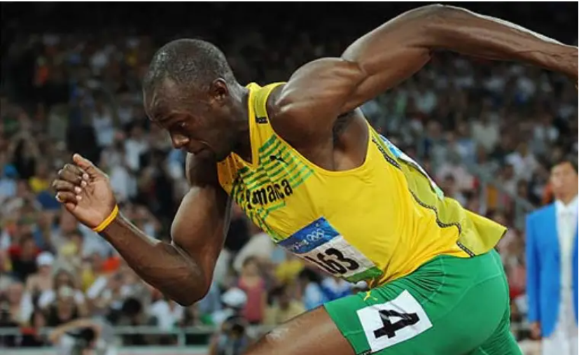
Method for Predicting
2024 Paris Olympic Games Men’s 100m

Slide 3
Introduction to the Group

Slide 4

Youyao Gao
Gender: Male
Nationality: China
Hometown: Shanghai
College: University of Nottingham Ningbo China
Emial: scyyg6@nottingham.edu.cn
youyaogao@gmail.com
15221996168@163.com
Contact Number: +86 15221996168
Computer skills: Python, C, java, Haskell, SQLite, HTML, CSS, Matlab, R, Geogebra, Latex
Language skills: English, Mandarin
Research interest: Data Science, Machine Learning, Computer Vision

Slide 5
Yu Liang

Slide 6
Haosong Sun
Gender: MALE
College: Beijing University of Posts and Telecommunications
Major: Electronic Information Engineering
Email: mrsun666@126.com
shs2022@bupt.edu.com
Skills: C/C++, Python, MATLAB
Interests: Machine Learning, Deep Learning, Signal Processing

Slide 7
Introduction to the Group
Xinyi Zeng

Slide 8
Outline
1. Pre-Project Preparations
· Waterfall Method and Agile Method
2. Development
· Data Collection (Web Scraping)
· Data Preprocessing (Data Cleaning)
· Feature Engineering (Correlation Analysis, PCA)
· Logistic Regression (Binary Classification)
· Model Building, Training, and Testing
· Model Evaluation (Class 1-9 Prediction)
3. Conclusion

Slide 9
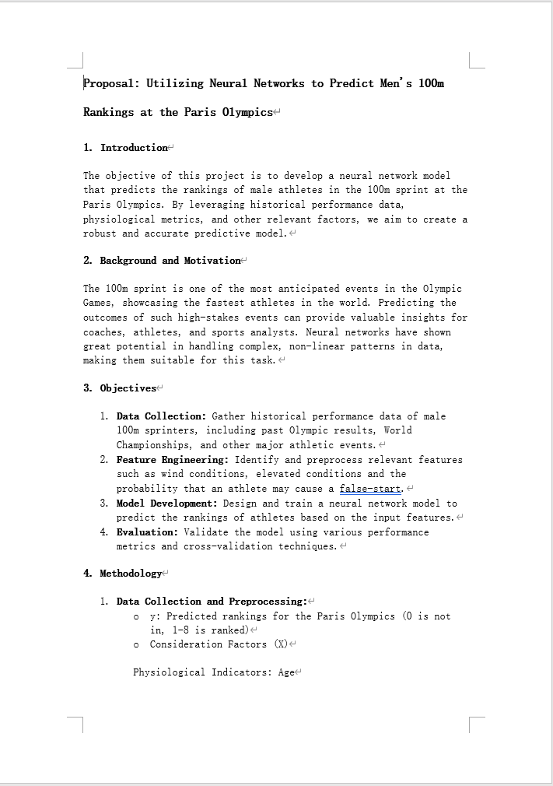
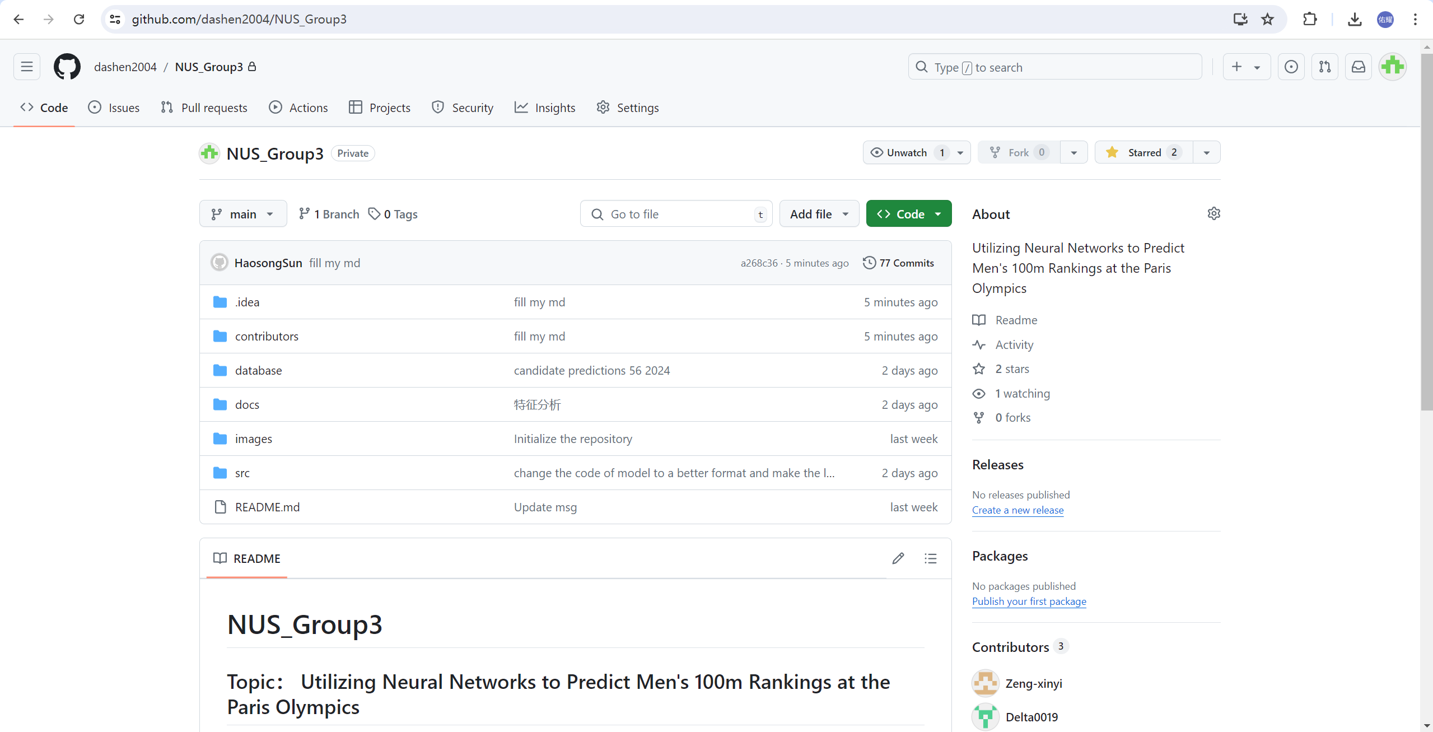
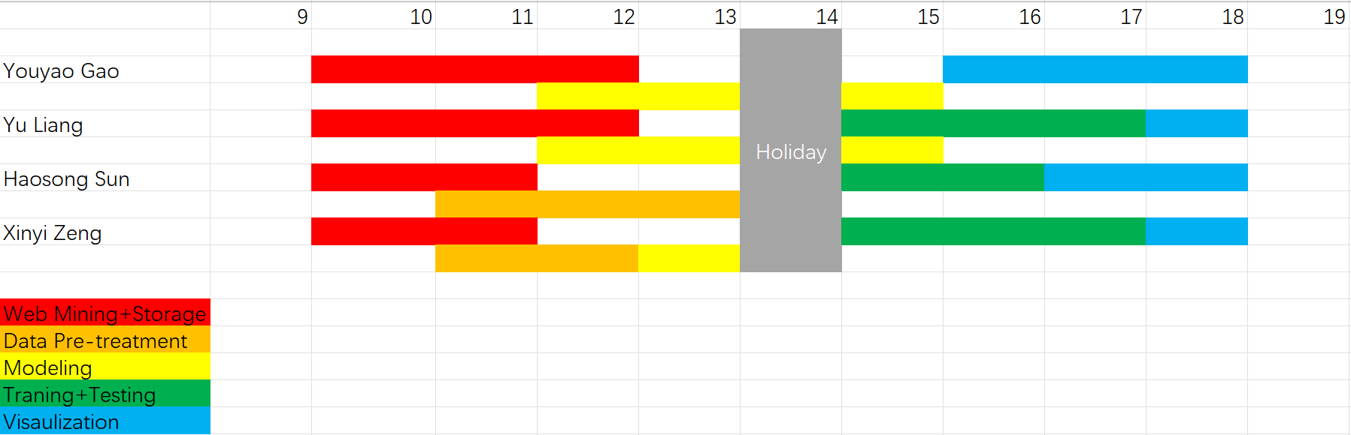
Pre-Project Preparations: Waterfall Method and Agile Method

Slide 10
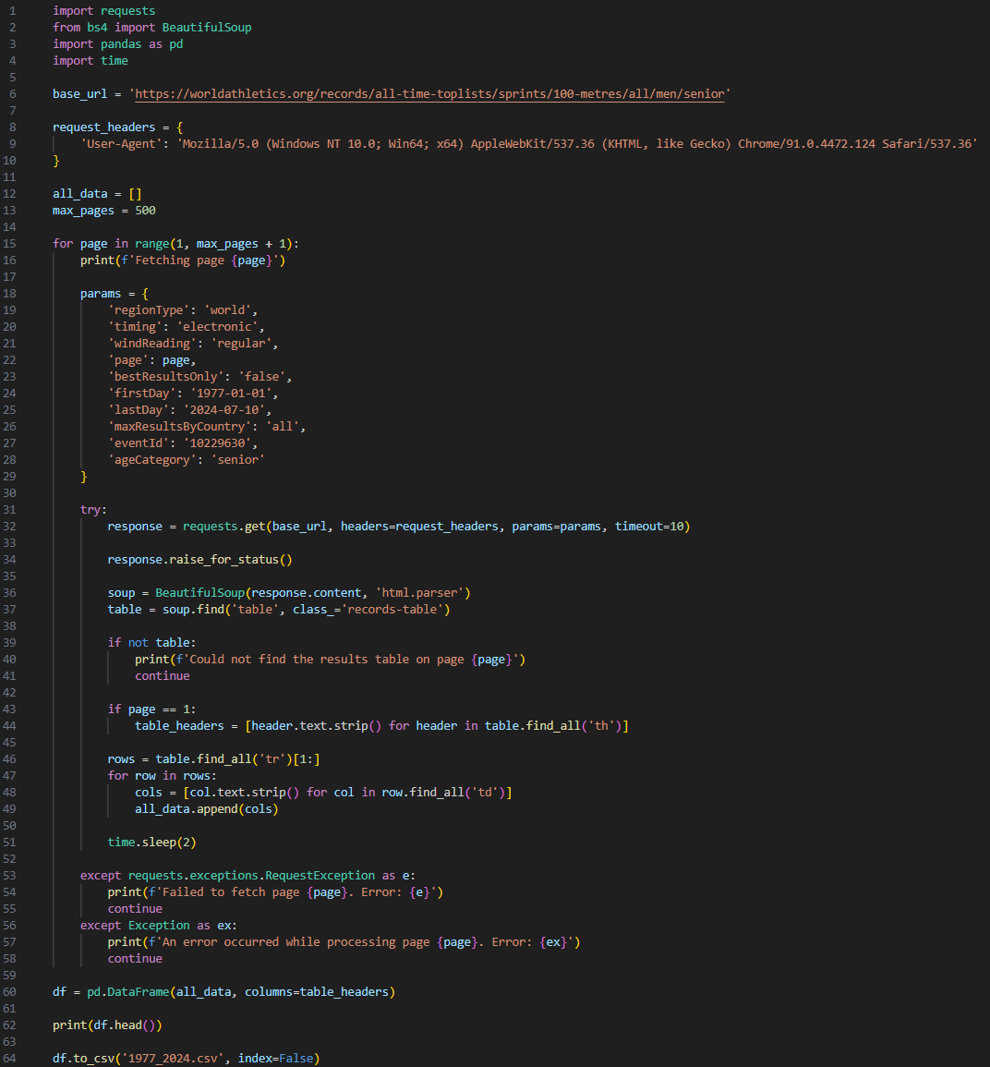
Development : Data Collection

Slide 11
Development : Data Collection

Slide 12
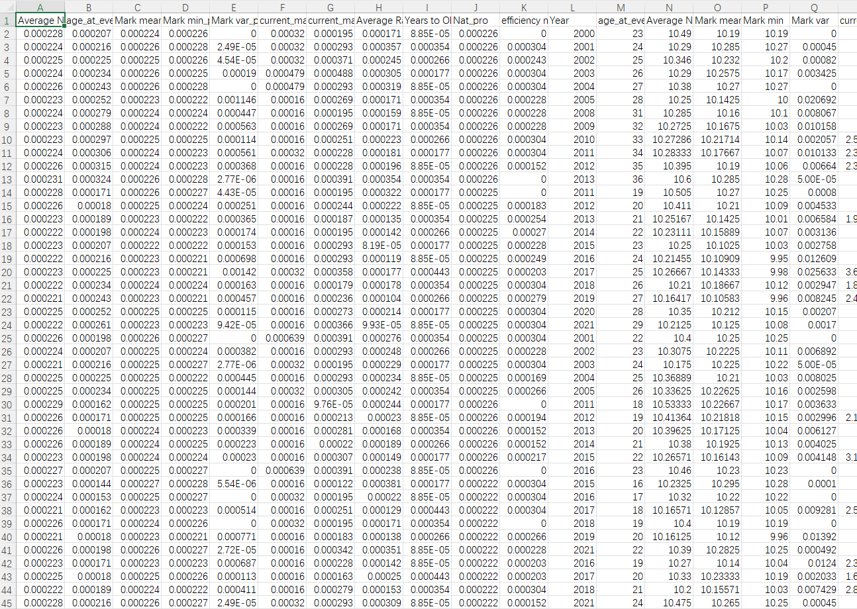
Development : Data Preprocessing

Slide 13
Development : Data Preprocessing

Slide 14
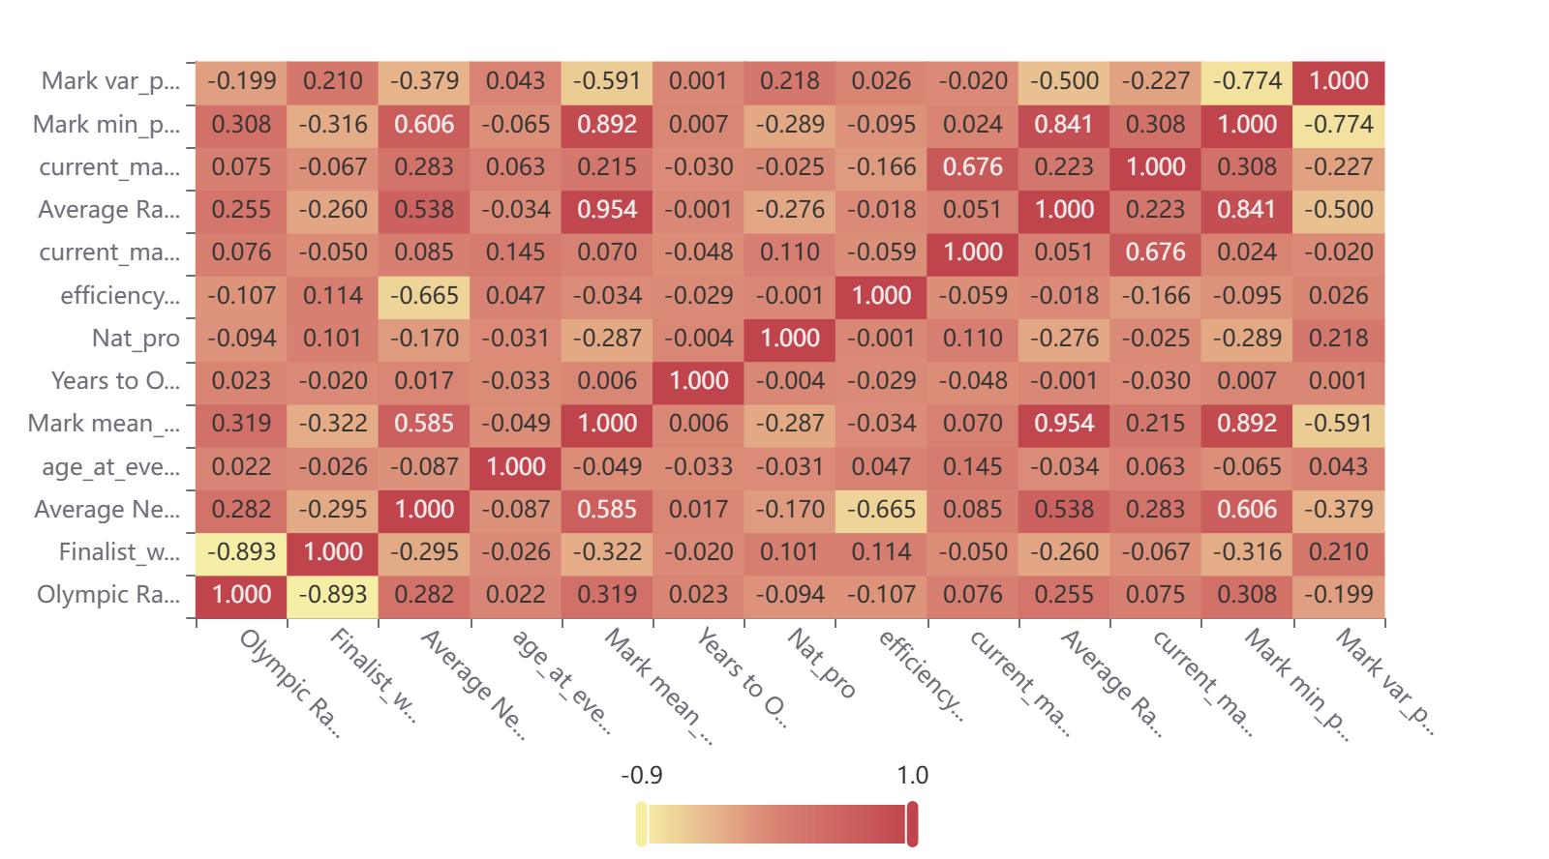
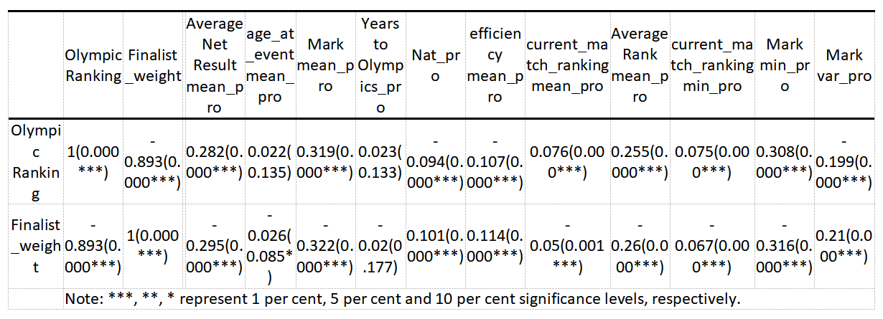
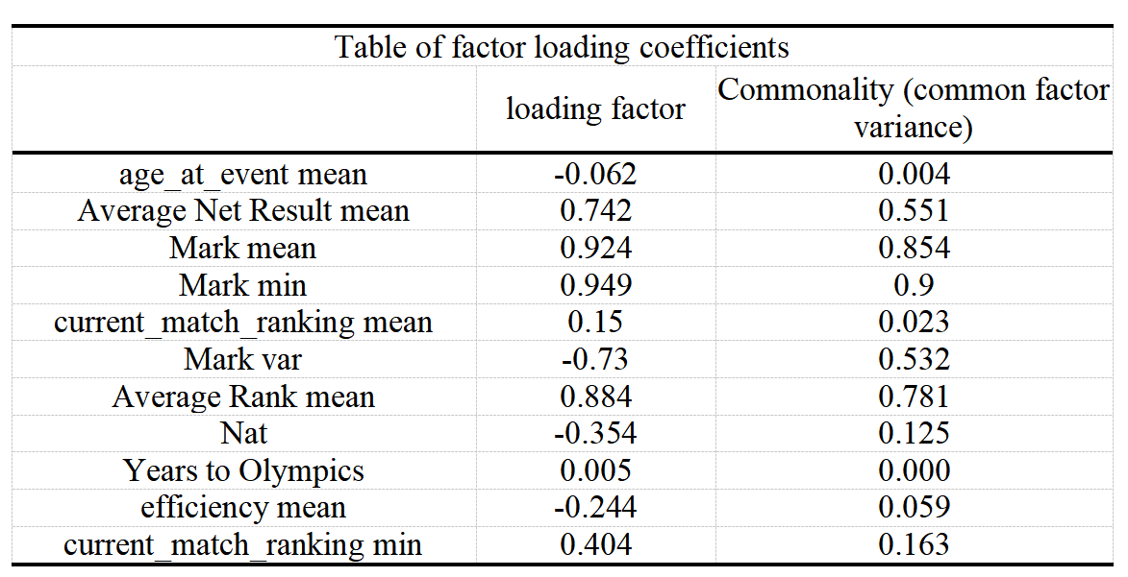
Development :
Feature Engineering

Slide 15
Development : Feature Engineering

Slide 16
Development : Feature Engineering

Slide 17
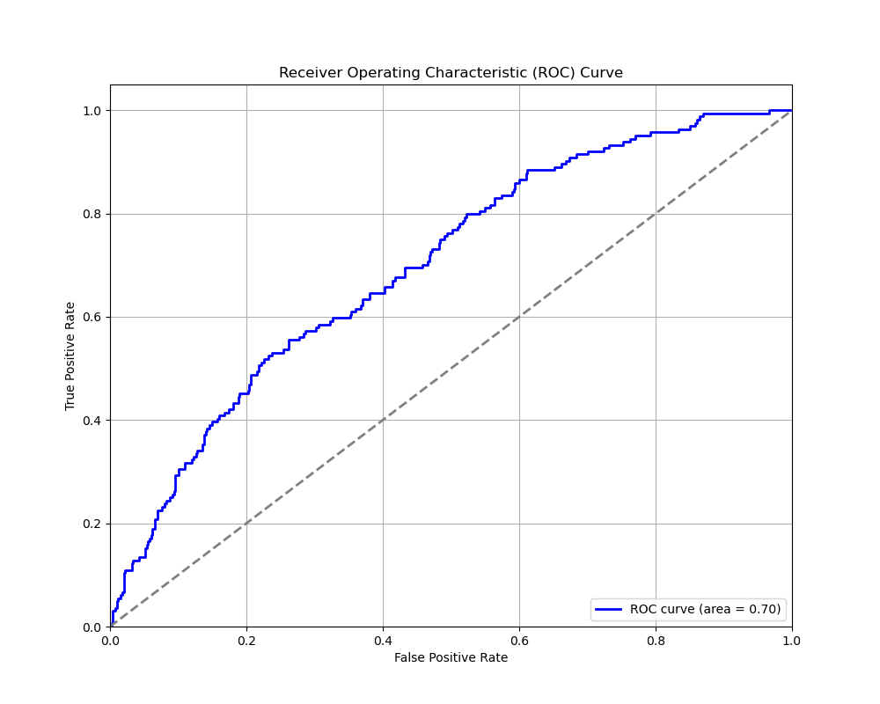
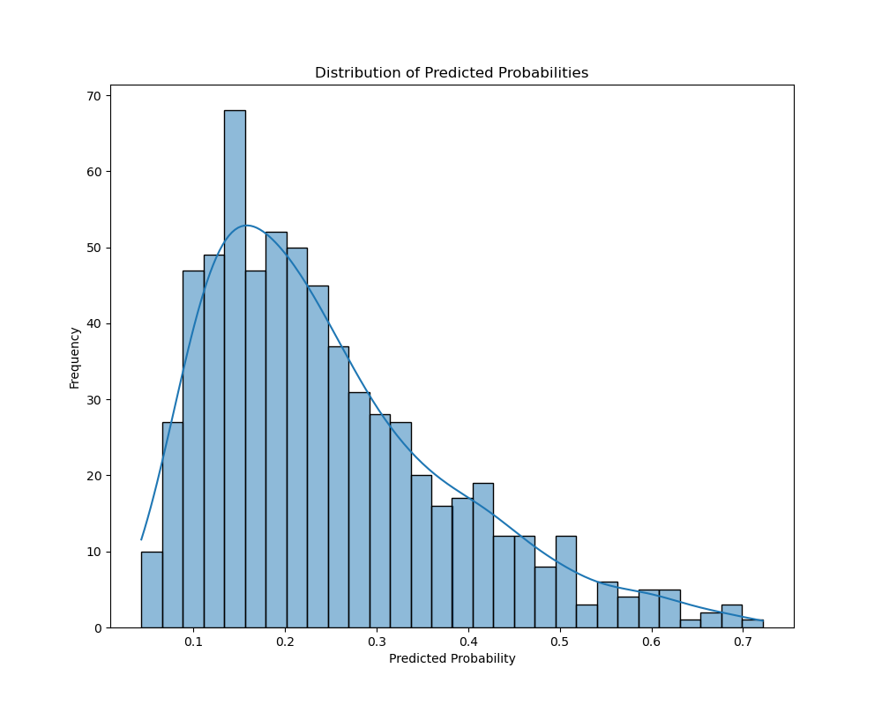
Development : Logistic Regression

Slide 18
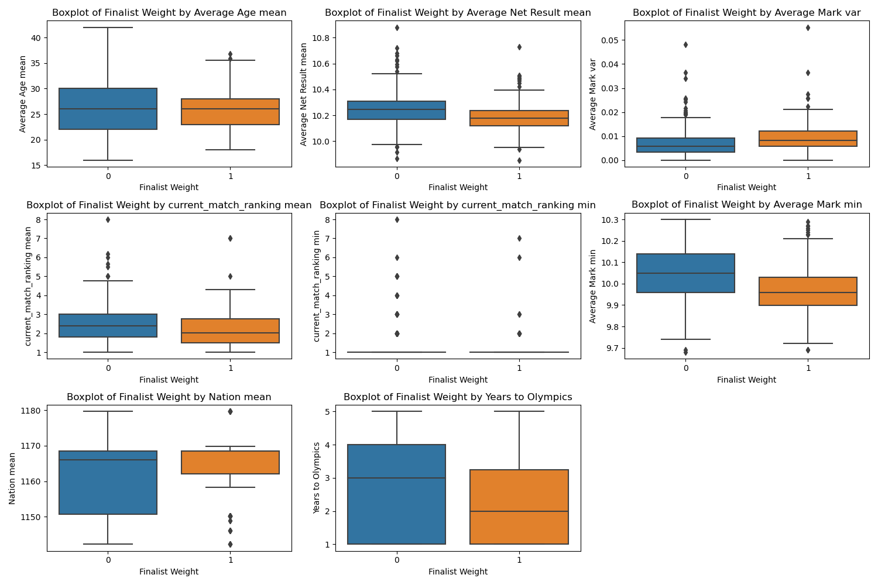
Development : Logistic Regression

Slide 19
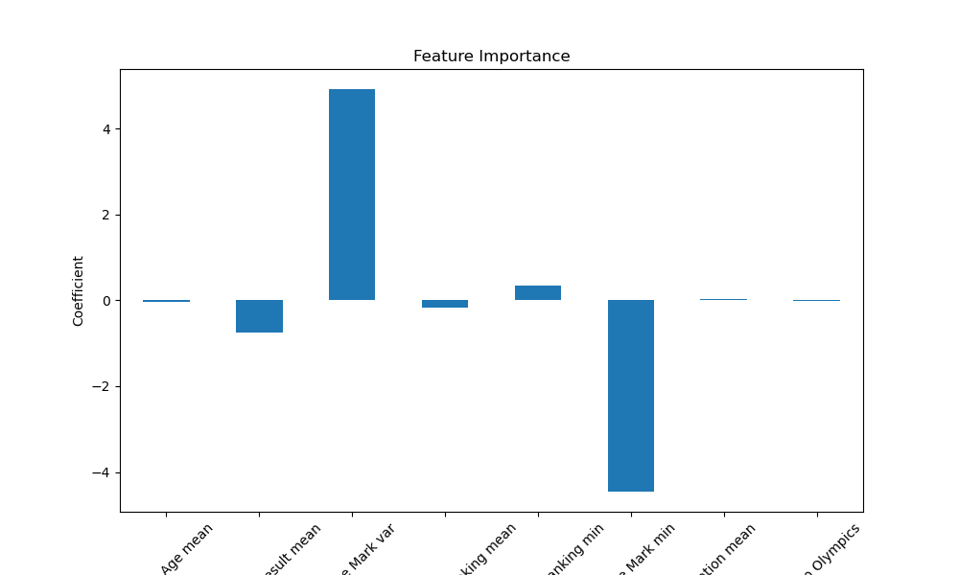
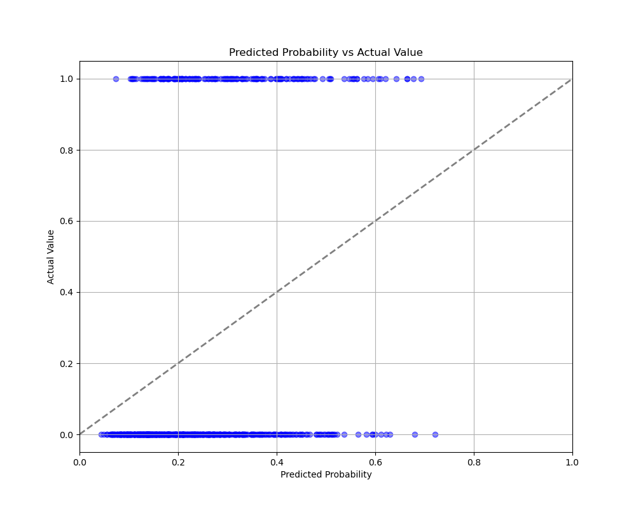
Development : Logistic Regression

Slide 20
Development : Model Building, Training, and Testing

Slide 21
Development : Model Building, Training, and Testing

Slide 22
Development : Model Building, Training, and Testing

Slide 23
Development : Model Evaluation

Slide 24
Conclusion

Slide 25
THANK YOU!

Slide 26
Reference List

