Slide 1

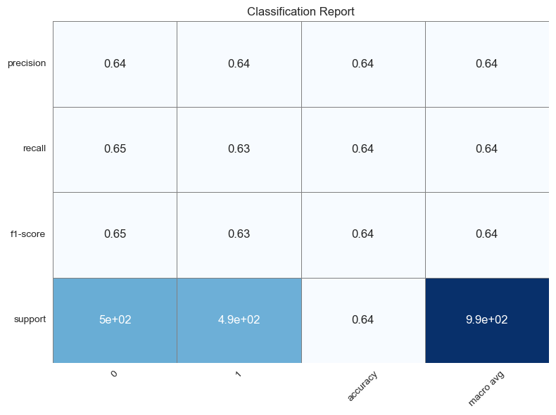
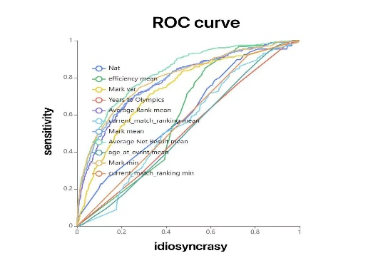
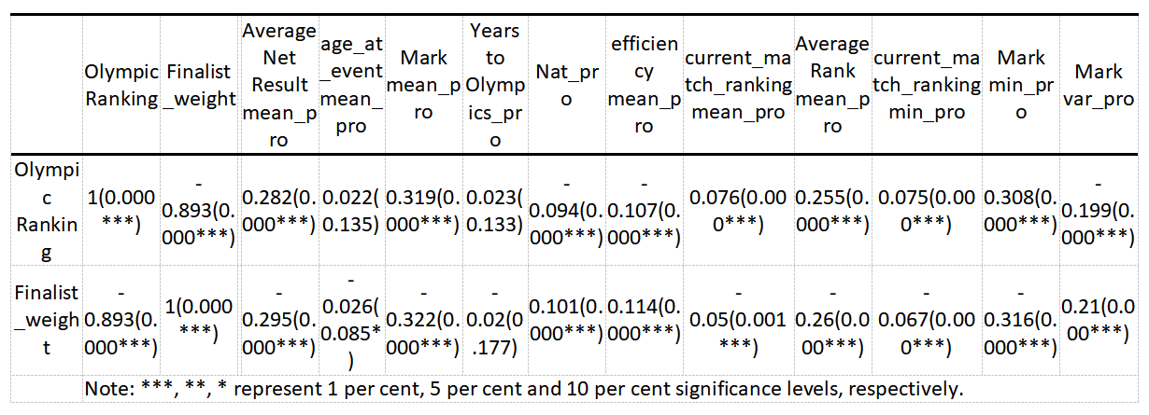
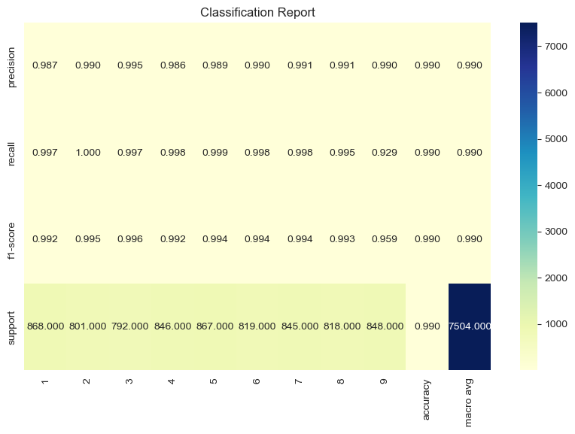
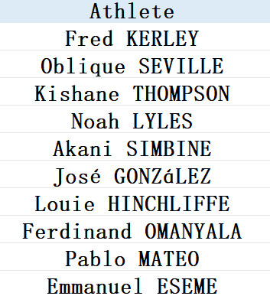

Predicting 2024 Paris Olympics Men’s 100m
Hypothesis:
Whether an athlete reaches the final is determined by the form (performance) of the previous four years of competition, ignoring the effects of possible missed plays and opponent specificity in the actual Olympic competition.
Logistic Regression Model
Web Mining:
Data were collected from https://worldathletics.org
Influencing Factors:
Age at event
Average Net Result mean
Mean mark
Best mark(min)
Variance of the mark
Mean match ranking
Best match ranking(min)
Average Rank mean
Mean efficiency
Nation Score
Years to Olympics
Our classification report for logistic regression model provides balanced precision, recall, and F1-scores around 0.64-0.65. The precision for both classes (0 and 1) is 0.64, indicating that 64% of the predicted positives are true positives. The recall values are 0.65 for class 0 and 0.63 for class 1, showing the model's ability to identify actual positives. The overall accuracy is 0.64, suggesting the model correctly classifies 64% of instances. Overall, the model shows balanced performance with areas for improvement in feature engineering and model tuning.
Characteristic engineering：
1. Handling of outliers and missing values 2. Data formatting
3. Normalization of data 4. Pearson correlation analysis
Main Model
Conclusion:
· Our logistic regression model, although scientifically sound and robust, has shown limited accuracy.
· Conversely, the random forest model displays exceedingly high accuracy. However, its simulation does not perfectly align with real-world conditions, indicating a need for further optimization and adjustments.
· The image on the right highlights the random forest model's predictions for strong contenders likely to reach the finals.
The classification report for main model provides an overview of the model's performance across nine classes (1 to 9). The precision values are all very high, ranging from 0.867 to 0.990, indicating that the majority of positive predictions for each class are correct. Recall values are similarly high, from 0.997 to 0.929, suggesting that the model successfully identifies most of the actual positive cases. The F1-scores, which balance precision and recall, reflect this consistency, with all values above 0.85. The overall accuracy of the model is 0.990, demonstrating excellent performance and reliability across all classes. This classification report highlights a robust model with consistent and reliable performance in predicting outcomes for each class.
Further Research:
For future work, we plan to refine our models using additional data and advanced feature engineering techniques. Continuous improvement and validation of the models will help in achieving more accurate predictions.
Group3:
Youyao Gao, Yu Liang, Haosong Sun, Xinyi Zeng
More information can be found on Github
https://github.com/dashen2004/NUS_Group3
NUS SOC Summer Workshop 2024

