Slide 1

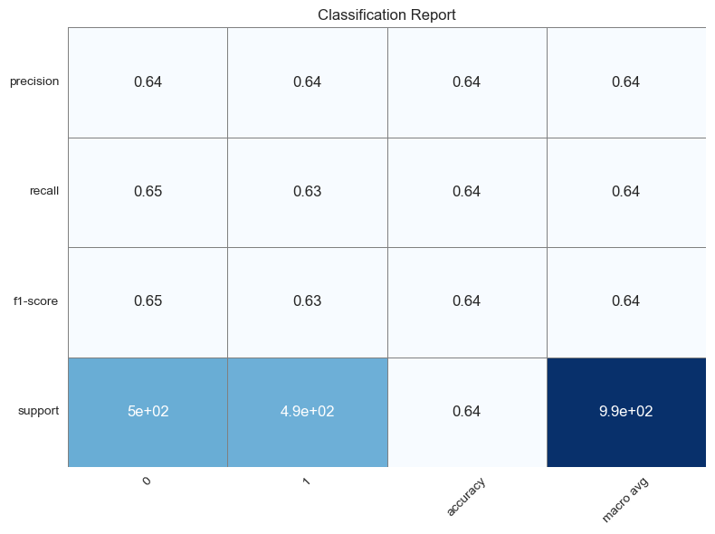
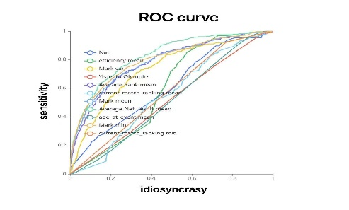
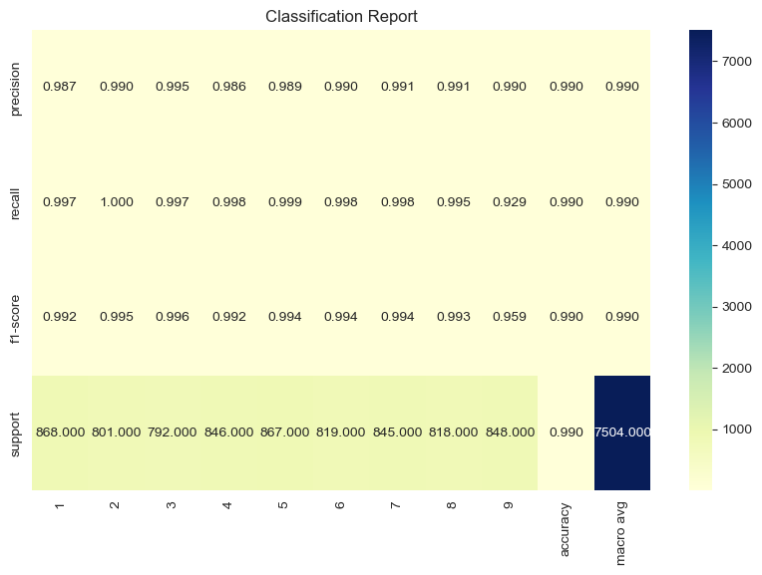
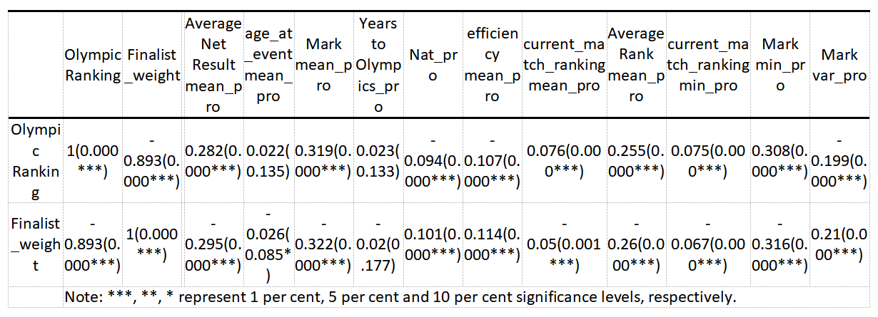

Predicting 2024 Paris Olympics Men’s 100m
Hypothesis:
Whether an athlete reaches the final is determined by the form (performance) of the previous four years of competition, ignoring the effects of possible missed plays and opponent specificity in the actual Olympic competition.
Logistic Regression Model
Influencing Factors:
Age at event
Average Net Result mean
Mean mark
Best mark(min)
Variance of the mark
Mean match ranking
Best match ranking(min)
Average Rank mean
Mean efficiency
Nation Score
Years to Olympics
Characteristic engineering：
Handling of outliers and missing values
Data formatting
normalization of data
Pearson correlation analysis
Main Model
More information can be found on Github
https://github.com/dashen2004/NUS_Group3
Group3:
Youyao Gao
Yu Liang
Haosong Sun
Xinyi Zeng
NUS SOC Summer Workshop 2024

