Slide 1
Information-efficient human-computer interfaces
David MacKay
Department of Physics, University of Cambridge
- with David Ward and Alan Blackwell
www.inference.phy.cam.ac.uk/mackay/

Slide 2
Information-efficient text entry
David MacKay
Department of Physics
University of Cambridge
- with David Ward and Alan Blackwell
www.inference.phy.cam.ac.uk/mackay/

Slide 3
Hands-free writing
Information-efficient
human-computer interfaces
David MacKay
Department of Physics
- with David Ward and Alan Blackwell
www.inference.phy.cam.ac.uk/mackay/

Slide 4
Dasher – A Data Entry Device Using Continuous Gestures and Language Models
David Ward, Alan Blackwell, and David MacKay
University of Cambridge
Original concept: MacKay and Lewicki, 1997

Slide 5
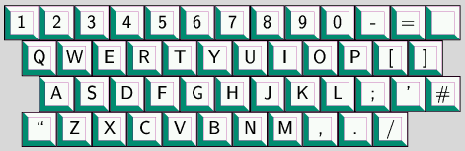
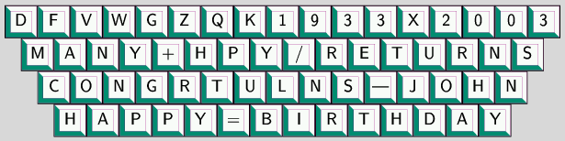
A famously inefficient writing method
Alternative keyboard layouts

Slide 6
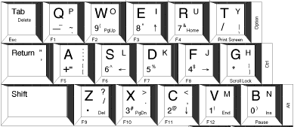
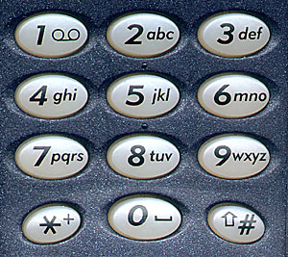
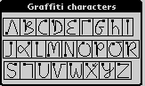

Text entry for handheld devices
Miniature or rearranged keyboards
Gestural alphabets
Unistrokes

Slide 7

Dynamic selection
Word-completion
Write ambiguously, disambiguate later
  T9
  Spellchecker
  Shorthand dsmbgu8 l8r
Quikwriting

Slide 8
What’s wrong with keyboards?

Slide 9
Why keyboards are inefficient
1. Information content of English ≈ 1 bit per character.
Each keypress on a QWERTY keyboard could convey ~ 6 bits.
2. Keyboard – digital : hands - analog.
A pointing finger can generate information at a rate of 14 bits per second (Drury and Hoffmann).
So... Potential writing speed of just one finger is
14 characters per second?
( ≈ 170 words per minute)

Slide 10
Writing and text-compression
Text compression
Text
Bit string
(preferably short)
00101101001...
Writing
Text
Gesture
(preferably brief)

Slide 11
Writing and text-compression
Optimal text compression – Arithmetic coding
Text
Bit string, viewed as a real number
.00101101001
probabilistic model
Writing with Dasher
Text
Real gesture
probabilistic model

Slide 12
Demonstration
- available for GNU/linux, windoze, and pocket PC
www.inference.phy.cam.ac.uk/dasher/

Slide 13
Arithmetic Coding
String S=x₁x₂x₃...
Divide the interval (0,1] into intervals equal to the probabilities of the symbols.
0
a
P(x₁=a,x₂=a)
P(x₁=a)
a
c
P(x₁=a,x₂=c)
P(x₁=b)
b
P(x₁=c)
c
1
P(x₁,x₂)=P(x₁)P(x₂|x₁)
P(x₁,x₂ ,x₃)=P(x₁)P(x₂|x₁)P(x₃|x₁,x₂)

Slide 14
Dynamics
Point to where you want to go
  Like driving a car
  Motion sickness? Passengers may get sick, driver doesn’t

Slide 15
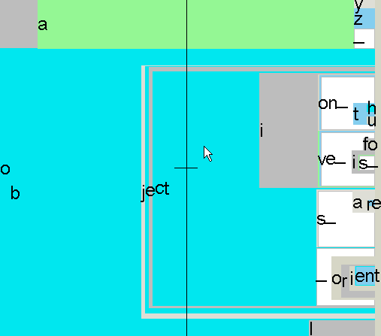
Benefits
Keyboard – usually one gesture per character
Dasher – some gestures select more than one character
Inaccurate gestures can be compensated for by later gestures

Slide 16
Benefits continued
Mode-free.
Can be used with any alphabet (e.g. Hiragana!)
Requires no special learning.
(knowledge of the chosen alphabetical order is helpful)
Can add extra characters to alphabet without any extra learning.

Slide 17
The Language Model
Based on PPM (Prediction by Partial Match), a context-based model.
Compresses most English to about 2 bits per character (could be improved)
Fast
Adaptive
Works with any language

Slide 18
Evaluation
10 volunteers
Dictation task
Emma, by Jane Austen
Automated dictation system with recorded speech
12 Dasher exercises, each 5 minutes long
Keyboard exercises between Dasher sessions
Measured writing speed and word error rate
5 min
3 min
Dasher
Keyboard

Slide 19
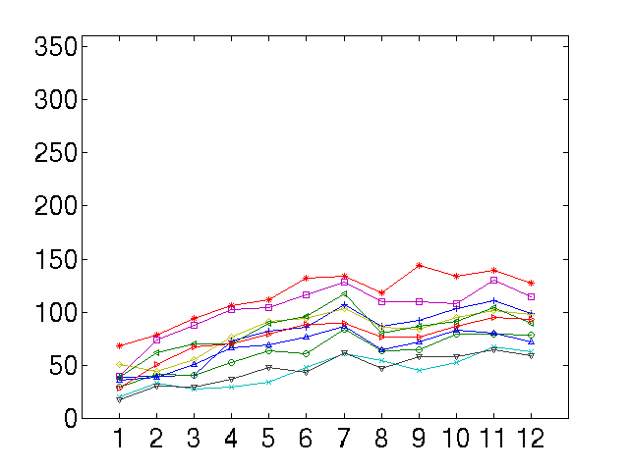
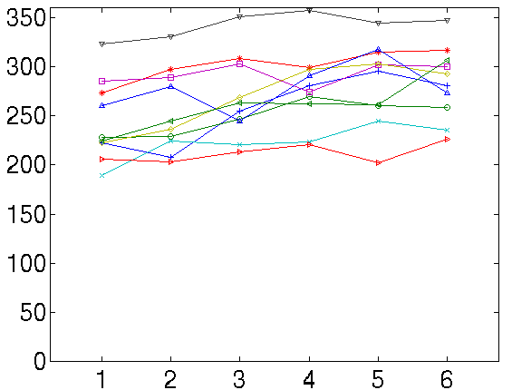
Results - writing speeds
Writing speed (cpm)
Writing speed (cpm)
Dasher
Keyboard
50 wpm
25 wpm
Exercise number
Exercise number

Slide 20
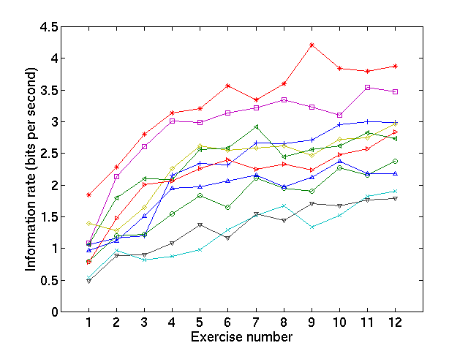
Results – information rate

Slide 21
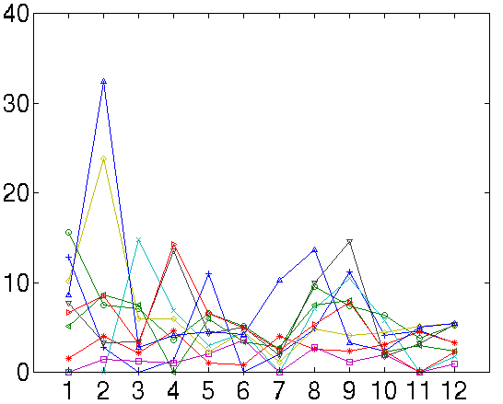
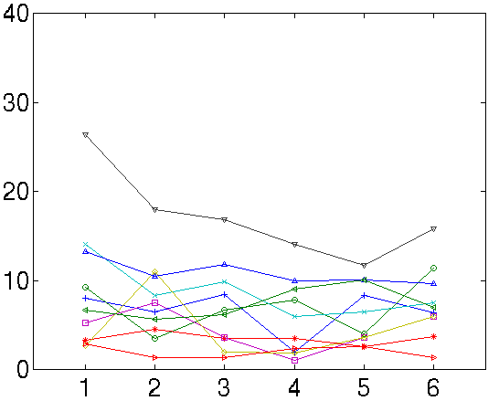
Results – writing errors
Dasher
Keyboard
Percentage of words wrong
Percentage of words wrong
Exercise number
Exercise number

Slide 22
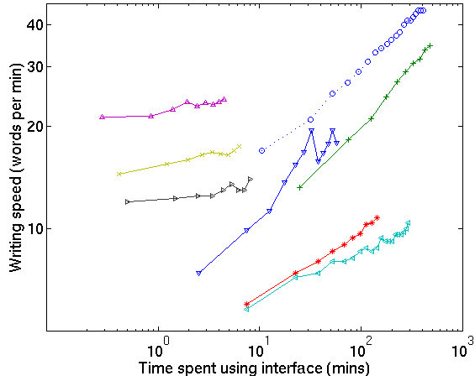
Comparison with other devices
one hand keyboard
Half-QWERTY
QWERTY-tapping
OPTI
stylus on
large tablet
Hand printing
fluctuating
keyboard
Bellman
ABC-tapping
Dasher
Stylus
TCK2
Chorded, one hand

Slide 23
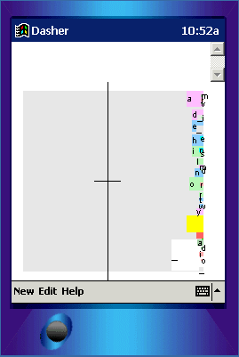
Mobile Text Entry
Pocket PC
Driven by stylus & touchscreen

Slide 24
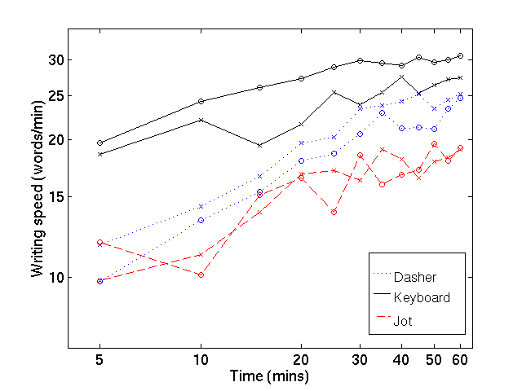
Palmtop Results

Slide 25
The main defect of Dasher
It demands visual attention
(like any predictive system)

Slide 26
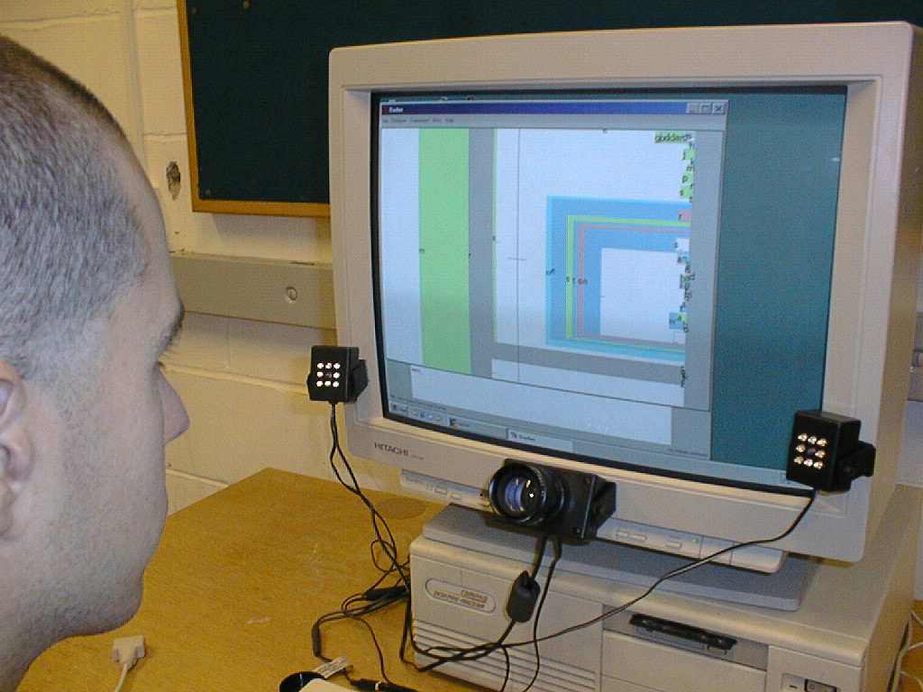
Eye gaze tracking

Slide 27
Hands-free writing

Slide 28
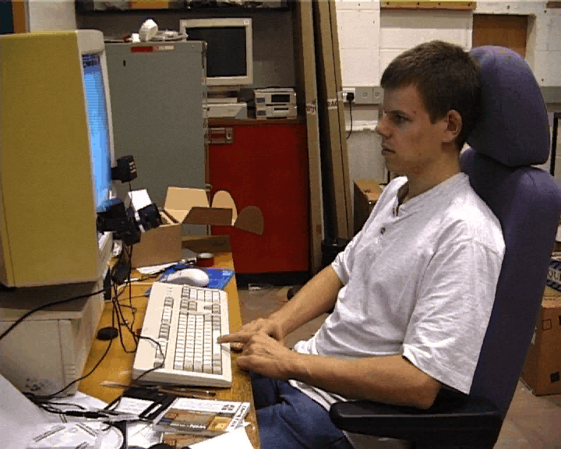

Slide 29
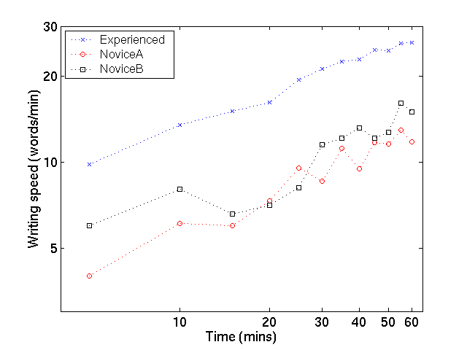
Eyetracking results

Slide 30
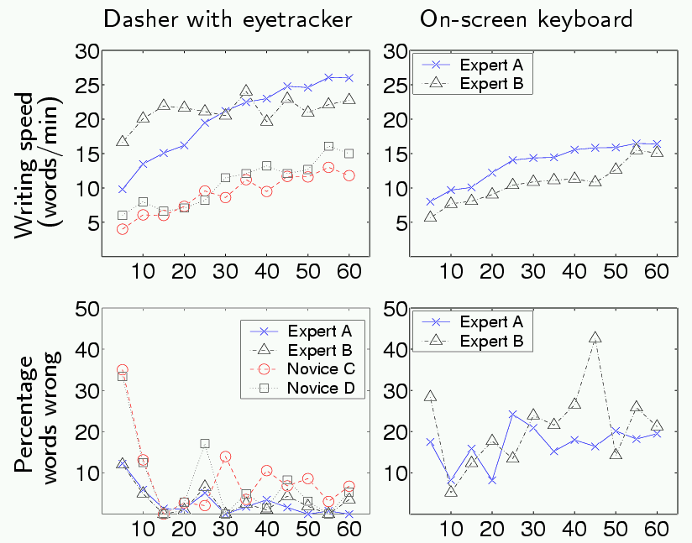
Eyetracking results

Slide 31
Another hands-free solution
Head-mouse

Slide 32
Different Character Sets
Include capital letters, punctuation
Japanese – Hiragana

Slide 33
Summary of Dasher
Exploits redundancy of language
Rapid learning rate
Applications
  - Mobile text entry
  - Special needs
Download Dasher!
  - available for linux, windoze, and iPaq handheld
www.inference.phy.cam.ac.uk/dasher/

Slide 34
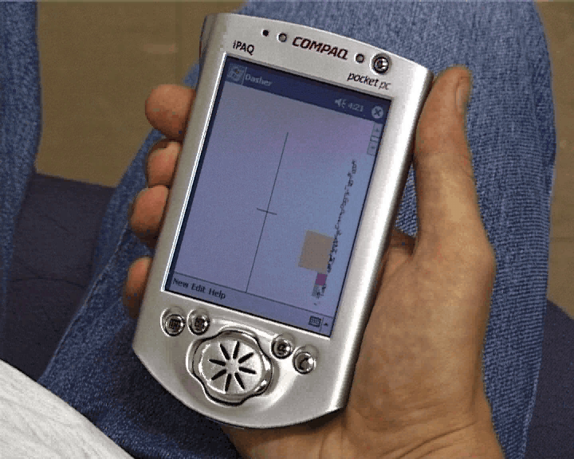

Slide 35
Download Dasher
- available for linux, windoze, and pocket PC
www.inference.phy.cam.ac.uk/dasher/
Development of Dasher is supported
by the Gatsby Charitable Foundation

Slide 36
Some Uses for Probabilities
“Bayesian Methods for Adaptive Models”
Fast approximate inference
Error-correcting codes
Efficient data-entry devices

