Slide 1
Dasher -
A Fast and Easy Keyboard Alternative
David MacKay
Department of Physics, University of Cambridge
  with David Ward, Iain Murray, Matthew Garrett,
Phil Cowans, and Alan Blackwell
Supported by Gatsby Charitable Foundation
www.inference.phy.cam.ac.uk/dasher/

Slide 2
Why keyboards are inefficient
1. Information content of English ≈ 1 bit per character.
Each keypress on a QWERTY keyboard could convey ~ 6 bits.
2. Keyboard – digital : hands - analog.
A pointing finger can generate information at a rate of 14 bits per second (Drury and Hoffmann).
So... Potential writing speed of just one finger is
14 characters per second?
( ≈ 170 words per minute)

Slide 3
Writing and text-compression
Text compression
Text
Bit string
(preferably short)
00101101001...
Writing
Text
Gesture
(preferably brief)

Slide 4
Writing and text-compression
Optimal text compression – Arithmetic coding
Text
Bit string, viewed as a real number
.00101101001
probabilistic model
Writing with Dasher
Text
Real gesture
probabilistic model

Slide 5
Demonstration
Dasher Version 3.0.0
available for GNU/linux, Windows, and iPaq handheld
Dasher is Free software
www.inference.phy.cam.ac.uk/dasher/

Slide 6
Dynamics
Point to where you want to go

Slide 7
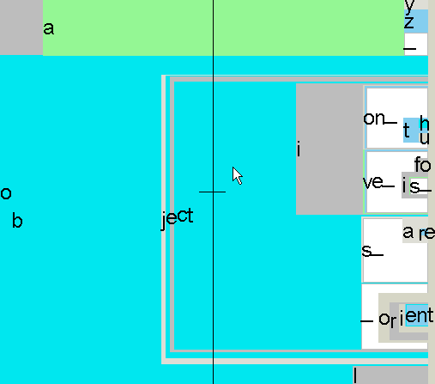
Benefits
Keyboard – usually one gesture per character
Dasher – some gestures select more than one character
Inaccurate gestures can be compensated for by later gestures

Slide 8
Benefits continued
Mode-free.
Can be used with any alphabet (e.g. Hiragana!)
Requires no special learning.
(knowledge of the chosen alphabetical order is helpful)
Can add extra characters to alphabet without any extra learning.

Slide 9
The Language Model
Can be trained on user’s own writing
Learns all the time

Slide 10
Evaluation
10 volunteers, using mouse
Dictation task
Emma, by Jane Austen
12 Dasher exercises, each 5 minutes long
Keyboard exercises between Dasher sessions
Measured writing speed and word error rate
5 min
3 min
Dasher
Keyboard

Slide 11
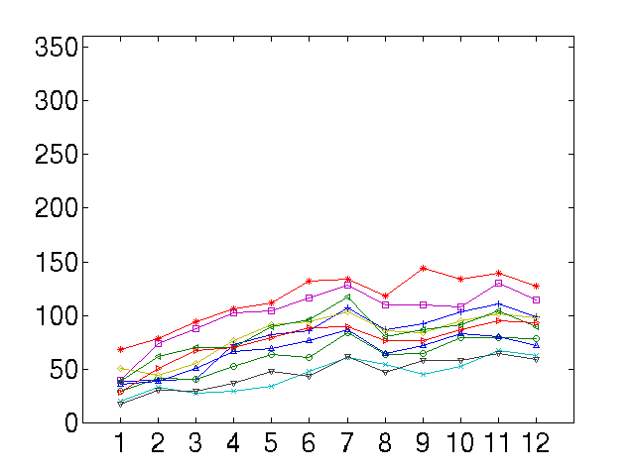
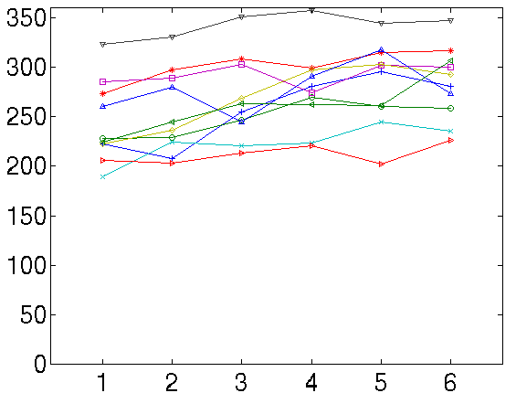
Results - writing speeds
Writing speed (cpm)
Writing speed (cpm)
Dasher
Keyboard
50 wpm
25 wpm
Exercise number
Exercise number

Slide 12
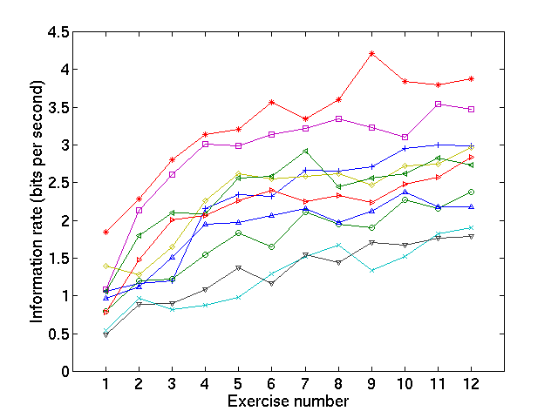
Results – information rate

Slide 13
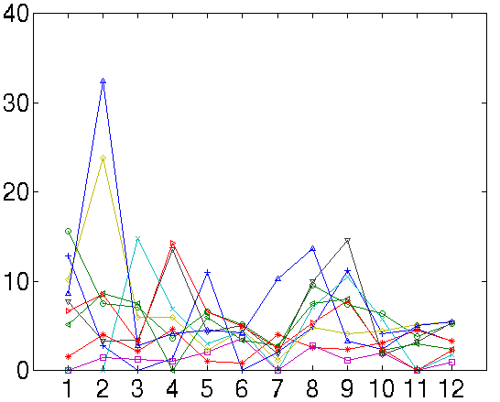
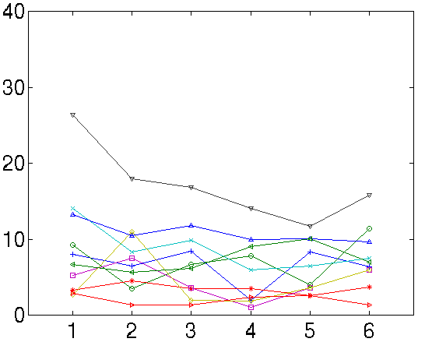
Results – writing errors
Dasher
Keyboard
Percentage of words wrong
Percentage of words wrong
Exercise number
Exercise number

Slide 14
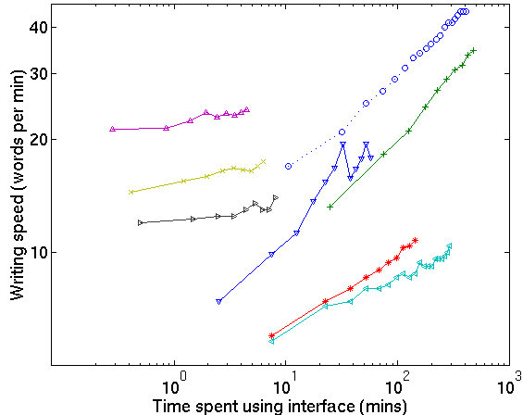
Comparison with other devices
one hand keyboard
Half-QWERTY
QWERTY-tapping
OPTI
stylus on
large tablet
Hand printing
fluctuating
keyboard
Bellman
ABC-tapping
Dasher
Stylus
TCK2
Chorded, one hand

Slide 15
The main defect of Dasher
It demands visual attention
(like any predictive system)

Slide 16
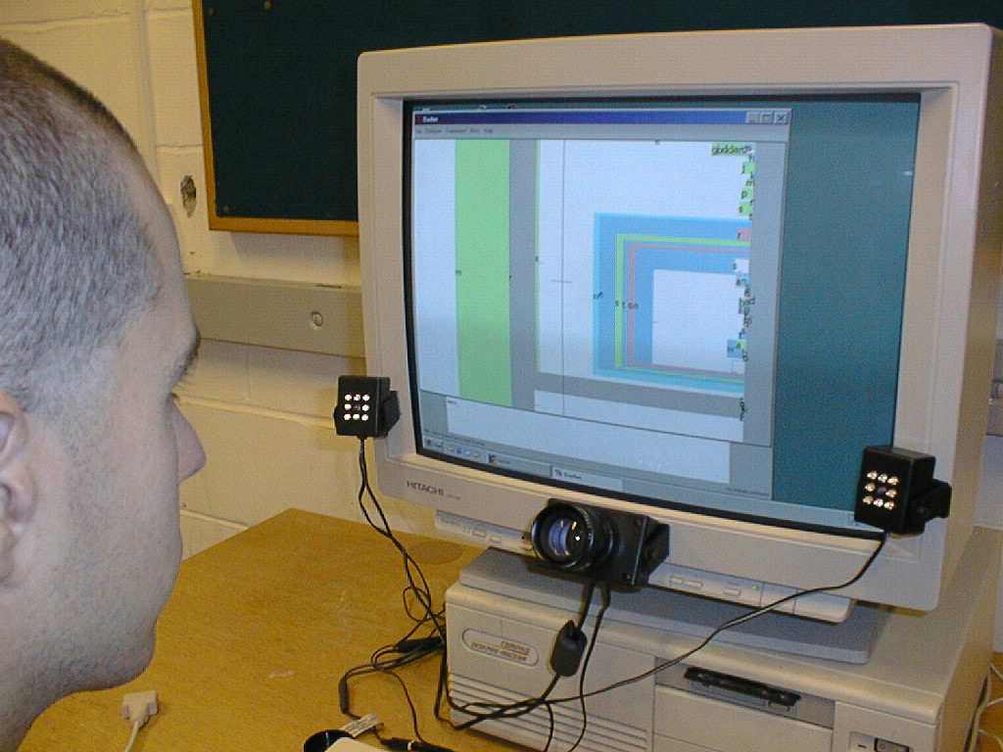
Eye gaze tracking

Slide 17
Hands-free writing
using QuickGlance eyetracker from EyeTech Digital Systems
(video clip: eye.avi, available from Dasher website)

Slide 18
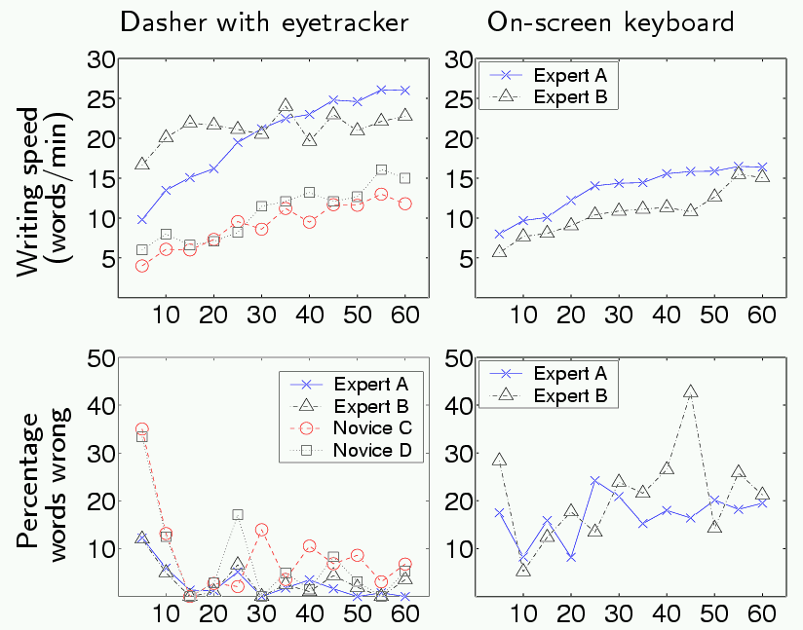
Eyetracking results

Slide 19
Hands-free writing
using NaturalPoint Head Mouse

Slide 20
Special Needs Options
Any pointer
    roller ball
    foot mouse
    head mouse <- Best buy!
    eye-tracker
    touch screen
  Only low pointing precision needed.
Text-to-speech: via clipboard
Stroke; ALS; thalidomide; quadriplegics
Rehabilitation?
Educational uses?

Slide 21
Future steps
All computer platforms
Portuguese, French, Italian, Russian, Dutch, Danish...
Version for restricted pointing ability
Improve dynamics for eye-tracking
Add “command mode”
- to allow all control operations to be done by Dashing
Alternative colour schemes
Seamless connections to other software

Slide 22
Download Dasher!
- available for GNU/linux, Windows, and iPaq handheld
Go to
www.inference.phy.cam.ac.uk/dasher/
or search for Dasher

