Slide 1
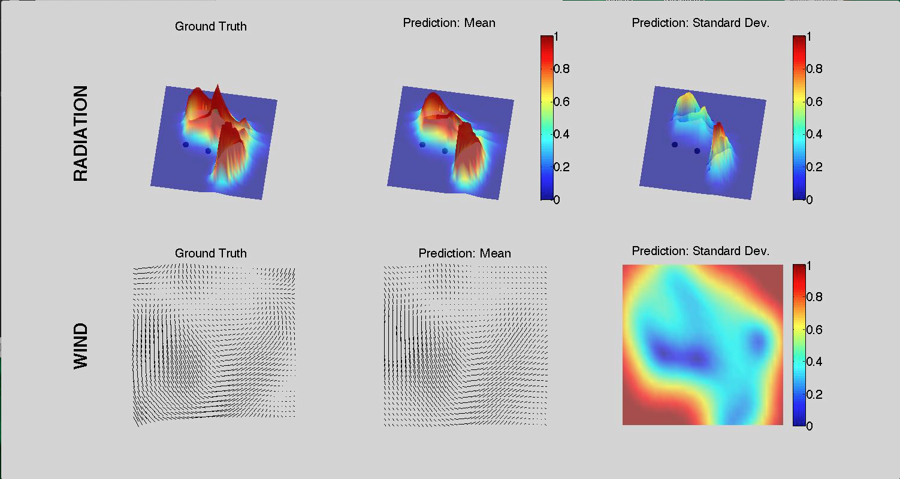
High intensity
High uncertainty
Monitors
Low intensity
Low uncertainty
Calm
Blowing (north westerly)
High uncertainty
Low uncertainty

Slide 2
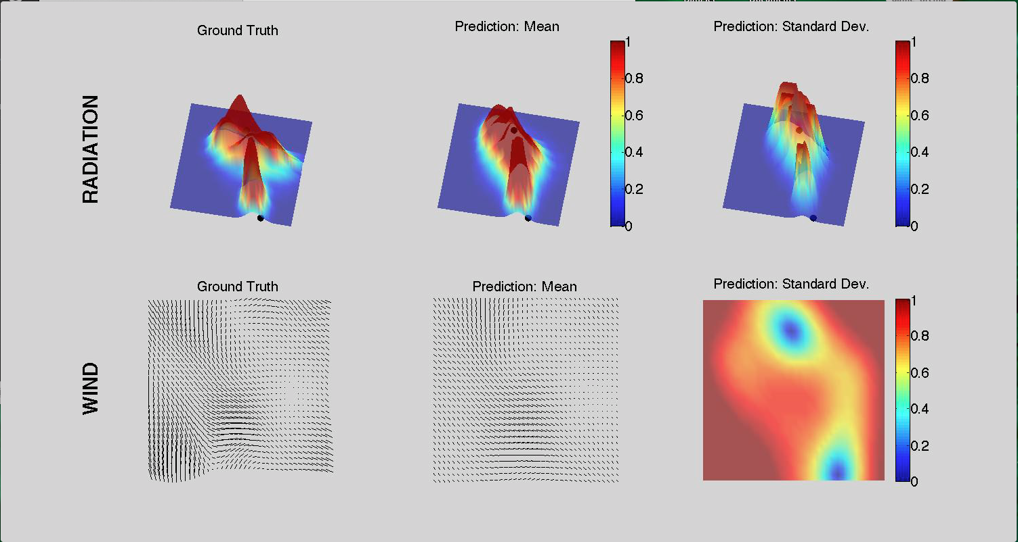
Gust
High uncertainty
Low uncertainty

