Slide 1
Week – 19
Tutorial Class

Slide 2
Agenda
LayoutManager
JComboBox
JRadioButton
JTextArea
JPanel

Slide 3
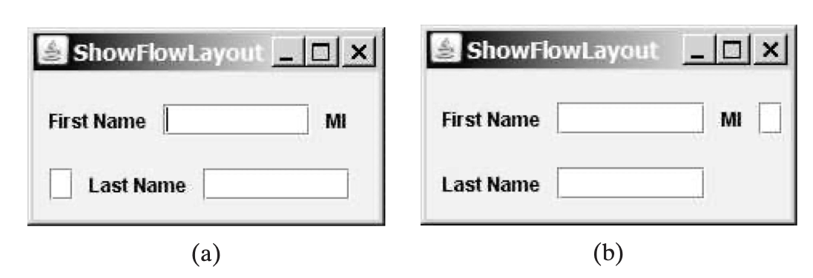
FlowLayout
Lays out the components in a single row. When one row is filled the next row is started

Slide 4
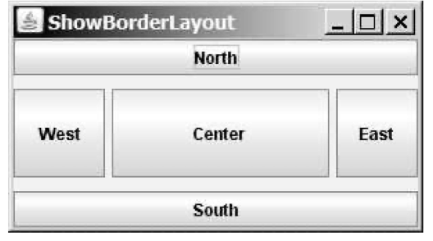
BorderLayout
divides a container into five areas: East, South, West, North, and Center.
Components are added to a BorderLayout by using add(Component, index),
The index can be
BorderLayout.EAST,
BorderLayout.SOUTH,
BorderLayout.WEST,
BorderLayout.NORTH,
BorderLayout.CENTER

Slide 5
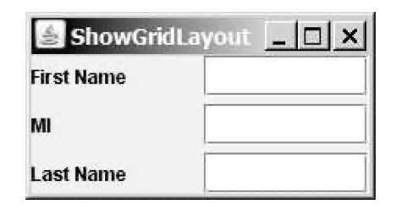
GridLayout
lays out components in a two-dimensional grid (table / matrix)
the number of rows and columns and columns can be defined

Slide 6
JPanel
JPanels are lightweight containers
JPanel are used as sub containers to group GUI components to achieve the desired layout
Various layouts can be set in a JPanel

Slide 7
JPanel Constructors
Constructor | Purpose
JPanel() | Creates a JPanel with the default FlowLayout
JPanel(LayoutManager l) | Creates a JPanel with a specific Layout Manager

Slide 8
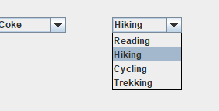
JComboBox
A combination of text field and a drop-down list
JComboBox can be editable or read- only depending on the choice of the programmer

Slide 9
JComboBox
Constructor | Description
JComboBox() | creates a new empty JComboBox .
JComboBox(E [ ] i) | creates a new JComboBox with items from specified array.

Slide 10
JComboBox Methods
Constructor | Description
addItem() | adds the item to the JComboBox
getItemAt(int i) | returns the item at index i
getItemCount() | returns the number of items from the list
removeItem(Object o) | removes an item from the item list.
removeAllItems() | removes all items from the item list
setEditable(boolean b) | Determines if the JComboBox is editable or not

Slide 11
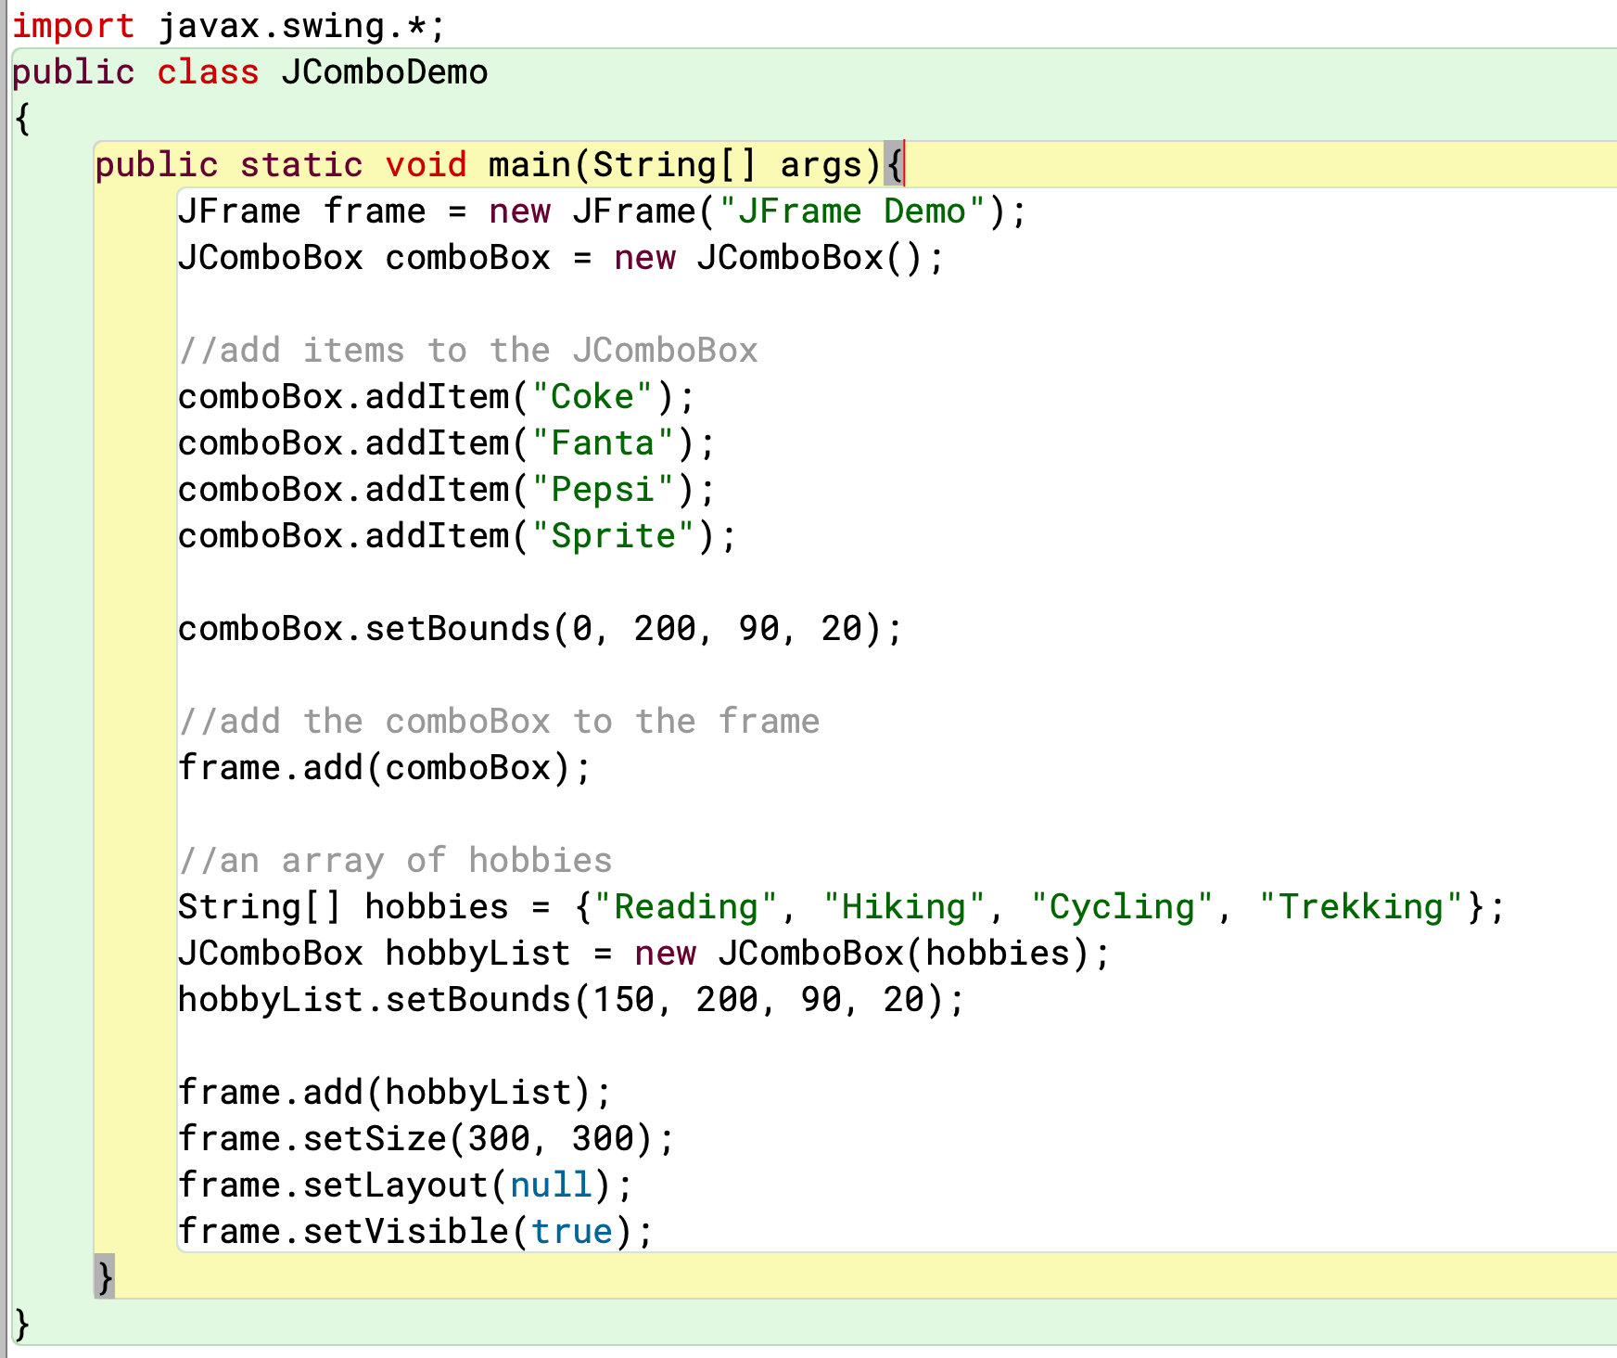

Slide 12
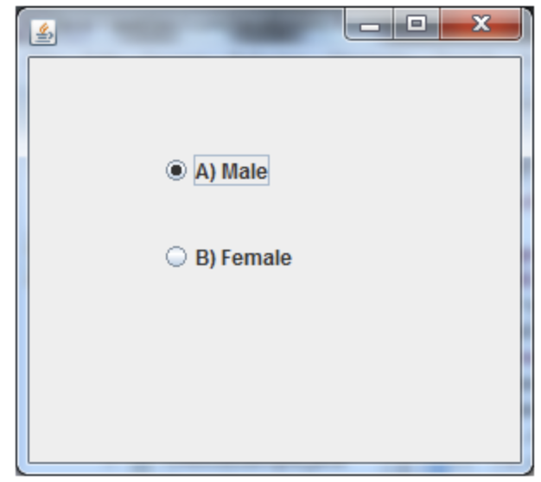
JRadioButton
The JRadioButton class is used to create a radio button.
It is used to choose one option from multiple options.

Slide 13
JRadioButton Constructor
Constructor | Description
RadioButton() | Creates an unselected radio button with no text.
JRadioButton(String s) | Creates an unselected radio button with specified text.
JRadioButton(String s, boolean selected) | Creates a radio button with the specified text and selected status.

Slide 14
JRadioButton Methods
Constructor | Description
void setText(String s) | It is used to set specified text on button.
String getText() | It is used to return the text of the button.
void setEnabled(boolean b) | It is used to enable or disable the button.
void setIcon(Icon b) | It is used to set the specified Icon on the button.
Icon getIcon() | It is used to get the Icon of the button.

Slide 15
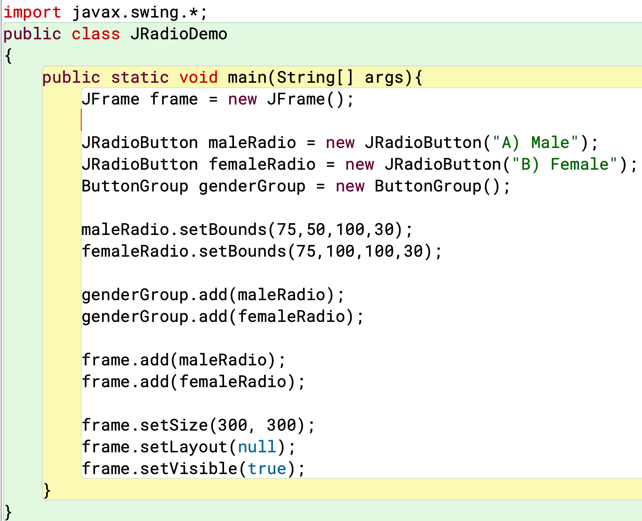

Slide 16
JTextArea
The JRadioButton class is used to create a radio button.
It is used to choose one option from multiple options.

Slide 17
JTextArea Constructor
Constructor | Description
JTextArea() | Creates a text area that displays no text initially.
JTextArea(String s) | Creates a text area that displays specified text initially.

Slide 18
