Slide 1

mT5 Translator
Trying to recreate Google Translate with Deep Learning
by Daria Aleksich

Slide 2
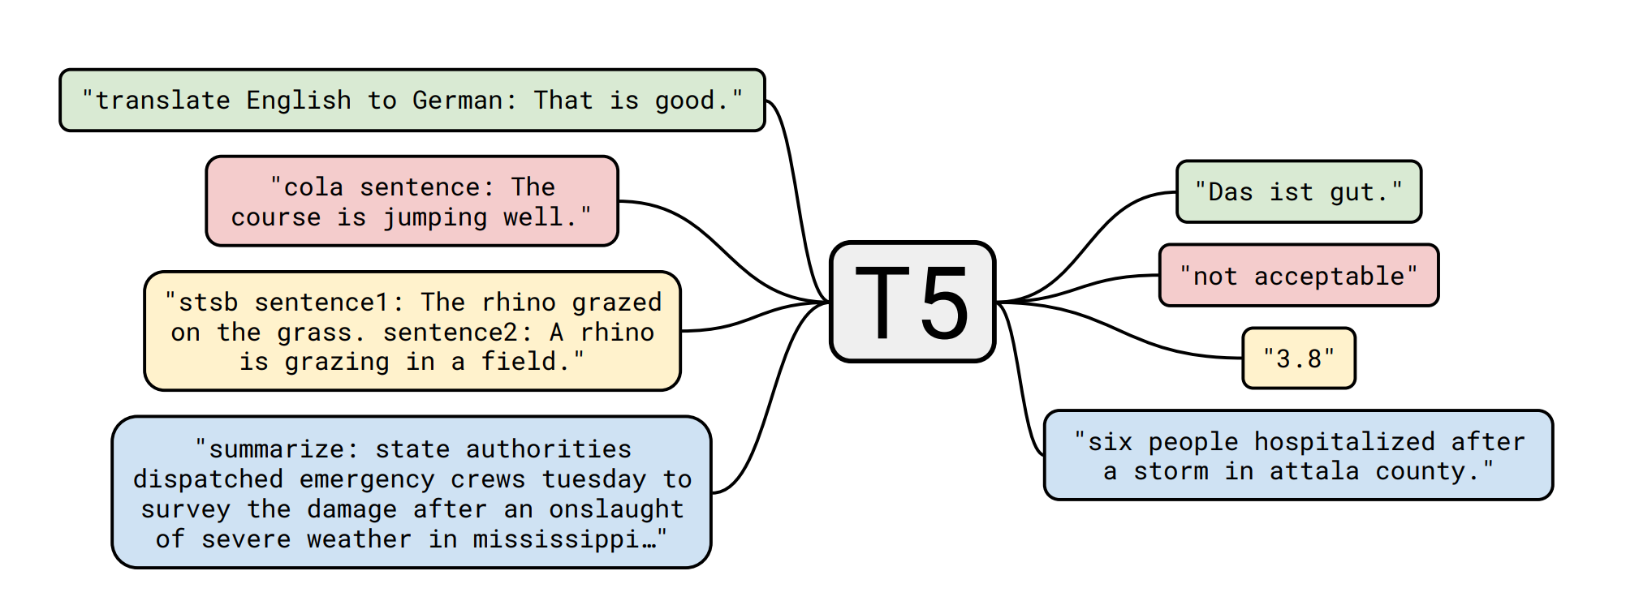
T5 Model (Google, 2019)
(Text-To-Text Transfer Transformer)
Input: task prefix/ descriptor + text
Output: text
Same model, loss function, and hyperparameters for all of tasks
Pre-trained on C4 dataset (750GB of English-language web scrapes)
State-of-art results on many NLP tasks

Slide 3
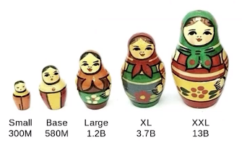
mT5 (Google, 2020)
Just like T5...but for 100+ languages!
T5’s architecture
Trained on mC4 dataset – multi-language version of C4
300 million - 13 billion parameters.
Pre-trained models:

Slide 4

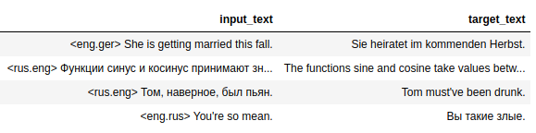
Data
TATOEBA machine translation challenge
200 000 language pairs
German-English
English-German
Russian-English
English-Russian

Slide 5

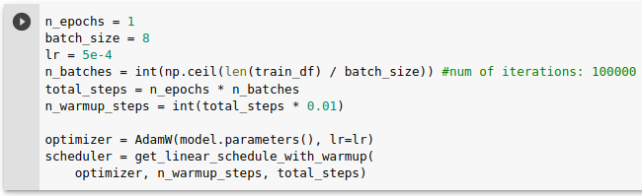


Training

Slide 6
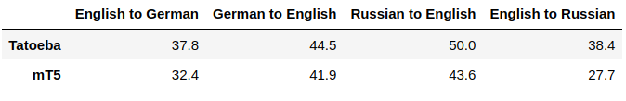

Results
BLEU (bilingual evaluation understudy)
- metric for evaluating a generated sentence to a reference sentence

Slide 7






Tech stack

