Slide 1
Kubernetes ConfigMap

Slide 2
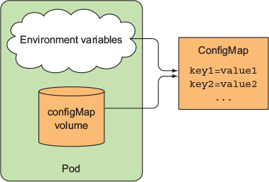
ConfigMap

Slide 3
Creating ConfigMap
$ kubectl create configmap fortune-config --from-literal=sleep-interval=25
$ kubectl create configmap my-config --from-file=config-file.conf

Slide 4
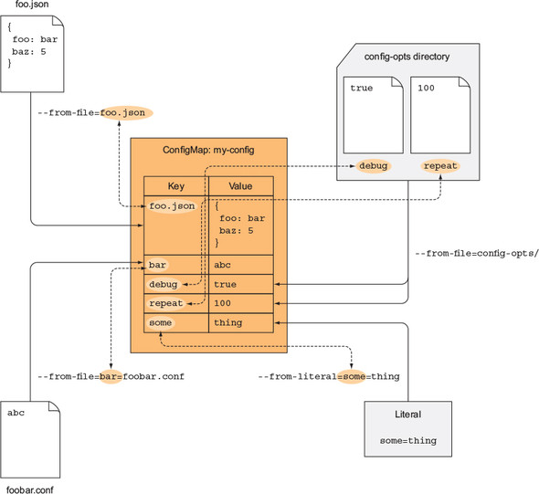

Slide 5
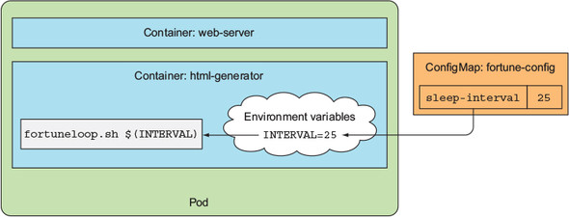

Slide 6
Resource Requests

Slide 7
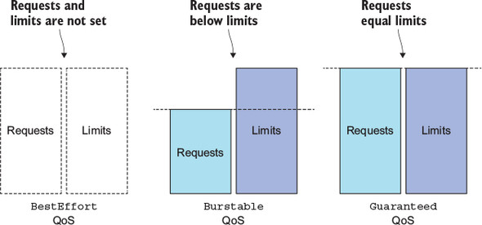
QoS

Slide 8
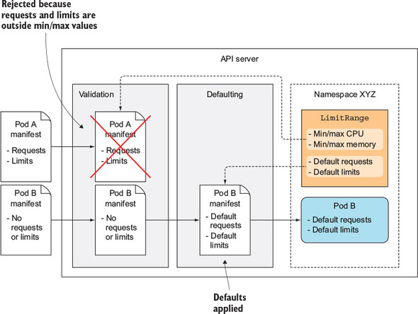
Namespace controlled Resource

Slide 9
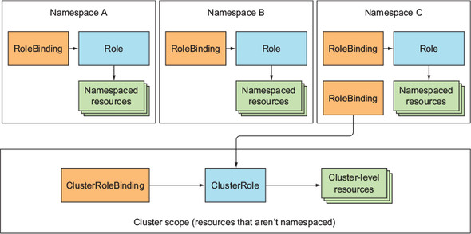
Cluster Role & Cluster role bindings

Slide 10
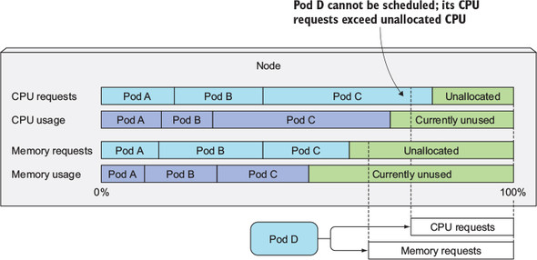
Node allocation based on cpu and memory

Slide 11
QoS based on cpu and memory req and limits
CPU requests vs. limits | Memory requests vs. limits | Container QoS class
None set | None set | BestEffort
None set | Requests < Limits | Burstable
None set | Requests = Limits | Burstable
Requests < Limits | None set | Burstable
Requests < Limits | Requests < Limits | Burstable
Requests < Limits | Requests = Limits | Burstable
Requests = Limits | Requests = Limits | Guaranteed

Slide 12
HA

Slide 13
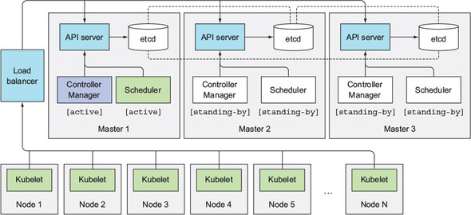
HA on Master

Slide 14
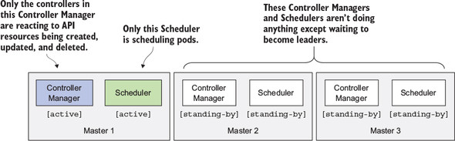
General points

Slide 15
API server is (almost completely) stateless (all the data is stored in etcd, but the API server does cache it).
Usually, one API server is collocated with every etcd instance.
Each individual component will only be active when it’s the elected leader.
Only the leader performs actual work, whereas all other instances are standing by and waiting for the current leader to fail.
General points

